Slide 1
Housing, The Cost-of-Living Crisis and Public Health in 2023
Dr Isobel Braithwaite
NIHR DOCTORAL Fellow and Public Health
Registrar, UCL Institute of health Informatics
Presentation & slideset developed jointly with Prof. Paul Roderick,
Faculty of Public Health Poverty SIG

Slide 2
Statement of interests
No interests to disclose.
PhD research funded by NIHR (Fellowship no. 302316)

Slide 3
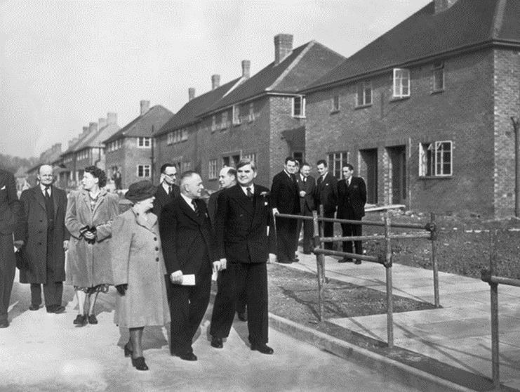
Homes fit for Heroes & post-WW2 Housing
Post WW1 demand - the 1919 Act - often known as the ‘Addison Act’, after Addison, the Minister of Health, made housing a national responsibility: LAs were given the task of developing new homes and rental accommodation where needed by working people.
Housing Act of 1930 obliged local councils to clear all remaining slum housing, and provided further subsidies to re-house inhabitants -> building of 700,000 new homes.
When Aneurin Bevan became a Minister in 1945, it was as Minister for Health and Housing.
The 1949 Housing Act removed the restriction of public housing to the ‘working classes’ so that council housing was available to all. He insisted on good design, increased space standards and the provision of an upstairs and downstairs W.C.
Notes:
More council houses were built in Wales between 1945 and 1951 than have been built since 1975.
WC point was revolutionary at a time when two-thirds of houses in the Rhondda valleys did not have an indoor toilet.

Slide 4
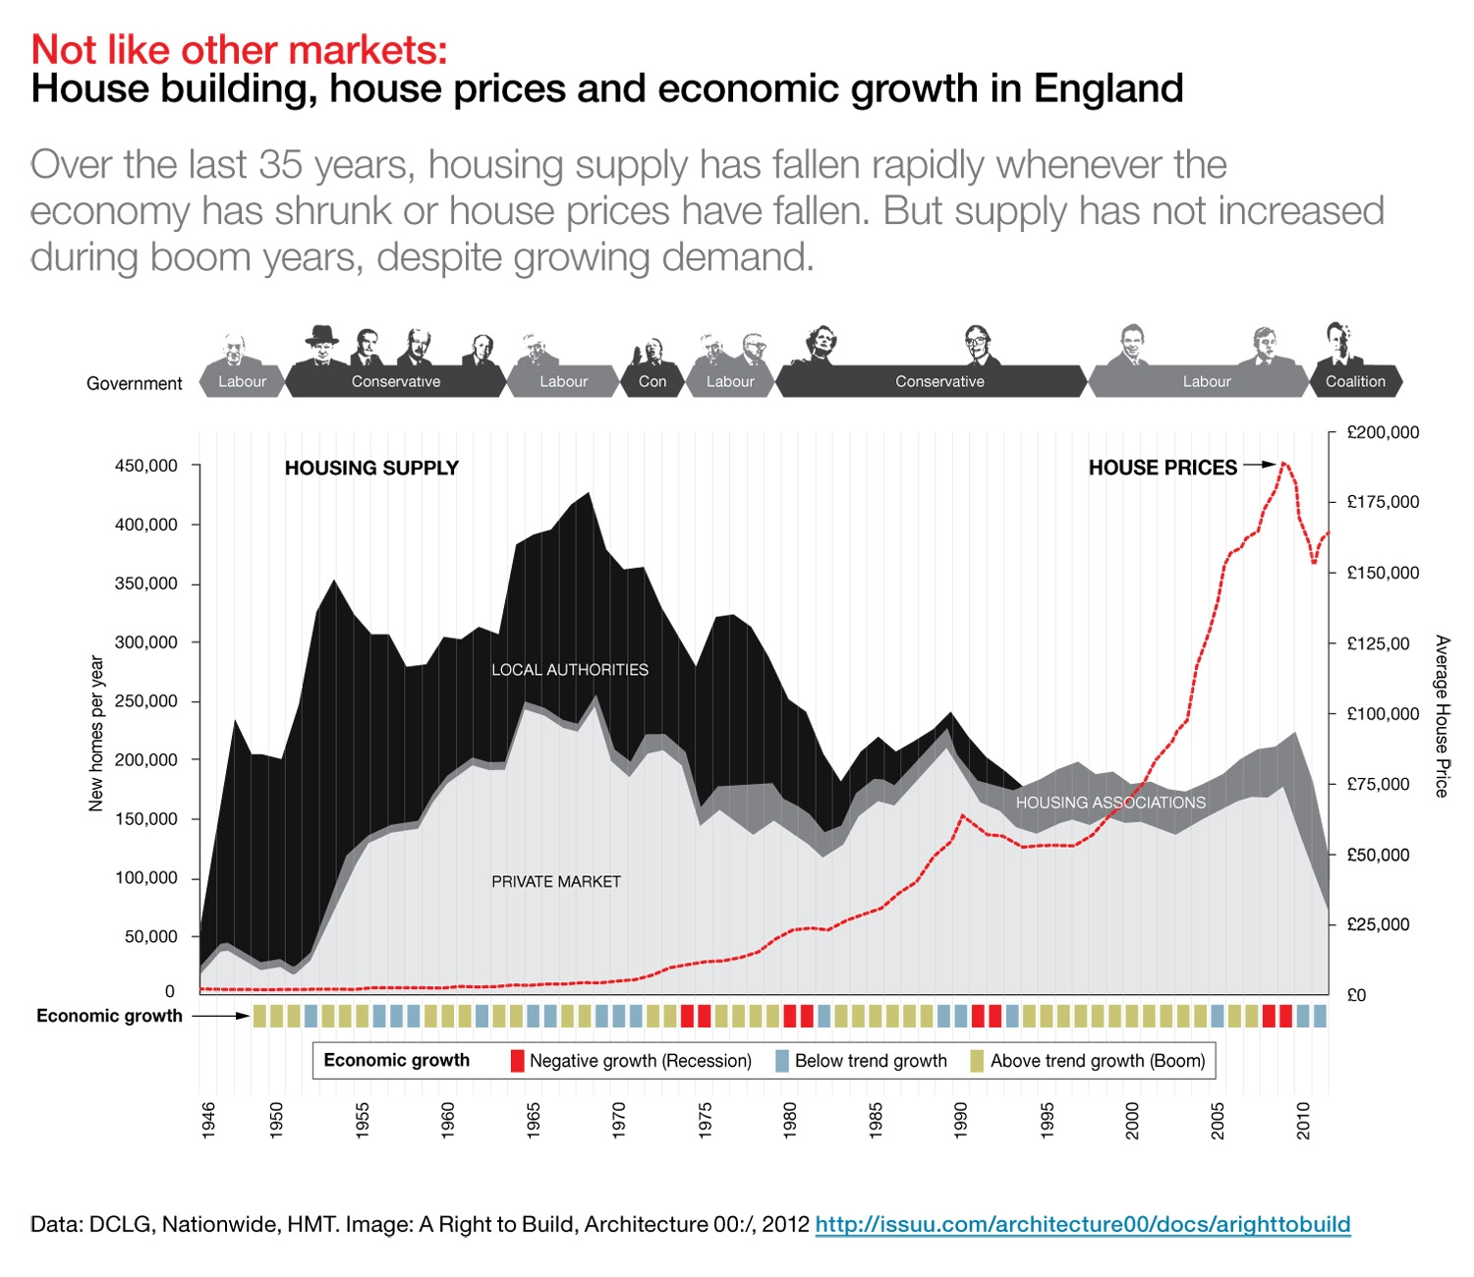

Slide 5
Right to Buy & housing sector deregulation
Introduced by Margaret Thatcher’s government through the Housing Act 1980. This also deregulated private tenancies, encouraging increasing financialisation of the housing sector.
Allows council tenants to purchase their homes at up to £116,200 cheaper in London and £87,200 elsewhere (& Housing Association tenants can use a smaller discount – Right to Acquire).
Over 40% of homes bought through right to buy are now rented out privately (with the rents paid through state funding – representing very poor value for money). Indirect effects include disincentivising the building of new social homes by councils (since RTB reduces their potential for future rental income and means that they would not receive the full sale receipt if they were sold).
Ended in Scotland since August 2016 and Wales since January 2019.
In Scotland, this was estimated to have kept 15,500 homes in the social rented sector for future generations in just the first 4 years, and from 2017-21, Scotland delivered over 9x more social-rented homes per capita than England.

Slide 6
Social Housing and Financialisation
NEF = New Economics Foundation
Notes:
40 local authorities have no new social housing at all

Slide 7
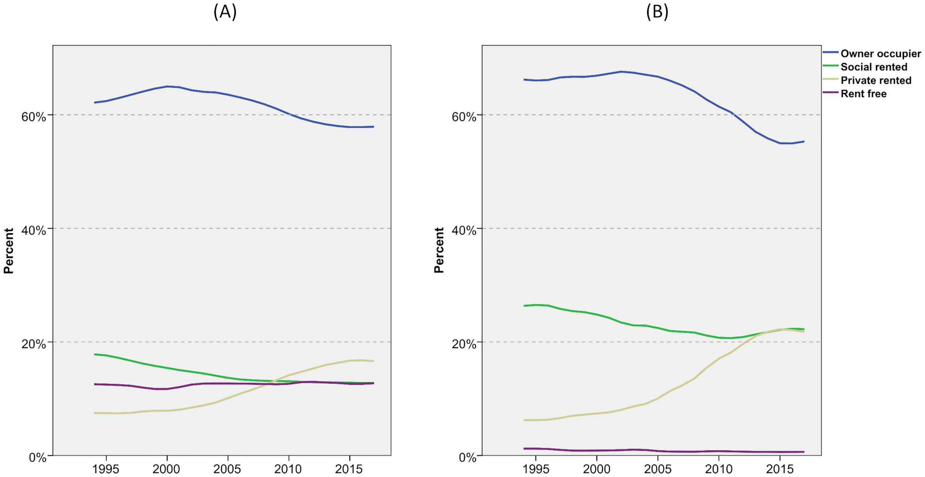
Tenure for adults and children, 1994/5 - 17/8
Adults
Children
Image from: Bailey (2020) Poverty and the re-growth of private renting in the UK, 1994-2018
Data source: FRS/HBAI data. (Financial years)

Slide 8
Which aspects of housing matter most fOr public health?
Health Foundation classification:
Affordability (ability to meet direct and indirect housing costs) – links closely to overcrowding
Quality (e.g. thermal, damp/mould, indoor AQ, safety, falls risks) – N.B. cold, energy inefficient homes also affect affordability through energy bills
Stability and security
Homelessness

Slide 9
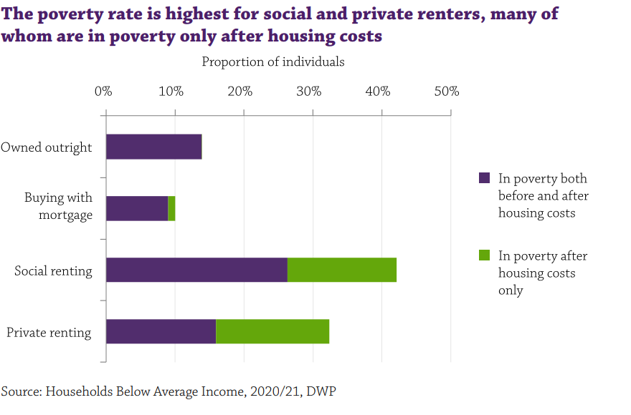
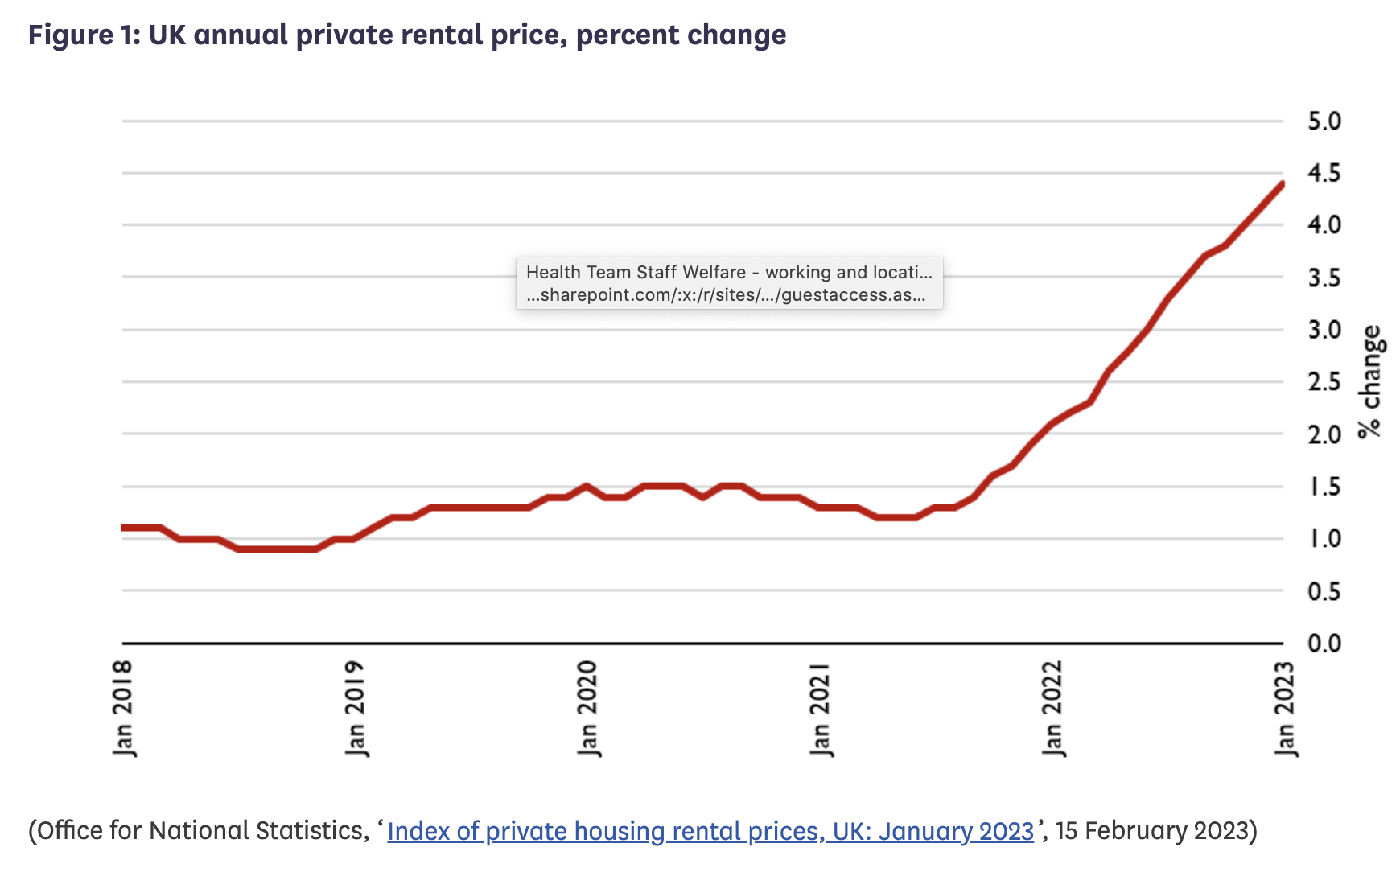
Housing costs are (becoming increasinglY) unaffordable, and Driving poverty

Slide 10
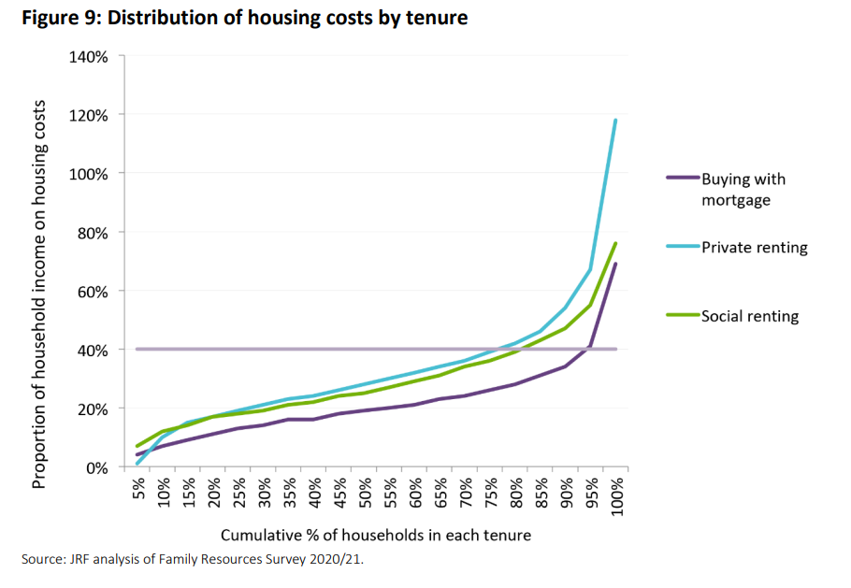
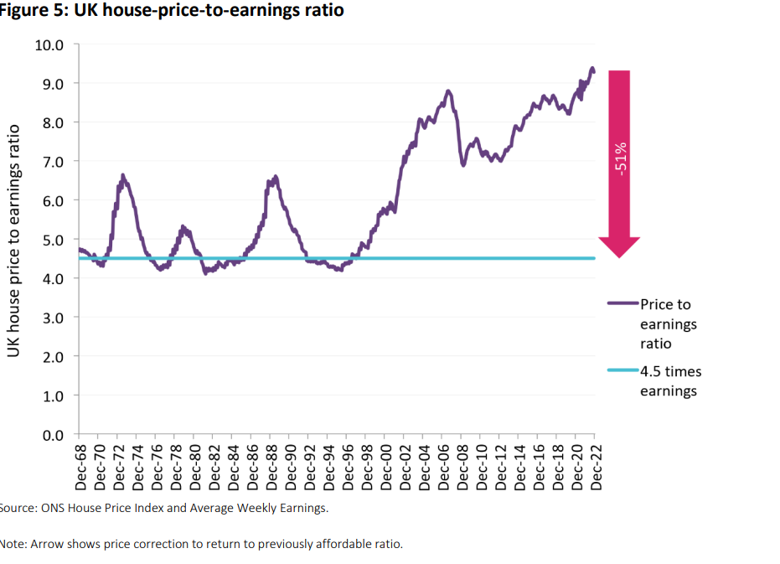

Slide 11
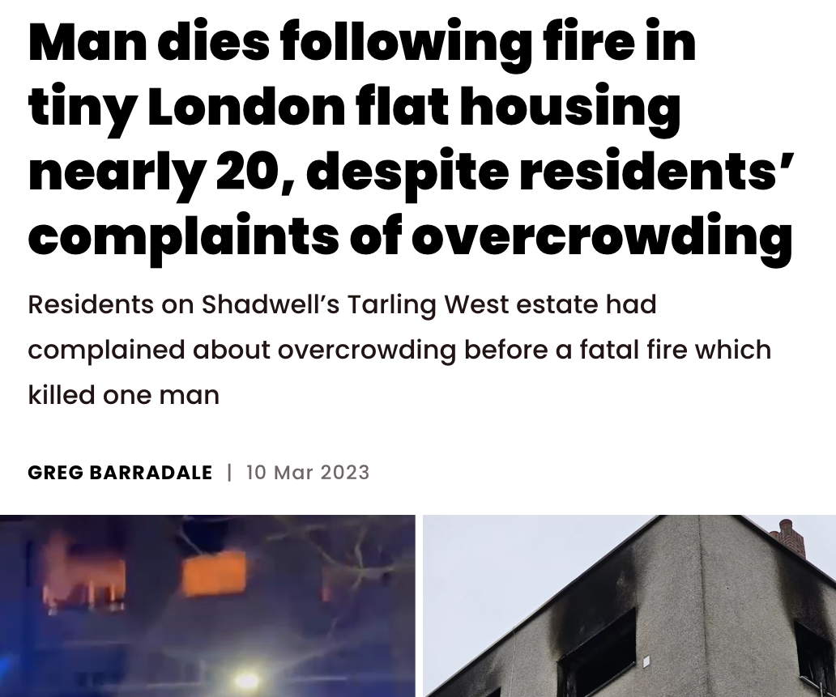
Lack of Affordability Drives Rising Rates of Overcrowding
Large increases in overcrowding in both social and privately rented tenures, putting both mental and physical health at risk.

Slide 12
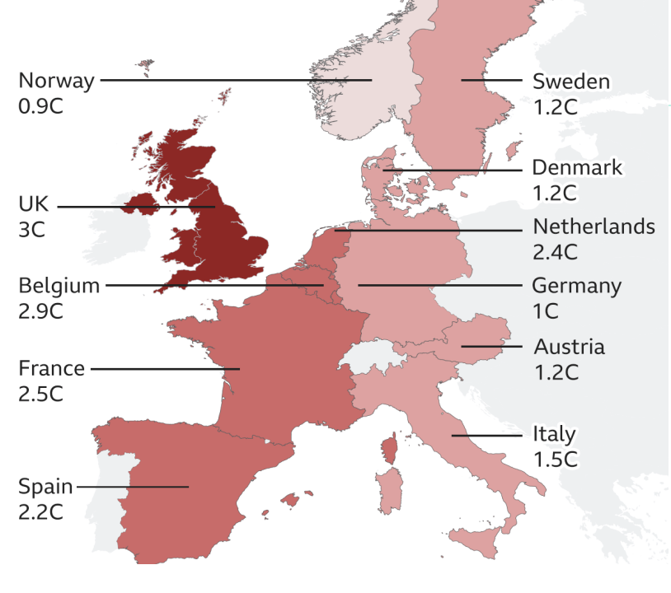
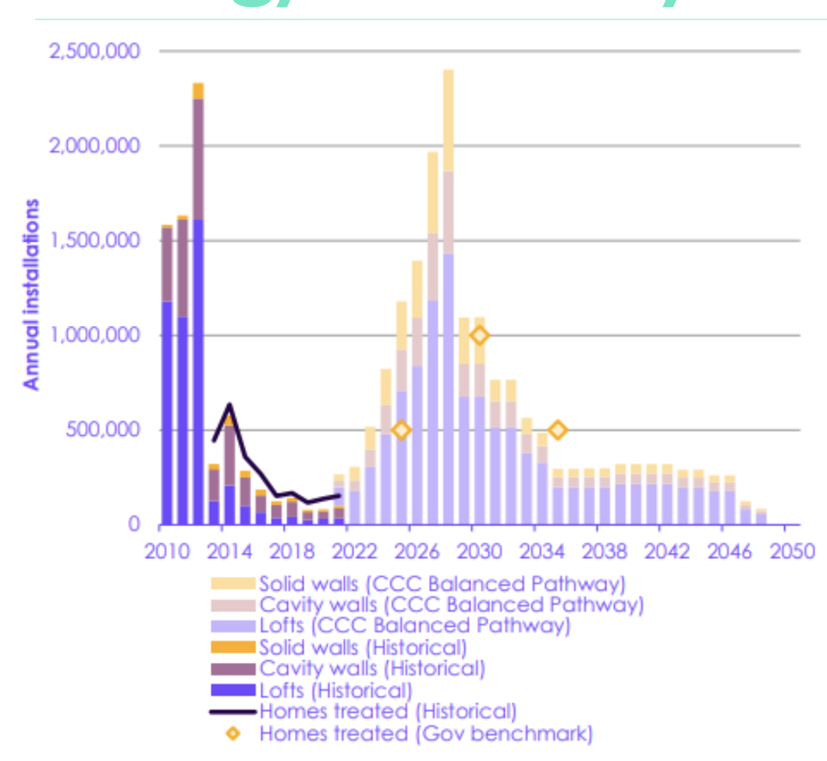
Quality: home insulation, cold and Damp
Poorly-insulated housing is a key driver of fuel poverty and of cold homes and damp.
Damp affects over 900,000 homes, and 653,000 had a Category 1 Hazard of excess cold in England (English Housing Survey 2021 estimates).
The UK’s homes are among the worst insulated in Europe, with average heat loss of 3ºC in 5 hours compared to 0.9ºC in Norway.
Annual retrofit installations plummeted following withdrawal of Government support in 2012 (CCC)
Source: Tado
Source: CCC

Slide 13
Quality & safety - continued
In 2021 the English Housing Survey estimated that, 23% of private rental sector homes did not meet the Decent Homes Standard – vs. 13% of owner-occupied & 10% of social-rented homes.
The % of people exposed to hazards such as cold, damp and mould is highest in low-income and minoritised groups.

Slide 14
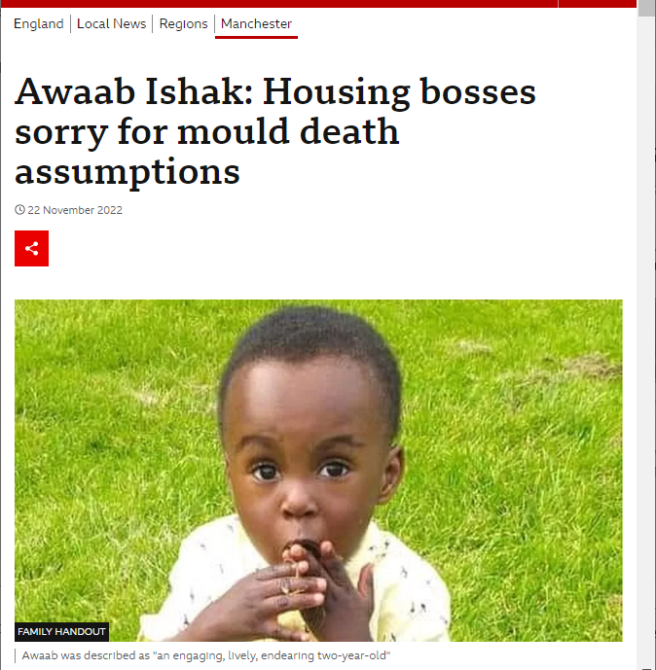
& these issues are affecting young people and minoritised groups most acutely

Slide 15
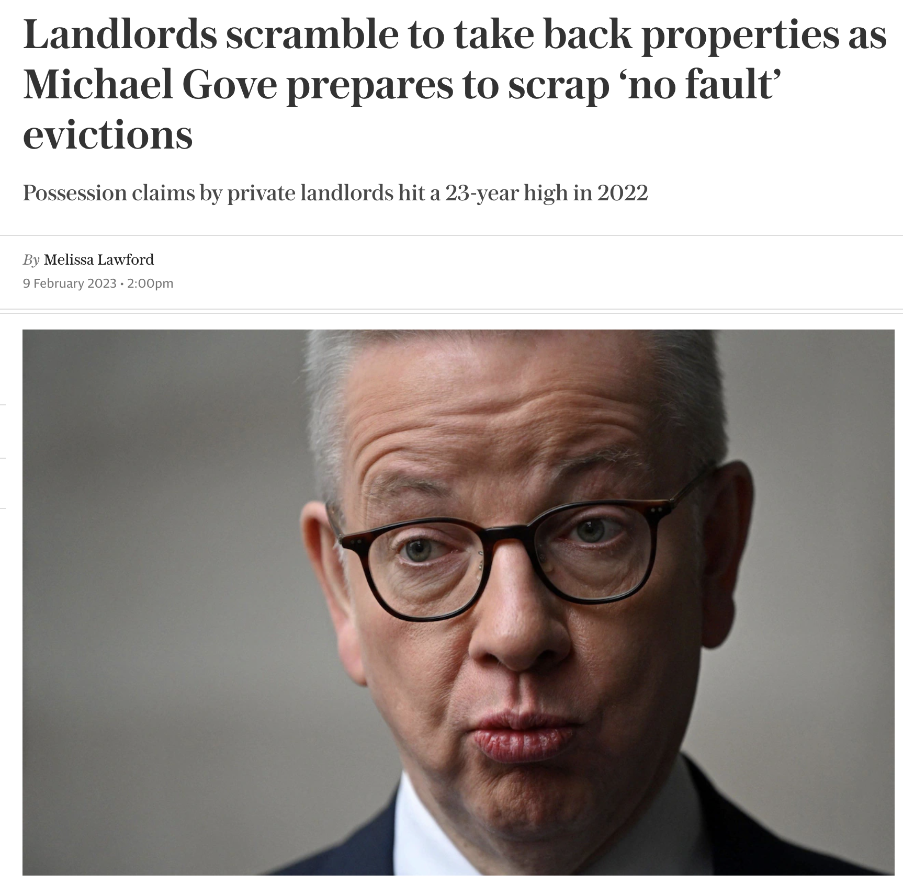
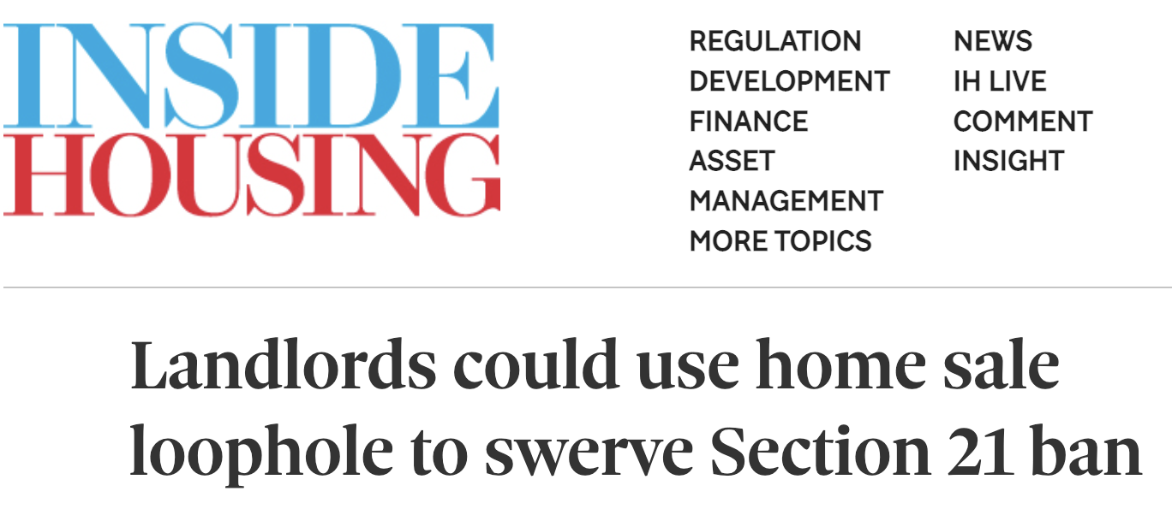
Housing Stability & Tenure Security
Housing stability is critical for health and home moves can adversely impact healthcare, education, social support (inc. access to childcare) & much more.
It is worse in the private rented sector:
1 in 5 children in the private rented sector had moved three or more times by the age of 14 years, compared to 9% in social rented and 3% in owner-occupied homes.
26% of parents who moved three or more times rated their
health as less than good, compared to 14% who did not move.
The Government has proposed to end Section 21 (no-fault) evictions in its Renters Reform Bill and White Paper, which is a positive step, but how this will play out in practice is not yet clear.

Slide 16
Rising rates of all types of Homelessness (inc. Living in Temporary Accommodation)
At least 271,000 people are officially recorded as homeless in England, inc. >120,000 children.
250,000 of those are housed in expensive and unstable temporary accommodation – ↑ by 74% in the last 10 years.
Becoming less and less temporary: over 2/3s of families have been there for >1 year.

Slide 17
Summing up: Housing as a major driver of the Cost-of-living crisis & the need for a Public health approach
Image: MEDIANEWS GROUP VIA GETTY IMAGES

Slide 18
What could help?
A national housing strategy to increase provision of social rented housing, including by addressing the harms from Right to Buy;
Well-targeted & funded measures to improve housing energy efficiency;
Increasing housing benefits;
Review and strengthen the enforcement regime around health and safety risks;
Funding for evidence-based solutions to, and prevention of, homelessness.

Slide 19
Thank you! Questions?
Please feel free to get in touch – Isobel.Braithwaite.13@ucl.ac.uk

Slide 20
References & Sources
House of Lords Library (2023) In Focus. ‘ Through the roof? Housing and the cost of living’. https://lordslibrary.parliament.uk/through-the-roof-housing-and-the-cost-of-living/
Joseph Rowntree Foundation - UK Poverty 2023: The essential guide to understanding poverty in the UK https://www.jrf.org.uk/report/uk-poverty-2023
Simon Hill, NEF (2022) Reversing the Decline of Social Housing https://neweconomics.org/2022/06/reversing-the-decline-of-social-housing
Simon Hill, NEF (2022) The damaging legacy of right to buy https://neweconomics.org/2022/05/the-damaging-legacy-of-right-to-buy
Inside Housing ‘Exclusive: 7% rise in former Right to Buy homes now rented privately’ https://www.insidehousing.co.uk/news/exclusive-7-rise-in-former-right-to-buy-homes-now-rented-privately-53507
Right to Buy scheme will not be revived in Scotland, say SNP https://www.thenational.scot/news/20197698.right-buy-scheme-will-not-revived-scotland-say-snp/
Bailey (2020) Poverty and the re-growth of private renting in the UK, 1994-2018 https://journals.plos.org/plosone/article?id=10.1371/journal.pone.0228273

Slide 21
References & Sources (continued)
Health Foundation Evidence Hub: Housing: What Drives Health Inequalities?
House of Commons Library (2022) Research Briefing. Housing conditions in the private rented sector (England) https://commonslibrary.parliament.uk/research-briefings/cbp-7328/
English Housing Survey 2021 https://www.gov.uk/government/collections/english-housing-survey
Lee A, Sinha I, Boyce T, Allen J, Goldblatt P. Fuel poverty, cold homes and health inequalities. London: Institute of Health Equity. 2022. https://www.instituteofhealthequity.org/resources-reports/fuel-poverty-cold-homes-and-health-inequalities-in-the-uk/read-the-report.pdf
Tado (2020) UK homes losing heat up to three times faster than European neighbours https://www.tado.com/gb-en/press/uk-homes-losing-heat-up-to-three-times-faster-than-european-neighbours

