Slide 1
UNMASKING THE INVISIBLE & SOMETIMES VISIBLE
Samia Latif
Assistant Academic Registrar FPH
Consultant Health Protection/Global Health
Chair Race Equality Network

Slide 2
Race, Racism and Antiracism
Race is a social construct dividing people into populations or groups based on various sets of physical characteristics (skin colour, facial type)
Racism is a determinant of health
Racism is a belief or behaviour that racial differences produce inherent superiorities or inferiorities in particular races
Anti-racism involves actively opposing and challenging racial prejudice, discrimination, and systemic racism.

Slide 3
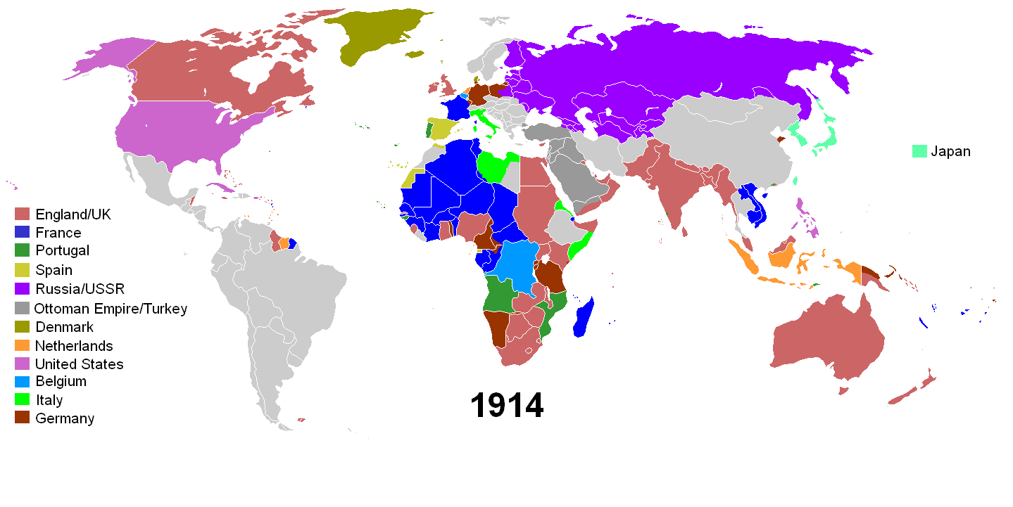
Our Identities Are Shaped By Our Circumstances & OUR CHOICES
“No one is born hating another person because of the colour of his skin, or his background, or his religion. People must learn to hate, and if they can learn to hate, they can be taught to love, for love comes more naturally to the human heart than its opposite.”
Nelson Mandela, Long Walk to Freedom

Slide 4
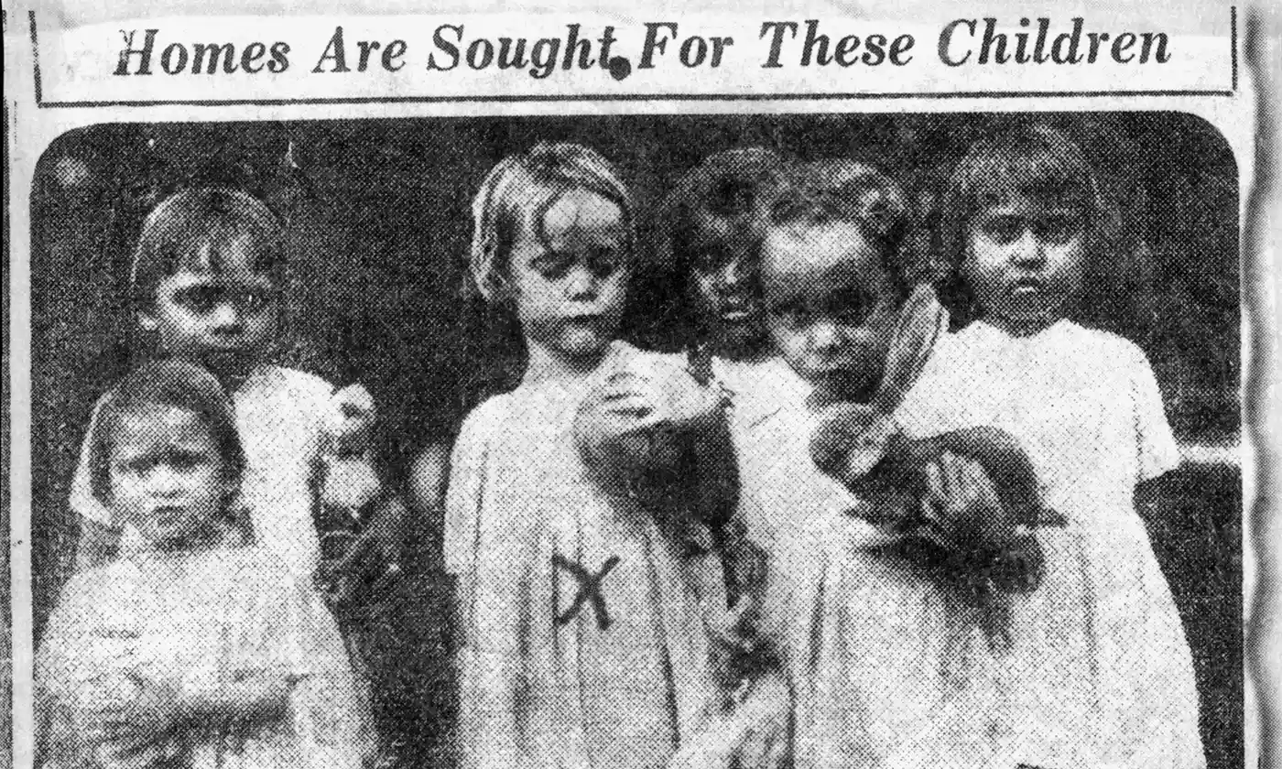
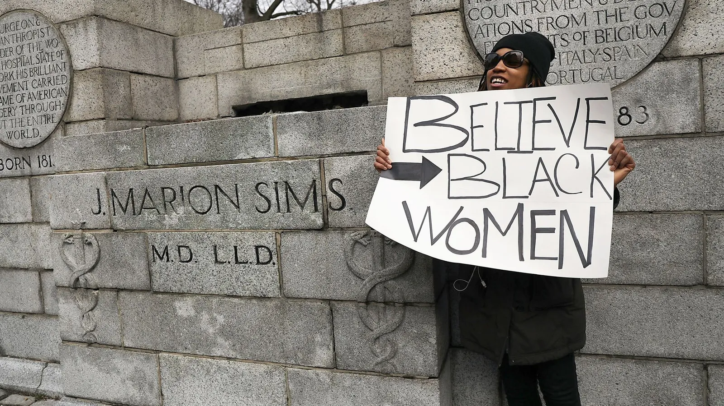
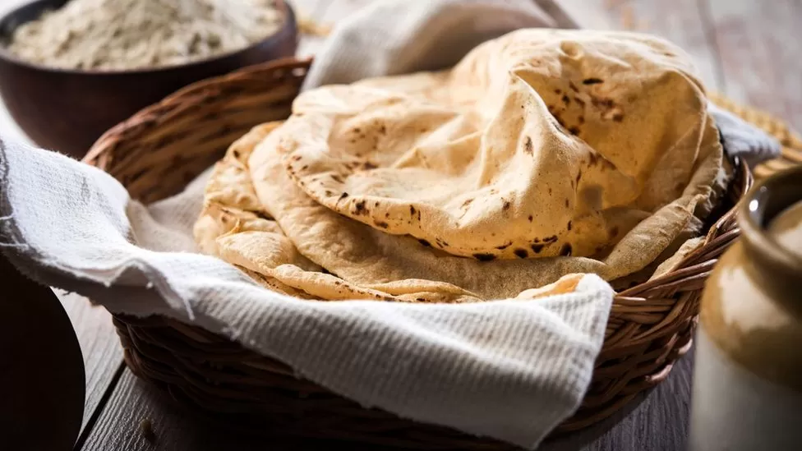
Historical Amnesia, Medical Exploitation and Experimentation

Slide 5
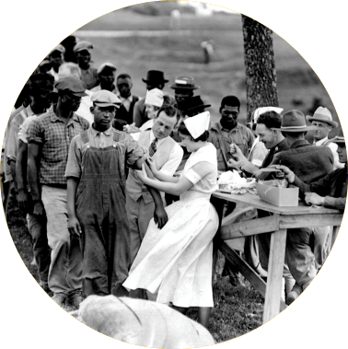
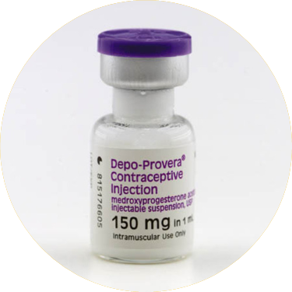
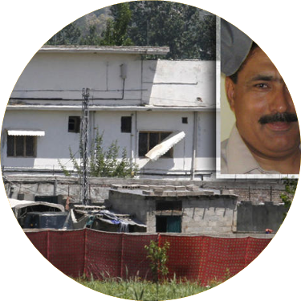
Historical Amnesia, Medical Exploitation and Experimentation

Slide 6
How can we reduce health disparities and promote equitable health outcomes
Ensure visible leadership
Ensure board level responsibility and accountability
Advocate for organisational commitment, D&I committees
Address concerns
Collect and analyse disaggregated data
Develop & implement culturally competent/intelligent health and public health services
Engage with communities
Provide/attend (implicit/unconscious) bias training
Conduct health equity impact assessments
Address social determinants of health
Advocate for policy change
Conduct research on health disparities
Develop culturally tailored health literacy initiatives
Establish targeted mentorship and pipeline programmes
Equity of Opportunity (EB recruitment, mentoring, coaching and sponsorship)

Slide 7
Examples of PH Initiatives and projects
UK
GLOBAL
The Race Equality Foundation & The Race Health Observatory
2021 Reforming the Mental Health Act White Paper
Local PH Initiatives
NHS Workforce Race Equality Standard (WRES)
National Institutes of Health Research (NIHR) Inclusion Health Research Alliance and University led research/initiatives
Public Health England's Review of COVID-19 Disparities
COVID-19 Health Inequalities Action Plan
RCP, RCS, RCPsych antiracism strategies, action plans & culturally competent curricula
PHE Race Equality Strategy
World Health Organization (WHO) guidelines for culturally sensitive health communication
Equitable Access to Healthcare Services – Rwanda’s community-based health insurance program, Mutuelles de Santé
Canada's Health Equity Impact Assessment (HEIA)
Anti-Racist Curriculum in Healthcare Education - The University of Cape Town, South Africa offers an elective course on decolonising healthcare
Global Health Equity Initiatives e.g. MSF
Brazil’s racial quota system - Regular path vs Affirmative Action systems

Slide 8
What is the FPH doing?
Acknowledging antiracism
EDI Committee and EDI SIG
High level webinars
Analysis of PH training recruitment
Fair Training
Decolonising the Curriculum
Applying an EDI lens to all policies and processes
Designing an antiracism charter

Slide 9
Decolonising the Curriculum
Acknowledge colonial histories
Diverse perspectives
Critical analysis of western centric approaches to PH
Racial & Social justice
Cultural competence and intelligence
Global health equity
Community engagement
Awareness and training
Any other ideas?

Slide 10
References
https://www.edi.nih.gov/blog/communities/understanding-racial-terms-and-differences
https://www.ncbi.nlm.nih.gov/pmc/articles/PMC1125797/
https://www.theguardian.com/australia-news/2016/feb/11/stolen-generations-hail-the-power-of-collective-healing
Track the History Timeline: The Stolen Generations | Australian Human Rights Commission
https://journals.sagepub.com/doi/abs/10.1177/01417789211016331#:~:text=In%202013%2C%20then%20Israeli%20Deputy,close%20to%2050%20per%20cent
https://www.theguardian.com/world/2011/jul/11/cia-fake-vaccinations-osama-bin-ladens-dna
https://www.npr.org/2021/09/06/1034631928/the-cias-hunt-for-bin-laden-has-had-lasting-repercussions-for-ngos-in-pakistan
https://www.vox.com/first-person/22256595/vaccine-covid-pakistan-cia-program
https://www.theguardian.com/science/2023/aug/25/coventry-mp-demands-inquiry-1960s-radioactive-study-south-asian-women

