Slide 1

Policy and advocacy in tobacco control
John Waldron
Policy Manager, Action on Smoking and Health
john.waldron@ash.org.uk
Notes:
Policy and advocacy in tobacco control
The tactics used by health harming industries, specifically the tobacco industry
Lessons can be applied to other commercial determinants of health

Slide 2
Outline of session
What is advocacy & why does it matter?
Exercise: Campaigning for raising the age of sale to 21
ASH approach to advocacy
Case study: Standardised tobacco packaging campaign
Q&A
Notes:
What is advocacy & why does it matter?
Exercise: Campaigning for raising the age of sale to 21 (10mins)
ASH approach to advocacy
Case study: Standardised tobacco packaging campaign
Q&A

Slide 3

Attack legitimate science
Attack and intimidate the scientists
Create arms-length front organisations
Manufacture false debate and insist on balance
Frame key issues in highly creative ways
Fund industry disinformation campaigns
Influence the political agenda
“Unhealthy industry tactics”
Moodie, R. (2017). What public health practitioners need to know about unhealthy industry tactics, American Public Health Association.
Notes:
Diagram showing key tactics unhealthy industries use to undermine public health policy – pioneered by tobacco companies
Throughout the session I’m going to use the example of tobacco to illustrate these

Slide 4
Origins of ASH
1962 Royal College of Physicians report on Smoking and Health set out the evidence
Government did little or nothing so in 1971 RCP set up ASH and published a second report
Set up as standalone advocacy charity to campaign for evidence-based policy development and implementation

Slide 5

Why is advocacy needed?
Problem stream
What is the problem?
Tobacco is leading preventable cause of death
Policy stream
What is the policy solution?
Political stream
Is the policy politically viable?
Public opinion
Political context
Media focus
Policy window
Opportunity for policy change
Source: Kingdon’s three streams of policy change (1984)
Notes:
Why is advocacy needed?
Three ‘streams’ which need to be influenced to open the policy window and create opportunity for policy change
Skilled advocates like ASH will work on all three – devise a policy that is politically acceptable, get it in the media, shape and take public opinion, and work on politicians – from the opposition to those in power
Don’t guarantee success but need to do all three to have a chance

Slide 6
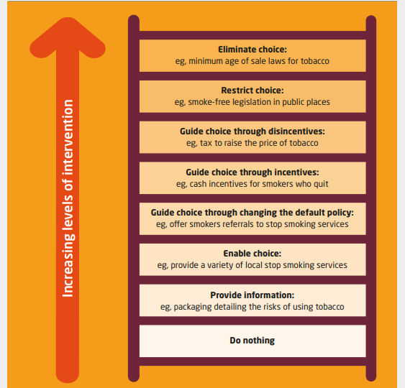
Why does advocacy matter?
Source: King’s Fund adaptation from Nuffield Council on Bioethics (2020)
Notes:
Once you open the window of opportunity you want to push the government towards the highest level of intervention – in the case of smoking and many other health policy areas this will be most effective
This diagram shows the intervention range from the lower level interventions – providing information – to big policy ideas
Lots of the lower level ones (increasing choice and information) will sound familiar from government announcements over the years. Tend to be less effective

Slide 7
Split into 5 groups

Slide 8
Your task
You are running a campaign to persuade Government to raise the tobacco age of sale from 18 to 21. You’ll all be assigned one of these people to plan a meeting with to further your campaign:
Chief Medical Officer
Chair of the Health Select Committee
SpAd at Department for Business, Energy
& Industrial Strategy
SpAd at Department of Health and Social Care
SpAd at Department for Education
(SpAd is Special Adviser – they are the political
advisers to Ministers)

Slide 9
Your task
Prep for your meeting:
What’s the objective?
Why are you meeting with this person?
Who are you taking with you?
What are your key messages?
You have 10 minutes
Notes:
CMO - want to make sure they can advocate for you, understand the issue, the political context and your narrative
Chair of HSC committee – want them to do an enquiry
Business SpAd (explain what this is) at business – relevant for enforcement – neutralise potential opposition
DHSC SpAd - what specifically you want them to do (policy) and why – how it would work - intelligence sharing about mood in govt/other departments/No 10 – maybe prep for meeting with health minister
Edu SpAd - could be allies who could champion internally
3 messages: Why policy needed, how it works, public/political popularity

Slide 10
Your task
Curve-ball!!! 5 minutes to decide how your campaign will respond:
Advisor to the PM tells a private meeting of business doners he’s ‘killed the policy’. The advisor has links to tobacco industry
Government published their response to a consultation of raising the age of sale 3 months ago but no further action has been taken
Government proposes their own bill to make Challenge 25 mandatory in England
Notes:
Key questions
What do you need to do?
What are the challenges/opportunities?
How can challenge be turned into opportunity?
Opportunity to ratchet up media and political pressure on govt for being ‘in bed with the industry’
Need to get the issue back on the agenda. Engage with allies/sympathetic voices in parliament, APPGs, HSC committee, amending relevant legislation. Combined with public facing campaigns to raise awareness and support. Engage media etc.
Great! Government has conceded need to do something and proposed something that will help. You have opportunity to amend legislation – raise awareness – pressure govt into going further

Slide 11
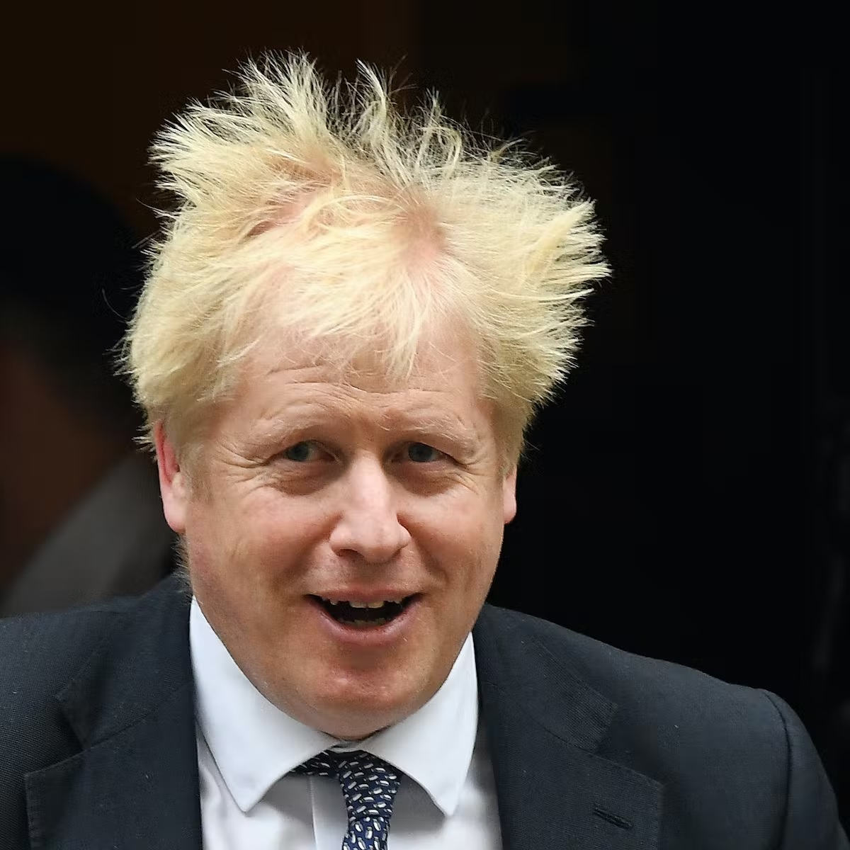
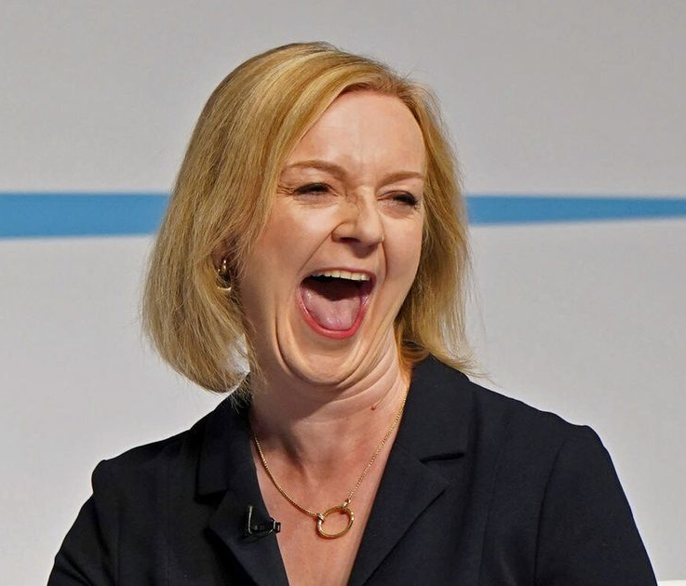
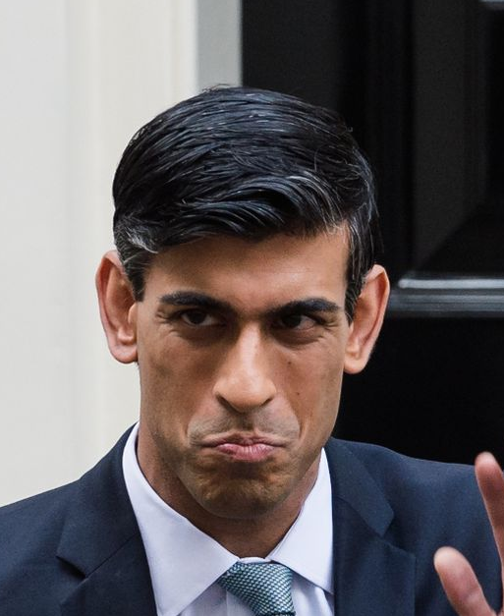
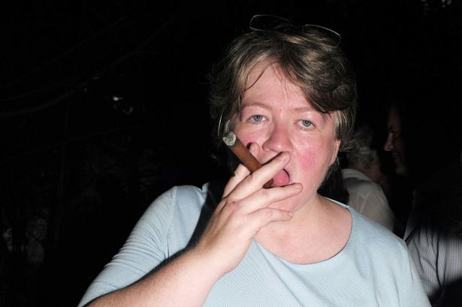
Curveball(s)
July 2019 – Sept 2022
Sept 2022 – Oct 2022
Oct 2022 - ?
SACKED
SACKED
SACKED
Notes:
I didn’t include the political turbulence last year in the list of scenarios because it seemed unfair but this is useful for illustrating how events can disrupt advocacy efforts
Impact for advocacy
Changes in Government are a massive challenge for advocacy because you lose all the Ministers you’ve built relationships with, any ongoing initiatives/plans get put on hold/binned, and you have to start making the case all over again – writing letters, arranging meetings, briefing ministers
All of the commitments on tobacco came from Ministers in the Johnson government. Ministers in Truss and Sunak governments inherited all this stuff and have to decide what they want to keep/bin - months/years of work from third sector, officials, civil servants, ministers down the drain
We had to adapt our framing/messaging to fit the new administration – then readapt it for the next one – crash course in trying to find opportunities among challenges

Slide 12
Advocacy: our approach
Set clear objectives
Work collaboratively
Frame the debate
Build the evidence
Find political champions
Show them the votes
Find the political lever

Slide 13
Setting objectives
2019 – Govt announced the ambition to make England Smokefree by 2030
2021 – All Party Group (APPG) on Smoking and Health publishes report on how to deliver ambition
2022 – DHSC commissions ‘Khan review: making smoking obsolete’ which makes recommendations for achieving smokefree 2030
Ambitions like the smokefree 2030 ambition are key for holding government to account
Reports like APPG report and Khan set out policies needed to achieve ambition – act as manifestos for change
Notes:
Set clear objectives – this is obvious but important. How do you measure success? Objectives need to be constant while your strategy to deliver them evolves with political landscape
Existing govt smokefree 2030 commitment from 2019 – helps to hold them to account – runs through all our advocacy since 2019. They aren’t going to drop it (minus a little wobble in the Truss month) so it’s something we can keep coming back to
Once you have the headline commitment you need the measures to achieve it
2021 – All Party Group on Smoking and Health (group of MPs and peers committed to tobacco control) published a report on how to deliver the 2030 ambition – written by ASH and key academics – sets out recommendations we are calling for
2022 - DHSC commissions ‘Khan review: making smoking obsolete’ which makes recommendations for achieving smokefree 2030 – takes forwards several APPG recommendations
These reports act as a manifesto for other voices in public health space – make sure everyone reading from same script

Slide 14
Working collaboratively one voice on tobacco
Broad TC/Health advocacy
community
SFAC Membership
(over 300 members)
SFAC Core Group
(15 members)
BHF CRUK
ASH
ASH’s in DN
Regional organisations
Notes:
Working collaboratively
ASH a very small organisation – leverage the support of others to achieve shared ambitions and aims
Explain spheres of influence on slide
SFAC core group – explain what SFAC is – work closely with this group to define shared strategy and messaging across organisations – need to speak with one voice
SFAC membership – NHS trusts and local councils who are committed to tackling smoking
Broad TC/health advocacy community – professionals in councils and the NHS, charities, academics etc.
Key benefits:
Using reputation and resource of others to lend credibility and weight
Unified message and ask from the sector on TC – all of these orgs calling for the same thing is much more powerful than just ASH
Both previous reports endorsed by over 100 health charities and organisations

Slide 15
Frame the debate
Smokefree public places campaign
In 2003 parliament was opposed to legislation
"freedom" and "rights" of smokers trumped evidence secondhand smoke harmful
We reframed the debate to focus on health at safety at work
Key messages “secondhand smoke is a killer” and “everyone has a right to a smokefree workplace”
Notes:
Next step - Framing debate on your terms and having control of the narrative to ensure the issue is understood favourably by the intended audience
In 2003 parliament was opposed to legislation
"freedom" and "rights" of smokers trumped evidence secondhand smoke harmful
We reframed the debate to focus on health at safety at work – impact on non-smokers which is the majority of people
Key messages “secondhand smoke is a killer” and “everyone has a right to a smokefree workplace” – flipping that ‘rights’ narrative on its head

Slide 16
Political champions
1979 Thatcher’s Public Health Minister at the World Conference on Tobacco or Health:
“The general proposition that I wish to put to you is that the solution to many of today’s medical problems will not be found in the research laboratories of our hospitals but in our parliaments.”
ASH set up All Party Parliamentary Group on Smoking and Health in 1976
Includes MPs/peers from all parties. Non-partisan
APPG is vital for influencing parliament
Notes:
Quote from Lord Young of Cookham who was a public health minister under Thatcher
He is one of the core members of the APPG on Smoking and Health which ASH set up in 1976
The Group includes MPs/peers from all parties who are passionate about ending smoking. It’s non-partisan and current chair is a conservative which makes it much more effective for influencing parliament + being taken seriously
APPGs and supportive individual politicians are key for getting things done in parliament e.g. submitting written questions, proposing amendments to legislation, meeting with Ministers, providing intelligence on parliamentary activity/procedure

Slide 17
Show them the votes
Notes:
Showing the votes = campaigning to increase support for policies + showing politicians how much public support there is for TC policies – No brainer
Chart shows growth in support for smokefree policies as the campaign went on – one of the positive things about tobacco policies is that support tends to continue increasing after they have been introduced
We use stats on public support for tobacco control measures in our public messaging, social media, PRs + comms aimed at politicians to help de-risk this area for policymakers and create space for tobacco control policies

Slide 18
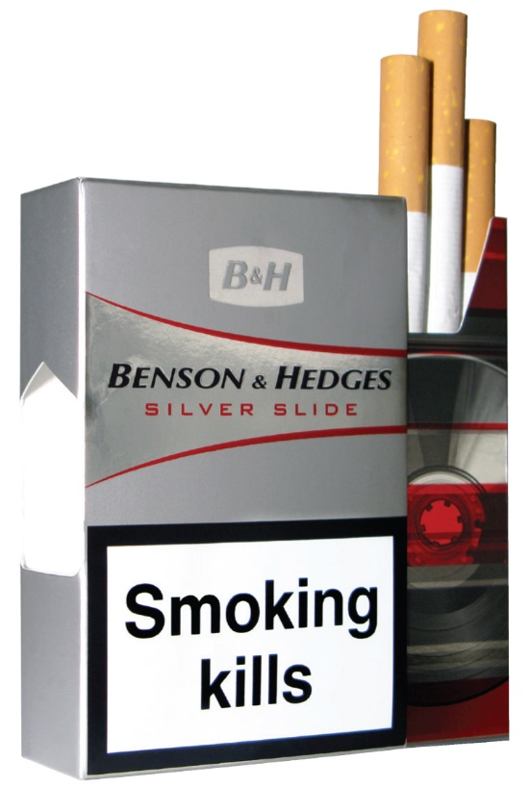
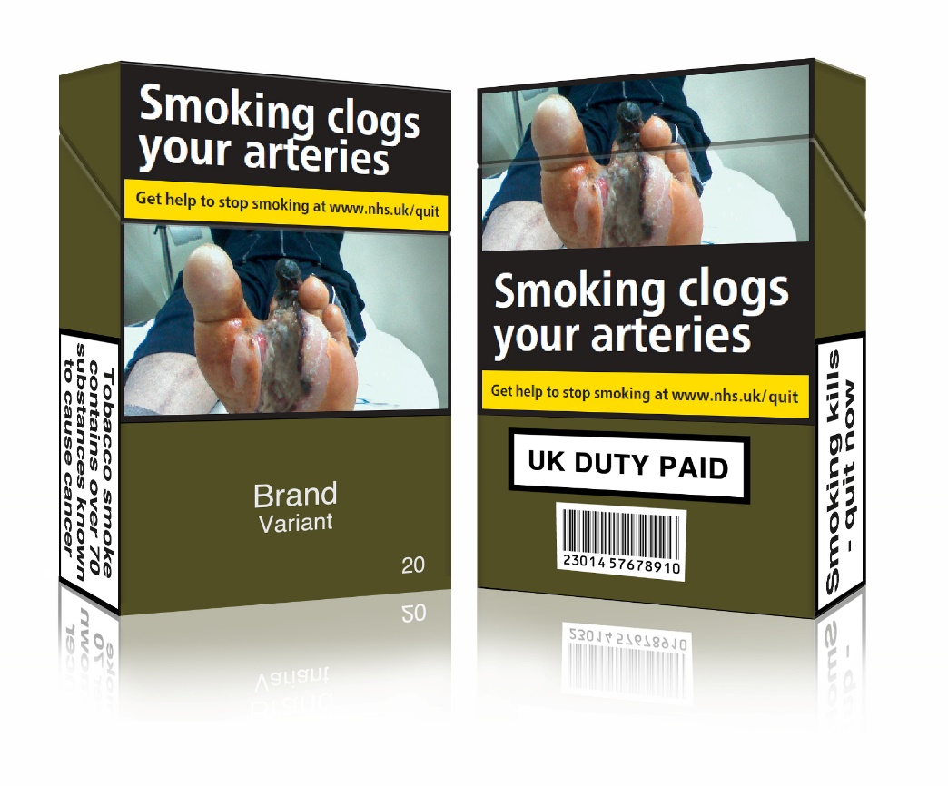
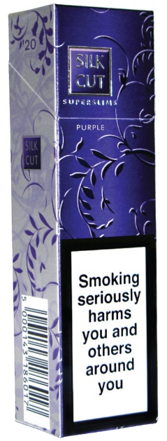
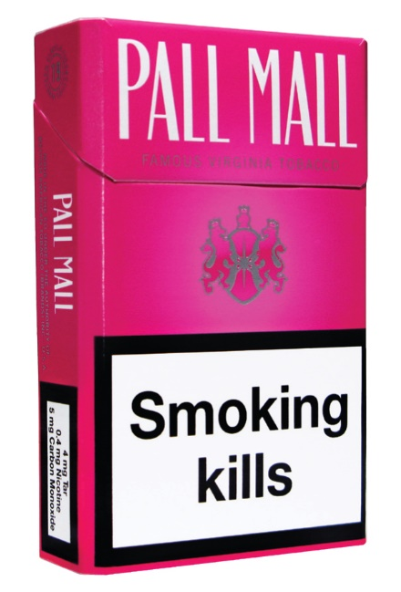
Standardised packaging
2008-2015
Notes:
Good example of a long, hard fought campaign
It shows what a unified PH community can do

Slide 19
Standard packs
Key messages:
  Packaging is advertising
  Advertising that is recruiting children
  Ending it has public, political and health support
  Adverse consequences unlikely
  Will support wider government policy
Action
  Pass legislation
Advocacy approach to support action
  Joined up parliamentary and media strategy
Notes:
Who do you need to engage, what they need to know, what do they need to do?
Key messages pushed by ASH and SFAC
Packaging is advertising – TI were helpful enough to say this themselves, outlining the importance of tobacco packaging to communicating brand value and quality. Leads to the question - Advertising is banned elsewhere, so why isn’t packaging?
Used to recruit children - 90% of adult smokers know what brand they will buy before they go into shops (Cancer Research UK, 2008). Kids main group influenced by packaging
Adverse consequences unlikely – ‘hard to see what could go wrong?’ Public TI line was that the ban wouldn’t have an impact – so why oppose it?
Action needed - legislation

Slide 20
2008: ASH report calls for Standard Packs
Standard packs campaign
2010: General Election
2011: New tobacco strategy published
2012: Consultation on Standard Packs
2014: Primary legislation passed
2015: Final regulations passed
2016: Regulations implemented
Notes:
Deceptively simple timeline but took 8 years

Slide 21

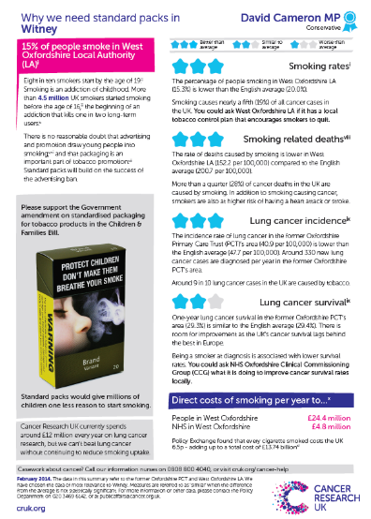

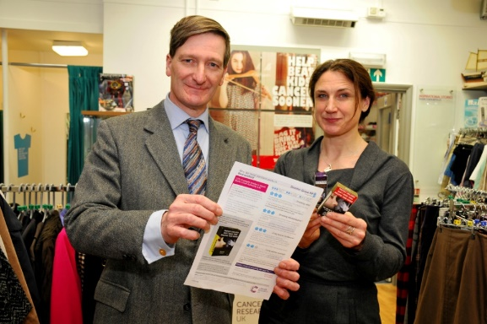
Launching the public campaign 2012
Conference London - January 2012
Consultation – April – August 2012
SFAC over 200 members
ASH, CRUK & SFSW key partners in the campaign
Notes:
In January 2012 Smokefree South West, ASH and Cancer Research UK launched a public campaign: ‘Plain packs protect’
At this point, SFAC had over 200 members to call on in support and promotion of the campaign
Also had the resource of partners including Cancer Research UK
Coincided with launch of government consultation on plain pack. Campaign launch helped build public momentum and drive supportive responses to the consultation
Campaign was framed around protecting children – CRUK produced a great advert showing schoolchildren playing with cigarette packs and saying how colourful and exciting and glamourous they were – impossible to argue against
https://youtube.com/watch?v=c_z-4S8iicc&si=EnSIkaIECMiOmarE

Slide 22
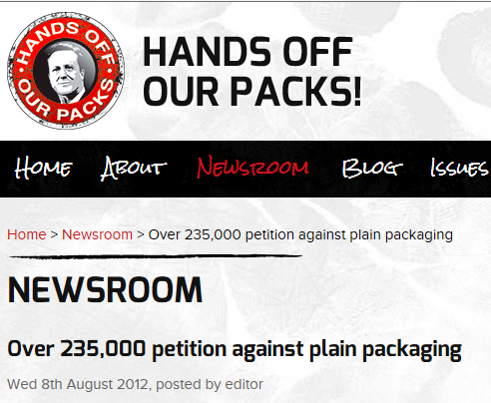
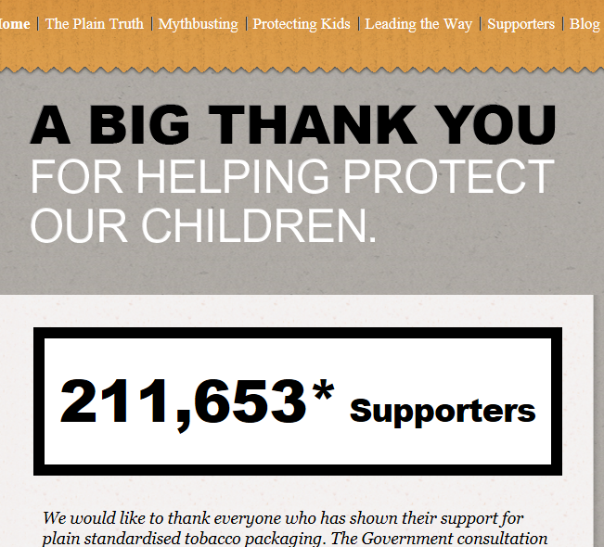
TI spent millions to get signatures
Notes:
Here’s what we are up against
ASH and SFAC launched petition to show support for plain packs (right)
Tobacco industry spent lots of money to get as many signatures as we did - JTI alone spent £2 million

Slide 23

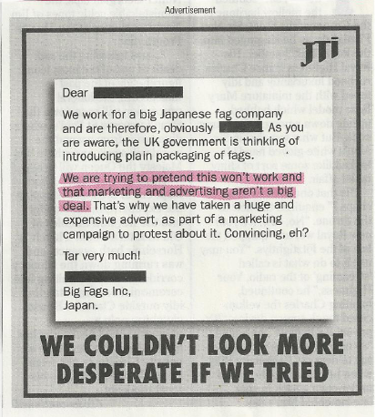
Big Tobacco: its own worst enemy
JTI alone spent £2 million on advertising
Notes:
Big tobacco its own worst enemy
Left-hand side is an advert JTI ran in lots of newspapers – quotes a letter from a DH official saying standardised packaging may not work (as yet no hard evidence of it’s impact)
Right-hand side is a spoof in private eye – ‘we’re trying to pretend this won’t work and that advertising and marketing aren’t a big deal’ – ‘we couldn’t look more desperate if we tried’
Entirely unforced error – highlights how weak their argument it. A challenge becomes an opportunity
Fun fact: JTI told to retract advert by ASA

Slide 24
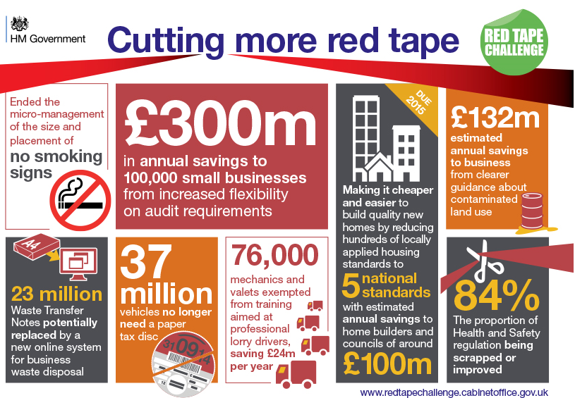
New Health Minister, other pressures, progress slows…
2011 Lansley’s TC Plan committed to consult
BUT “Red tape challenge”
Hunt replaces Lansley
Consultation completed but put on ice in 2013
Election coming up
PM Jan 2014 “this is the first government in modern history to reduce overall domestic regulation for business while in office. 800 regulations have already been abolished or simplified – with tens of thousands of pages of red tape still to face the chop.”
Notes:
New challenges
Big focus in Government to cut red tape – tobacco policy seen as unnecessary regulation
Hunt replaces Lansley
Gov didn’t want to be seen as anti-smoking with political threat from UKIP
Consultation completed but put on ice in 2013

Slide 25
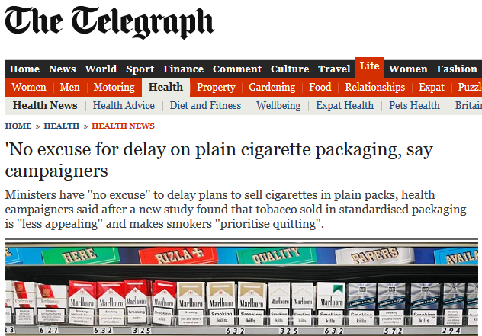
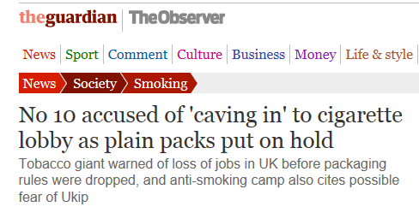
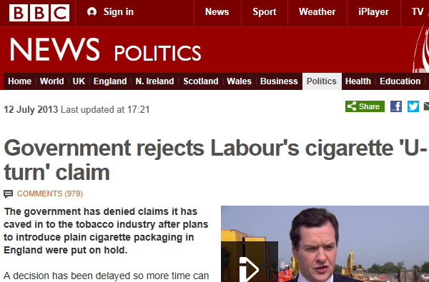
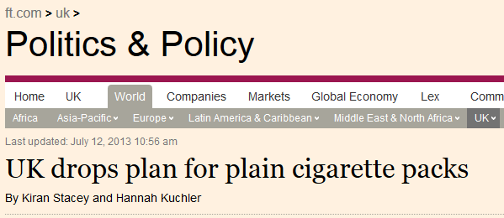

Plain standardised Packs:
July 2013 put on hold
Notes:
Challenges into opportunity – gov benching the consultation is a good opportunity to turn up pressure on gov and get plain packs back on media and political agenda
Importance of engaging media – these stories don’t get there on their own

Slide 26
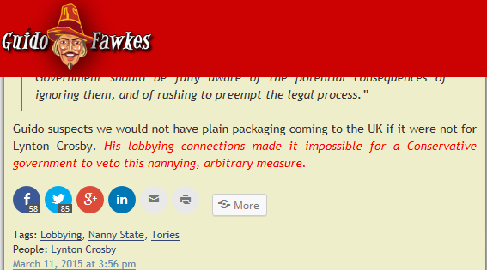
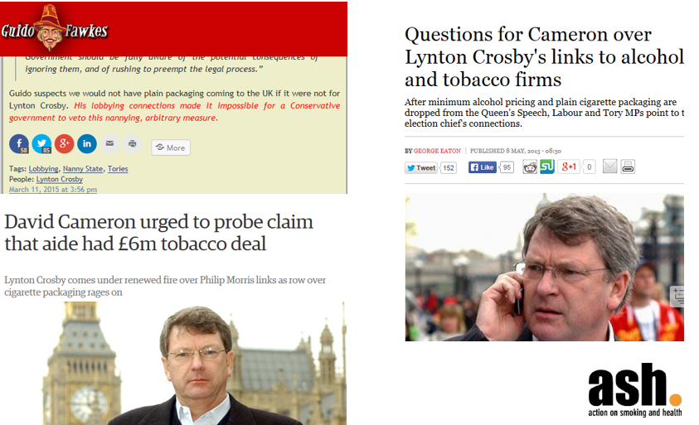
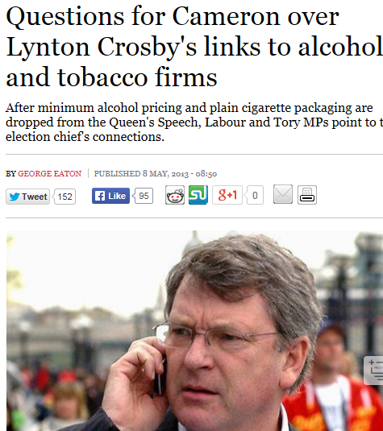
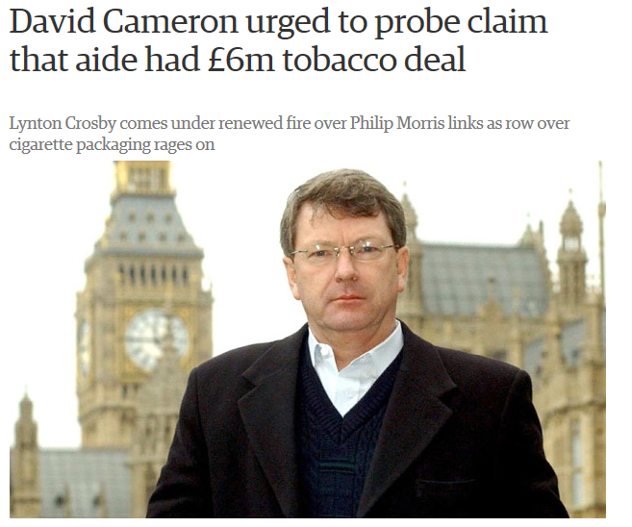
Lynton Crosby: secret weapon
Notes:
Lynton Crosby is an Australian lobbyist who had worked with the tobacco industry. Hired by David Cameron after he was elected in 2010
When standard packs were put on hold it was revealed that Crosby had links to tobacco industry – his company was previously hired by BAT to fight plain packs in Australia. Tobacco lobbyist at the centre of government as plain packs consultation hits a wall - opportunity to embarrass the gov by making it look like they are in bed with tobacco industry
again how to you maximise the opportunities to come out of this? These news stories don’t get there on their own!
Emerged later that Crosby had been hired in 2012 by PMI to lobby against plain packs in the UK.

Slide 27
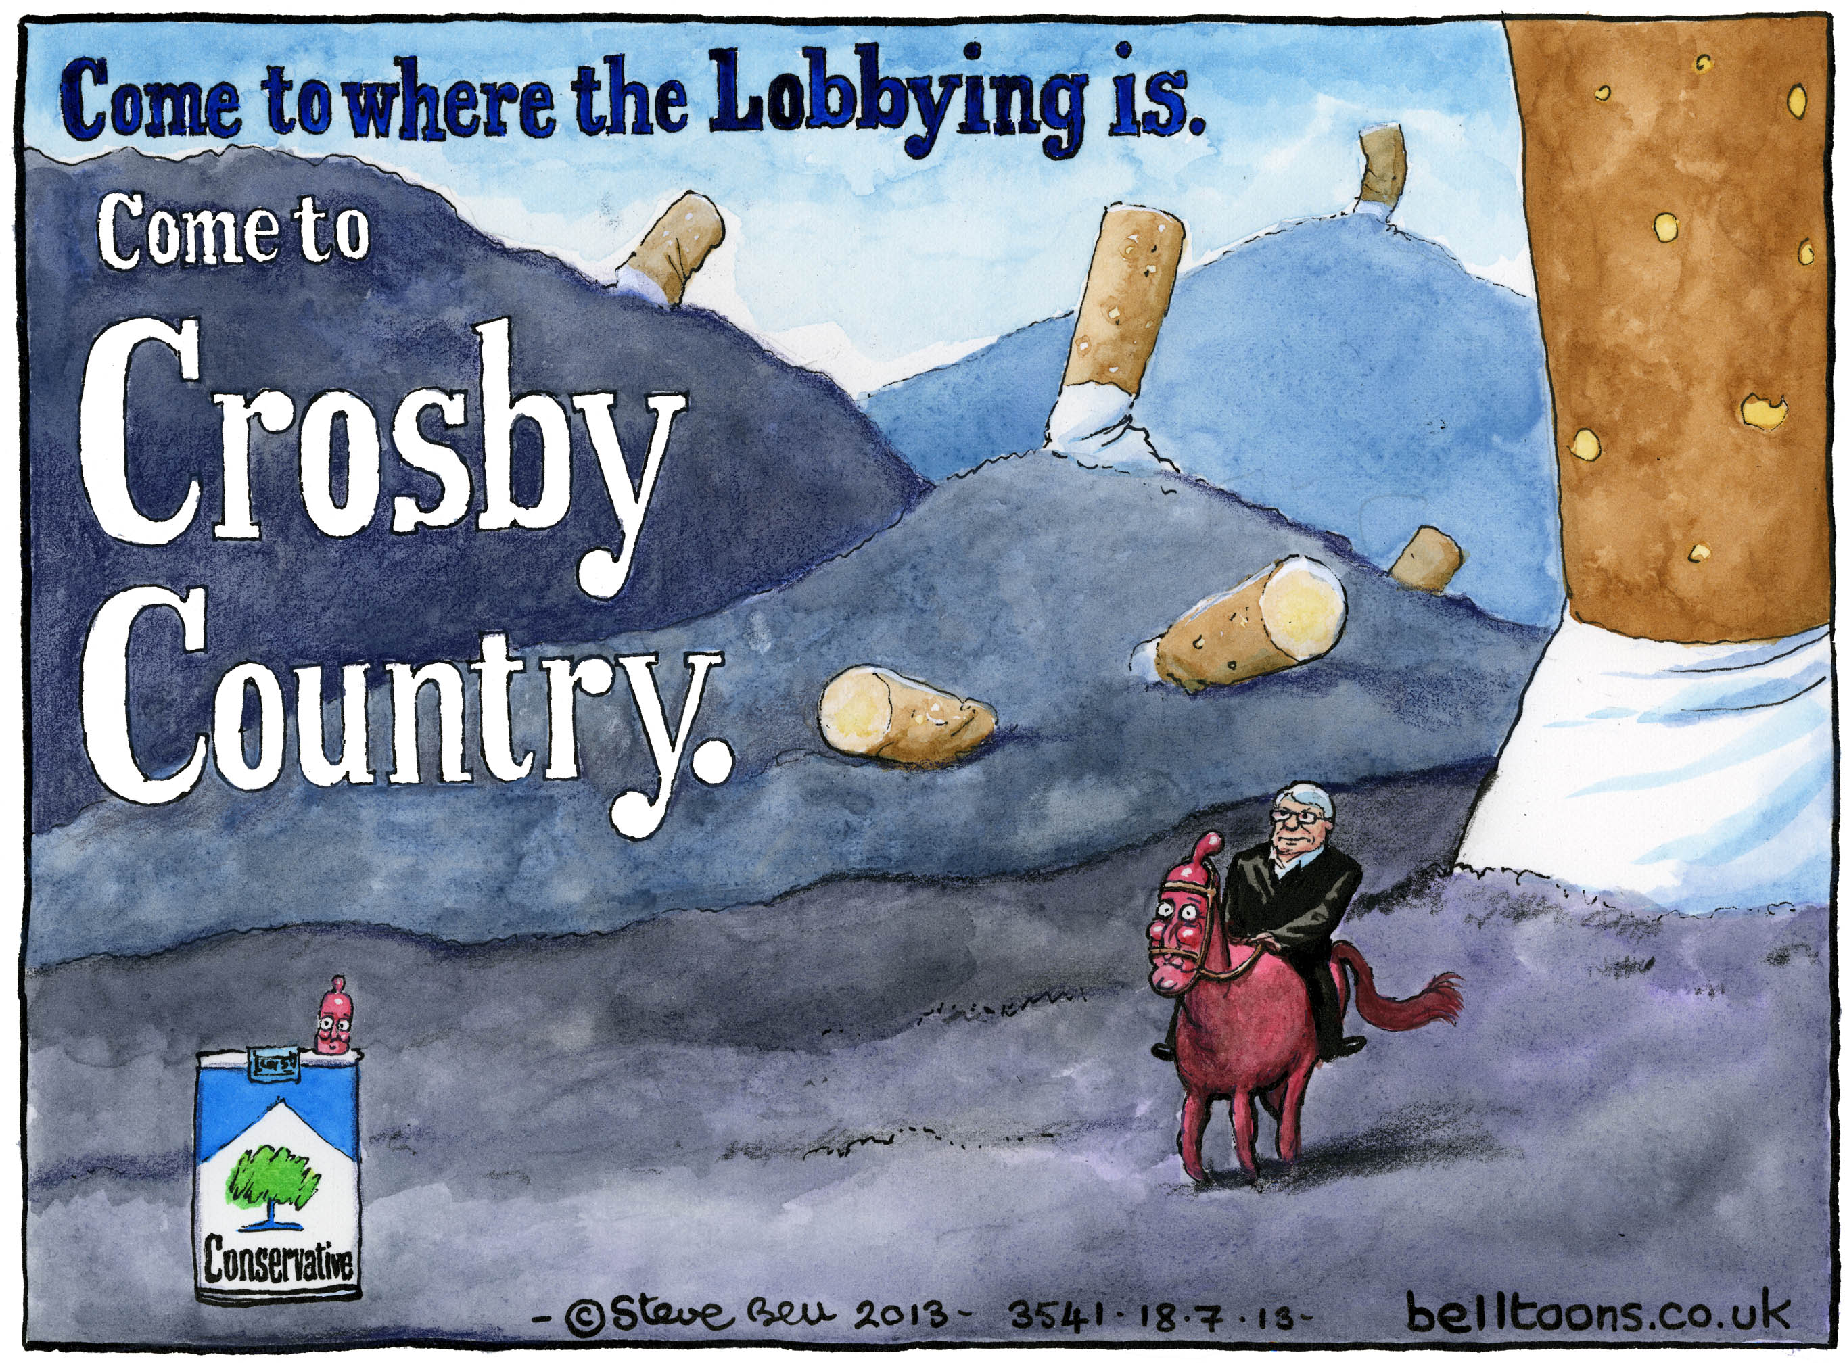
Notes:
https://www.theguardian.com/commentisfree/cartoon/2013/jul/17/lynton-crosby-conservatives-cartoon

Slide 28
Front organisations/allies
Research organisations:
Foundation for a Smokefree World
Trade bodies:
Federation of independent retailers
Tobacco retailers association
Association of convenience stores
Tobacco companies
Bloggers
Thinktanks:
IEA
Taxpayers Alliance
Adam Smith Institute
Front groups:
Forest
Notes:
Brings us onto the issue of how harm causing companies use front groups to influence debate and manufacture opposition to public health measures
Mixture of front groups, people with shared ideological/commercial interests, useful idiots

Slide 29
Attack science/scientists
You think your enemy is Big Tobacco. But those days are over. Your enemy now is the ever-growing swarm of angry smokers from all over the world, gradually coalescing into a super-swarm.
And they all hate you. And people like you. They hate your guts. They really do.
Those nasty emails and phone calls you’ve been getting… they’re not going to stop. They’re going to become more and more frequent. You should start worrying when bricks start getting thrown through your window, or messages daubed on your door. They won’t be planned or organised either. They’ll just happen.
Notes:
Extract from a letter sent to Prof Linda Bauld, high profile UK academic studying impact of 2007 smoking ban, has regularly appeared on media. Letter send by pro-smoking blogger who was known for using threatening language against public health advocates/compared them to nazis. Said he wanted to kill our CEO.
Letter was widely shared online among pro-smoking bloggers
Bauld and other tobacco advocates have also received:
Attacked in tobacco industry publications
Aggressive blog posts on smokers’ websites
Anonymous phonecalls
Threats
https://tobaccotactics.org/article/linda-bauld/
https://www.independent.co.uk/news/science/exclusive-smoked-out-tobacco-giant-s-war-on-science-2347254.html

Slide 30
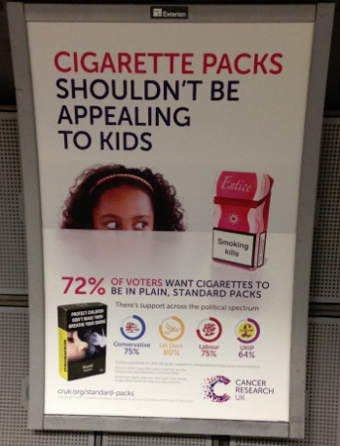
“Show me the votes”
Public opinion in support
Parliamentarians in support
Industry not trusted
Commons vote 367 in favour 113 against
Notes:
Shows 72% of public support
Includes party breakdowns
As a consequence parliamentarians were supportive
Industry not trusted – partly due to its own actions

Slide 31
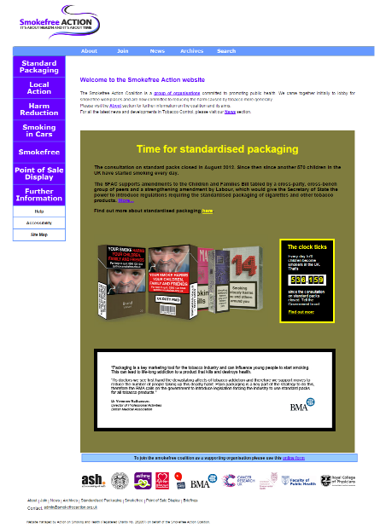
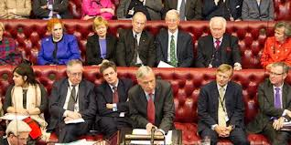
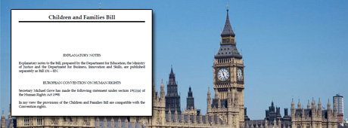
The political lever
Children and Families
Bill Autumn 2013
4 peers from all parties tabled
amendment
Allowed parliament to decide
Government adopted
amendment
Passed overwhelmingly
Notes:
Children and Families Bill Autumn 2013
4 peers from all parties tabled amendment adding plain packs to the bill
Allowed parliament to decide
Because of overwhelming public and political pressure Gov adopted amendment
Passed overwhelmingly

Slide 32
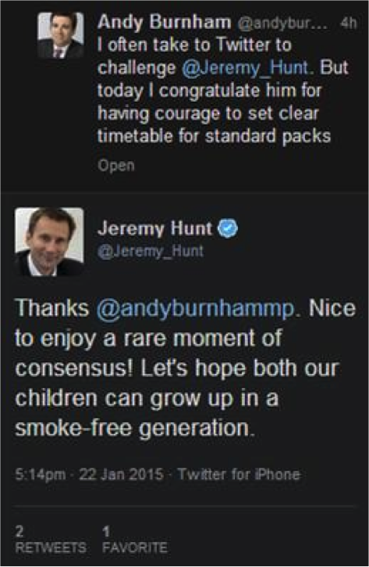
Growing the political consensus
Smokefree legislation was a real game changer
Strong public support + no single political party could take credit (so they all did)
Ending smoking has become a non-partisan issue
Still a challenge to get new measures adopted
Once adopted Govt owns them
Notes:
Political consensus has really shifted from 1950s when politicians didn’t want to touch smoking + TI was powerful
Smokefree legislation was a real game changer - denormalised smoking – politicians started to see TC as political opportunity
Ending smoking has become a non-partisan issue with strong public support - no 1 political party could take credit (so they all did)
Image shows a tweet from Andy Burnham (shadow health) to Jeremy Hunt (health) after gov passed standard packs legislation
Jeremy Hunt being so supportive is a big deal when Government was considering dropping the policy 2 yrs before
Arguments that people are having around regulating other harmful products (junk food, alcohol, gambling) are ones which tobacco control advocates had years ago. Experience from tobacco shows that the opposition can be overcome but it takes time and there will be setbacks

Slide 33
Opposition verdict
“The manifesto of this tiny pressure group is, in effect, the manifesto of whichever party is in power. The only difference is that governments often ignore their own manifesto commitments ……whereas the ASH manifesto is always implemented to the letter.”
Christopher Snowdon, Institute of Economic Affairs. The Spectator, 1/6/2015

Slide 34
Summary
Know exactly what you’re working towards
Build and use your networks
Develop and use the evidence
Take control of the conversation
Turn challenges into opportunities
Think long-term
Pragmatic analysis & relentless optimism

Slide 35
QUESTIONS
AND ANSWERS

Slide 36
Further information
ASH: www.ash.org.uk
Tobacco Tactics www.tobaccotactics.org

