Slide 1
Digital transformation in public health
Dr Pritesh Mistry
Twitter & Threads: @mustbemistry
Email: p.mistry@kingsfund.org.uk

Slide 2
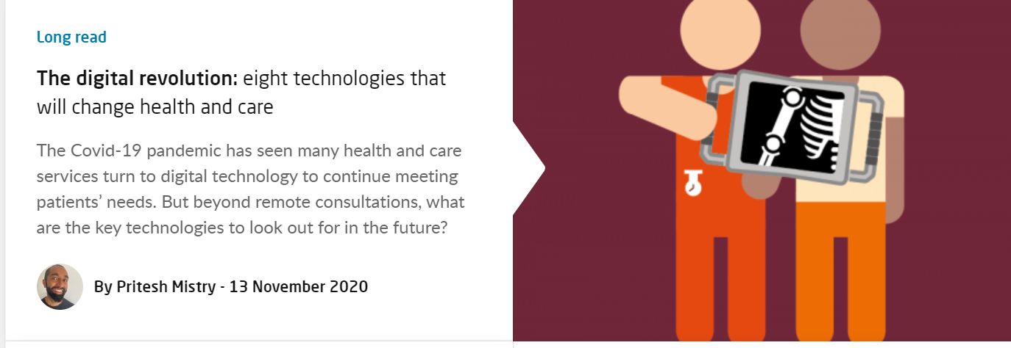
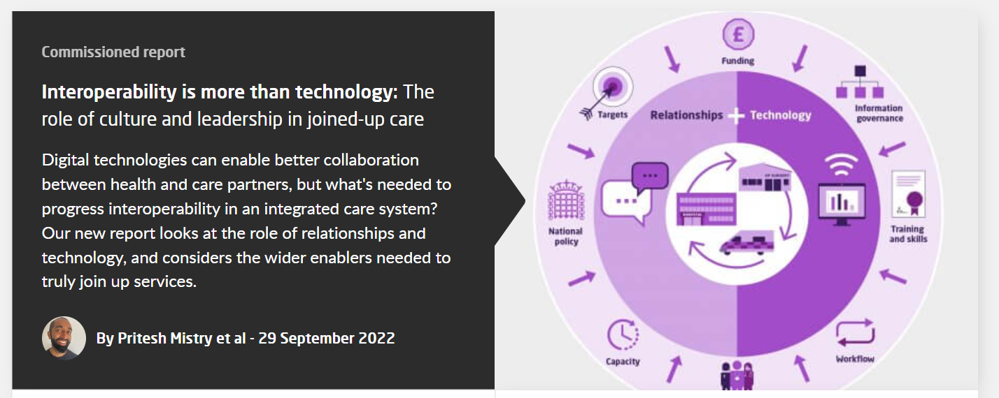
Who am I?

Slide 3
Who are The Kings Fund?
Health and Care Think Tank
125 years
Independent organisation
Research
Policy development
Convening
Leadership and organisational development
Thought leadership

Slide 4
What is digital public health?
Not modify public health principles
Not a novel field in itself
It is support and enable the implementation of public health principles
It is a means and new set of tools to do this.
preventing disease, prolonging life and promoting health and well-being through the organised efforts and informed choices of society, organisations, public and private, communities and individuals

Slide 5
Why digitalise? And what about transformation?
Potential benefits from digital tools:
cure -> prevention
helping to put people and patients at the centre of care
support patient empowerment
more efficient, safer and cheaper
It’s not about replacing everything with digital approaches but blending the two.
Transforming the how not the what
Personalisation and precision
Automation
Prediction
Data analytics
Interaction and communication

Slide 6
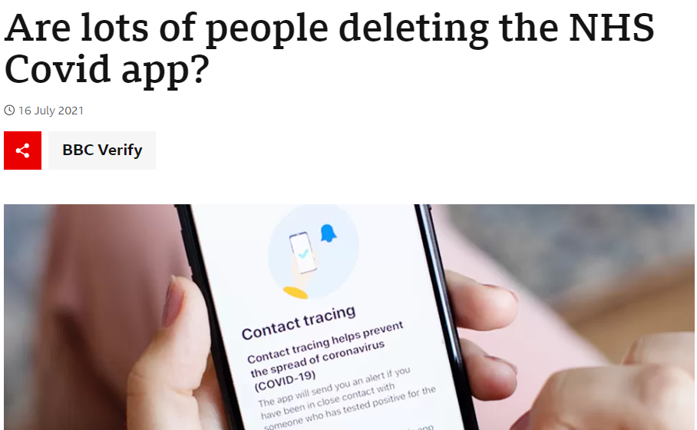
Rapid changes in pandemic conditions
Location data (GPS) proximity information (Bluetooth) with personalised messaging to support contact tracing and slowing disease spread
Human behaviour
Vaccine rollout combined with data to reduce inequalities
Easy to reach locations (bus)
Trusted voices (WhatsApp)
Sewage surveillance data for disease modelling

Slide 7
Where can digital tech make change?
Automation and prediction
Disease propagation automation of reporting
NLP (natural language processing) analysis of free-text information in death certificates - identify potential drug overdose deaths months prior to traditional coding and data release
NLP (natural language processing) on social media posts (1.8 million a day) to predict disease occurrence and identify potential outbreaks in real-time
Chicago Department of Public Health software identifies children at high risk of lead poisoning and prioritises homes for lead inspections using historical blood lead level tests, home inspection data, child characteristics, property value assessments and census data

Slide 8
Where can digital tech make change?
Data
Step change in data availability and with AI the usability improves too
Novel streams of data for insight into social, behavioural, and environmental determinants of health.
social media, search engines, forums, news media, mobile devices and apps (social determinants)
Wearable devices have data on movements and physiological measures
Environmental sensors have data on air pollution, water quality, environmental noise, weather conditions, and green space
Linkage to traditional public health data, including that from administrative records, electronic health records, census and health survey data

Slide 9
Where can digital tech make change?
Interaction and communication
Generate their own health data, monitor and interpret them, impacting patient empowerment.
Smartphone applications support a change behavioural risk factors (i.e. physical activity) impacting primary prevention.
Internet and social media mean two-way communication, rapid engagement and education of the population through trusted and tailored public health information
Targeted public health campaigns focusing on those who may be most receptive using sentiment analysis and social media

Slide 10
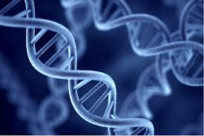
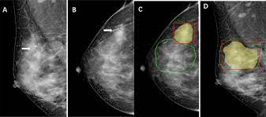
Where can digital tech make change?
Secondary prevention
Genomics applied to identify people at risk of developing diseases
AI for mammography currently second reader may one day be fully automated

Slide 11
Where can digital tech make change?
Workforce
Expect digitalisation to change staff roles, functions, and competencies
Likely the workforce will expand to include technical professionals (i.e. informaticians and engineers)
Education and training should aim to increase digital literacy but not give specific instructions on future technologies
New additional skills will be needed for AI scrutiny, development, evaluation and implementation,
Training of public health professionals can become more personalised by combining virtual reality and artificial intelligence tools – insights

Slide 12
Key points
Expect digitalisation to mean changes to staff members
All tech is useful from the mundane to the cutting edge
The data isn’t perfect and it’s in silos but need to start somewhere
It’s a starting point to make some improvements and progress from there
Don’t underestimate the importance of data visualisation
AI potential is huge but beware of bias, black box systems and inequalities
Public and population level information but with local links to make improvements

Slide 13
Thank you Twitter & Threads - @mustbemistry LinkedIn email – p.mistry@kingsfund.org.uk

