Slide 1
Psychiatry and Public Health: a meeting of minds
Professor Wendy Burn, President of the Royal College of Psychiatrists
Professor John Middleton, President of the Faculty of Public Health
Dr Amabel Dessain, Psychiatry Core Trainee
Dr Neha Shah, Public Health Registrar
10th May 2019
Notes:
Rough Structure
(Amabel)We would like to introduce ourselves as a public health registrar and core psychiatry trainee who are part of a group of London and South East based trainees who have been exploring opportunities to develop cross specialty learning. We are extremely grateful to Professor Burn and Professor Middleton for joining us and taking the hotseat today and giving us the platform to ask some questions and hopefully open up a conversation about how we might take things forward, both in other areas and at national level.
Whilst we are obviously believers that cross-speciality opportunities benefit both specialties, we wanted also to assess whether the need was felt by our colleagues. On the slide we have some key findings from local surveys carried out by psychiatry and public health registrars.
(Amabel to present Psych slides)
(Neha to present PH slides)
We are of course only one region but we have no reason not to expect that similar interest exist nationally.
We have a few questions we have prepared and will hopefully have time to open up for a question or two from the audience.
(Neha) Drawing on your experience, both as practitioners and as leaders influencing training and policy, where do you think psychiatry and public health can and should be working together?
(Amabel) How can we strengthen these areas in our work, taking into account challenges such as time and energy particularly when collaborative working is often an addition to a clinical role?
(Neha)What do you think are the key levers to help make public mental health learning a universal part of the psychiatry and public health learning experience?
(Amabel) – if time any further questions from audience
(Neha) Close

Slide 2
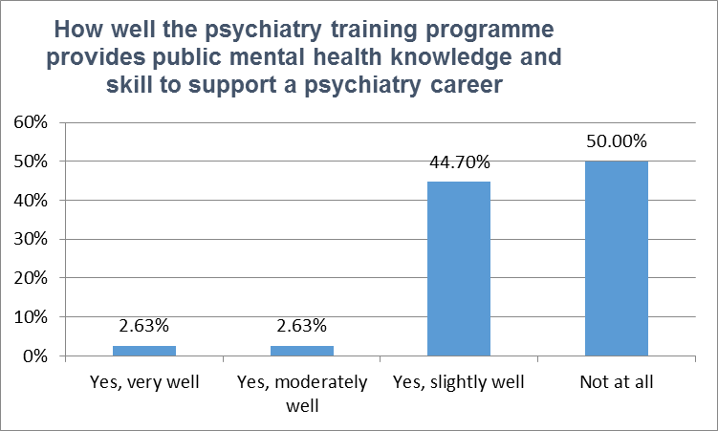
Psychiatry Survey responses
39/260 psychiatry core and higher specialty trainees across London and South East.
30% with some previous experience in public health
Key Needs
92% expressed interest in training placement opportunities in local authorities and 89% in other relevant settings such as PHE.
Interest expressed in learning more about:
Social determinants of mental health including poverty; housing; adverse childhood experience and social media
culturally diverse groups and disadvantaged populations e.g. refugees, asylum seekers and other migrants
Knowledge of commissioning and working toward better integration with wider statutory, GP and council services to improve support in the community
Notes:
39 respondees (out of approx 260 trainees not taking into account out of programme activity) Majority CT2 or CT3 with 11 STs

Slide 3
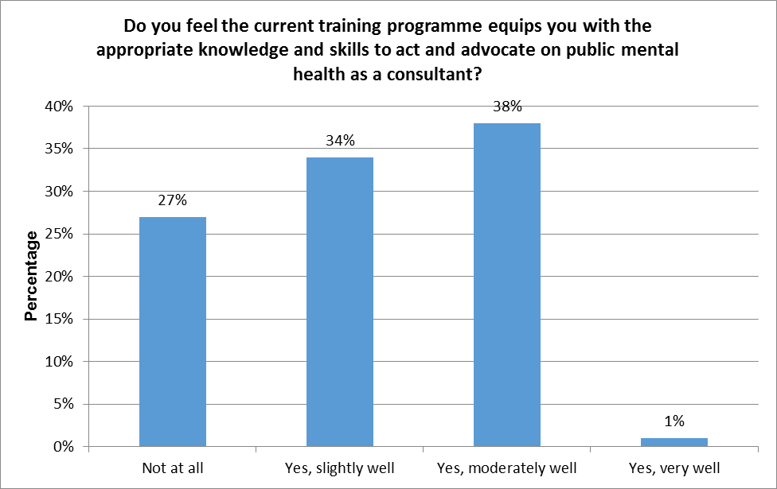
Public Health Survey responses
79/110 public health trainees across London and South East
Key Needs
70% expressed interest in placements in Acute mental health trusts (currently none available in London) and 54% in PHE and other relevant settings.
33% would welcome a greater focus on healthcare / treatment
33% would welcome a greater focus on prevention of mental ill health
22% would welcome a greater focus on links between physical and mental health
Promotion and wider determinants appeared to be better addressed within the programme, likely through local Authority Placements
Notes:
-Good uptake rate
-few felt well equipped by end of training, when broken down into training stage confidence lessened throughout programme

