Slide 1
Joint FPH/RCPsych meeting; Public Mental Health. London May 10th 2019
Public Health approaches to alcohol; politics, partners and psychiatrists
Professor Joe Barry
Chair of Population Health Medicine
10th May 2019

Slide 2
Outline of talk
Context
Strategising
Role of data
Industry approach
Politics
Current position
The future

Slide 3
Alcohol consumption per capita, in litres of pure alcohol, 1989-2000 EU countries
 | 1989 | 2000
Luxembourg | 12.5 | 12.1
Ireland | 7.6 | 11.1
Portugal | 10.4 | 10.8
France | 12.8 | 10.5
Germany | 10.4 | 10.5
Spain | 10.8 | 10.0
Denmark | 9.6 | 9.5
Austria | 10.3 | 9.4
Greece | 8.4 | 8.0
Belgium | 9.5 | 8.4
Netherlands | 8.2 | 8.2
United Kingdom | 7.6 | 8.4
Italy | 9.9 | 7.5
Finland | 7.6 | 7.1
Sweden | 5.6 | 4.9

Slide 4
High Risk Drinking Patterns in Ireland
Source: ESPAD, CLAN, IDS

Slide 5
Indicators of Alcohol related harm
Unintentional injuries/personal harm
Personal relationships
Interpersonal violence/public safety
Drink driving
Alcohol related mortality
Mental health problems
Cost of alcohol related problems

Slide 6
Conditions which facilitate societal drinking problems
Overall consumption
Drinking patterns
‘Culture’
Easy accessibility
High public demand
Aggressive marketing
Political factors

Slide 7
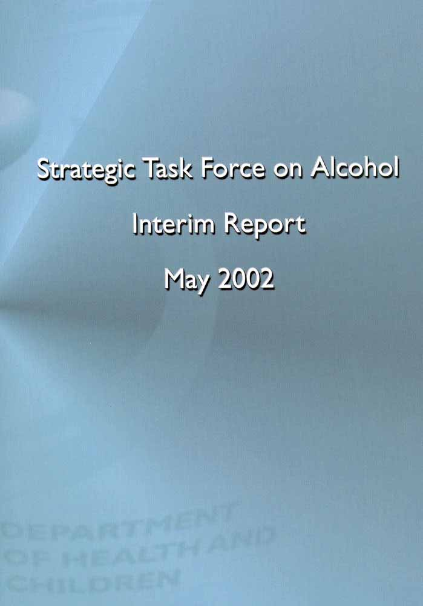
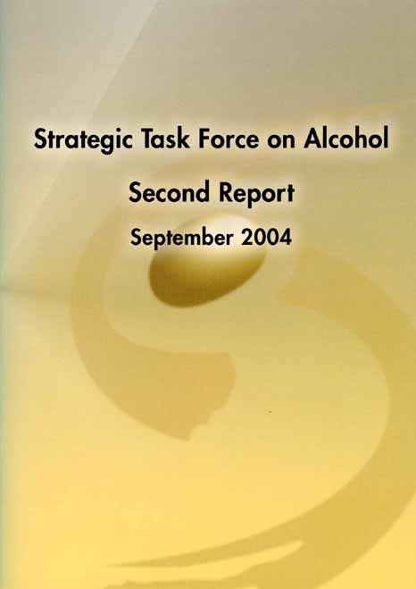
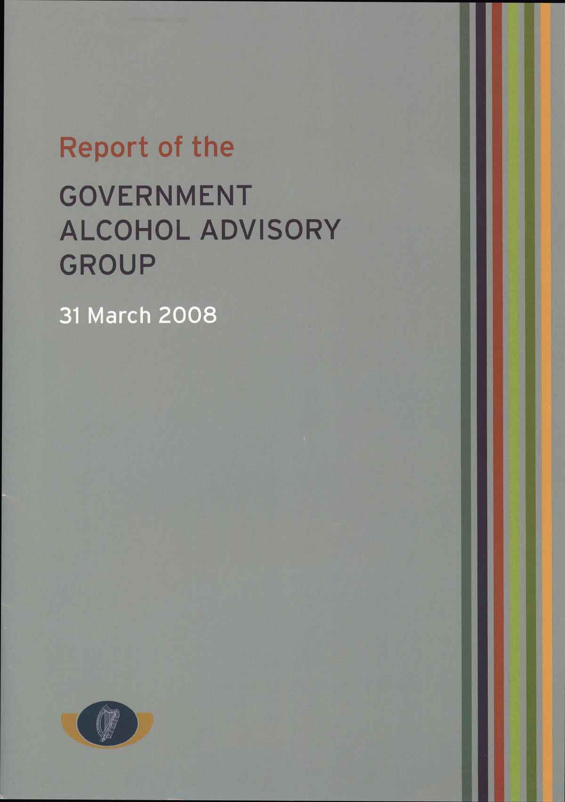

Slide 8
World Health Organisation (Global Strategy to reduce harmful use of alcohol)
Ten areas for national action:
leadership/awareness/commitment,
health service response,
community action,
drink driving policies,
availability of alcohol,
marketing,
pricing,
reducing negative consequences,
illicit alcohol,
monitoring/surveillance

Slide 11
National Substance Misuse Strategy 2012
Supply Pillar Increase price ‘Social responsibility’ level on drinks industry Structural separation HSE objections to licences Legislation on distance sales Phase out drinks industry sponsorship of sport and other large public events | Treatment and Rehabilitation Pillar Establish a clinical directorate Early intervention guidelines Strengthen FASD surveillance Specialist detoxification services Screening and brief interventions in various settings Family support services Vulnerable groups
Prevention Pillar Screening tools should reflect Irish standard drink (10g) Labels should include grams, calories and health warnings Alcohol-free venues for young people Counter measures aimed at families Drug/alcohol intervention programmes with onward referral | Research Pillar Develop epidemiological indicators (prevalence, demand for treatment, deaths, harms, expenditure) Develop and prioritise a research programme

Slide 12
Strategy
Politicians
Media
Hearts and minds
Partners
NGOs
Training bodies
Interested people

Slide 13
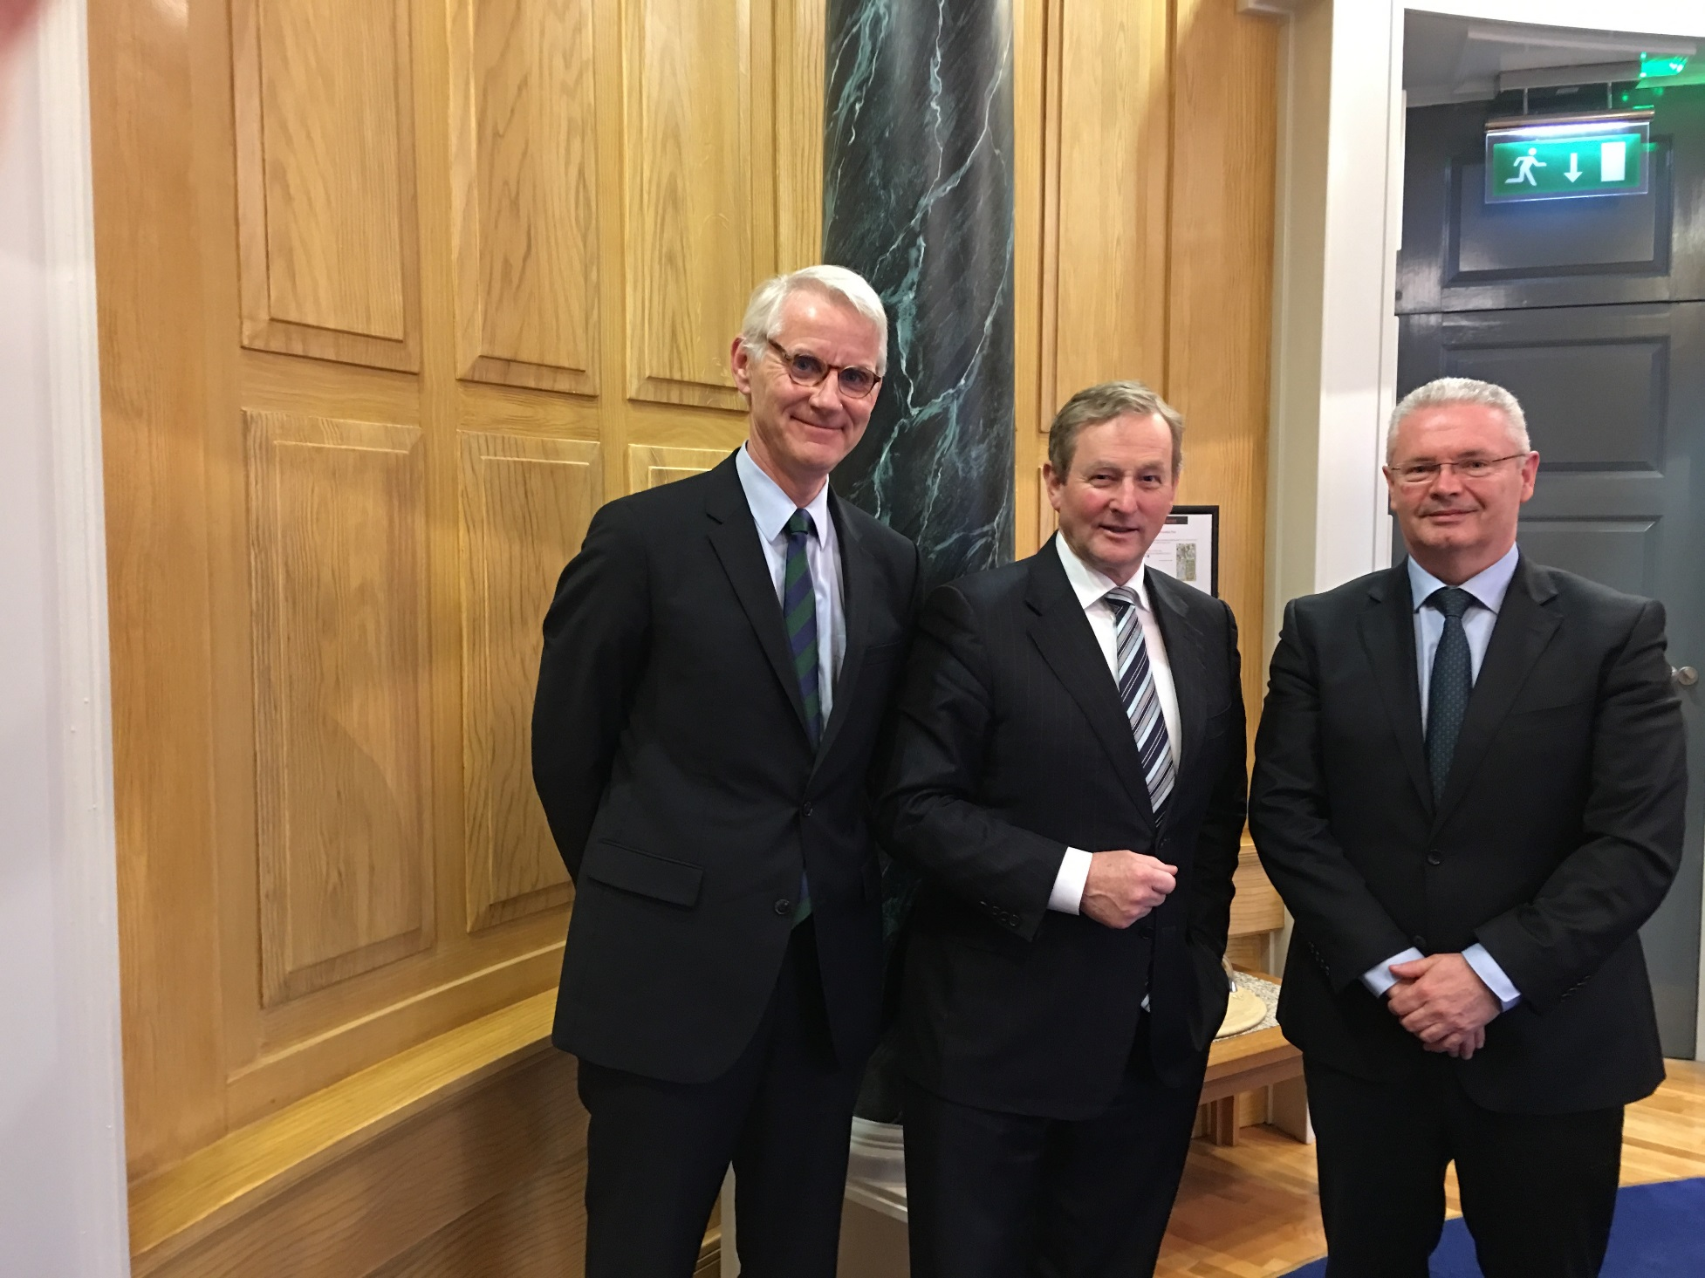
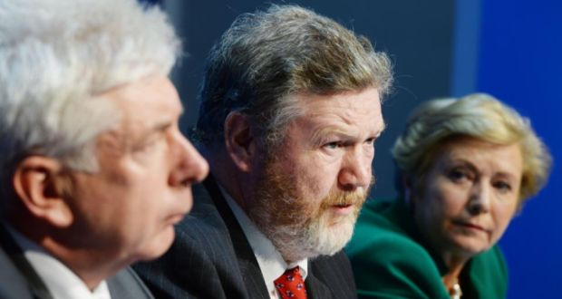
The political journey ….

Slide 15
Deaths on Irish Roads 1961-2013
RBT
Blood alcohol reduced to 100 mg/ml
Notes:
15

Slide 18
HSE alcohol screening in four emergency departments, 2010
M-SASQ – Modified Single Alcohol Screening Questionnaire How often have you had 5 or more standard drinks if female, or 7 or more if male, on a single occasion in the last year?
Less than monthly | 460/944 (49%) | No intervention
Monthly to weekly | 345/944 (36%) | Brief advice
Daily or almost daily | 83/944 (9%) | Referral
Refused to participate | 56/944 (6%)
Source: Armstrong & Barry (2014)

Slide 19
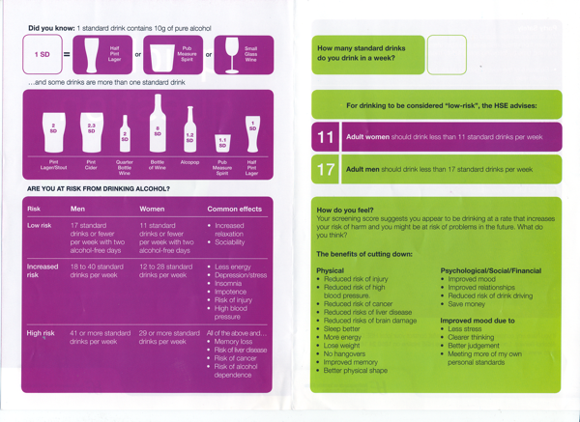
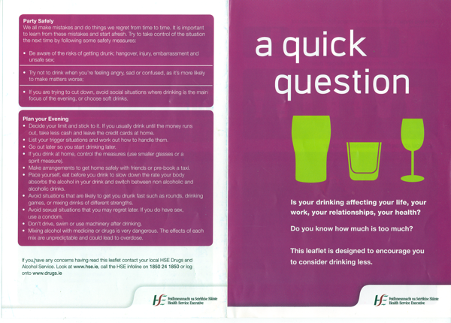
Health Service Executive

Slide 21
Number of licences issued in Ireland 1998-2013 by licence type
 | 1998 | 2001 | 2004 | 2007 | 2010 | 2013
Pubs | 10,395 | 11,272 | 9,946 | 9,402 | 8,393 | 8,414
Spirit retailers off-licences | 589 | 792 | 983 | 1,342 | 1,537 | 1,746
Wine only off-licences | 483 | 1,284 | 2,790 | 3,691 | 3,206 | 3,370
Source: Statistical reports 1998-2013, Revenue Commissioners

Slide 26
Prevalence of AH20 in general population
%
Over one in four people reported 1+ harms due to others drinking

Slide 27
%
Overall
one in ten workers reported 1+ harms from co-workers drinking

Slide 28
%
One in ten children were exposed to 1+ harms from others drinking

Slide 29
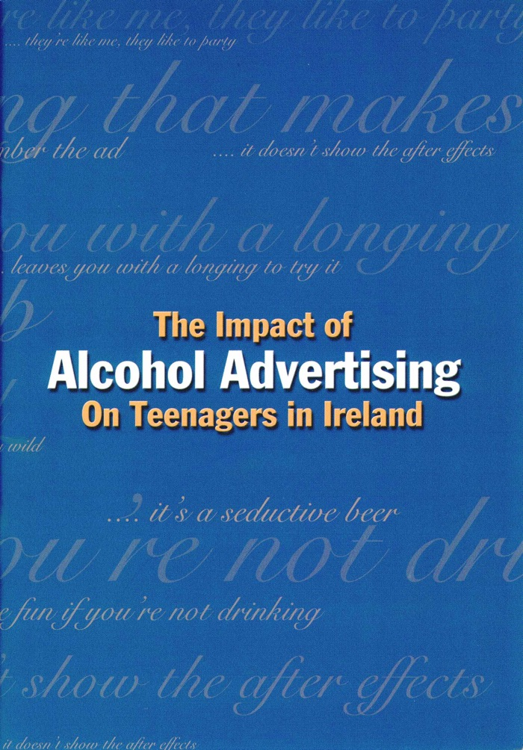

Slide 30
Alcohol and sexual attraction
There were some fine women in that ad. You might get a fine woman dancing around with a bottle of Guinness (boy 15-17, Guinness)
You’ll have lots of drink and meet the opposite sex (girl 12-14, Coors Light)
It’s trying to say you’ll have a better chance of scoring (boys 12-14 Coors Light)
It’s a seductive beer (girl 15-17, Heineken)
Makes boys randy, makes you look nice when you’re pouring it in the glass (girl 15-17, Heineken)

Slide 31
Mood alteration
It will improve your personality (boy 15-17, Bacardi Breezer)
Alcohol goes to your brain and it makes you do things you wouldn’t normally do (girl 15-17, Guinness)
It gets you mad out of it, have a good time with it (boy 12-14, Coors Light)
It’s good because it makes you wild (girl 12-14, Bacardi Breezer)
Your man forgets all his worries and stuff (boy 15-17, Bacardi Breezer)

Slide 32
Adolescent Development
Separation/individuation and identity formation
Self-awareness
Labelling own emotional state
Questioning values
Experimentation
Risk taking
Peer alliances
Family needs to evolve simultaneously
‘Turmoil’ is NOT the norm

Slide 36
DIAGEO DAY!

Slide 37
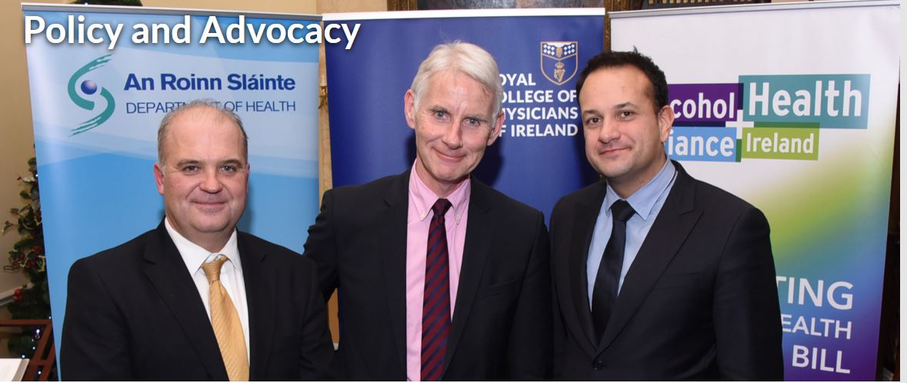
December 2015 …...
Public Health (Alcohol) Bill published at the Royal College of Physicians of Ireland December 2015
Pictured: Dr Tony Holohan, Chief Medical Officer, Prof Frank Murray, Dr Leo Varadkar, Minister for Health

Slide 38
Public Health (Alcohol) Bill
Minimum Unit Pricing
Structural separation
Advertising restrictions
Labelling

Slide 39
A powerful alliance that supported the
Public Health (Alcohol) Bill

Slide 41
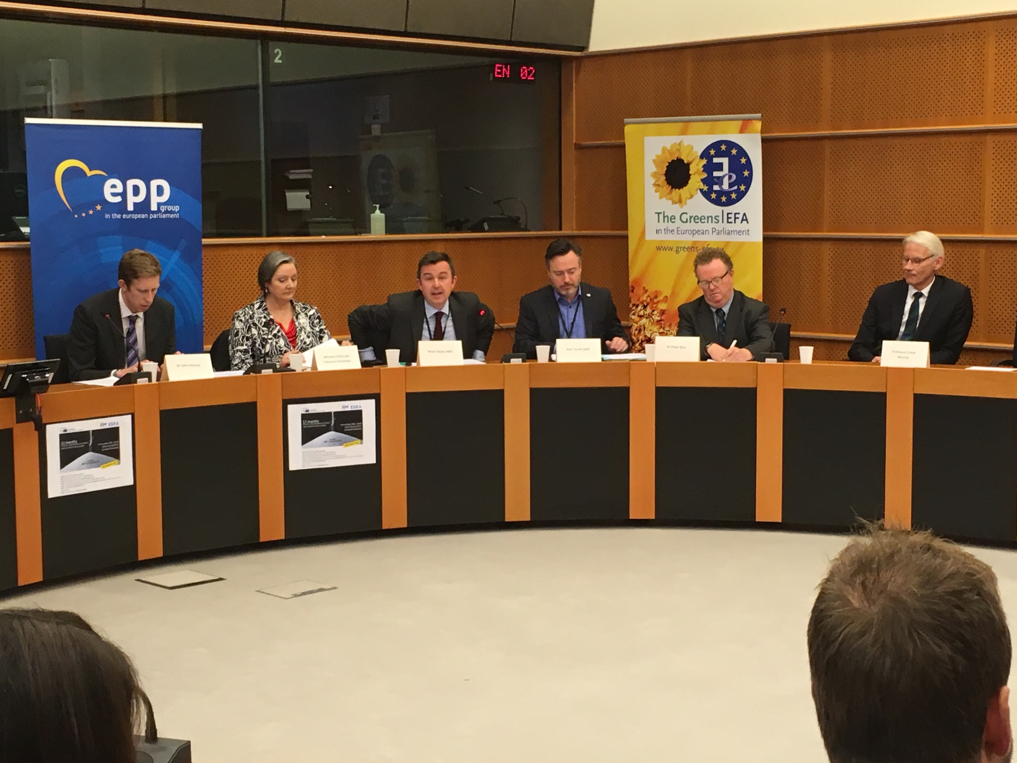
International influence….
Prof Murray spoke at an event in the European Parliament organised by Irish MEP Brian Hayes and attended by Minister for Health Promotion, Marcella Corcoran Kennedy

Slide 42
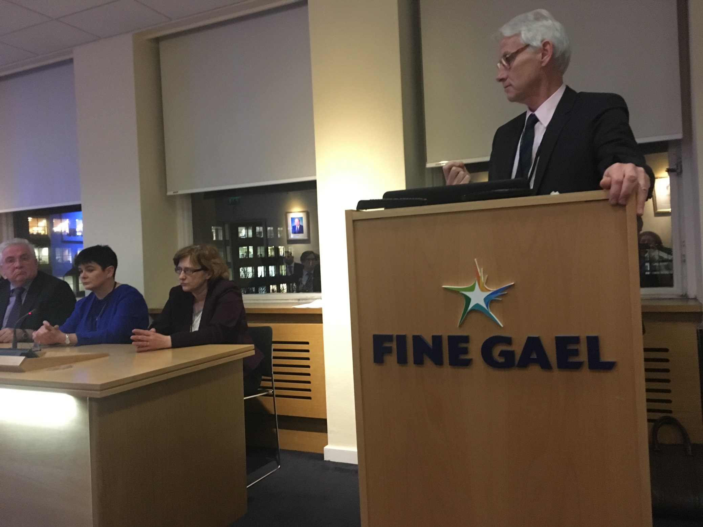
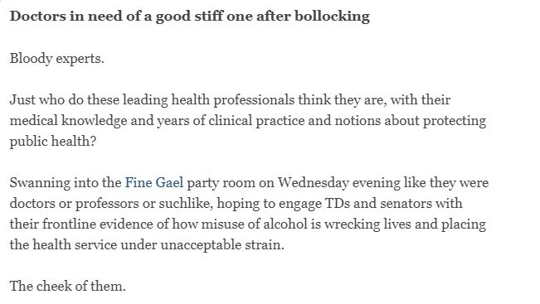
Getting slaughtered …..

Slide 43
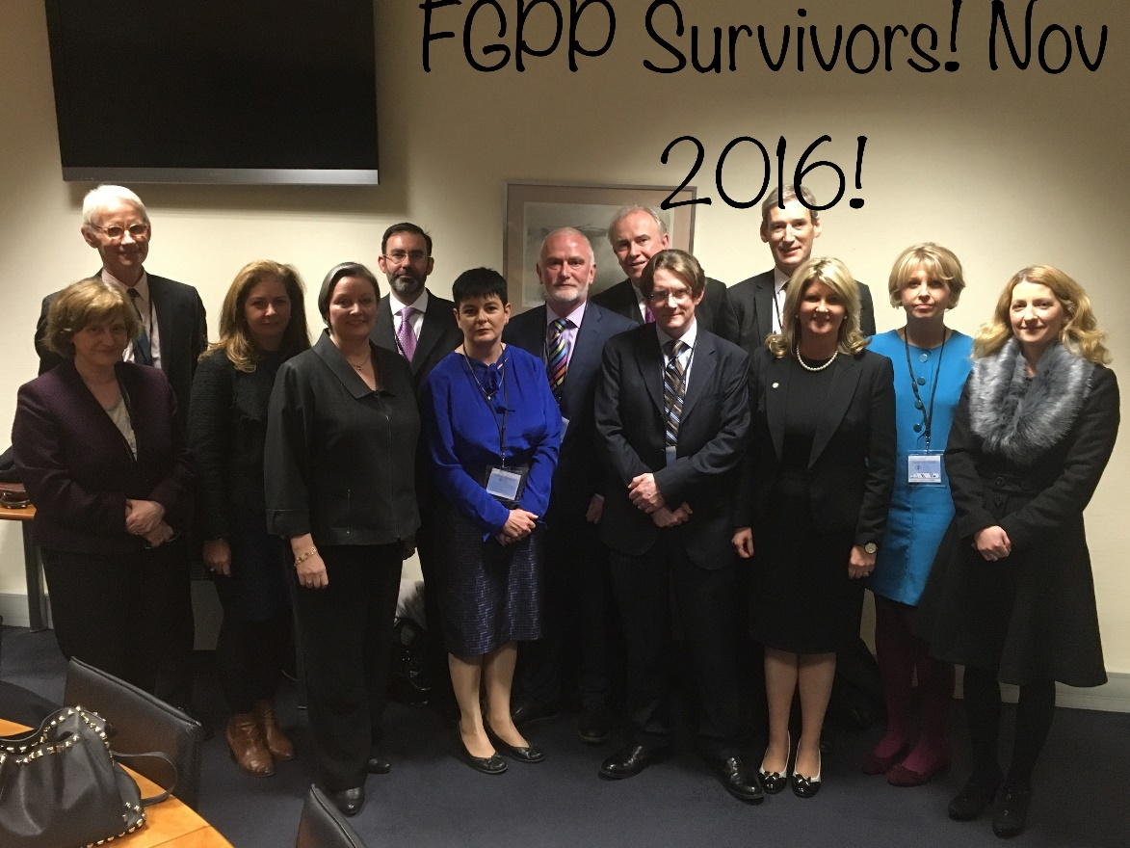
We survived!

Slide 44
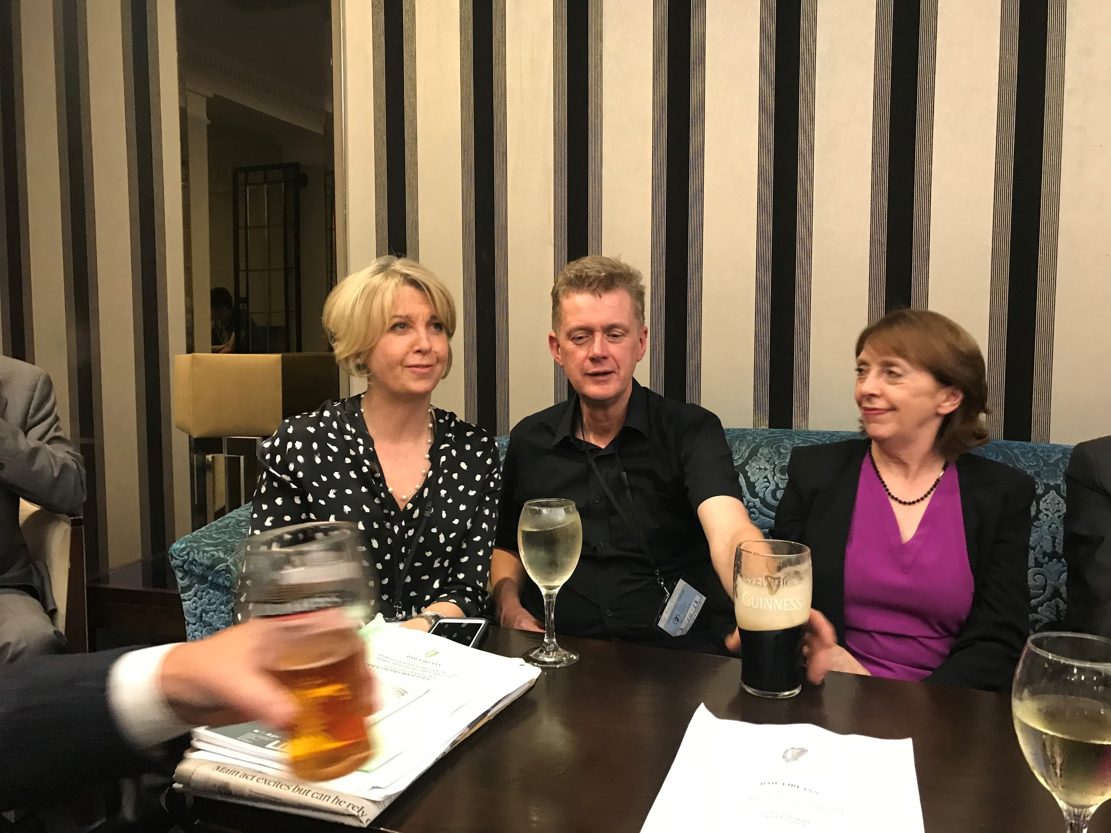
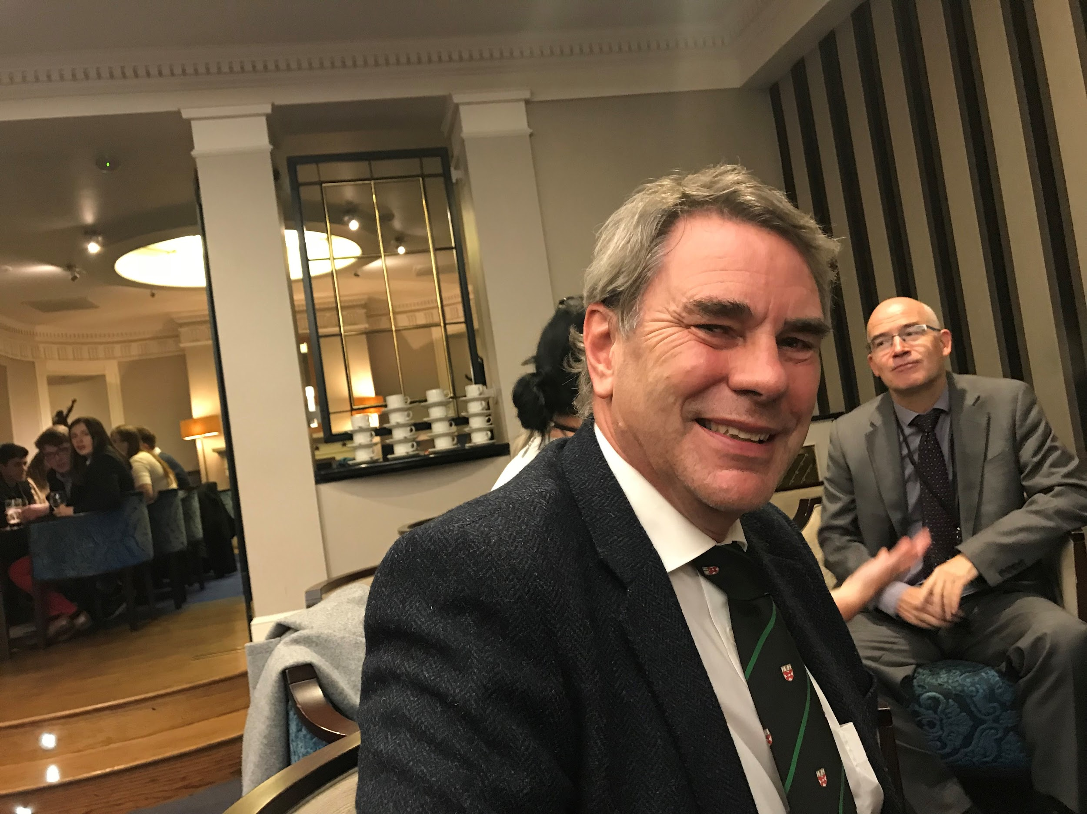
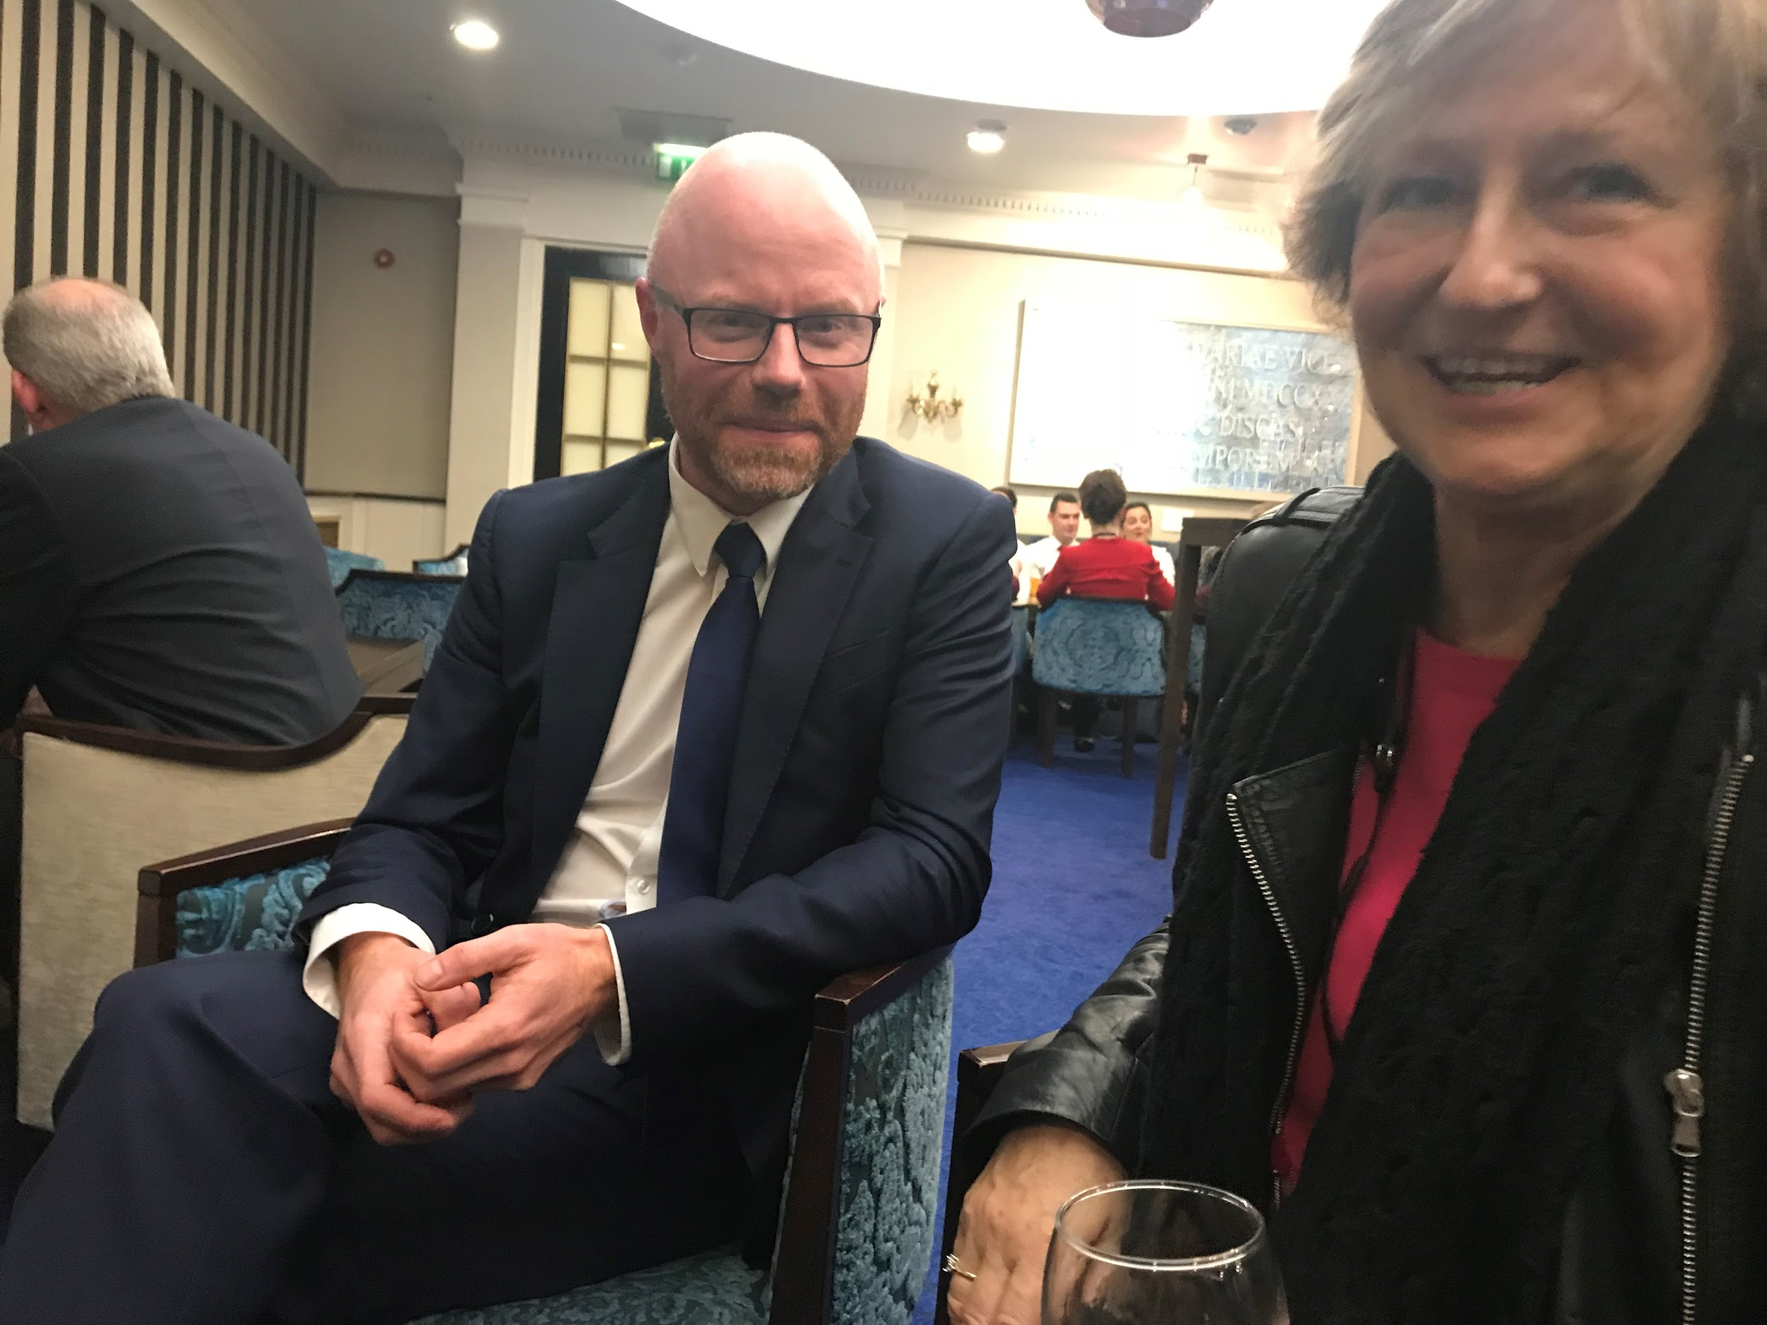
Celebrating passage in the Dáil

Slide 45
Timetable for commencement
Bill passed in October 2018
12th November 2019 Convenience advertising
12th November 2020 Structural separation
12th November 2021 Advertising at sports events

