Slide 1
Adverse Childhood Experiences:
Science to Action
Tamasin Knight: Consultant in Public Health Medicine, NHS Tayside
Lynne McNiven: Interim Director of Public Health NHS Ayrshire & Arran

Slide 2
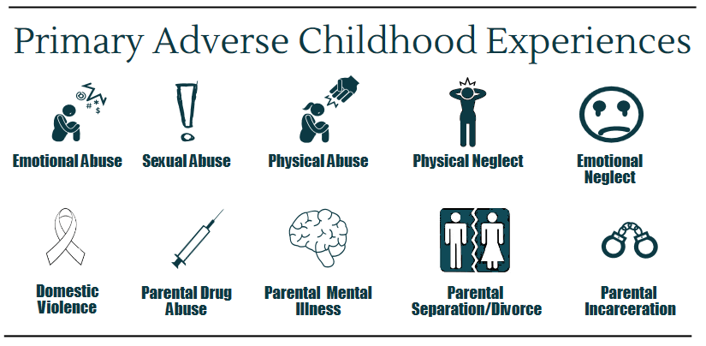
Notes:
Adverse Childhood Experiences are stressful experiences in childhood. The term Adverse Childhood Experiences (ACEs) comes from a study in USA in 1990s where researchers asked adults whether they had experienced the childhood adversities listed on this slide and linked this to their health outcomes in later life. They found that ACEs are very common, that experiencing ACEs is linked with poorer mental and physical health as an adult, and that as the number of ACEs a person experiences so does their risk of experiencing poor health.
Studies in England and Wales suggest that around half of population have at least one ACE, and 1 in 10 people have four or more ACEs. In the Growing up in Scotland study (birth cohort 2004/5 ) two thirds of children had at least one ACE.
ACEs are now considered wider than the original ten listed on this slide – and would also include experiences of bullying, bereavement, community violence.
For more info see: http://www.healthscotland.scot/population-groups/children/adverse-childhood-experiences-aces/overview-of-aces

Slide 3
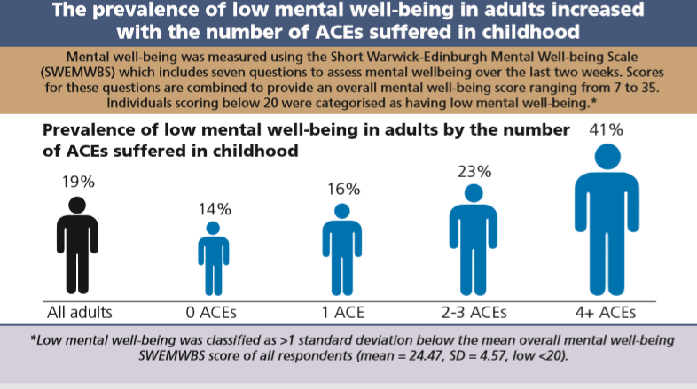
Source: Adverse Childhood Experiences and their Association with Mental Wellbeing in the Adult Welsh Population. Public Health Wales NHS Trust, 2016
Notes:
This study from Wales shows that as the number of ACEs a person has experienced increases, so does the prevalence of low mental wellbeing.

Slide 4
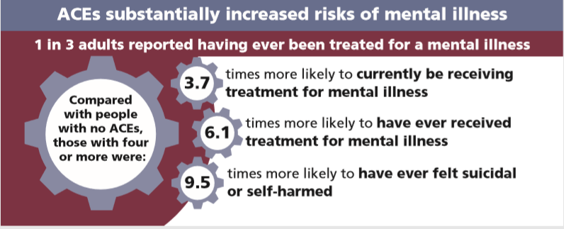
In those with four or more ACEs, the adjusted proportion reporting current mental illness was 28% in those without a trusted adult relationship in childhood but only 19% in those who always had such a relationship.
Source: Sources of resilience and their moderating relationships with harms from adverse childhood experiences. Public Health Wales NHS Trust, 2018
Notes:
This slide shows the findings of Welsh research exploring the link between ACEs and mental illness.
There are also studies looking at specific mental health conditions and childhood adversity e.g. Varese et al (2012) found the association between childhood adversity and psychosis was significant and the population attributable risk was 33%

Slide 5
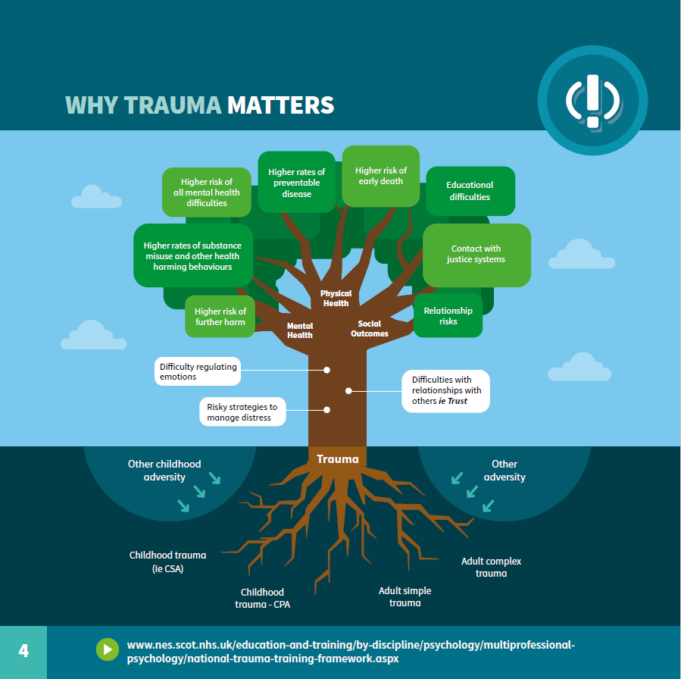
Transforming Psychological Trauma: A Knowledge and Skills Framework for the Scottish Workforce (NHS Education for Scotland and Scottish Government)

Slide 6
“Preventing and mitigating adverse childhood experiences (ACEs) is a moral imperative”
Scottish Government, Programme for Government 2018-19
Notes:
There is a team within the Scottish Government focused on addressing ACEs. See: https://www.gov.scot/publications/adverse-childhood-experiences/
There is also a childhood adversity team in NHS Health Scotland (a national Health Board working to reduce health inequalities and improve health), and a Scottish ACEs hub.

Slide 7
Policy & Legislation
National e.g. Child and Adolescent Health and Wellbeing Action Plan, GIRFEC, Criminal Justice, Trauma Training Framework, Children’s and Young People’s Act (Scotland), etc
National Public Health Priorities and formation of Public Health Scotland
Local e.g. Parenting Strategy, Corporate Parenting Strategies, Staff Care and Training Policy, etc
Community Planning Partnership (CPP), Integrated Children’s Services and Integrated Health and Social Care Partnership Statutory Planning
Child Poverty (Scotland) Act 2017: Local Joint Action Plans
Children (Equal Protection from Assault) (Scotland) Bill
Notes:
NATIONAL SCOTLAND PUBLIC HEALTH PRIORITIES
A Scotland where:
1 We live in vibrant, healthy and safe places Place and Community
2 We flourish in our early years Early Years
3 We have good mental wellbeing Mental Health and Wellbeing
4 We are not dependent on harmful substances tobacco/ Alcohol/ Drugs
5 We have a sustainable, inclusive economy with equality of outcomes for all Poverty and Social Exclusion (including inequality)
6 We eat well, have a healthy weight and are physically active Diet and Physical Activity

Slide 8
Child Poverty
Poverty is a risk factor for experiencing ACEs
Poverty restricts and constrains parents
Poverty can be reduced – local child poverty action plans, welfare rights - income maximisation, financial inclusion pathways
Notes:
While anyone can experience adverse childhood experiences, poverty is a risk factor.
Data from the Growing Up in Scotland study showed that the percentage of children experiencing 4 or more ACEs was 10 times higher in the bottom income quintile compared to the most affluent. See: Marryat & Frank (2017). Adverse Childhood Experiences in Scottish children’s lives: a prospective study
Link to NHS Health Scotland child poverty pages: http://www.healthscotland.scot/population-groups/children/child-poverty/child-poverty-overview/causes-of-child-poverty

Slide 9
Advocacy to support the Children (Equal Protection from Assault) (Scotland) Bill
Notes:
This Bill aims to give children in Scotland the same legal protection from physical assault as adults by prohibiting physical punishment of children.
See: https://www.parliament.scot/parliamentarybusiness/CurrentCommittees/110066.aspx

Slide 10
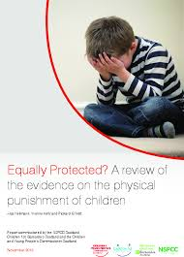
Public Health Evidence
“The international evidence could not be any clearer – physical punishment has the potential to damage children and carries the risk of escalation into physical abuse.”
Professor Sir Michael Marmot
Notes:
The image on the slide is of a review of the evidence on the physical punishment of children carried out at University College London: https://learning.nspcc.org.uk/research-resources/2015/equally-protected/
Physical punishment is linked with a range of adverse outcomes including increased childhood aggression and antisocial behaviour, depression and anxiety, and carries the risk of escalation into child maltreatment.

Slide 11
Human Rights - UN Convention on the Rights of the Child
Article 19 – the right of the child to protection from all forms of violence
Article 24 – the right of the child to enjoy the highest attainable standard of health
Notes:
The United Kingdom is a signatory to the UN Convention on the Rights of the Child.
The UN Committee on the Rights of the Child is clear that any form of physical punishment is a breach of children’s human rights under Article 19.

Slide 12
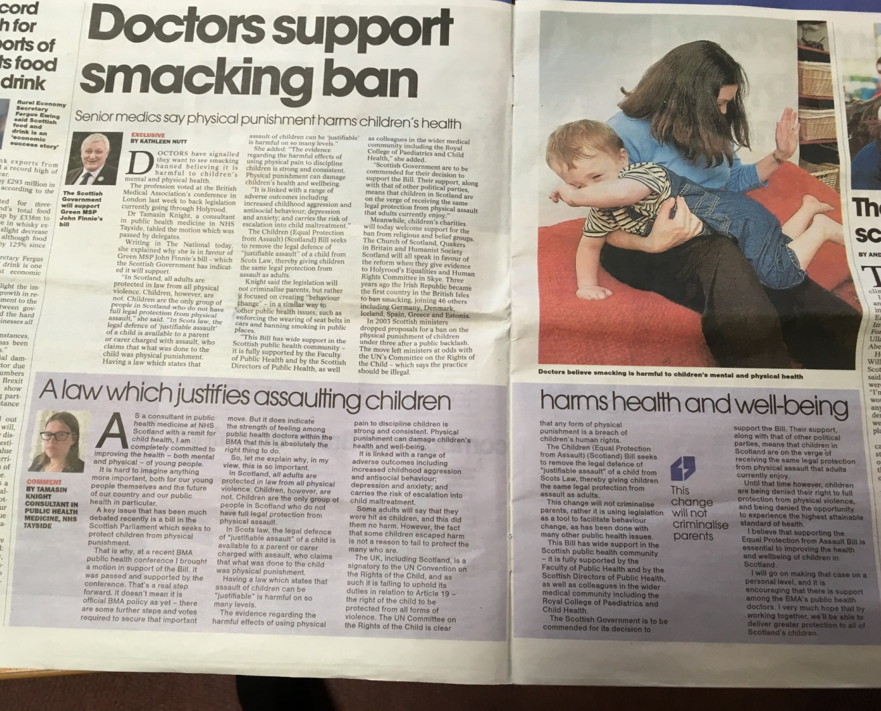
Advocacy
FPH working alongside NSPCC, Barnardos, Royal College of Paediatrics and Child Health
Submitted written evidence response(s) supporting the Bill
Supportive media coverage
Image source: The National, March 15th 2019
Notes:
Link to Faculty of Public Health written evidence in support of the Bill: https://www.fph.org.uk/media/2321/equal-protection-fph-response-2.pdf
Link to article in The National (Scottish national newspaper) ‘A law which justifies assaulting children harms health’: https://www.thenational.scot/news/17502438.tamasin-knight-a-law-that-justifies-assaulting-children-harms-health/

Slide 13


So What........
Notes:
Adverse Childhood or Community Experiences can be considered a ‘Civic Issue’ and as such it will take the combined efforts of society to develop strategies and policy to prevent and mitigate the impacts of trauma and adversity…….
We work in complex organisations which in turn have varying relationships with other statutory, third sector or independent organisations as well as communities themselves…….how can we hope to make a difference? Where do you start? Strat where you are and do what you can!

Slide 14
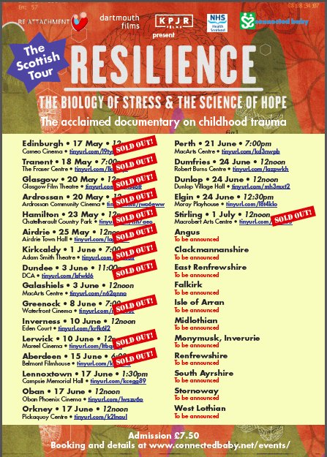
Raising Awareness…..
Notes:
The initial tour raised awareness from the First Minister to local communities. Public Health in Ayrshire bought the rights and we have now delivered almost 70 viewings followed by facilitated panel discussions…….Community Groups, Elected Members, Police Scotland in Ayrshire, Community Planning Partners, Housing Officers, Criminal Justice, ED, Paediatric, Maternity, Health Visiting, Family Nurse Partnership, Addiction and Mental Health teams, child minders, schools, colleges and university…..
Papers presented to the NHS Board, CPPs and IJBs.
Conferences: national, regional, local
Director Of PH Annual Reports across Scotland highlighting ACEs

Slide 15
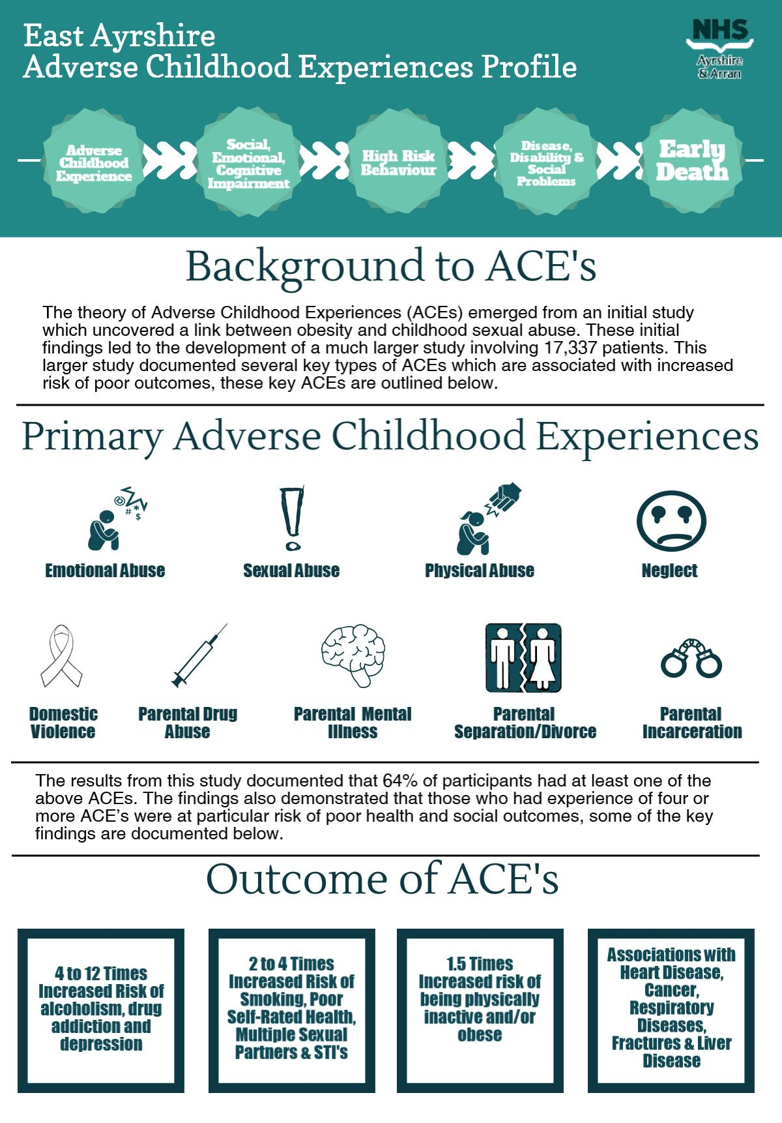
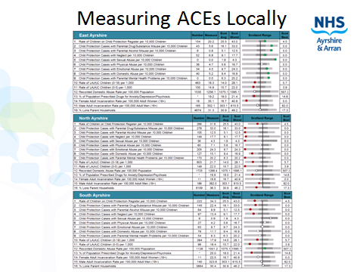
Notes:
Initial analysis of proxy measures make ACEs tangible and makes sure the challenge ahead is extremely visible for everyone

Slide 16
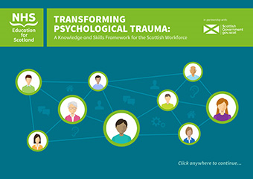
Trauma Informed Practice….
‘what has happened to you? NOT ‘what’s wrong with you’?
Principles of trust, safety, collaboration, empowerment and choice
Notes:
Trauma is very common, especially among some groups such as people in prison, substance misuse services , mental health services. Trauma is dominated by powerlessness and often done by other people. Safe and supportive relationships support recovery. Being trauma informed can give people a different experience of relationships – safety rather than threat, collaboration not coercion, choice not control. Secondly, people who have experienced trauma can be v sensitive to triggers, trauma informed services can avoid re-traumatisation and avoidance of services.
National trauma training framework: http://www.nes.scot.nhs.uk/media/3971582/nationaltraumatrainingframework.pdf
Trauma-informed practice for the workforce animation: https://vimeo.com/274703693

Slide 17
Notes:
Research suggests that reductions in healthcare usage can be achieved through giving service-users the opportunity to disclose and discuss their personal experiences of adversity in childhood (Felitti, 2017).
This research involved a cohort of 130,000 participants who had a brief conversation with their healthcare provider regarding their experience of ACEs. This contact provided clinicians an opportunity to explain the link between experiences of adversity, physiological/behavioural changes and associated physical and mental health outcomes later in life.
Results from this study demonstrated a 35% reduction in GP visits and an 11% reduction in ED visits over the course of a year long follow up period.
It is proposed that the mechanism behind this effect results from providing individuals with an explanatory model for their current health related behaviours and conditions, which in turn increases their self-regulatory capacity

Slide 18




Working together….
Notes:
Absolutely none of this ‘Civic Issue’ can be achieved by one organisation but we can work together to support and nurture communities…..
Listen to the voices of those with ‘Lived Experience’: people who have been through the criminal justice systems, care systems, health and social care systems. Hear the voices of those who have been part of gangs, have been addicts, have lost children to violence, have been affected by suicide, have been affected by domestic violence…..we can learn from their experiences.
The very services we provide unwittingly cause trauma too to our clients and to our staff so supporting staff to be trauma aware is a key part of providing a gold standard service
Examples:
Campus Officers supporting young people within schools being ‘Trusted adult’
Children’s Houses: trauma training for staff
Developing Trauma training for NHS Health and Social Care teams, Police Fire Service, Education Sectors
Deep End Practices Glasgow
Linking with other existing areas of work e.g. Domestic Abuse, Expect Respect, Violence Reduction Unit: Peer Navigators in ED, Carnegie, ‘Kindness Rocks’, Recovery Cafes, etc

Slide 19
References
Bellis, M, Lowey, H, Leckenby, N, Hughes K, Harrison D (2014) Adverse childhood experiences: retrospective study to determine their impact on adult health behaviours and health outcomes in a UK population. Journal of Public Health, 36: 81-91
Bellis M, Ashton K, Hughes K, Ford K, Bishop J, Paranjothy S (2015) Adverse Childhood Experiences and their impact on health-harming behaviours in the Welsh population. Public Health Wales NHS Trust
Bellis M (2016) Adverse Childhood Experiences, Resilience and Equity – setting a course for a healthier Wales. Available from: http://www.healthscotland.scot/media/1267/2_mark-bellis-presentation.pdf
Couper S & Mackie P (2016) ‘Polishing the Diamonds’ – Addressing Adverse Childhood Experiences in Scotland. Available from: http://www.scotphn.net/wp-content/uploads/2016/06/2016_05_26-ACE-Report-Final-AF.pdf
Felitti VJ, Anda RF. The relationship of adverse childhood experiences to adult medical disease, psychiatric disorders and sexual behaviour: Implications for healthcare. In Lanius RA, Vermetten E, Pain C, eds. The impact of early life trauma on health and disease: the hidden epidemic. (2010). Cambridge: Cambridge University Press, p.77-87
Smith, M, Williamson A, Walsh, D, McCartney, G (2016) Is there a link between childhood adversity, attachment style and Scotland’s excess mortality? Evidence, challenges and potential research. BMC Public Health, 16: 655

