Slide 1
We know a lot about illness but what causes wellness?
Faculty of Public Health
10th May 2019

Slide 2
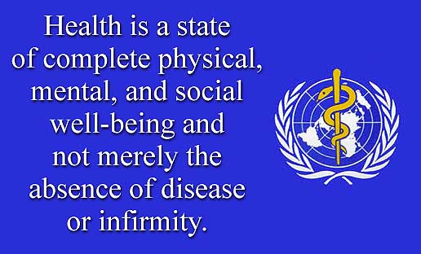

Slide 3
What people believe about Scotland’s health
The Scots are unhealthy
It’s because they smoke a lot
They eat the wrong kind of food
They drink too much
If only they adopted healthy habits, they would be healthy
Only ONE of these statements is true!
Notes:
The focus of socierties is often to bad things we do. For example, these are some things that appear in the newspapers about Scotland’s health. We are told that we are unhealthy because of our habits. Most of these statements are untrue. Indeed only one of them is correct. If we built our pocicies just around prevention of smoking, for example, we would miss the opportunities that a different approach would bring. Yet, everyone believes that behaviour change by itself will make a difference.

Slide 4
Life expectancy trends
Portugal
Scotland
Notes:
This slide shows the growth in LE in the richest 20% of people (top line) and the poorer 20% of people (bottom line)
You can see that there has been a widening gap in LE since the 1950s. If the gap that existed between the rich and poor in the 1950s had remained the same and the poor had increased LE at the same rate as the rich, the average in Scotland would be above the average of our European comparison countries.

Slide 5

World Health Organization (1997 and 2003)
www.heartstats.org
Notes:
We cannot attribute our position at the bottom of our comparison countries to smoking. This study of smoking rates in 15 year olds across the WHO Euro region shows that Scotland’s teenagers werent big smokers

Slide 6
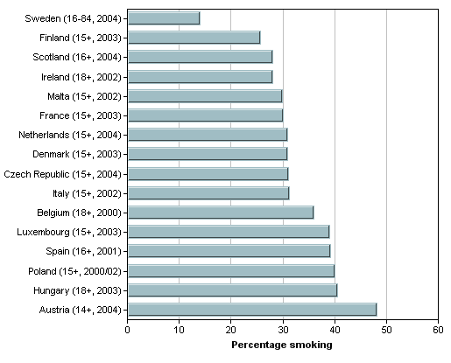
Smoking prevalence - Males
Males
Notes:
This study of smoking rates in men carried out before our smoking ban in public places came into forceshows that our male smoking rates are not the highest in Europe

Slide 7
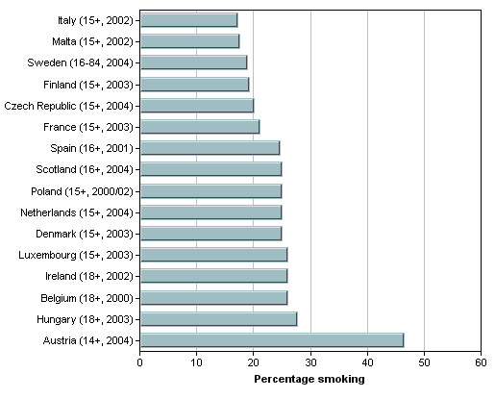
Smoking prevalence - Females
Females
Notes:
Our women have realtively higher smoking rates but they are still not the highest in Europe. We do not have the lowest mortality because we have the highest smoking rate

Slide 8
Coronary heart disease mortality
Men aged 15-74 years
Age-standardised mortality per 100,000
Notes:
Is consumption of fatty food the problem? Well, Finland is the country we look to for evidence that changing fatty food consumption reduces heart disease mortality. In the 1960s, Finland had a very high mortality from heart disease. It implemented a series of policies which reduced fat consumption and this reduction was followed by a significant fall in mortality from heart disease. However, diets in Scotland did not change in their fat content and, as the graph shows, heart disease rates fell in Scotland at the same rate as it did in Finland and in other countries. The fall in heart disease in men since the 1960s is probably due to the rte of reduction in smolking in men and the introduction of better therapies such as statins

Slide 9
So, what causes wellness?

Slide 10
All cause mortality,men 65-69
3951
1665

Slide 11
Slope index of inequality
X
Mean =
2694
X
X
2763
X
X
All cause, M65-69
2763/2694 = 1.025

Slide 12
Male inequalities, all causes, all ages

Slide 13
Slope index of inequality breakdown by cause of death
SII=
2763
SII=
792
SII=
1971
All cause
IHD
Other causes

Slide 14
Male inequalities, all ages, by cause
All other causes
IHD

Slide 15
Relative inequalities in mortality by cause
Men, Scotland 2000-02

Slide 16
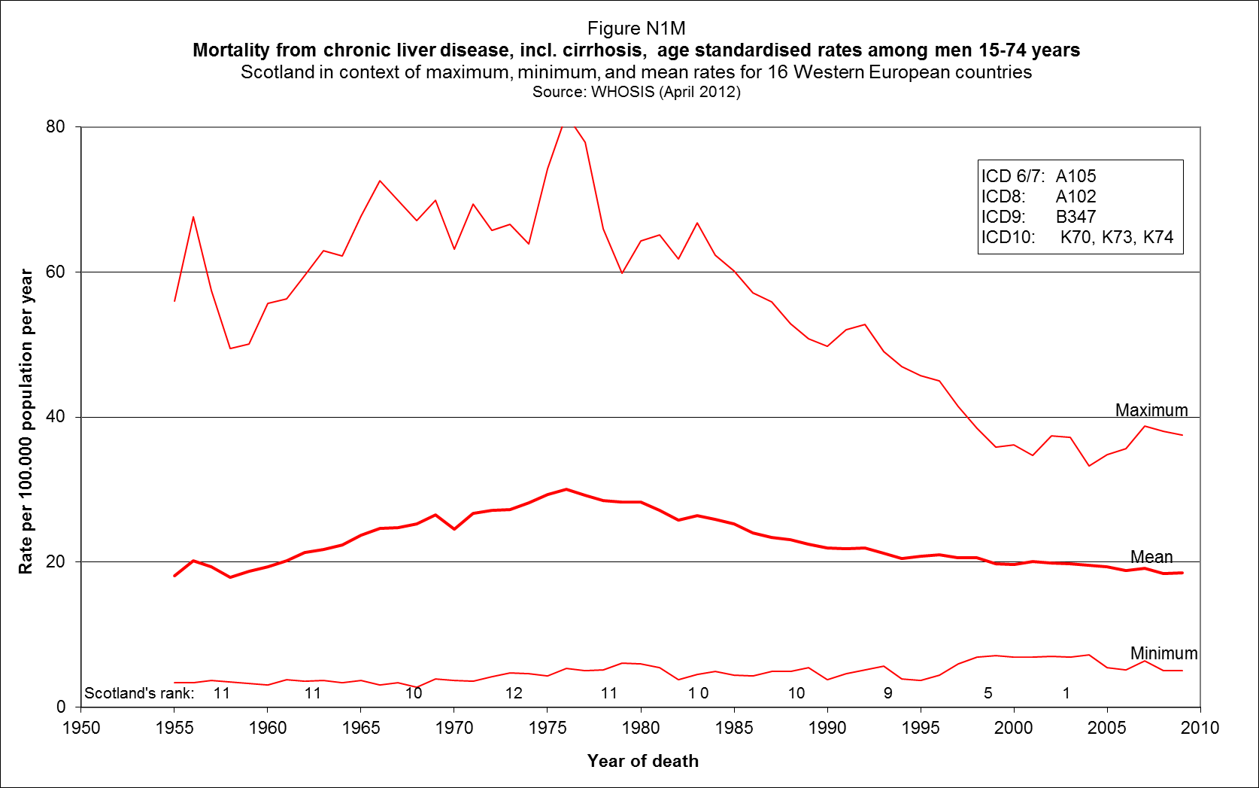
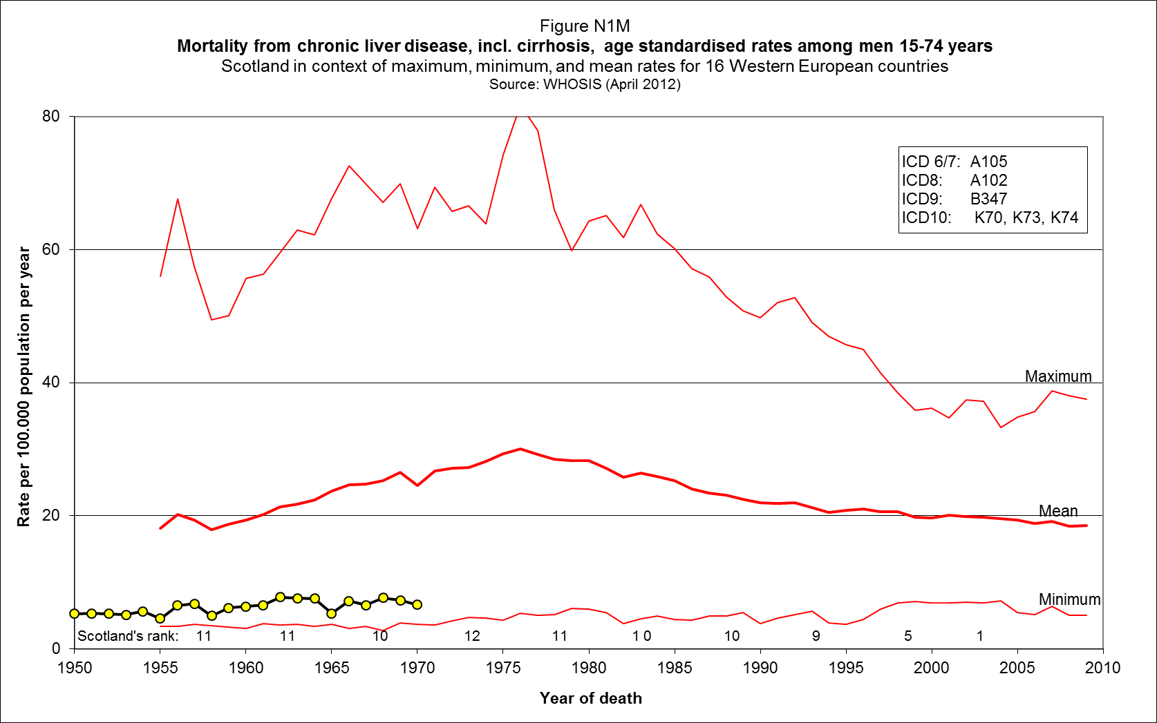
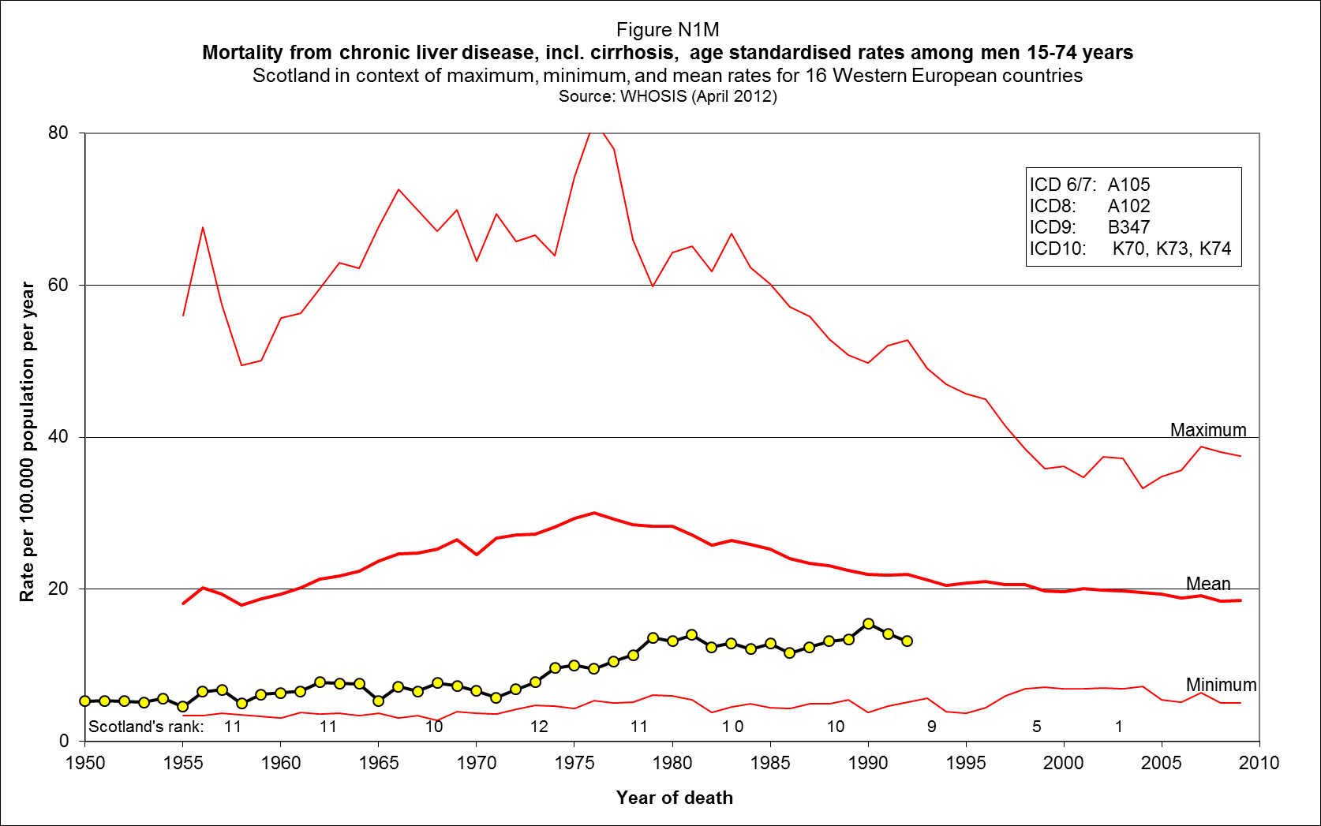
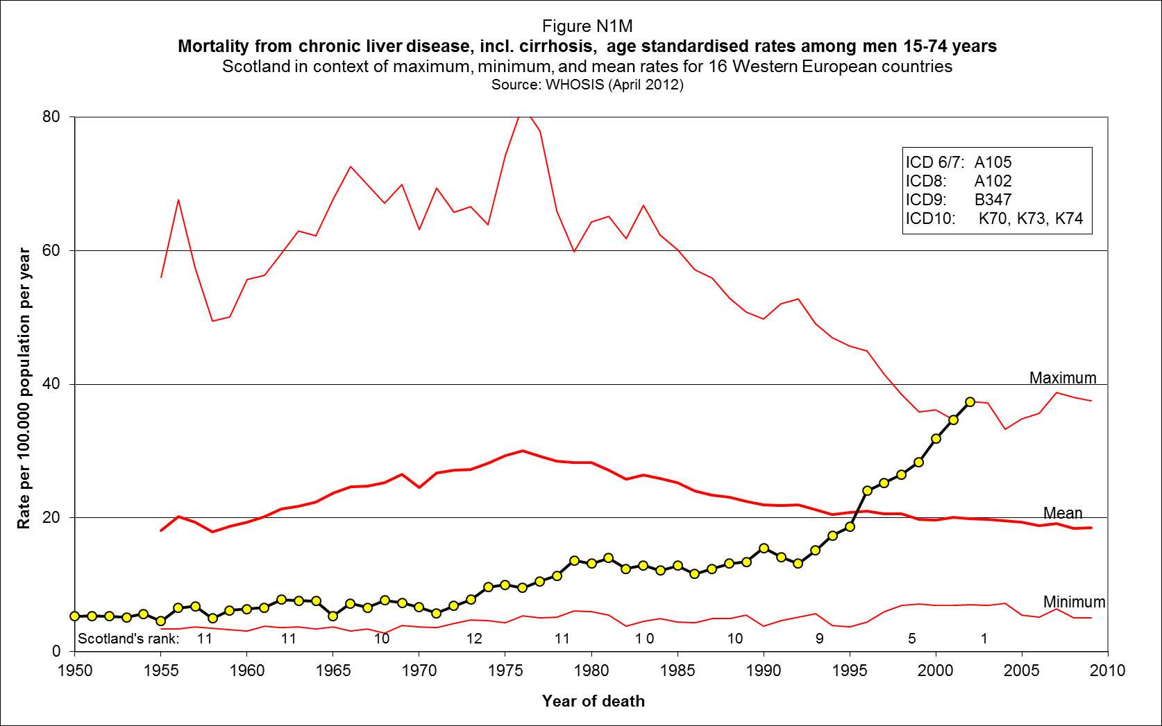
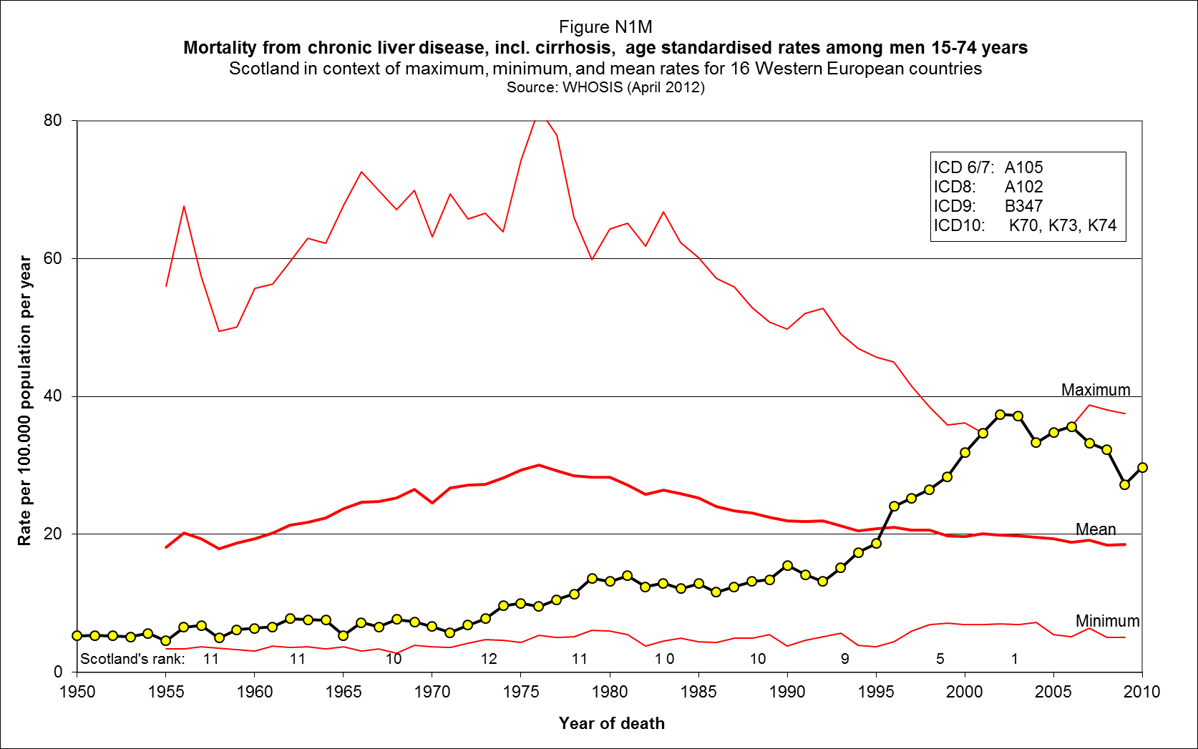
Chronic liver disease, including cirrhosis
Source: Whyte B., Ajetunmobi T. Still “the sick man of Europe”? GCPH, 2012
Notes:
Note – this slide has animations
The emergence of these psychosocial causes of death has, as we discussed at the beginning of this talk emerged in the past few decades. This slide is a summary of data on mortality from Chronic Liver Disease, most of these deaths are due to alcohol.The line at the top shows the highest mortality in any of our 16 western european countries since 1950. The line at the bottom of the slide is the minimum mortality of any of our 16 countries, the line isn the middle is the mean mortality of the 16 countries
Press 1
From 1950 until 1970, Sscotlnd had one of the lowest alcoholic liver disease in Western Europe
Press 2
From 1979 until 1990, the mortality rate rose a bit but it was still below the average of western Europe.
Press 3
From 1990 until 2005, it was a different story

Slide 17
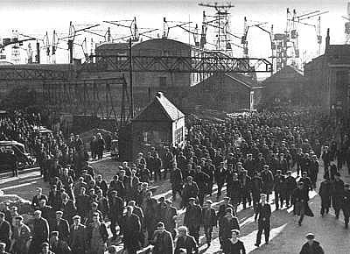
Workers in the 1950s

Slide 18
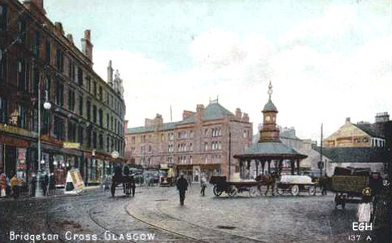
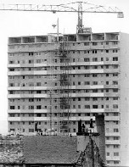
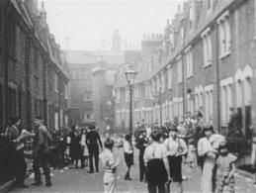

More liveable housing?

Slide 19
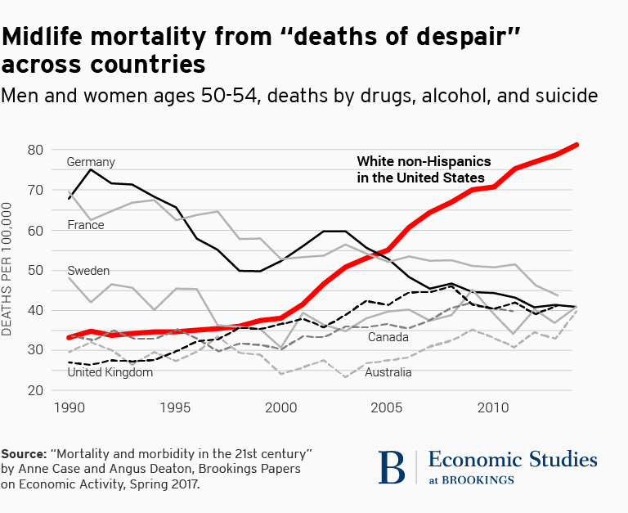
US mortality 1999-2015

Slide 20
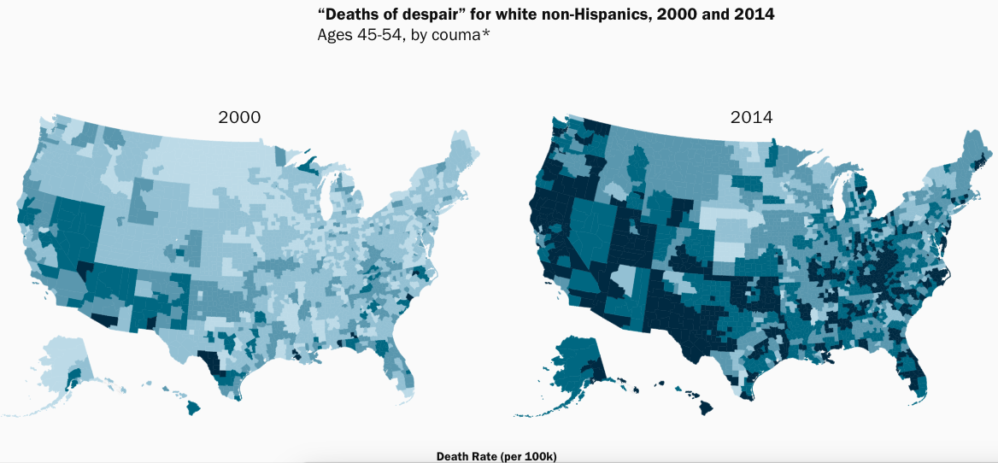
US mortality 1999-2015

Slide 21
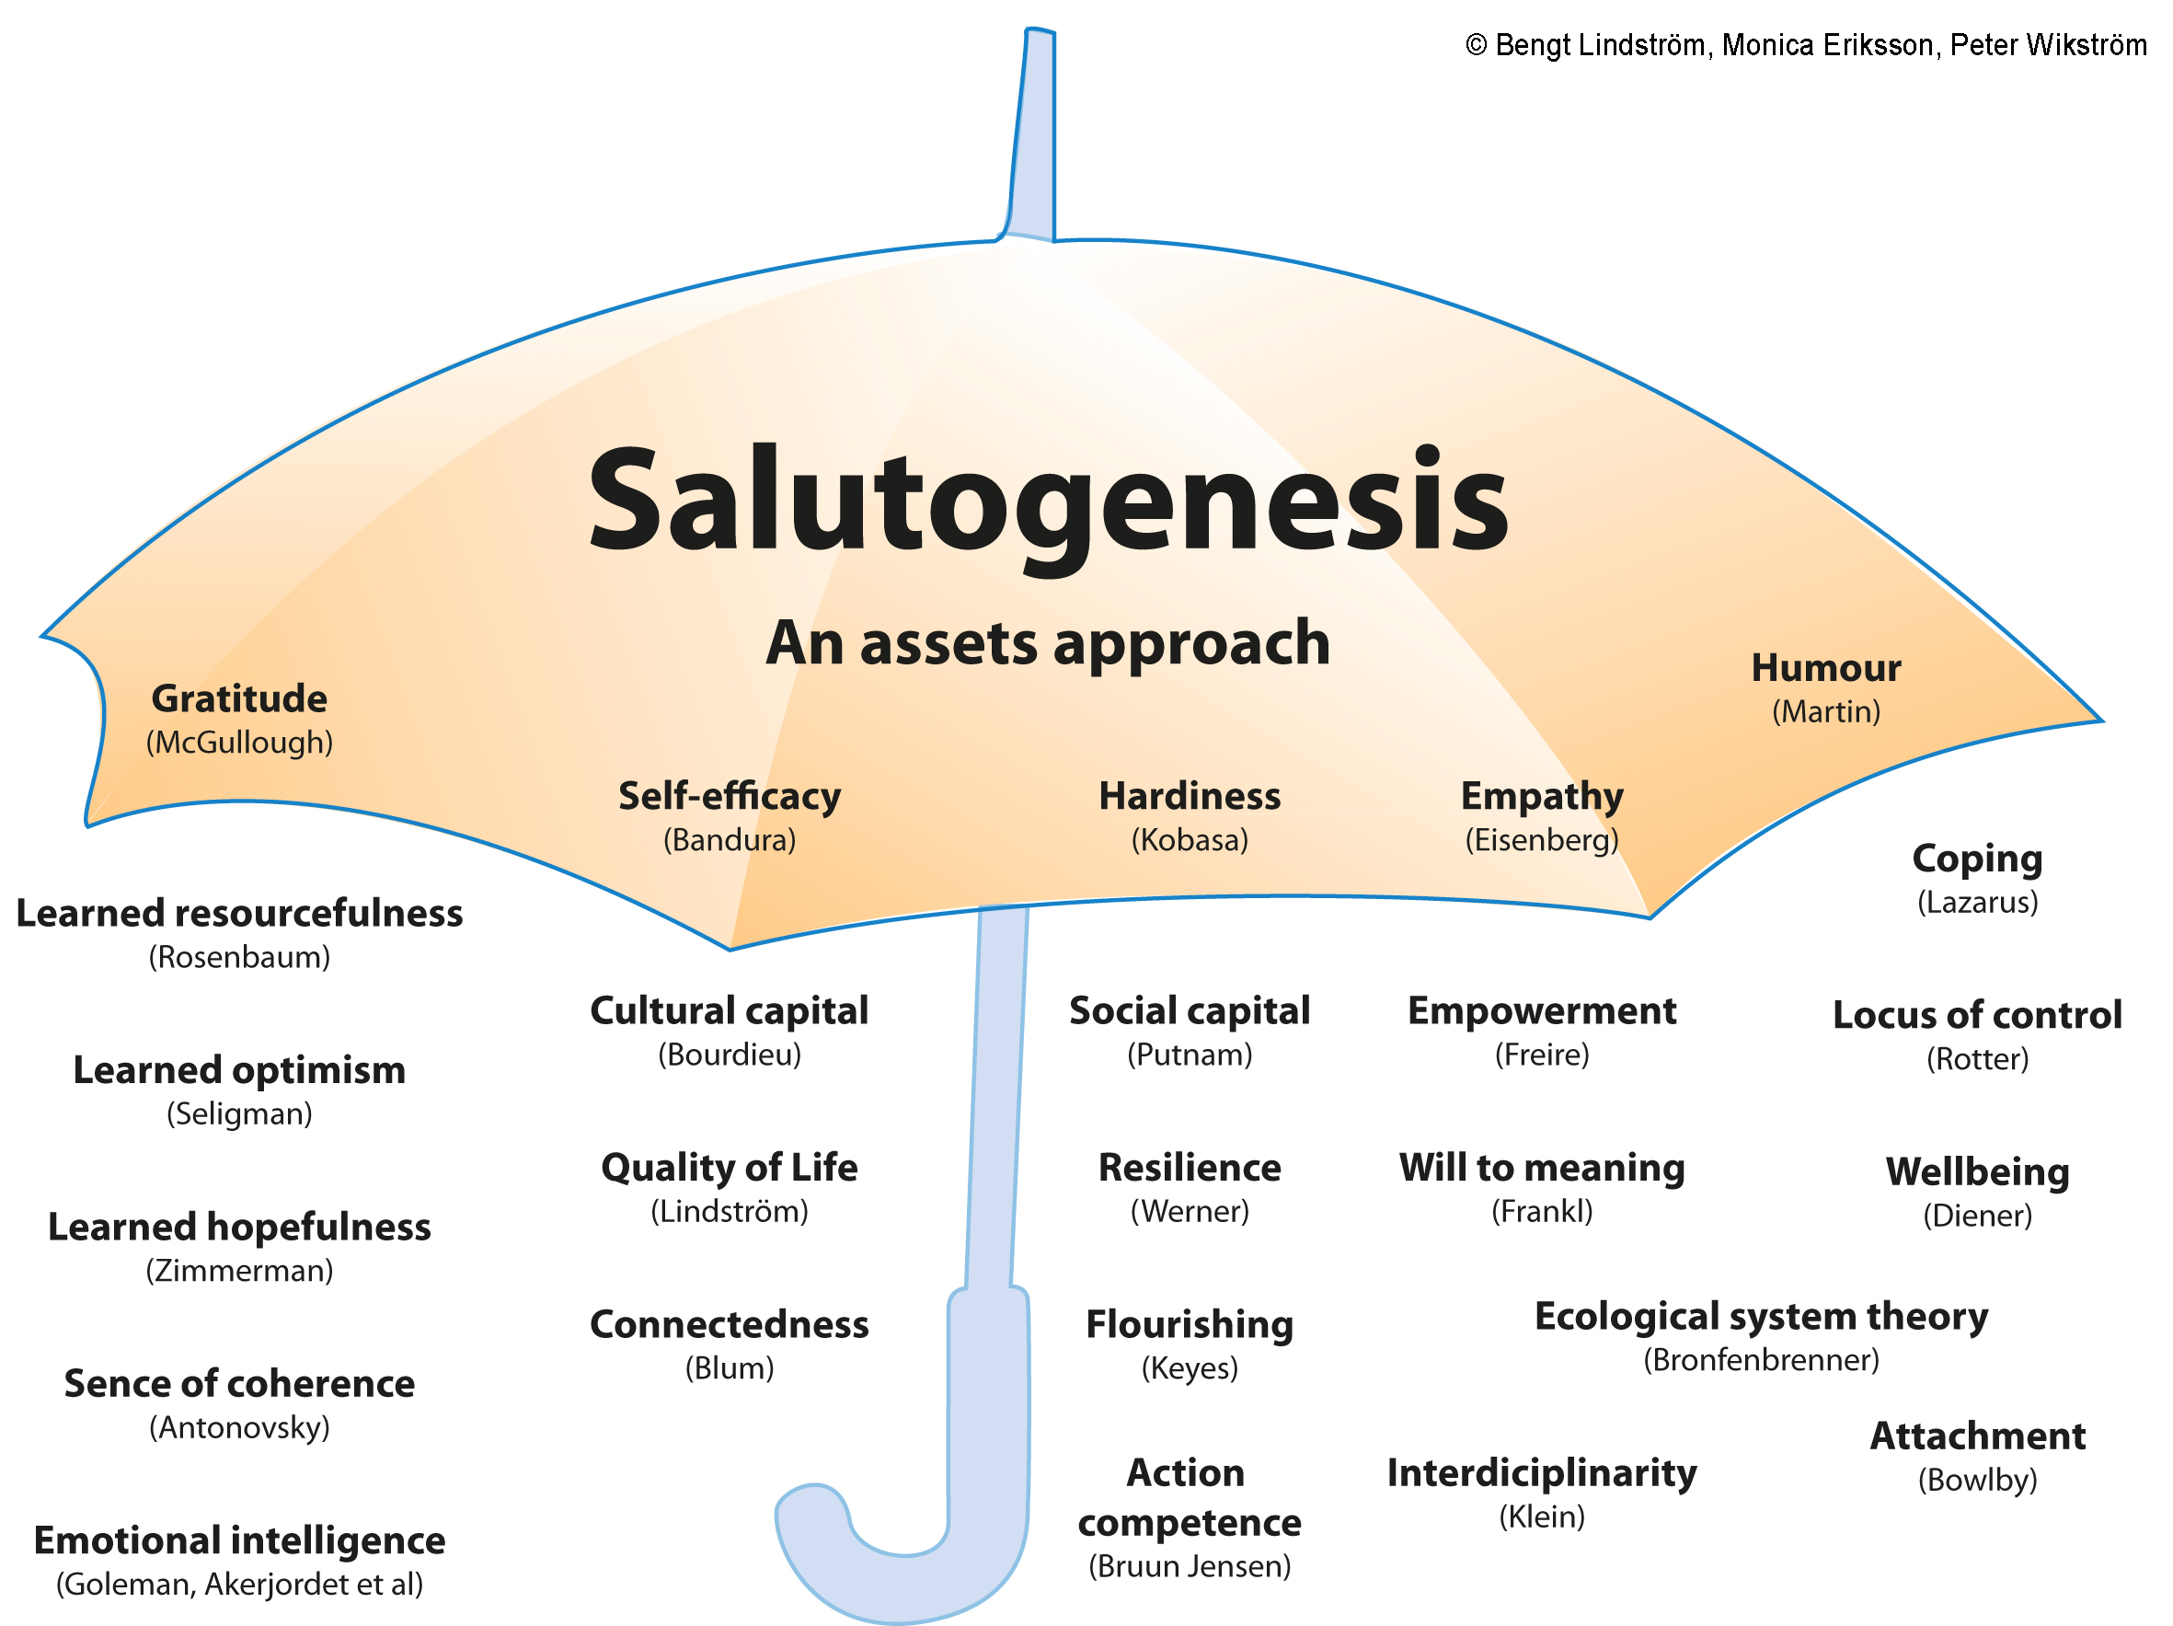
Notes:
There are many theories as to how health and wellbeing can be created. This slide comes from the Nordic School of Public Health where they have brought together 25 different psychological theories of “Health Creation” or salutogenesis.Some of them are relevant to the Glasgow situation. I’ll mention just two of them: will to meaning and sense of coherence

Slide 22
For the creation of health....
....the social and physical environment must be:
Comprehensible
Manageable
Meaningful
......or the individual would experience chronic stress
Notes:
22
Failure of see the world as..........would be extremely stressful
22

Slide 24
STRESS AND GRADE OF EMPLOYMENT: MEN
Salivary Cortisol
Time of Day
Steptoe et al. 2003, Psychosomatic Medicine, 65, 461-470
Notes:
24
Men at the top of an occupational hierarchy have higher diurnal cortisols that men lower down a hierarchy and this is assumed to be due to be due to control. At the top of a hierarchy if someone was given a task they didn’t like thay can pass it down thew line. At the bottom of the hierarchy, the person has no possibility of passing it on. He has less control over his work and this is stressful. (This relates to Antonovskys point about manageability)

Slide 25
Notes:
25
Even at a national level, you can see the relationship between control and mortality. In former Soviet countries, those with lowest control (Russia) have highest mortality and Czech Rep and Poland have high control and low mortality
25

Slide 26
Risk of death
- by level of hopelessness
RHR
Everson et al 1996
Notes:
26

Slide 27
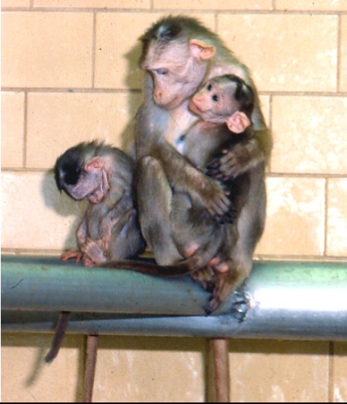

Slide 28
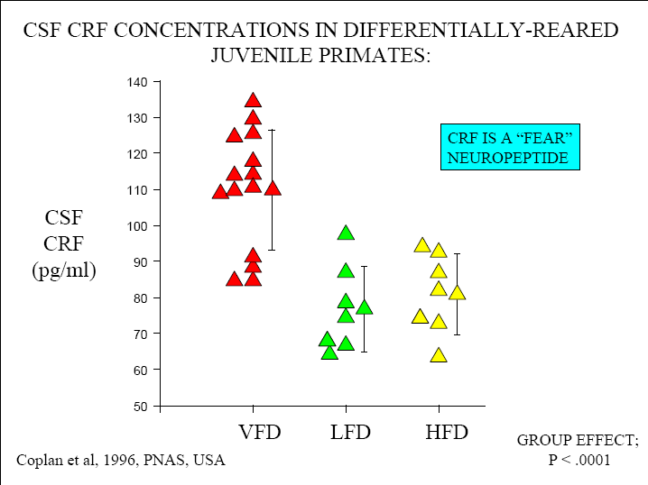

Slide 29
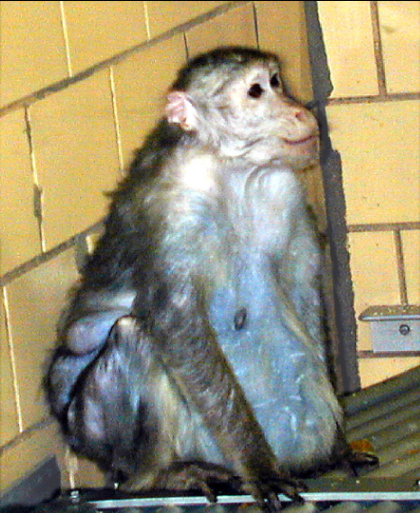

Slide 30
Notes:
Dr Bruce McEwen, with whom we are collaborating has studied the brains of these monkeys. He finds that they do not develop in the same way as monkeys not exposed to stress. The PF cortex gets less cell growth, as does the hippocampus but the amygdala sees more dense connections develop between cells. The significance of that is that the hip[pocampus suppresses the stress response while the amygdala upregulates it. If they get out of balance a potentially permanent resetting of the stress response results. Also, the hippocampus is important in memory development so any reduction in cell growth could affect learning. The amygdala is associated with emotion so enlargement here will cause aggression, anxiety etc
Loss of PF cortex will reduce executive functioning

Slide 31
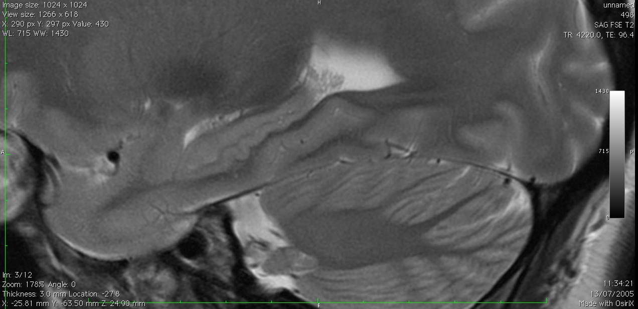
Notes:
MRI scan of hippocampus. We’re measuring HC volume in affluent/deprived glaswegians

Slide 32
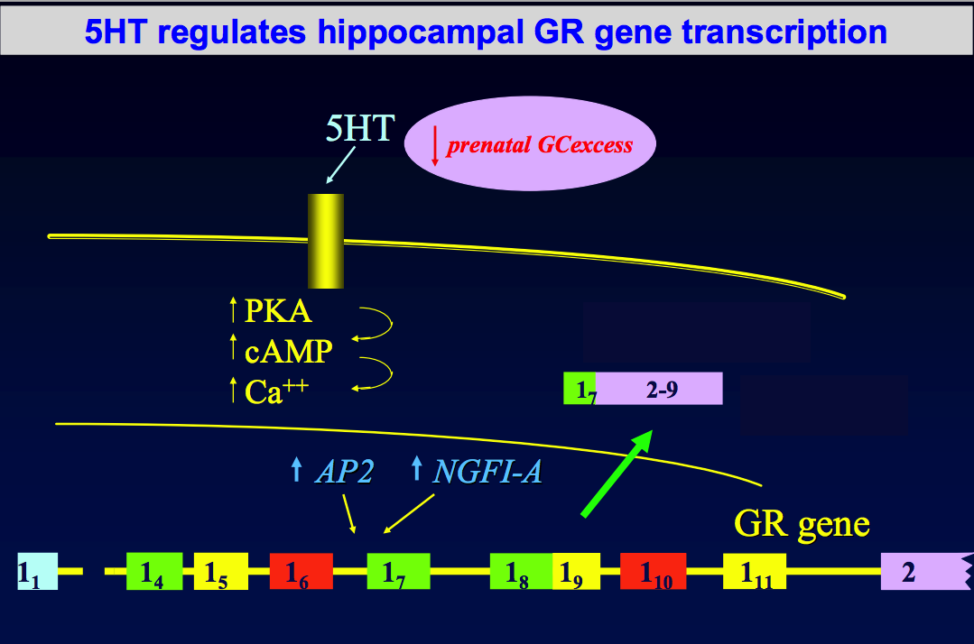
The molecular biology of a hug

Slide 33
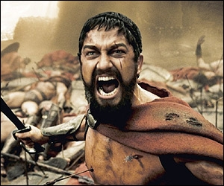
MAOA – “The warrior gene”

Slide 34
Adverse childhood events study
Physical/sexual/emotional abuse
Neglect (physical/emotional)
Domestic substance abuse
Domestic violence
Parental mental illness
Parental criminality

Slide 35
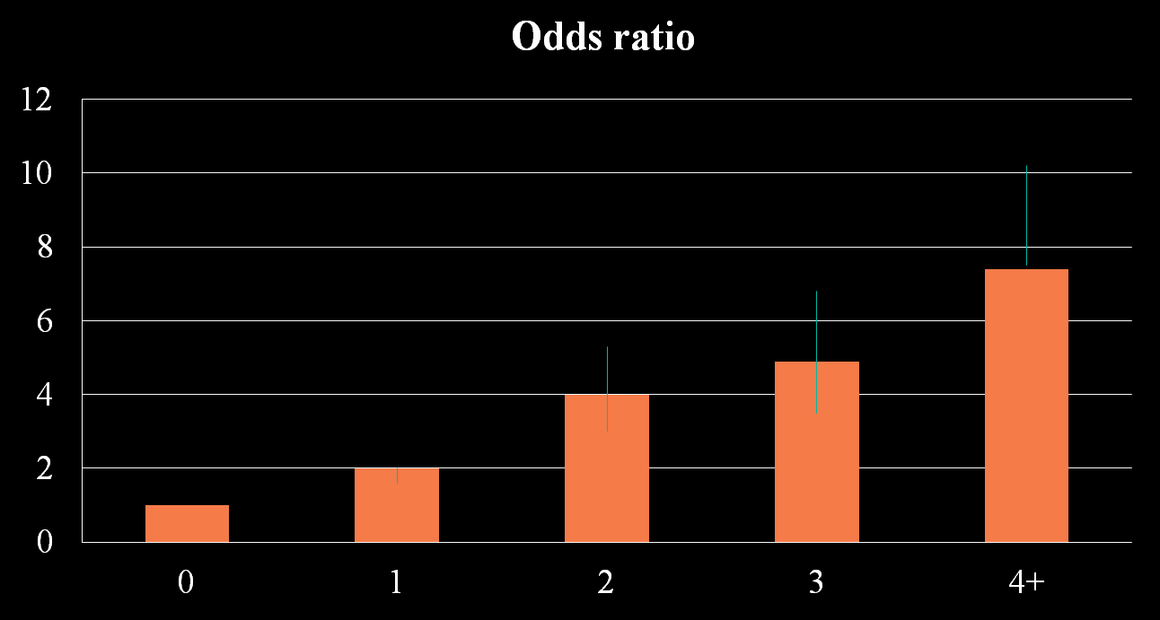
Adverse childhood events risk of alcoholism
Hillis et al 2011

Slide 36
Economic cost of child maltreatment
“The total lifetime economic burden resulting from new cases of fatal and nonfatal child maltreatment in the United States in 2008 is approximately $124 billion in 2010 dollars. This economic burden rivals the cost of other high profile public health problems, such as stroke and Type 2 diabetes (Fang et al., 2012).”

Slide 38
The Broadway experiment
“The most efficient way to spend money on the homeless might be to give it to them.”
The Economist November 4th2010

Slide 39
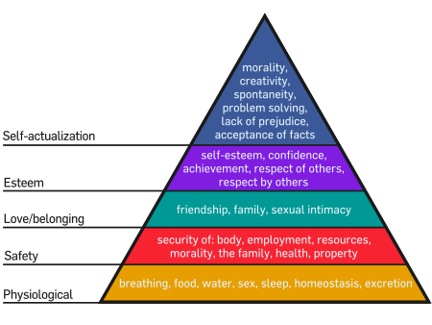
Maslow

Slide 40
Maslow 2.0
All that other stuff
Self actualisation

Slide 41
The Broadway experiment
City of London
13 rough sleepers with 4-45 year history
Personalised budget (up to £3000)
Personalised support
“What do you need?
Build trust and sense of control and ability to make choices

Slide 42
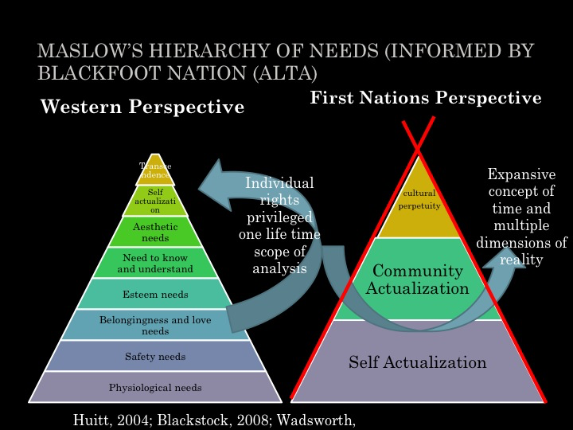

Slide 43
Beacon and Old Hill Estate (Falmouth)
Between 1996 and 2004….
  Crime down by 50%
  Post natal depression down by 70%
  Unemployment down by 70%
  Child protection registrations down 65%
  Teenage pregnancies down from 14% to<1%

Slide 44
Wellbeing
Purpose and meaninng
Sense of control
Self esteem
Supportive networks
= Wellbeing
Behaviours
Smoking
Obesity
No exercise
Poor diet
Outcomes
Heart Disease
T2 Diabetes
COPD
Lung Cancer
Ability to choose

Slide 45
The cycle of alienation
Initial event
Unequal outcomes
Consequences
Mental health problems
Loss of self efficacy, esteem,
control
In education offending
health
Chaotic early years
WorklessnessPoverty
Alienation

Slide 46
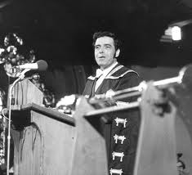
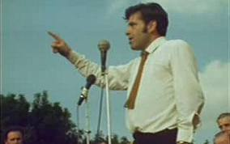
Jimmy Reid 1971

Slide 47
Rectorial Address
“Let me right at the outset define what I mean by alienation. It is the cry of men who feel themselves the victims of blind economic forces beyond their control. It's the frustration of ordinary people excluded from the processes of decision making. The feeling of despair and hopelessness that pervades people who feel with justification that they have no real say in shaping or determining their own destinies....”

Slide 48
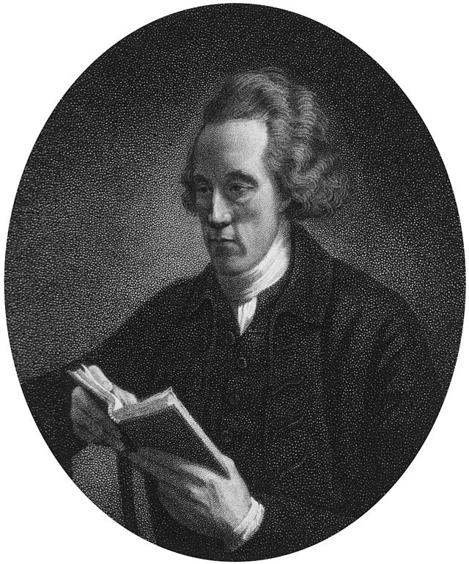
Joseph Townsend 1739-1816
“Hunger will tame the fiercest animals. “It will teach decency and civility, obedience and subjection … it is only hunger which can spur and goad the poor on to labour.”

Slide 49
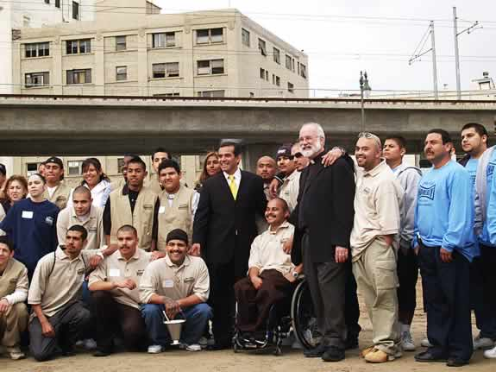

Slide 50

Fr Greg Boyle
“Here is what we seek: a compassion that can stand in awe at what the poor have to carry rather than stand in judgment at how they carry it.”
― Gregory Boyle

Slide 51
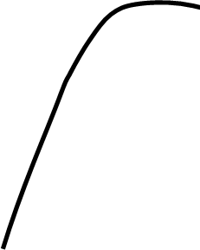
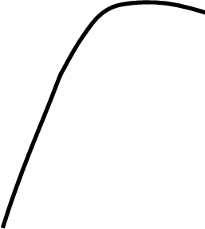
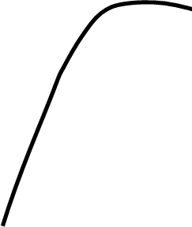
Getting to the Third Curve
Ceding power
Sharing power
MOBILISING
SOCIAL ACTION
Outcomes
Keeping power
QUALITY
IMPROVEMENT
NEW PUBLIC
MANAGEMENT
Targets,
sanctions,
inspections
CO-PRODUCTION
QUALITY IMPROVEMENT
PERFORMANCE MANAGEMENT
Time

Slide 52

Lila – at 7 months old!

Slide 53
