Slide 1
Induction Pack for New Registrars in Public Health
August 2019
FPH Specialty Registrar Committee

Slide 2
Congratulations on your appointment to the Specialty Training Scheme.
Welcome to our community of Specialty Registrars across the Four Nations.
This is an exciting time to be working to improve the public’s health as globally we focus on the Sustainable Development Goals, nationally we tackle UK priorities such as air quality and the integration of health and social care, and locally we seek to understand and address inequalities in health and the wider determinants – such as education and housing.
Together with partner agencies and the communities we serve, each day brings a new challenge. Whatever your interests and skills, this programme offers something for everyone!
This pack has been written by Registrars for Registrars and aims to:
introduce you to the Faculty of Public Health (FPH) and Specialty Registrar Committee (SRC); and
summarise key elements of the Training Programme and complement the in-depth inductions of the regional Training Programmes.

Slide 3
FPH oversees the quality of public health training and professional development
FPH exists to:
Develop public health with a view to maintaining the highest possible standards of professional competence and practice, including through setting, monitoring and promoting standards in education and training for public health in the UK
promote for the public benefit the advancement of knowledge in the field of public health; and
act as an authoritative body for the purposes of consultation and advocacy in matters of educational or public interest concerning public health.
The strategic vision is:
“To maximise effective public health action at local, regional, national and global levels by drawing on and supporting its members to deliver, influence and lead public health”
Take time to read “The UK Faculty of Public Health Strategy 2019-2025”

Slide 4
All Registrars enrol with the FPH. Membership offers additional benefits.
Enrolment and Membership cost:
All Registrars are required to enrol with FPH and pay the first annual Training and Membership fee within three months of commencing the training scheme.
For 2019 the Registrar Training and Membership fee is £298 (fee subject to annual review in line with inflation).
FPH fees (including exam fees) can be claimed against tax as work expenses by HMRC.
Membership Benefits
A free subscription to our quarterly Public Health Journal.
A monthly e-bulletin with updates on FPH, wider public health news, and opportunities to get involved.
Dedicated online members area with your resources and public health profile, and FPH Extra (discounts off products & services).
Access to Special Interest Groups (SIGs); our member led networks focused on particular themes such as transport or global public health.
Keep an eye out for your invitation to join as a member from marijana curic

Slide 5
The Specialty Registrar Committee (SRC) is here to ensure your views are heard.
Our Vision Statement
The SRC is a formal subgroup of the FPH Education Committee.
Its purpose is to represent the interests of Specialty Registrars in Public Health from across the UK, ensuring the views of registrars are heard at FPH Committees.
Those views may be in relation to FPH policy, national consultations, business and project objectives, training, the practice of public health, and to the maintenance and improvement of population health.
Your Involvement
Each region nominates two registrar representatives (six for London, Kent, Surrey & Sussex).
SRC reps attend regular meetings, act as SRC rep on other FPH committees, and engage with one or more of the SRC’s priority workstreams.
SRC priorities for 2019/20 are:
Improving communication between FPH and StRs
Advocacy for public health
Supporting FPH processes and policies to improve equity
Find out who your regional SRC Rep is, and how you can get involved!

Slide 6
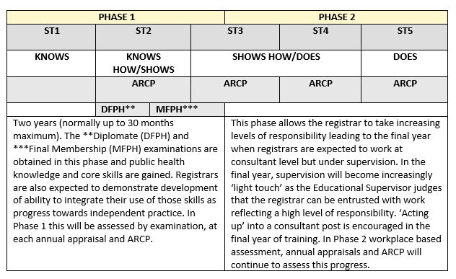
Specialty training generally lasts 5 years*
In Phase 1 you’ll focus on acquiring key skills and knowledge – as evidenced by completing a Masters in Public Health, passing the FPH Diplomate Exam (DFPH), and signing off learning outcomes through your portfolio of work.
In Phase 2, you’ll consolidate core competencies in generalist settings and develop special interests – as evidenced by passing the Final Membership Exam (MFPH), and signing off further learning outcomes.
StRs have an Annual Review of Competencies and Progression (ARCP
*shorter for those who arrive with a Masters in Public Health and longer for those who train less than full time or take time out of programme (OOP).
The Gold Guide sets out the overarching arrangements for speciality training.
Read more about training
on the FPH website

Slide 7
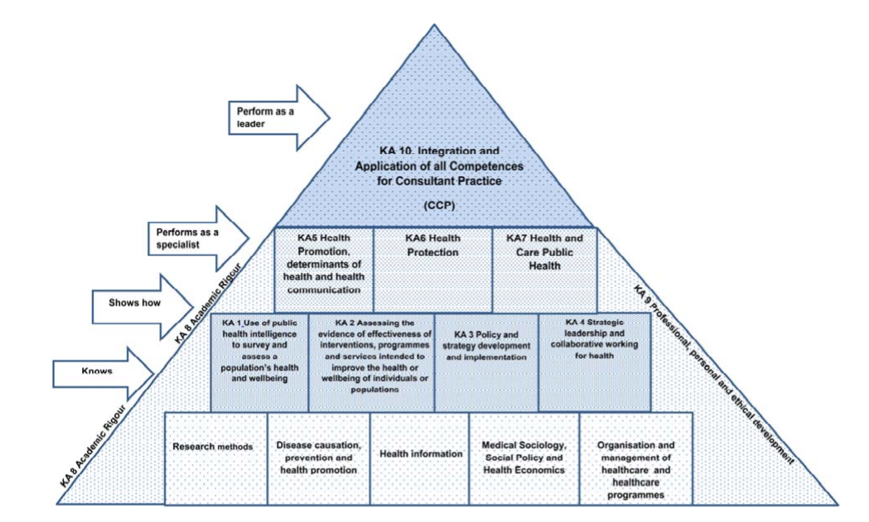
The Curriculum describes the learning outcomes for Registrars through training.
Miller’s adapted model of learning for public health
Download the 2015 curriculum here

Slide 8
Over time, you’ll gain experience in a number of settings.
 | Phase 1 | Phase 2
England | Local authority, health protection team | e.g. Local authority, university, health protection team, acute trust, community trusts, third sector, Nationally Available Training Placements
Northern Ireland | Public Health Agency | e.g. Public Health Agency, Queen’s University Belfast, Northern Ireland Cancer Registry, Department of Health
Scotland | Geographical health board | e.g. Health board, Scottish Government, specialist health boards, Glasgow Centre for Population Health
Wales | Local public health team | e.g. Health protection team, health intelligence division, Welsh Government, university, Nationally Available Training Placements
Talk to your Training Programme about out of programme / overseas options

Slide 9
The Diplomate and Final Membership exams
The FPH Diplomate Exam (DFPH)
Tests knowledge, understanding and application of the scientific basis of public health and related disciplines incl: applied statistics, behavioural sciences, health economics and management.
2 papers over 2 days (1A, 1B, 2A, 2B); January and June sittings, London.
Passing the exam leads to Diplomate membership of the FPH (DFPH).
Registrar suggested resources: Textbook: Mastering Public Health (Lewis et al.) Health Knowledge website, Ed Jessop Course, BMJ Statistics.
Details including syllabus and specimen papers here
The FPH Final Membership Exam (MFPH)
A 'show how' assessment of ability to apply relevant knowledge, skills and attitudes to the practice of public health.
Format: Role play, 6 stations; 4-5 times a year, London.
Passing the Final Membership Exam leads to Full Membership of the FPH (MFPH).
Registrar suggested resources : Textbook Practising Public Health (Briggs et al.).
Details including example scenarios here
Ask your Training Programme what support for exam preparation is available to you.

Slide 10
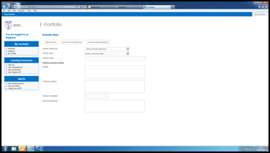
Reflective practice is intrinsic to specialty training and professional practice
Registrars use the FPH ePortfolio to evidence and reflect on work and activities completed in line with the required learning outcomes.
Supported by your educational and academic supervisors, SpRs consider:
What went well.
What was more challenging.
How this changes their practice moving forwards.
What (if any) new learning needs you have identified.
For more information on ePortfolio see here.
Keep an eye out for your invitation to sign up and start using ePortfolio

Slide 11
Throughout training, you’ll be supported and assessed year on year.
Support is available from a number of sources:
Educational Supervisor – oversees progress and provides training and supervision, appraisals and reporting.
Academic supervisor – provides specific input e.g. research opportunities, exam preparation, academic placements.
Project supervisors – provide day to day support.
Training programme director – overall help and guidance.
Other registrars – for peer support e.g. buddy on arrival, local networks.
Your progress – as evidenced by your ePortfolio and supervisor reports - is assessed at your ARCP.
Satisfactory completion of training leads to registration with either the General Medical Council (GMC) specialist register or the UK Public Health Register (UKPHR).
Registration is mandatory to practice as a consultant in public health in the UK .
Familiarise yourself with your Training Programme’s Educational Supervisor Toolkit

Slide 12
There’s plenty of opportunity to connect with the wider public health community and keep up to date.
Inter-national
Join FPH Special Interest Groups (SIGs) e.g. Public Health Africa and the European Network of Medical Residents in Public Health (Euronet).
National
Join the Registrar Yahoo Group by emailing phtraineenetwork-subscribe@yahoogroups.com; attend conferences e.g. FPH, Public Health England; join FPH Network SIGs & Networks: & http://new.fph-groups.org.uk/
Regional
Get involved with activities via your Training Programme e.g. communications platform, committees, journal club, learning sets, conferences.
Personal
Keep up to date by signing up for e-newsletters, podcasts, twitter feeds or blogs… (see next slide for ideas).
Discuss your study budget with your Training Programme and look out for opportunities advertised

Slide 13
As well as SRC reps, some other Public Health StR representatives you might want to seek out include:
Your national UNITE Rep (currently Tanith Palmer tanith_palmer@yahoo.com)
•Your national BMA Rep info.phmc@bma.org.uk)

Slide 14
Lastly, a few ideas from the SRC to get you going….
Follow (e-newsletters, twitter etc.): BMJ, HSJ, DH, PHE, King’s Fund
Journals: JPH, EJPH, The Lancet, BMJ
Podcasts: Lancet (quite a few), BMJ (quite a few), BBC (Inside Health, More of Less: Behind the Stats etc.), Training in Public Health, Sawbones
Blogs: PHE Screening, PH matters (PHE), Local Democracy and Health
Tools to make life that little bit easier:
Surveys: SurveyMonkey
Scheduling: Doodle
Poll: Poll Everyone
Create infographics: Easel.ly and Infogram
Reference Management: Mendeley
If you have any suggestions to add to this list, let your SRC Rep know!

Slide 15
Above all, if you have any questions, do please ask!
Angela (SRC Chair) can be reached at angela.cartwright2@nhs.net
FPH is always happy to help and can be contacted via: educ@fph.org.uk

