Slide 1


Reducing the supply of and
demand for illicit tobacco
Catherine Taylor, Regulation Manager, Fresh and Balance
FPH Smoking and Vaping Special Interest Group
2nd December 2025

Slide 2
Tobacco kills (whether it’s legal or illegal)
“People smoke for the nicotine but they die from the tar”
Dr Michael Russell
Tobacco and its smoke: lethal consumer product; thousands of chemicals, 250 toxins, 69 are known to cause cancer; up to 2/3 of smokers will die early; huge contributor to health inequalities.
Illegal tobacco – no worse for you but it’s cheap, accessible, will be sold to anyone
10.4% England smoking rate but higher rates among key groups – health inequalities issue
Routine and manual workers
Those with long term mental health conditions
People living in social housing – double the average
Most smokers want to quit
Many lack confidence, have low awareness, underestimate the risks
They need as many options and routes as possible
Many households could be lifted out of poverty if smoking reduced

Slide 3

The Fresh programme and evidence base in the North East
Funded by local authorities and the ICB
3 key goals of Fresh programme:
1- Helping smokers to stop and stay stopped
2- Preventing uptake
3- Reducing exposure to secondhand smoke and other harms
Specific strand on illicit tobacco – working locally, regionally, nationally through the Illicit Tobacco Partnership.

Slide 4
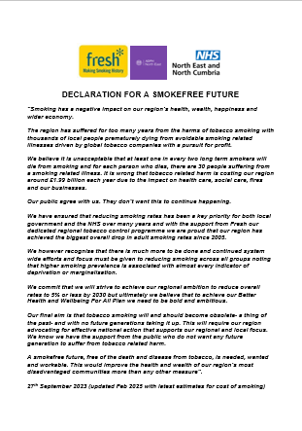
North East Declaration for a Smokefree Future:
Fresh, ADPHNE, ICB
A smokefree future, free of the death and disease from tobacco, is needed, wanted and workable. This would improve the health and wealth of our region’s most disadvantaged communities more than any other measure”.

Slide 5
The importance of price
The most effective policy lever
Encourages quitting
Reduces uptake
Reduces health inequalities
Saves lives
High tobacco prices in the UK compared to other countries
Low prices – high smoking rates – active illicit tobacco market
Strong UK tax policy (though industry will always try to undermine)
But still room for improvement e.g. hand rolling tobacco tax too low
Autumn Budget 2025 – continued tax rises
And stop smoking support is vital
Specific focus on illicit tobacco as part of overall tobacco control
Illicit tobacco undermines pricing and all other measures (youth access)

Slide 6
What is illegal tobacco?
Can take many different forms with variations in the terms used:
Illicit white, or cheap white, tobacco brands: no legal market in the UK. Legally manufactured in factories overseas and imported illegally to the UK. Duty has not been paid and appropriate health warnings and images might not be present.
Non-UK duty paid products: genuine but have been smuggled into the UK without duty being paid. May include tobacco made for the UK or products intended for sale in another country, or duty-free cigarettes being illegally sold rather than kept for personal use.
Counterfeit or fake products: illegally manufactured, made to look like recognised brands and sold by a party other than the original trademark or copyright holder.

Slide 7
Insight into the illicit trade
Still seen by many buyers as a victimless crime/ a service and efforts to tackle it are motivated by tax
A perception the market is made up of lots of small duty free sellers – people like them
A belief the market is divided into two types
“duty free” (what they think they’re buying)
“the bad stuff” – fakes and cigarettes from abroad which most try to avoid (though always a risk – all tobacco kills)
Committed buyers can be defiant and reject “don’t buy” pleas – but still only half of illicit buyers buy regularly
Can be an opportunistic purchase or from a trusted source
Campaigns have shifted comfort levels – making people less comfortable – and a link between comfort and size of market

Slide 8
Insight into the illicit trade
Perception there is less illegal tobacco readily available than a decade ago
A feeling the authorities will take it seriously – a marked change to 2010 insight
Non-smokers are probably more comfortable in reporting
Sales to children are the main unprompted concern and main reason most would report - though some buyers challenged whether their dealer would do so – key message
Links to crime can make people twice – key message – though global organised crime/ trafficking can feel too remote
Shopkeepers are concerned and want harsher penalties
Loss of alcohol licence and lottery terminal could be powerful deterrents for shops

Slide 9
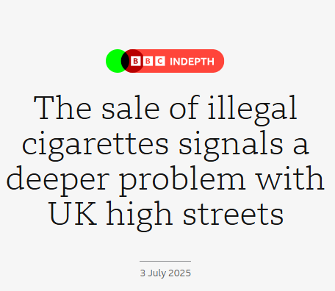
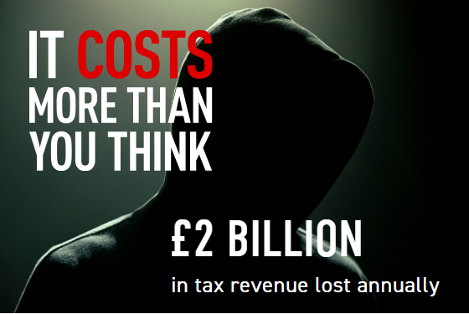
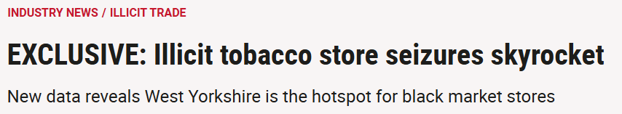
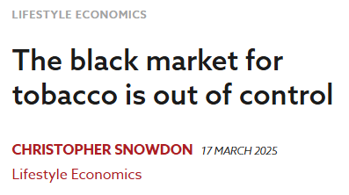
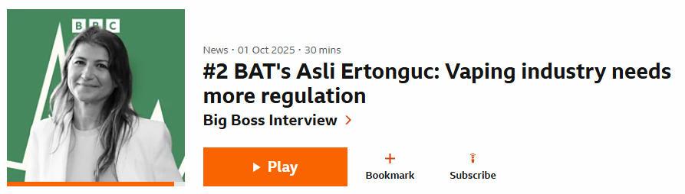
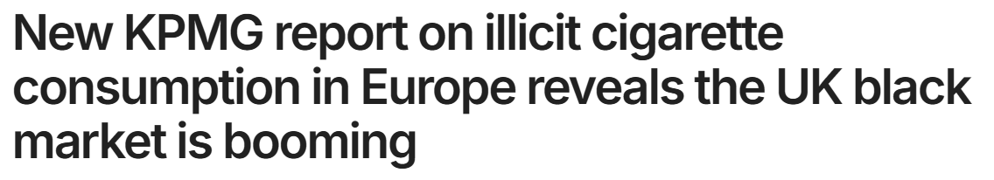
We need vigilance around narratives and where they are coming from…
… especially as the Tobacco and Vapes Bill is making progress

Slide 10
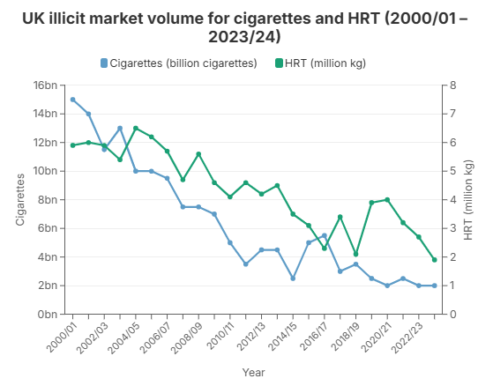
HMRC official figures
The size of the illicit market has declined significantly in the last two decades due to:
robust national strategy
strong enforcement at all levels
sustained tobacco control measures to reduce smoking overall.

Slide 11
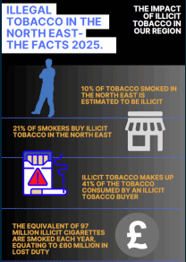
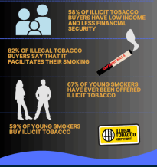

Slide 12
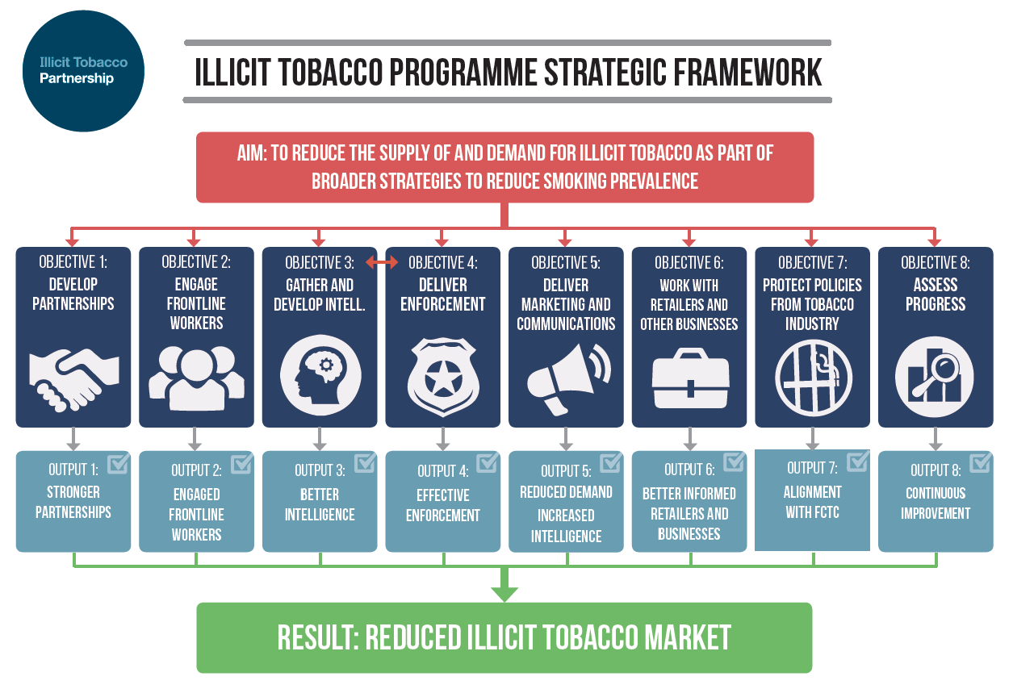

Slide 13
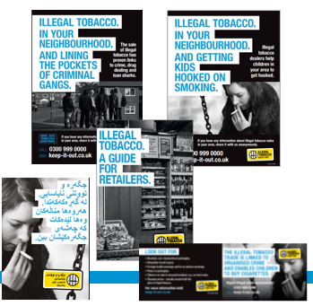
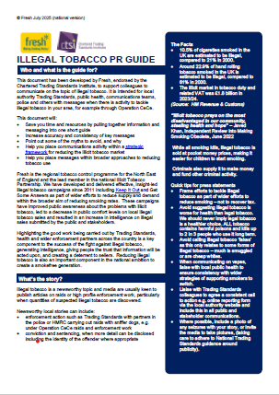
The importance of communications: the Keep It Out campaign and regular PR: reducing demand, generating intelligence

Slide 14
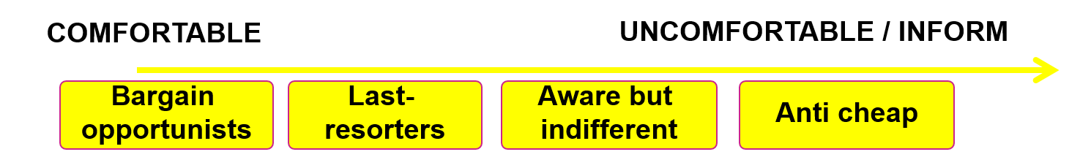
Approach/ aims
Initiate a normative shift within communities against illicit tobacco
Aim at whole communities – not just a “don’t buy” plea to smokers Potential to motivate non-smokers for intel by raising awareness of impact
Raise issue in communities where it is bought and sold – the problems it causes and how it affects local families
Disrupt supply; Target both smokers and non-smokers with opportunities to pass on intelligence – convert more people who turn a blind eye
Reduce demand; Make potential buyers think twice by raising awareness of the “bigger picture” and the harmful trade they are supporting
Raise a credible deterrent against selling illicit tobacco and the penalties
Give confidence - show people in local communities the problem is being taken seriously and anonymous information will be acted upon
Move key audiences towards discomfort – the main indication of people’s likelihood of buying and informing
Quitters
Concerned infrequents

Slide 15
Key messages
The best way to reduce the illicit tobacco market is to reduce smoking overall
Addressing illicit tobacco is a key part of a comprehensive approach to tobacco control
Partnership between public health and enforcement colleagues is key
The illicit tobacco market is on the long-term decline
Keeping tobacco prices high is vital to reduce smoking rates – needs to be combined with stop smoking support and robust enforcement – a ‘polluter pays’ levy on the tobacco industry will help with this
Be vigilant around the tobacco industry – their tactics, their narrative

Slide 16
Useful tools, resources, recommendations
From Smuggling to Spin: how the tobacco industry hijacked the illicit trade debate
New illicit tobacco FAQ page – facts, trends, industry tactics
Tobacco Tactics
Illicit Tobacco Strategic framework
Keep It Out (for North East partners only)
PR guide – to support drafting quotes and press releases (main message – all tobacco kills)
Guidance for Trading Standards on complying with Article 5.3 (tobacco industry will always present themselves as part of the solution…)

Slide 17
info@fresh-balance.co.uk
Facebook – Keep It Out
LinkedIn - https://www.linkedin.com/company/fresh-and-balance
www.illicit-tobacco.co.uk (hosted on Fresh and Balance website)
@FreshSmokeFree
www.freshquit.co.uk for smokers to find out about quitting
www.fresh-balance.co.uk about Fresh and Balance programme

