Slide 1
FPH Specialty Registrars’ Welcome and Induction Tuesday 29 September 2020

Slide 2
Professor Maggie Rae PrFPH, FRCP Hon, FRSPH, FRSM
President, Faculty of Public Health
David Chappel
Academic Registrar

Slide 3
Specialty Registrars’ Committee
Alex Allen
Chair, SRC

Slide 4
FPH e-Portfolio
Gareth Cooke
FPH Education and Training Manager

Slide 5
Education & Training Team
Support for Registrars throughout training . . .
Enrolments
CCT
Exams
OOP
ePortfolio
All queries to educ@fph.org.uk

Slide 6
How it works

Slide 7
Evidence ...

Slide 8
Activity

Slide 9
Learning Outcomes . . .

Slide 10
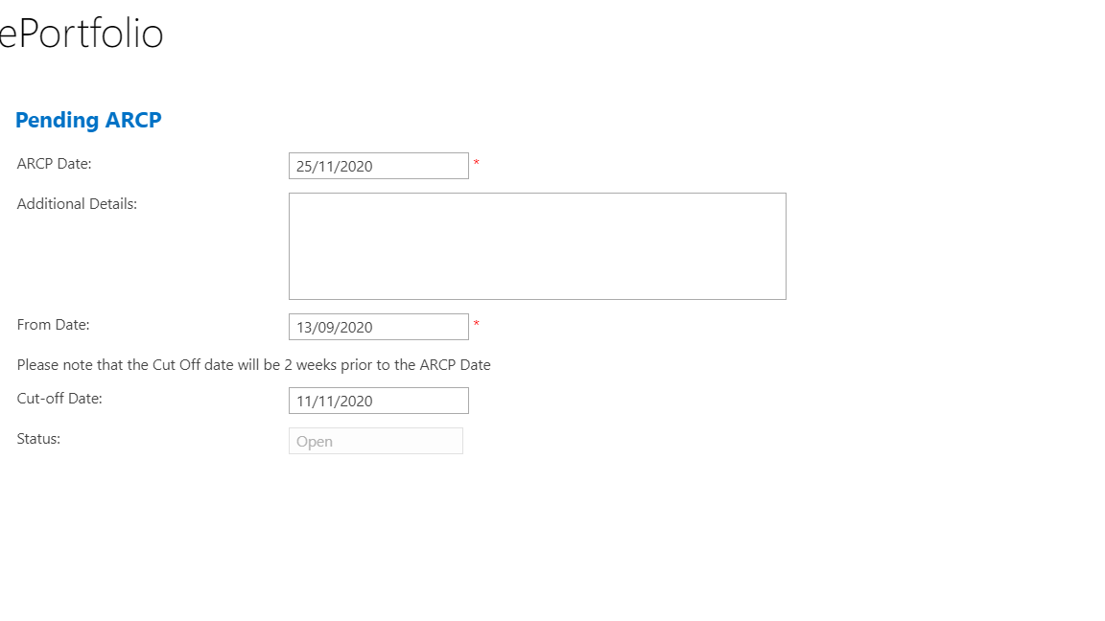
ARCP
Annual Review of Competencies Progression

Slide 11
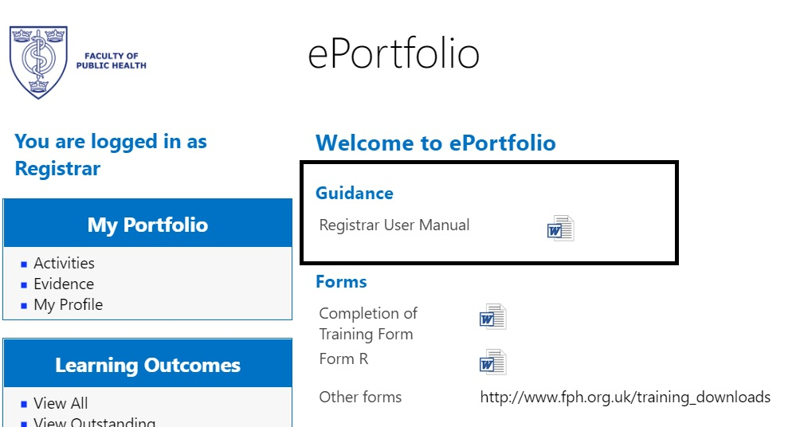
Resources
Guidance on the system

Slide 12
Resources
Education and Training team: educ@fph.org.uk
ePortfolio Champions

Slide 13
FPH Special Interest Groups
Julian Ryder
FPH Director of Education, Standards and Advocacy

Slide 14
Special Interest Groups (SIGs)
Faculty policy generation and members
What are SIGs are what do they do?
Source of knowledge and expertise for FPH
Focus on specific policy areas in public health
Support workforce training and development
Improve public health policy at a local, national, and global level
Promote new research and lead PH response on issues
Who can join the FPH SIGs?
Governance - how do they feed into FPH policy?
Support
Notes:
Introduce – here for one year

Slide 15
Special Interest Groups
Policy areas covered
Changing policy landscape (E&D SIG)
Recent highlights:
Alcohol SIG
Food SIG
Sustainable Development SIG
Home > Policy and Campaigns > Special Interest Groups
Notes:
Introduce – here for one year

Slide 16
FPH Examinations
Saran Shantkumar
StR representative on Diplomate Exam Working Group
Anne Whittington
StR representative on Membership Exam Working Group

Slide 17
Diplomate (DFPH) Examination
“Knows how” exam, detailed syllabus
Two papers, two days
Paper 1: knowledge
Two parts: 1A (2h30) and 1B (1h40)
10 structured questions (10 marks each) on:
Research methods
Disease prevention / health promotion
Health information
Medical sociology, social policy, health economics
Organisation and management of healthcare

Slide 18
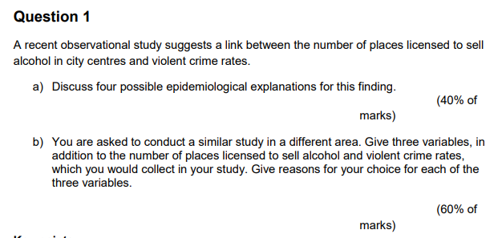
DFPH Examination
Example

Slide 19
DFPH Examination
Paper 2: Skills
2A (2h30): critical appraisal & follow-on Qs on PH theme [50 marks]
2B (2h): practical stats and epi [50 marks]

Slide 20
DFPH Examination
Preparation
3-4 months (?)
No reading list
Past papers (from 2011)
Specimen Qs for paper 2B on FPH site

Slide 21
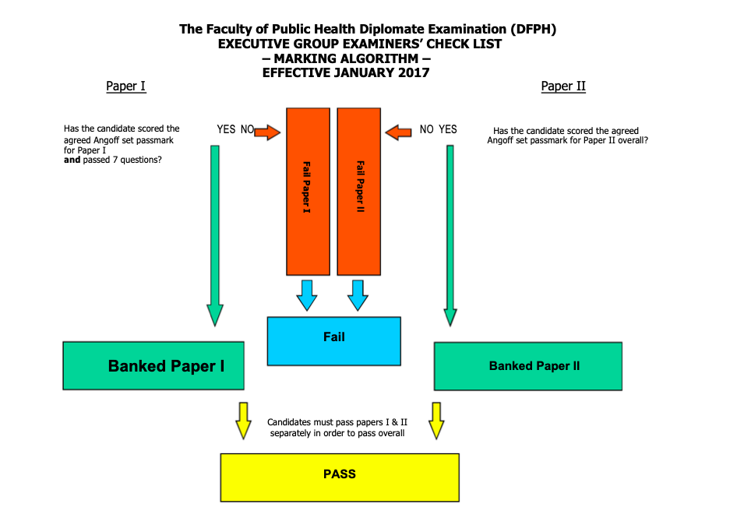
DFPH Examination
Marking algorithm
Can “bank” a paper

Slide 22
DFPH Examination
Online format from November 2020
Same format – regulations to be published shortly
More information here
Contact exams team: educ@fph.org.uk

Slide 23
FPH Examinations
Anne Whittington
StR representative on Membership Exam Working Group

Slide 24
Your questions
Irfan Ghani
FPH Director of Training and Public Health Consultant

