Slide 1
FPH Specialty Registrars’ Welcome and Induction Monday 27 September 2021
Welcome to the Faculty: Prof Maggie Rae (President) and David Chappel (Academic Registrar)
Specialty Registars’ Committee (Fatai Ogunlayi)
ePortfolio (Gareth Cooke)
Faculty Special Interest Groups and policy work (Julian Ryder)
Faculty exams (Fatai Ogunlayi and Dalia Youssef)
Q&A (Irfan Ghani)

Slide 2
Professor Maggie Rae PrFPH, FRCP Hon, FRSPH, FRSM
President, Faculty of Public Health
David Chappel
Academic Registrar

Slide 3
Specialty Registrars’ Committee
Fatai Ogunlayi
Vice Chair, Specialty Registrars’ Committee

Slide 4
Congratulations on your appointment to the Specialty Training Scheme
Welcome to our community of Specialty Registrars across the Four Nations.
This is an exciting time to be working to improve the public’s health as we work with partners to bring the pandemic under control and continue to protect the health of the public. Globally we are also focusing on the Sustainable Development Goals, nationally we are tackling UK priorities such as air quality and the integration of health and social care, and locally we seek to understand and address inequalities in health and the wider determinants – such as education and housing.
Together with partner agencies and the communities we serve, each day brings a new challenge. Whatever your interests and skills, this programme offers something for everyone!
This pack has been written by Registrars for Registrars and aims to:
Introduce you to the Faculty of Public Health (FPH) and Specialty Registrar Committee (SRC)
Summarise key elements of the Training Programme
Complement regional training programme inductions

Slide 5
FPH oversees the quality of public health training and professional development
FPH exists to:
Develop public health with a view to maintaining the highest possible standards of professional competence and practice, including through setting, monitoring and promoting standards in education and training for public health in the UK.
Promote for the public benefit the advancement of knowledge in the field of public health; and
Act as an authoritative body for the purposes of consultation and advocacy in matters of educational or public interest concerning public health.
The strategic vision is:
“To maximise effective public health action at local, regional, national and global levels by drawing on and supporting its members to deliver, influence and lead public health”
Take time to read “The UK Faculty of Public Health Strategy 2020-2025”

Slide 6
All Registrars enrol with the FPH. Membership offers additional benefits
Enrolment and Membership cost:
All Registrars are required to enrol with FPH and pay the first annual Training and Membership fee within three months of commencing the training scheme.
For 2021 the Registrar Training and Membership fee is £298 (fee subject to annual review in line with inflation).
FPH fees (including exam fees) can be claimed against tax as work expenses by HMRC.
Membership Benefits:
A free subscription to our quarterly Public Health Journal.
A monthly e-bulletin with updates on FPH, wider public health news, and opportunities to get involved.
Dedicated online members area with your resources and public health profile, and FPH Extra (discounts off products & services).
Access to Special Interest Groups (SIGs); our member led networks focused on particular themes such as transport or global public health.
Keep an eye out for your invitation to join as a member from Marijana Curic
Notes:
Membership and examination fees frozen for a second year running

Slide 7
The Specialty Registrar Committee (SRC) is here to ensure your views are heard
Our Vision Statement
The SRC is a formal subgroup of the FPH Education Committee.
Its purpose is to represent the interests of Specialty Registrars in Public Health from across the UK, ensuring the views of registrars are heard at FPH Committees.
Those views may be in relation to FPH policy, national consultations, business and project objectives, training, the practice of public health, and to the maintenance and improvement of population health.
Your Involvement
Each region nominates two registrar representatives (six for London, Kent, Surrey & Sussex).
SRC reps attend regular meetings, act as SRC rep on other FPH committees, and engage with one or more of the SRC’s priority workstreams.
Find out who your regional SRC Rep is, and how you can get involved!
Notes:
DFPH used to be January and June, now moved to March and Oct – example of where FPH has responded to Registrars / SRC feedback (impact on holidays, childcare, and changeover).

Slide 8
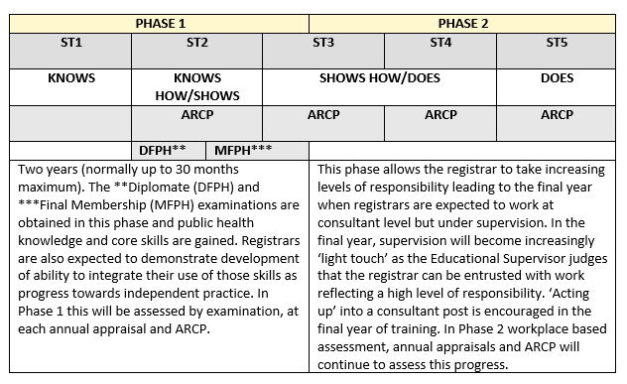
Specialty training generally lasts 5 years*
*shorter for those who arrive with a Masters in Public Health and longer for those who train less than full time or take time out of programme (OOP).
For more info visit: FPH website
The Gold Guide sets out the overarching arrangements for speciality training.
Notes:
In Phase 1 you’ll focus on acquiring key skills and knowledge – as evidenced by completing a Masters in Public Health, passing the FPH Diplomate Exam (DFPH), and signing off learning outcomes through your portfolio of work.
In Phase 2, you’ll consolidate core competencies in generalist settings and develop special interests – as evidenced by passing the Final Membership Exam (MFPH), and signing off further learning outcomes.
StRs have an Annual Review of Competencies and Progression (ARCP)
The DFPH and MFPH will be covered in more detail later on on the presentation.

Slide 9
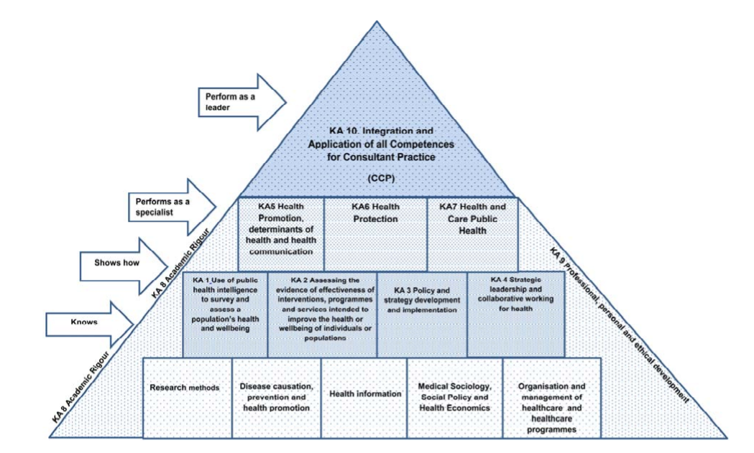
The Curriculum describes the learning outcomes for Registrars through training
Download the 2015 curriculum here
Figure: Miller’s adapted model of learning for public health

Slide 10
Over time, you’ll gain experience in a number of settings
Mandatory placements | Local authority or health board Health protection
Subsequent placements | E.g. Academic, Hospital, Commissioning organisation, Public health organisation etc.
National opportunities | Nationally Available Training Placements FPH projects
Out of Programme (OOP) | Training (OOPT), Experience (OOPE), Research (OOPR)
Talk to your Training Programme about out of programme / overseas options
Notes:
Mandatory include an organisation that delivers broad range of public health functions (e.g. LA or HB). Health protection is another mandatory placement (
Subsequent placements: Depends on educational needs (competency), area of interest, career goals. Determined by locally – speak to TPDs
NATP – Opportunity to acquire specific or contextual experience usually at a national level
FPH Projects: Normally generated by the Faculty or by a Special Interest Group (SIG) within the FPH

Slide 11
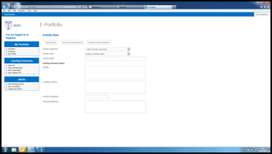
Reflective practice is intrinsic to specialty training and professional practice
Registrars use the FPH ePortfolio to evidence and reflect on work and activities completed in line with the required learning outcomes.
Supported by your educational and academic supervisors, SpRs consider:
What went well.
What was more challenging.
How this changes their practice moving forwards.
What (if any) new learning needs you have identified.
For more information on ePortfolio see here.
Keep an eye out for your invitation to sign up and start using ePortfolio
Notes:
Key to this is to engage early on – don’t wait till ARCP (annual review)
Gareth will say more about e-portfolio later on.

Slide 12
Throughout training, you’ll be supported and assessed year on year.
Support is available from a number of sources:
Educational Supervisor – oversees progress and provides training and supervision, appraisals and reporting.
Academic supervisor – provides specific input e.g. research opportunities, exam preparation, academic placements.
Project supervisors – provide day to day support.
Training programme director – overall help and guidance.
Other registrars – for peer support e.g. buddy on arrival, local networks.
Your progress – as evidenced by your ePortfolio and supervisor reports - is assessed at your ARCP.
Satisfactory completion of training leads to registration with either the General Medical Council (GMC) specialist register or the UK Public Health Register (UKPHR).
Registration is mandatory to practice as a consultant in public health in the UK .
Familiarise yourself with your Training Programme’s Educational Supervisor Toolkit
Notes:
Some of these differ between deaneries (some also have clinical supervisors and not all have academic supervisors)

Slide 13
There’s plenty of opportunity to connect with the wider public health community and keep up to date
Inter-
national
Join FPH Special Interest Groups (SIGs) e.g. Public Health Africa and the European Network of Medical Residents in Public Health (Euronet).
National
Join the Registrar Google Group https://groups.google.com/g/phtraineenetwork; attend conferences e.g. FPH, Public Health England; join FPH Network SIGs
Regional
Get involved with activities via your Training Programme e.g. communications platform, committees, journal club, learning sets, conferences.
Personal
Keep up to date by signing up for e-newsletters, podcasts, twitter feeds or blogs… (see next slide for ideas).
Discuss your study budget with your Training Programme and look out for opportunities advertised
12
Notes:
Julian will say more about SIGs

Slide 14
Lastly, a few ideas from the SRC to get you going….
Follow (e-newsletters, twitter etc.): BMJ, HSJ, DH, PHE, King’s Fund
Journals: JPH, EJPH, The Lancet, BMJ
Podcasts: Lancet (quite a few), BMJ (quite a few), BBC (Inside Health, More of Less: Behind the Stats etc.), Training in Public Health, Sawbones
Blogs: PHE Screening, PH matters (PHE), Local Democracy and Health
Tools to make life that little bit easier:
Surveys: SurveyMonkey and Google forms
Scheduling: Doodle
Poll: Poll Everyone
Create infographics: Easel.ly and Infogram
Reference Management: Mendeley
If you have any suggestions to add to this list, let your SRC Rep know!

Slide 15
Above all, if you have any questions, do please ask!
Fatai (SRC Vice Chair) can be reached at fatai.ogunlayi@nhs.net
FPH is always happy to help and can be contacted via: educ@fph.org.uk

Slide 16
FPH e-Portfolio
Gareth Cooke
FPH Education and Training Manager
Notes:
The FPH electronic portfolio (ePortfolio) system provides Specialty Registrars with a central platform for the management of information and documentation on progression of learning against the public health specialty training curriculum during their time in training. The ePortfolio allows trainees to relate documentation and evidence to the curriculum and incorporates the ability to record various sign offs.
To access the ePortfolio please click here.
The training ePortfolio is managed by the registrar who must reflect on and record their achievements on an on-going basis. It is intended to be used as a complementary tool to aid in the recording of training activity, and monitoring progression along with regular meetings with Registrars and their supervisor.
More info available on FPH website: https://www.fph.org.uk/training-careers/specialty-training/training-eportfolio/

Slide 17
Education & Training Team
Support for Registrars throughout training . . .
Enrolments
CCT
Exams
OOP
ePortfolio
All queries to educ@fph.org.uk

Slide 18
How it works
Notes:
The following briefly outlines how work is signed off on the system
Evidence is uploaded to the system.
An Activity is created and linked with the Evidence and a Learning Outcome.
This is submitted by the registrar for approval by an Activity Supervisor/Educational Supervisor.
Once all activities associated with a Learning Outcome are approved the Learning Ouctome Sign of Sheet (LOSOS) can be submitted to the Educational Supervisor for sign off.
All LOSOS are associated with an ARCP date, which in effect groups a body of work under one heading so that progress can be reviewed by your deanery. Once a ARCP date has been reached, and the panel has reviewed the Registrars work then a new ARCP should be created by the Registrar to capture the next period’s work.
The diagram above illustrates the progression through the e-portfolio functionality from start to finish, from adding evidence through to submitting an ARCP.

Slide 19
Evidence ...
Notes:
Evidence is uploaded as part of the sign off process for Learning Outcomes.
Please remember that evidence containing confidential/sensitive information evidence uploaded to the system should be redacted where appropriate.
Your Educational Supervisor or Training Programme Director should be able to advise on what is appropriate evidence to upload to the system.
Go to My Portfolio > “Evidence”
· The list shows all the evidence added to the system by the Registrar. The items on this page can be sorted by Evidence Name, Date Added etc.
· The “Search bar” allows the filtering of the results in the Evidence Dashboard.
· Please note that users should avoid using non-alphanumeric symbols in the naming of their evidence as this can cause difficulties in downloading evidence from the system.

Slide 20
Activity
Notes:
Activity Summary Sign off sheets are the first step towards signing off Learning Outcomes and capture the detail of the work you are completing.
Go to My Portfolio > Activities
Activities will need evidence attached to them and to be associated with a LOSOS.
LOSOS without Activities attached to them will not have any associated evidence and in effect will be “blank”.
For more information please refer to the ePortfolio user manual for registrars

Slide 21
Learning Outcomes . . .

Slide 22
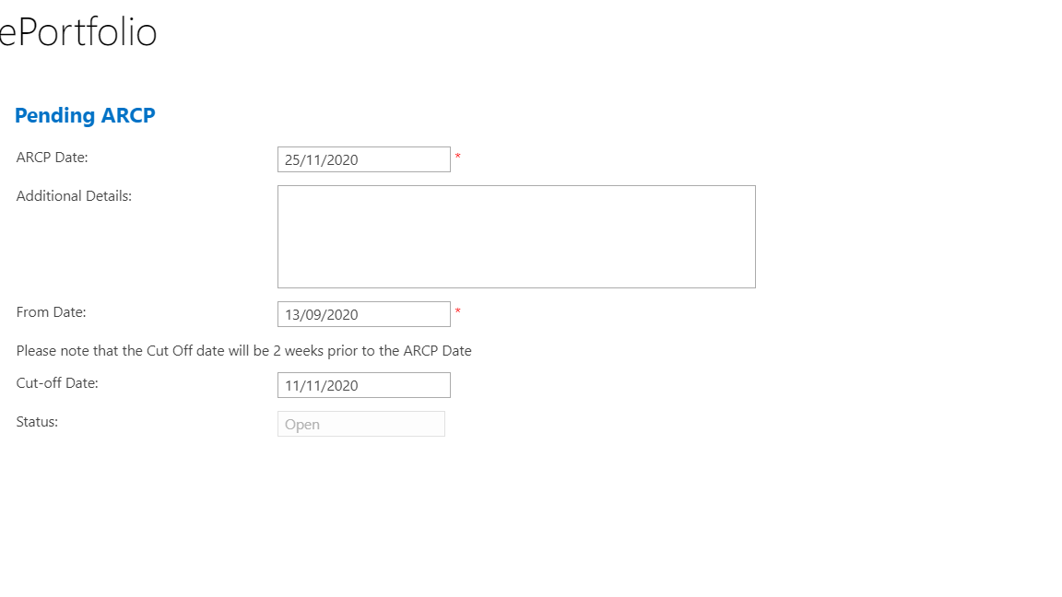
ARCP
Annual Review of Competencies Progression
Notes:
The ARCP is a way to group to together work that has been completed over a period of time to demonstrate progression through training for the ARCP panel. When the training panel meets they will be able to view your progress by the information attached to the ARCP.
Your deanery may have specific requirements regarding the submission of documents for the panel. You should contact them to clarify the process.

Slide 23
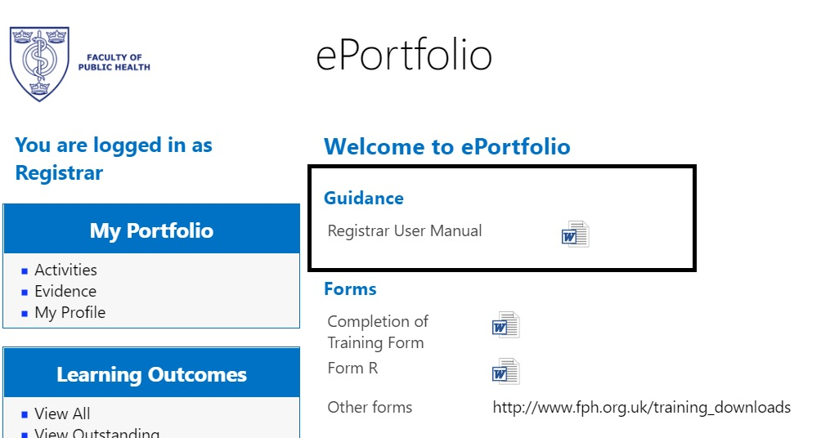
ePortfolio User Manual available on system
Links to demo 1 and demo 2
Notes:
An ePortfolio User manual is available on the ePortfolio login page.
The following links will take you to video demonstrations of how the ePortfolio works and steps needed to upload evidence, submit Activities and how Learning Outcomes are signed off.
https://www.youtube.com/watch?v=A_9iYcOwWt8 and https://vimeo.com/175849496
Both videos were created by Public Health Registrars.

Slide 24
Resources
Education and Training team: educ@fph.org.uk
ePortfolio Champions

Slide 25
FPH Special Interest Groups
Julian Ryder
FPH Director of Education, Standards and Advocacy
Notes:
Introduction

Slide 26
Special Interest Groups (SIGs)
What are SIGs are what do they do?
Groups of Faculty members with an interest in a specific policy area
Source of knowledge and expertise for FPH
Support workforce training and development
Improve public health policy at a local, national, and global level
Promote new research and lead the public health response on a range of issues
Who can join the FPH SIGs? You can….

Slide 27
Context
The Faculty of Public Health currently has:
4,000 members – mainly UK but all over the world
27 active committees – ‘lifeblood’ of a membership organisation, essential to governance
32 SIGs, each reporting to a committee
16 staff (15 WTEs) – focussed on the ‘must do’s’

Slide 28
Special Interest Group reporting structure
FPH Board
Health Policy Committee
Children & Young People Mental Health | Academic Research Committee | Health Improvement Committee | Health Services Committee | Health Protection Committee | Climate & Health Committee | Global Health Committee | Ethics Committee | Equality & Diversity Committee
 | PH Educators in Medical Schools Public health Information & Intelligence | Alcohol Arts and Health Economics Food Healthy Places Healthy Spatial Planning Musculo-skeletal Health Oral Health PH Film Transport | Social Care Drugs Genomics Maternal Health Primary Care Sexual and Reproductive Health | Health Protection (Education & Training) | Sustainable Development | Addressing NCDs in LMICs Africa Europe Global Violence Prevention India Pakistan Sudan Yemen | PH Ethics | Equality & Diversity

Slide 29
Role of the SIGs
SIGs are convened by FPH members to tackle some of the most pressing issues facing the public’s health today
The Faculty has 4,000 public health experts in its membership and the SIGs are the best way to harness that expertise
SIGs provide our members with a platform to speak out in one voice on a particular topic
They shape and lead Faculty policy in a number of fields and provide additional ‘reach’ and engagement which the Faculty can’t always do centrally
They provide the Faculty with a source of expertise and support across all areas of our work

Slide 30
Faculty support for SIGs
SIGs are self-administered, but….
SIG webpages
Media and publicity – link to Faculty social media reach (20k Twitter followers, YouTube, Facebook, website, members’ e-bulletin)
Possible StR projects to support specific learning outcomes (e.g. climate change)
Access to TC and VC facilities and meeting rooms in FPH’s office (when we’re fully open again, though increasing expectations around remote meeting)

Slide 31
Recent policy areas
Changing policy landscape
Recent areas of focus:
Equality and diversity
Climate change
Drugs
Afghanistan
Alcohol
Food poverty
Blood pressure/CVD
Health inequalities (COVID-19)

Slide 32
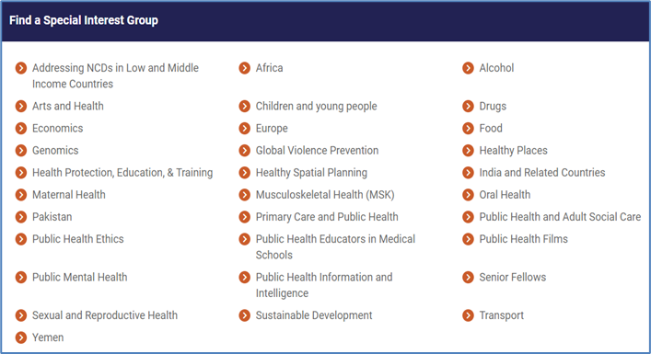
Where to find the SIGs…
FPH Homepage > Policy and Campaigns > Special Interest Groups

Slide 33
FPH Examinations
Fatai Ogunlayi
StR representative, Diplomate Exam Development Committee
Dalia Youssef
StR representative, Membership Exam Development Committee

Slide 34
Diplomate (DFPH) Examination
“Knows how” exam, detailed syllabus
Two papers, two days
Paper 1: knowledge
Two parts: 1A (2h30) and 1B (1h40)
10 structured questions (10 marks each) on:
Research methods
Disease prevention / health promotion
Health information
Medical sociology, social policy, health economics
Organisation and management of healthcare

Slide 35
DFPH Examination
Paper 2: Skills
2A (2h30): critical appraisal & follow-on Qs on PH theme [50 marks]
2B (2h): practical stats and epi [50 marks]
Notes:
E.g. of follow-up Qs: Draft a reply to your local politician or write a media bulletin
Time on 2B has been extended to 2 hours

Slide 36
DFPH Examination
Preparation
3-4 months (?)
No reading list
Past papers (2011 – 2017)
Hints and tips from examiners
Specimen Qs for paper 2B on FPH site
Ask your Training Programme
what support for exam preparation is available to you.
Notes:
FPH no longer publish past papers - retained in a reusable question bank

Slide 37
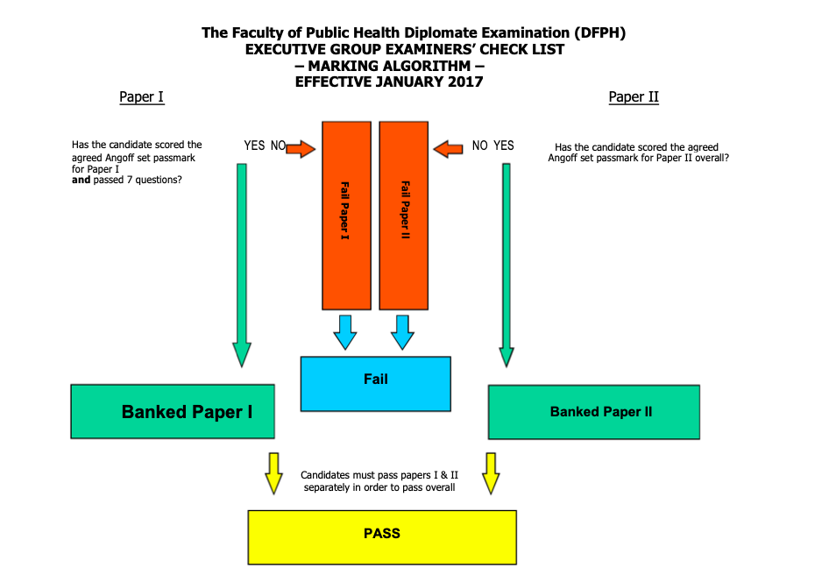
DFPH Examination
Marking algorithm
Can “bank” a paper

Slide 38
DFPH Examination
Online format from November 2020
Same content
More information here
Contact exams team: educ@fph.org.uk

Slide 39
Membership Examination
Dalia Youssef
StR representative, Membership Exam Development Committee
Notes:
Formerly known as the Part B
Officially known as Final Membership Examination.
Sometimes called the Objective Structured Public Health Examination (OSPHE).
This is a brief overview of the exam.

Slide 40
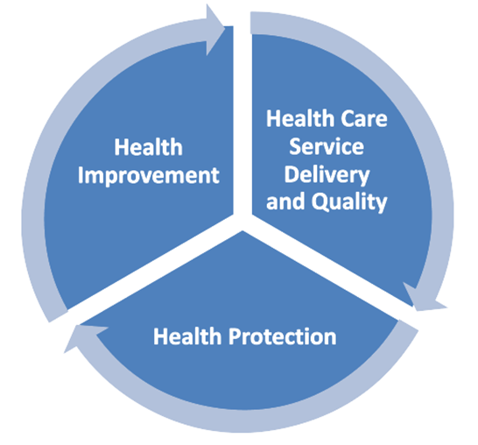
Membership (MFPH) Examination
“Shows how” assessment
6 scenarios, ~2 hours
Application of knowledge (syllabus), skills and attitudes to the practice of public health
Sit 6-9 months after DFPH, 2 years from end of training
Notes:
This is a “show how” role-play assessment of a candidate’s ability to apply relevant knowledge, skills and attitudes to the practice of public health
It is an an approximately 2 hour practical assessment made up of 6 scenarios.
The scenarios are chosen to represent everyday public health issues in commonly experienced settings across the three domains of public health practice: health improvement, health protection, healthcare public health.
Real-life scenarios often based on the experiences of examiners who write the scenarios. Example - radio interview about vaccinations, or meeting with councillor about suicide rates in local area.
What is being assessed?
Application of theory to practice, therefore not a strictly content-based exam - not expected to regurgitate the entirety of Part A syllabus

Slide 41
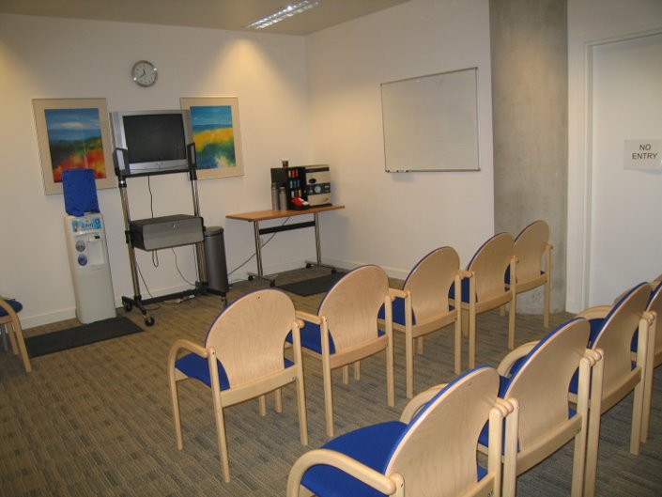
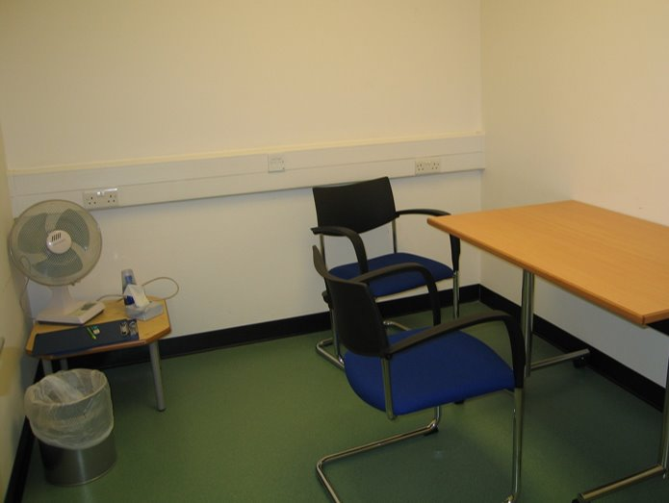
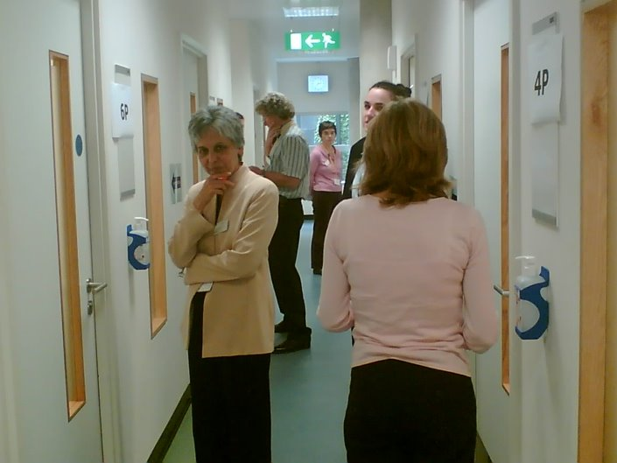
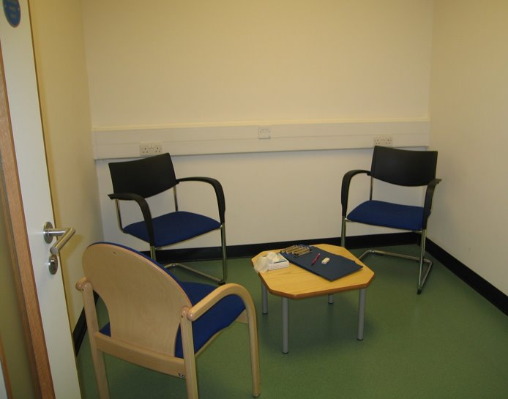
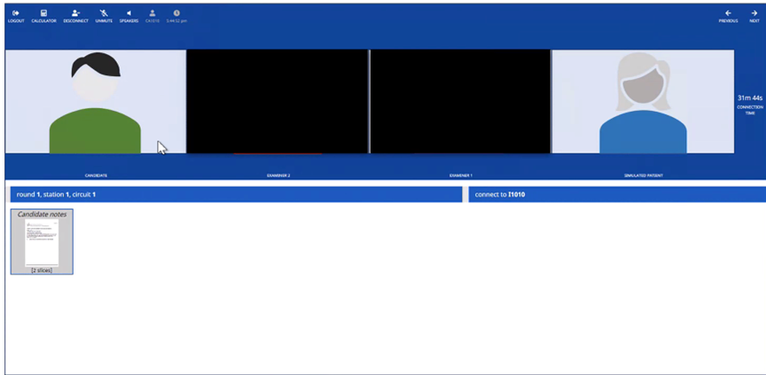
MFPH Format
Briefing room
Prep room
6 scenarios, cycle:
8 minute preparation station to review briefing material
1 minute transfer time
8 minute examination station
1 minute transfer
~ 2 hours, guided through stations by facilitators
Mix of professional actors and public health professionals as role players
Online from November 2020 (Pratique), will revert to face to face June 2022*
Transfer corridor
Exam room
Online Pratique platform
Notes:
The MFPH takes the form of six scenarios.
Each scenario will have a 8 minute preparation station in which you review briefing material - this can be some data for example
Each examination station also lasts 8 minutes - here you will have a discussion with the role-player, this discussion is scripted so all candidates in that sitting are asked the same questions
You have approximately one minute to transfer from the prepaparton to examination station for each scenario
Sounds complicated - but do not worry, plenty of facilitators to guide you round
*subject to national COVID guidelines.

Slide 42
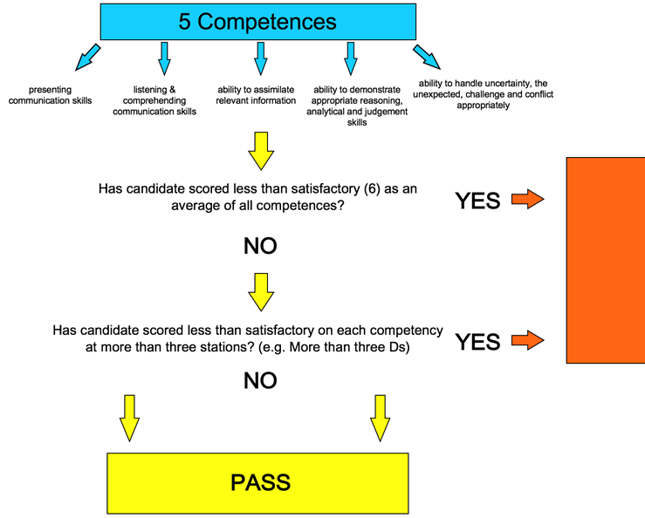
MFPH - Competencies assessed
Communication skills: presenting (verbal and non-verbal)
Communication skills: listening, comprehending, responding
Assimilating & using relevant information
Reasoning, analytical and judgement skills; giving a balanced view
Handling of uncertainty, the unexpected, challenge and conflict
Notes:
In each examination station, a role player and an examiner assess candidates across the same five competency areas at every station
Graded A-E, with A being excellent, B being good, C being adequate, D being just below adequate and E being poor.
Need an average of C for each competency to pass, with at least a C in 3 stations - so possible to do less well on two stations, but still pass by doing well in other stations.
Transition: Resources
5 Competencies:
The ability to demonstrate presenting communication skills (verbal and non-verbal) appropriately in typical public health settings: presenting to a person or audience
The ability to demonstrate listening and comprehending communication skills (verbal and non-verbal) appropriately in typical public health settings: listening and responding appropriately
The ability to assimilate relevant information from a variety of sources and settings and using it appropriately from a public health perspective
The ability to demonstrate appropriate reasoning, analytical and judgement skills, giving a balanced view within public health settings
The ability to handle uncertainty, the unexpected, challenge or conflict
Marking
Using marking guidance, the examiner grades each competency A-E, with A being excellent, B being good, C being adequate, D being just below adequate and E being poor. These grades are later converted into numerical scores and then combined to produce an overall exam score and an average for each of the five competency areas.
A candidate awarded a C for each competency at all six stations would indicate a pass overall. However, the marks for each competency are averaged, so it is possible to do less well on, say, two stations, and yet still pass overall by getting marks higher than a C at other stations. The other requirement for a pass is that each competency area must be marked at C or above at half or more of the stations.
Outcome is pass or fail. There are awards available for top performing candidates.

Slide 43
How to prepare
Use your placements to gain relevant experience
Get started 6-8 weeks prior to exam
Familiarise yourself with MFPH website
Practice, practice, practice
Set up revision group
Public health colleagues including supervisors and consultants
Friend and families (especially layperson scenarios)
Make use of national and local resources (see next slide)
Do a mock if you can
Take study leave

Slide 44
MFPH Resources
MFPH page on FPH website (including FPH scenarios)
Useful blogs and articles:
https://academic.oup.com/jpubhealth/article/38/1/189/2362659
https://www.drcath.net/hot-desk1/part-b-exam
https://betterhealthforall.org/2019/08/05/top-10-part-b-exam-tips-from-kevin-smith-part-b-examiner/
https://betterhealthforall.org/2018/06/06/the-winner-of-the-2018-fph-mcewan-award-shares-her-advice-on-preparing-for-the-part-a-exam/
Deanery tutorials, mocks and peer-produced resources
National WhatsApp revision group
Contact exams team: educ@fph.org.uk
Ask your Training Programme what support for exam preparation is available to you.

Slide 45
Your questions
Irfan Ghani
FPH Director of Training and Public Health Consultant

