Slide 1
COP26 - FPH Members' briefing
Wednesday 27 October 2021

Slide 2
COP26 - FPH Members' briefing
Introduction
Professor Maggie Rae
FPH President

Slide 3
Introduction - today’s session
4.00 Introduction
4.05 Presentation
What is COP26?
Overview of COP26 programme and the health-specific events
FPH at COP26 - as observer
what all members can do (including at home)
4.25 The Faculty’s statement and members’ opportunities to contribute to this
4.30 Breakout groups
What do members want out of COP26?
What questions do you have?
4.45 Q and A (panel)
4.55 Next steps and closing remarks

Slide 4
COP26 - FPH Members' briefing
What is COP26?
Professor Sue Atkinson CBE
Chair, FPH Climate and Health Committee

Slide 5
What is COP26?
COP = Conference of the Parties of UNFCCC
UNFCCC = UN Framework Convention on Climate Change (197 countries)
“preventing dangerous human interference with the climate system”
Framework for intergovernmental efforts to tackle climate change
UNCC:Learn Climate change negotiations and health e-learning module (3hrs self-paced) https://unccelearn.org/course/view.php?id=127&page=overview

Slide 6
Paris agreement – a reminder
COP21 (2015)
Legally binding international treaty on climate change
Goal is to limit global warming to well below 2, preferably to 1.5 degrees Celsius compared to pre-industrial levels
Also provides a framework for financial, technical and capacity building support to countries that need it

Slide 7
COP26 Glasgow
26th annual meeting (postponed from 2020 due to COVID-19 pandemic)
UK Presidency
31 October – 12 November 2021
Many prior negotiations (bi-laterals etc.)
Presidency programme (Blue Zone)
Green Zone and other events

Slide 8
COP26 Goals
Mitigation: Secure global net zero by mid-century and keep 1.5 degrees within reach
Adaptation: Adapt to protect communities and natural habitats
Finance: Mobilise finance
Collaboration: Work together to deliver
Notes:
https://ukcop26.org/cop26-goals/
1. Secure global net zero by mid-century and keep 1.5 degrees within reach
Countries are being asked to come forward with ambitious 2030 emissions reductions targets that align with reaching net zero by the middle of the century.
To deliver on these stretching targets, countries will need to:
accelerate the phase-out of coal
curtail deforestation
speed up the switch to electric vehicles
encourage investment in renewables.
2. Adapt to protect communities and natural habitats
The climate is already changing and it will continue to change even as we reduce emissions, with devastating effects. At COP26 we need to work together to enable and encourage countries affected by climate change to:
protect and restore ecosystems
build defences, warning systems and resilient infrastructure and agriculture to avoid loss of homes, livelihoods and even lives
3. Mobilise finance
To deliver on our first two goals, developed countries must make good on their promise to mobilise at least $100bn in climate finance per year by 2020.
International financial institutions must play their part and we need work towards unleashing the trillions in private and public sector finance required to secure global net zero.
4. Work together to deliver
We can only rise to the challenges of the climate crisis by working together.
At COP26 we must:
finalise the Paris Rulebook (the detailed rules that make the Paris Agreement operational)
accelerate action to tackle the climate crisis through collaboration between governments, businesses and civil society.

Slide 9
COP26 Programme (week 1)

Slide 10
COP26 Programme (week 2)

Slide 11
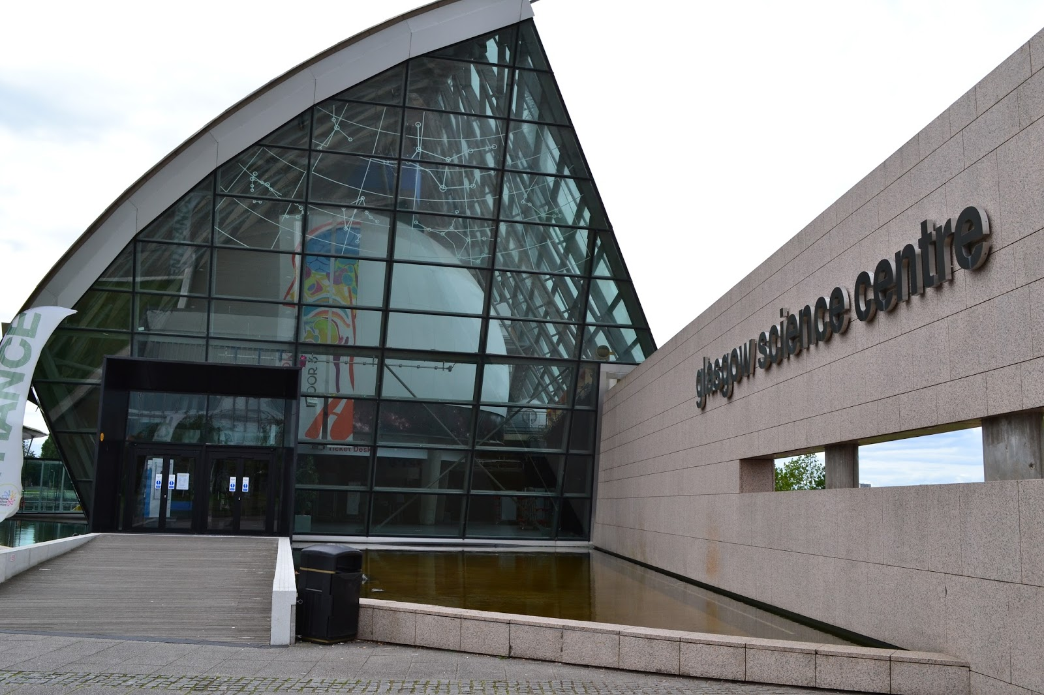
COP26 Green Zone and other events
Green Zone - Glasgow Science Centre
Other events
before, during and after COP26
local, national, international events

Slide 12
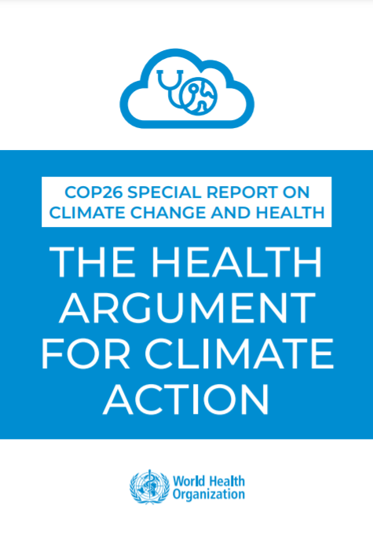
How will health be included at COP26?
COP26 health events GCHA's public calendar available here
2021 Global Conference on Health and Climate
Sat Nov 6th 9:00-17:30 UK.
WHO special report:
“The Health Argument for Climate Change”
FPH – observer status

Slide 13
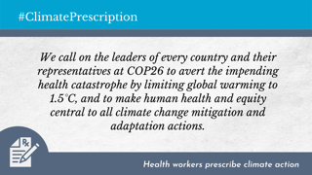
International health community – prior to COP 26
#HealthyClimatePrescription letter (and Medical Journals editorial)
WHO’s Health Argument for Climate Action
Health professionals cycling from London to Glasgow carrying the #HealthyClimatePrescription letter and the WHO’s "Health Argument for Climate Action”
Diarmid Campbell-Lendrum, head of the WHO Climate Change and Health Unit, cycling from Geneva to London to deliver both of these documents to the doctors. Follow Diarmid’s journey on twitter and/or check out Ride for their Lives
GCHA NDC Scorecards See the updated map and new country scorecards here.
Lancet Countdown Report The 2021 report
UK policy briefing published alongside the global report.

Slide 14
Anything to watch out for?
Which world leaders attend
Health in COP26 limited focus to health system adaptation and science
Waste is not well included in COP26
Carbon offsetting and carbon offloading
Greenwashing
Risk of a false dichotomy between the economy and the environment
Failure of global North to acknowledge (and pay) its debt to the global South

Slide 15
Public health role
FPH Observer status – five people as ‘observers’
Network with other health delegates (common voice for health)
Informally raise voice of health – impact of climate change and co-benefits
FPH two-minute statement at COP26 (link in the chat forum)
FPH webinar on the Climate Emergency in November e-bulletin
Local and regional COP26-related events now and during COP26
Post-COP26 maintain momentum
FPH climate and health strategy – November Faculty board

Slide 16
FPH statement at COP26
Emergency and opportunity
Climate change and environmental breakdown is undoubtedly the single biggest health threat facing humanity, but also presents the biggest opportunity for improving health. It is a key part of public health’s role, locally and globally, to raise the importance of and realise the co-benefits to health, the climate, and environment, such as through actions which increase active travel, improve air quality, and promote sustainable food systems. It is our mission to support the UK public health workforce in taking a leading role in this work, protecting and improving the health of the planet and the population at the same time so that further impacts of climate and environmental breakdown may be prevented before more lives and homes are lost. We believe that a healthier climate and planet for all communities across the globe and future generations is possible. We will work to make this a reality, but we are clear that health professionals cannot hope to achieve this alone.
Call to action
We call on the four nations of the UK to commit to shared ambitious goals which respond to this threat to our population’s health and very existence with the urgency required, taking immediate action to limit global warming to 1.5°C, and putting in place adaptation measures to protect from the very real health risks that communities already face. We call on the UK to also recognise its global responsibilities as a self-proclaimed leader on climate action and one of the biggest contributors to this crisis. To be effective, actions and targets must reflect two aspects key to all public health work: addressing commercial and wider determinants of health and recognising the stark inequalities in who is impacted the most by climate change. And we call on all leaders and citizens, here in the UK and globally, to join us in making the necessary changes in whatever role they have before it is too late.

Slide 17
Your input to statement
We have posted the draft statement we plan to present at COP26 on a public document and we are giving Faculty members the opportunity to shape what the statement says.
The link to access the statement and comment on it is in the chat function of this Zoom meeting.
Access to the statement and the chance to comment on it will be closed tonight at 6pm.

Slide 18
Breakout session
Two questions to discuss:
What do Faculty members want out of COP26?
What questions do you have?

Slide 19
COP26 - FPH Members' briefing
Breakout Groups

Slide 20
COP26 - FPH Members' briefing
Q&A Panel

Slide 21
COP26 - FPH Members' briefing
Next Steps and Close
Professor Maggie Rae
FPH President

