Slide 1

Embedding social welfare advice services in primary care
Dr Cheryl Lowes – Liverpool Network
Alliance, Social Health Lead Debbie Nolan - Health Programme Manager, Citizens Advice Liverpool Clare Mahoney – Liverpool CCG

Slide 2

https://youtu.be/engv7s2hXjw?t=2

Slide 3

Outline
How we started
Growing the evidence-base & case for change
What we are most proud of
Questions and challenges

Slide 4

Citizens Advice on Prescription Liverpool
Set up in 2015 for all GPs and mental health services, it provides a response within 2 working days on a wide range of social welfare needs, e.g. debt, housing, income maximization.
Focus on reducing health inequalities and the ‘inverse care law’ so that those who have the greatest barriers to receiving support are enabled to connect to people and places in their community of choice.
Barriers are conceived as being both internal and external.

Slide 5

Roll out across general practice
12 month pilot, initial findings showed that the patients referred by GP teams were:
Living in very low-income households (30% on less than £320 pcm)
Less likely to access advice and support on the high street
Likely to have a CMHP or SMI
Significantly poorer and sicker than the average Liverpool resident
The case for city-wide roll-out using investment £500K pa from LCCG was successfully made.
Notes:
Move away from primary care

Slide 6

As a GP it is transformative to be able to say- there is service I can link you to- and to be able to do it so quickly with the simple …referral form. Advice on Prescription is a win- win.”
Jane H Roberts GP Aintree Park Group Practice
The Advice on prescription service…“gives our GPs an extra tool in the box for supporting people whose needs may not necessarily be medical but are absolutely impacting on how they feel…Our patients get fantastic support and advice and the feedback has been 100% positive. We see this type of social prescribing as a vitally important part of General Practice now and in the future”.
Simon Bowers GP Fulwood Green Medical Centre, Liverpool
Notes:
Move away from primary care

Slide 7




Citizens Advice case management system
Follow up with a sample to record outcomes after advice
Record case data, e.g. channel, depth of advice, type of issue, casenotes
Capture profile data incl. age, gender, ethnicity and health/disability
Create a unique client record when someone first presents to the service

Slide 8
Inverse care law: reaching patients furthest away from (preventative) care & support?
What is the demographic, socio-economic and health profile of the clients that have utilised the LCAP service?
What health and social care service utilisation patterns does the population who use the service have?
What impact has the service had on health outcomes and health service utilisation?
Health Foundation grant £75K helped us link data for analysis

Slide 9
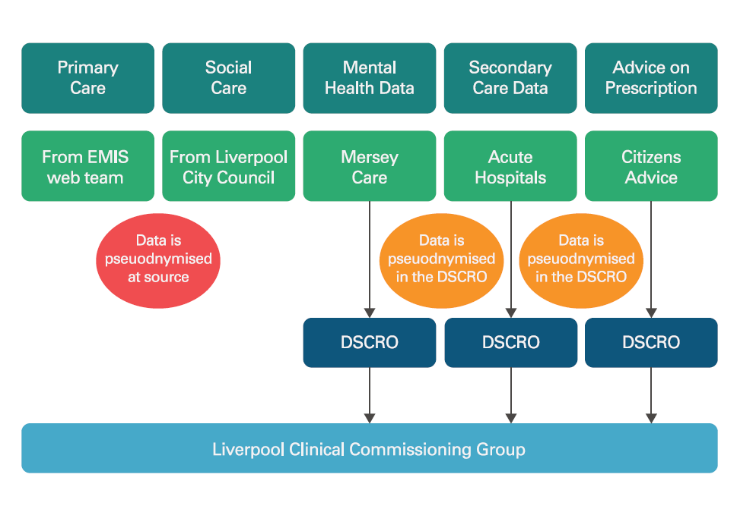
Linking multiple data-sets

Slide 10
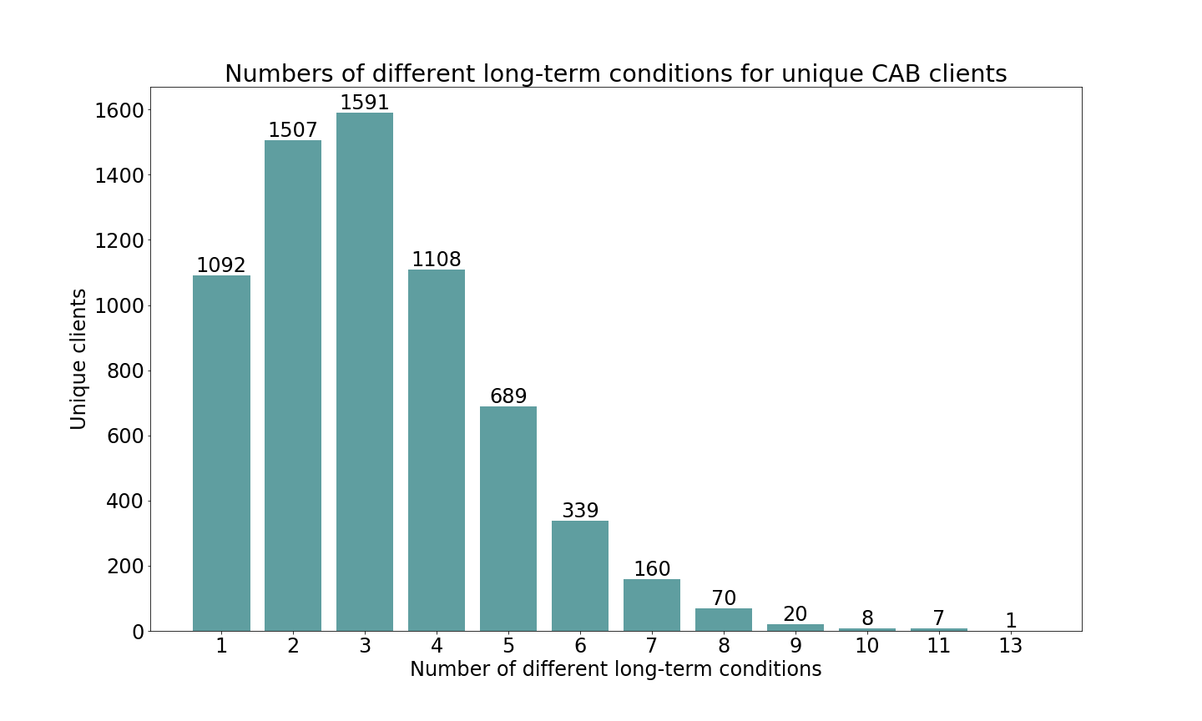
Data showed LCAP clients had multiple LTCs
Notes:
Analysis showed that the service was reaching patients of extreme low-income, working age, with multiple long-term conditions.
Higher prevalence of: COPD & other respiratory conditions, Anxiety, Depression, Bi-polar, Psychosis, Poisoning, Smokers,
More women than men, mainly working age adults
80% referrals from general practice,
20% from mental health services.
2/5ths of case load known to mental health services,
3/5th acute services - short-stay admissions for MUS & gastro

Slide 11
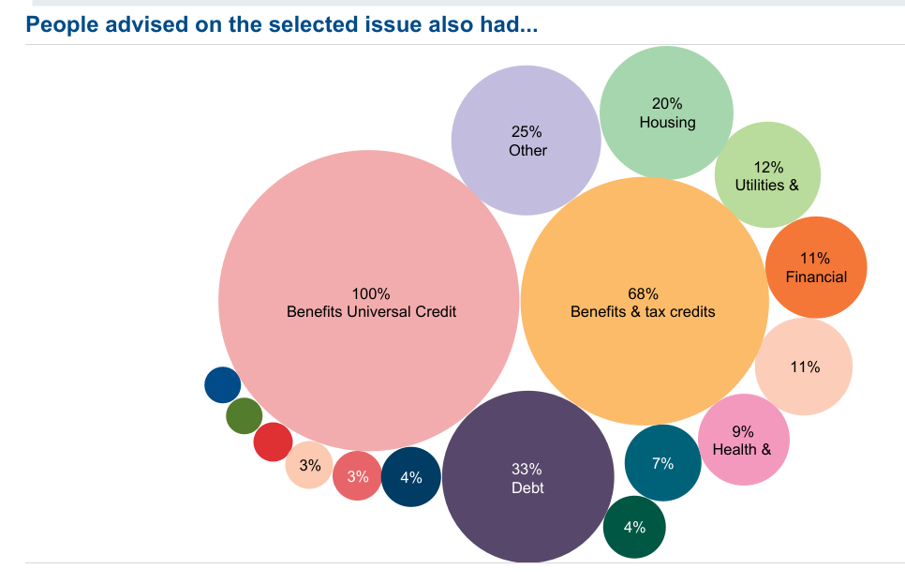
CA data shows patients have multiple needs
In 2021 - 22, CA data for England and Wales showed that amongst people who had a mental health issues and needed help with benefits:
68% needed support to access Personal Independence Payment (PIP) issues and tax credits
33% had a debt or money worry
20% had a housing issue
Notes:
other food banks and charitable support

Slide 12

Scale-up model
SETTING | 2015 | 2016 | 2017 | 2018 | 2019 | 2020 | 2021 | 2022 | 2023
Primary Care & SMI | 7043 | 8631 | 8978 | 9000 | 9000 | 9000 | 8000 | 8000 | 8000
Respiratory |  |  |  | 410 | 500 | 500 | 500 | 500 | 500
Perinatal |  |  |  |  |  | 250 | 1000 | 1000 | 750
Cancer |  |  |  |  |  | 350 | 500 | 600 | 600
ICCTs |  |  |  |  |  | 500 | 500 | 500 | 500
Other secondary care, LCC |  |  |  |  |  |  | 1500 | 1500 | 1500
Urgent Care/A&E |  |  |  |  |  |  | 500 | 500 | 500
TOTALS | 7043 | 8631 | 8978 | 9410 | 9500 | 10850 | 12500 | 12500 | 13000
Lead provider and alliance delivery model in place
Financially sustainable model, joint commissioned by LCC and LCCG
Alignment with needs-led commissioning of third sector/ community resilience
2021-23
April 2022
Full alignment with City recovery planning
Needs assessment with LCC and VCSE driving investment plan
Commence procurement of lead provider and services in scope
Continue to scale up and evaluate model
Dec 2020
Nov 2020
Workforce development plan in place
Digital platform procured and mobilization underway
Coherent shielded patient response in place
Scale up model into urgent care, perinatal and other priority health services
Oct 2020
June 2020

Slide 13




Evaluating the health impact and cost-effectiveness of Ways-to-Wellbeing, a whole system approach to mitigate poverty over the life course
Notes:
To add content, overtype the details of your presentation above. This will automatically pick up the font, Arial Black, which should be used throughout your presentation. Try to keep titles to at least 36pt and body text should be a minimum of 12pt throughout.
To add in a blank slide at any stage of the presentation, click on ‘Insert/New Slide’. This will pick up the blue colour of the presentation automatically, as well as the appropriate font.

Slide 14
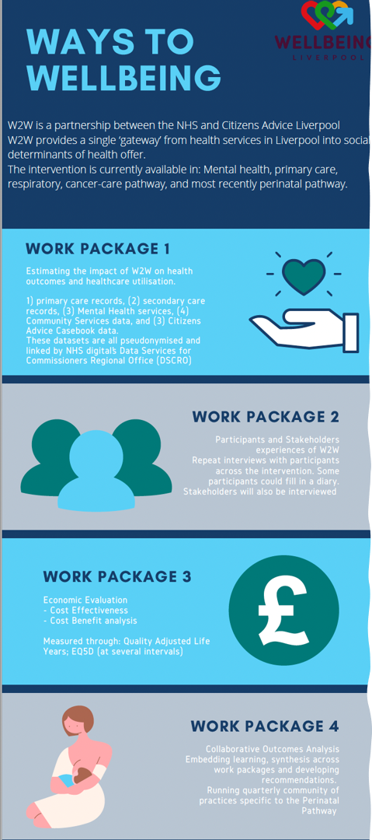

Slide 15


Citizens Advice on Prescription Liverpool
How it works

Slide 16

What is it?
An enhanced social prescribing service for Liverpool that provides a blended offer of social welfare and wellbeing support that focuses on reducing health inequalities & removing internal and external barriers to participation in community life:
Two linked but distinct parts:
Advice on Prescription - a social welfare - practical offer - advice and support in relation to benefits, debt, housing, employment
Ways to Wellbeing - a link worker offer provides awareness of and supported access to health enhancing activities in the community
Notes:
Move away from primary care

Slide 17
Citizens Advice on Prescription at NHS Liverpool (Short)

Slide 18
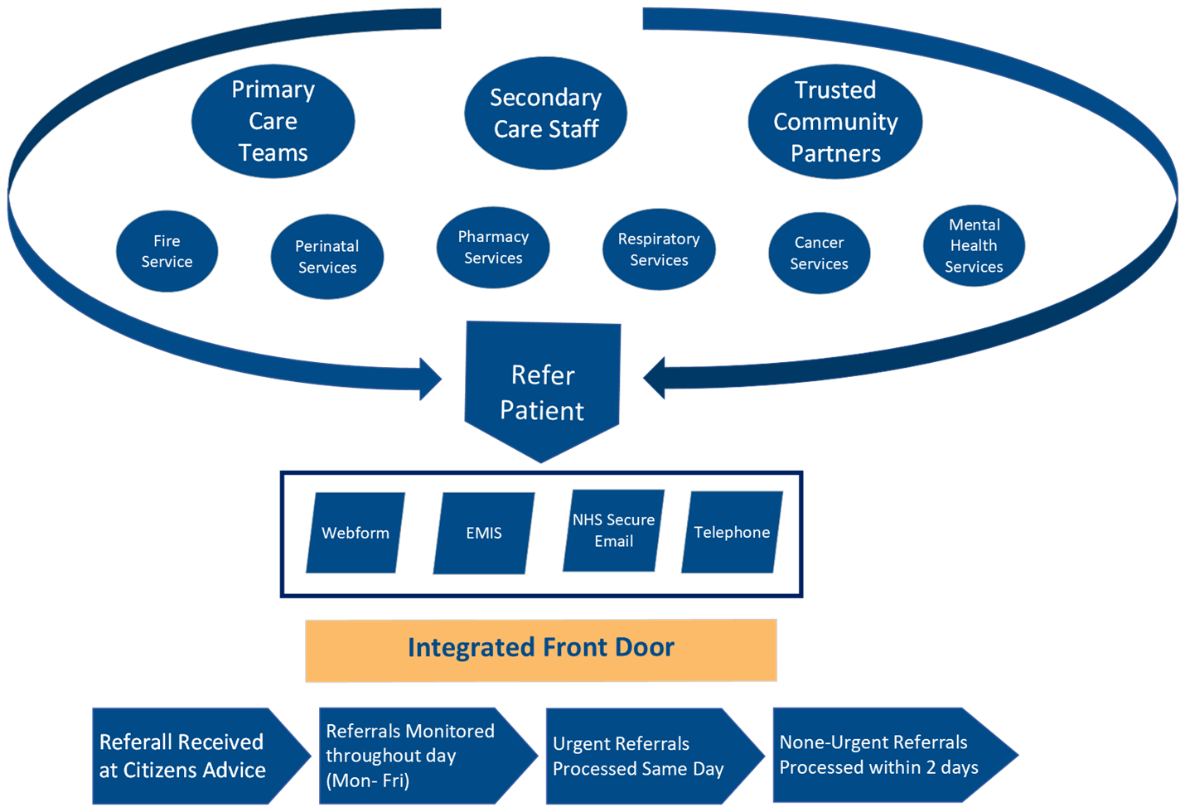

Slide 19
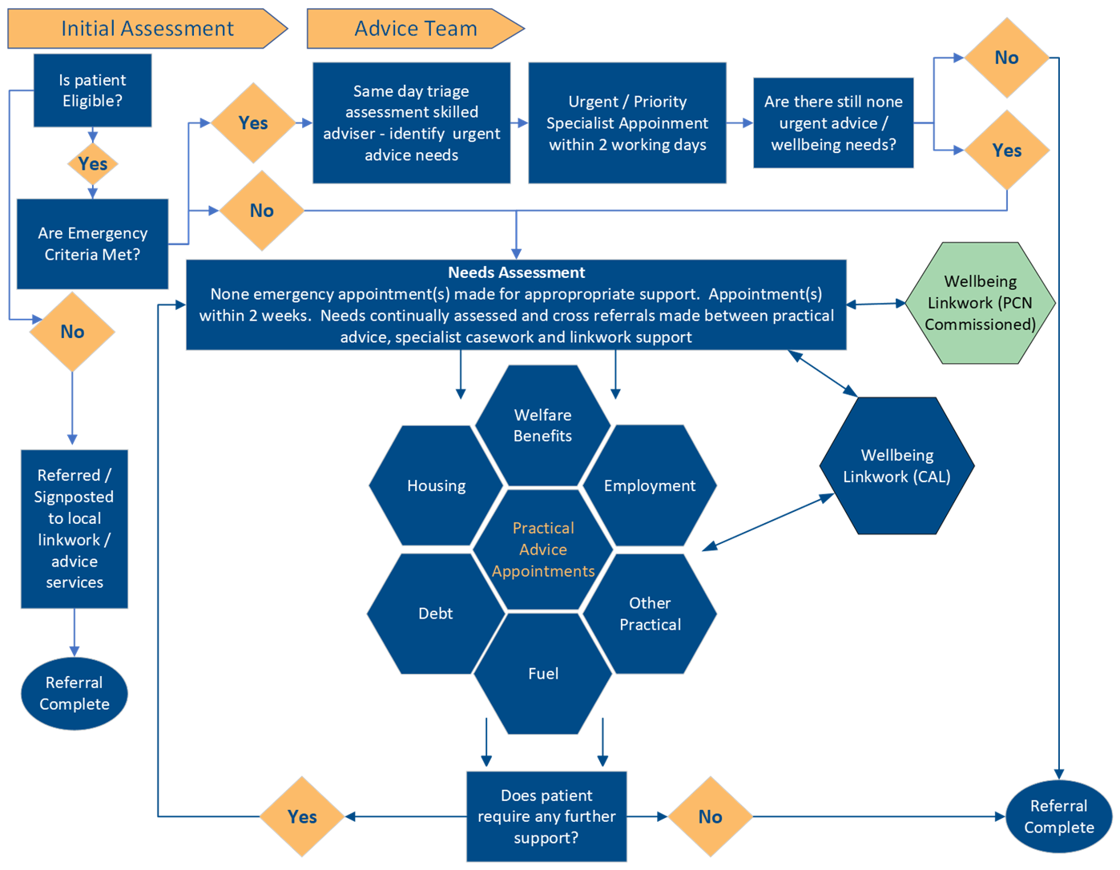

Slide 20
CASE STUDIES
Referred by GP - Lorna is a lone parent with two small children, working part-time as a carer.
She had presented for the third time in a month for help with headaches and requesting an increase in existing medication for depression and anxiety. When questioned by her GP it became clear that she had overwhelming debt and was facing eviction from her home.
The eviction notice that was due to be heard in the county court in 2 days’ time. She was distraught with worry over losing her home and perhaps because of this, even losing her children to local authority care.
The rent arrears were £700 and she had been prioritising payday loans and a bank overdraft and so did not have enough money, in any week, to pay her rent in full.
We were able to prepare a financial statement and refer her directly to a specialist housing adviser who accompanied her to court and presented her case. The possession order was suspended but to keep her home she will have to pay full rent and keep up payments on the arrears.
Our specialist debt worker supported Lorna to manage her debts and place holds on all pending bailiff action, and to manager other debts.
Lorna was offered support to work with community based agencies to build her confidence and skill base. She was referred to a local women’s organisation where she was supported to write a cv with a view to looking for better paid work.

Slide 21
CASE STUDIES
Referral and presenting issues
Mark is a 45-year-old man lives alone., no friends and relies on his elderly parents for company.
Referred by his GP following a presentation at surgery with his mother who was concerned about his anxiety and low mood.
Health Conditions:
Autistic Spectrum Disorder, Sleep apnoea, Depression, anxiety and low mood, Type II diabetes
PIP award refused on assessment, his income had fallen so drastically -unable to meet his outgoings and was considering moving in with his mother.
Mother frail and vulnerable and said that she didn’t feel able to cope with disruption of having her son move back home and so suggested that they visit their GP.
Contact
Appointment with welfare caseworker made within days of referral
Practical Advice and Support provided
A mandatory reconsideration re. PIP was lodged. Process can take many months.
In an effort to keep mark in his own home, Mark was supported to manage his income by reducing his weekly outgoings and access foodbanks/pantries, he was also being supported by his parents with a £50 a week loan.
Challenged DWP decision, award reinstated and income increased by £550 a month – supported by link worker to attend a slow walking group which he still attends weekly

Slide 22
What else are we most proud of?
System stewardship - collaboration and inclusiveness
New service for secondary care
Embedding social welfare into integrated care teams
Project to tackle health inequalities through perinatal pathways
Communities of practice that bring key stakeholders from along the pathways together

Slide 23
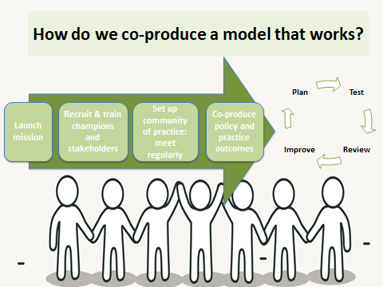

Slide 24

Challenges
Funding: NHS England £ millions of investment in social prescribing does not currently include a move towards integration poverty mitigation support into health services
Model assumes that general practice is the most accessible part of the universal health system – but general practice is changing rapidly and its hard to see the patterns
Impact of digitalisation is significant – drive is towards the digital, but that assumes that patients have access to working kit, that they are literate and digitally savvy etc
Role of public health? In Liverpool this initiative is sometimes perceived as too far downstream. One of the reasons we introduced the focus into integration along the perinatal pathway
System complexity – many moving parts

Slide 25
Summary
Our experience in Liverpool suggests that cities and towns where there are high levels of deprivation, need both elements: a social prescribing model that includes welfare advice at its core, providing the means to help patients mitigate the underlying causes of poverty wherever possible
Our ambition is to systematically equip all universal and first level health services with rapid access to a core determinants response
Our challenge is to ensure LCAP develops as an adaptive model that integrates with the various social prescribing schemes as they come on stream in Liverpool as well as the ever-changing landscape of health-care delivery

Slide 26

“I will remember that I do not treat a fever chart….but a sick human being, whose illness may affect the person's family and economic stability. My responsibility includes these related problems, if I am to care adequately for the sick”

Slide 27

Thank You
You can find some of the data sets referenced in this presentation here:
https://www.health.org.uk/improvement-projects/addressing-non-clinical-risk-in-people-with-long-term-conditions-and-multion
and here

