Slide 1
FPH Specialty Registrars’ Welcome and Induction Wednesday 28 September 2022
Welcome to the Faculty: Prof Kevin Fenton (President) and David Chappel (Academic Registrar)
Specialty Registars’ Committee: Fatai Ogunlayi (Chair, SRC)
ePortfolio: Gareth Cooke (Education & Training Manager)
Faculty Special Interest Groups and policy work: Julian Ryder (Deputy CEX)
Faculty exams: Fatai Ogunlayi and Cat Pinho-Gomes Vice Chair, SRC)
Q&A: Irfan Ghani (Director of Training)

Slide 2
Welcome to Public Health
Professor Kevin Fenton CBE PrFPH PhD
President of the Faculty of Public Health
Twitter: @ProfKevinFenton

Slide 3
Welcome and thank you!
Welcome to the public health training programme.
A light has been shone on public health for the past three years and there is no better time to join the specialty.
Thank you to our Academic Registrar, David Chappel, for inviting me to speak with you today, and for his fantastic work developing the new curriculum, and ensuring the training programme remains attractive and exams remain fair.
Thank you to all of you here today for the outstanding work you have delivered before starting the training programme. This is an incredibly competitive speciality to join, so congratulations.
As future public health leaders, the Faculty will do all it can to support and advocate for you as you journey through the training programme.

Slide 4
Drivers and influences on public and population health in the United Kingdom
Infectious Diseases
New COVID-19 pandemic phases; nosocomial transmission; staff sickness absence; monkeypox; influenza and other respiratory infections; public and staff vaccination programmes
Rising tide of NCDs
Pre-pandemic rises now accelerated; concerns about recovery of preventive and treatment services; multi-morbidity; increasing avoidable admissions and deaths
Health Inequalities
COVID-19 direct and indirect impacts; vaccine inequities; social and structural drivers which exacerbate risk of morbidity and mortality; need to have resolute focus.
Urgent and emergent threats
The post-pandemic economic, social and structural challenges; health and care system sustainability. Compounded by the cost-of-living, housing, social cohesion, climate & ecological crises - requires bolder, systems responses from us all
Building upon the COVID-19 lessons
The power of data and insights; multi-sectoral and multi-level partnerships; innovation engaging and empowering communities; tackling social and structural drivers of health; rebuilding trust and tackling misinformation
Workforce
Understanding post-pandemic challenges; future pipeline; workforce resilience; equality, diversity and inclusion; new skills and capabilities; connecting and integrating workforce for the public’s health

Slide 5
FPH Strategy 2020 – 25 Better Health for all – Leaving no one behind

Slide 6
Presidential priorities

Slide 7
Working with you
Public health training and registrars are at the heart of the Faculty’s work
We ensured the work of public health registrars during COVID-19 was recognised
We have recently revised the curriculum to bring it up to date
We have adapted exams over the past three years to allow the training pathway to continue
We have advocated for additional training numbers in public health
Many ways to get involved with the Faculty
Special Interest Groups working a range of issues (anti-racism, climate and ecological crisis, drug reform, academic public health…)
Faculty committees and Board
Registrar projects contributing to your training
Please contact myself or the Education & Training team to find out how to get involved.

Slide 8
David Chappel
Academic Registrar

Slide 9
Specialty Registrars’ Committee
Fatai Ogunlayi
Chair, Specialty Registrars’ Committee

Slide 10
Congratulations on your appointment to the Specialty Training Scheme
Welcome to our community of Specialty Registrars across the Four Nations.
This is an exciting time to be working to improve the public’s health as we work with partners to bring the pandemic under control and continue to protect the health of the public. Globally we are also focusing on the Sustainable Development Goals, nationally we are tackling UK priorities such as air quality and the integration of health and social care, and locally we seek to understand and address inequalities in health and the wider determinants – such as education and housing.
Together with partner agencies and the communities we serve, each day brings a new challenge. Whatever your interests and skills, this programme offers something for everyone!
This pack has been written by Registrars for Registrars and aims to:
Introduce you to the Faculty of Public Health (FPH) and Specialty Registrar Committee (SRC)
Summarise key elements of the Training Programme
Complement regional training programme inductions

Slide 11
FPH oversees the quality of public health training and professional development
FPH exists to:
Develop public health with a view to maintaining the highest possible standards of professional competence and practice, including through setting, monitoring and promoting standards in education and training for public health in the UK.
Promote for the public benefit the advancement of knowledge in the field of public health; and
Act as an authoritative body for the purposes of consultation and advocacy in matters of educational or public interest concerning public health.
The strategic vision is:
“To maximise effective public health action at local, regional, national and global levels by drawing on and supporting its members to deliver, influence and lead public health”
Take time to read “The UK Faculty of Public Health Strategy 2020-2025”

Slide 12
All Registrars enrol with the FPH. Membership offers additional benefits
Enrolment and Membership cost:
All Registrars are required to enrol with FPH and pay the first annual Training and Membership fee within three months of commencing the training scheme.
For 2022 the Registrar Training and Membership fee is £298 (fee subject to annual review in line with inflation).
FPH fees (including exam fees) can be claimed against tax as work expenses by HMRC.
Membership Benefits:
A free subscription to our quarterly Public Health Journal.
A monthly e-bulletin with updates on FPH, wider public health news, and opportunities to get involved.
Dedicated online members area with your resources and public health profile, and FPH Extra (discounts off products & services).
Access to Special Interest Groups (SIGs); our member led networks focused on particular themes such as transport or global public health.
Keep an eye out for your invitation to join as a member from Marijana Curic
Notes:
Membership and examination fees frozen for a second year running

Slide 13
The Specialty Registrar Committee (SRC) is here to ensure your views are heard
Our Vision Statement
The SRC is a formal subgroup of the FPH Education Committee.
Its purpose is to represent the interests of Specialty Registrars in Public Health from across the UK, ensuring the views of registrars are heard at FPH Committees.
Those views may be in relation to FPH policy, national consultations, business and project objectives, training, the practice of public health, and to the maintenance and improvement of population health.
Your Involvement
Each region nominates two registrar representatives (four for London).
SRC reps attend regular meetings, act as SRC rep on other FPH committees, and engage with one or more of the SRC’s priority workstreams.
Find out who your regional SRC Rep is, and how you can get involved!
Notes:
DFPH used to be January and June, now moved to March and Oct – example of where FPH has responded to Registrars / SRC feedback (impact on holidays, childcare, and changeover).

Slide 14
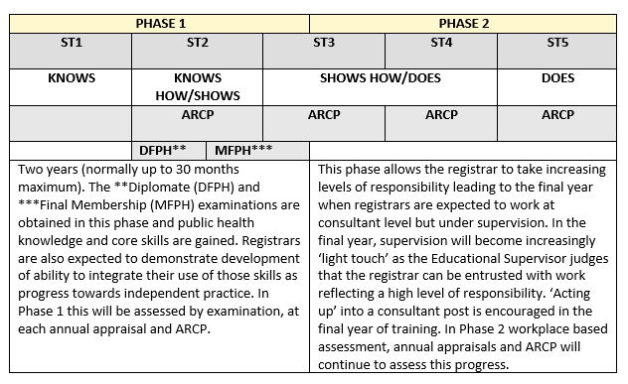
Specialty training generally lasts 5 years*
*shorter for those who arrive with a Masters in Public Health and longer for those who train less than full time or take time out of programme (OOP).
For more info visit: FPH website
The Gold Guide sets out the overarching arrangements for speciality training.
Notes:
In Phase 1 you’ll focus on acquiring key skills and knowledge – as evidenced by completing a Masters in Public Health, passing the FPH Diplomate Exam (DFPH), and signing off learning outcomes through your portfolio of work.
In Phase 2, you’ll consolidate core competencies in generalist settings and develop special interests – as evidenced by passing the Final Membership Exam (MFPH), and signing off further learning outcomes.
StRs have an Annual Review of Competencies and Progression (ARCP)
The DFPH and MFPH will be covered in more detail later on on the presentation.

Slide 15
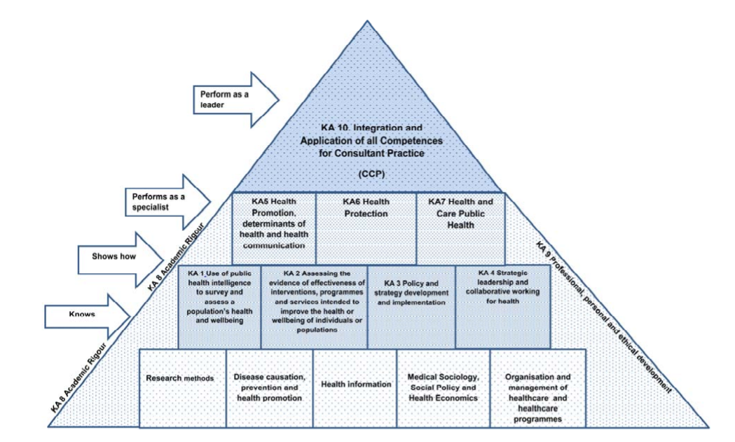
The curriculum describes the learning outcomes for Registrars through training
Download the 2022 curriculum here
Figure: Miller’s adapted model of learning for public health

Slide 16
Over time, you’ll gain experience in a number of settings
Mandatory placements | Local authority or health board Health protection
Subsequent placements | E.g. Academic, Hospital, Commissioning organisation, Public health organisation etc.
National opportunities | Nationally Available Training Placements FPH projects
Out of Programme (OOP) | Training (OOPT), Experience (OOPE), Research (OOPR)
Talk to your Training Programme about out of programme / overseas options
Notes:
Mandatory include an organisation that delivers broad range of public health functions (e.g. LA or HB). Health protection is another mandatory placement (
Subsequent placements: Depends on educational needs (competency), area of interest, career goals. Determined by locally – speak to TPDs
NATP – Opportunity to acquire specific or contextual experience usually at a national level
FPH Projects: Normally generated by the Faculty or by a Special Interest Group (SIG) within the FPH

Slide 17
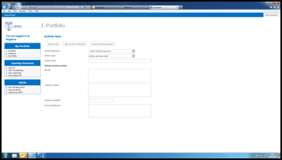
Reflective practice is intrinsic to specialty training and professional practice
Registrars use the FPH ePortfolio to evidence and reflect on work and activities completed in line with the required learning outcomes.
Supported by your educational and academic supervisors, SpRs consider:
What went well.
What was more challenging.
How this changes their practice moving forwards.
What (if any) new learning needs you have identified.
For more information on ePortfolio see here.
Keep an eye out for your invitation to sign up and start using ePortfolio
Notes:
Key to this is to engage early on – don’t wait till ARCP (annual review)
Gareth will say more about e-portfolio later on.

Slide 18
Throughout training, you’ll be supported and assessed year on year
Support is available from a number of sources:
Educational Supervisor – oversees progress and provides training and supervision, appraisals and reporting.
Academic supervisor – provides specific input e.g. research opportunities, exam preparation, academic placements.
Project supervisors – provide day to day support.
Training programme director – overall help and guidance.
Other registrars – for peer support e.g. buddy on arrival, local networks.
Your progress – as evidenced by your ePortfolio and supervisor reports - is assessed at your ARCP.
Satisfactory completion of training leads to registration with either the General Medical Council (GMC) specialist register or the UK Public Health Register (UKPHR).
Registration is mandatory to practice as a consultant in public health in the UK .
Familiarise yourself with your Training Programme’s Educational Supervisor Toolkit
Notes:
Some of these differ between deaneries (some also have clinical supervisors and not all have academic supervisors)

Slide 19
There’s plenty of opportunity to connect with the wider public health community and keep up to date
Inter-
national
Join FPH Special Interest Groups (SIGs) e.g. Public Health Africa and the European Network of Medical Residents in Public Health (Euronet).
Email for Euronet UK
National
Join the Registrar Google Group https://groups.google.com/g/phtraineenetwork; attend conferences e.g. FPH, Public Health England; join FPH Network SIGs
Regional
Get involved with activities via your Training Programme e.g. communications platform, committees, journal club, learning sets, conferences.
Personal
Keep up to date by signing up for e-newsletters, podcasts, twitter feeds or blogs… (see next slide for ideas).
Discuss your study budget with your Training Programme and look out for opportunities advertised
18
Notes:
Julian will say more about SIGs

Slide 20
Lastly, a few ideas from the SRC to get you going….
Follow (e-newsletters, twitter etc.): BMJ, HSJ, DH, PHE, King’s Fund
Journals: JPH, EJPH, The Lancet, BMJ
Podcasts: Lancet (quite a few), BMJ (quite a few), BBC (Inside Health, More of Less: Behind the Stats etc.), Training in Public Health, Sawbones
Blogs: PHE Screening, PH matters (PHE), Local Democracy and Health
Tools to make life that little bit easier:
Surveys: SurveyMonkey and Google forms
Scheduling: Doodle
Poll: Poll Everyone
Create infographics: Easel.ly and Infogram
Reference Management: Mendeley
If you have any suggestions to add to this list, let your SRC Rep know!

Slide 21
Above all, if you have any questions, do please ask!
Fatai (SRC Chair) can be reached at fatai.ogunlayi@nhs.net
FPH is always happy to help and can be contacted via: educ@fph.org.uk

Slide 22
FPH e-Portfolio
Gareth Cooke
FPH Education and Training Manager
Notes:
The FPH electronic portfolio (ePortfolio) system provides Specialty Registrars with a central platform for the management of information and documentation on progression of learning against the public health specialty training curriculum during their time in training. The ePortfolio allows trainees to relate documentation and evidence to the curriculum and incorporates the ability to record various sign offs.
To access the ePortfolio please click here.
The training ePortfolio is managed by the registrar who must reflect on and record their achievements on an on-going basis. It is intended to be used as a complementary tool to aid in the recording of training activity, and monitoring progression along with regular meetings with Registrars and their supervisor.
More info available on FPH website: https://www.fph.org.uk/training-careers/specialty-training/training-eportfolio/

Slide 23
Education & Training Team
Support for Registrars throughout training . . .
Enrolments
CCT
Exams
OOP
ePortfolio
All queries to educ@fph.org.uk

Slide 24
Evidence ...
Notes:
Evidence is uploaded as part of the sign off process for Learning Outcomes.
Please remember that evidence containing confidential/sensitive information evidence uploaded to the system should be redacted where appropriate.
Your Educational Supervisor or Training Programme Director should be able to advise on what is appropriate evidence to upload to the system.
Go to My Portfolio > “Evidence”
· The list shows all the evidence added to the system by the Registrar. The items on this page can be sorted by Evidence Name, Date Added etc.
· The “Search bar” allows the filtering of the results in the Evidence Dashboard.
· Please note that users should avoid using non-alphanumeric symbols in the naming of their evidence as this can cause difficulties in downloading evidence from the system.

Slide 25
Learning Outcomes . . .

Slide 26
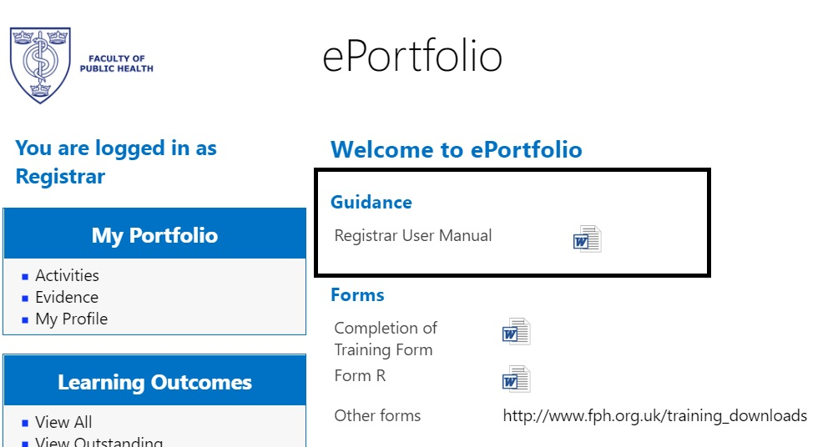
ePortfolio User Manual available on system
Links to demo 1 and demo 2
Notes:
An ePortfolio User manual is available on the ePortfolio login page.
The following links will take you to video demonstrations of how the ePortfolio works and steps needed to upload evidence, submit Activities and how Learning Outcomes are signed off.
https://www.youtube.com/watch?v=A_9iYcOwWt8 and https://vimeo.com/175849496
Both videos were created by Public Health Registrars.

Slide 27
Resources
Education and Training team: educ@fph.org.uk
ePortfolio Champions

Slide 28
FPH Special Interest Groups
Julian Ryder
FPH Deputy CEX and Director of Education, Standards & Advocacy
Notes:
Introduction

Slide 29
Context
The Faculty of Public Health currently has:
4,000 members – mainly UK but all over the world
27 active committees – ‘lifeblood’ of a membership organisation, essential to governance
32 SIGs, each reporting to a committee
17 staff (16 WTEs) – focussed on the ‘must do’s’

Slide 30
Special Interest Groups (SIGs)
What are SIGs are what do they do?
Groups of Faculty members with an interest in a specific policy area
Source of knowledge and expertise for FPH
Support workforce training and development
Improve public health policy at a local, national, and global level
Promote new research and lead the public health response on a range of issues
Who can join the FPH SIGs?

Slide 31
Faculty SIGs and who they report to
Health Protection Committee
Health Protection (E&T)
Equality & Diversity C’ttee
E&D
Ethics Committee
Ethics
Academic & Research Committee
PH Educators in Med Schools
Public Health Information & Intelligence
Academic Public Health
Global Health Committee
Sudan
Global Violence
Europe
Africa
India
Yemen
Pakistan
Health Improvement C’ttee
Alcohol
Health Economics
Food
Healthy Places
Arts & Health
Spatial Planning
MSK
Oral Health
Public Health Film
Transport
Poverty
Health Services Committee
Adult Social Care
Primary Care
Sexual Health
Drugs
Genomics
Climate & Health C’ttee
Sust Devt
Advocacy & Policy Committee
CYP and BACAPH
Mental Health
Notes:
We are not prescriptive about the topic area or work programme of existing or proposed/new SIGs, but they must be established in line with the Faculty’s overall strategic priorities
SIG members need to be FPH members (associates at least)
SIGs need to develop an annual work plan which relates to that of the parent committee and report back on progress mid and end year
Submit all substantive public-facing work to the parent committee for sign-off (consultation responses, reports, discussion documents, position papers etc)
All SIG work should be appropriately signed off and badged as Faculty policy
Work with the Faculty’s Communication Manager on all media work

Slide 32
Role of the SIGs
SIGs are convened by FPH members to tackle some of the most pressing issues facing the public’s health today
The Faculty has 4,000 public health experts in its membership and the SIGs are the best way to harness that expertise
SIGs provide our members with a platform to speak out in one voice on a particular topic
They shape and lead Faculty policy in a number of fields and provide additional ‘reach’ and engagement which the Faculty can’t always do centrally
They provide the Faculty with a source of expertise and support across all areas of our work

Slide 33
Faculty support for SIGs
SIGs are self-administered, but….
SIG webpages
Media and publicity – link to Faculty social media reach (20k Twitter followers, YouTube, Facebook, website, members’ e-bulletin)
Possible StR projects to support specific learning outcomes (e.g. climate change)
Access to TC and VC facilities and meeting rooms in FPH’s office (when we’re fully open again, though increasing expectations around remote meeting)

Slide 34
Recent policy areas
Changing policy landscape
Recent areas of focus:
Equality and diversity
Climate change
Drugs
Afghanistan
Alcohol
Food poverty
Blood pressure/CVD
Health inequalities (COVID-19)
Notes:
Equality and Diversity Special Interest Group
The equality and diversity SIG aims to bring together registrars and consultants with a common interest in issues of equality and diversity within the public health training programme as well as the wider public health of the population
Our focus over the past year has been to examine and ensure fairness and diversity in recruitment to the training scheme with the strong belief that a diverse public health workforce is a better workforce.
We aim to offer a national career mentoring scheme early next year for ethnic minority registrars in public health.
We are in the process of developing a new work plan for next year to address inequalities outside of ethnicity such as those relating to disability, LGBTQ+ and other protected characteristics.
ACADEMIC SIG
SUSTAINABLE DEVT SIG
FPH Health Protection (Education & Training) SIG

Slide 35
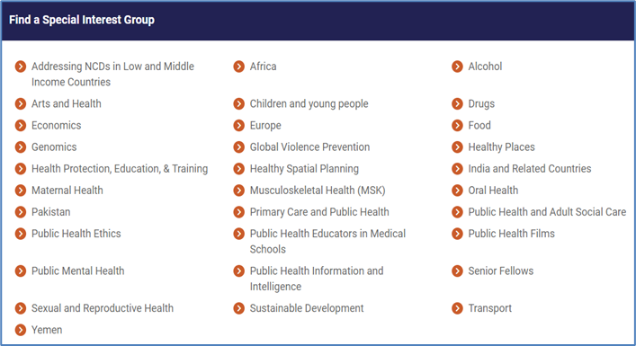
Where to find the SIGs…
FPH Homepage > Policy and Campaigns > Special Interest Groups

Slide 36
FPH Examinations – Diplomate (DFPH Exam)
Cat Pinho-Gomes
StR representative, Diplomate Exam Development Committee

Slide 37
Diplomate (DFPH) Examination
“Knows how” exam, detailed syllabus
Two papers, two days
Paper 1: knowledge
Two parts: 1A (2h30) and 1B (1h40)
10 structured questions (10 marks each) on:
Research methods
Disease prevention / health promotion
Health information
Medical sociology, social policy, health economics
Organisation and management of healthcare

Slide 38
DFPH Examination
Paper 2: Skills
2A (2h30): critical appraisal & follow-on Qs on PH theme [50 marks]
2B (2h): practical stats and epi [50 marks]
Notes:
E.g. of follow-up Qs: Draft a reply to your local politician or write a media bulletin
Time on 2B has been extended to 2 hours

Slide 39
DFPH Examination
Preparation
3-4 months (?)
No reading list
Past papers (2011 – 2017)
Hints and tips from examiners
Specimen Qs for paper 2B on FPH site
Ask your Training Programme
what support for exam preparation is available to you.
Notes:
FPH no longer publish past papers - retained in a reusable question bank

Slide 40
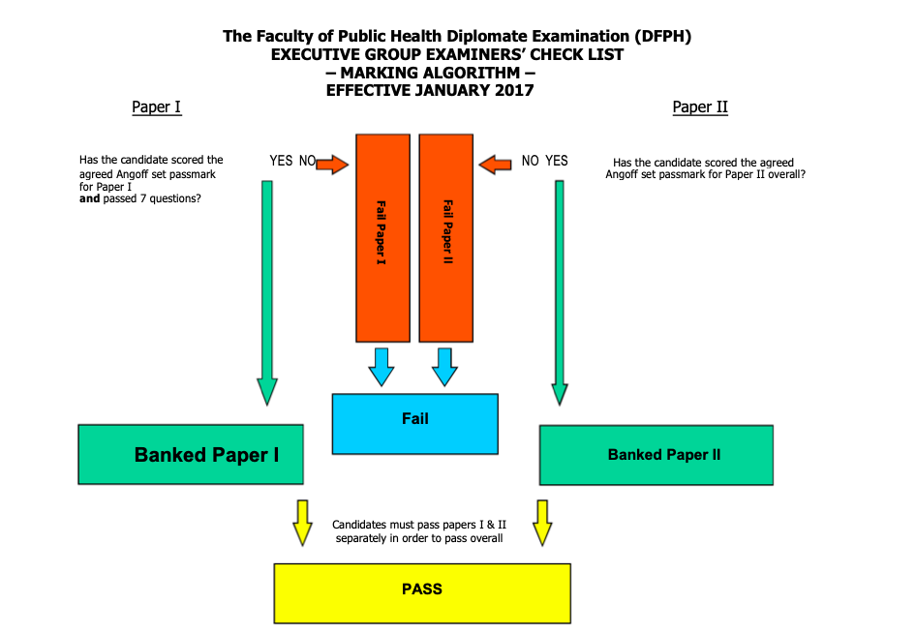
DFPH Examination
Marking algorithm
Can “bank” a paper

Slide 41
DFPH Examination
Online format from November 2020
Same content
More information here
Contact exams team: educ@fph.org.uk

Slide 42
Membership Examination MFPH)
Fatai Ogunlayi
Chair, Specialty Registrars’ Committee
Notes:
Formerly known as the Part B
Officially known as Final Membership Examination.
Sometimes called the Objective Structured Public Health Examination (OSPHE).
This is a brief overview of the exam.

Slide 43
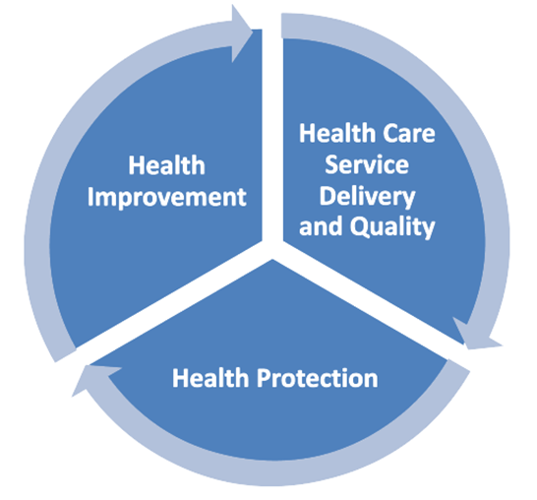
Membership (MFPH) Examination
“Shows how” assessment
6 scenarios, ~2 hours
Application of knowledge (syllabus), skills and attitudes to the practice of public health
Sit 6-9 months after DFPH, 2 years from end of training
Notes:
This is a “show how” role-play assessment of a candidate’s ability to apply relevant knowledge, skills and attitudes to the practice of public health
It is an an approximately 2 hour practical assessment made up of 6 scenarios.
The scenarios are chosen to represent everyday public health issues in commonly experienced settings across the three domains of public health practice: health improvement, health protection, healthcare public health.
Real-life scenarios often based on the experiences of examiners who write the scenarios. Example - radio interview about vaccinations, or meeting with councillor about suicide rates in local area.
What is being assessed?
Application of theory to practice, therefore not a strictly content-based exam - not expected to regurgitate the entirety of Part A syllabus

Slide 44
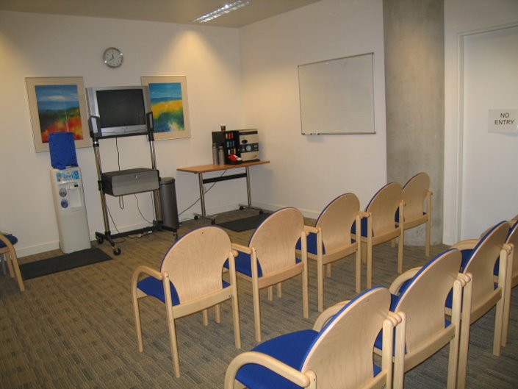
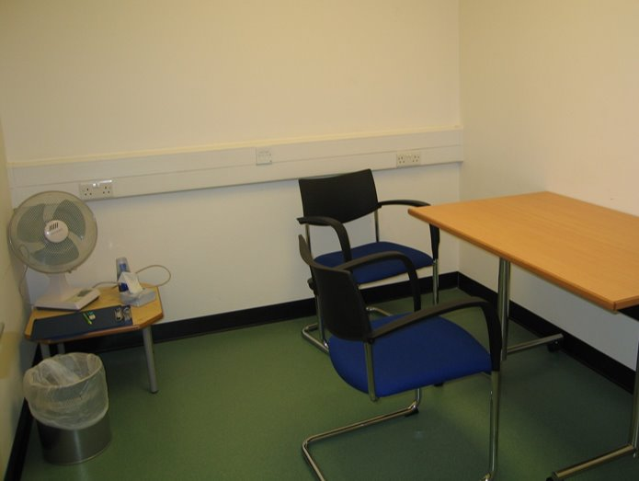
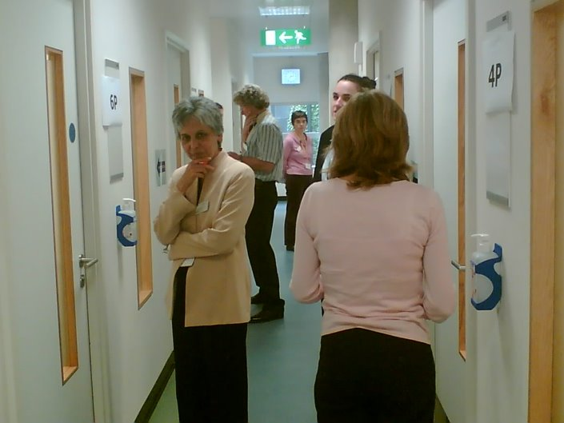
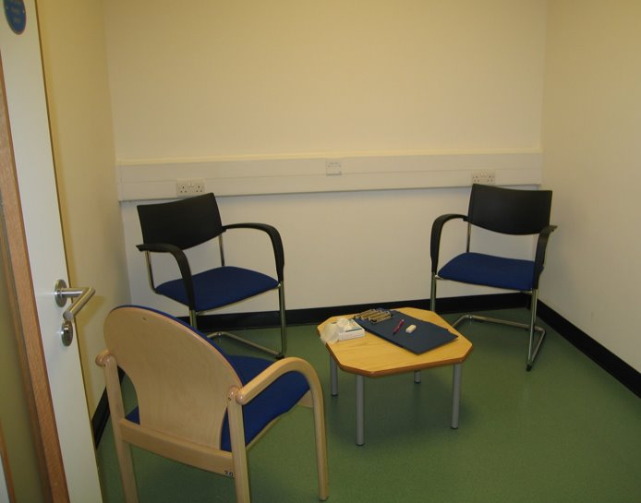
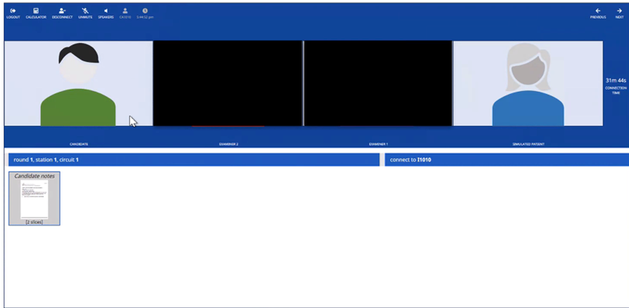
MFPH Format
Briefing room
Prep room
6 scenarios, cycle:
8 minute preparation station to review briefing material
1 minute transfer time
8 minute examination station
1 minute transfer
~ 2 hours, guided through stations by facilitators
Mix of professional actors and public health professionals as role players
Online from November 2020 (Pratique), will revert to face to face September 2022*
Transfer corridor
Exam room
Online Pratique platform
Notes:
The MFPH takes the form of six scenarios.
Each scenario will have a 8 minute preparation station in which you review briefing material - this can be some data for example
Each examination station also lasts 8 minutes - here you will have a discussion with the role-player, this discussion is scripted so all candidates in that sitting are asked the same questions
You have approximately one minute to transfer from the prepaparton to examination station for each scenario
Sounds complicated - but do not worry, plenty of facilitators to guide you round
*subject to national COVID guidelines.

Slide 45
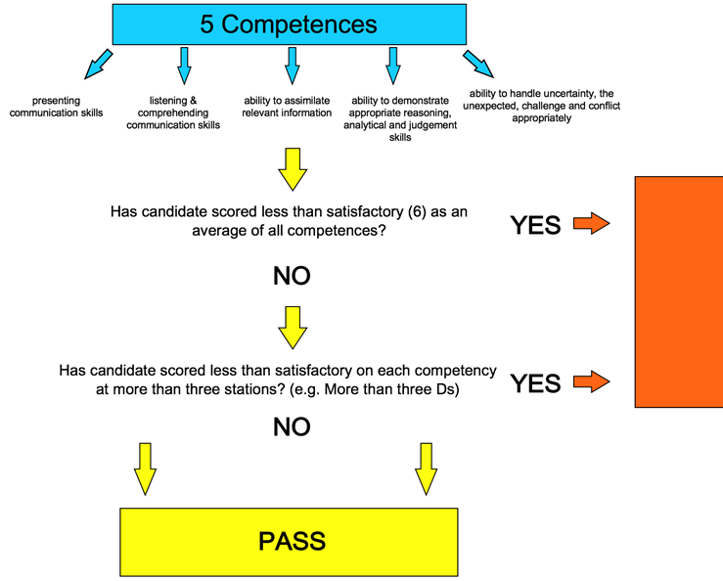
MFPH - Competencies assessed
Communication skills: presenting (verbal and non-verbal)
Communication skills: listening, comprehending, responding
Assimilating & using relevant information
Reasoning, analytical and judgement skills; giving a balanced view
Handling of uncertainty, the unexpected, challenge and conflict
Notes:
In each examination station, a role player and an examiner assess candidates across the same five competency areas at every station
Graded A-E, with A being excellent, B being good, C being adequate, D being just below adequate and E being poor.
Need an average of C for each competency to pass, with at least a C in 3 stations - so possible to do less well on two stations, but still pass by doing well in other stations.
Transition: Resources
5 Competencies:
The ability to demonstrate presenting communication skills (verbal and non-verbal) appropriately in typical public health settings: presenting to a person or audience
The ability to demonstrate listening and comprehending communication skills (verbal and non-verbal) appropriately in typical public health settings: listening and responding appropriately
The ability to assimilate relevant information from a variety of sources and settings and using it appropriately from a public health perspective
The ability to demonstrate appropriate reasoning, analytical and judgement skills, giving a balanced view within public health settings
The ability to handle uncertainty, the unexpected, challenge or conflict
Marking
Using marking guidance, the examiner grades each competency A-E, with A being excellent, B being good, C being adequate, D being just below adequate and E being poor. These grades are later converted into numerical scores and then combined to produce an overall exam score and an average for each of the five competency areas.
A candidate awarded a C for each competency at all six stations would indicate a pass overall. However, the marks for each competency are averaged, so it is possible to do less well on, say, two stations, and yet still pass overall by getting marks higher than a C at other stations. The other requirement for a pass is that each competency area must be marked at C or above at half or more of the stations.
Outcome is pass or fail. There are awards available for top performing candidates.

Slide 46
How to prepare
Use your placements to gain relevant experience
Get started 6-8 weeks prior to exam
Familiarise yourself with MFPH website
Practice, practice, practice
Set up revision group
Public health colleagues including supervisors and consultants
Friend and families (especially layperson scenarios)
Make use of national and local resources (see next slide)
Do a mock if you can
Take study leave

Slide 47
MFPH Resources
MFPH page on FPH website (including FPH scenarios)
Useful blogs and articles:
https://academic.oup.com/jpubhealth/article/38/1/189/2362659
https://www.drcath.net/hot-desk1/part-b-exam
https://betterhealthforall.org/2019/08/05/top-10-part-b-exam-tips-from-kevin-smith-part-b-examiner/
https://betterhealthforall.org/2018/06/06/the-winner-of-the-2018-fph-mcewan-award-shares-her-advice-on-preparing-for-the-part-a-exam/
Deanery tutorials, mocks and peer-produced resources
National WhatsApp revision group
Contact exams team: educ@fph.org.uk
Ask your Training Programme what support for exam preparation is available to you.

Slide 48
Your questions
Irfan Ghani
FPH Director of Training and Public Health Consultant

