Slide 1
THE British Society for the study of community dentistry (BASCD)
FPH - Oral Health Special Interest Group
Charlotte Jeavons Oral Health Improvement Lead 2022/23 | Maria Morgan Immediate Past President 2022/23

Slide 2
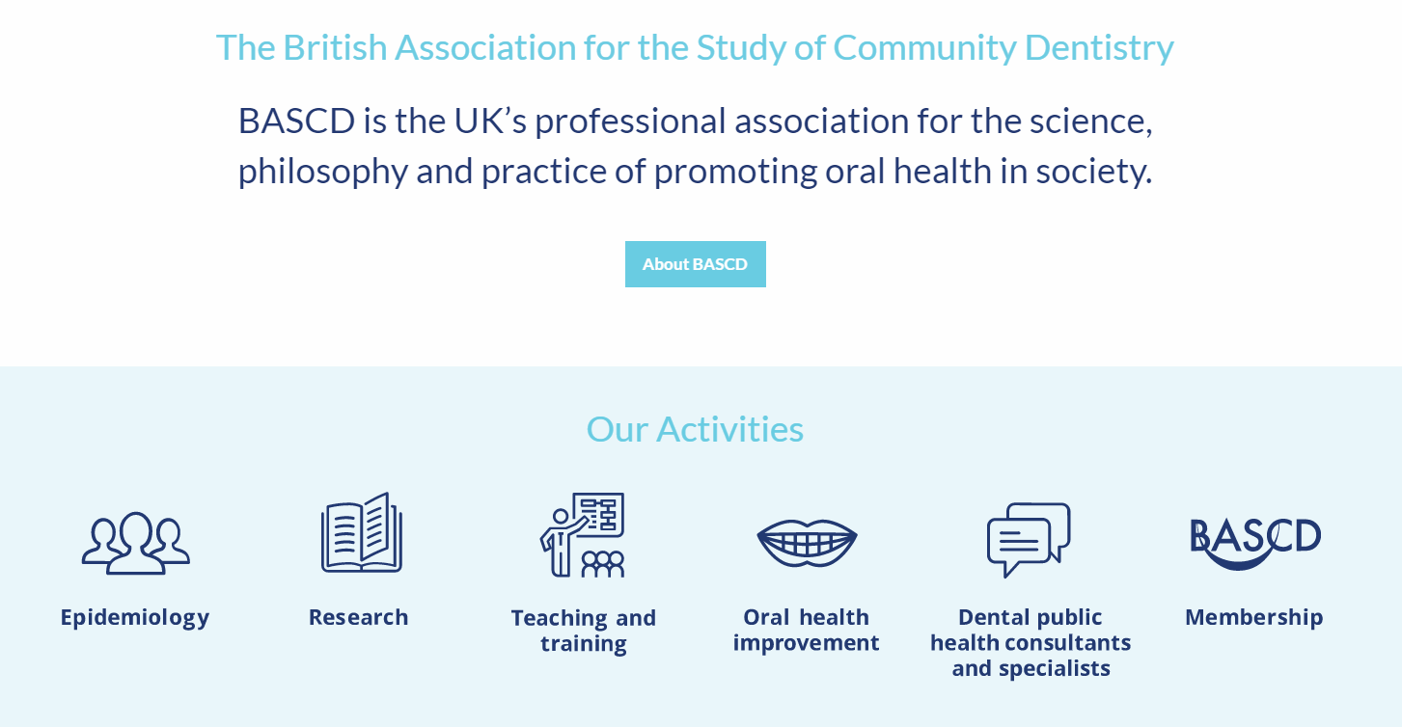
Who are we?

Slide 3
What do we do?
Drive, with passion and determination, the promotion and improvement of population oral health and the prevention of poor oral health by:
  Bringing together multidisciplinary skills and teams to make an impact on health inequalities in communities
  Providing strong leadership to both its members and organisations that have a stake in population oral health
  Lobbying on issues, policies and practices that it knows makes a difference
  Enabling and supporting members, through education and training, to implement strategies and policies

Slide 4
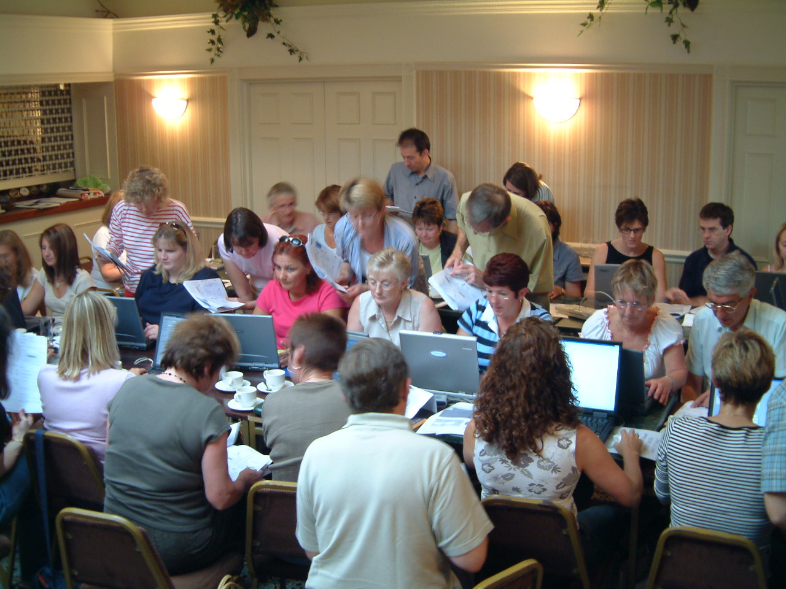
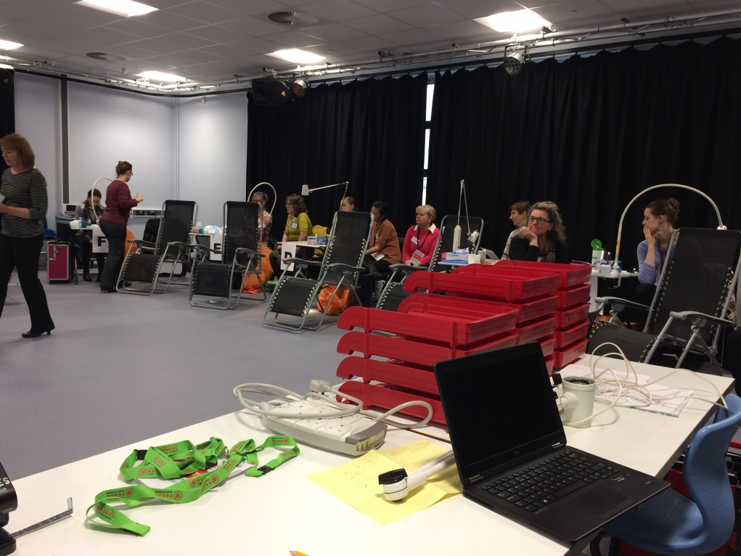
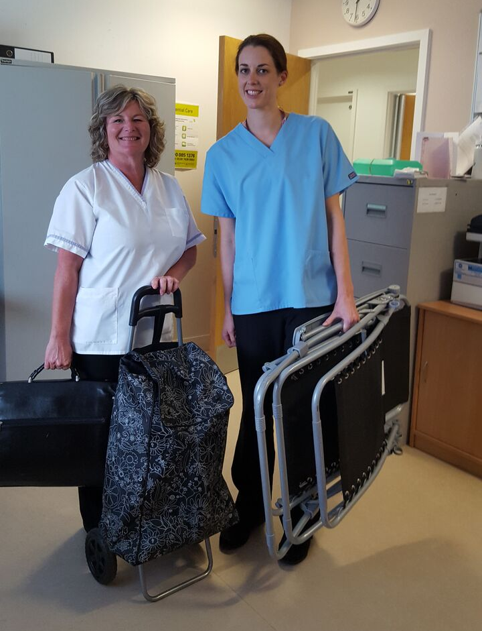
epidemiology
Community Dental Services “public health in action”

Slide 5
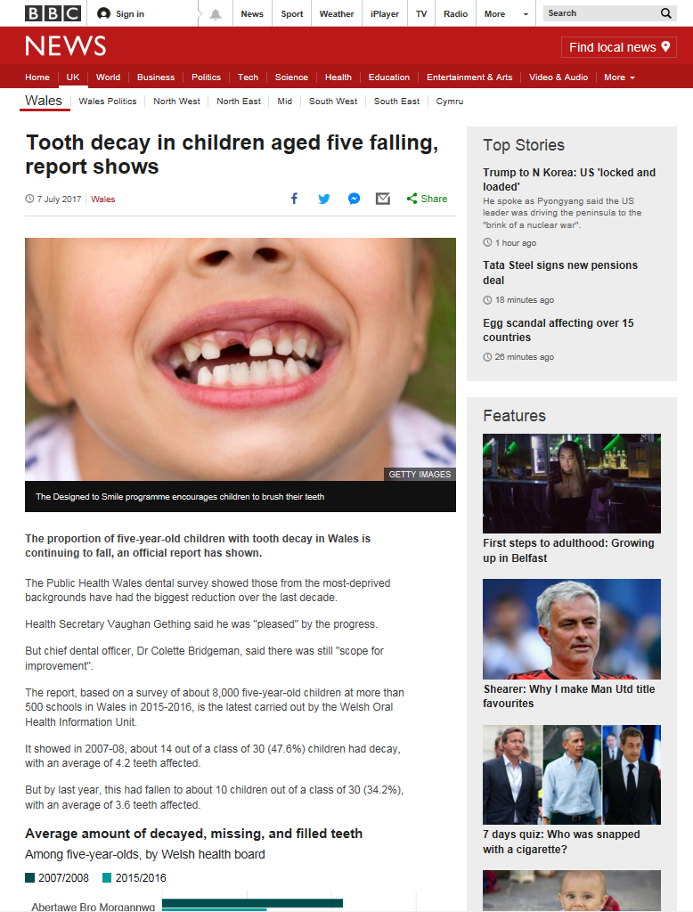
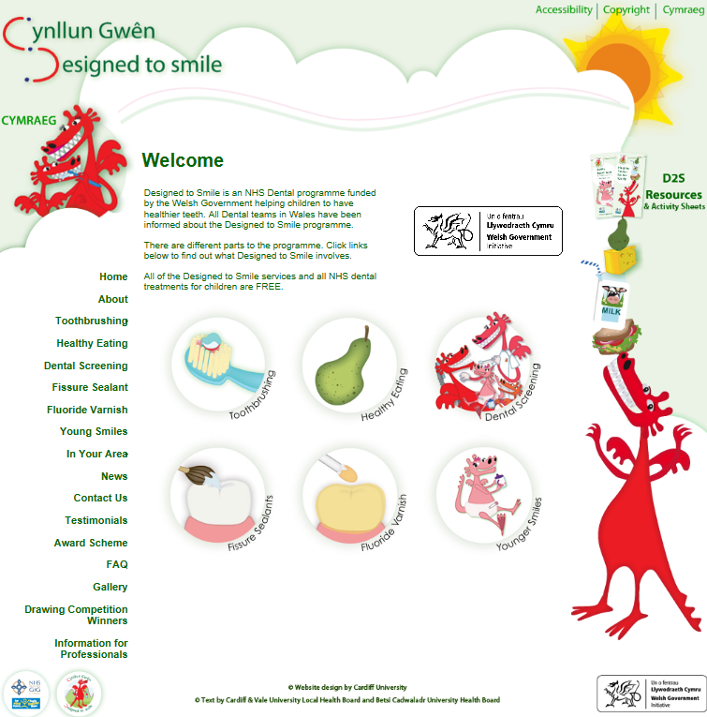
Evaluate services and health promotion initiatives

Slide 6
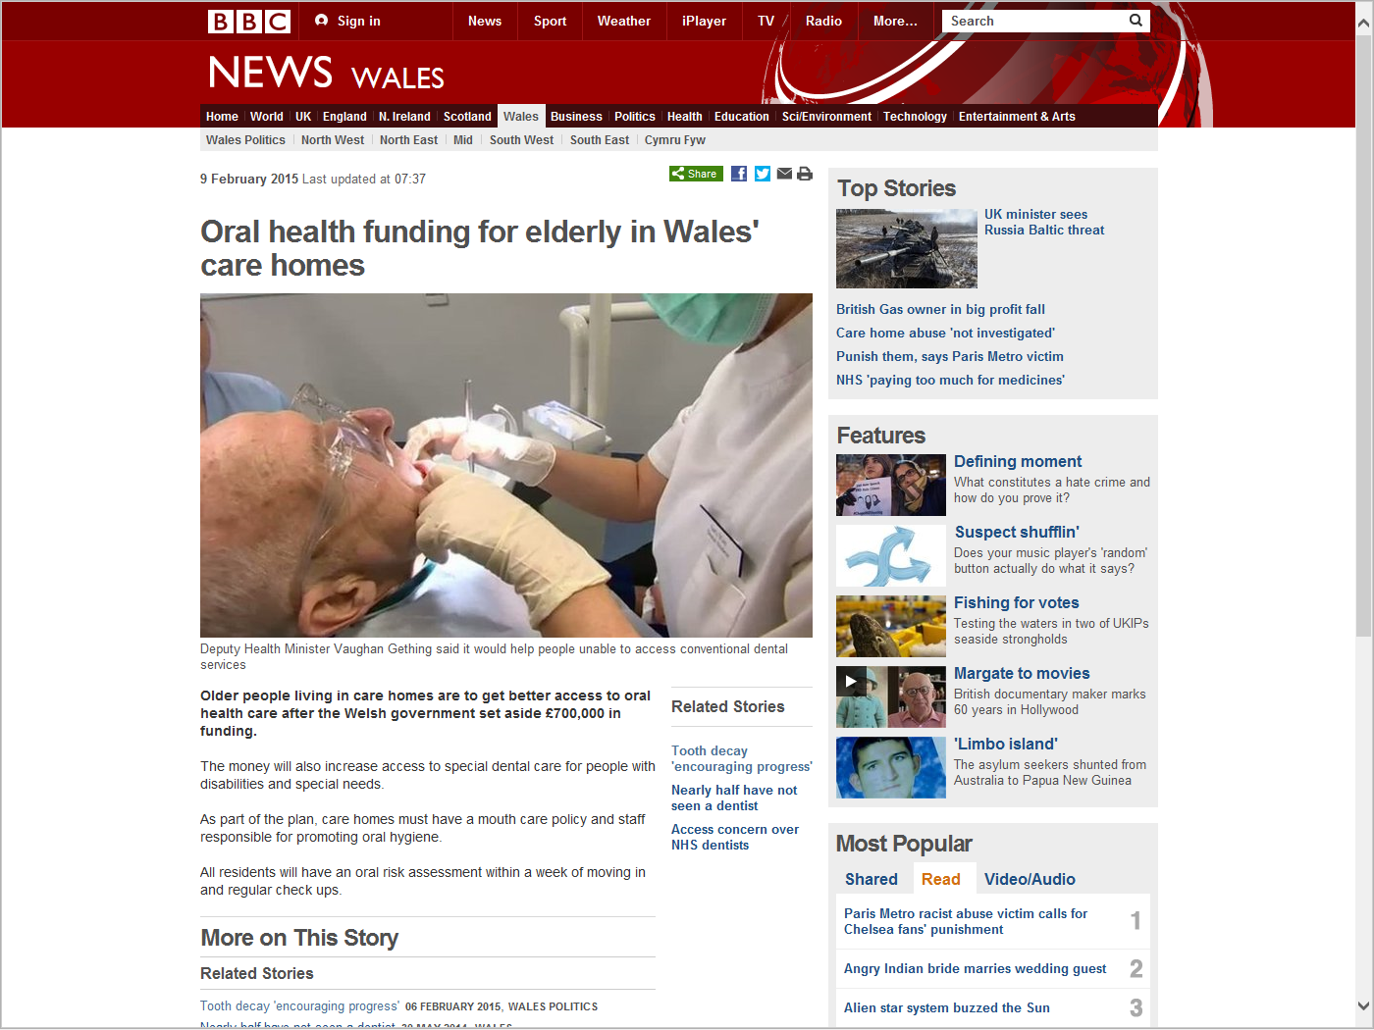
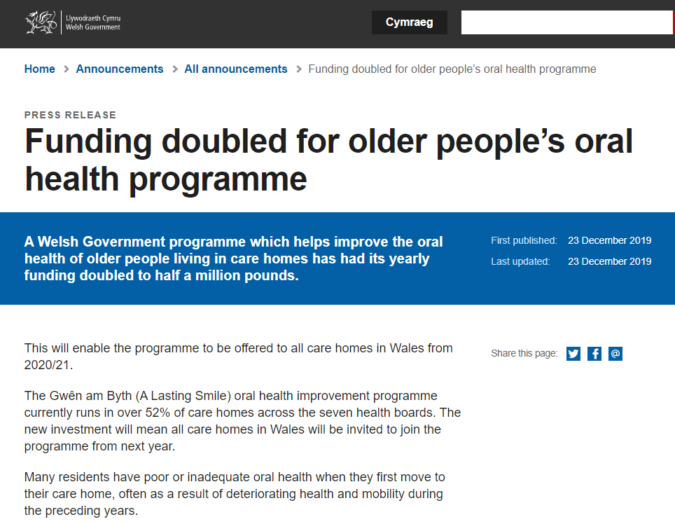
Secure funding for underserved vulnerable groups

Slide 7
research
High quality research is essential to inform health policy, the dental profession and stakeholders on a range of issues in order to improve the oral and general health of patients and the wider population.
We facilitate research collaborations between NHS & academic members.
We provide a forum for dialogue between DPH & community dentistry researchers & those involved with policy development/the provision of health services.
BASCD can advise members on the conduct of high-quality community dentistry/DPH research, including methodological approaches, research ethics, research training and impact.

Slide 8
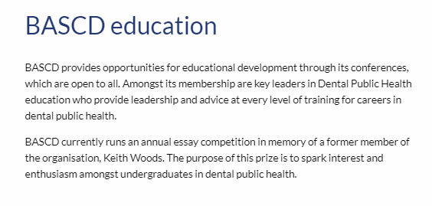
Teaching & training

Slide 9
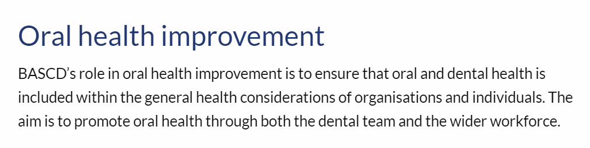
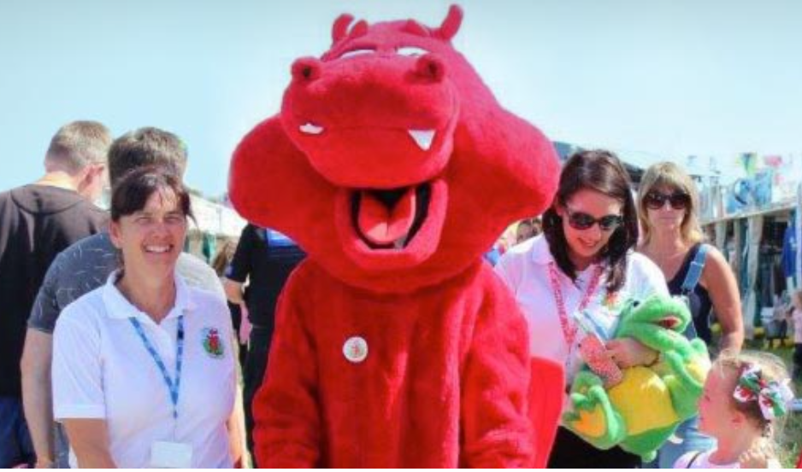
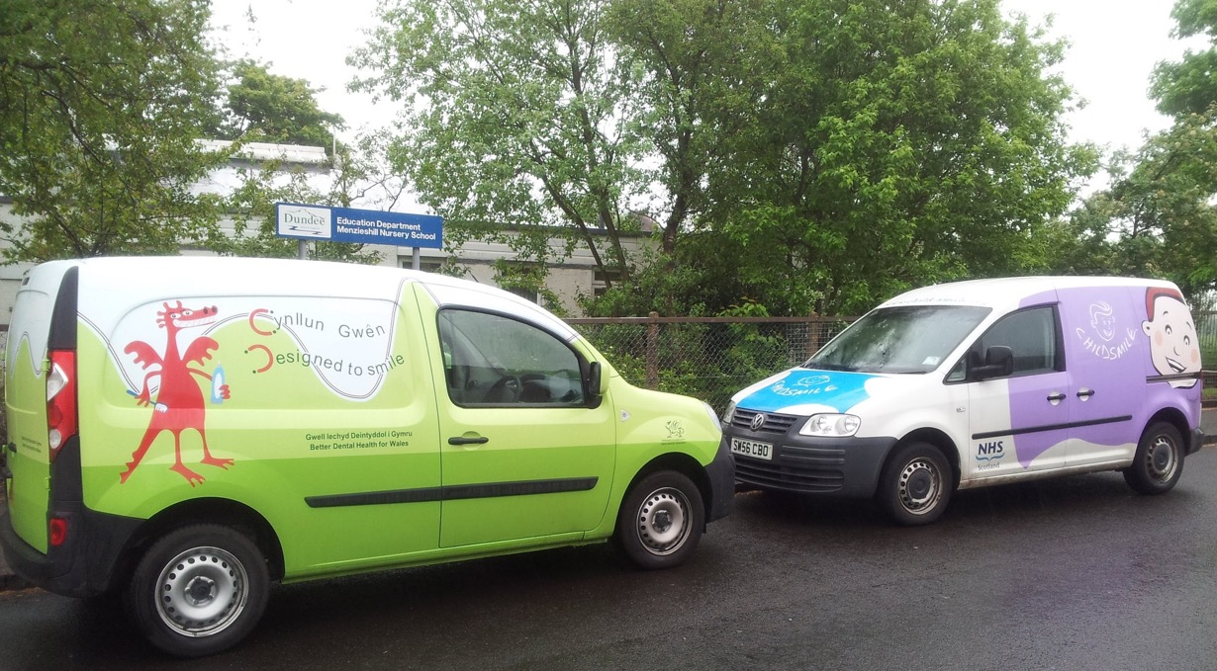
Oral Health improvement
Community Dental Services “public health in action”

Slide 10
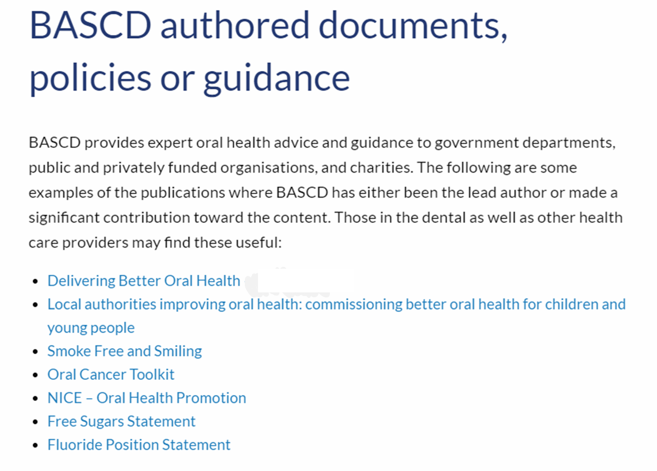
Oral Health improvement

Slide 11
Delivering Better Oral health V4
An evidence-based toolkit for prevention
supports primary care dental teams to promote oral & general health
facilitates the provision of optimal care, advice, and support for patients in achieving and maintaining good oral health
an educational resource for dental schools, postgraduate deaneries and other providers and commissioners of dental teaching
is equally appropriate to dental specialists and their teams
may be used across health and social care
allows commissioning bodies to implement preventive care pathways
https://www.gov.uk/government/publications/delivering-better-oral-health-an-evidence-based-toolkit-for-prevention
Notes:
DELIVERING BETTER ORAL HEALTH

Slide 12
POLICIES & CONSULTATIONS
DHSC - Consultation on future water fluoridation schemes, joint with FPH
Position Statement on Community Water Fluoridation
Statement on Free Sugars

Slide 13
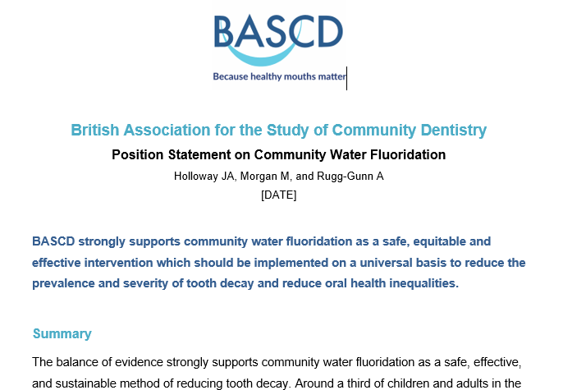
Notes:
Currently in draft (December 2022).

Slide 14
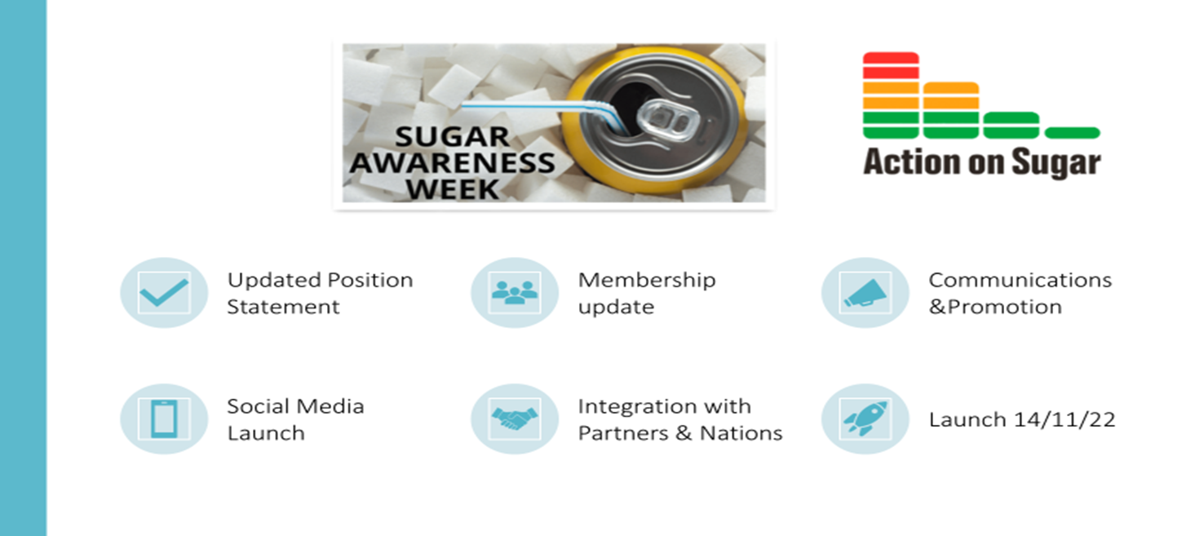
British Association for the Study of Community Dentistry
Position statement of free sugars
Polglass L, Morgan M, and Jeavons C
2022

Slide 15
membership
Membership is open to all
We need more members from wider public health ☺
“public health in action”

Slide 16





Join in!
@bascd_uk
@bascduk
@bascd_uk
WEB
https://www.bascd.org/
Notes:
Website https://www.bascd.org/

