Slide 1
Global Health Placements Working Group
National Survey Results
December 2022

Slide 2
Agenda
DEMOGRAPHICS
DEMAND
BARRIERS
PLACEMENT MAPPING
SUMMARY

Slide 3
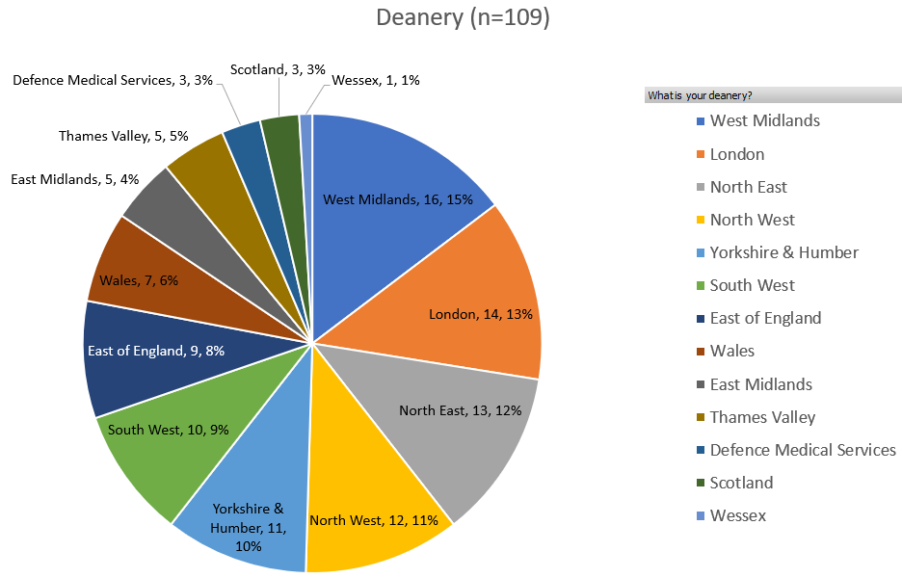
Demographics
109 responses
Most from West Midlands, London, and North East
All deaneries represented
11 respondents (10.1%) had previously undertaken a global health placement (GHP)

Slide 4
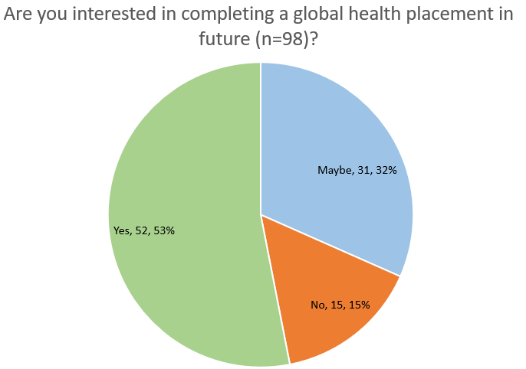
Demand
11 (10.1%) had previously undertaken a global health placement, 7 of these wished to do a second
52 (53%) wished to in future, with a further 31 (32%) considering it.
15 (15%) did not wish to complete a GHP
Notes:
In total, 83 trainees, 85% are seriously considering a GHP

Slide 5
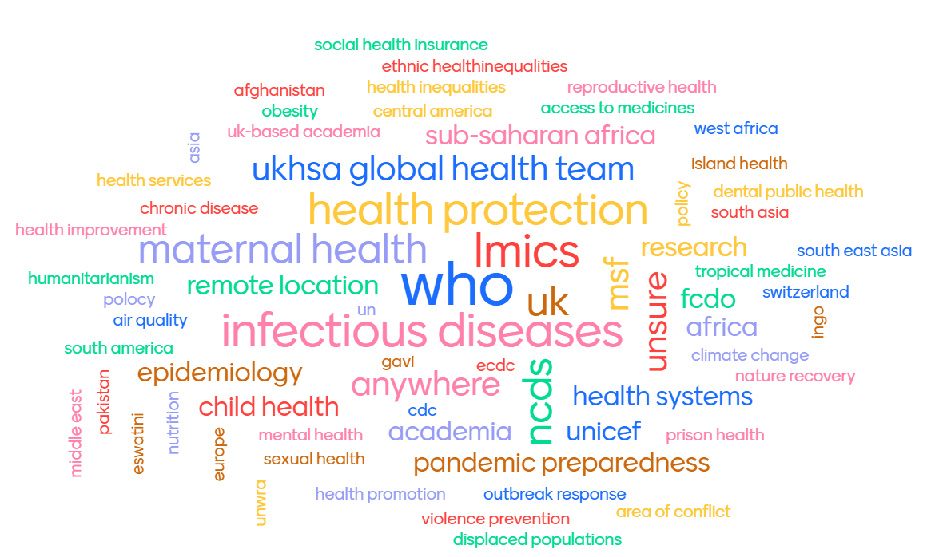
Demand
What topic area, organisation or location did you have in mind? (n=53)
policy

Slide 6
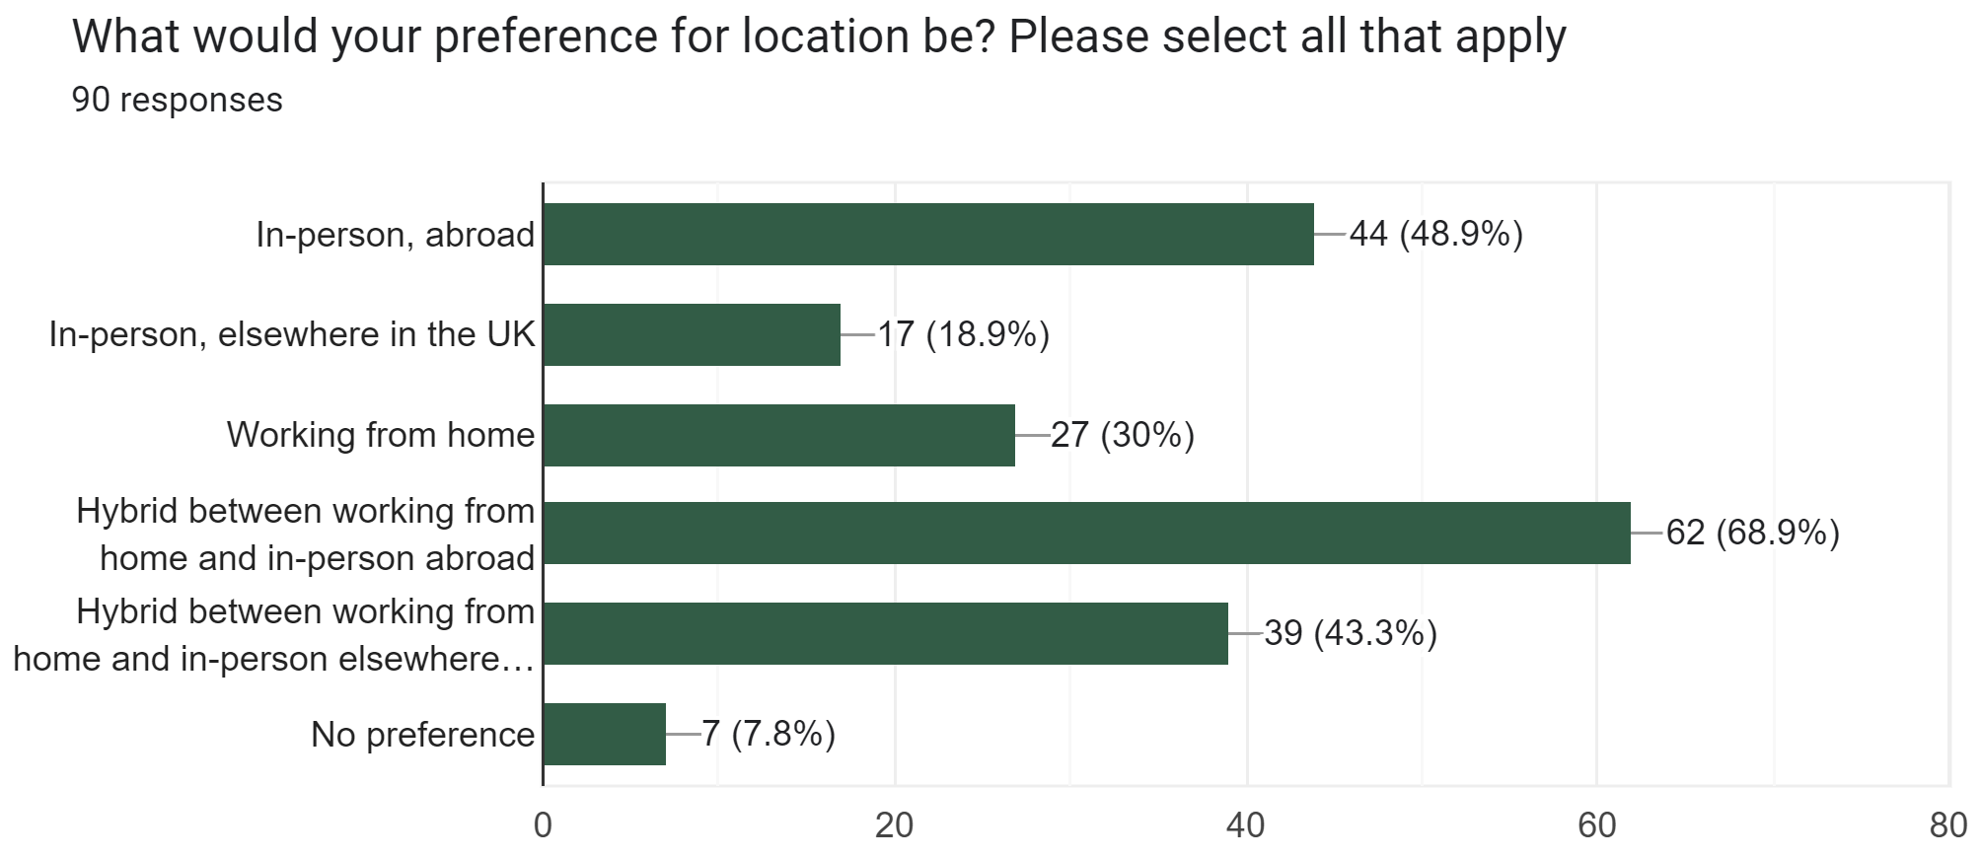
Demand
Highest preference:
Hybrid: WFH and in-person abroad (62, 69%)
In-person abroad (44, 49%)
Hybrid: WFH and in-person elsewhere in UK (39, 43.3%)

Slide 7
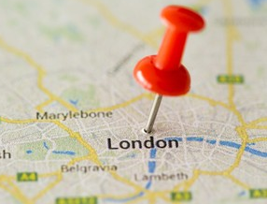
Remote working vs. London or overseas-based
“I am worried about global health opportunities moving to being UK based, therefore preventing those of us who do not have substantive experience working and living in a different culture from gaining the breadth of experience and skills that you can gain from being deployed abroad”
“With the new digital approach to working, would be very happy to undertake a project virtually and still feel a lot could be learned without needing to relocate”
BUT…..
“I feel like completing a global health placement would make me a much more well rounded registrar and be invaluable as an opportunity, but it just doesn't fit with my lifestyle…… Opportunities to complete global health placements remotely is therefore I feel a really important option for many of us with similar situations”
“I think it would be interesting to think about whether remote placements are more of an option now or whether there are issues there too e.g contributing to reduced capacity building in country and whether might compound issues around not really understanding the context”
[re hybrid working or WFH] “This has been the norm at PHE/UKHSA Global Ops for many years and as such they have a better system for maintaining wellbeing/communication/ meetings than local authorities/health protection teams”
“Having the UK location at London just makes these placements impossible for me”
“I feel global health placements are not possible for me now I have small children as most seem to be based in London and require that location commitment”
“Remote working should have made global or national treasure placements more accessible for the rest of the country”
“I think a lot of experiences are still very London centric. Without funding available for those who would need to travel long distances this isn't equitable, especially in the current financial climate”

Slide 8
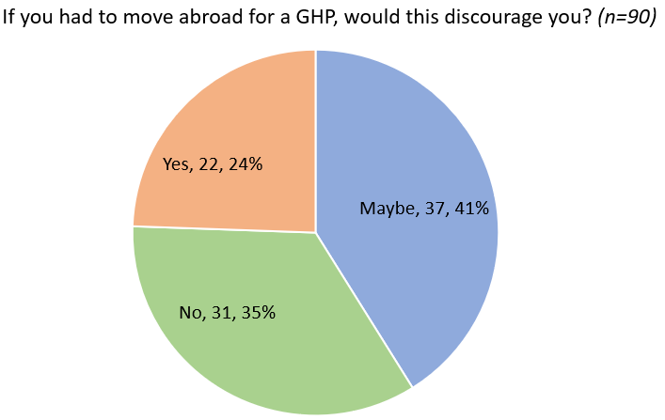
Barriers
If yes, why? (Free text, n=50)
Commonest (by far): family commitments/dependents
Children, especially if single parent
Caring responsibilities
Disruption to partner’s career
More feasible if short trips abroad
Suggestion of ‘registrar swap’
Next commonest: financial implications
Mortgage, and paying rent on top
Relocation costs - need assistance with family relocation
Also:
Long length of placement
Ethical concerns about impacts of short placement on host country
Concern about safety in host country as LGBT/ethnic minority
Notes:
Discuss potential bias against registrars with families and from working class backgrounds
Reference previous report

Slide 9
Barriers
Why would you not be interested in a global health placement? (n=40, select all that apply)
62.5% due to dependents
45% unwilling to relocate
30% potential financial implications
15% not interested
5% unsure of the opportunities available
Free text: belief that skills are better placed locally, bureaucracy involved in doing a GHP ‘in training’, ethical and environmental concerns about potential harmful impact of short term placements

Slide 10
Placement Mapping: General
36 placements collated
Usually 6 months, some 12 months
Variety of organisations: WHO, MSF, PHE/UKHSA Global Ops, projects with academic teams
Variety of topics
Usually nationally advertised, in-programme
Some self-funded/stipend and self-organised OOPE
Some only available to specific deaneries

Slide 11
Placement Mapping: Challenges
Bureaucracy of organising the placement
Inadequate supervision in host country/organisation
Politics/politics/political influence
Lack of travel reimbursement
Negotiating time OOP
GMC approval
Building on previous work:

Slide 12
Placement Mapping: Benefits
…to host country/organisation
“providing free extra public health capacity, and additional skills”
“public health expertise in the team”
“new knowledge through research, and capacity building though my support to [local] researchers”
“knowledge sharing on public health issues”
“outputs for commissioned work and organisation of several high level meetings”
“delivering a necessary function rather than being supernumerary”
“strengthening of emergency preparedness”
“policy development, public health advocacy with senior leaders”

Slide 13
Placement Mapping: Benefits
…to local work in the UK
Knowledge/skills/experience:
policy development
PH advocacy with senior leaders
knowledge sharing
senior-level responsibilities
funding, budget management
supervision of junior staff
multisectoral engagement
influencing
leadership of a complex project
research ethics, academic skills
working with communities
participatory research
PH approach in emergencies
…and much more!
“skills learned are certainly of benefit to upskilling PH trainees and practice in the UK... particularly the partnership model and understanding that local leadership with technical expert support is more sustainable”
“..brought back experience and learning that I could not have achieved locally”
“...all these skills will be used in everyday PH work in future placements”
“transferable learning to local HCPH/commissioning”
“[my GHP] informed domestic policy… helped a UK agency develop stronger partnerships”

Slide 14
Voices of registrars
“I feel like completing a global health placement would make me a much more well rounded registrar and be invaluable as an opportunity, but it just doesn't fit with my lifestyle with dependents, mortgage, strong dependence on a stable income, need for continuous NHS service for future potential maternity, pension implications etc. Opportunities to complete global health placements remotely is therefore I feel a really important option for many of us with similar situations.”
“I strongly feel that placements with a global focus are a key part of UK training but am often made to feel as if I am being trained for the UK only and somehow I should respect that and not pursue a global agenda or focus in my work…. I feel that my interests are not being valued and that somehow I should be prepared to work for nothing or even pay to access training opportunities, which I believe to be wrong and unfair”
“I think that we should be able to have ES based in the UK that can supervise us on global health placements, as it feels like this is a barrier which could stop us undertaking a lot of placements”
“Having the UK location at London just makes these placements impossible for me.”

Slide 15
StR awareness of global placements
“Awareness of opportunities and the logistics involved are significant barriers - would be good to have a better process of advertising the placements”
”I don't know what opportunities are available - unless you are already in the know and well connected it is really difficult to find out about options, especially if you train in a region that does not have a very many trainees that undertake these types of opportunities”
“It would be great to have a list of the options available - i have no idea”
“There is a real lack of awareness amongst StRs in [my deanery] about opportunities to work/train in global health”

Slide 16
Remuneration & financial barriers
“Would be nice to be paid while doing training abroad. I'm not sure why I would have lost my salary during that year, despite doing a massive amount of public health work” [respondent who had to turn down a competitive global health placement]
“I think a lot of experiences are still very London centric. Without funding available for those who would need to travel long distances this isn't equitable, especially in the current financial climate”
“I feel that my interests are not being valued and that somehow I should be prepared to work for nothing or even pay to access training opportunities, which I believe to be wrong and unfair”
“Financially, it is not an option for many trainees who cannot self-fund or take the financial hit of a reduced salary (dependents, other financial commitments)”

Slide 17
Summary
109 responses, all deaneries and dental PH
Only 11 had done a GHP (updated map produced)
83 (85%) considering one - demand for variety of topics and organisations
Biggest barriers remain family commitments and caring responsibilities, and potential financial implications
Clear demand for hybrid and fully remote options
Articulated benefits to both the host country/organisation, and to public health knowledge and practice on return to the UK, aligned with the UKFPH curriculum
Be mindful of ethical and environmental impact of short-term placements

