Slide 1
Austerity, inflation and mortality trends
Gerry McCartney
University of Glasgow
May 2023

Slide 2
Synopsis
The rate of improvement in life expectancy has slowed markedly in many high-income countries since c.2012 – before COVID-19
For people living in the most deprived areas, life expectancy is declining
There is good evidence that economic policy – and particular forms of austerity in particular – are responsible
These worsening trends have been exacerbated by the direct and indirect impacts of COVID-19
…and now by inflation and the impacts on real incomes
The public health voice on all of these issues has been somewhat muted

Slide 3
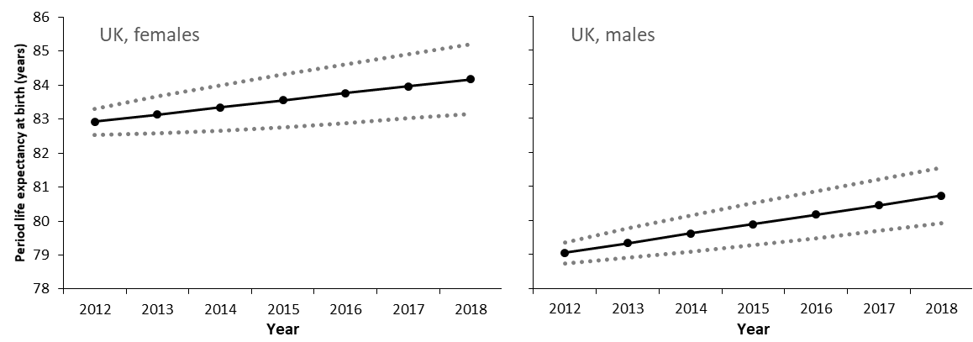
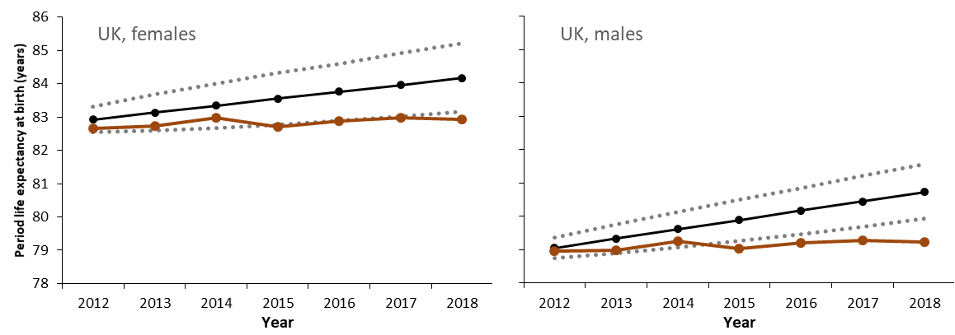
Actual versus projected life expectancy
(based on the 1990-2011 baseline)

Slide 4
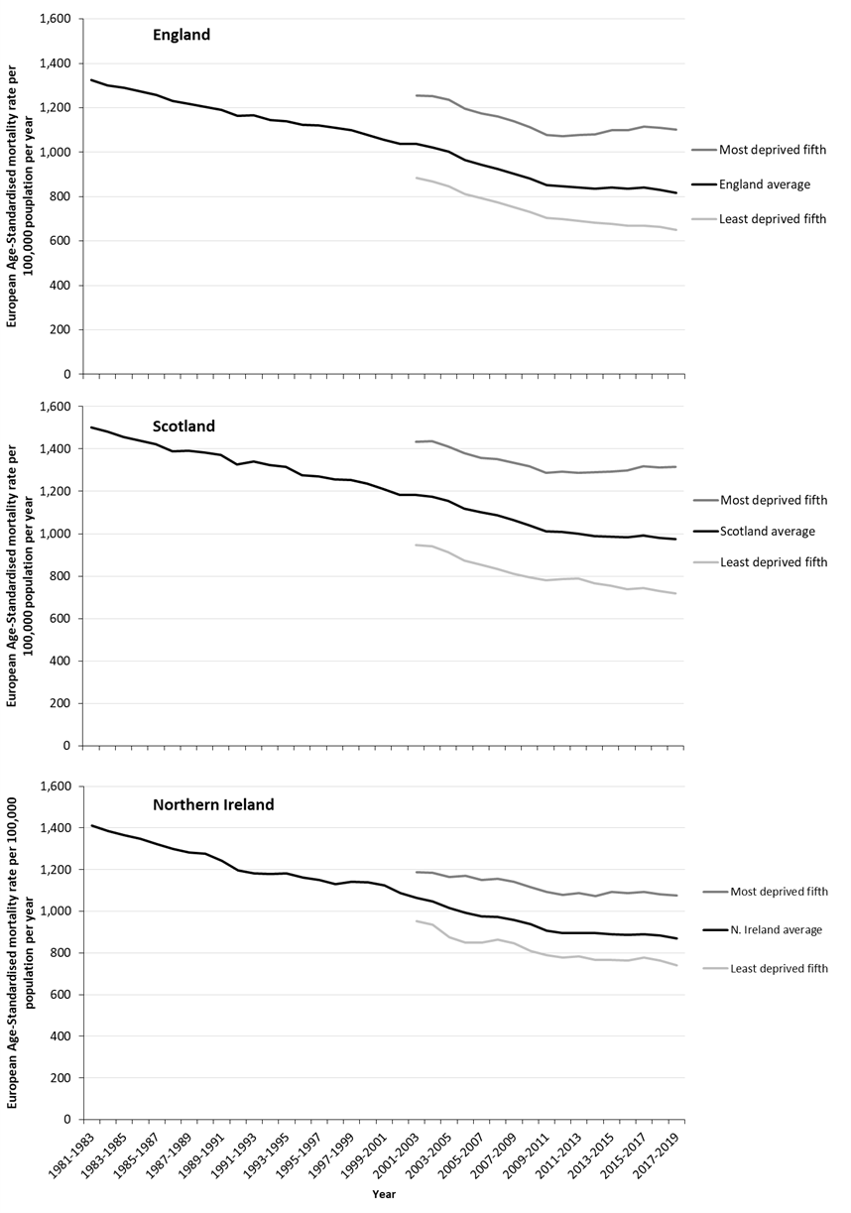

Inequalities in rolling three-year average European age-standardised mortality rates (by deprivation fifth), all ages and all causes, females (Source: updated version of analysis published in Walsh et al, 2020)

Slide 5
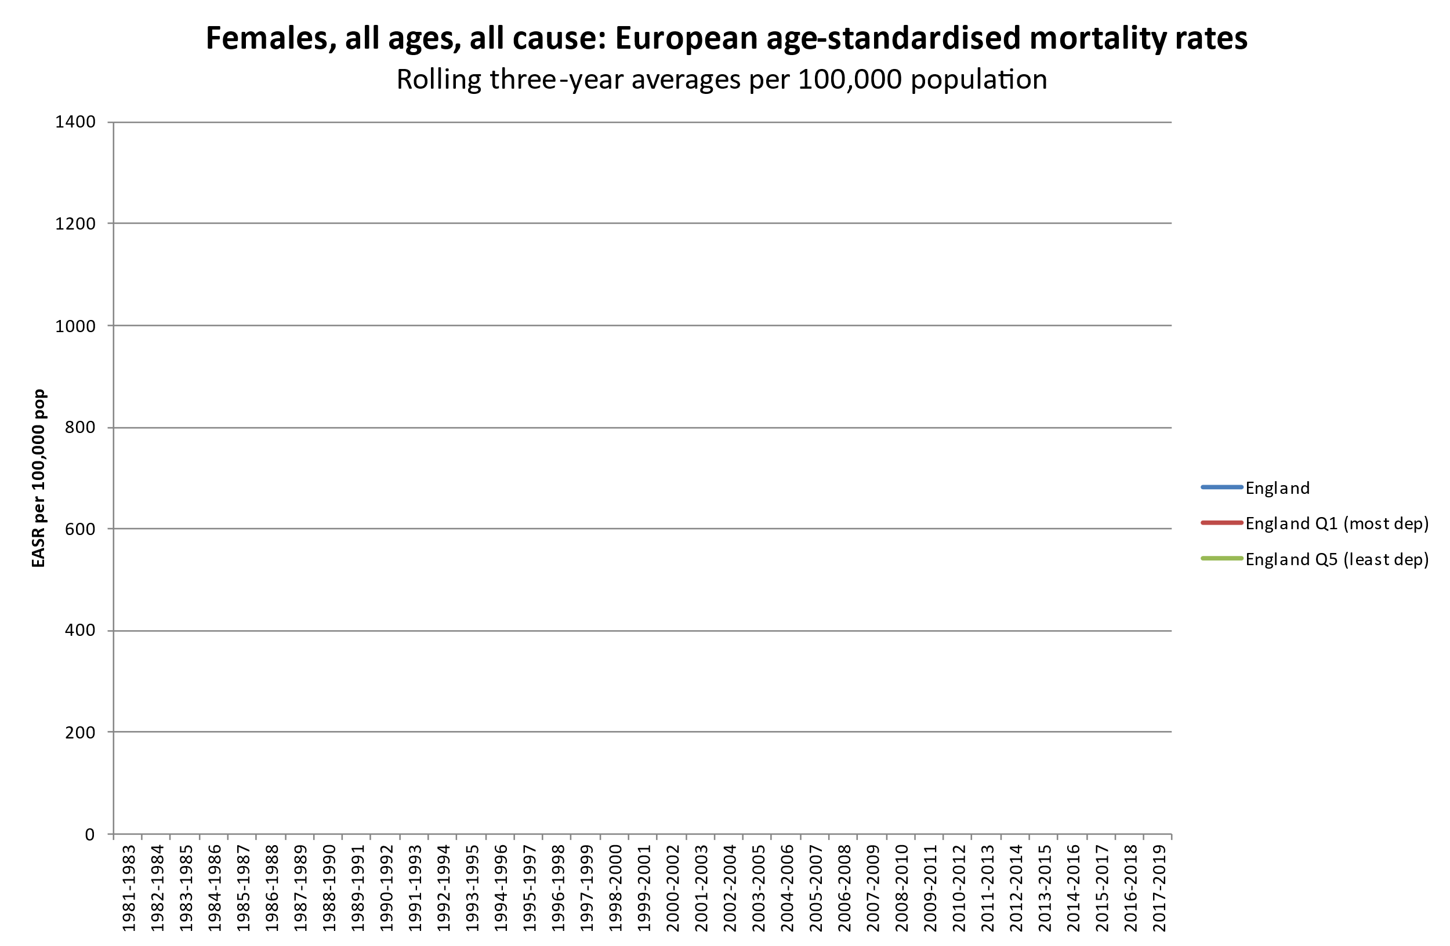
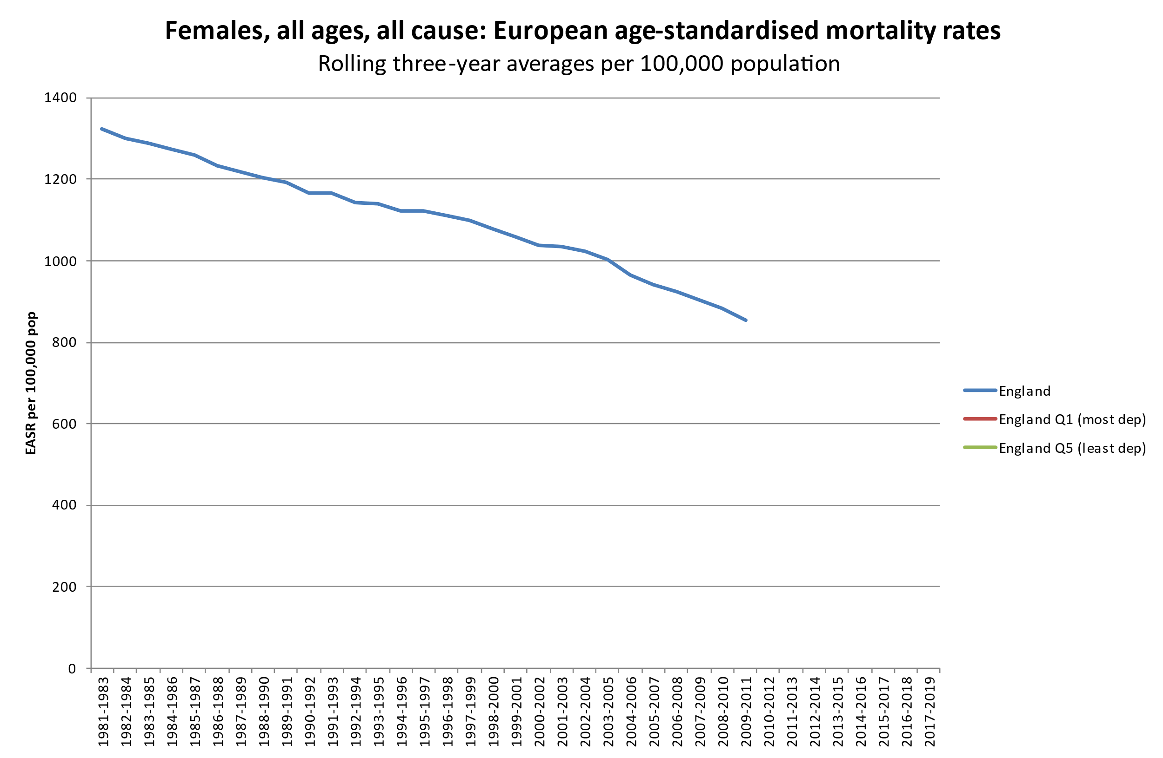
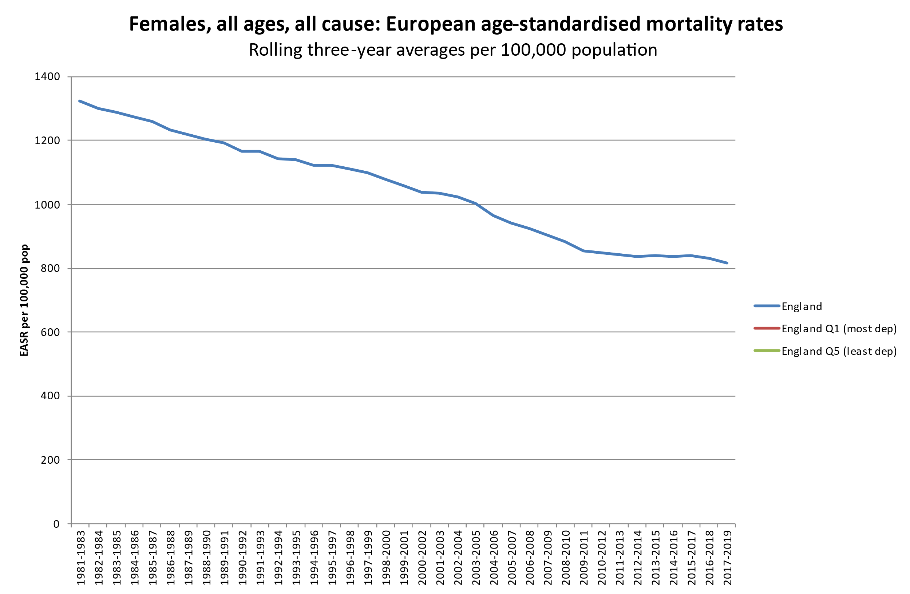
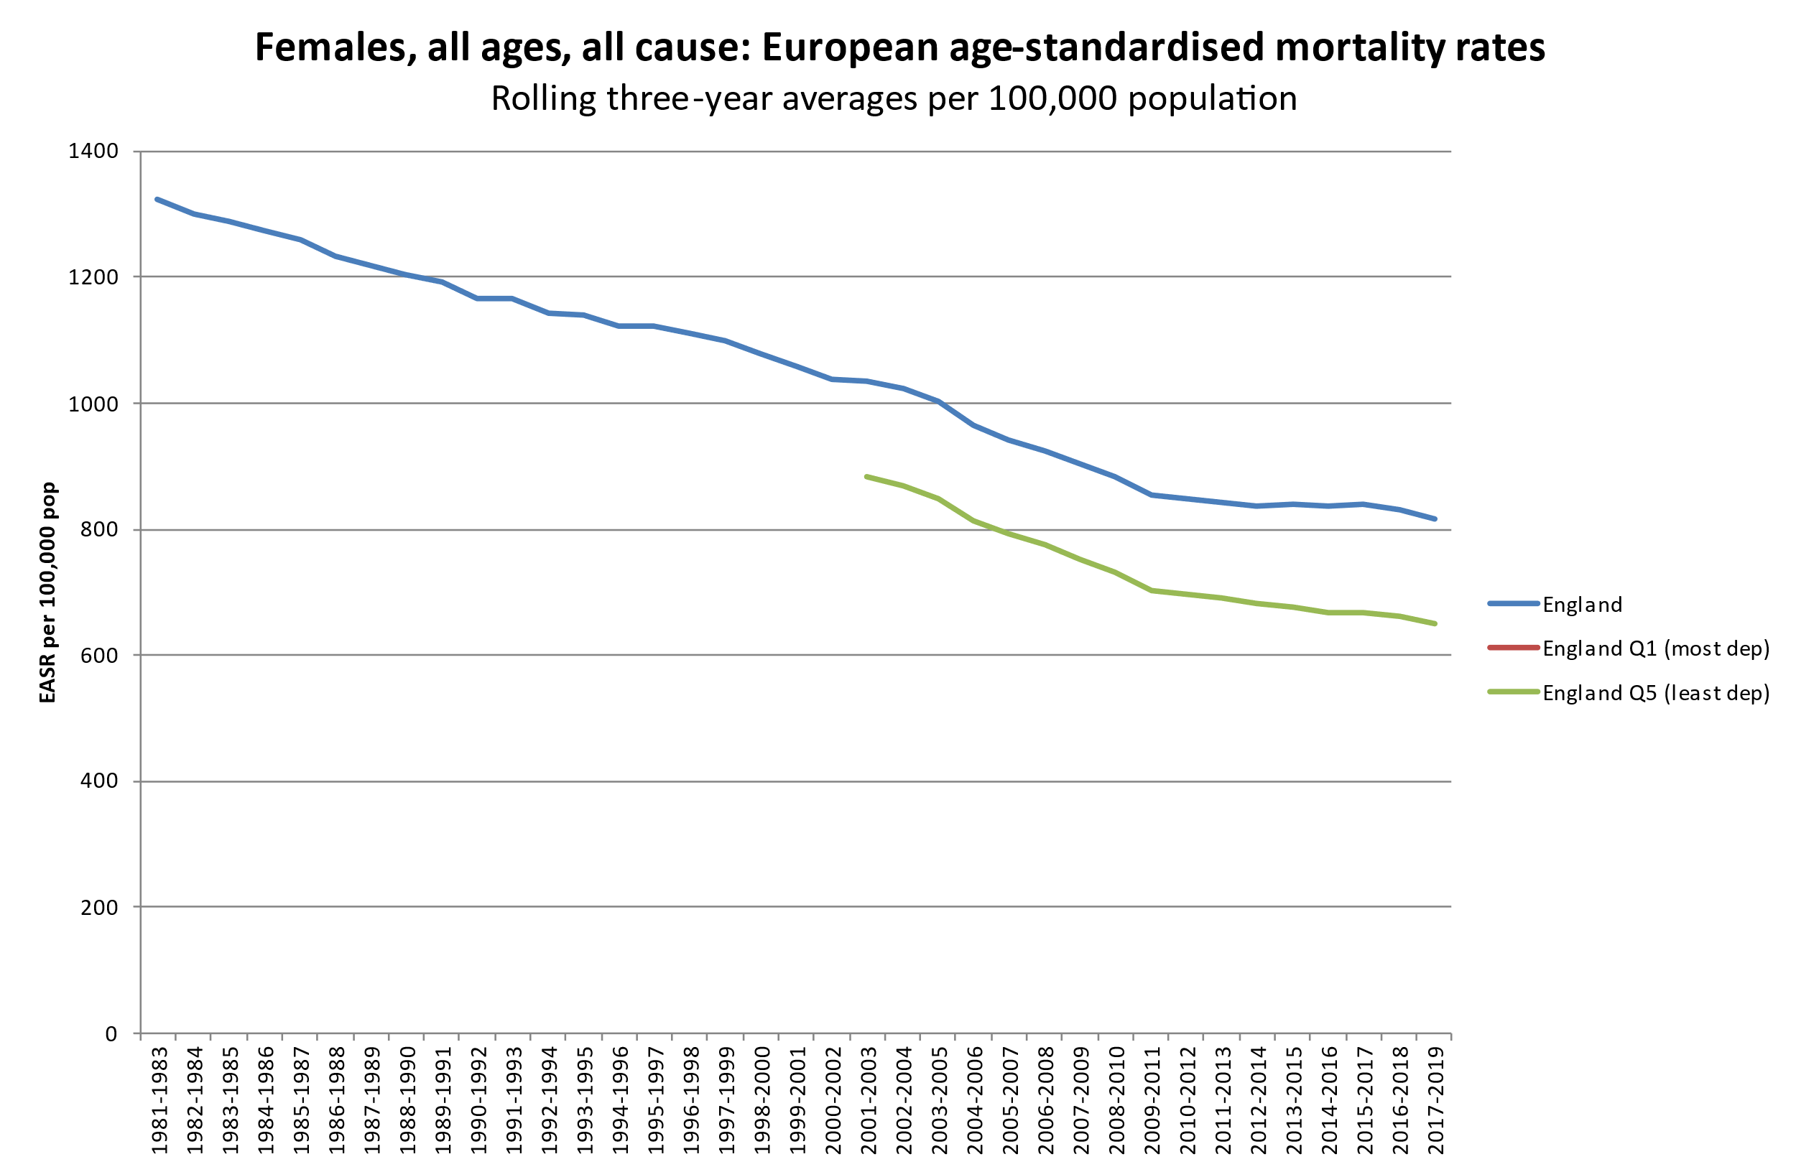
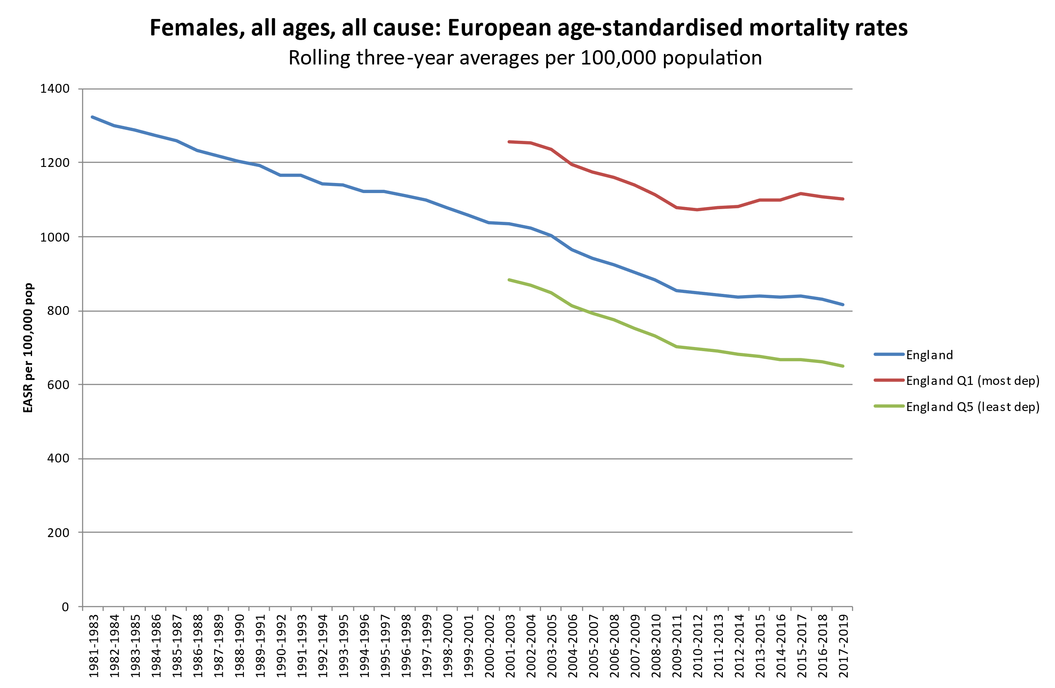
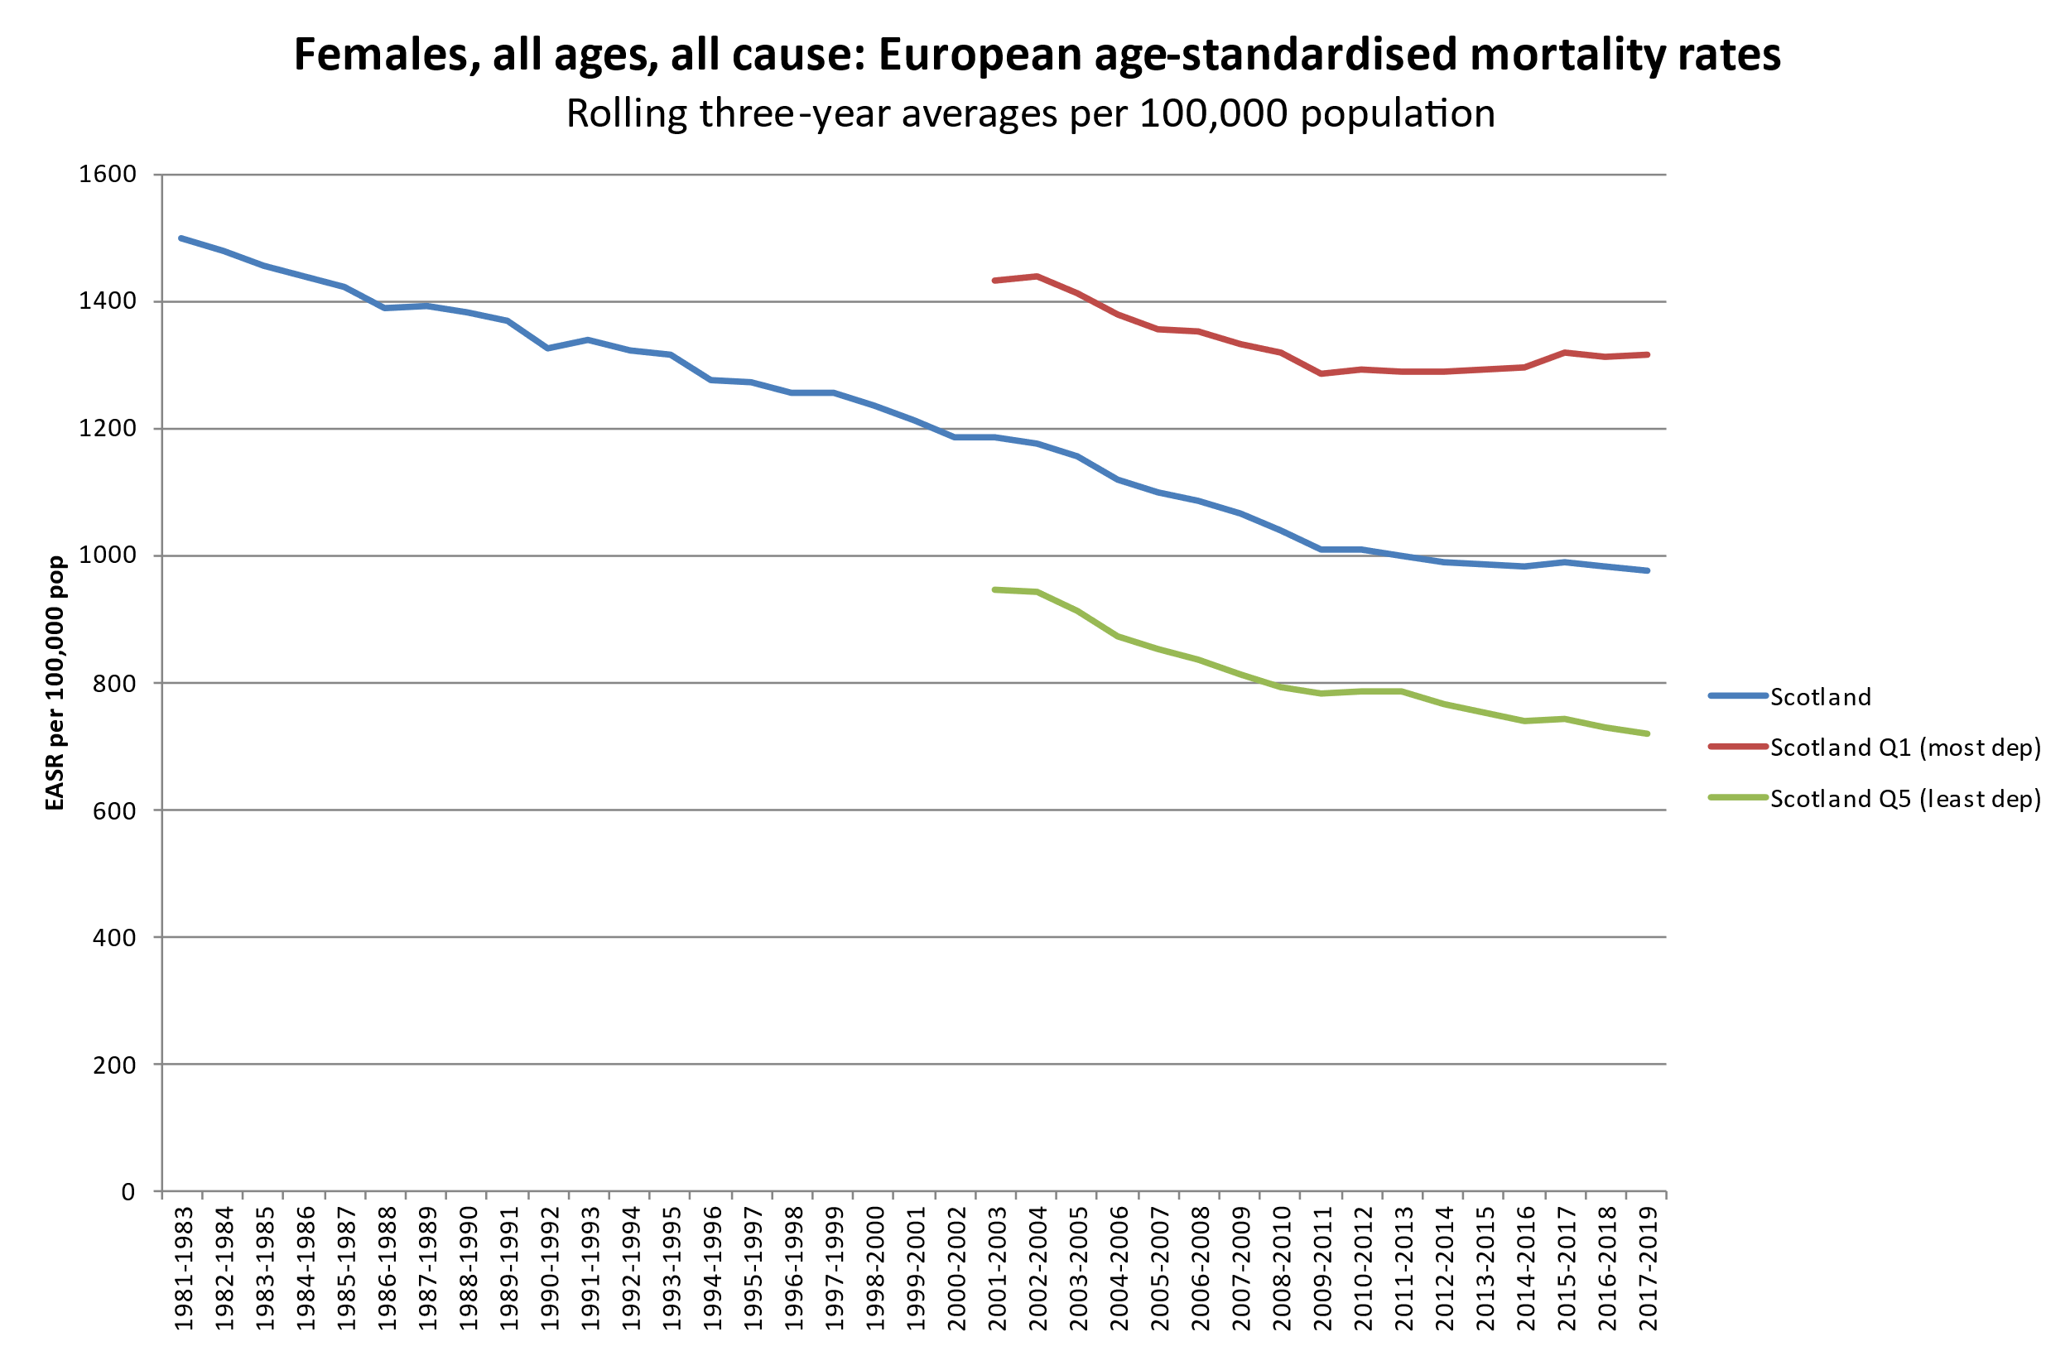
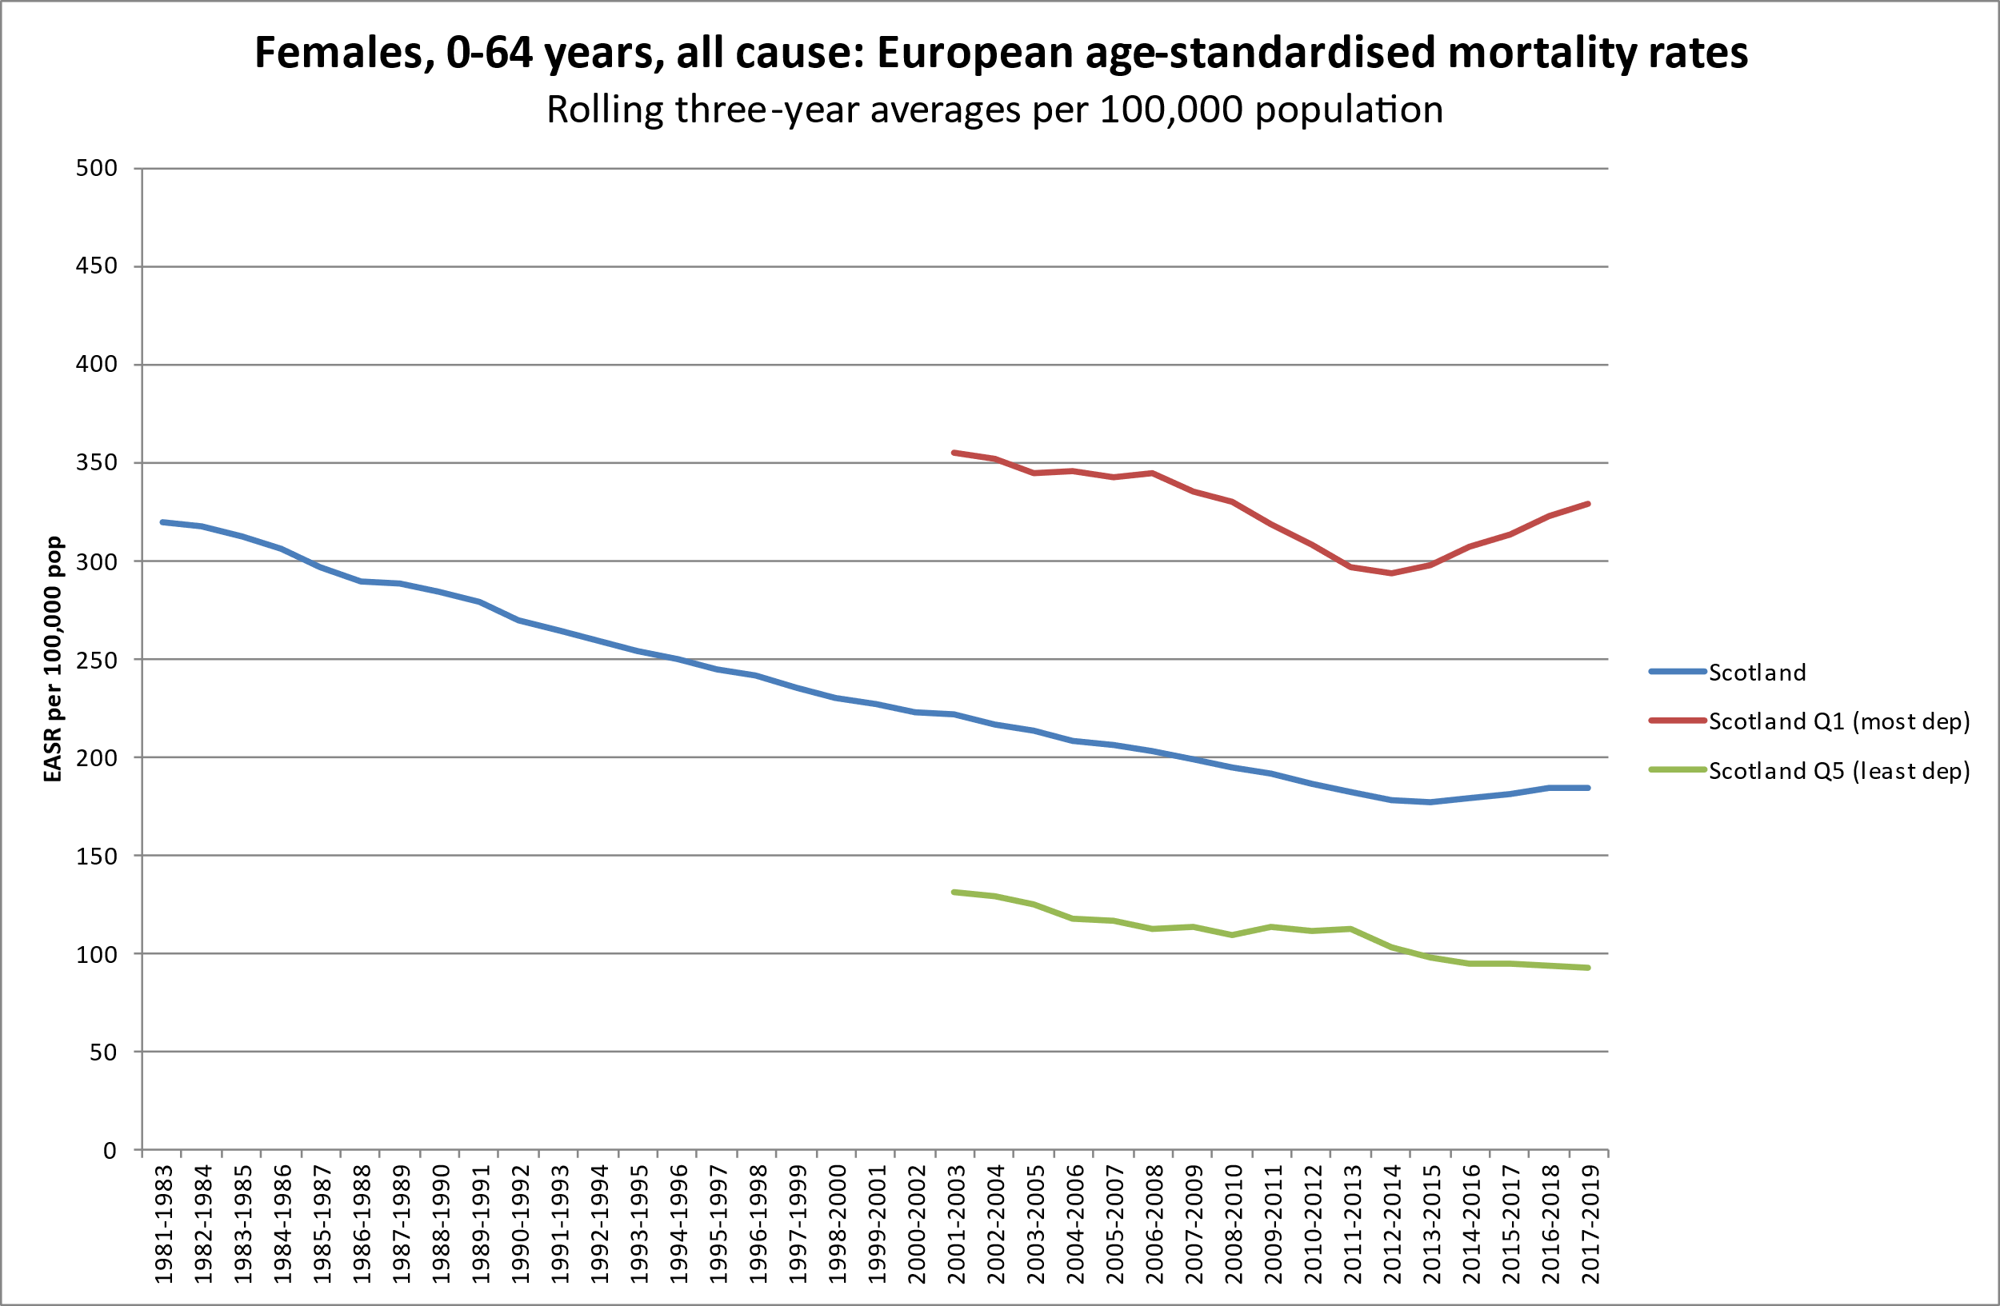
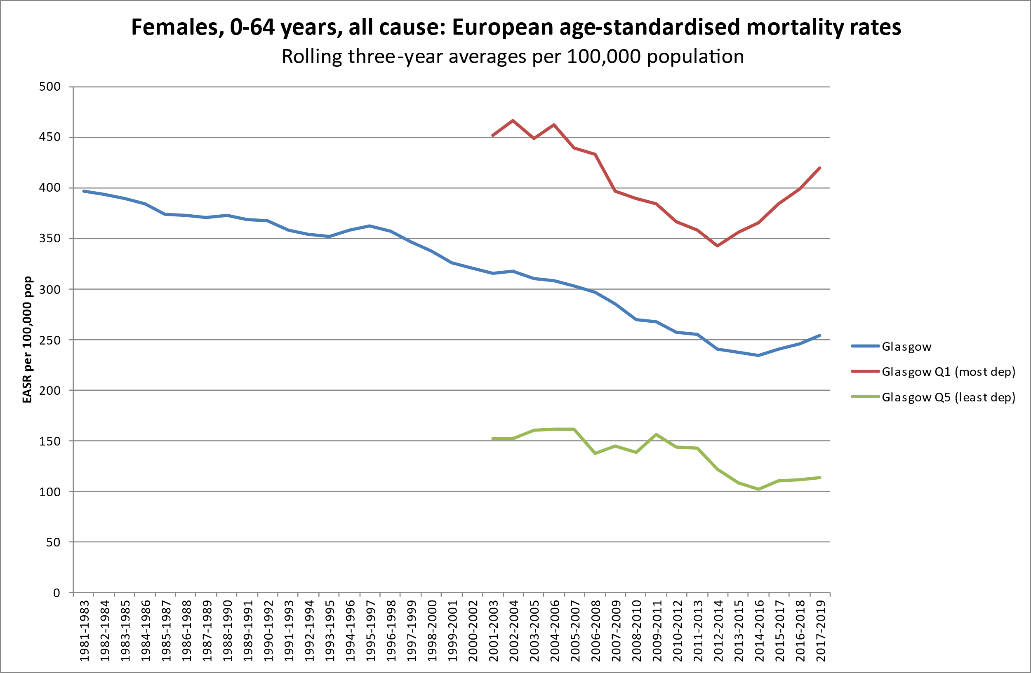
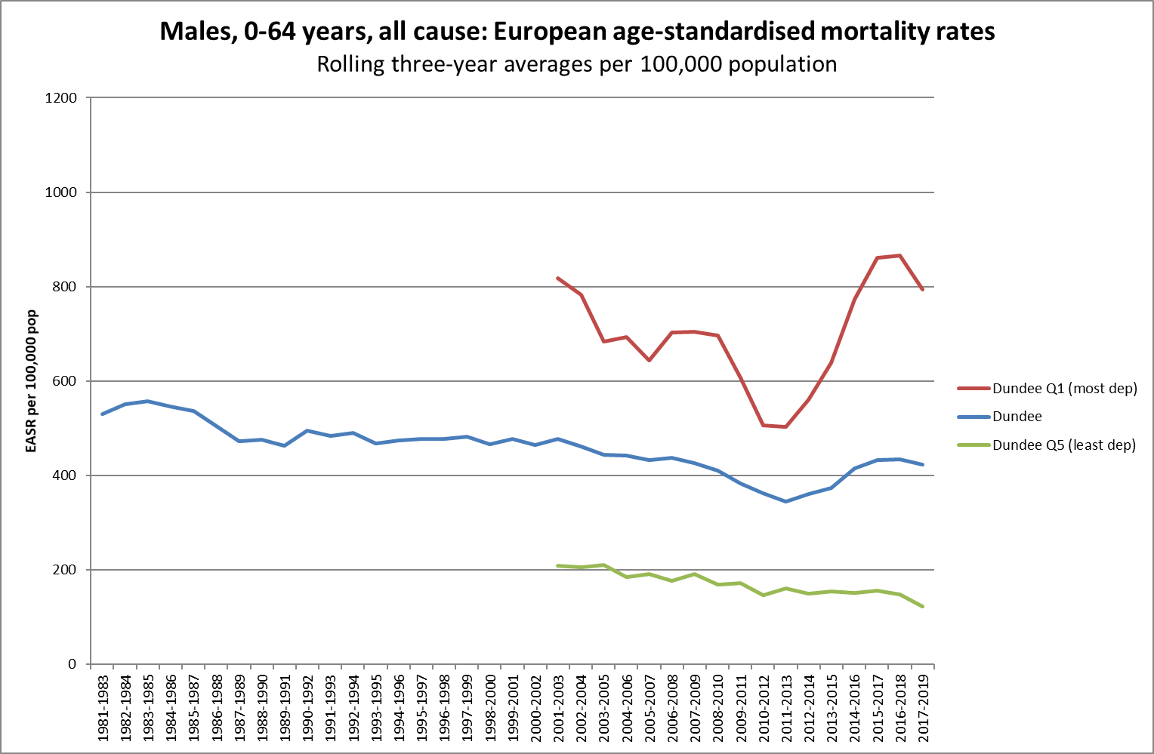
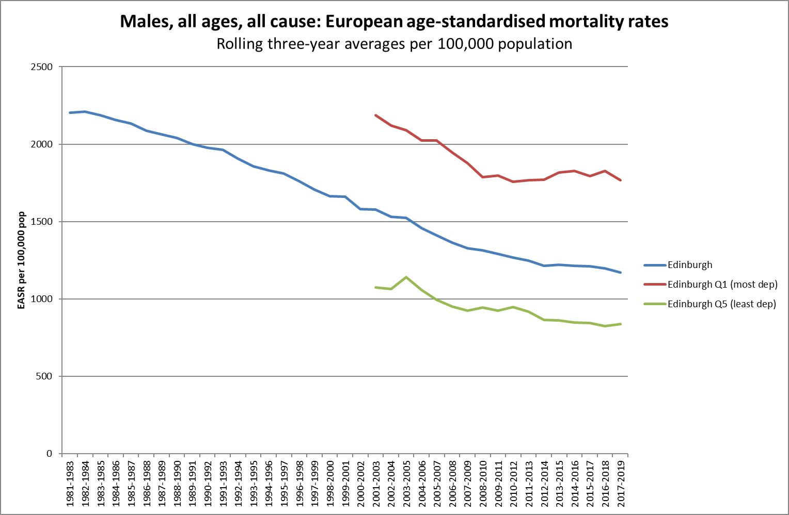
Changing mortality rates in the UK
2010: start of UK Government ‘austerity’ programme with aim of cutting public spending by £85 billion¹
Social security budget alone to have been cut by £47 billion by 2020/21²
Office for Budget Responsibility 2013.
Scottish Government 2017 (quoting OBR figures)

Slide 6
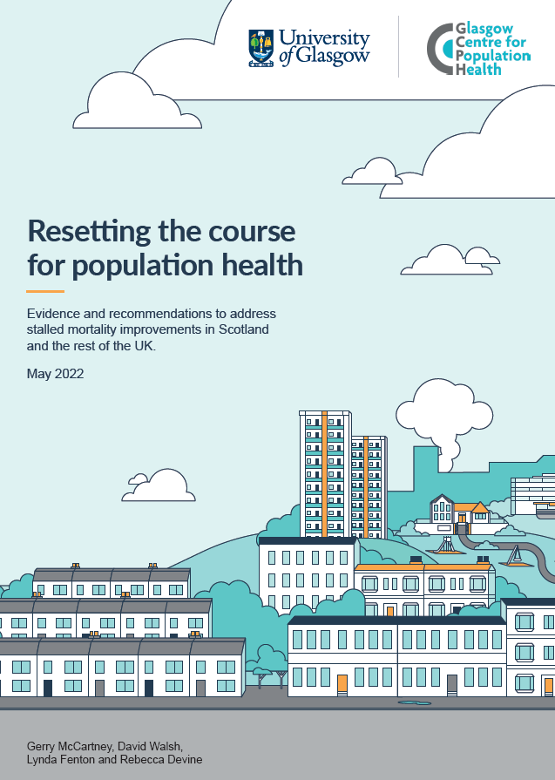
Causes of the stalled trends
Austerity implemented across countries after around 2010
Historical increases in obesity

Slide 7
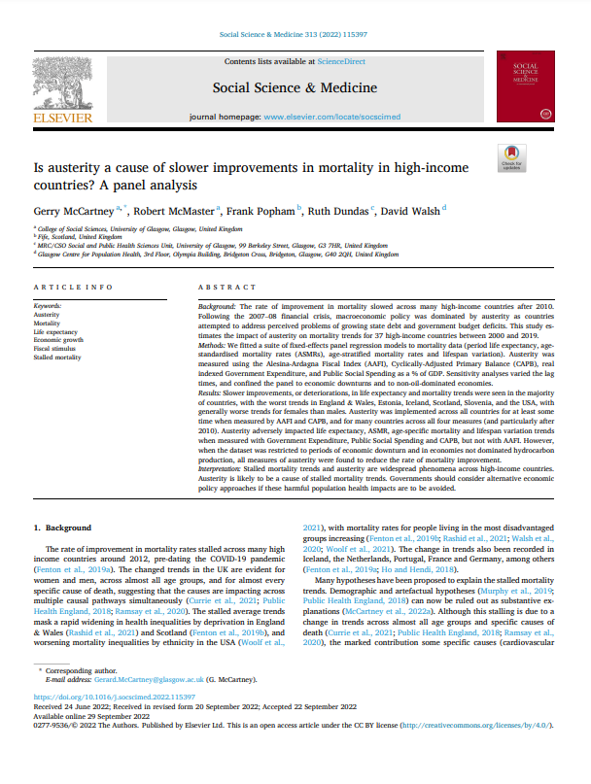
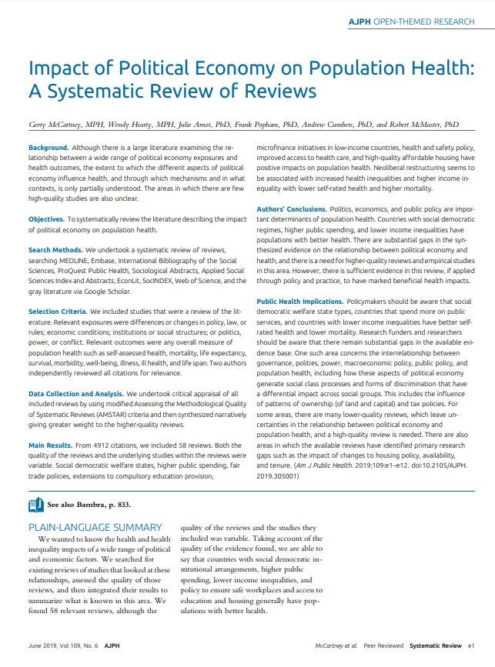
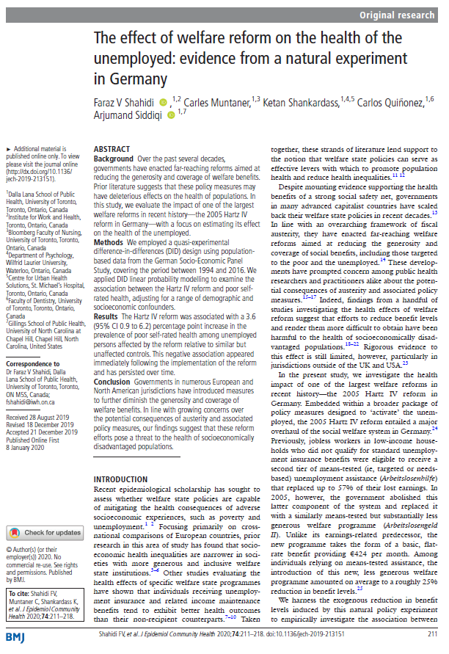
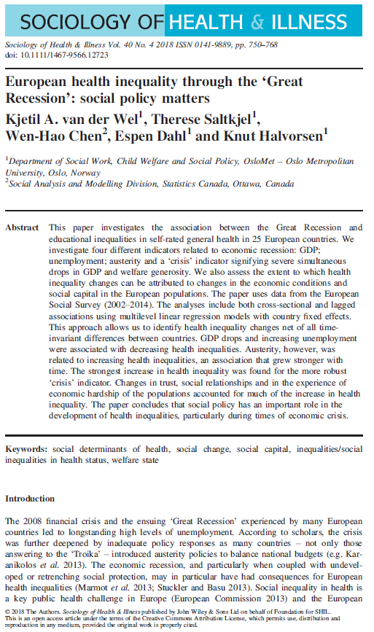
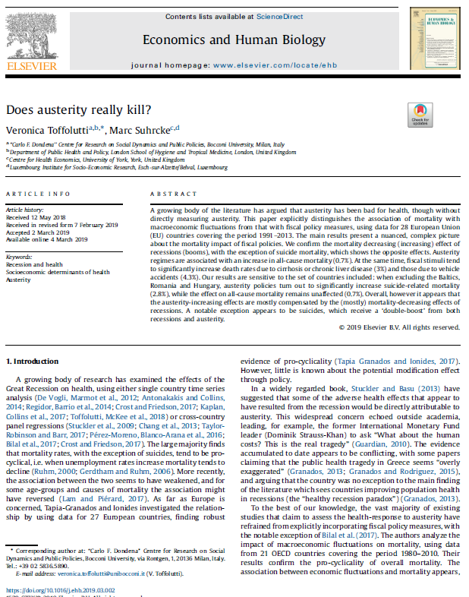
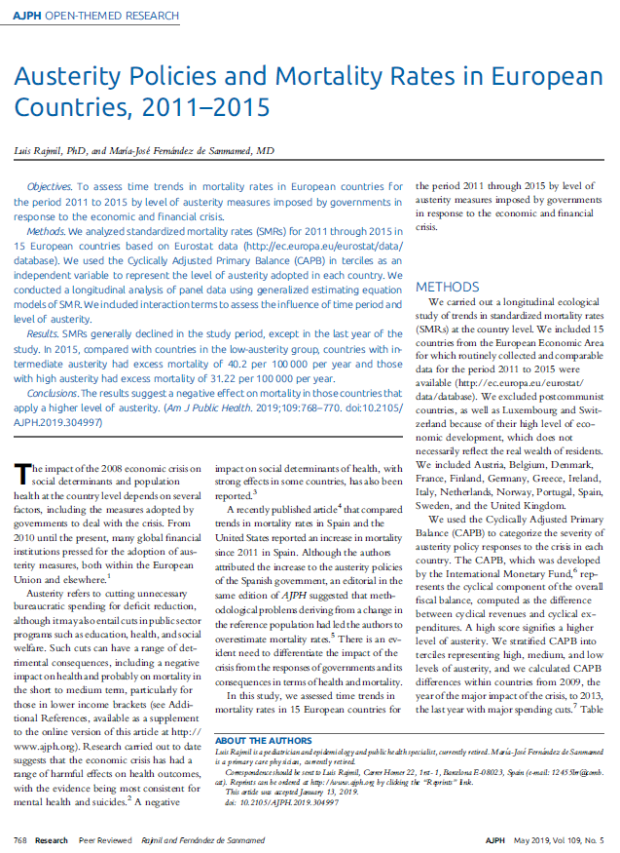
Is there evidence to support this?
Er, yes..
Huge literature on political determinants of health
International evidence of the impact of austerity policies

Slide 8
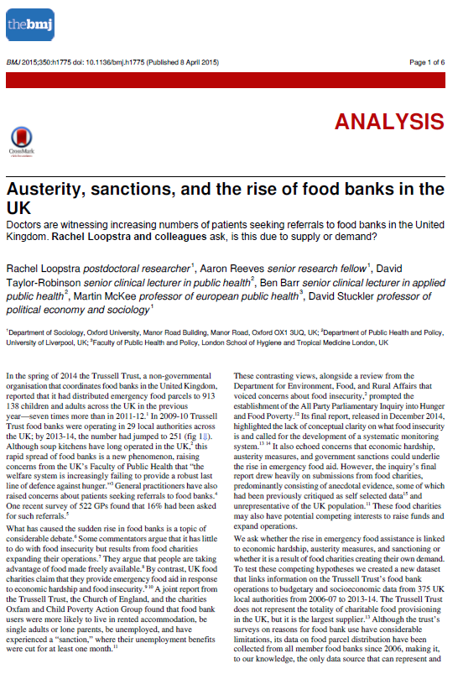
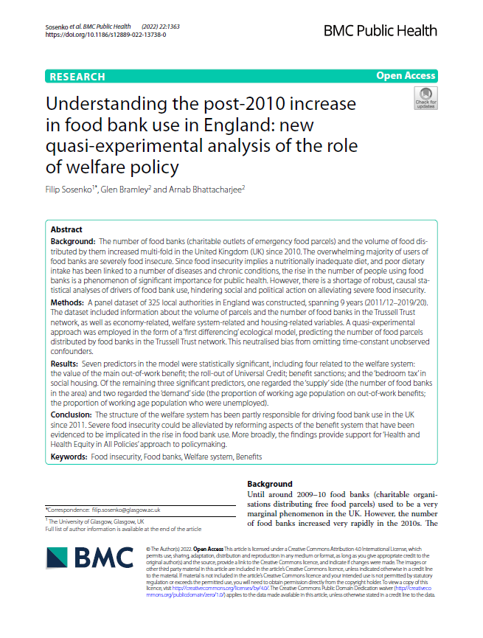
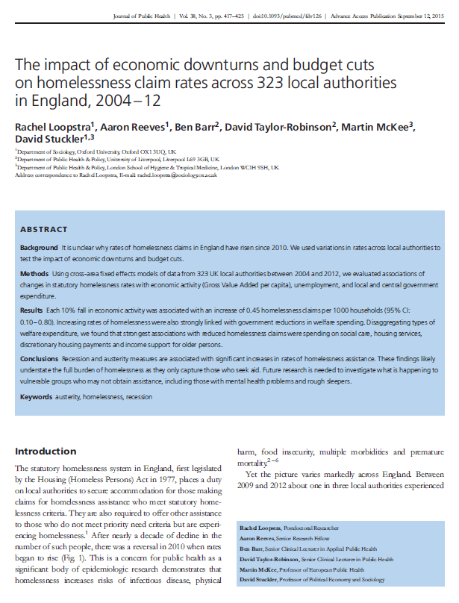
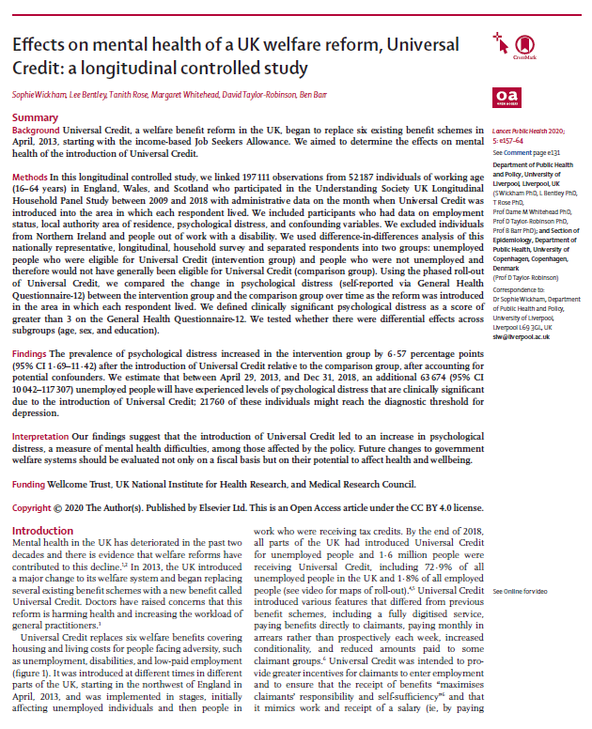
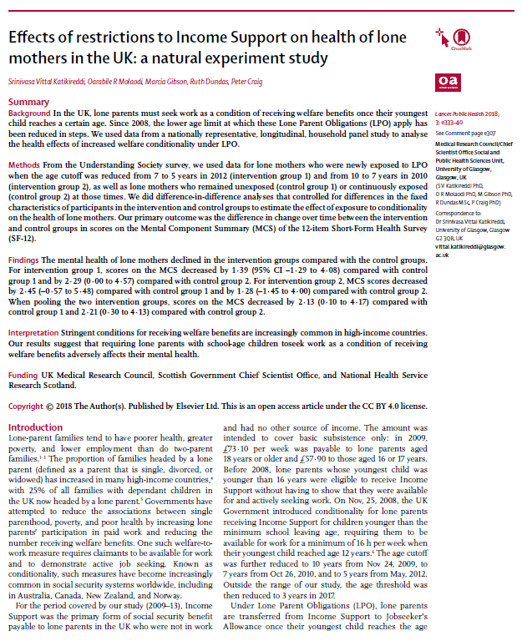
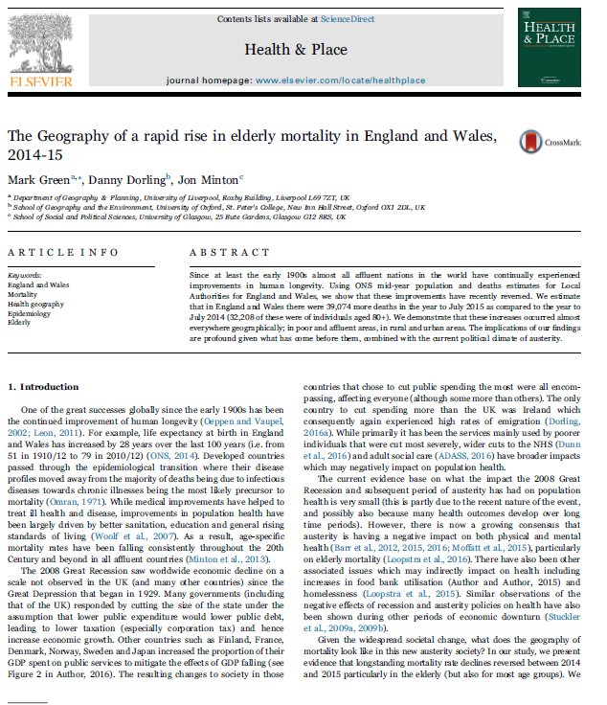
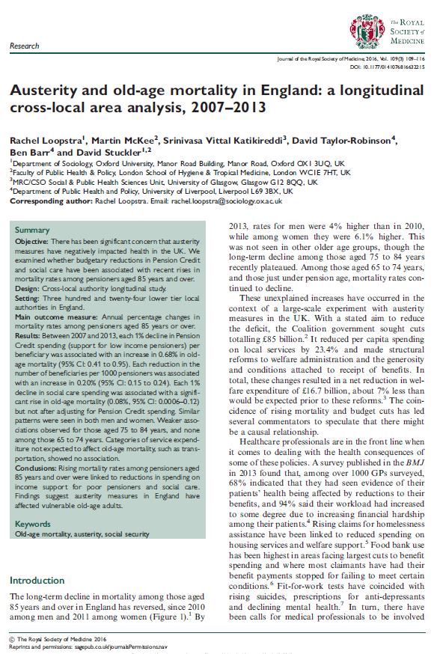
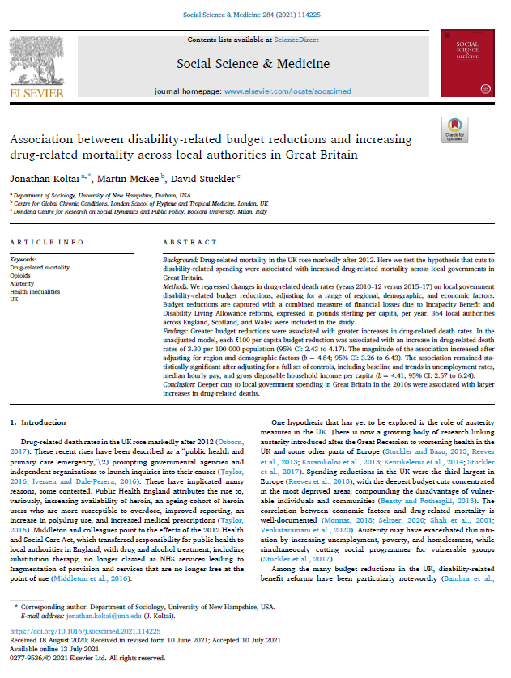
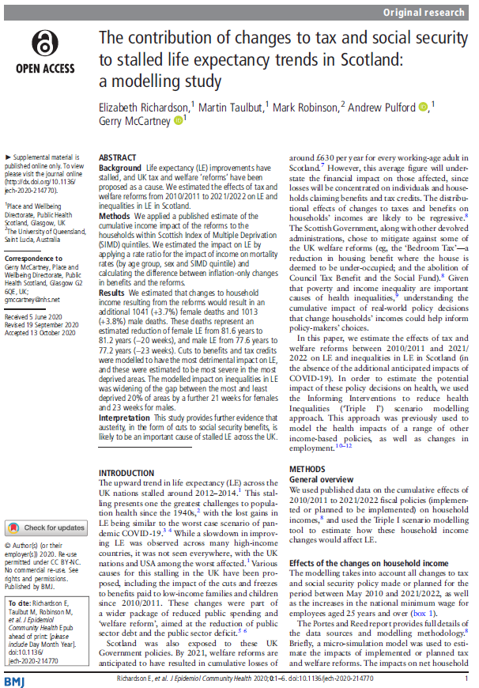
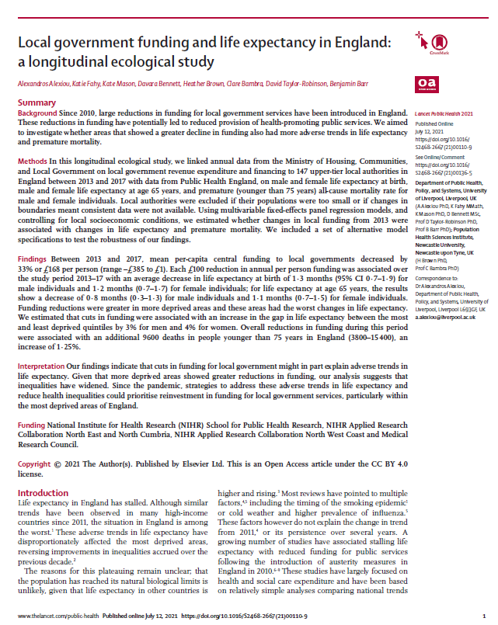
Is there evidence to support this?
Er, yes..
Huge literature on political determinants of health
International evidence of the impact of austerity policies
Wealth of UK evidence of the impact of this particular type of austerity…

Slide 9
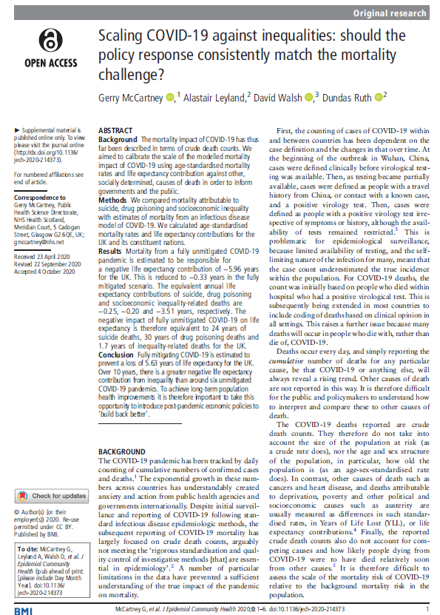
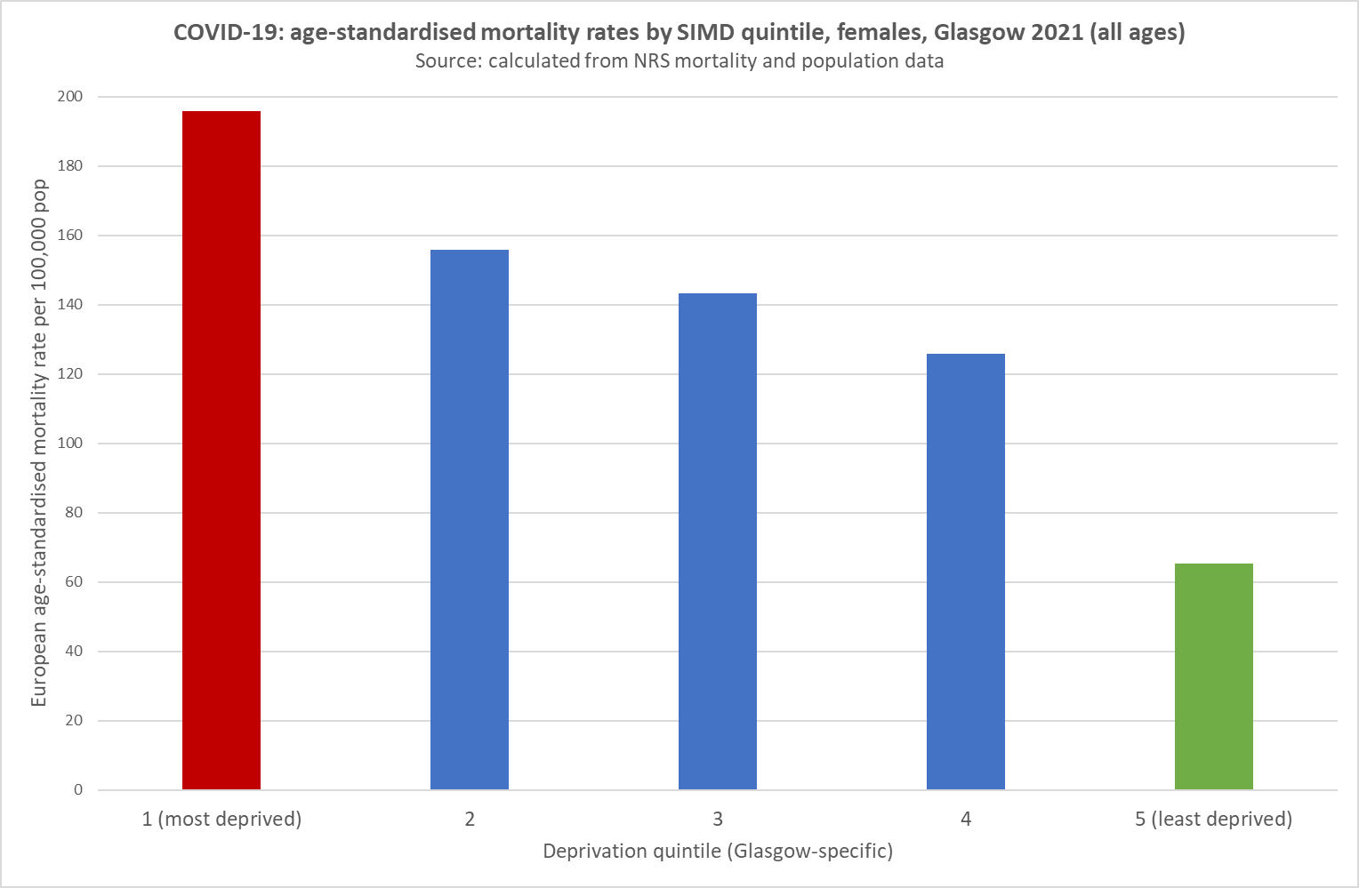
COVID-19
These trends pre-date COVID-19 pandemic
But are – obviously – massively important context for understanding the scale of pandemic inequalities
The impact of COVID-19 is large, but nowhere near as large as the impacts of inequalities

Slide 10
COVID-19
The indirect impacts are also very important
Unmet need for healthcare
Economic and social consequences of infection control measures

Slide 11
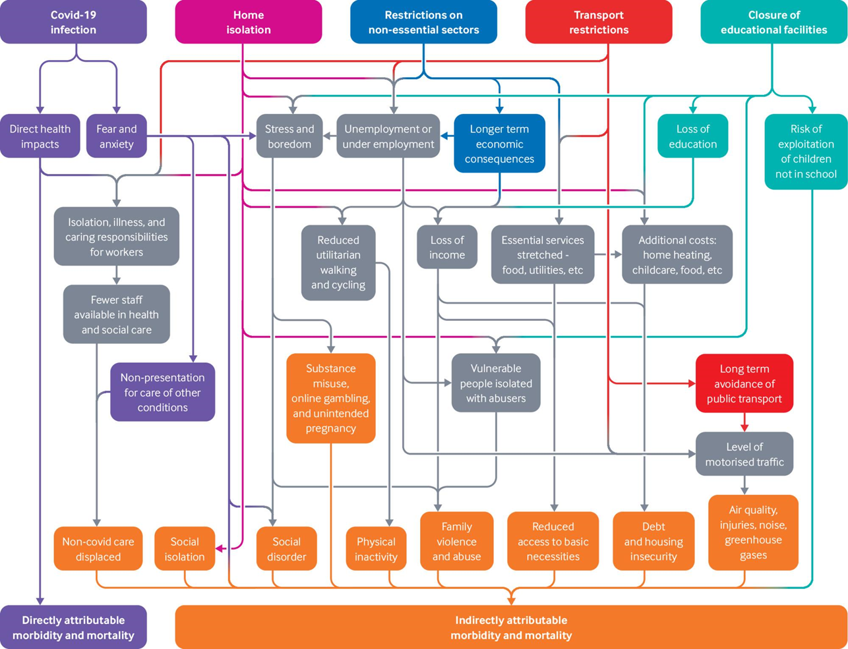
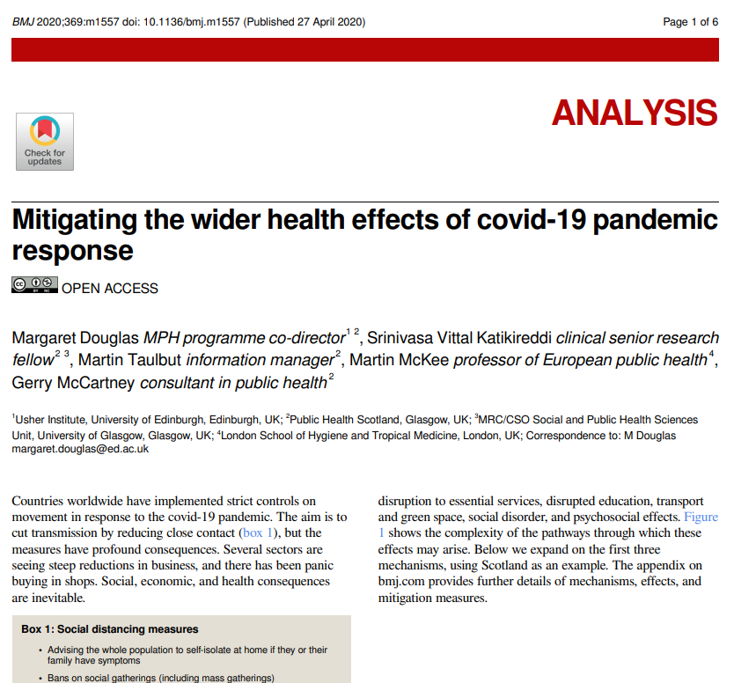

Slide 12
Impacts of inflation
We used an existing policy simulation tool (Triple I) to estimate the impacts of inflation on mortality in Scotland
The estimated impacts are large, even when mitigated by the Energy Price Guarantee and other measures seeking to reduce the costs of living
Preprint article available here: https://www.medrxiv.org/content/10.1101/2022.11.30.22282579v1

Slide 13
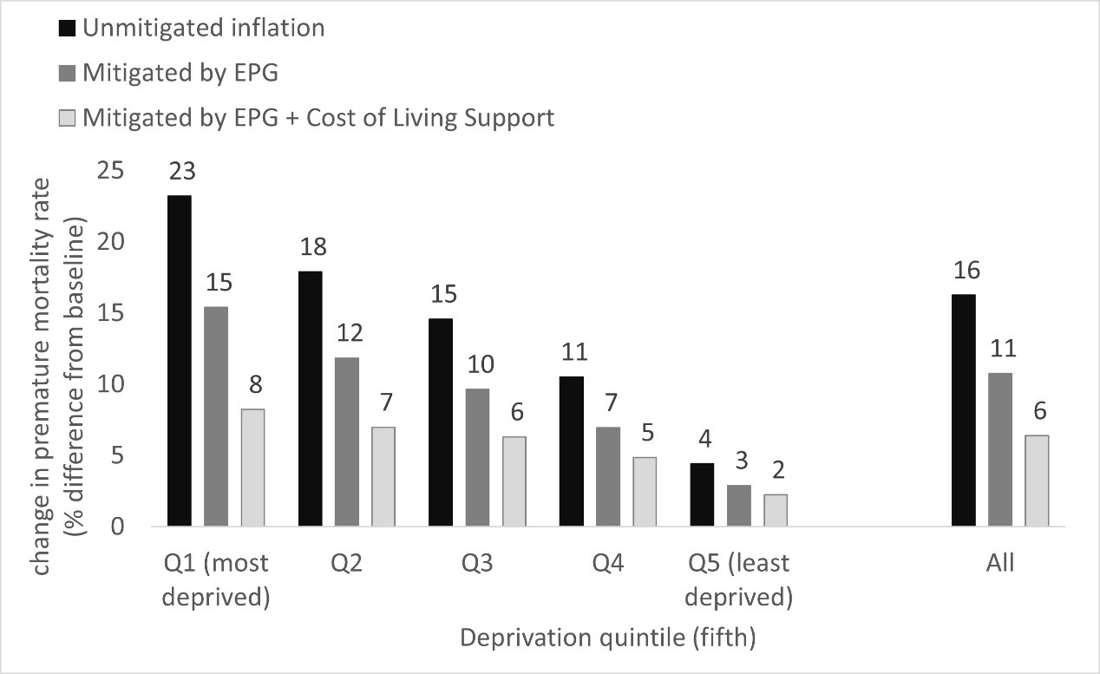
Impacts of inflation
Preprint article available here: https://www.medrxiv.org/content/10.1101/2022.11.30.22282579v1

Slide 14
Conclusions
The current higher than expected mortality across the UK can be explained by:
  Ongoing impacts of austerity that have impacted since around 2012
  The direct and indirect impacts of COVID-19
  The impacts of inflation on real household incomes, especially in the lowest income groups
Calls for improved uptake of secondary prevention measures as a response to the current mortality trends are insufficient

Slide 15
Links to recent report and animation: www.gcph.co.uk/life-expectancy
Email: gerard.mccartney@glasgow.ac.uk
Thanks to my co-authors: David Walsh, Lynda Fenton, Rebecca Devine, Margaret Douglas, Elizabeth Richardson, Neil Craig
Statement of interests: No interests to disclose.

