Slide 1
The Impact of the Cost of Living Crisis in Swindon
9th May 2023
Helena Robinson
Head of Health Improvement Services

Slide 4
Citizens Advice Swindon – Resident Survey
Initial survey June 2022
Repeated March 2023

Slide 6
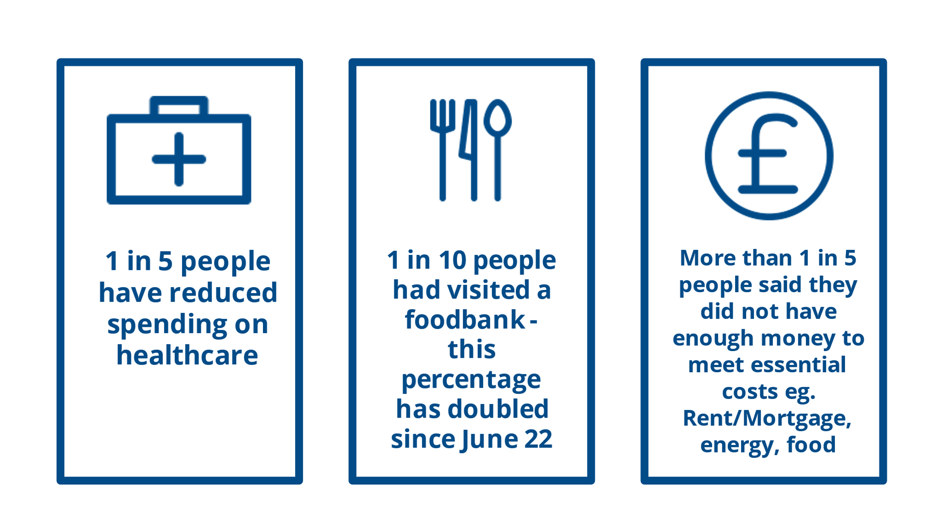

Slide 7
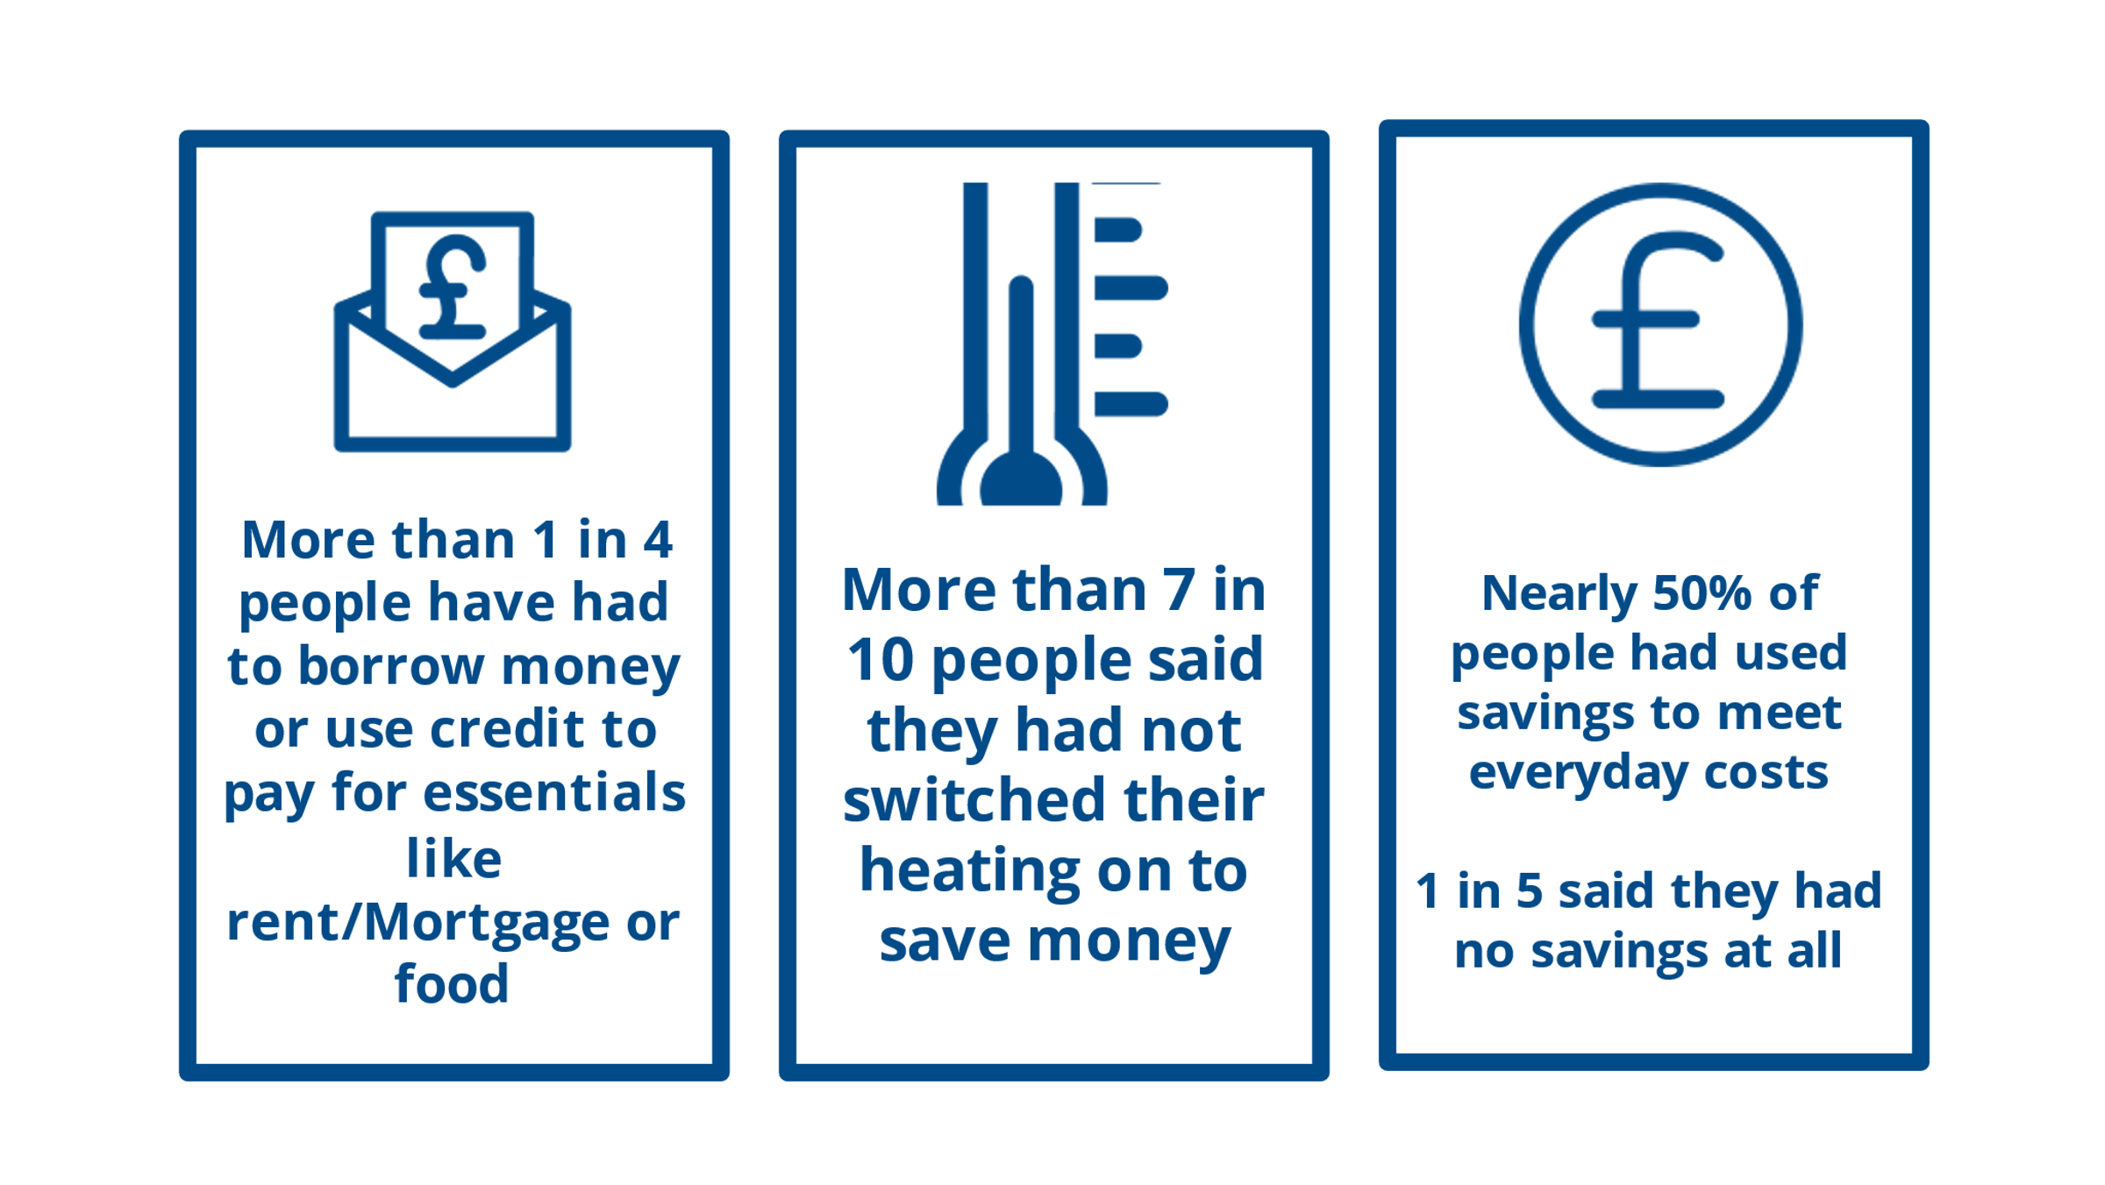

Slide 8
Swindon Borough Council - Response
Public Health Leadership
Established strategic cost of living group – covering all council departments – joining things up internally
Established cost of living partnership to support wider organisations and residents - join up across the system
Notes:
.

Slide 9
Keeping on Track – Plan for Swindon
Consider individuals and groups facing the greatest health inequality and design programmes, activities and interventions which reach those most in need
Ensure governance and funding is well considered and allows for good collaboration, new conversations and exploration of doing things differently.
Harness the skills, interests and connections from internal and external workforce to ensure everyone is equipped to support Swindon residents and that insight, knowledge and resource is shared.
Build the capacity of communities, local groups and individuals to self-serve and play a part in improving the situation for them and others.
Engage with communities and ensure programmes and messages reach as far and wide as possible and activities and provision are accessible

Slide 10
Keeping on Track – Some Headlines
Household Support Fund (HSF) – 905 grants issued / £109k
Swindon Emergency Assistance Fund (SEAF) - 50 households per month
School vouchers – 9k households; 26k vouchers (£550k)
Over £140k distributed to Voluntary & Community Sector partners
Citizens advice: Financial First Aid - £281k benefit realisation
Expand Local Heroes programme – 60 volunteers / 210 hours in Feb 23’
Facilitate Feeding Swindon Partnership – 69 organisations, 28 council teams

Slide 11
Warm and Welcome Spaces
40+ venues including council and community owned spaces
Place for connections, resources and advice
https://www.swindon.gov.uk/warmandwelcome

Slide 12
Cost of Living – 18 Top Tips
7m missing income related benefits & pension credits
Childcare costs
Support with housing payments and council tax
Carer’s allowance
Hardship help for energy
Healthy start/Free school meals
Debt advice
Help with health costs
Mental health support
Website: 32k impressions; Facebook over 1m impressions; Twitter 130k impressions
https://www.swindon.gov.uk/info/20013/benefits_and_swindon_money_matters/1260/help_if_youre_struggling_with_living_costs

Slide 13
Support for Employees
Series of employee workshops and information
Everyday finance
Financial wellbeing
Savings and investing
Planning for retirement
Family and finances

Slide 14
More distance to travel…
Use of Health Inequality funding
Use of shared prosperity funding
Warm and welcome / cool and welcome
18m plan – marathon not a sprint

Slide 15
LGA Public Health Annual Report 2023
Responding to cost of living challenges: Swindon | Local Government Association

