Slide 1


Cost of living crisis: the view from Wales
Dr Louisa Petchey
Senior Policy Specialist, Public Health Wales
9 May 2023

Slide 2

Wales at risk
Low income
Wales has higher levels of poverty compared to the UK with almost 1 in 4 in poverty for the last decade
Homeless
Nearly 12,000 homeless households of which 4000 in priority need and further 9000+ threatened
Disability
28% of people report a disability in Wales - higher than any other part of the UK (national average of 22%)
At risk populations
Older
Over 65s represent over a fifth of the population in Wales, the highest proportion of all UK countries
Children
More than 1 in 3 children in Wales live in relative income poverty - higher than the UK average
Rural
Nearly 1 in 3 people in Wales live in rural areas making it the second most rural nation of the UK

Slide 3
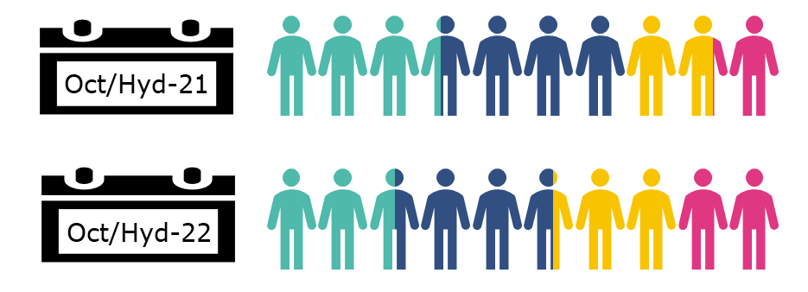
Crisis of severity & scale
Oct 2021
Oct 2022
● Secure ● Exposed ● Struggling ● In serious difficulties
Reference (Wales-specific data provided by authors)

Slide 4

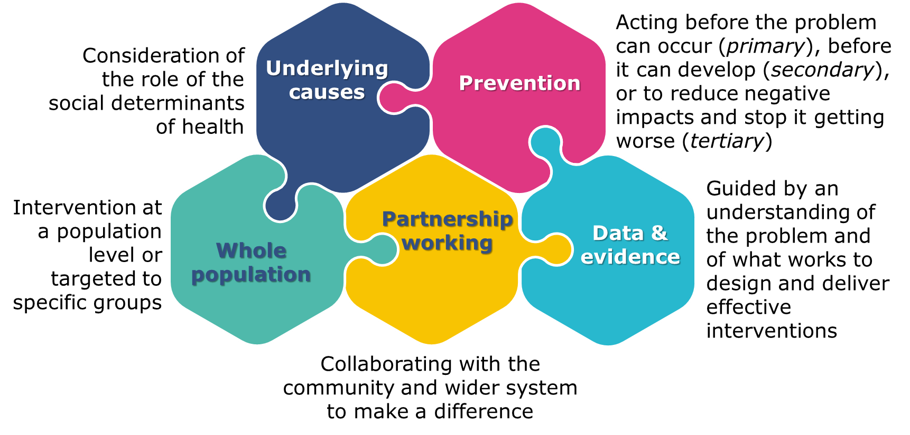
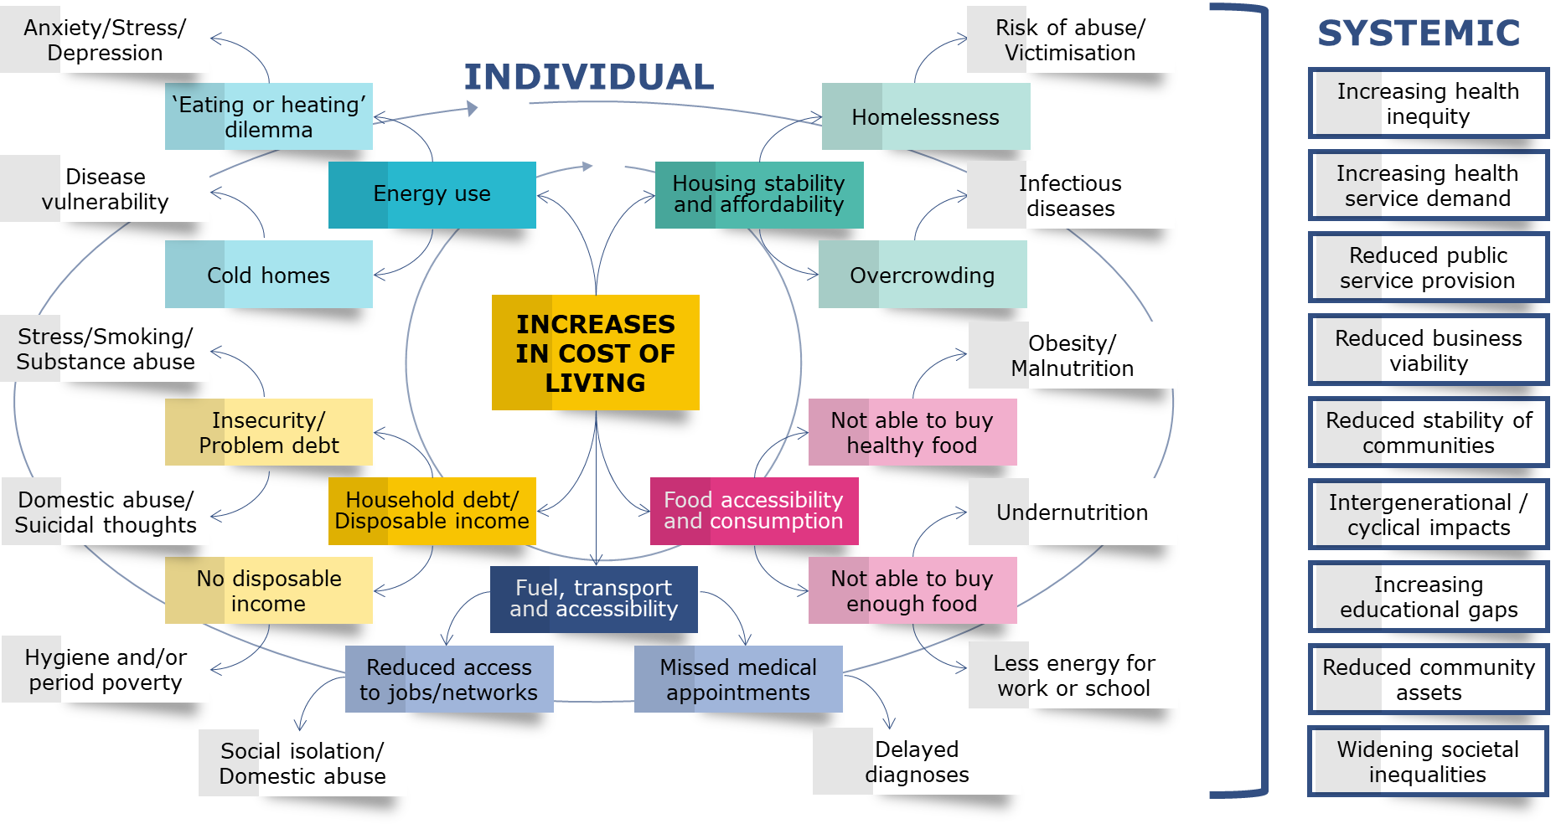
A public health lens

Slide 5





Taking action ourselves
Supporting our staff
Strengthening our winter comms
Enabling access to screening & sign-posting
Re-orientating our work programmes
Providing targeted support & collaborating with community sector

Slide 6


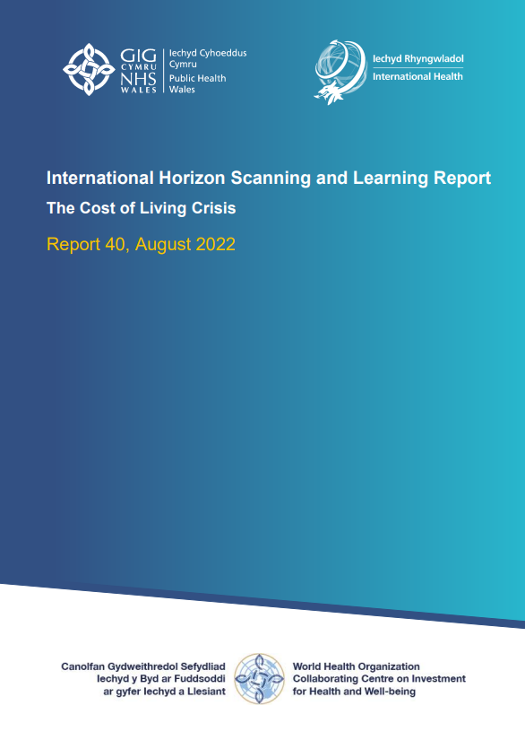
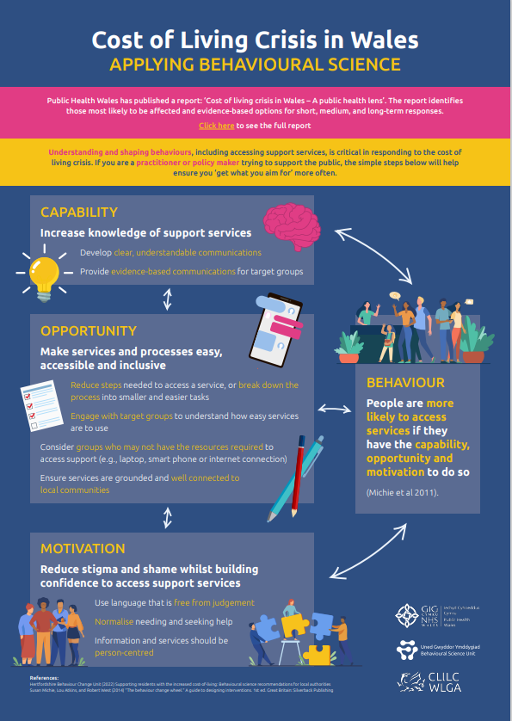
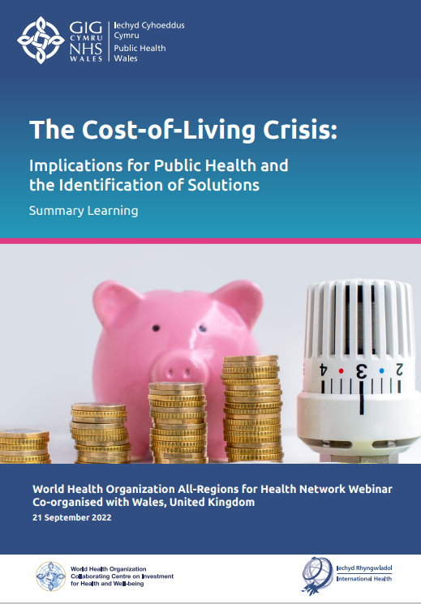
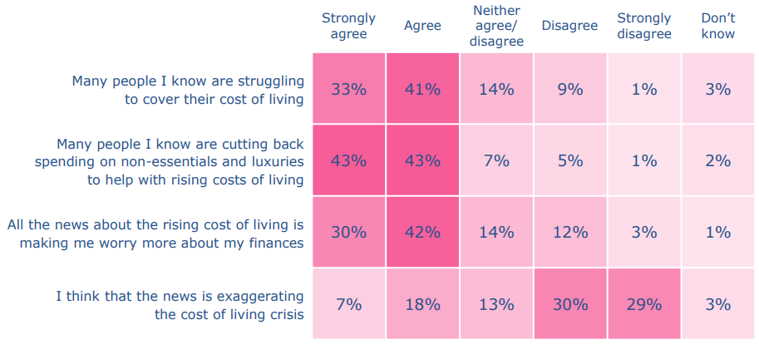





Supporting the system
“Taking action on the cost of living crisis in Wales”

Slide 7
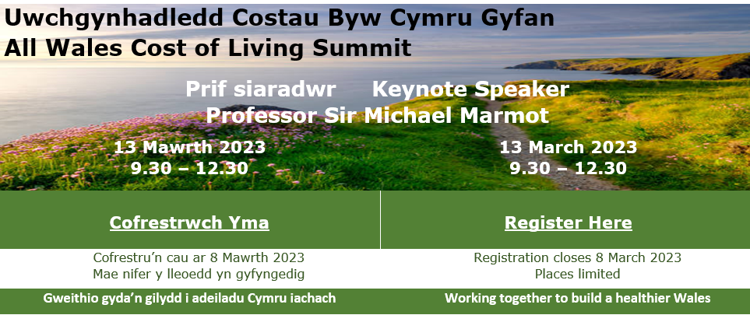
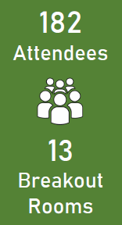
Convening the system
How important to health and well-being is action on cost of living? 4.8 out of 5 | How useful have you found the summit? 4.3 out of 5
What opportunities do you have to affect the impact of cost of living? 3.3 out of 5 | How would you rate your knowledge/skills/abilities to affect the impact? 3.3 out of 5
 | Short-term | Medium-term | Long-term
Local/ Regional | Make support easily accessible Inform service delivery | Improve partnership working & coordination Involve communities | Future ways of working Health equity
National | Set national direction & coordination Funding that supports the system | Use evidence to inform action Increase service offer | A healthier Wales A more equal Wales

Slide 8
Short-term
Medium-term
Longer-term

Slide 9






Welsh Government
£200 Wales Fuel Support Scheme
Fuel Voucher Scheme
Welsh Gov’t CoL support
Discretionary Assistance Fund (DAF)
£150 cost of living support scheme
Real Living Wage for social care
Expansion of free childcare & school meals

Slide 10
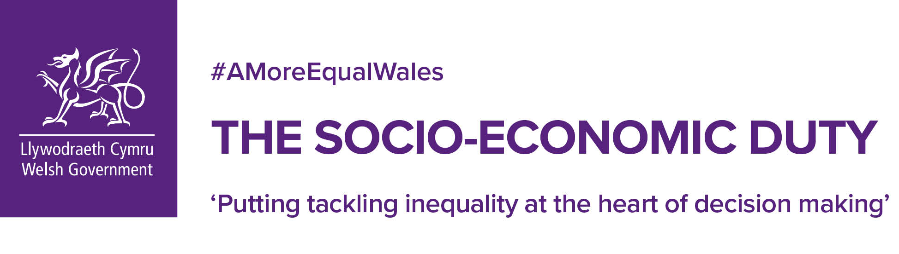

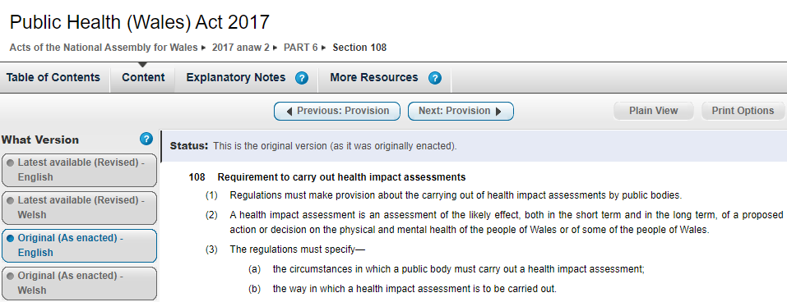
Enabling policies
Prosperous
An innovative, productive and low carbon society which recognises the limits of the global environment and therefore uses resources efficiently and proportionately (including acting on climate change); and which develops a skilled and well-educated population in an economy which generates wealth and provides employment opportunities, allowing people to take advantage of the wealth generated through securing decent work.
Resilient
A nation which maintains and enhances a biodiverse natural environment with healthy functioning ecosystems that support social, economic and ecological resilience and the capacity to adapt to change (for example, climate change).
Healthier
A society in which people’s physical and mental well-being is maximised and in which choices and behaviours that benefit future health are understood.
More equal
A society that enables people to fulfil their potential no matter what their background or circumstances (including their socio-economic background and circumstances).
Globally responsible
A nation which, when doing anything to improve the economic, social, environmental and cultural well-being of Wales, takes account of whether doing such a thing may make a positive contribution to global well-being.
Vibrant culture and thriving Welsh language
A society that promotes and protects culture, heritage and the Welsh language, and which encourages people to participate in the arts, and sports and recreation.
Cohesive communities
Attractive, viable, safe and well-connected communities.

