Slide 1

Food insecurity:
Highlights from local and national work
Dr Dianna Smith, Dr Grace Grove, Dr Elizabeth Taylor, Dr Nida Ziauddeen & Prof Nisreen Alwan
9th May 2023
Poverty and the cost of living crisis – a public health emergency

Slide 2
Statement of Interest
This work is funded by NIHR Applied Research Collaboration Wessex

Slide 3
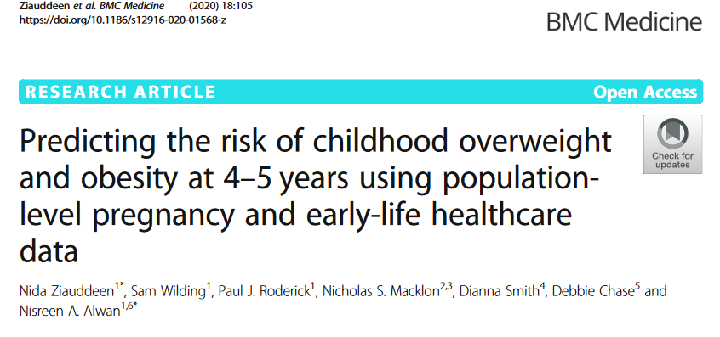

The Wessex FRIEND Toolbox
(Family Risk IdEntificatioN and Decision)
Childhood obesity risk estimation (individual measures)
Enhanced Health visiting
Social networking & asset mapping tool
Greenspace, food insecurity, child poverty (area-based measures)

Slide 4

Wessex FRIEND: consultations
Lead: Dr Dianna Smith
Semi-structured interviews with service providers & local government representatives (n=11)
Format: sharing current maps of estimates, discussion of observations of client demographics & drivers of need for food aid

Slide 5
Wessex FRIEND: Estimating food insecurity (national work)
Lead: Dr Dianna Smith
Updated more generic measures of relative deprivation
(Green et al 2018, Burke & Jones 2019)
Made the data and methods available to all. FREE.
Added distance to medium/large supermarkets
Sourced additional data to represent newly identified risk factors

Slide 6
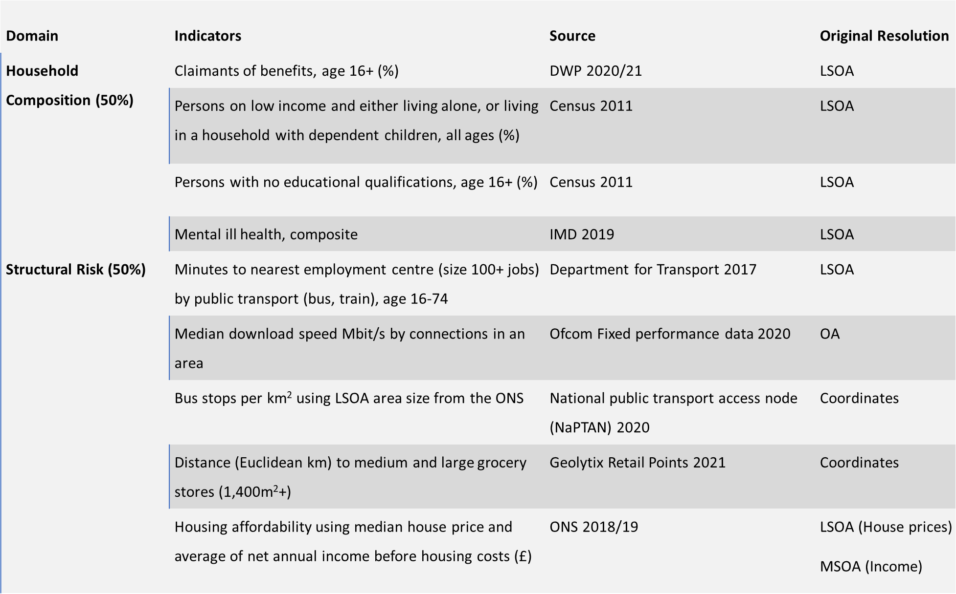

Slide 7
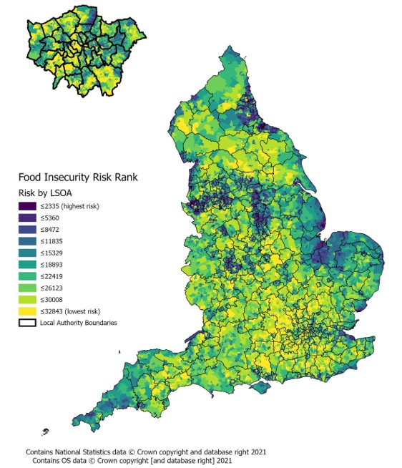

Slide 8
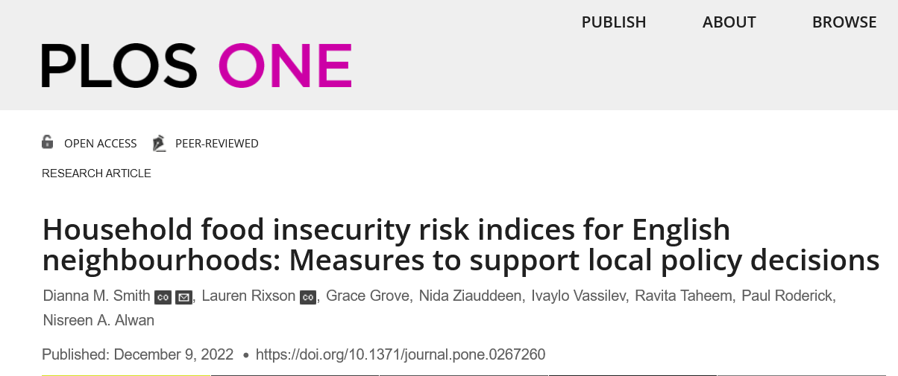
Validation
Spearman’s Rank correlation and χ2 analysis (deciles)
Free School Meal uptake, Child Obesity in Year 6 2017, IMD 2019, IDACI 2019
Urban and Rural areas explored separately
Strongly correlated with these external variables
Notes:
Income Deprivation Affecting Children Index (IDACI)

Slide 9
How is this useful?
Enabling improved targeting of resources in neighbourhoods
JSNA & food poverty action plans
Data and maps have been shared directly with 50+ local authorities, AgeUK, JRF, Citizens Advice
Planning for interventions: food pantries, holiday hunger activities
Website. Teams can add their own data and share internally, download data and maps: https://www.mylocalmap.org.uk/iaahealth/ (co-developed with Sustain and Southampton City Council)

Slide 10
“It is part of our intelligence that Council staff and food alliance organisations can use to work out where extra services may be needed. It also confirmed what we’d heard anecdotally about some areas where there was high need – yet few services.”

Slide 11

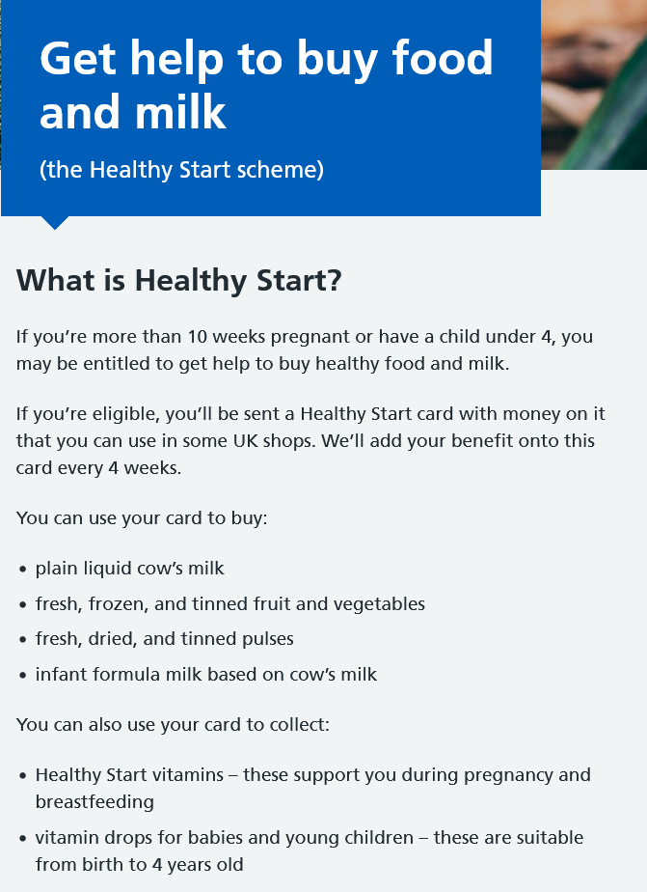
Wessex FRIEND: qualitative work
Lead: Dr Grace Grove
Health visitors working on an enhanced HV programme and parents under their care
Online focus groups and interviews
Topics covered included food poverty, the Healthy Start programme and the local health visiting service

Slide 12
“My grandma helps me a lot. She actually takes me food shopping once a month 'cause I'm on universal credit, while I’m a single mum, not by choice but I can barely afford my bills, let alone food, on top of that.”
Parents
“I get healthy start vouchers… it used [to be] £3.10, but as of last month they’re £4.25 and that's made like such a massive difference. 'cause before I could just buy my milk and maybe a bag of apples. But now I can afford to buy some grapes or something.”
[on foodbanks] “this week I got chocolate cake, donuts, some bread, some beans, and some pasta so, I mean the donuts and the cake were nice… but that's what we had [to eat].”

Slide 13
Health visitors
[on Healthy Start]
“I think some would benefit from it who aren't eligible, and that's quite frustrating. You know, they really do need it and then they’re more dependent on the fair fareshare food and things. But obviously that's not always appropriate for the tiny children, but it's frustrating when you can see that a family needs it and they don't fit the criteria.”
“Not having a car… they're relying on bringing that back on the bus, so they tend to get things more locally, that's more expensive and less healthy.”

Slide 14
Impact of COVID
Prioritising the child
Professional’s reluctance to discuss
Themes
Enablers:
Cost
Availability of equipment
Time & planning
Food preferences
Transport
Education
Discounted or free food
Family support
Healthy Start
Barriers to healthy eating:

Slide 15
Wessex DIET:
Determining the Impact of food
insEcurity in young families and Testing interventions
Assessing impact and challenges to feasibility of planned food aid interventions to support better funding prioritisation in local government

Slide 16



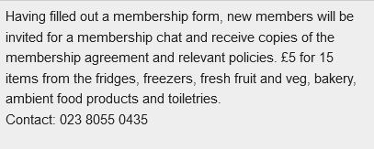
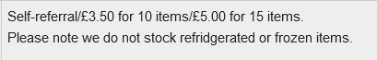
Food pantries or membership clubs:
Pay a weekly membership and then select (discounted) food items

Slide 17
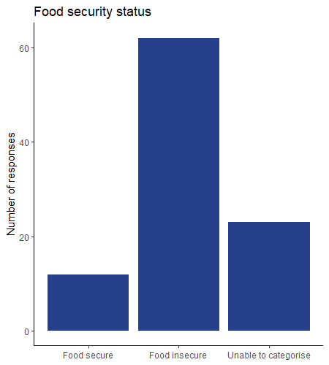
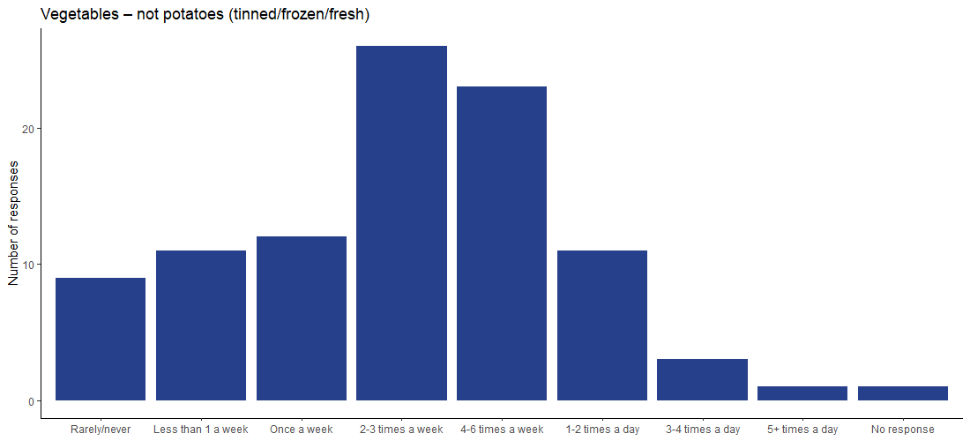
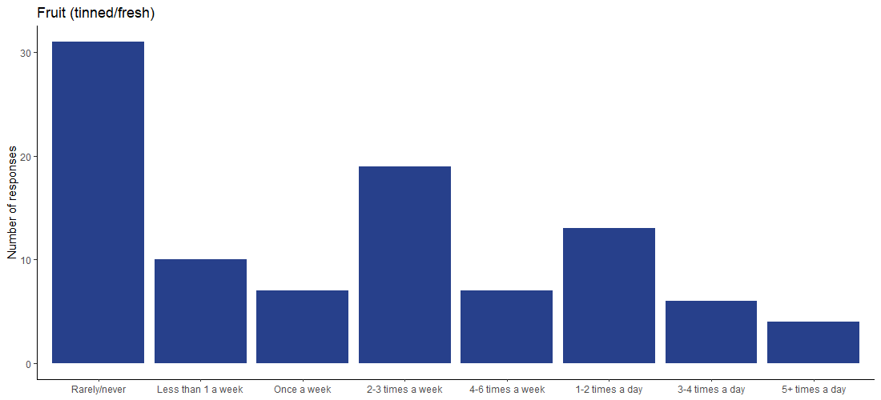
Wessex DIET (ongoing):
baseline survey (n=97)

Slide 18
I love it. I absolutely love it. I've gone to it every single week since it started. I love the community, you know, speaking to the volunteers and just, I've met quite a few new people, which is quite nice as well. And it's just it's nice to kind of be able to save a little bit of money because before food market me and my husband were constantly in our overdrafts by quite a lot
Married, 3 children, full-time mum
And I've noticed that I'm kind of having more fruit and vegetables since going..
Barriers to healthy eating:
Time, making sure having enough food to prepare meals together

Slide 19
And I found as well, you know, I could get sort of like a week's worth of shopping for like, although you can only use up to a fiver and you can go round and get yourself, but after a couple of weeks that built up the bits that didn't use. So it was like, you know having really full, full cupboards again and it was great.”
Single male, lives alone, employed
And you know I've got a good bit of shopping for a really low price which, you know helped me out no end cause I’m only on a single income
Barriers to healthy eating:
Cost

Slide 20
Email: n.a.alwan@soton.ac.uk, d.m.smith@soton.ac.uk
Twitter: @Dr2NisreenAlwan @geodianna
NIHR ARC Wessex
Southampton City Council
Hampshire County Council
Dorset Council
Southampton City Mission
Southampton Social Aid
Cookbox
Thank you:
Jane Appleton
Ivo Vassilev
Paul Roderick
Fran Richards
Marta Disegna
Tim Lloyd
Sally Shillaker
Naomi Mason
Em Rahman
Lucy Dennis
Farihah Choudhury
Barrie Margetts
Simon Oldham
Jen Sissons
Ravita Taheem
Sara Crawford
Duncan House
Jason Murphy

