Slide 1



A crisis on our doorstep
The deepening impact of the cost-of-living crisis on children and young people in the UK
Ali Cooper
Child Poverty Lead, Barnardo’s
No interests to disclose
E: Alistair.cooper@barnardos.org.uk

Slide 2
Context: Rising child poverty
Sources:
      - Interviews & Focus Group
      - Analysis of Children’s Emergency Fund
      - Survey of 316 children
      - Polling 1000 parents

Slide 3
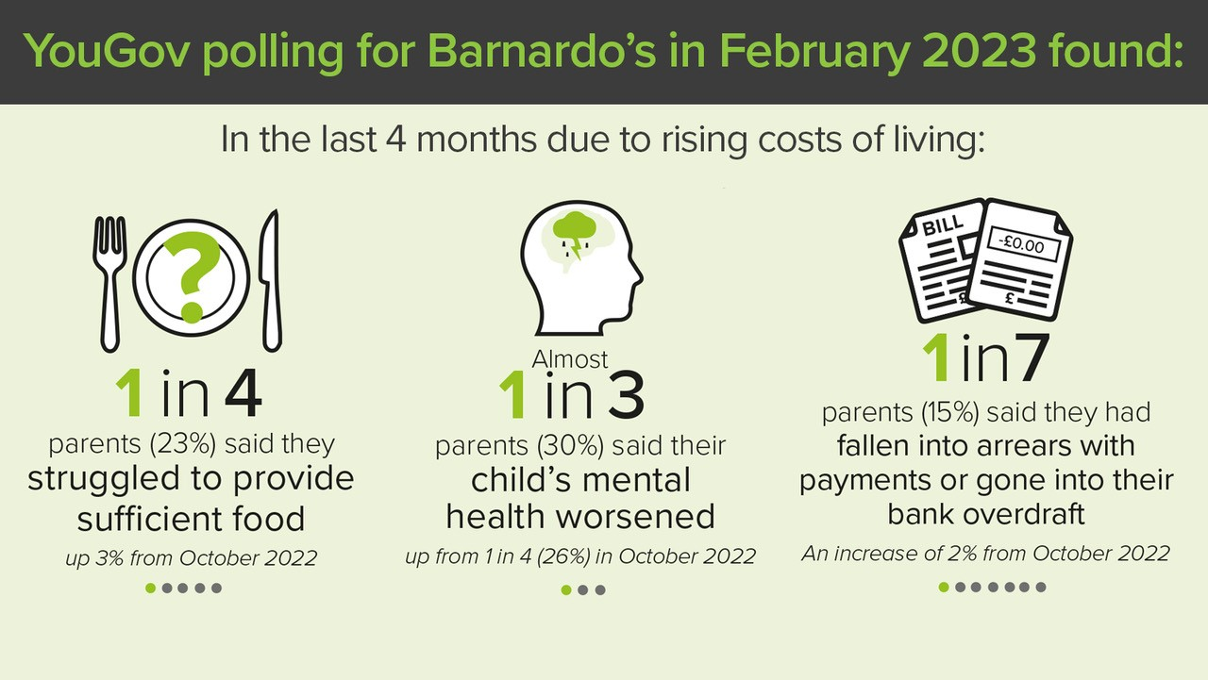

Slide 4

Key concerns
      Hunger
      Essential items - beds/bedding
      Warm housing
      Mental health
      Physical health
“the sad truth was that the only thing that he could strip back was his sons’ swimming lessons, it was really sad. When you see stuff like that it’s really heart-breaking.”
Barnardo’s Practitioner, Inverclyde

Slide 5

Recommendations
Targeted action and ambition
Extend Free School Meals
End the two-child limit
Mental Health Support Teams in every school

Slide 6
Contact:
Alistair.cooper@barnardos.org.uk
Becky.rice@barnardos.org.uk
Ali Cooper
Child Poverty Lead, Barnardo’s
E: Alistair.cooper@barnardos.org.uk

