Slide 1
Role of enforcement in Tobacco Control
Tobacco is the single most dangerous consumer product in the world. Cancer Research UK estimate that 2 in 3 people who smoke long term will die from their habit and at least a quarter of deaths are caused by tobacco
People “smoke for the nicotine but die from the tar”…… so nicotine alternatives can be very helpful to move people away from the tar in tobacco
BUT important that nicotine alternatives are LESS harmful or no point to them

Slide 2
2 main ways of reducing tobacco harm
Getting people who smoke to quit
Stopping people who don’t smoke from ever starting
ALL LEGISLATION DESIGNED TO ACHIEVE ONE OR BOTH OF THESE AIMS

Slide 3

Legislation without (possible) enforcement is just words on calf skin

Slide 4
Push back against legislation
Not possible to enforce
Increases illicit trade
Won’t work

Slide 5
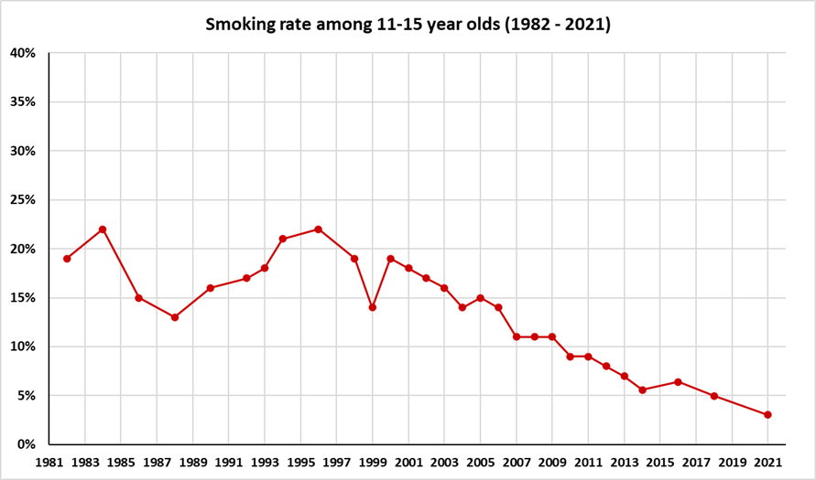

Slide 6
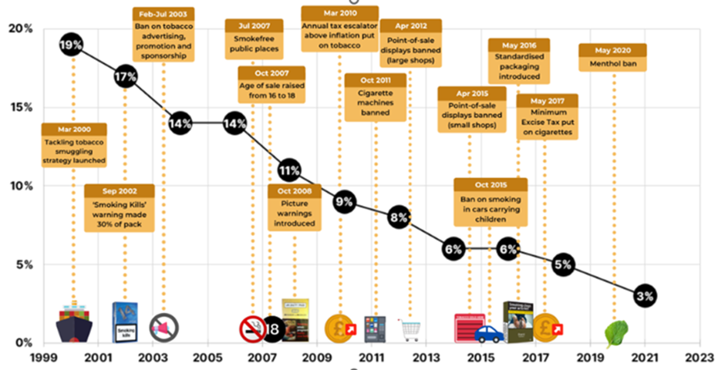

Slide 7
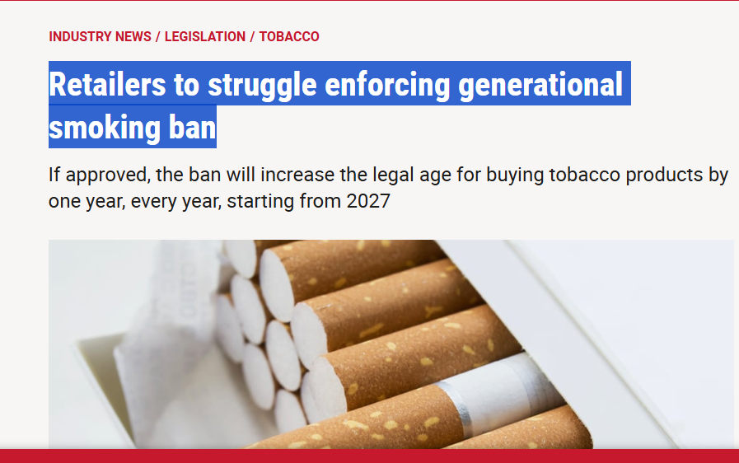
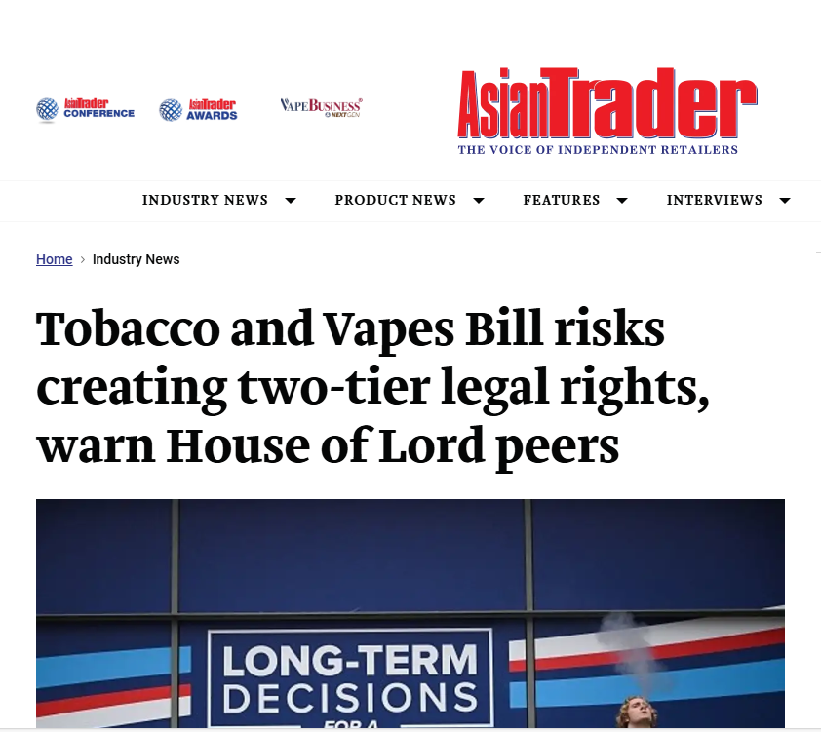
Challenges to Tobacco and Vapes Bill
“We all want to help reduce smoking, but [not] at the expense of our staff safety or livelihoods. And the reality is the responsible retailers who’ll be hit hardest by this Bill aren’t those already selling to minors. It’s unthinkable that the government is contemplating new laws when existing age-of-sale enforcement by thousands of illicit shops is so woeful.” Paul Cheema C-Talk

Slide 8
Smokefree Generation Policy
It is an offence to sell any of the following to a person born on or after 1 January 2009— (a) a tobacco product; (b) a herbal smoking product; (c) cigarette papers.
A person who commits an offence under this section is liable on summary conviction to a fine not exceeding level 4 on the standard scale. (£2500)

Slide 9
Smokefree Generation Policy
Currently – salesperson asks customer how old they are.
Future – salesperson asks customer what their date of birth is.
Due Diligence – asking for ID which gives date of birth (no change)

Slide 10
Tobacco and Vapes Bill
On the face of the bill – come into force 6 months after Royal Assent
Stop free distribution (current enforcement loophole)
Age of sale restrictions for other nicotine products and 0% vapes (current enforcement loophole)
Ban on vending machine sales of vapes and other nicotine products (straightforward to enforce)
Enabling TS to issue FPNs for various offences (additional penalty opportunity)

Slide 11
Tobacco and Vapes Bill
On the face of the bill – come into force at a date to be determined after Royal Assent
Ban on vape and other nicotine products sponsorship and advertising – needs to be very clear to enable enforcement

Slide 12
Tobacco and Vapes Bill
May come into force following further consultation
Regulation of the flavours of vapes and other tobacco and nicotine products
Regulation of product features and design of vapes and other tobacco and nicotine products
Regulation of point of sale displays for nicotine and non-nicotine vapes and other nicotine products

Slide 13
Tobacco and Vapes Bill
May come into force following further consultation continued
Regulation of the packaging of vapes and other tobacco and nicotine products
A new registration system for tobacco products, tobacco related devices, herbal smoking products, vaping products and nicotine products.
A new licensing scheme for tobacco and nicotine products (including vapes) so that only premises which have a license can sell them
Extension of smoke-free places and creation of vape-free places

Slide 14
Summary
Most tobacco, vapes and nicotine regulation enforced by Trading Standards Officers
We contribute in a unique and critical way to reducing tobacco harm in our communities
The UK wants a SmokeFree Generation – we need to deliver

