Slide 1
Climate & Health Advocacy

Slide 2
Structure of this slide-set
Ctrl & click on the links to go to the relevant section
Background: FPH Climate & Health strategy: advocacy theme
Summary outputs from scoping work
Synthesis
More detailed slides on key papers
Notes:
Background & purpose
The Faculty’s Climate & Health Strategy includes advocacy as one of its key priorities. As part of the implementation of the strategy, we undertook some scoping work, learning from past experiences and research. At this webinar, we want to share what we’ve found so that colleagues can make use of the learning to inform future advocacy efforts.
Aims:
To share what we’ve found and done in the scoping group of the advocacy for climate & health workstream
To help people understand how to use the resources we’ve produced (a quick synthesis and reading list)
To give people a chance to have a go at putting some of the resources into practice (frameworks and tools for advocacy)
To inform work on proactive & reactive advocacy efforts

Slide 3
Structure of this slide-set
Ctrl & click arrow to return to summary slide
Background: FPH Climate & Health strategy: advocacy theme
Summary outputs from scoping work
Synthesis
More detailed slides on key papers

Slide 4
FPH climate & health strategy’s aims
Our vision for climate and health
Better health for all – leaving no one behind, now and for future generations
The Faculty of Public Health becomes a credible and respected voice on climate, environment and health impacts, and supports the public health workforce to lead on strategies to protect health and wellbeing for current and future generations.
Our mission for climate and health
As the professional membership body for public health, we will work to promote and protect health for everyone and will:
- Ensure that the public health workforce has the knowledge, skills and capability to work on mitigation and adaptation to the climate emergency and environmental breakdown, including access to resources and the confidence to make the case for the health co-benefits of action on climate change
- Advocate for inequalities to be essential to all work on climate, the environment and health, recognising that climate injustice creates health inequalities locally and globally
- Demonstrate leadership by becoming a net-zero organisation

Slide 5
Strategy’s wording around advocacy
Advocacy
We will deliver an ambitious advocacy agenda with clear priorities and a strong evidence base to drive positive changes in addressing the climate, environment and health emergency at a global, national and local level
Our priorities to 2025
Coordinate and collaborate with other organisations on key advocacy messages, at global, national and local levels, e.g. collaborate with others to proactively advocate on issues which are related to climate, environment and health
Ensure that our members have the skills for advocating on climate change, environment, and health, specifically ensuring that they are able to advocate for those most affected by climate change and environmental breakdown, e.g. develop an "advocates" or "spokesperson" scheme for members to be able to advocate on key issues
Develop a theory of change in order to inform our advocacy on climate change, the environment and health, e.g. workshops to develop our theory of change and consider how best to influence action in this field, ensuring that this includes a review of how to effectively advocate and learn from historical mistakes
Prioritise advocacy where the outcomes will have the most impact such as high impact topic areas or where the opportunity to influence is greatest.

Slide 6
Summary of the Advocacy workstream
Our aims are:
To contribute to skills & support for members (who are better able to advocate and doing more advocacy as a result)
A focus on inequalities
Some success (tbc how measured) on proactive & reactive advocacy by the Faculty & the SIG
We will start by:
Some scoping, reviewing & learning from others & the past
Develop focused proactive advocacy on a very small number of issues
Develop mechanisms (eg a group) for reactive advocacy
Skills programme & networks & other support for members & SIGs doing advocacy
Developing our Theory of Change for advocacy
Notes:
Focus today is on updating from the scoping workstream
Will also bring in the proactive advocacy campaign
For information:
Reactive process is in place
Skills programme – we did a survey and have been putting on webinars, with plan to synthesis findings to inform longer-term skills programme
Theory of change was developed for strategy as a whole and interim version for the advocacy workstream, could also be used in developing proactive advocacy

Slide 7
Summary of scoping work
We have completed a ‘quick and dirty’ review to summarise the literature on advocacy. The purpose of this review was to inform the FPH’s advocacy workstrand within the Climate & Health Strategy.
The outputs of this review are:
A reading list comprising the full set of papers that we included from our purposive search - this can be searched for in-depth information and added to over time. It is structured against the themes for the synthesis (see next slide)
This slideset summary (see next slide)
As a group, we can also help with providing more detailed input to the proactive advocacy & skills strands as requested (capacity permitting), for example presenting an overview of ingredients for success or suggesting tools or frameworks to use in planning campaigns.
Notes:
Brief methods:
We have completed a ‘quick and dirty’ review to summarise the literature on advocacy. The purpose of this review was to inform the FPH’s advocacy workstrand within the Climate & Health Strategy.
We undertook a purposive search using the following methods:
We searched for the following terms Search 1: “Effective advocacy” “climate” “health” Search 2 advocacy complex system “public health” Search 3 "systematic review" "societal change" in:
First 5 pages of Google
First 5 pages of Google Scholar
Campbell Collaboration
Cochrane
IPCC research synthesis
We searched the websites of ally organisations that we have mapped for terms “Advocacy” “climate” “health”
We searched websites of PH professional organisations for terms “Pedagogy” “skills” “advocacy” “training”
We asked for recommendations from key stakeholders including PH declares & SIG & advocacy working group
We snowballed (ie followed up references from initial results)
Included papers for the full reading list
We used researcher judgement about whether articles contributed to answering the research questions to determine whether to include in the full reading list.
The research questions were:
What works in advocacy for climate and health?
Historically, what has worked to achieve large scale societal change?
Historically, what are the mistakes we need to learn from? (de-prioritised due to capacity and some overlap with what has worked)
Which organisations have already done thinking on any aspect of this whose websites / social media might point to some key resources?
What can we learn about public health advocacy from the COVID-19 pandemic? (de-prioritised initially due to capacity)
What works for skills? What does a successful skills for advocacy programme look like?
How is the reading list currently structured?
It includes columns with information on:
Which search did it come from?
Which 'perspective'? / Who is the advocacy aimed at?
Title
Author/s
Link to publication
Abstract
Key points of relevance to our ToC development
Which research question/s does it contribute to?
Key paper? (this identifies whether we were including it in the summary synthesis)
Whether / how it contributes to the framework for analysis:
Skills?
Case for advocacy / does it work?
Ingredients for successful advocacy
Types of advocacy
Case studies
Climate / Ecological focus?
Other social change / PH focus?
Things often missing
Synthesis and summary: pulling out key points from the reading list
We each added papers to the reading list and added information into the columns as described above.
We went through to decide whether the paper should be a ‘key paper’ (initially we tried to pick the ‘top 5’ from each search, but changed this to ‘key paper’ because some searches yielded more results than others).
We then summarised the key papers on a slide each in this powerpoint.
We also contributed to an initial list of themes to start to generate a framework for analysis (slide 2)
We also listed the range of things that could be found in the reading list (slide 10)
We then further consolidated the themes into a shorter framework:
Case for advocacy
Historical mistakes
Ingredients for success
Types of advocacy
Skills for advocacy (this theme was added part way through the process of summarising to better reflect the different topics)
Things that are missing
We then further summarised all of the individual slides (which each summarised a key paper) into short bullet points under each of these themes and identified (using icons) whether they contributed:
• Theory
• Tools
• Experience / evidence

Slide 8
Structure of this slide-set
Ctrl & click arrow to return to summary slide
Background: FPH Climate & Health strategy: advocacy theme
Summary outputs from scoping work
Synthesis
More detailed slides on key papers

Slide 9
Summary outputs from scoping work
Ctrl & click on the links to go to the relevant section
Each paper in the synthesis is annotated to show whether it is helpful for
Theory
Tools
Experience / evidence
The scoping slide-set includes:
A summary synthesis of key papers
The case for advocacy
Historical mistakes / lessons we need to learn from
‘Ingredients’ for successful advocacy
Types of advocacy
Advocacy skills
Things that are missing from the literature
Key things you can find in the reading list
Some tools and frameworks
A slide per key paper - a bit more detail on the papers included in the synthesis
Notes:
In addition to the reading list itself, we have also collated the results in this slideset for easier digestion and sharing with others. This includes a summary of some key papers grouped on certain themes to help structure thinking around advocacy, why it matters and how to make it work. It is also your guide to what else you can find across the reading list, and some tools and frameworks, plus a slide per important paper, that we hope you’ll find useful. And we’ve also tried to code the key papers into three categories for easier navigation: theory, tools or experience
Click on the links to take to the synthesis for that theme

Slide 10
Structure of this slide-set
Ctrl & click arrow to return to summary slide
Background: FPH Climate & Health strategy: advocacy theme
Summary outputs from scoping work
Synthesis
More detailed slides on key papers
Throughout the synthesis, ctrl click on the underlined title or author text to get the link to the full papers
Ctrl & click the arrows to get to the slides the key papers

Slide 11
Summary of findings: synthesis summary
Ctrl & click arrow to return to synthesis summary
Theme heading | Short explanation of the evidence |  |  | Snippet to whet your appetite
The case for advocacy | Advocacy is effective in achieving improvements in population & planetary health |  |  | Changes in social norms are critical for mitigation and often start with pilot experiments led by dedicated individuals and niche groups
Historical lessons to learn from | Analysis of what has and has not worked - from very strategic to very tactical |  |  | 11 commandments for Public Health Advocacy
‘Ingredients’ for successful advocacy | The ‘ingredients’ include: Professional training Policy A focal point |  | Networks Framing Cross-party-political work | Evidence it is possible to create and strengthen political commitment over time through concerted strategic action through 18 key factors including: effective networks, strong leadership, civil society mobilisation, supportive political administrations, societal change and focusing events, cohesive and resonant framing, robust data systems and available evidence.
 | Identification of 18 factors that drive political commitment Campaigns using more strategies and involving more groups involved = more effective Tools based on experience & success for use
Types of advocacy | Analysis of different types of advocacy and when they are most useful including theories, systems approaches, and ecosystems of social change |  |  | A framework to analyse which advocacy theory suits your goals and then point to which advocacy strategies and tactics to use.
Advocacy skills | Summarises the key skills |  |  | ‘advocacy often requires its practitioners to be unpopular vanguards.’ Helpful tools and toolkits on advocacy in general and some communications specific work on climate & justice
Advocacy skills | Content knowledge in three key areas: organisational and behavioural change, communications, and social movement theory theories of social change critical analysis strategic framing | understanding the underlying tussle for values, winning the definition, importance of resonant communication the ability to collaborate with a diverse set of stakeholders on complex problems |  | ‘advocacy often requires its practitioners to be unpopular vanguards.’ Helpful tools and toolkits on advocacy in general and some communications specific work on climate & justice

Slide 12
Summary of findings: case for advocacy
Ctrl & click arrow to return to synthesis summary
IPCC WG3 report Demonstrates level of certainty in evidence for demand-side mitigation and the role of different forms of advocacy in achieving this including: collective action underpins system change, changes in social norms are critical for mitigation and often start with pilot experiments led by dedicated individuals and niche groups, middle actors are important and under-used
See also:
Review on UN Nutrition Decade (in ingredients for success summary) which demonstrates possibility of creating and strengthening political commitment
Casebook for advocacy (in skills for advocacy section) which makes the case for the importance of advocacy in public health
Chapman on public health advocacy (in skills for advocacy section) which discusses some of the evidence for advocacy in public health

Slide 13
Summary of findings: historical mistakes / lessons
Ctrl & click arrow to return to synthesis summary
Three decades…why haven’t we bent the emissions curve? Analyses historical reasons for not reducing emissions across multiple lenses, common thread is the role of power, identifies lessons including: importance of challenging entrenched power and mindsets, changing norms and institutions that are reproducing problems driving climate change, need for greater breadth of thinking, focus on equity, high-carbon lifestyles and conditions for enabling new social imaginaries to disrupt status quo
11 commandments for PH advocacy reflections from Mike Daube who has played a big role in critical public health campaigns in Australia and internationally over more than four decades. Useful to read in more depth to learn from past when developing campaigns. 11 commandments are: act on sound evidence for action, be professional, develop comprehensive approaches and consensus positions – and work in coalitions, clear messages, understand government, policy, politics, politicians, bureaucracy, be non-partisan, understand and work with the media, be innovative, don’t be satisfied with soft options, be impatient – but patient, oppose and expose the opposition.

Slide 14
Summary of findings: ingredients for success (1)
Ctrl & click arrow to return to synthesis summary
Health professionals are motivated to act/educate on climate and ecological emergency.
Barriers = time constraints, lack of knowledge, feeling they won’t make a difference, too risky personally or professionally, concern about controversy. Action = professional education, communication training, patient education materials, policy statements, guidance
Kotcher et al
Most effective message: EXPLAIN THE RISK - Explain the problem (e.g. negative impacts of air quality), THE SOLUTION- explain how solution will benefit health (e.g. clean energy better AQ), NORMATIVE APPEAL - explain that most people support the solution, and how many people are taking action to advocate for the solution.
Kotcher et al
Establish an organizational home for climate and health work, provide training and resources, engage in climate advocacy as an organization, and network with other organizations
Mendoza-Vasconez et al
Importance of communication skills and framing, working with allies, working will all political parties, working with political leaders
Lysack et al

Slide 15
Summary of findings: ingredients for success (2)
Ctrl & click arrow to return to synthesis summary
Freudenberg et al Analyses 12 case studies of public health advocacy and identifies lessons including more effective campaigns used more advocacy strategies (5.3 versus 4.1) and involved more constituencies (6.3 versus 5.1) than less effective ones. Case studies include one on automobiles emissions.
Review on UN decade of Nutrition Useful for understanding what is needed to create and strengthen political commitment (and evidence this is possible to achieve over time through concerted strategic action). Identifies 18 factors that drive commitment, key commitment drivers across different contexts include effective networks, strong leadership, civil society mobilisation, supportive political administrations, societal change and focusing events, cohesive and resonant framing, robust data systems and available evidence. Also identifies context specific drivers and barriers (for LMIC and HIC)
Networks, advocacy and evidence in public health Analyses 2 case studies to highlight the importance of ‘policy networks’ and ‘advocacy’ Key ingredients for success include: regular engagement within diverse network, trust, clear research-informed proposals, ability to deal with disagreement through strategic trade-offs to keep focused, leadership (some advocacy groups functioning as knowledge brokers), a high degree of scientific consensus perceived and communicated externally, a supportive wider social and political context.
Chapman advocacy for public health a primer Presents 10 key questions for PH advocates to think through when developing a media based advocacy campaign, followed by a case study to illustrate. Also includes links to lots of helpful resources (some listed in the slide notes for the paper)
Future Advocacy recommends asking three key questions in order to design an effective advocacy strategy: what do we want?
Who can give it to us? Why haven’t they given it to us already?
Notes:
See also
historical lessons 11 commandments paper which covers some ingredients for success based on experience

Slide 16
Summary of findings: types of advocacy
Ctrl & click arrow to return to synthesis summary
Mapping the movement for climate change and health helpful in identifying the gaps and role that the FPH could play as part of a movement of organisations, focuses on climate and health movements in England, identifies different methodological approaches used, a gap for systems change focus and argues for shift to working as a ‘cohesive ecosystem.’
10 Theories to Inform Advocacy Identifies and describes 10 theories, split between Global theories (theories that explain how policy change occurs more broadly), and Tactical theories (theories from various social science disciplines that apply to common advocacy tactics that are likely part of broader advocacy efforts or campaigns) and when these might be useful. Could contribute to analysis of which theories to use when planning a campaign.
Middle-Out Perspective analyses how people working between government (top) and individuals (bottom) act to promote broader societal changes from the middle-out (rather than the top-down or bottom-up), illustrates with two case studies and identifies that using a wide range of middle-out can broaden coalitions and that care needs to be taken as they are not neutral, recommends mapping
Hunter et al provides a detailed worked example of using complex systems thinking to achieve a public health goal. Their approach includes seven integrated tasks (mapping stakeholders, umbrella review, policy mapping, participatory systems modelling, use of discrete choice experiments to understand relative importance of different approaches to car dependency, deliberative democracy, collaborative implementation planned and delivered by multiple stakeholders) through which they expect to attain a systemic view of the car dependency issue, potential intervention approaches to reduce it, and a framework for integration of interventions through coordination of stakeholder actions.
Bill Moyer looked at different activist roles and their influence at different moments for social change. This can help define different types of advocacy within the project or movement.
Notes:
See also
case for advocacy section IPCC report covers types of advocacy too
Lessons for advocacy Freudenberg et al also covers types of advocacy used including coalition building, media advocacy, and public mobilization, policy advocacy, community organization, litigation, letter writing, and public protest
Lessons for advocacy: Networks & Advocacy Smith & Weishaar also reviews types of advocacy

Slide 17
Summary of findings: advocacy skills
Ctrl & click arrow to return to synthesis summary
Casebook on advocacy in public health (includes case studies), World Federation of Public Health Associations, establishes what is public health advocacy and emphasizes the importance of advocacy as an essential public health function by bringing together 18 cases of public health advocacy from different corners of the world. Aims to increase knowledge and capacity to develop and implement advocacy strategies and inspire development of curricula and other training to strengthen advocacy.
The Advocacy Toolkit, Public Health Advocacy Institute of Western Australia, explains advocacy, includes examples and case studies, tips to work with the media, and practical tools to help you and your organisation advocate on your issue, also goes through types of advocacy and components of an advocacy framework (see eg frameworks section on later slides)
Public health advocacy discussion paper, Alberta Health Services, makes the case for increased theoretical competency, particularly increased content knowledge in three key areas: organizational and behavioural change, communications, and social movement theory – all areas typically not included in public health education curricula. Outlines the key attributes of public health advocacy, highlights and explore the main challenges to practicing public health advocacy, and identifies key skills required for public health advocacy including: theories of social change, critical analysis, strategic framing and the ability to collaborate with a diverse set of stakeholders on complex problems.
Advocacy in Public Health (Chapman) Discusses focal points for public health advocacy (different upstream factors identified), reflects on experience and uses case studies to illustrate, identifies importance of media (different types) as main source of information for public, identifies and reflects (through case studies) on 3 key debates (when is regulation justified, what methods are justified, what is the evidence advocacy works). Suggests 4 important public health skills / attributes as: 1) understanding the underlying tussle for values, 2) winning the definition, 3) importance of resonant communication, 4) ‘advocacy often requires its practitioners to be unpopular vanguards.’
Fairness in UK climate advocacy messaging (Climate Outreach) this report recommends testing campaign messages with different groups in order to understand how they are perceived, to unpick how different policies will affect different income levels, and to ground messages in the idea that the least well off should pay less when it comes to climate policies.

Slide 18
Summary of findings: things missing
Ctrl & click arrow to return to synthesis summary
Lack of indigenous and local knowledge in the academic literature on transformation means missing important perspectives (https://www.ecologyandsociety.org/vol25/iss1/art3/)
Need to: build appropriate psychological support into behavior change interventions, work with groups who can provide each other with emotional peer support, and ensure health and social care professionals are given adequate training.Frontiers | Relationships Between Climate Mitigation Actions and Mental Health: A Systematic Review of the Research Landscape | Climate (frontiersin.org)

Slide 19
Key things you can find in the reading list
Ctrl & click arrow to return to synthesis summary
Historical analysis of why change has / has not happened (including systematic review of mitigation identifying triggers, barriers, outcomes)
Evidence for different types of social change (including protest movements) and why they have / have not happened
Theory & practice on social change (types of decision making etc)
Importance of building support into change systems (eg https://www.frontiersin.org/articles/10.3389/fclim.2022.794669/full)
Framing as part of advocacy - lessons from when it goes wrong as well as what works (eg Reflections on how framing affects whether and how an issue is considered for addressing - potential backfiring of more discussion is the potential for capture of the issue by people with vested interests in not solving it https://www.cambridge.org/core/books/abs/regimes-of-inequality/in-and-out-of-the-overton-window/8A11D7389C64F66B58AB68FC0424FE20)
Systems thinking & theory applied to Climate Change, Societal transformation & advocacy (including case studies of how to apply this)
Mapping of behaviours that may impact on UK Net Zero and some distributional impacts as well as acceptability (may be useful for targeting specific campaigns)
Analysis of different types of advocacy
Theory about advocacy (including power analyses)
Case study examples of successful advocacy (focused on PH, CC or similar)
Case studies of broader transitions (going beyond advocacy) and pulling out what works
Toolkits for advocacy
Definitions of terms (transition, transformation, etc)
Climate communications
Systematic review on behaviour change interventions
Ctrl & click on the book icon to access the reading list
Notes:
Key things you can find in the reading list: a summary
Reading list is a google doc and can be added to over time as a living document

Slide 20
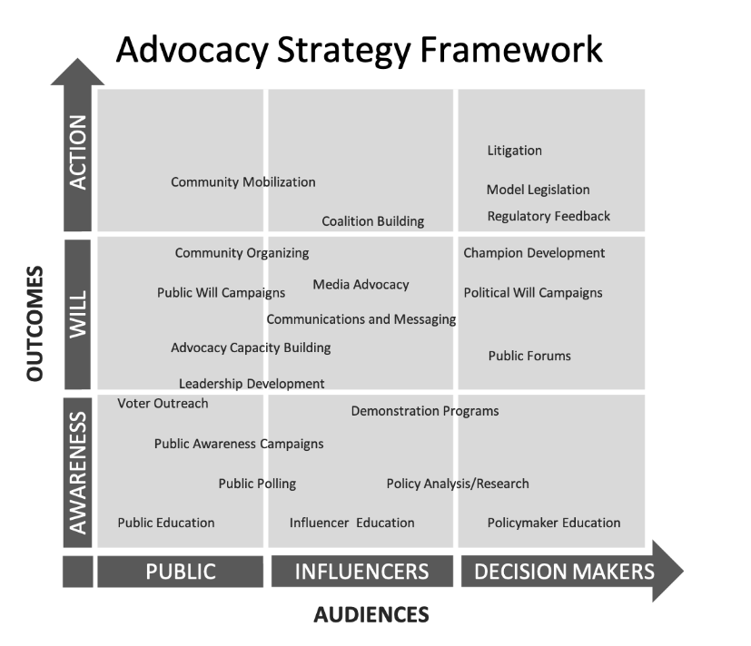
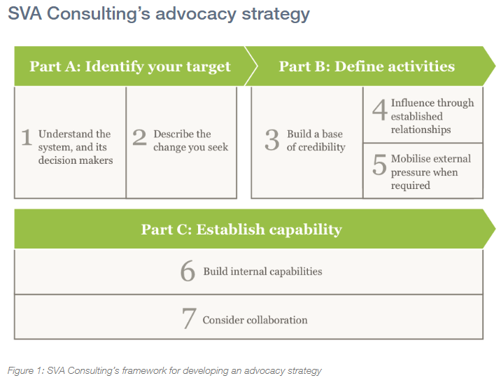
Example frameworks (1)
Ctrl & click arrow to return to synthesis summary
https://www.evaluationinnovation.org/publication/the-advocacy-strategy-framework-3/
https://www.socialventures.com.au/sva-quarterly/seven-steps-to-effective-advocacy/

Slide 21
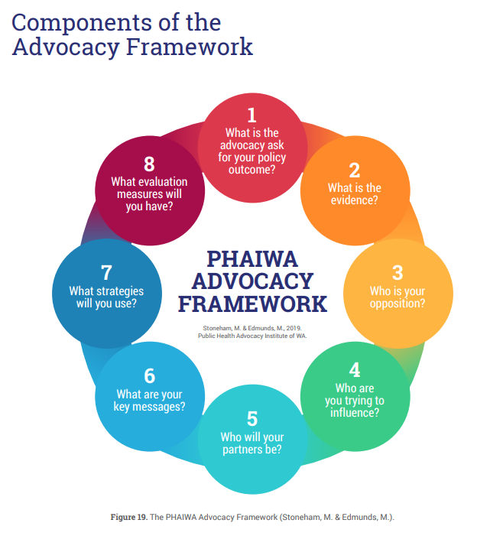
Example frameworks (2)
Ctrl & click arrow to return to synthesis summary
‘Policy adoption is not simply a matter of presenting the best facts and evidence to policy makers and sitting back to watch evidence triumph over other considerations. With rare exceptions, policy entrepreneurs and advocates need to engage in serious, extended and highly strategic efforts to ensure that evidence is communicated in ways that make it publicly and politically compelling, so that inaction is not an option.’ (Chapman)
This is from the Advocacy Toolkit from The Public Health Advocacy Institute (Western Australia)
The toolkit is a practical resource that supports and encourages health professionals and interested organisations to engage in advocacy. It covers background, planning your advocacy, tips and case studies as well as the framework.
https://www.phaiwa.org.au/wp-content/uploads/2019/09/2019_Advocacy-in-Action-A-Toolkit-for-Public-Health-Professionals-1.pdf
Notes:
This is from the Advocacy Toolkit from The Public Health Advocacy Institute (Western Australia)
The toolkit is a practical resource that supports and encourages health professionals and interested organisations to engage in advocacy. The Advocacy in Action toolkit:
Demystifies advocacy,
Includes examples and case studies demonstrating how advocacy strategies can be applied across different issues,
Offers tips to effectively work with the media, and
Provides practical tools to help you and your organisation advocate on your issue.
The fourth edition of the Advocacy in Action toolkit, released in 2019, features more examples and case studies, a comprehensive guide to evaluation, and more tips on working with the media.

Slide 22
Structure of this slide-set
Ctrl & click arrow to return to summary slide
Background: FPH Climate & Health strategy: advocacy theme
Summary outputs from scoping work
Synthesis
More detailed slides on key papers

Slide 23
What makes a brilliant advocacy strategy?
Ctrl & click arrow to return to synthesis summary
Based on a mini masterclass series from Future Advocacy (a consultancy), their three key questions for a brilliant advocacy strategy are:
The first – what do we want?
The second – who can give it to us?
The third - why haven’t they given it to us already?
By mapping responses of surveys of public health professionals to these questions, we could come up with an overarching advocacy strategy.
Apparently, the third question tends to be the hardest, with the following barriers being the most common:
The decision-makers don’t know about our problem, or our solution
They know but they have no incentive to act
The opposing side is more powerful
There’s another issue or constituency which has crowded us out
Our proposed solution is fundamentally flawed in some major way
Notes:
https://commonslibrary.org/what-makes-a-brilliant-advocacy-strategy/
3 alternative Qs (https://static1.squarespace.com/static/5e49ea5f94c2c44a94262103/t/5e717474eb2c831e97409adb/1585871018471/Art_of_Advocacy.pdf)
I. What do you want?
II. What does the political map look like?
III. What is your plan of action to win?

Slide 24
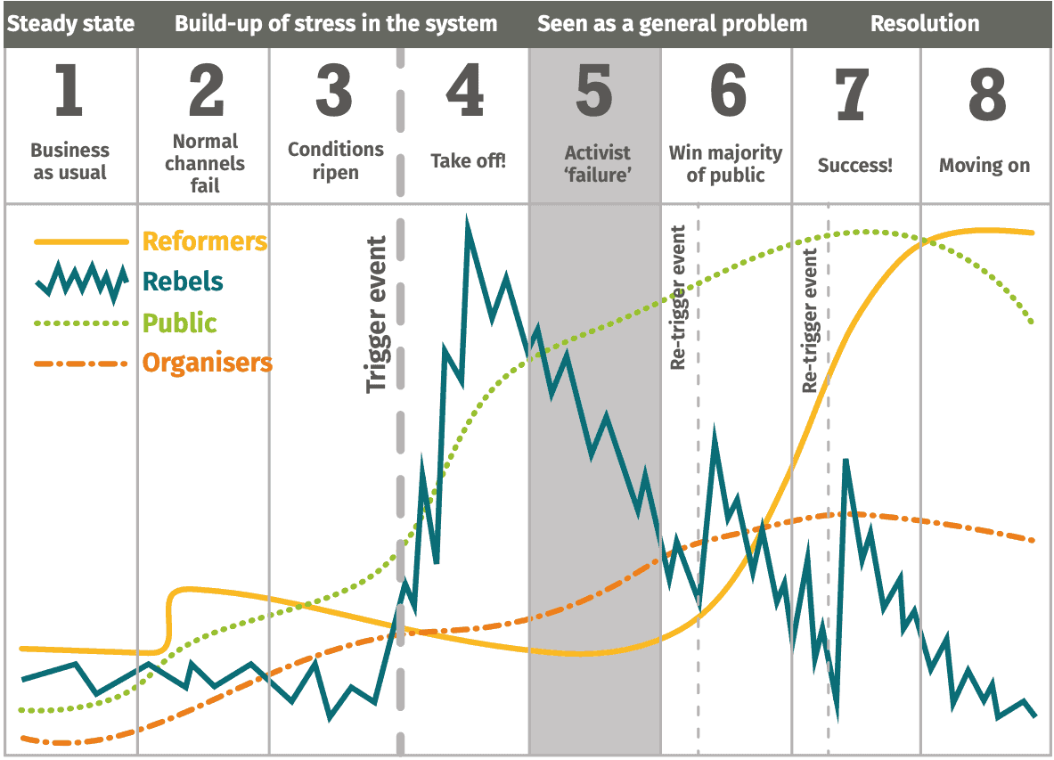
Different roles in activism
Ctrl & click arrow to return to synthesis summary
Bill Moyer developed the Movement Action Plan (MAP), incorporating 8 stages of a social movement and four roles of social activism after observing various social movements in the 1970s.
These roles have different parts to play at different stages of change - what roles are public health professionals willing to play and which actions might we associate with each role?
Natural roles as reformers and organisers may not be effective if we are at stage 3-5 when rebels and the public have a greater prominence.
Notes:
https://commonslibrary.org/bill-moyers-movement-action-plan-and-four-roles-of-activism/

Slide 25
‘Fairness’ in UK climate advocacy - Climate Outreach
Ctrl & click arrow to return to synthesis summary
Recommendations for advocates include (from Climate Outreach report):
Ensure fairness is embedded in campaign planning and development .
Find out whether your campaign messages will be perceived as fair, and by whom .
Call for local and national governments to give people a meaningful say in how policies are designed and who they benefit.
Don’t duck the difficulties that some people may face during the transition, but ‘pass the mic’ to trusted messengers who can reach audiences and communities that activists cannot .
Ground communications in commonly held views that the less well-off should pay less, and future generations matter .
Present the potential for the climate transition to act as a counter to the unfairness of life in Britain today .
Be aware that the British public does not instinctively share the same sense of deep unfairness that drives climate justice campaigners .
Position accelerated UK action and leadership as something we should be proud of, no matter what countries like China or India are doing .
Notes:
https://climateoutreach.org/download/27159

Slide 26
Paper title: Views of health professionals on climate change and health: a multinational survey study
Ctrl & click arrow to return to synthesis summary
Method: survey of >4000 health professionals around the world
Findings:
Health professionals broadly care about climate change and feel responsibility to educate others about the problem
Barriers to action/advocacy: time constraints, lack of knowledge, feeling they won’t make a difference, too risky personally or professionally, concern about controversy
Things that are helpful to take action: professional education, communication training, patient education materials, policy statements, guidance
Kotcher et al
Notes:
Theme: the case for advocacy/requirements for advocacy (IL, added to section 3)

Slide 27
Paper title: Advocacy messages about climate and health are more effective when they include information about risks, solutions, and a normative appeal: Evidence from a conjoint experiment
Ctrl & click arrow to return to synthesis summary
Method: 7500 participants in USA, testing message combinations
Findings:
The following enhanced the overall motivational value of a message:
Including the health consequences of climate change
Including the health benefits of climate solutions
Including calls to action
Most effective message: EXPLAIN THE RISK - Explain the problem (e.g. negative impacts of air quality), THE SOLUTION- explain how solution will benefit health (e.g. clean energy better AQ), NORMATIVE APPEAL - explain that most people support the solution, and how many people are taking action to advocate for the solution.
Kotcher et al
Notes:
Theme: Skills for advocacy (IL, added to section 3)

Slide 28
Paper title: Advocacy to support climate and health policies: recommended actions for the Society of Behavioral Medicine
Ctrl & click arrow to return to synthesis summary
“The Policy and Advocacy subgroup was comprised of experts in public health, climate policy, and health behavior change, who worked together to identify priorities and develop recommendations. We worked under the premise that building political will for climate policy action is the most urgent goal, and we recommended promotion of citizen advocacy for this purpose. Because citizen advocacy is a set of behaviors, SBM members can use behavioral science to identify and scale up interventions, working collaboratively with communities targeted for marginalization. Recommendations for SBM included establishing an organizational home for climate and health work, providing training and resources, engaging in climate advocacy as an organization, and networking with other organizations”
Mendoza-Vasconez et al
Notes:
Theme: Structures required for advocacy (IL, added to section 3)

Slide 29
Paper title: Effective policy influencing and environmental advocacy: Health, climate change, and phasing out coal
Ctrl & click arrow to return to synthesis summary
Lessons from the perspective of a network of NGOs influencing coal phase out in Canada: Key ingredients:
Interdisciplinarity
Building relationships with allies
Selecting primary frame and orientation for advocacy e.g. health/energy/environment (and testing these frames out on audience)
multi -partisan political orientation (not associating with only one party, trying to engage with all political parties)
Engaging political leaders
Communication skills, including engaging with the media
https://journals.sagepub.com/doi/full/10.1177/0020872814567485
Notes:
Theme: skills for advocacy (IL added to section 3)
Lysack et al

Slide 30
Paper title: Working Group 3 contribution to the Sixth Assessment Report (IPCC) technical summary
Ctrl & click arrow to return to synthesis summary
High level summary of specific approaches and the level of confidence in the evidence for their contribution. This provides level of certainty in evidence for demand-side mitigation and the role of different forms of advocacy in achieving this.
Key points:
Demand-side mitigation and new ways of providing services can help avoid and shift final service demands and improve service delivery. Rapid and deep changes in demand make it easier for every sector to reduce GHG emissions in the short and medium term (high confidence).
Collective action as part of social or lifestyle movements underpins system change (high confidence). Collective action and social organising are crucial to shift the possibility space of public policy on climate change mitigation. For example, climate strikes have given voice to youth in more than 180 countries. In other instances, mitigation policies allow the active participation of all stakeholders, resulting in building social trust, new coalitions, legitimising change, and thus initiate a positive cycle in climate governance capacity and policies.
Transition pathways and changes in social norms often start with pilot experiments led by dedicated individuals and niche groups (high confidence)
The current effects of climate change, as well as some mitigation strategies, are threatening the viability of existing business practices, while some corporate efforts also delay mitigation action (medium confidence).
Middle actors – professionals, experts, and regulators – play a crucial albeit underestimated and underutilised role in establishing low-carbon standards and practices (medium confidence).
Social influencers and thought leaders can increase the adoption of low-carbon technologies, behaviours, and lifestyles (high confidence).
https://report.ipcc.ch/ar6wg3/pdf/IPCC_AR6_WGIII_FinalDraft_TechnicalSummary.pdf
Notes:
Theme: case for advocacy and types of advocacy (added to case for advocacy, AB)

Slide 31
Paper title: Three Decades of Climate Mitigation: Why Haven't We Bent the Global Emissions Curve?
Ctrl & click arrow to return to synthesis summary
Analyses historical reasons for not reducing emissions across multiple lenses including the role of power
Key points:
Analysis through nine thematic lenses—covering issues of climate governance, the fossil fuel industry, geopolitics, economics, mitigation modeling, energy systems, inequity, lifestyles, and social imaginaries—draws out multifaceted reasons for our collective failure to bend the global emissions curve.
a common thread that emerges across the reviewed literature is the central role of power, manifest in many forms, from a ‘dogmatic political-economic hegemony and influential vested interests to narrow techno-economic mindsets and ideologies of control.’
Identifies some key lessons:
Entrenched geopolitical, industrial, and military power and associated mindsets are fundamental barriers to effective mitigation.
We need a greater breadth of thinking
The lack of progress means we now require a rapid, system-level change within both industrialized and industrializing societies.
We need to change norms and institutions that are reproducing the problems driving climate change
Attention to equity, high-carbon lifestyles, and conditions for enabling new social imaginaries has the potential to disrupt dominant, high-carbon development pathways.
And questions to guide future efforts
https://www.annualreviews.org/doi/10.1146/annurev-environ-012220-011104#_i27
Notes:
Theme: what works in advocacy (added to learning from history AB)
More detail:
Identifies some key lessons:
Entrenched geopolitical, industrial, and military power and associated mindsets are fundamental barriers to effective mitigation.
We need a greater breadth of thinking (Orthodox schools of thought and research traditions (including highly constrained forms of modeling), particularly in the fields of economics, energy, and climate mitigation, need to be challenged and replaced with, or complemented by, more heterodox approaches)
The lack of progress means we now require a rapid, system-level change within both industrialized and industrializing societies.
We need to change norms and institutions that are reproducing the problems driving climate change (Transformations toward more sustainable and just futures require a radical reconfiguration of long-run sociocultural and political-economic norms and institutions currently reproducing the very problems driving climate change).
Attention to equity, high-carbon lifestyles, and conditions for enabling new social imaginaries has the potential to disrupt dominant, high-carbon development pathways.
And questions to guide future efforts
How could geopolitical competition over energy resources and ideologies of control that frame dominant responses to climate change be challenged and overcome?
How have mainstream economics and neoliberal responses to climate change (e.g., carbon markets and a broader financialization of the environment) become so pervasive, and what opportunities are there for alternative or complementary approaches?
How can research approaches currently dominating advice and underpinning climate mitigation policy (such as integrated assessment modeling) be complemented with a more varied array of approaches and perspectives?
How could approaches that rapidly reduce energy-related emissions be realized (e.g., actively displacing and disassembling fossil fuel–based energy systems, and energy demand management practices)?
How can the large asymmetry in responsibility for emissions within, as well as between, nations be addressed in climate policy and governance?
How can fossil fuel–based, high-carbon lifestyles, practices, and visions of incremental mitigation be rapidly replaced by sustainable alternatives and profound system change, informed by a timely response to the Paris temperature and equity commitments?
How can knowledge systems and institutions currently reproducing the very problems driving climate change be transformed?
How can existing and new social movements mobilize popular power and social imaginaries in a way that effectively challenges the status quo and helps drive structural change at the scale and pace required?

Slide 32
Paper title: Mapping the movement for climate change and health in England: a descriptive review and theory of change analysis
Ctrl & click arrow to return to synthesis summary
Through movement mapping, the article describes and offers reflections on the climate change and health ecosystems in England. This is helpful in identifying the gaps and role that the FPH could play as part of a movement of organisations.
Key points:
Identifies methodological approaches used including Formal education programmes; Awareness-raising; Purchasing-procurement power; Advocacy; Financial; Media-messaging; Networking; Knowledge generation; and Policy making, of which education, awareness-raising, and advocacy are most commonly used.
Tendency to focus on individual and sectoral rather than system change
Argues for ‘a mind-set shift that recognises different players as part of a cohesive ecosystem with better coordination and collaboration may reduce unnecessary work, and facilitate more cohesive outcomes.’
https://journals.sagepub.com/doi/full/10.1177/17579139211058303
Notes:
Theme: role of different groups within advocacy / types of advocacy (added to types of advocacy AB)

Slide 33
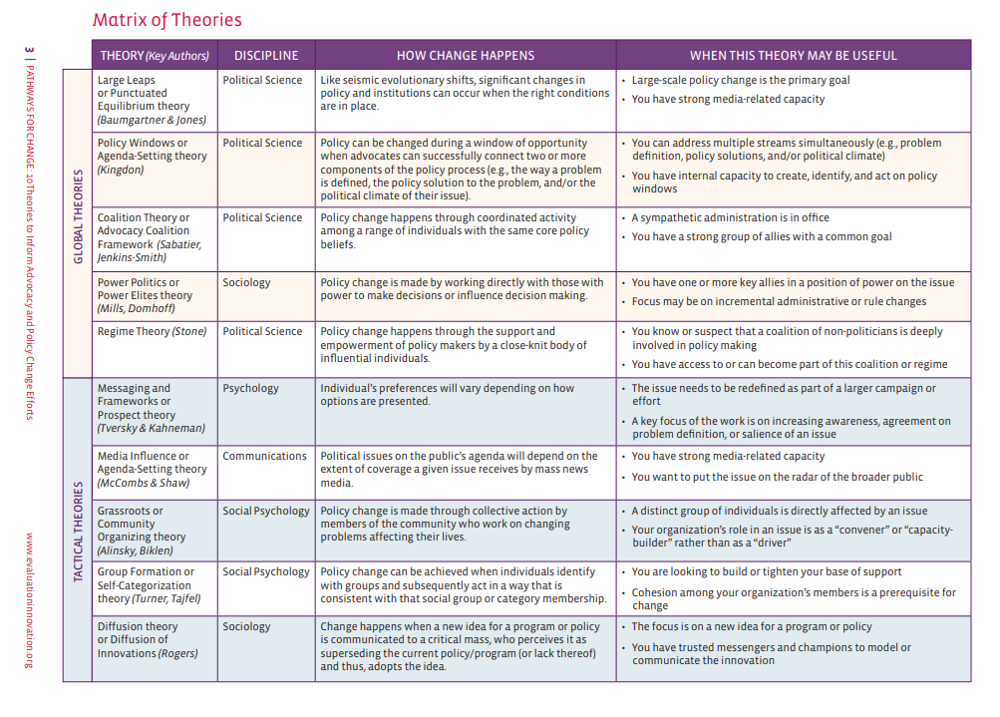
Paper title: 10 Theories to Inform Advocacy and Policy Change Efforts
Ctrl & click arrow to return to synthesis summary
Identifies and describes 10 theories, split between Global theories (theories that explain how policy change occurs more broadly), and Tactical theories (theories from various social science disciplines that apply to common advocacy tactics that are likely part of broader advocacy efforts or campaigns)
Identifies when the theories may be useful
http://www.pointk.org/resources/files/Pathways_for_Change.pdf
Notes:
Theme: Types of advocacy (AB added)

Slide 34
Paper title: Public Health Campaigns to Change Industry Practices That Damage Health: An Analysis of 12 Case Studies
Ctrl & click arrow to return to synthesis summary
Analyses 12 case studies to pull out key points and lessons
Key points:
Ingredients for successful advocacy are pulled out from the case studies eg more effective campaigns used more advocacy strategies (5.3 versus 4.1) and involved more constituencies (6.3 versus 5.1) than less effective ones.
Covers types of advocacy: coalition building, media advocacy, and public mobilization, policy advocacy, community organization, litigation, letter writing, and public protest
Includes case studies including one on automobiles
https://academicworks.cuny.edu/cgi/viewcontent.cgi?article=1316&context=sph_pubs
Notes:
Theme: types of advocacy, ingredients for successful advocacy (added to ingredients for success AB)

Slide 35
Various skills case studies and toolkits
Ctrl & click arrow to return to synthesis summary
Casebook on advocacy in public health (includes case studies), World Federation of Public Health Associations, establishes what is public health advocacy and emphasizes the importance of advocacy as an essential public health function by bringing together 18 cases of public health advocacy from different corners of the world. https://www.wfpha.org/casebook-on-advocacy-in-public-health/
The Advocacy Toolkit, Public Health Advocacy Institute of Western Australia, explains advocacy, includes examples and case studies, tips to work with the media, and practical tools to help you and your organisation advocate on your issue http://www.phaiwa.org.au/the-advocacy-toolkit/
Public health advocacy discussion paper, Alberta Health Services, makes the case for increased theoretical competency, particularly increased content knowledge in three key areas: organizational and behavioural change, communications, and social movement theory – all areas typically not included in public health education curricula. Hoover notes the strategic importance of working collaboratively in multi-stakeholder coalitions, which allows stakeholders to take on relevant and institutionally appropriate roles as required. For example, it might be that non-governmental organizations would serve as the ‘public’ face of the coalition while other organizations contribute more fully ‘behind-the-scenes.’ https://phabc.org/wp-content/uploads/2015/07/Public-Health-Advocacy.pdf
Notes:
Theme: skills for advocacy (added to new section skills, AB)

Slide 36
Paper title: What drives political commitment for nutrition? A review and framework synthesis to inform the United Nations Decade of Action on Nutrition
Ctrl & click arrow to return to synthesis summary
Using framework synthesis and realist review, an initial framework was derived from relevant theory and then populated with empirical evidence to test and modify it. Includes that political commitment can be created and strengthened over time through strategic action.
Key points:
Identified 18 factors that drive commitment, organised into five categories:
actors;
institutions;
political and societal contexts;
knowledge, evidence and framing;
capacities and resources.
Identifies key commitment drivers across different contexts as:
effective networks,
strong leadership,
civil society mobilisation,
supportive political administrations,
societal change and focusing events,
cohesive and resonant framing,
robust data systems and available evidence.
Low-income and middle-income country studies also frequently reported international actors, empowered institutions, vertical coordination and capacities and resources.
In upper-middle-income and high-income country studies, private sector interference frequently undermined commitment.
https://gh.bmj.com/content/3/1/e000485
Notes:
Theme: ingredients for successful advocacy, case for advocacy (added to ingredients, AB)

Slide 37
Paper title: Advocacy in public health: roles and challenges
Ctrl & click arrow to return to synthesis summary
Makes the case for advocacy in public health training
Key points:
Importance of media.
Discusses focal points of public health advocacy
Reflects on experience of public health advocacy and uses case studies to illustrate
Identifies 3 key debates (and reflects on them through the case studies):
When is state regulation of the liberty of individuals justified?
What methods of advocacy are justified?
What evidence do you have that advocacy works?
Suggests important skills for public health advocacy as:
Understanding the underlying tussle for values
Winning the definition
The importance of resonant communication
‘Advocacy often requires its practitioners to be unpopular vanguards’
‘The challenge for advocacy here is to avoid being entrapped by carefully engineered attempts by such opponents to frame debate in interminable ‘more research is needed’ policy bogs, while at the same time never going beyond the science that underpins sound public health policy.’
‘advocates wishing to be looked over, rather than overlooked (as Mae West put it) need to have an instinctive understanding of the popular subtexts of their issues, as much as the overt surface factual dimensions of the debates in which they engage.’
https://academic.oup.com/ije/article/30/6/1226/651750?login=false
Notes:
Theme: skills for advocacy (added to new section skills, AB)
Key points:
Importance of media. Argues that media (of different types) is general public’s main source of information and public health change happens following significant media attention on issues
Discusses focal points of public health advocacy (seeking to change upstream factors like laws, regulations, policies and institutional practices, prices, and product standards).
Suggests ‘advocacy shares strategies with public relations, but differs in that it invariably involves contested definitions of what is at issue. Advocates therefore often find themselves engaged in public conflict with sometimes powerful interest groups or governments determined to resist change.’
Reflects on experience of public health advocacy and uses case studies to illustrate (efforts to advance legislative reforms in gun control and reduce motor vehicle injury)
Identifies 3 key debates (and reflects on them through the case studies):
When is state regulation of the liberty of individuals justified?
What methods of advocacy are justified?
What evidence do you have that advocacy works?
Suggests important skills for public health advocacy as:
Understanding the underlying tussle for values: ‘The ability to recognize and productively reframe the subtexts of communication rather than simply engaging in epidemiological trumping (‘our study is better than your study’) is perhaps a cardinal skill of effective advocacy….discourses in advocacy are almost always not about the surface issues being debated or about who has got the best data or evidence. They are more about values bound up in issues such as perceived injustice, disempowered communities symbolically lashing out at power elites, the mistrust of science and authority, back-to-nature idylls and future shock, and money bulldozing human rights and dignity’
Winning the definition ‘The interest group that succeeds in having its definition of these same events or issues adopted by those able to implement legislative or policy changes will generally be the group that wins’.
The importance of resonant communication: ‘the currency of advocacy is metaphor, analogy, symbol and efforts to present data in ways that are resonant and memorable to often inexpert target audiences. The apposite sound bite that ‘a non-smoking section of a restaurant is about as useless as a non-urinating section of a swimming pool’ probably conveys more to the average person than the earnest pronouncements of hundreds of scientists at indoor air conferences could ever hope achieve with the same broad communicative purpose.
‘Advocacy often requires its practitioners to be unpopular vanguards.’

Slide 38
Paper title: Networks, advocacy and evidence in public health policymaking: insights from case studies of European Union smoke-free and English health inequalities policy debates
Ctrl & click arrow to return to synthesis summary
Draws on two empirical case studies of efforts to promote public health evidence to decision makers (protection from secondhand smoke in Europe and tackling health inequalities in England), to highlight the primacy of ‘policy networks’ and ‘advocacy’ for understanding the role of evidence in achieving policy change.
Key ingredients for successful advocacy distilled from the case study analysis:
regular engagement between diverse network members,
high levels of trust built through regular meeting and comms,
clearly defined, research-informed policy proposals
where disagreement arose, collectively engaged in strategic policy trade-offs, allowing the network to coalesce around the policy proposal with greatest network support,
clear organisational leadership by some advocacy groups functioning as knowledge brokers
network members perceived, and outwardly communicated, a high degree of scientific consensus
a supportive wider social and political context.
https://bristoluniversitypressdigital.com/view/journals/evp/14/03/article-p403.xml
Notes:
Theme: ingredients for successful advocacy, types of advocacy (added to ingredients for success, AB)

Slide 39
Paper title: Advocacy for public health: a primer
Ctrl & click arrow to return to synthesis summary
Presents 10 key questions followed by a case study
10 questions for PH advocates. Focuses on media as advocacy
1 What are your public health objectives with this issue?
2 Can a “win-win” outcome be first engineered with decision makers?
3 Who do the key decision makers answer to, and how can these people be influenced?
4 What are the strengths and weaknesses of your and your opposition’s position?
5 What are your media advocacy objectives?
6 How will you frame what is at issue here?
7 What symbols or word pictures can be brought into this frame?
8 What sound bites can be used to convey 6 and 7?
9 Can the issue be personalised?
10 How can large numbers of people be quickly organised to express their concerns?
https://jech.bmj.com/content/58/5/361
Notes:
Work through as a framework if time
Theme: strategies / tools for advocacy (added to ingredients for success, AB)
Also includes links to key resources
A large bibliography on health, advocacy and the mass media http://www.health.usyd.edu.au/resources/mchbib/index.html
Two recent guides on tobacco control advocacy and movement building http://strategyguides.globalink.org/
Designing effective action alerts for the internet http://dlis.gseis.ucla.edu/people/pagre/alerts.html
The National Coalition Building Institute http://www.ncbi.org/
Jim Shultz’s key questions in developing advocacy strategy http://www.democracyctr.org/resources/strategy.html (plus a link to his book The Democracy Owner’s Manual)
Powerpoint presentation on advocacy from Ontario Public Health Association http://www.opha.on.ca/resources/generic_advocacy.ppt

Slide 40
Paper title: Democracy is not a spectator sport: 11 commandments for public health advocacy
Ctrl & click arrow to return to synthesis summary
Reflections from Mike Daube, Professor of Health Policy at Curtin University, who has played a big role in critical public health campaigns in Australia and internationally over more than four decades.
11 commandments are:
Act on sound evidence for action and the measures proposed – but when you have that, act.
Be professional
Develop comprehensive approaches and consensus positions – and work in coalitions
Clear messages
Understand government, policy, politics, politicians, bureaucracy – at all levels, and seek to work with all.
Be non-partisan
Understand and work with the media
Be innovative
Don’t be satisfied with soft options
Be impatient – but patient.
The 11th is: Oppose and expose the opposition, because:
They are often the single biggest factor in resisting public health measures.
They are always the best funded and most determined.
While their opposition may seem to affect only, for example tobacco or alcohol or junk food, this extends to attacking and undermining public health much more broadly.
https://www.croakey.org/longread-democracy-is-not-a-spectator-sport-11-commandments-for-public-health-advocacy/
Notes:
Theme: what works in advocacy lessons from history (added to lessons from history, AB)

Slide 41
Paper title: The Middle-Out Perspective – an approach to formalise ‘normal practice’ in public health advocacy
Ctrl & click arrow to return to synthesis summary
Describes and applies the ‘Middle-Out Perspective (MOP)’ as a lens to examine how actors positioned between government (top) and individuals (bottom) act to promote broader societal changes from the middle-out (rather than the top-down or bottom-up).
Key points:
introduces the MOP conceptual framework and customises it for a public health audience by positioning it among existing concepts and theories for actions within public health.
Illustrates using two UK case studies (increasing signalised crossing times for pedestrians and the campaign for smoke-free legislation).
Demonstrates
that involving a wider range of middle actors, including those not traditionally involved in improving the public’s health, can broaden the range and reach of organisations and individuals involving in advocating for public health measures
that middle actors are not neutral. They can be recruited to improve public health outcomes, but they may also be exploited by commercial interests to block healthy policies or even promote a health-diminishing agenda.
Suggests that using the MOP as a formal approach can help public health organisations and practitioners consider potential ‘allies’ from outside traditional health-related bodies or professions. Formal mapping can expand the range of who are considered potential middle actors for a particular public health issue.
https://www.medrxiv.org/content/10.1101/2021.11.17.21266405v1
Notes:
Theme: types of advocacy

Slide 42
Paper title: Developing System-Oriented Interventions and Policies to Reduce Car Dependency for Improved Population Health in Belfast: Study Protocol
Ctrl & click arrow to return to synthesis summary
Provides a detailed worked example of using complex systems thinking to achieve a public health goal. This could be useful for developing our proactive advocacy work.
Their approach includes seven integrated tasks through which they expect to attain a systemic view of the car dependency issue, potential intervention approaches to reduce it, and a framework for their integration through the co-ordination of stakeholder actions
1: Map stakeholders and partnerships influencing car dependency using stakeholder network analysis;
2: A review of systematic reviews regarding interventions to reduce car dependency;
3: Map-related policies via analysis of policy documents and semi-structured interviews;
4: A participatory group model building workshop to co-produce a shared understanding of the complex system perpetuating car dependency and a transition vision;
5: Using Discrete Choice Experiments, survey road users to evaluate the importance of transport infrastructure attributes on car dependency and on alternative modes of travel;
6: Citizen juries will ‘sense-check’ possible actions; and,
7: Stakeholders will interpret the findings, plan orchestrated multi-sectoral action, and agree on ways to sustain collaborations towards the common vision of reducing car dependency.
https://www.mdpi.com/2079-8954/9/3/62
Notes:
Theme: complex systems approach to developing advocacy (added to types of advocacy, AB)

Slide 43
Paper title:
Ctrl & click arrow to return to synthesis summary
Summary
Key ingredients:
add
Add link
Notes:
Theme: add

