Slide 1
FPH Special Interest Groups (SIGs) All SIG Chair meeting
Monday 8 April 2024

Slide 2
Agenda for today
Time | Item
12:00 | Introduction (Professor Kevin Fenton)
12:10 | SIG Governance (Julian Ryder)
12:20 | SIG Spotlight Presentations – 7 minutes Sexual and Reproductive Health Academic Public Health Children and Young People (BACAPH) Sustainable Development Africa AI and Digital Public Health Health Protection (Education & Training)
13:10 | Discussion on cross-SIG collaboration
13:50 | Summary of meeting and agreed next steps
14:00 | Meeting close

Slide 3
Introduction Professor Kevin Fenton

Slide 4
Our Vision For the Public’s Health
UK Faculty of Public Health

Slide 5
Good public health is the foundation for increasing economic productivity, ensuring our health and care services are sustainable, maximising the potential of our children and ensuring everyone has a fair chance to live a long, fulfilling and healthy life.
At present we are paying a high price for poor health. We have record levels of long-term sickness, health and care services are unable to cope, millions of families live in poverty and children’s life chances are compromised even before they start school.
The Faculty of Public Health (FPH) believes that bold action led by the UK government, the devolved administrations and local government to invest in good public health would make a profound and rapid difference to our society.
The ban on smoking in public places and the recent bold and ambitious government announcements on creating a smokefree generation and reducing vaping among children are testament to the unique leadership role government can play in improving the nation’s health, economic productivity and life chances.
At the heart of our vision is the belief that everyone deserves the chance to live a long and healthy life, and that it is unacceptable for people's life expectancy and health outcomes to be determined by their postcode, ethnicity or income.

Slide 6
Faculty of Public Health
Board Focus Areas (2022-2025)
Support the wellbeing of the public health workforce who are facing increasingly complex challenges
Work with partners to ensure improved clarity, equity, and experience for public health practitioners across their career pathway
Our People
A resilient, diverse and inclusive UK and global public health workforce fit for the future
Our Partnerships
Effective system leadership to improve the health of the public across all UK nations
We will expand formal and informal relationships with allied public health professionals and organisations focussed on improving the public’s health and tackling health inequalities
Our Policies
A clear, unequivocal, and effective champion for health and equity in all policies
Tackling poverty and the cost-of-living crisis
Maximising NHS prevention & population health
Climate change and health
Tackling health inequalities and a public health approach to anti-racism
Living healthier for longer across the life-course
Our Programmes
Promote evidence-informed public health programmes to improve the public’s health
What is Public Health? Ensuring the FPH is the lead voice for defining our profession, the PH system engaging members
Future Public Health: Building upon the COVID-19 pandemic to steer the future of public health practice, training, and workforce.
Our Global Impact
Promoting and enabling members to contribute to improvements in global health
Continue to deliver on our role as global leaders in training, development and support for the public health workforce and deliver critical policy agendas in partnership with other key global stakeholders

Slide 7
Key opportunities for FPH SIGs
Policy home for the FPH – proactive, responsive, evidence based
Opportunity to support members development and engagement
Collaboration and integration between SIGs on priority policy initiatives
Better governance and visibility of the FPH advocacy voice
Strong focus on equity, partnership and impact in our Voice

Slide 8
Promote policies and programmes that support people and communities to attain optimal health and wellbeing
Creating a smoke-free generation
Reducing alcohol-related harm
Reducing drug dependence
Supporting a healthy, sustainable diet and physical activity across the lifecourse
Building a healthy workforce
Tackling health inequalities and their drivers
Tackle poverty to ensure everyone has the chance to live a long and healthy life
Addressing poverty and the cost-of-living crisis
Giving children the best start in life
Addressing the root causes of economic inactivity
Protect the nation from infectious diseases and prepare for health threats and emergencies
Taking action against climate-related health harm
Building health protection and pandemic preparedness
Increase investment in public health and prevention as assets for society, and make health a priority for cross-government action
Investing in the specialist public health workforce
Enhancing public health through fair funding of local services
Delivering population-level interventions and policies

Slide 9
SIG Governance Julian Ryder

Slide 10
Role of the Special Interest Groups (SIGs)
SIGs are established by FPH members to harness and disseminate the knowledge and skills of the Faculty's 5,000 members.
36 SIGs each report to one of our standing or sub-committees.
SIGs offer members a unified platform to address public health challenges and play a pivotal role in shaping and leading FPH policy initiatives, extending the Faculty's influence across various domains.
The primary objective of SIGs is to bolster FPH's overarching mission of improving the health and wellbeing of local communities.

Slide 11
SIG Governance
Health Protection Committee
Health Protection (E&T)
Health Services Committee
Adult Social Care
Primary Care
Sexual and Reproductive Health
Drugs
Emergency Services
Women’s Health
Health Improvement Committee
Alcohol
Health Economics
Food
Healthy Places
Arts & Health
MSK
Oral Health
Public Health Film
Poverty
Artificial Intelligence (AI )and Digital Public Health
Academic & Research Committee
PH Educators in Medical Schools
Public Health Information & Intelligence
Academic
Public Health
Climate & Health Committee
Transport
Sustainable Development
Notes:
We are not prescriptive about the topic area or work programme of existing or proposed/new SIGs, but they must be established in line with the Faculty’s overall strategic priorities
SIG members need to be FPH members (associates at least)
SIGs need to develop an annual work plan which relates to that of the parent committee and report back on progress mid and end year
Submit all substantive public-facing work to the parent committee for sign-off (consultation responses, reports, discussion documents, position papers etc)
All SIG work should be appropriately signed off and badged as Faculty policy
Work with the Faculty’s Communication Manager on all media work

Slide 12
SIG Governance
Equality, Diversity & Inclusion Committee
Equality & Diversity
Ethics Committee
Ethics
Global Health Committee
Sudan
Global Violence
Europe
Africa
India
Yemen
Pakistan
Disasters & Humanitarian Response
Non-communicable Diseases in Low- and Middle-Income Countries
Advocacy & Policy Committee
Children and Young People
Mental Health
Commercial Determinants of Health

Slide 13
Approval process
Any materials developed by the SIG, which the SIG wishes to be FPH-branded, must be approved by the FPH.
FPH approval process:
FPH facilitates approval of SIG policy and advocacy work, including consultation responses, joint letters, position statements, and policy briefings.
Please send final versions to Georgia and Julian, who will facilitate FPH approval. Ideally, approval is requested a week before the deadline, in order to give the FPH sufficient time to review.
Once approved, we will format and upload documents to the website, publicising as needed.

Slide 14
Faculty Support for SIGs
Events: Assistance with logistics, promotion, and feedback for SIG events. SIGs may use FPH video-conferencing facilities and meeting rooms as needed.
Promotion of SIG work: Promotion of SIG activities through various channels including the FPH bulletin, social media, and website.
Workplans: Provision of guidance, approval, and publicity for SIG workplans.
Projects: FPH supports SIGs to develop specialty registrar projects to address learning outcomes.
Guidance: FPH provides relevant guidance and protocols to support SIG operations. This includes identifying relevant consultations, communication, membership management, GDPR compliance, etc.
Joint working: Facilitation of cross-SIG collaboration and new shared workspace for SIG Chairs.

Slide 15
Expectations of SIGs
Policy development: Including policy initiatives, consultation responses and briefings etc.
Annual workplans: Submit annual workplans to FPH, ensuring incorporation of FPH strategic priorities, EDI and Anti-racism Framework.
Membership management: Use of the portal, ensuring FPH members only, unless a formal arrangement exists with a partnership organisation.
Governance: Regularly attend and update at parent committee meetings.
Reporting to FPH on:
Proposed events
Proposed policy initiatives
Changes in chair(s)
Annual progress on workplans

Slide 16
FPH Portal - SIG Membership Management
FPH has developed a SIG Administration and Management feature in the FPH Members Portal.
All membership management must now be done through this new feature ‘My Committees/SIGs’, which will facilitate more efficient membership management and communication with members for Chairs.
This will ensure that those joining FPH SIGs are FPH members – excluding those SIGs who have pre-existing MoUs with external organisations.
SIG Chairs will be able to view the most up-to-date membership details of their SIG at any time, including application details and email addresses.
We have developed a guide for SIG Chairs to support Chairs through the transition to the new process.
Notes:
The guide outlines:
How prospective members can join and leave a SIG through the portal
How to view SIG members and their details
How to easily contact all SIG members, using the most up-to-date membership information
How to remove a SIG member

Slide 17
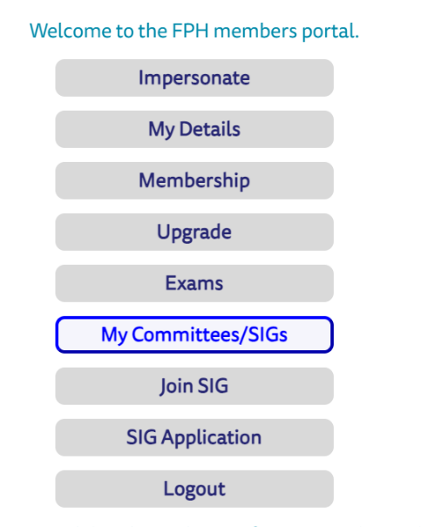
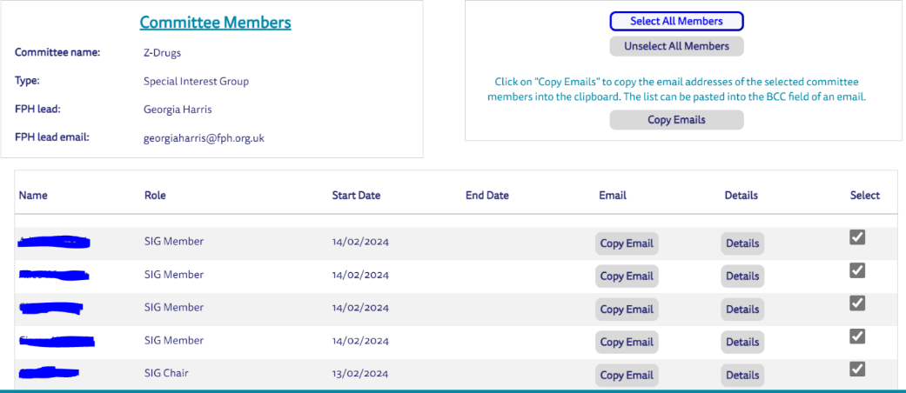
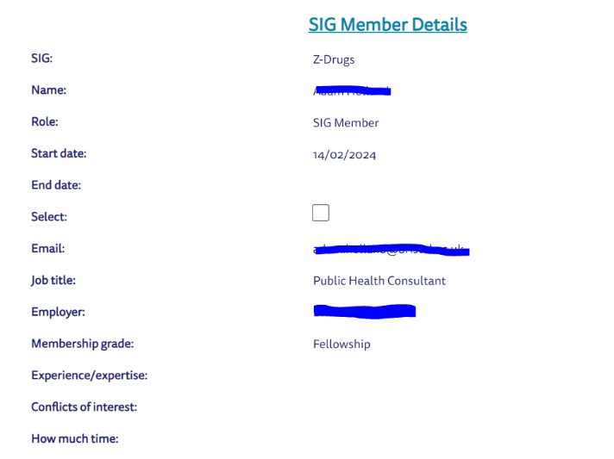
FPH Portal - SIG Membership Management Viewing SIG member information
Log into the FPH Members Portal and select ‘My Committees/SIGs’ as seen here →
This will take you to a list of all SIG(s) you chair.
If you select ‘Details’ on this page, you will be taken through to the up-to-date SIG membership list, as pictured below:
By clicking on ‘Details’ next to an individual’s name, you will be able to view the following information about each SIG member as seen here →
Name
Role in the SIG
Start and end date (of SIG membership)
Email
Job title and employer
FPH membership grade
Experience/expertise (optional)
Conflicts of interest (mandatory)
How much time they can commit to the SIG (optional)

Slide 18
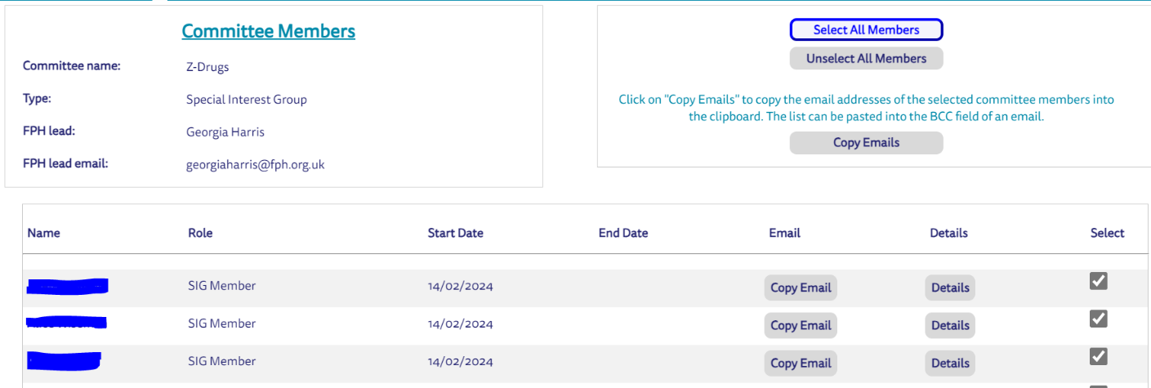
FPH Portal - SIG Membership Management Contacting SIG members
CRM will always contain the most up-to-date membership list, as well as the most up-to-date contact details for SIG members.
To email all SIG members, you will need to:
Click the ‘Select All Members’ button
Click the ‘Copy Emails’ button
Paste the email addresses into the BCC field of an email in your chosen server
You can also copy the email address of individual or multiple SIG members by selecting them as below:

Slide 19
Children and Young People SIG (BACAPH) Ann Hoskins

Slide 20
British Association of Child and Adolescent Public Health
Mission: To improve the health and wellbeing of children and
young people now and in the future.
BACAPH organisation acts as a Special Interest Group (SIG) for children and young people's public health in both the Faculty of Public Health (FPH)
and the Royal College of Paediatrics and Child Health (RCPCH).
Crossing the parent organisations for paediatric and public health professionals, BACAPH provides a unique interdisciplinary perspective on the complex problems of child and adolescent public health.
https://bacaph.org.uk

Slide 21
Objectives
use expertise in child health and population health management to support and influence the development of integrated care systems
promote the development and implementation of evidence-based child public health programmes in key focus areas – prevention & early intervention, child poverty and inequalities, and climate change
empower workforce to become effective advocates for children's public health in our key focus areas
use specific opportunities, including the RCPCH conference, to promote research and professional collaboration to tackle important challenges in child public health - inequality reduction through clinical practice
provide opportunities for professionals to build expertise, develop networks, and improve practice, for example, joint training posts and SPIN modules.

Slide 22
Developed and delivered workplan
PH SpR helped develop new strategy 22/23, this years workplan based on the strategy.
Civil Service Fast track secondment for 6 months – webinars, admin, improved website. Developed the BACAPH YouTube (YT) Channel
PH SpR sub-group support work. Includes 2 PH SpRs on 1day/week secondment for 6 months
Ran the BACAPH session in RCPCH annual conference:
Population Health Medicine and what it means for clinicians.
Included presentations on:
Advocacy for poverty in children,
Value Paed SpR attachment to PH team, Newcastle LA,
Intersecting ethnic and socio-economic inequalities in infant mortality in England

Slide 23
Collaboration
Report: The Health of the Next Generation- Good Food for Children
Substantial input from BACAPH to child food policy and advocacy report (in liaison with Food SIG, FPH, RCPCH, and other PH org. ) supported event at House of Lords, Tuesday 16th January 2024.
Joint meetings between PH and Paediatricians in training
PH SpRs supported delivery of this years objectives
-Developed ICS framework for Children and Young People
(presented at RCPCH conf)
- DELPHI exercise on leadership for C&YP PH in the new system

Slide 24
How SIGs have effectively engaged current members, promoted their work, grown their membership
Webinars - organised by SpRs in paediatrics and Public Health and advertised in FPH bulletin eg: Introduction to Child Public Health, Climate and Health, Infant Mental Health (collaboration Mental Health SIG),
Blog on publication of AoMRC report on child health.
Editorial on free school meals – BACAPH member one of authors
E-bulletins are published on the second Thursday of every month giving update on latest research/publications related to children young people
.

Slide 25
Sexual and Reproductive Health SIG
Natalie Daley
Co-chair of the SRH SIG

Slide 26
Progress to date
Activity | Outcome | Progress to date
Learning and training on SRH topics | To deliver ‘lunch and learn’ sessions outside of regular meetings to increase accessibility, generate more interest in the SIG and attract new members. | Two ‘lunch and learn’ sessions have been held. PrEP uptake in underserved groups had 70+ attendees.
Collaboration with partners and other SIGs e.g. BASHH, BHIVA, criminal justice partners, commissioners, clinicians etc. | To increase the influence of the SRH SIG and its collaboration on specific projects with partners. | Obtained FPH endorsement for a letter by BASHH Bacterial SIG to private providers offering STI testing kits to address inappropriate testing and treatment. FPH also endorsed a position statement from FSRH on the reclassification of oral emergency contraception and Bayer’s Fair Fees for Fitting campaign which is a campaign to secure equitable funding for LARC. Supporting implementation of the FSRH Hatfield vision through attendance at and participation in subgroups on improving access to emergency contraception. Representation at meetings of the APPG on SRH.

Slide 27
Progress to date
Activity | Outcome | Progress to date
Communications and awareness raising | To strengthen the voice and influence of the SRH SIG and share its expertise by attending events, providing input into consultations and writing blogs, articles and opinion pieces on areas of relevance. | Inputted into consultations on relationships, sexual health and parenthood education and the implementation of safe zones around abortion clinics in Scotland. Published a blog on the sexual and reproductive health inequalities experienced by women who have sex with women for Pride Month.
Modern slavery workstream | To provide input to and feedback from the UK Modern Slavery Training Delivery Group (UK MSTDG), as a member of the health task and finish group. This is to improve identification of and support for modern slavery victims in healthcare settings. | Work of the UK Modern Slavery Training Delivery Group paused while it awaits guidance from the Home Office as to the direction of travel.

Slide 28
Collaboration
Sought out opportunities to collaborate.
Invited guest speakers to meetings.
Resulted in working with:
BASHH – Bacterial SIG and conference
FSRH
LSHTM
Met with the chairs of the Health of Women and Girls SIG to identify potential areas of joint working.

Slide 29
Engagement with members and membership growth
Engagement with members
Regular emails to members with relevant SRH information.
Invitations to write blogs/articles and get involved in work areas.
Doodle Polls for meetings to maximise attendance.
Membership growth
Ad hoc conversations publicising the SIG.
Broadening our audience through lunch and learns.
Attendance at other SIG meetings (e.g. BASHH BBV SIG)

Slide 30
Promotion of our work
Working on improving this.
Current promotion
Use of the FPH website – upload lunch and learns and consultation responses.
Blogs
Social media
Future plans
Use of FPH newsletters
Increased use of social media
Editorials/articles

Slide 31
Plans for 24-26
Activity | Outcome | Future plans | Outputs
Increase engagement in topics related to the sexual and reproductive health of children and young people | To increase the understanding of SRH topics in relation to children and young people | Connection established with the BASHH Adolescent SIG and an area of support/joint working identified. Consultation responses relevant to children and young people uploaded to the SRH SIG webpage. | Engagement in work related to children and young people (e.g. relationships and sex education, child sexual abuse, child sexual exploitation); establishment of links with the BASHH Adolescent SIG and responding to consultations relevant to children and young people.
Anti-racism | To tackle ethnic inequalities in SRH and promote an anti-racist approach to sexual and reproductive healthcare. | Published blogs, press releases and articles and share these regularly with SIG members. Lunch and learn sessions with a specific focus on reducing ethnic inequalities in SRH. Agreed collaborative projects focusing on reducing ethnic inequalities in SRH. | Include a focus on anti-racism and reducing ethnic inequalities in lunch and learns. Use communications to raise awareness of the impact of racism on SRH outcomes and ethnic inequalities. Identify opportunities to collaborate with other SIGs to reduce ethnic inequalities in sexual and reproductive health.

Slide 32
Academic Public Health SIG
Dr Seb Walsh (MBChB, MPhil, MFPH)
APH SIG Co-Chair
NIHR Doctoral Fellow, University of Cambridge
Specialty Registrar (ST4, OOPR), East of England

Slide 33
APH SIG
APH SIG will provide a forum to enhance the exchange of ideas, knowledge, experiences and information about academic public health training and career development across the four nations of the UK; in order to contribute to the faculty’s authoritative voice for academic public health, and support the work to develop high quality standards of collaborative, multi-disciplinary, public health practice in the UK
Launched summer 2022
Reports to Academic Research Committee (ARC)

Slide 34
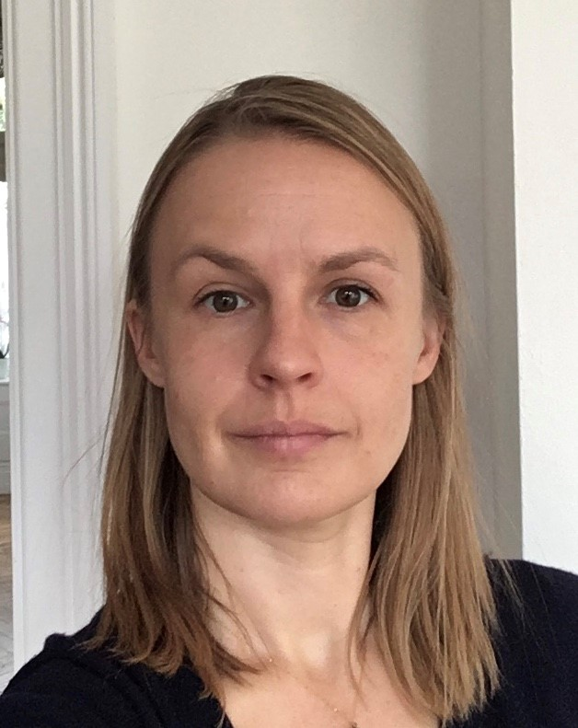
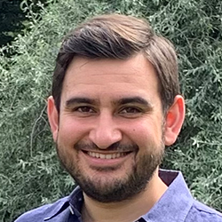
SIG Co- Chairs
Dr Cat Pinho-Gomes
CL at UCL
Dr Joanna McLaughlin
CL at Bristol
Dr Seb Walsh
DF at Cambridge

Slide 35
Membership
~70 members
~1/2 registrars
~2/3 in formal academic roles
100 on mailing list
115 in WhatsApp group

Slide 36
Activities
Webinars
Diversity of topics and speakers
Partnership with other SIGs (e.g., SD, Mental Health, Poverty)
Conduit between membership and ARC/FPH
e.g. ACF applications
Conference mapping
Annual members survey

Slide 37
Plans
Digest 2024 members survey
Continue to grow webinar attendance and SIG membership
Conference meet-ups/partnership (e.g. Lancet PH Science conference)
Open to further collaborations

Slide 38
Sustainable Development Special Interest Group
Anya Gopfert Maria van Hove

Slide 39
What is the Sustainable Development SIG for?
Notes:
How do you define what the SIG for?
USP – network, learning, exchange, spiritual home
Identify gaps and try to fill them
Identify high impact actions

Slide 40
Membership
Notes:
Membership
- Approximately 180 people on the mailing list, with 30-40 active people within the SIG (attending meetings and sub groups)
- Never our aim to increase members – it happened naturally - (except for specific target group – consultants).
- Open approach to membership, anyone can join – we have been thinking about whether that is the best operating model or not – have not yet come to a final conclusion – but because one of the main aims is to raise awareness and capacity, it felt wrong to restrict people who were interested in the topic from joining
- The size is a size that is very difficult to manage, requires a lot of time commitment
- Challenge - how to keep members engaged, engaging people in their areas of interest

Slide 41
Activities 2024
Organise a programme of webinars on sustainable development and climate change
Develop and publish resources to support public health action on sustainable development
Develop the education and training offer for FPH members, including but not limited to public health registrars, consultants and practitioners.
Respond to government and NHS consultations where appropriate and capacity allows
Promote SIG activity & engage with public health professionals, with a specific focus to recruit public health consultants to the SIG
Engage with and influence COP processes
Proactive advocacy campaign on opposing fossil fuel expansion
Adaptation working group
Revisioning the Public Health System

Slide 42
Africa SIG Aliko Ahmed Victor Joseph

Slide 43
Some of SIG activities:
The People’s Tribunal blog with SD SIG
Statement on the PH impact of the conflict on Sudan with Sudan SIG
Statement on the Impact of the earthquake in Morocco and the floods in Libya
AMR colleagues visiting from Ghana
Engagement with FPH members in Africa
Webinar on the MoU with SA
Africa SIG and FPH celebrate BHM
Workshop on mentoring at CPIA
Research bids with colleagues in Africa

Slide 44
Peoples-Praxis
Peoples-Praxis supports graduates of master’s degrees in Public Health and related fields such as health management, monitoring and evaluation or health promotion, who work in low-to middle-income countries, to empower them to extend and apply their skills and knowledge towards improving the health of their populations, through a practice based experiential programme
The invitation:
- recruit suitable mentees
- join us in being mentors
- use, comment on and contribute to our resources.
- get involved in the charity itself as part of the steering group
Register online or contact Hannah.Patrick@NICE.org.uk for more information

Slide 45
Collaborated with other SIGs and partner organisations
Built relationship with other SIG chairs, so it was easy and quick to collaborate on statements (for example Earthquake in Morocco, Floods in Libya, conflict in Sudan) and writing a blog for FPH
Build on our members’ assets: we have meeting planned with Somalia Ministry of Health
Provided a platform for our members; for example the work with Malawi and with NHS Consortium recruiting mentors/peers to form a community of practice. We also provided a platform for Peoples Praxis
Presented the work at the GH Committee Away Day 7th March 2024
Attended conferences; like Conference of Public Health in Africa (CPHIA), Kigali, Rwanda, 2022

Slide 46
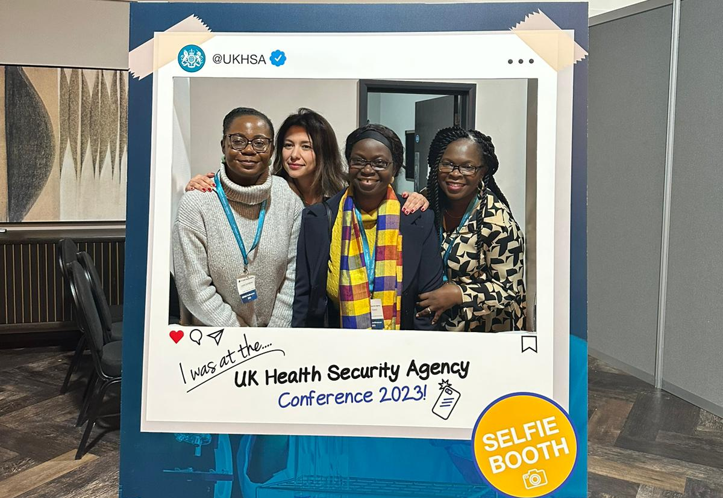
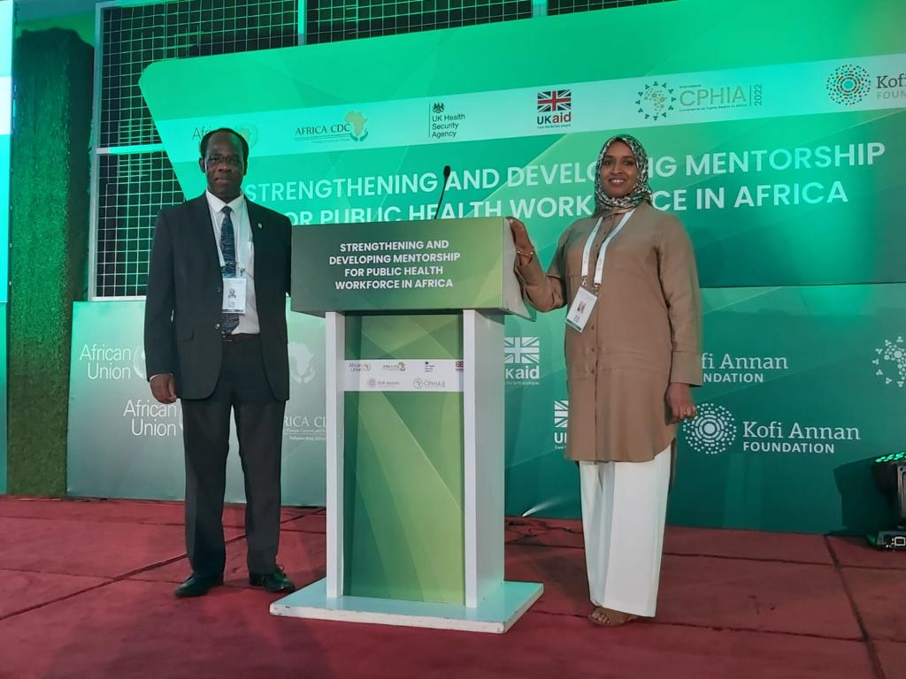
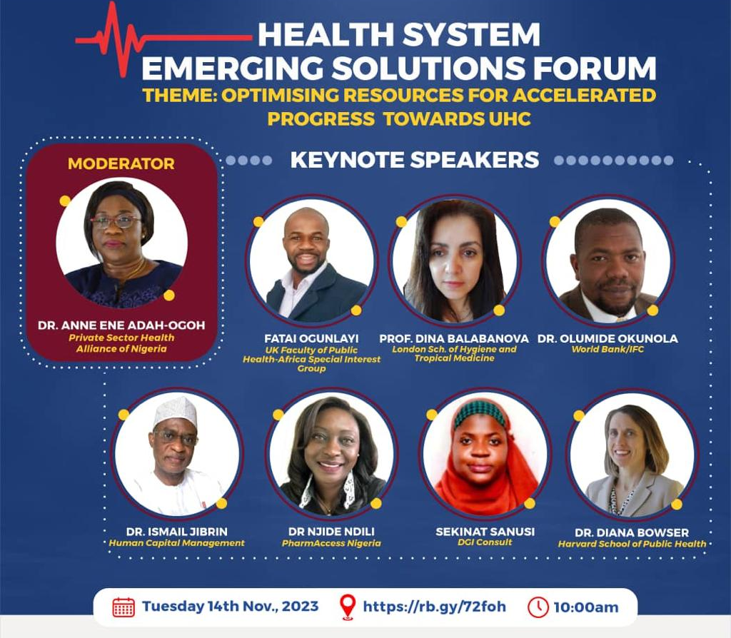

Slide 47
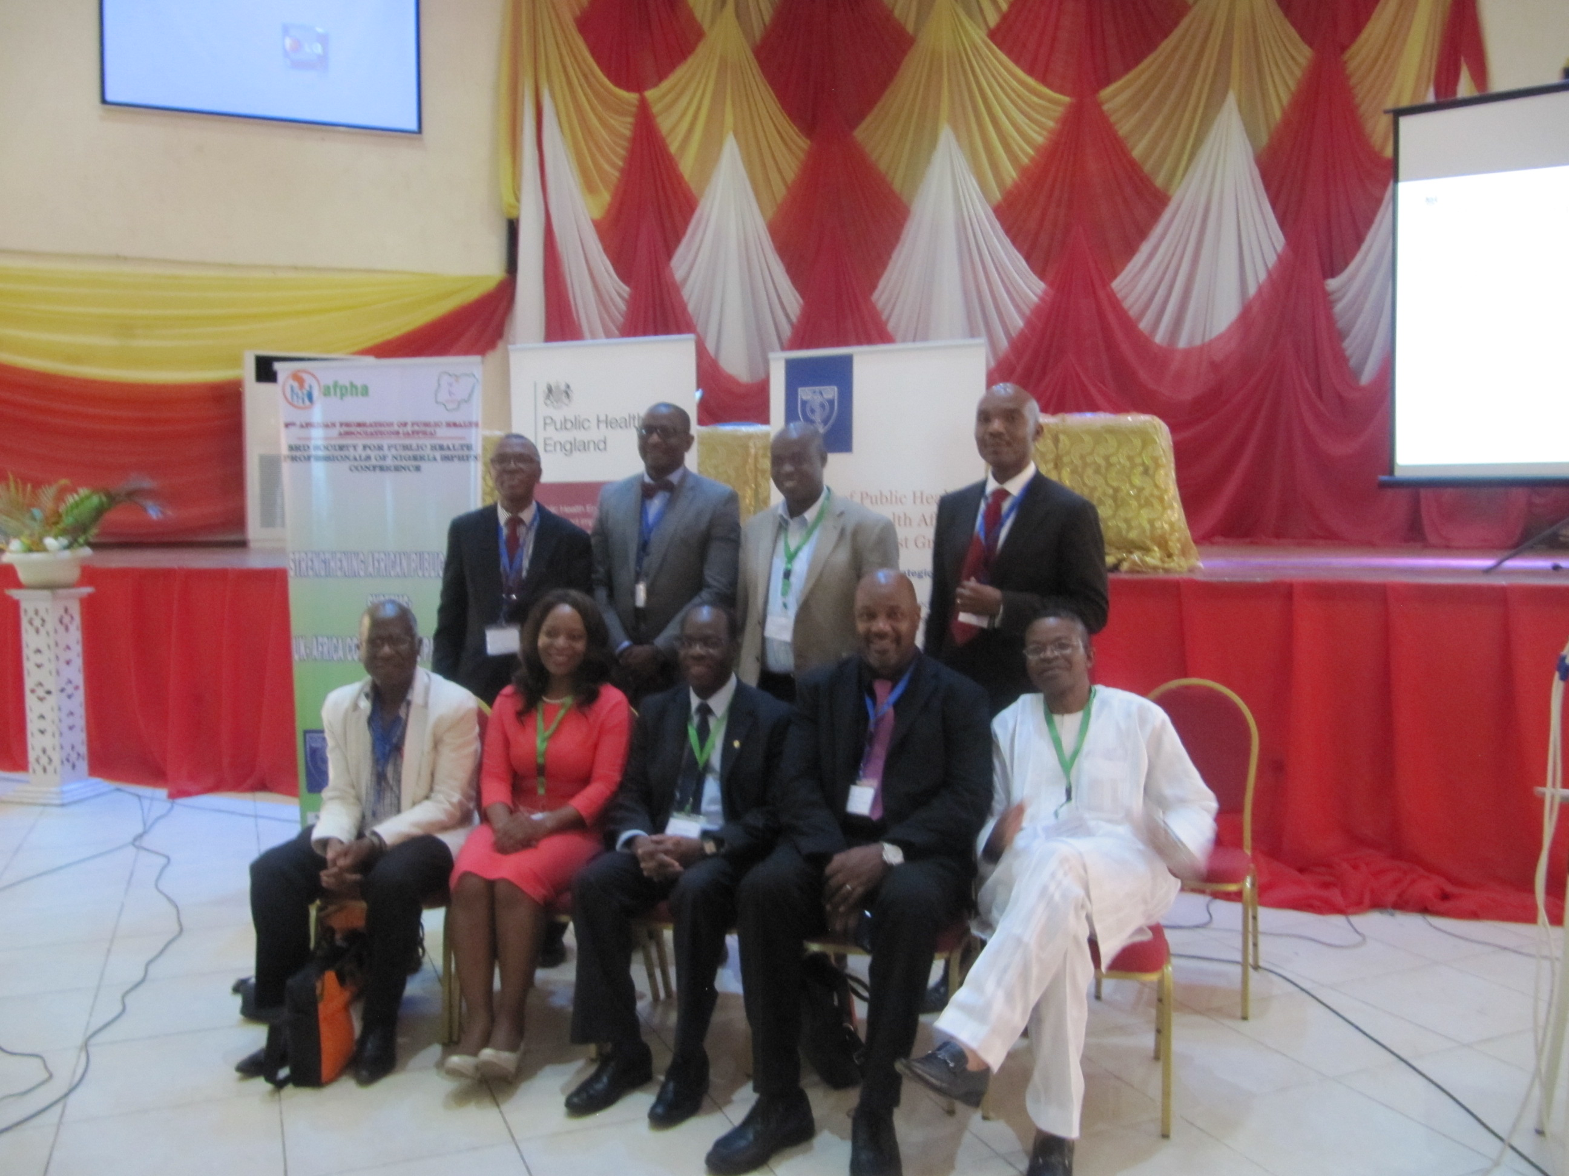

Slide 48
The New Steering Group of FPH Africa SIG from 1 April 2024
Dr Victor Joseph, Chair
Prof. Diane Ashiru-Oredope, Vice Chair
Dr Hadjer Nacer, Secretary
Fatai Ogunlayi, Partnership & Engagement - Member
Dr Fatumo Abdi, PH Systems - Member
Dr Ado Hadejia Mohammed, Research & Development - Member
Lily Makurah, Member

Slide 49
Artificial Intelligence (AI) and Digital Public Health Alisha Davies (AI) Sam Field, Elliot Roy-Highley (Digital Public Health)

Slide 50
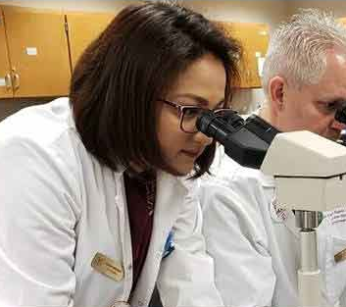
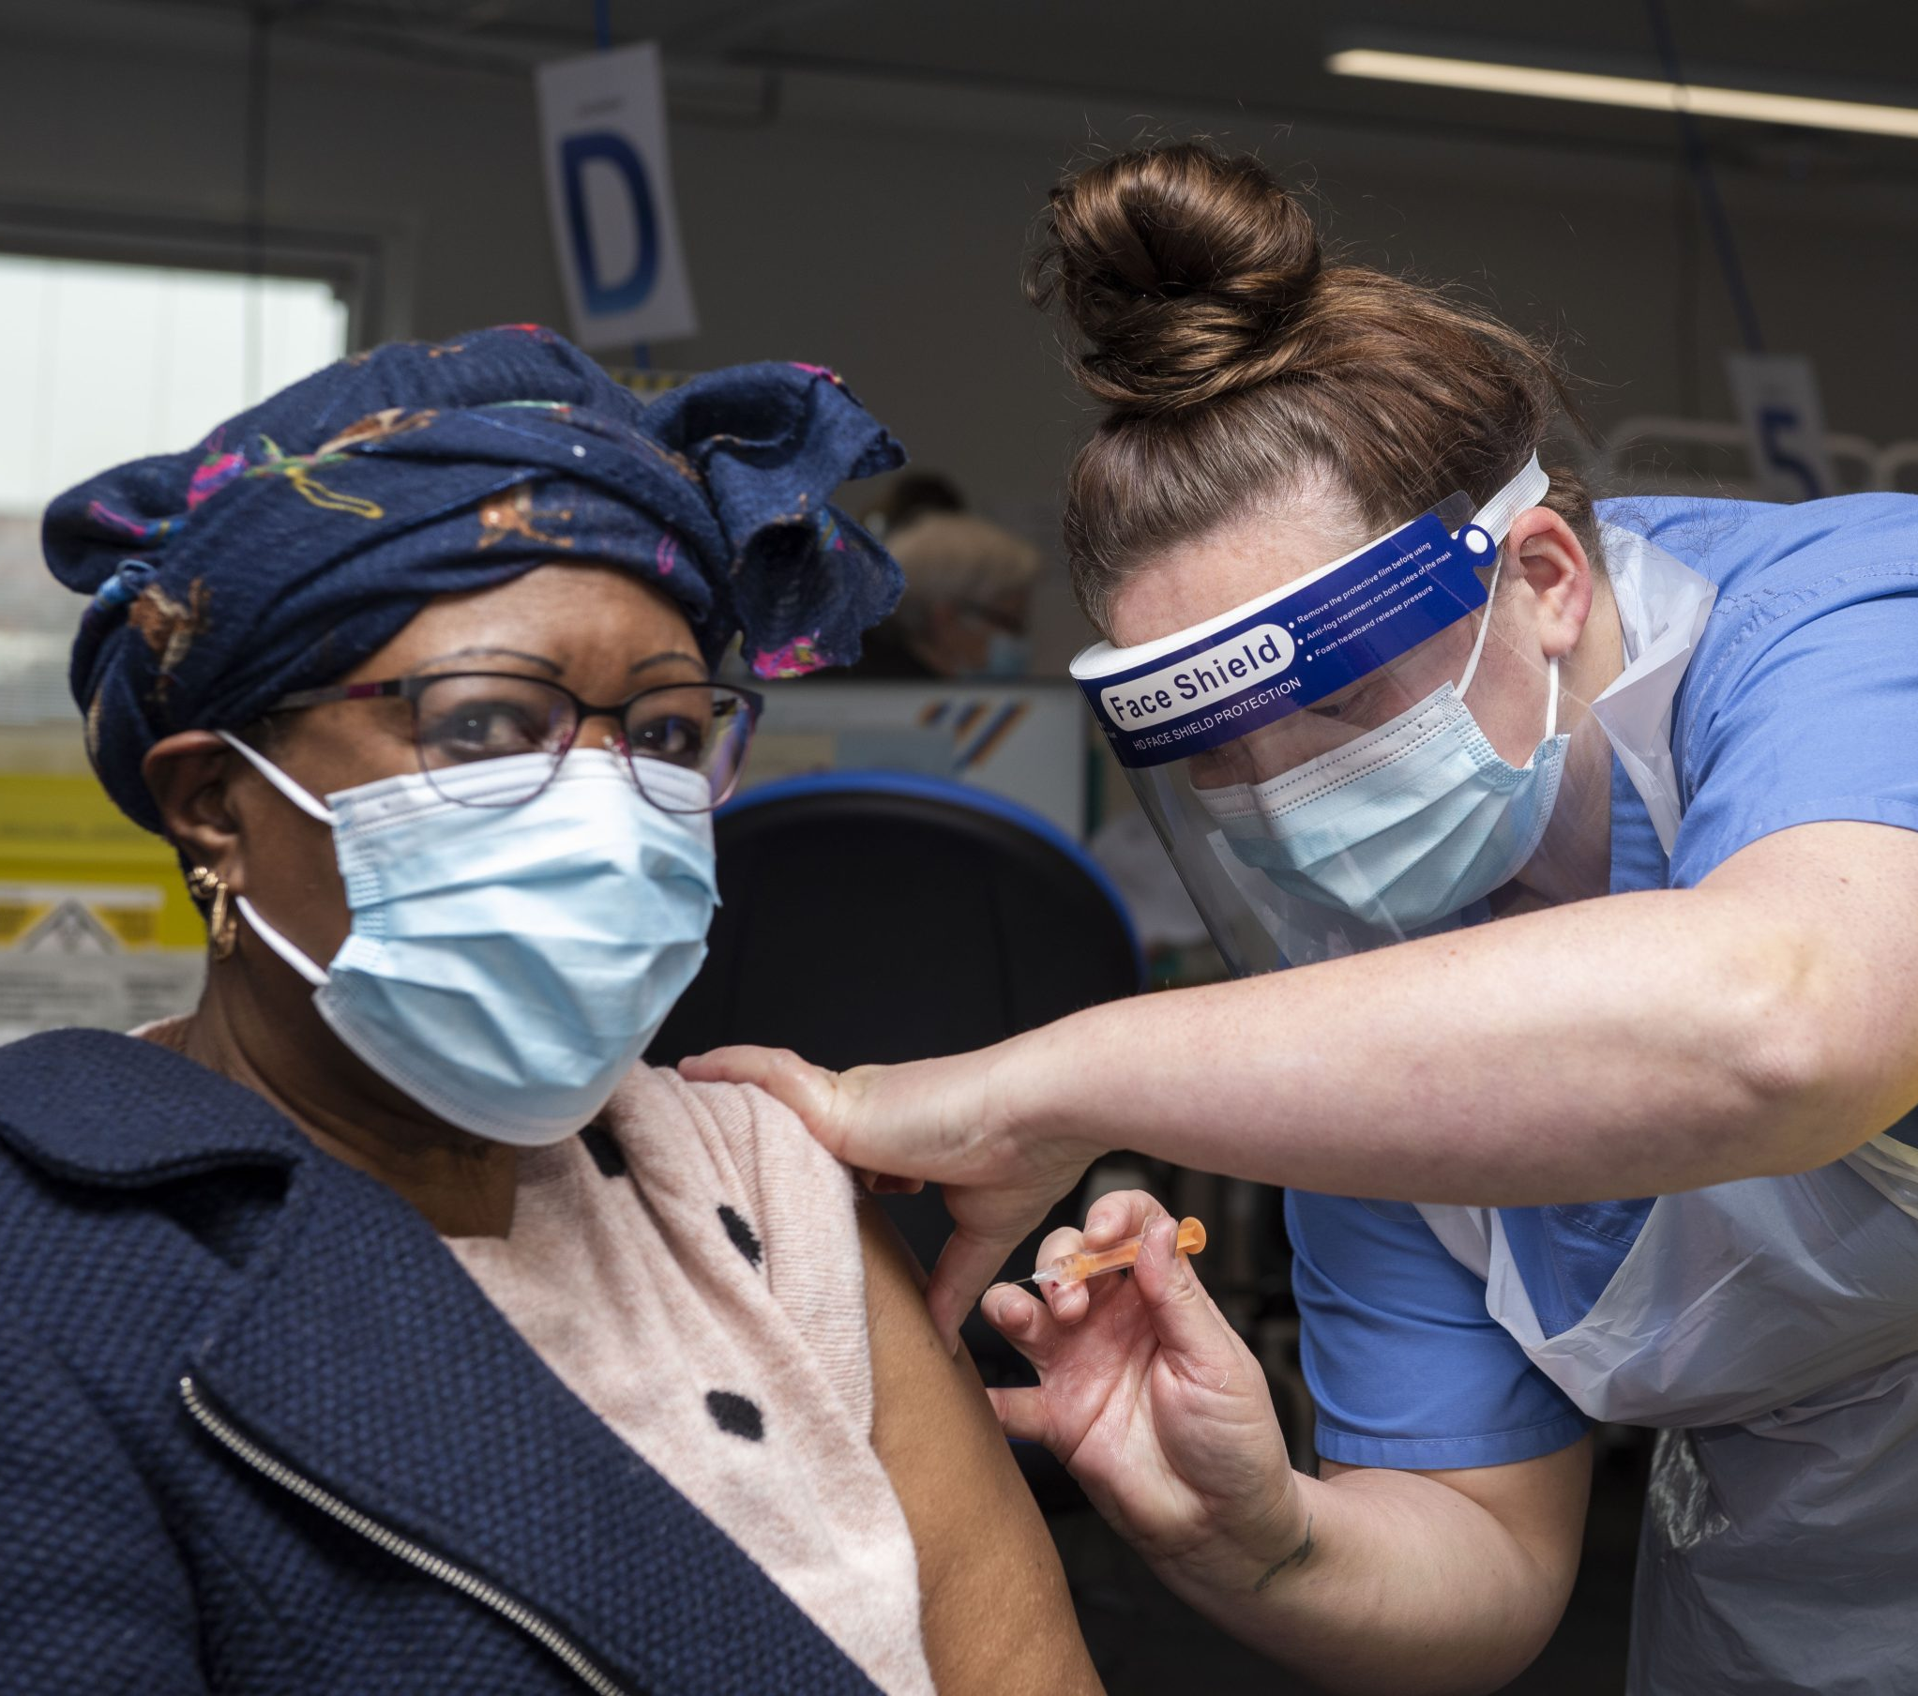
HEALTH PROTECTION (EDUCATION AND TRAINING) SIG CO-CHAIRS: MEGAN CORDER AND PRAVEENA SYMEONOGLOU

Slide 51
GROWING OUR MEMBERSHIP
80 members as of March 2024
Expansion to include non-registrars
StRs, consultants, academics, clinical leads, practitioners, commissioners
Representation from all regions and four nations

Slide 52
COLLABORATING WITH PARTNERS
FPH Health Protection Committee
Four Nations health protection oversight group
UKHSA Postgraduate Training Faculty
Specialty Registrars Committee
Ad-hoc working groups

Slide 53
WORKPLAN DEVELOPMENT
Continue to promote diversity in SIG activities and membership, including Four Nations involvement and cooperation
Promote CPD and knowledge sharing between SIG members
Continue to expand membership of SIG to include and meet the training needs of FPH members from a range of professional backgrounds
Identify, monitor, and address any issues related to health protection training and education e.g. opportunities, quality, access or disparities
Support FPH Health Protection committee and UKHSA training faculty in opportunities and projects which benefit SIG members’ development
Contribute to consultations or forums which seek improve the standards of health protection education and training across the membership

Slide 54
PROMOTING OUR WORK
Regional representatives
FPH health protection committee
Four Nations training day

Slide 55
Collaboration Discussion
Notes:
Input questions

Slide 56
For discussion: breakout room 1
What is your SIG already doing to collaborate across the FPH and external partners?
What has worked the best, what has been a challenge?
How have you incorporated EDI and anti-racism into your workplans and meetings?

Slide 57
For discussion: breakout room 2
Based on discussions today, what do you think your SIG could do to foster collaboration, promote their work and engage better with current and potential future members?
Are there any clear next steps?
What could the FPH do to support this?

Slide 58
Summary and next steps

Slide 59
Meeting Close
Thank you for attending!

