Slide 1
FPH Specialty Registrars’
Welcome and Induction
Friday 5 September 2025
Welcome to the Faculty: Tracy Dazskiewicz (President) and Meng Khaw (Academic Registrar)
Specialty Registrars’ Committee: Nancy Zheng (Chair, SRC), Tom Irving (Vice Chair, SRC), Jack Haywood, Vice Chair
ePortfolio: Gareth Cooke (Education & Training Manager)
Faculty Special Interest Groups and policy work: Julian Ryder (Deputy CEX) & Georgia Harris (Policy Coordinator)
Faculty exams: Jack Haywood (Vice Chair, SRC)
Q&A: Irfan Ghani (Assistant Academic Registrar)

Slide 2
Welcome to Public Health
Professor Tracy Daszkiewicz
President of the Faculty of Public Health

Slide 3
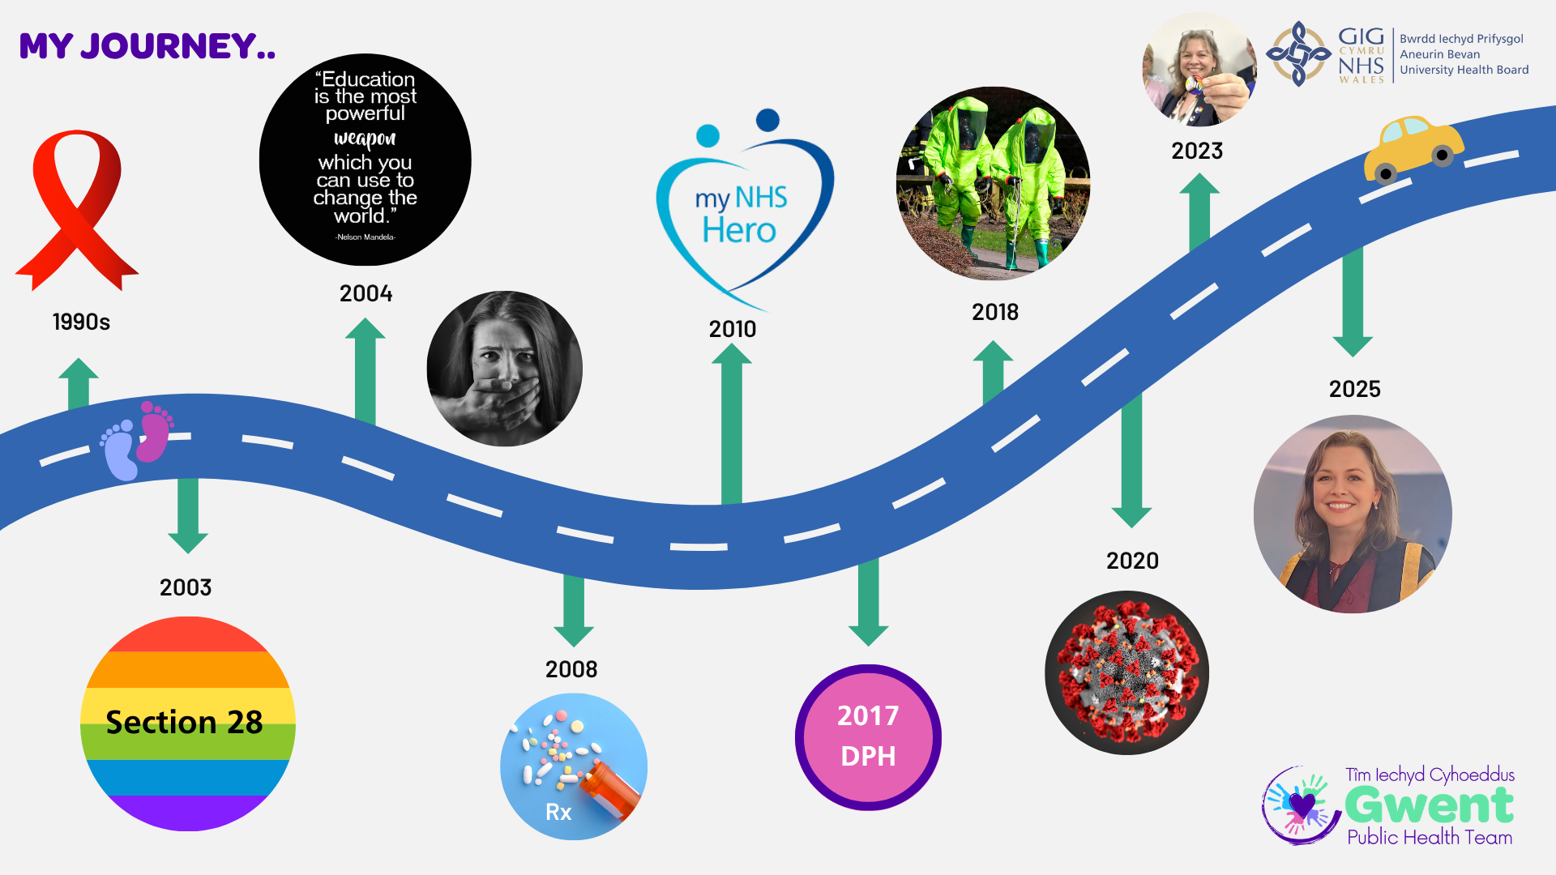

Slide 4

FPH Strategy 2025-30
Our Vision

Slide 5
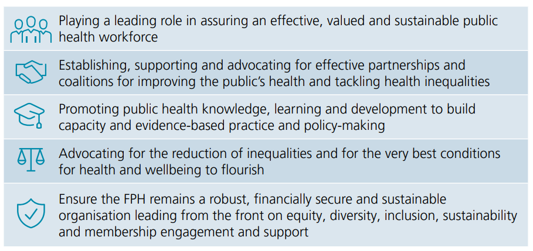
FPH Strategy 2025-30
Our Mission

Slide 6
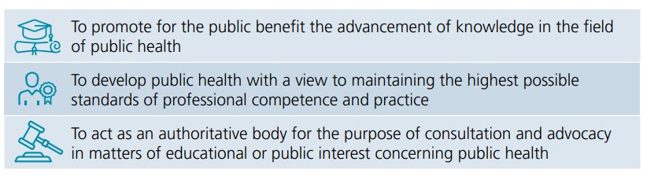
FPH Strategy 2025-30
Our Charitable Objects

Slide 7
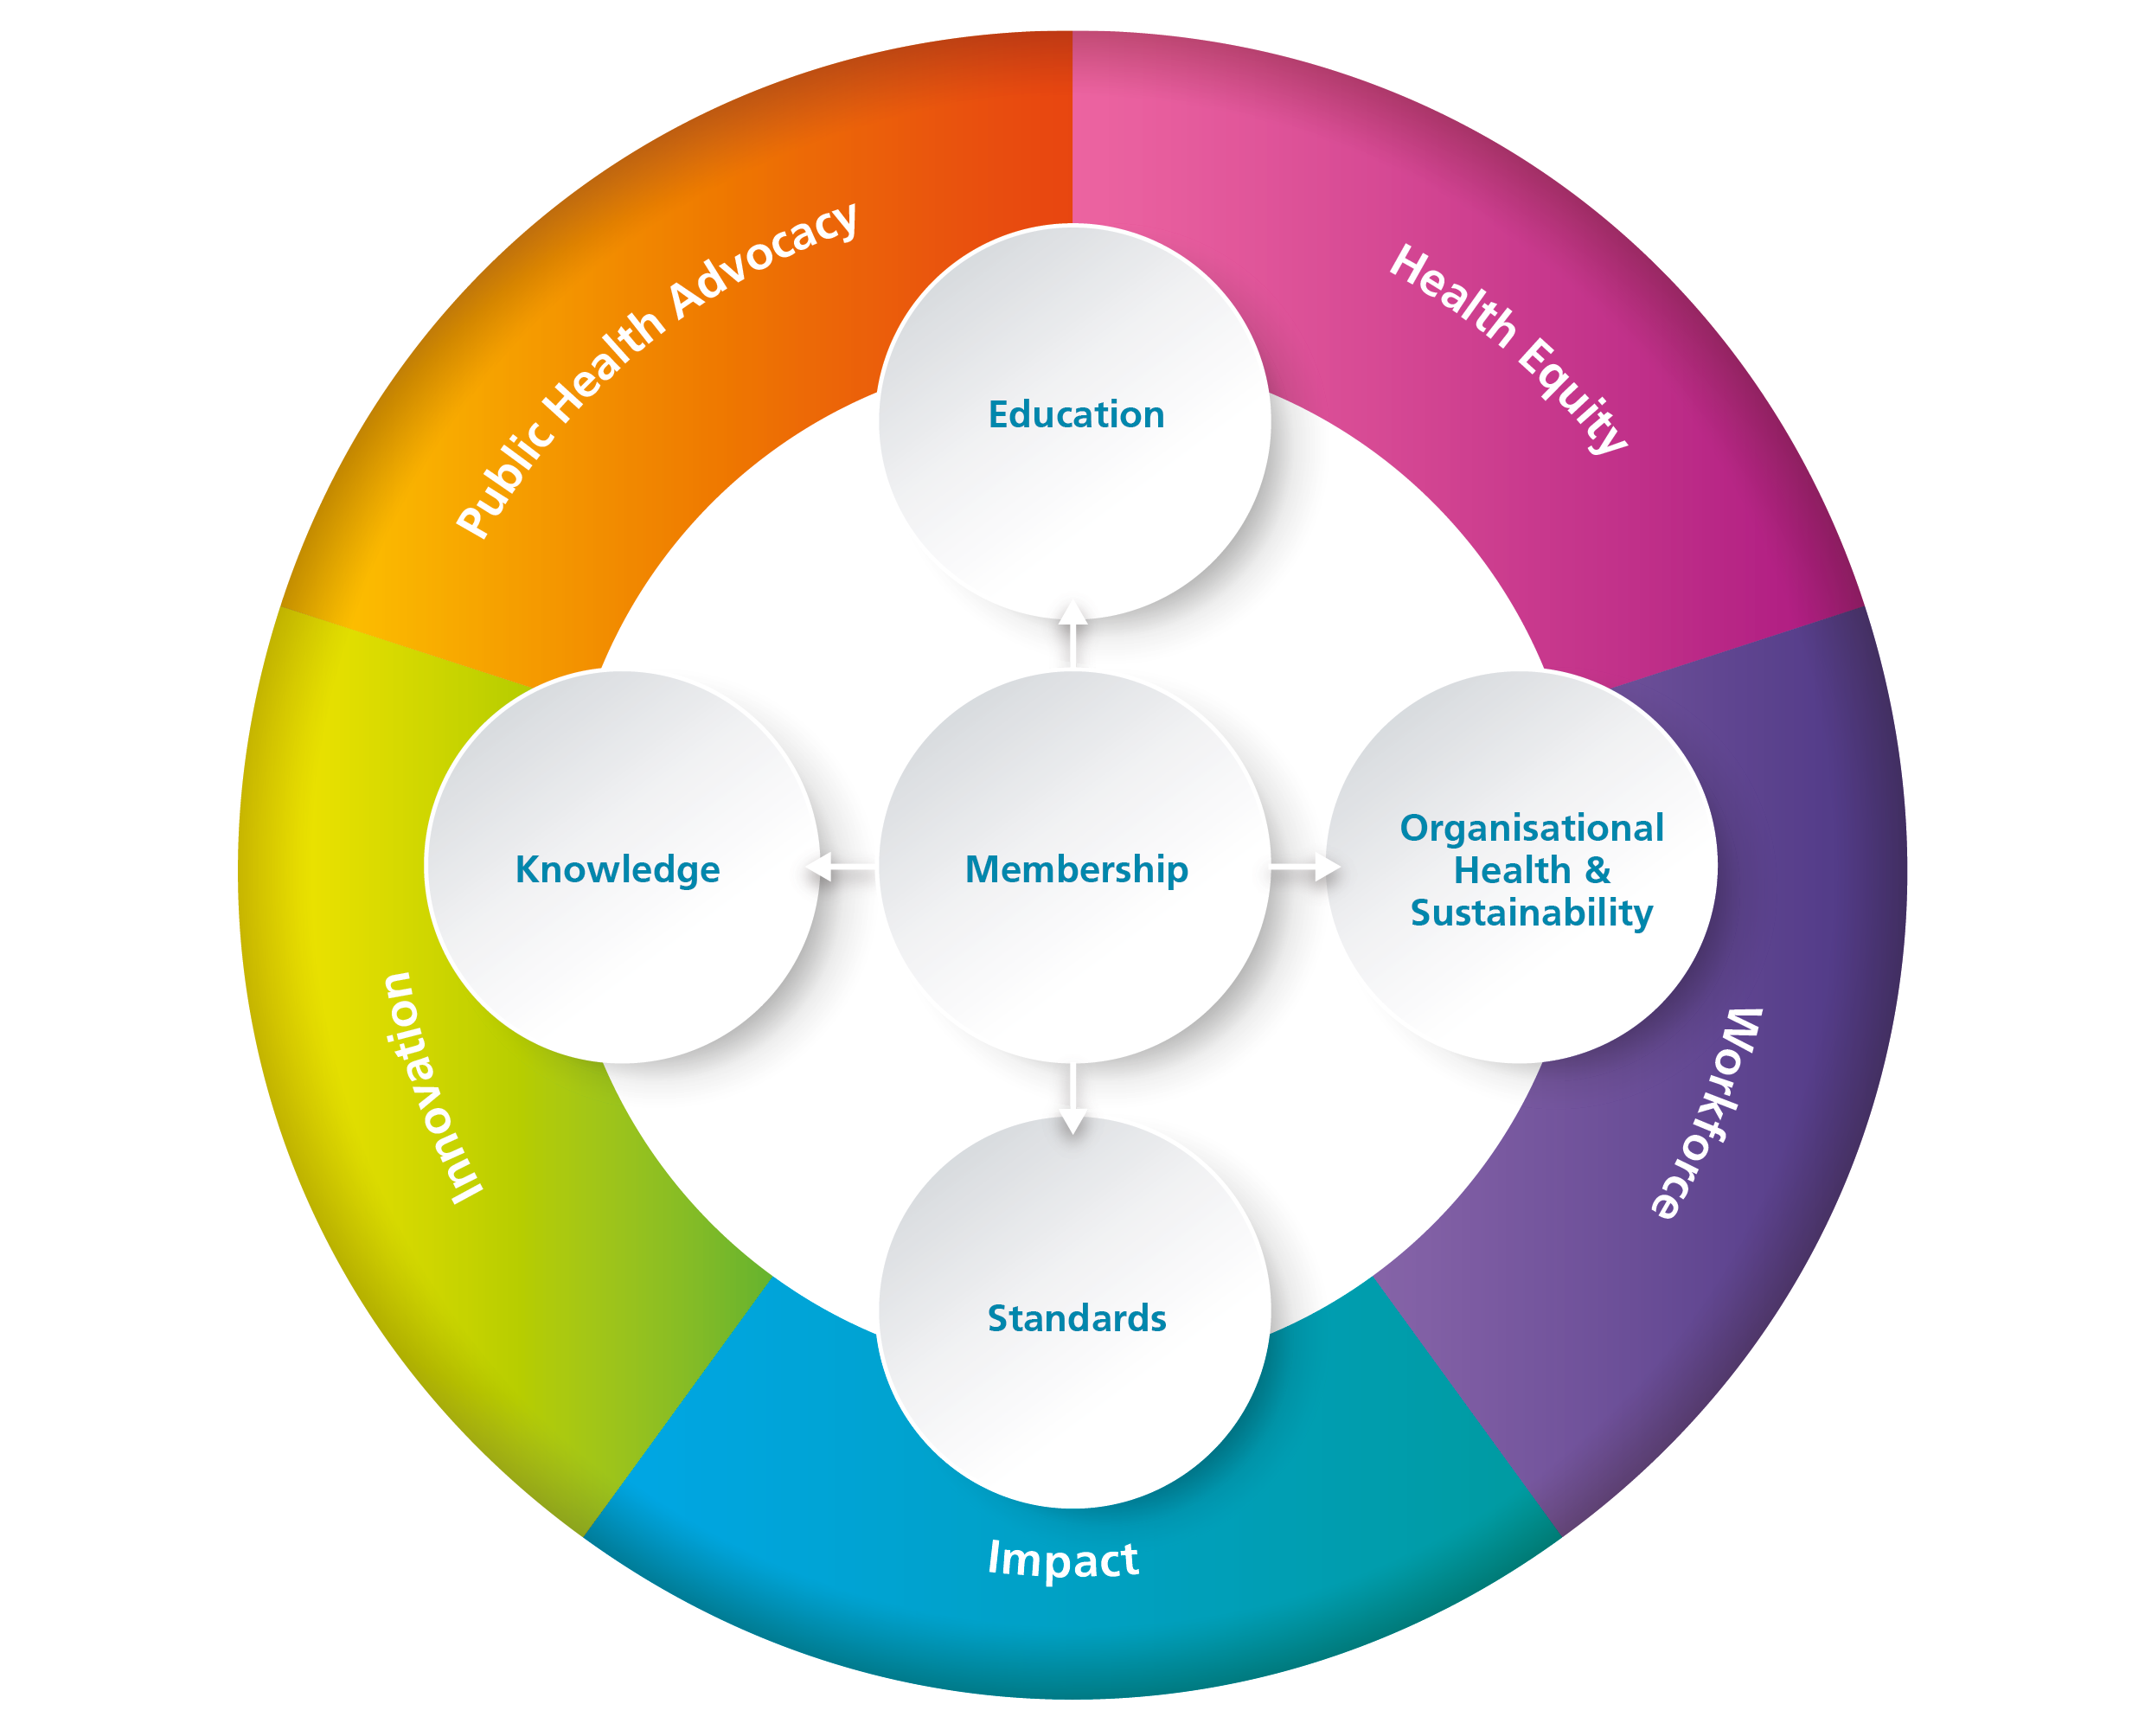
FPH Strategy 2025-30
Focus Areas

Slide 8
Professor Meng Khaw
Academic Registrar

Slide 9




Overview
Enrolment
Curriculum
Assessment
Training
Governance

Slide 10
Enrolment with FPH
Registrars are required to enrol with FPH within three months of commencing the training scheme. You will receive an email with instructions.
For 2025 the Registrar Training and Membership fee was £304. Reduced fees are available to those on lower incomes.
Membership and exam fees can be claimed against tax as work expenses by HMRC.
Notes:
Membership and examination fees frozen for a second year running

Slide 11
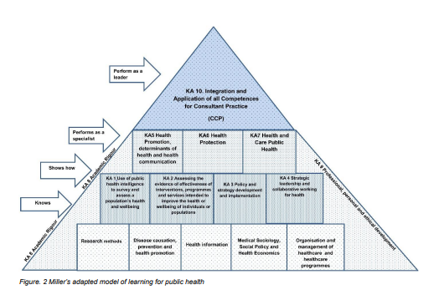
Curriculum Review
FPH framework to achieve competencies required for specialist public health practice
New curriculum due in 2027
Project plan agreed with opportunity for engagement and consultation
Steering and working groups established
Initial consultation in autumn 2025
Carried out alongside an ongoing review of FPH assessment

Slide 12
Assessment: FPH exam applications & adjustments

Slide 13
Training: No. of public health registrars over time

Slide 14
Training: Recruitment
FPH input to recruitment of PH and PH/GP training programme
FPH role defined
  Custodian of person spec
  Workforce numbers
  Assurance of process
Review of governance for 2026 recruitment round
Continued work to reduce differential attainment
Record number of applications
  2710 PH (1817 Medic, 893 Other)
  2173 PH/GP
  Assessment centre
  1774 invited and attended
  770 passed
Selection centre
  318 interviewed
  212 appointable
  108 posts accepted

Slide 15
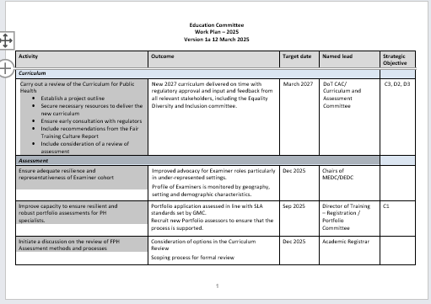
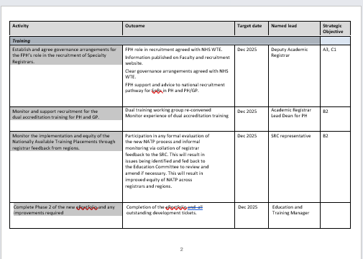
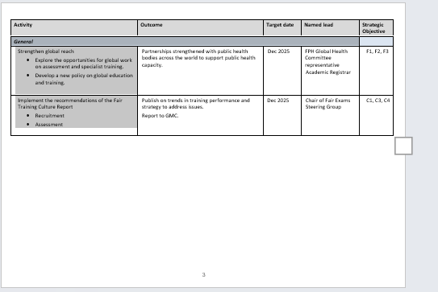
Governance: Education committee
Workplan agreed for 2025
  Derived from deep-dive discussions
  Aligned to key priorities on Curriculum development, Assessment and Training
Establishing sub-groups/working groups
  Curriculum review
  Strategic Assessment review
  Strategic Recruitment Advisory Group
  Fair Exams
Collaborative working with
  Equality, Diversity and Inclusion committee
  Global Health Committee

Slide 16
Fair Training and Assessment
Fair Training Strategy established
Fair Exams report in November 2024 and establishment of the Fair Exams Steering Group
Decolonisation and Anti-racism in FPH report in June 2025 – curriculum development
Engagement with external partners including the UKPHR, AoRMC EDI forum, GMC Fair Training Culture Workshop, RCOG
Fair Exams Steering Group workplan
  Improving data collection on candidates
  Qualitative research study on DFPH attainment
  Piloting targeted support and feedback for DFPH
  Mapping existing regional offer for DFPH & MFPH preparation and formative feedback

Slide 17
Specialty Registrars’ Committee
Tom Irving, Vice Chair
Jack Haywood, Vice Chair
Nancy Zheng, Chair

Slide 18
Specialty Registrars' Committee (SRC)
The SRC is the voice of Public Health Specialty Registrars and a formal part of the FPH structure, meaning we get a direct channel to decision-makers.
We represent and advocate for the interests of all public health registrars, working collaboratively with the FPH and partners to promote high quality and equitable specialty training in public health.
Some priority areas for 2025 (subject to agreement):
Expanding access to nationally available placements
Improving experiences of hybrid working
Contributing towards review of training curriculum
Equity between medics and non-medics
Ensuring reasonable adjustments are available
Notes:
DFPH used to be January and June, now moved to March and Oct – example of where FPH has responded to Registrars / SRC feedback (impact on holidays, childcare, and changeover).

Slide 19
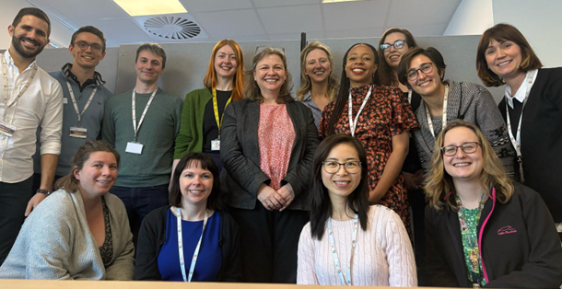
SRC away day
Update picture

Slide 20
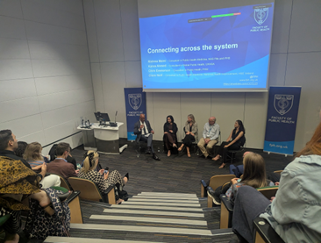
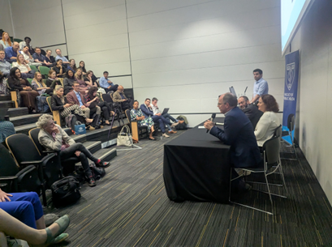
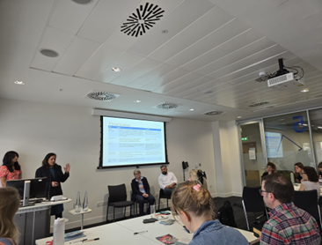
National Registrar Conference

Slide 21
Local Reps and SRC Reps
Your region will have local reps and SRC reps!
Generally, your local reps will advocate for registrars on local School issues – work closely with the Head of School and Training Programme Directors
SRC reps will advocate for registrars on national issues
Local and SRC reps will work together as some local issues may also be present nationally – so can advocate at both levels
If in doubt, reach out to one of your reps and they will advise

Slide 22
SRC Reps
Chair | Nancy Zheng
Vice-Chairs | Anna Goulding
 | Jack Haywood
 | Tom Irving
Defence | Andrew Stuart
Dental | Grant Creaney
East Midlands | Caroline Panto
 | Joseph Williams
East of England | VACANT
 | Sara Al Khafaji
London | Jamie Smyth
 | Paula Del Rey Puech
 | Varthani Kirupanandan
 | Isabelle Risso-Gill
London | Jamie Smyth
 | Paula Del Rey Puech
 | Varthani KIRUPANANDAN
 | Isabelle Risso-Gill
Kent, Surrey & Sussex | Rabia Khattak
 | VACANT
North East | Kavita Chawla
 | Kaat Marynissen
North West | Jessica Smith
 | Mary Cronin
Northern Ireland | Lynsey Patterson
 | Maeve Middleton
Scotland | Beth Dorrans
 | Paul Athanasopoulos
Scotland | Beth Dorrans
 | Paul Athanasopoulos
South West | VACANT
 | Sian Reece
Thames Valley | Bethany Ferris
 | Branagh Crealock-Ashurst
Wessex | Emma Pacey
 | Sarah Davidson
West Midlands | João Martins
 | Elinor Laws
Yorkshire and Humber | Sulia Celebi
 | Marie Rogerson
Wales | Jason Sarfo-Annin

Slide 23
Next steps
Look out for opportunities to join the SRC as vacancies arise in your region – you will be informed through local mechanisms when this is the case
Please feel free to reach out!
Nancy (SRC Chair) can be reached at x.zheng@nhs.net
The best route to contact FPH on training matters is: educ@fph.org.uk

Slide 24
FPH e-Portfolio
Gareth Cooke
FPH Education and Training Manager
Notes:
The FPH electronic portfolio (ePortfolio) system provides Specialty Registrars with a central platform for the management of information and documentation on progression of learning against the public health specialty training curriculum during their time in training. The ePortfolio allows trainees to relate documentation and evidence to the curriculum and incorporates the ability to record various sign offs.
To access the ePortfolio please click here.
The training ePortfolio is managed by the registrar who must reflect on and record their achievements on an on-going basis. It is intended to be used as a complementary tool to aid in the recording of training activity, and monitoring progression along with regular meetings with Registrars and their supervisor.
More info available on FPH website: https://www.fph.org.uk/training-careers/specialty-training/training-eportfolio/

Slide 25
Education & Training Team
Support for Registrars throughout training . . .
Enrolments
CCT
Exams
OOP
ePortfolio
        All queries to educ@fph.org.uk

Slide 26
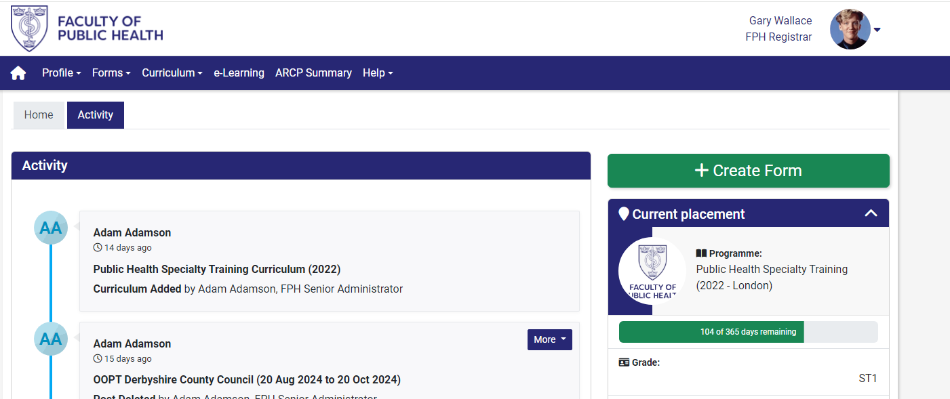
What is the ePortfolio?

Slide 27
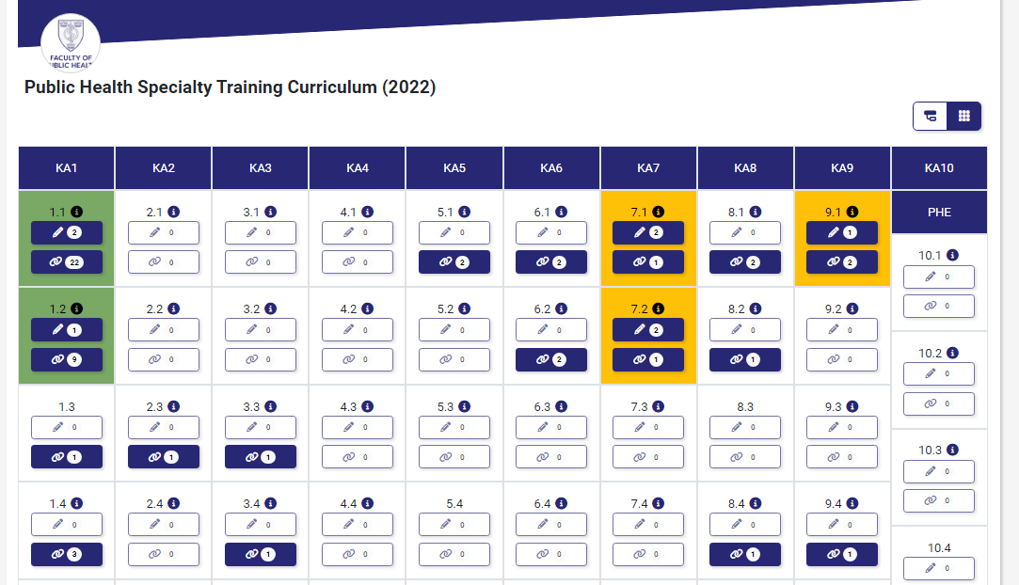
How the ePortfolio works

Slide 28
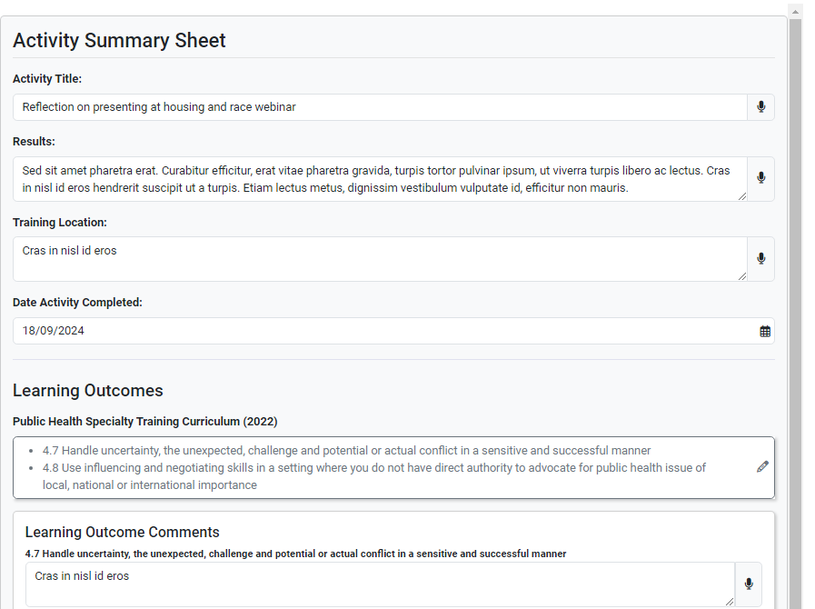
How the ePortfolio works

Slide 29
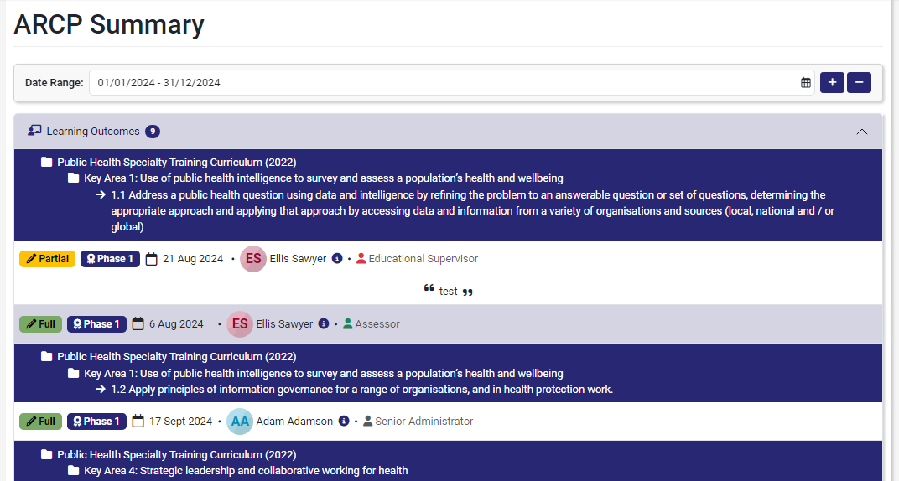
ARCPs

Slide 30
Confidential Data
Please note that Faculty staff, FPH Education & Training Officers, Educational Supervisors, TPD and regional Training Programme staff will have access to your accounts and will be able to view all documents within for the purposes of administrating training.
When uploading evidence to the ePortfolio you should ensure that any sensitive information has been redacted. If you are unsure you should ask your Educational Supervisor.
Notes:
An ePortfolio User manual is available on the ePortfolio login page.
The following links will take you to video demonstrations of how the ePortfolio works and steps needed to upload evidence, submit Activities and how Learning Outcomes are signed off.
https://www.youtube.com/watch?v=A_9iYcOwWt8 and https://vimeo.com/175849496
Both videos were created by Public Health Registrars.

Slide 31
Future Developments
FPH approval for Out of Programme Applications
Recording ARCP outcomes
Certificate of Completion of Training (CCT) applications

Slide 32
Resources
Education and Training team: educ@fph.org.uk
ePortfolio Champions

Slide 33
FPH Special Interest Groups
Julian Ryder
FPH Deputy CEX and Director of Education, Standards & Advocacy
Georgia Harris
FPH Policy Coordinator
Notes:
Introduction

Slide 34
Context
The Faculty of Public Health currently has:
Nearly 6,000 members – mainly UK but all over the world
27 active committees – ‘lifeblood’ of a membership organisation, essential to governance
37 SIGs, each reporting to a committee
19 staff (17 FTEs) – focussed on the ‘must do’s’
Notes:
JULIAN

Slide 35
Special Interest Groups (SIGs)
SIGs are established by FPH members to harness and disseminate the knowledge and skills of the Faculty’s 6,000 members.
37 SIGs each report to one of our standing or sub-committees.
SIGs offer members a unified platform to address public health challenges and play a pivotal role in shaping and leading FPH policy initiatives, extending the Faculty's influence across various domains.
The primary objective of SIGs is to bolster FPH's overarching mission of improving the health and wellbeing of local communities.
Notes:
JULIAN

Slide 36
What do FPH SIGs do?
  SIGs act as a source of knowledge and expertise for FPH
  Support workforce training and development
  Improve public health policy at a local, national, and global level
  Promote new research and lead the public health response on a range of issues
Notes:
GEORGIA

Slide 37
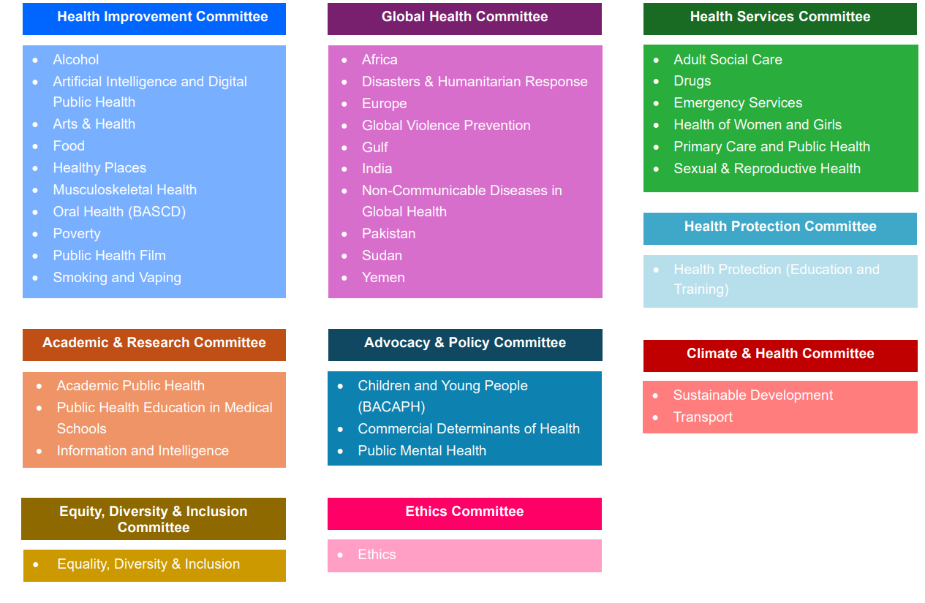
Faculty SIGs and who they report to
Notes:
GEORGIA

Slide 38


Recent policy areas
  Commercial determinants of health
  Public health intelligence
  Poverty
  Drugs
  Climate and health
  Smoking and vaping
  Mental health
  Find out more at www.fph.org.uk → Policy and Advocacy → Special Interest Groups
Notes:
GEORGIA

Slide 39
Faculty support for SIGs
SIGs are self-administered, with FPH support.
Events: Assistance with logistics, promotion, and feedback for SIG events. SIGs may use FPH video-conferencing facilities and meeting rooms as needed.
Promotion of SIG work: Promotion of SIG activities through various channels including the FPH bulletin, social media, and website.
Workplans: Provision of guidance, approval, and publicity for SIG workplans.
Projects: FPH supports SIGs to develop specialty registrar projects to address learning outcomes.
Guidance: FPH provides relevant guidance and protocols to support SIG operations, including membership management, GDPR compliance, etc.
Joint working: Facilitation of cross-SIG collaboration, including identifying relevant consultations.
Notes:
GEORGIA

Slide 40
FPH Examinations – DFPH & MFPH
Jack Haywood
ST4, London
Speciality Registrar Committee (Vice-Chair)

Slide 41
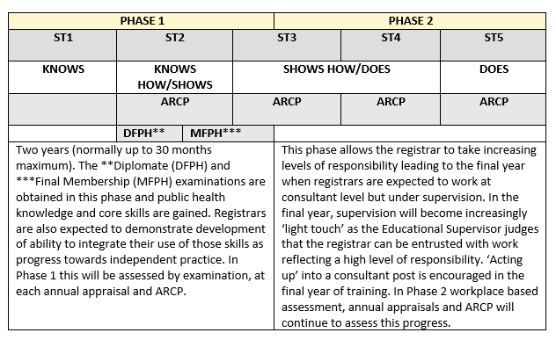
Where do exams fit into training?
Notes:
Usually completed in phase 1 of training but MFPH can in practice extend into phase 2.

Slide 42
Diplomate (DFPH) Examination
“Knows how” exam, detailed syllabus
Two papers, two days (delivered in test centres)
March and October sittings
  Paper 1: Knowledge (2h 30 & 1h 40 exams)
  10 structured questions (10 marks each)
                Research methods
    Disease prevention and health promotion
    Health information
    Medical sociology, social policy, health economics
    Organisation and management of healthcare
Notes:
This is a “knows how” written assessment of a candidates' knowledge and understanding of the scientific basis of public health, and their ability to apply their knowledge and skills to the practice of public health.
It is split into two papers sat over two days (one rest day in between). Paper 1 and Paper 2 are split into two parts; 1A, 1B, 2A and 2B.
Paper 1 is designed to test knowledge. You’ll be asked to answer 10 short answer questions across the range of the syllabus to demonstrate knowledge of the core science of public health. This is split up into different sections…
The DFPH is sat online with remote invigilation.

Slide 43
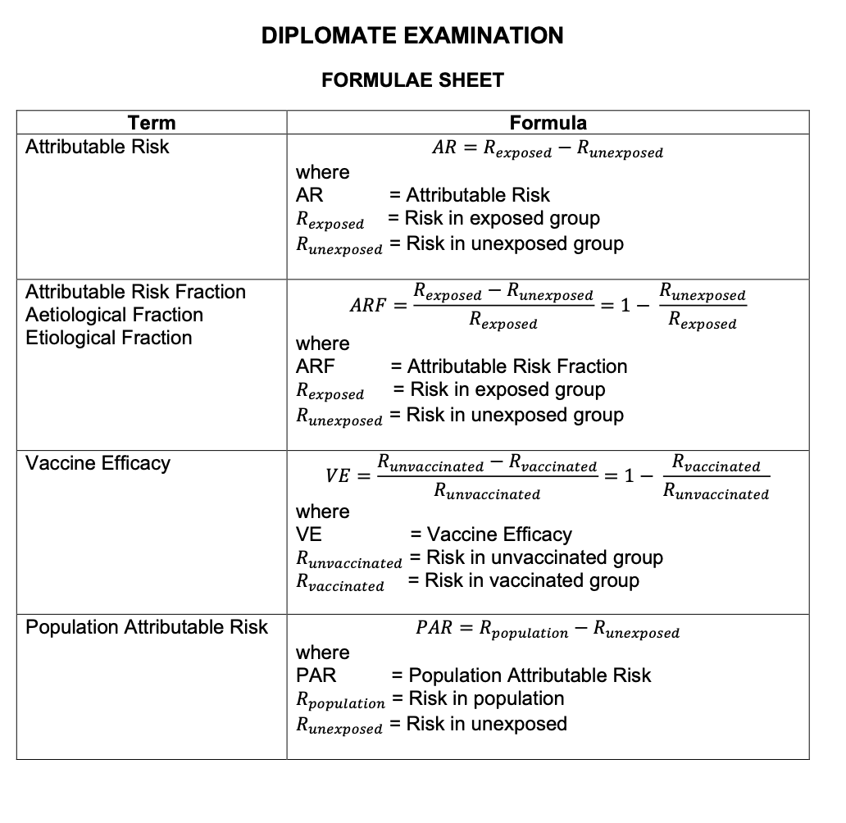
DFPH Examination
Paper 2: Skills
  2A (2h30): Critical appraisal & follow-on questions on a PH theme
  2B (2h): Practical statistics & data interpretation
    You are provided with a formulae sheet
Notes:
Paper 2 is designed to test candidates' public health skills. Candidates must answer the question posed in both sections.
Paper 2A is a critical appraisal (with a word limit) followed by several follow-up questions; these might be items like ‘summarise article for a local councillor’ or a request to respond to a media inquiry about the findings. My personal reflections on this are that you are approaching this as a public health professional e.g. think about the public health implications of the findings- it’s not a straightforward exercise in criticising a paper (although you are also trying to demonstrate those skills as well)
Paper 2B – data interpretation skills. Formulae sheet provided.
E.g. of follow-up Qs: Draft a reply to your local politician or write a media bulletin
Time on 2B has been extended to 2 hours

Slide 44

DFPH Examination
Preparation
  3-4 months
  No reading list
    Mastering Public Health
    https://www.healthknowledge.org.uk
  Specimen Questions - updated
  Hints and tips from examiners
Each region usually has its own exam preparation series too!
Notes:
3-4 months good amount of time, remember to make use of study leave.
No reading list but there is a syllabus - Health Knowledge & Mastering Public Health both useful resources and map onto syllabus. Also useful to review content from any public health masters completed during or before training. Awareness of ‘hot topic’ issues also really useful for adding substance to your answers, so keep up to date with recent challenges in public health.
FPH no longer publish past questions for paper 2B - retained in a reusable question bank. However, specimen papers available.

Slide 45

DFPH Examination
Familiarise yourself with the passing criteria/algorithm
You can "bank" a paper
Please remember – many candidates take more than one attempt to pass the DFPH
Reasonable adjustments available
Lots of additional information in the DFPH section of the FPH website
Contact exams team: educ@fph.org.uk
Notes:
(approx. 1 in 3 candidates don’t pass both papers each sitting). This is a hard exam.
Reasonable adjustments are available – this can result in things like additional time, rest breaks, use of a headset/ear plugs.
So, what next?

Slide 46
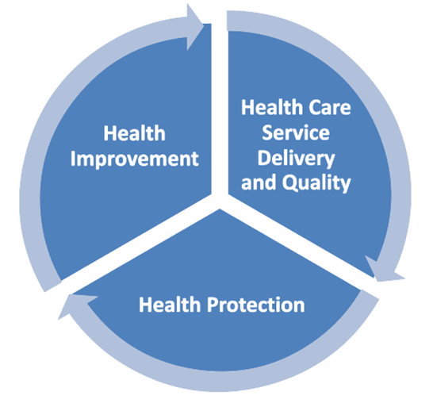
Membership (MFPH) Examination
“Shows how” assessment
6 scenarios, ~2 hours
Application of knowledge (syllabus), skills and attitudes to the practice of public health
Just a guide: sit 9-12 months after DFPH, ~2 years from end of training
Notes:
This is a “show how” role-play assessment of a candidate’s ability to apply relevant knowledge, skills and attitudes to the practice of public health
It is an an approximately 2 hour practical assessment made up of 6 scenarios.
The scenarios are chosen to represent everyday public health issues in commonly experienced settings across the three domains of public health practice: health improvement, health protection, healthcare public health.
Real-life scenarios often based on the experiences of examiners who write the scenarios. Example - radio interview about vaccinations, or meeting with councillor about suicide rates in local area.
What is being assessed?
Application of theory to practice, therefore not a strictly content-based exam - not expected to regurgitate the entirety of Part A syllabus

Slide 47
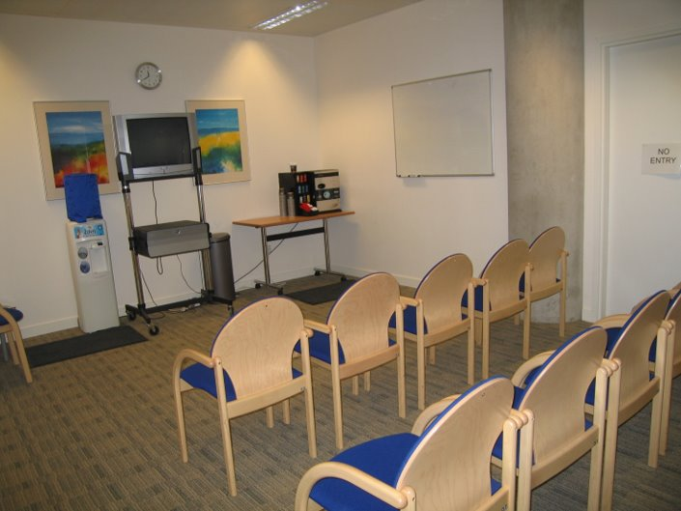
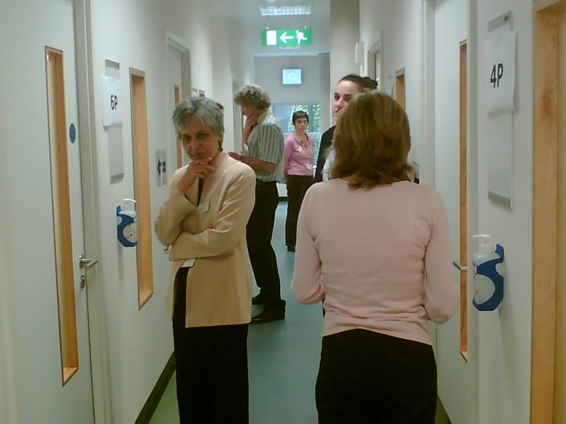

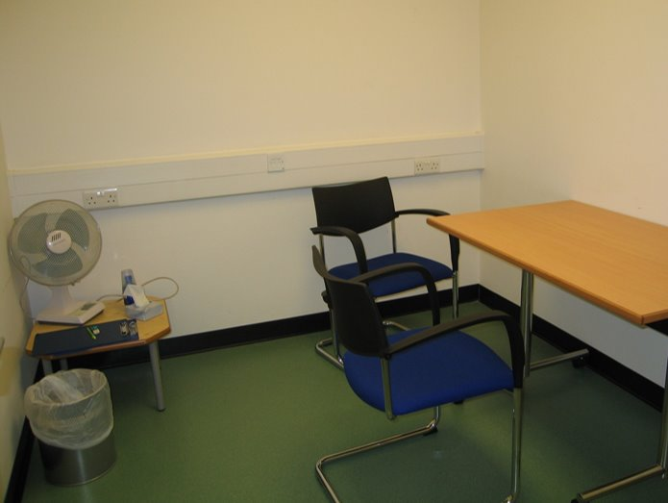
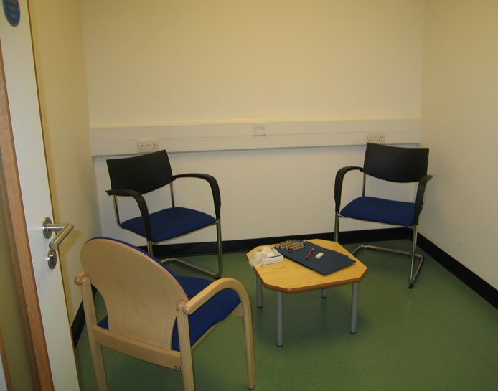
MFPH Format
6 scenarios, cycle:
  8 minute preparation station to review briefing material
  1 minute transfer time
  8 minute examination station
  1 minute transfer
~ 2 hours, guided through stations by facilitators
Mix of professional actors and public health professionals as role players
Face to face
Briefing room
Transfer corridor
Prep room
Exam room
Notes:
The MFPH takes the form of six scenarios.
Each scenario will have a 8 minute preparation station in which you review briefing material - this can be some data for example
Each examination station also lasts 8 minutes - here you will have a discussion with the role-player, this discussion is scripted so all candidates in that sitting are asked the same questions
You have approximately one minute to transfer from the preparation to examination station for each scenario
Sounds complicated - but do not worry, plenty of facilitators to guide you round

Slide 48
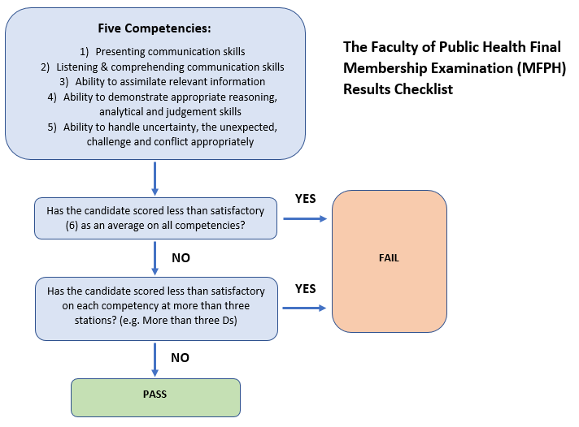
MFPH - Competencies assessed
Communication skills: presenting (verbal and non-verbal)
Communication skills: listening, comprehending, responding
Assimilating & using relevant information
Reasoning, analytical and judgement skills; giving a balanced view
Handling of uncertainty, the unexpected, challenge and conflict
Notes:
In each examination station, a role player and an examiner assess candidates across the same five competency areas at every station
Graded A-E, with A being excellent, B being good, C being adequate, D being just below adequate and E being poor.
Need an average of C for each competency to pass, with at least a C in 3 stations - so possible to do less well on two stations, but still pass by doing well in other stations.
Transition: Resources
5 Competencies:
The ability to demonstrate presenting communication skills (verbal and non-verbal) appropriately in typical public health settings: presenting to a person or audience
The ability to demonstrate listening and comprehending communication skills (verbal and non-verbal) appropriately in typical public health settings: listening and responding appropriately
The ability to assimilate relevant information from a variety of sources and settings and using it appropriately from a public health perspective
The ability to demonstrate appropriate reasoning, analytical and judgement skills, giving a balanced view within public health settings
The ability to handle uncertainty, the unexpected, challenge or conflict
Marking
Using marking guidance, the examiner grades each competency A-E, with A being excellent, B being good, C being adequate, D being just below adequate and E being poor. These grades are later converted into numerical scores and then combined to produce an overall exam score and an average for each of the five competency areas.
A candidate awarded a C for each competency at all six stations would indicate a pass overall. However, the marks for each competency are averaged, so it is possible to do less well on, say, two stations, and yet still pass overall by getting marks higher than a C at other stations. The other requirement for a pass is that each competency area must be marked at C or above at half or more of the stations.
Outcome is pass or fail. There are awards available for top performing candidates. 7 years to pass post DFPH.

Slide 49
How to prepare
Use your placements to gain relevant experience
Get started 6 - 8 weeks prior to exam
Familiarise yourself with MFPH website
Practice, practice, practice
  Set up revision group
  Public health colleagues including supervisors and consultants
  Friend and families (especially layperson scenarios)
Make use of national and local resources (see next slide)
Do a mock if you can
Take study leave
Reasonable adjustments available
Notes:
Use your placements to gain relevant experience
Get started 6-8 weeks prior to exam – not as much ‘knowledge’ to assimilate,
Familiarise yourself with MFPH website
Practice, practice, practice
Set up revision group
Public health colleagues including supervisors and consultants
Friend and families (especially layperson scenarios)
Make use of national and local resources (see next slide)
Do a mock if you can
Take study leave

Slide 50
MFPH Resources
MFPH page on FPH website (including FPH scenarios)
Useful blogs and articles:
  https://academic.oup.com/jpubhealth/article/38/1/189/2362659
  https://www.drcath.net/hot-desk1/part-b-exam
  https://betterhealthforall.org/2019/08/05/top-10-part-b-exam-tips-from-kevin-smith-part-b-examiner/
  https://betterhealthforall.org/2018/06/06/the-winner-of-the-2018-fph-mcewan-award-shares-her-advice-on-preparing-for-the-part-a-exam/
Deanery tutorials, mocks and peer-produced resources
National WhatsApp revision group
Contact exams team: educ@fph.org.uk
Like the DFPH, most regions have a preparation series and/or mock exam

Slide 51
Your questions
Irfan Ghani
FPH Assistant Academic Registrar
Training Programme Director, West Midlands

