Slide 1
Poverty and the cost-of-living crisis – a public health emergency conference
May 2023
@MichaelMarmot
http://www.instituteofhealthequity.org

Slide 2

Why treat people and send them back to the conditions that made them sick?

Slide 3


Marmot Principles
Create and develop healthy and sustainable places and communities
Strengthen the role and impact of ill health prevention
Tackle racism, discrimination and their outcomes
Pursue environmental sustainability and health equity together
Give every child the best start in life
Enable all children, young people and adults to maximise their capabilities and have control over their lives
Create fair employment and good work for all
Ensure healthy standard of living for all

Slide 4
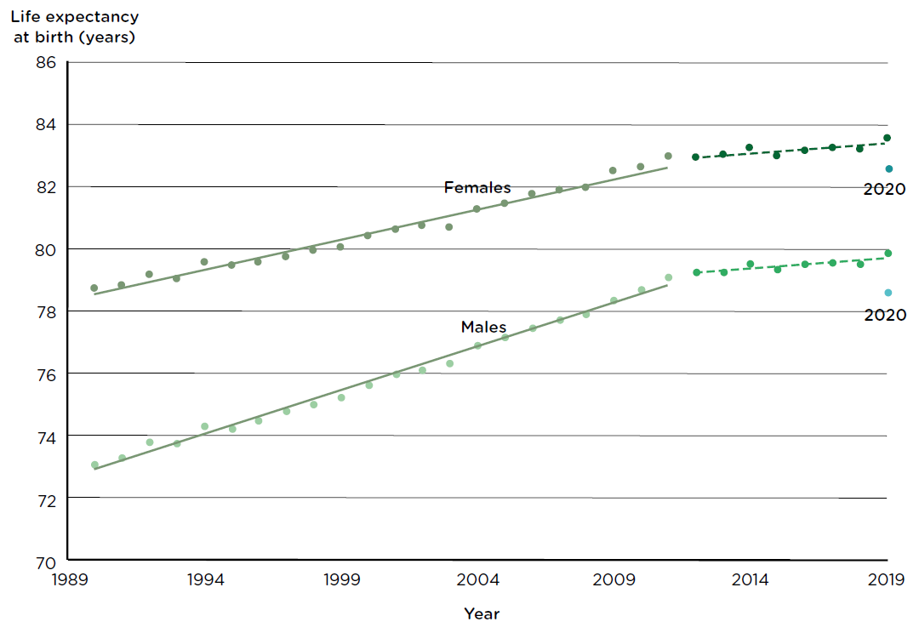
Increases in life expectancy at birth stalling in England
Source: Office for National Statistics

Slide 5
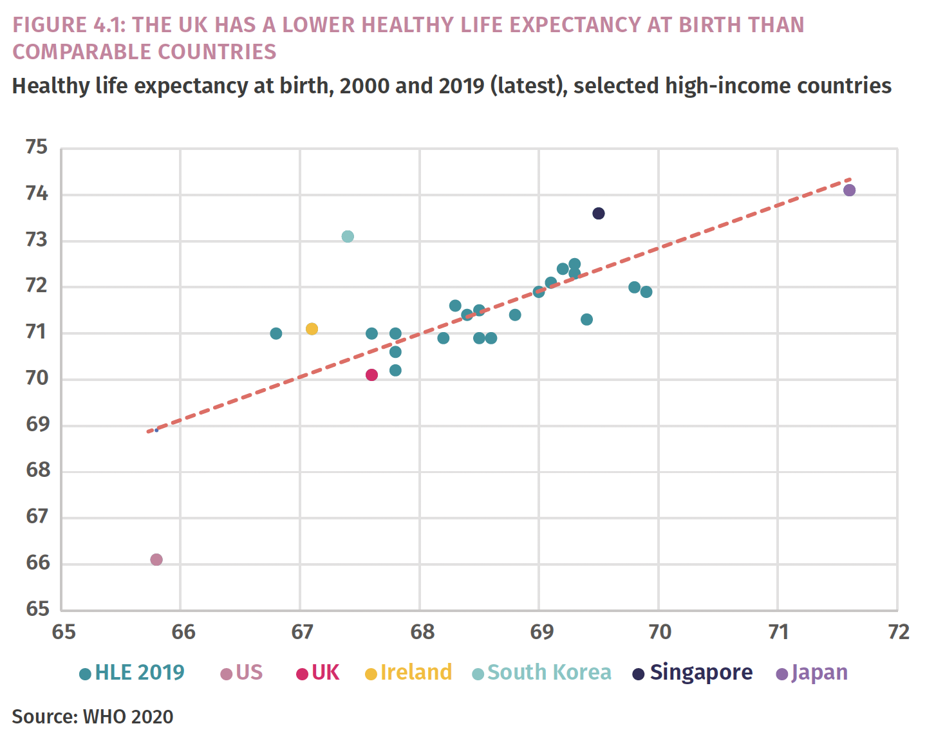
IPPR Commission on Health and Prosperity

Slide 6
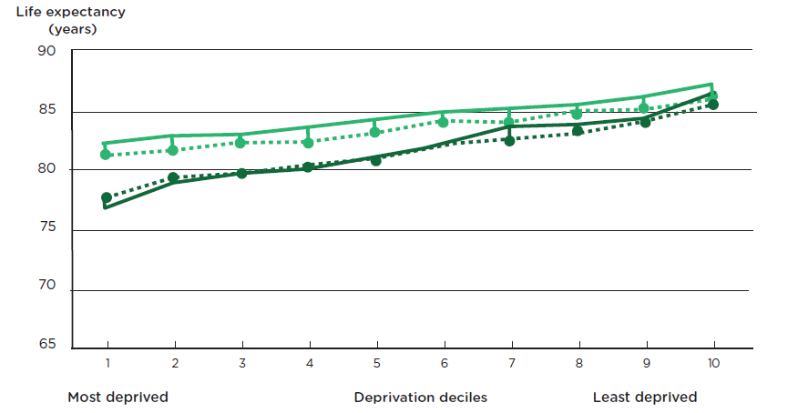
Life expectancy at birth by sex and deprivation deciles in London and the North East regions
Women

Slide 7
Not just poverty but the gradient

Slide 8
Proportionate Universalism

Slide 9
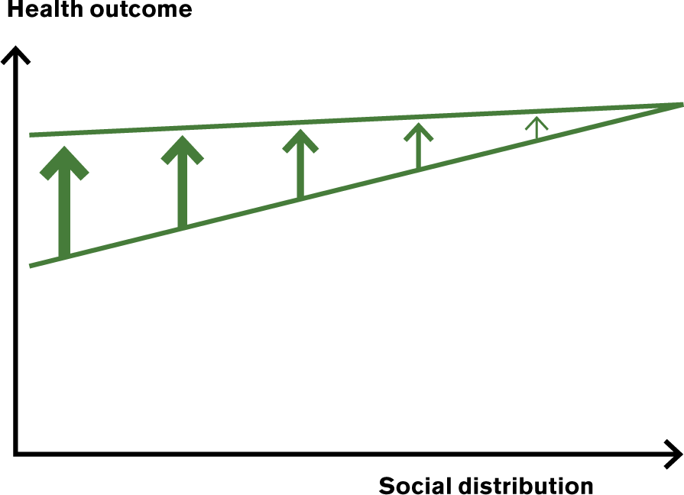
Levelling–up the social gradient in health

Slide 10
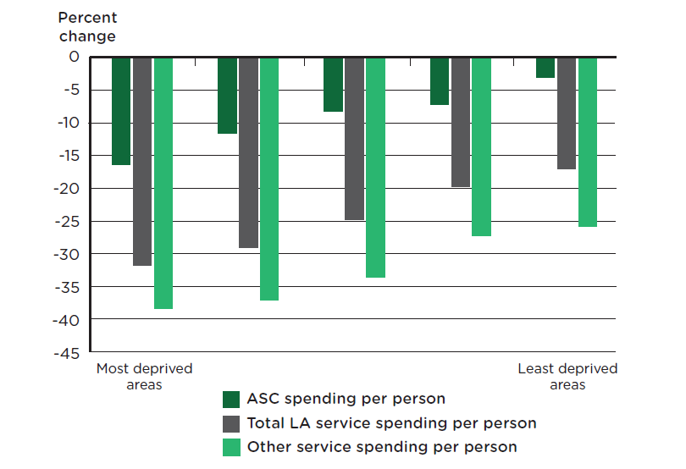
Average change in council service spending per person, England, by quintile of Index of Multiple Deprivation average score, 2009/10 to 2017/18

Slide 11
Poverty and the Cost of Living Crisis
Losses vs. Gains
Relative vs. Absolute Poverty
Funding of Public Services

Slide 12
Losses vs. Gains

Slide 13
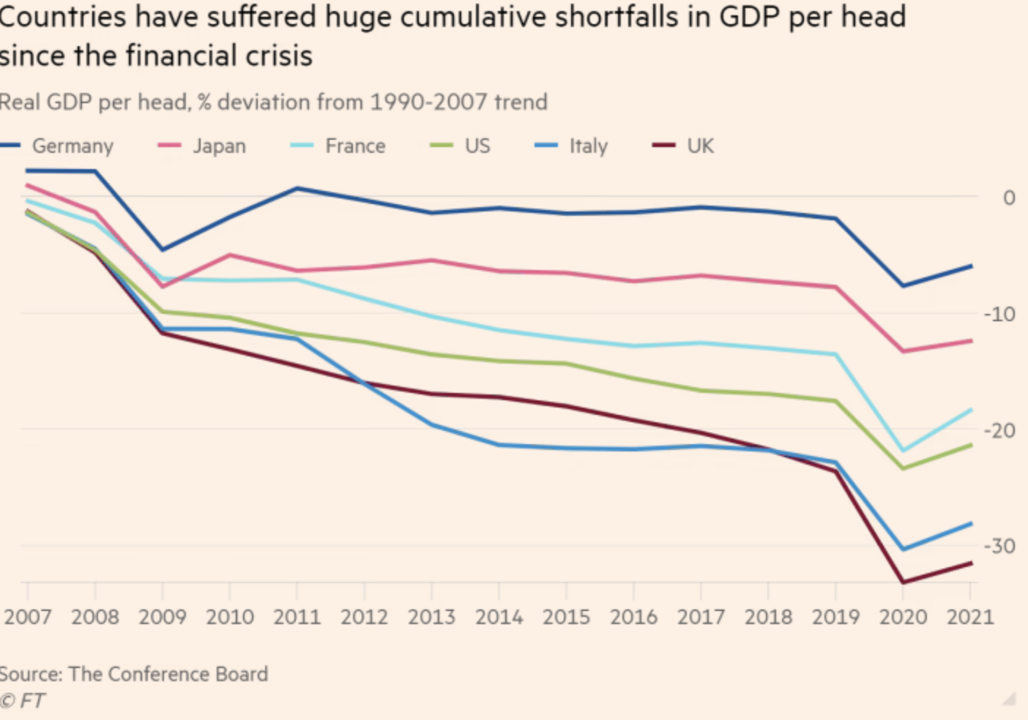

Slide 14
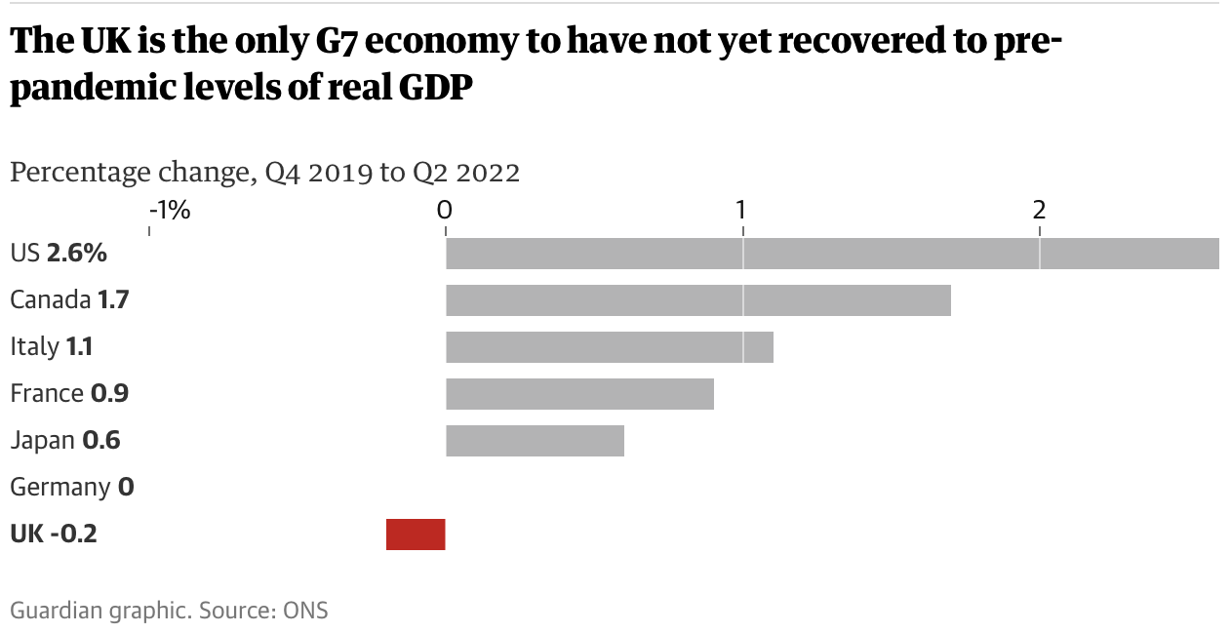

Slide 15
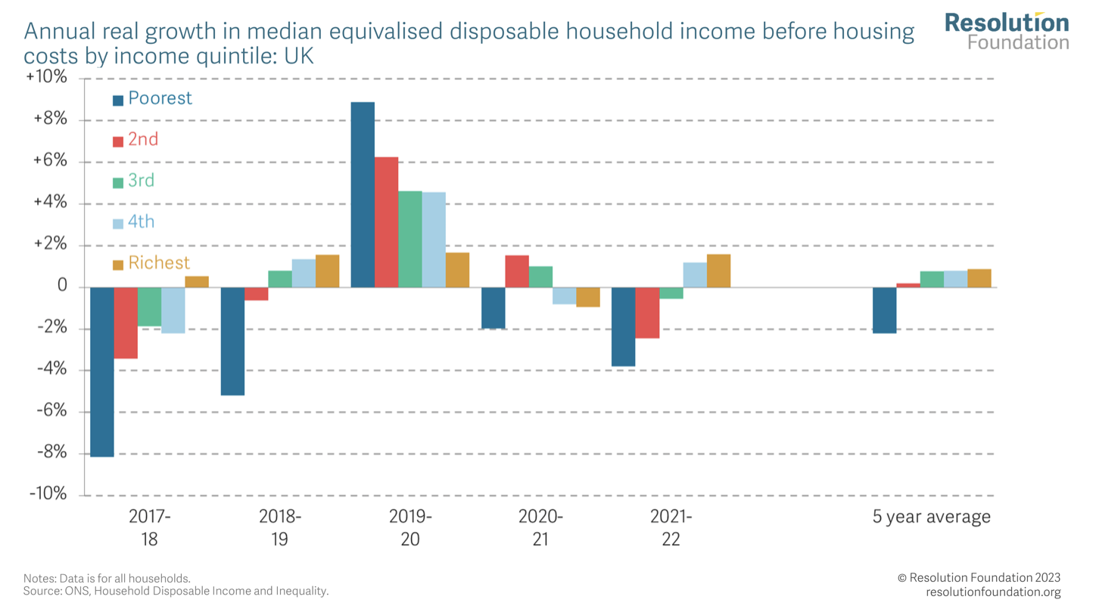

Slide 16
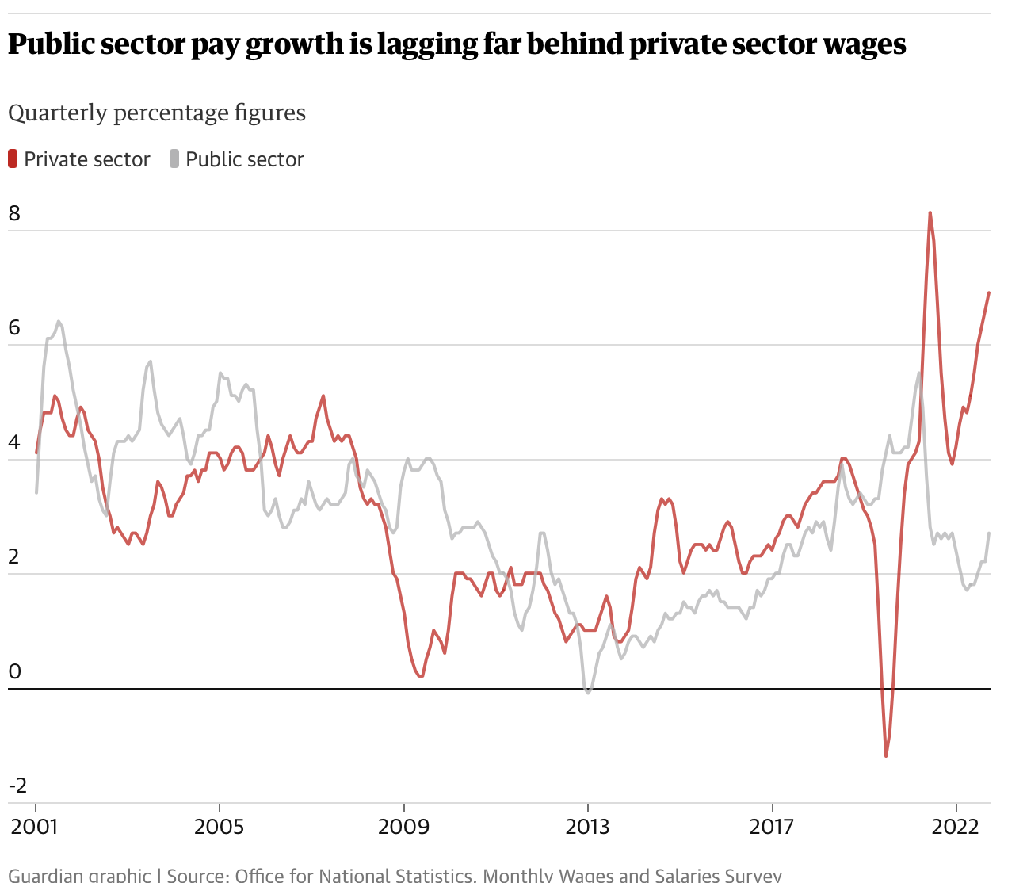

Slide 17
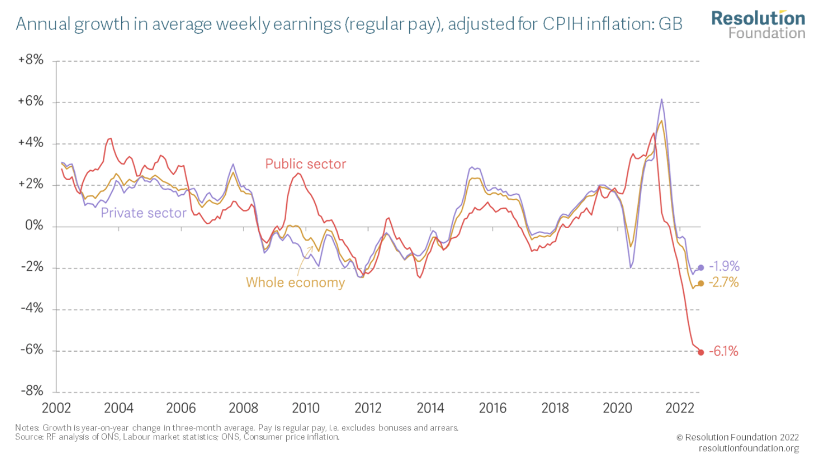

Slide 18
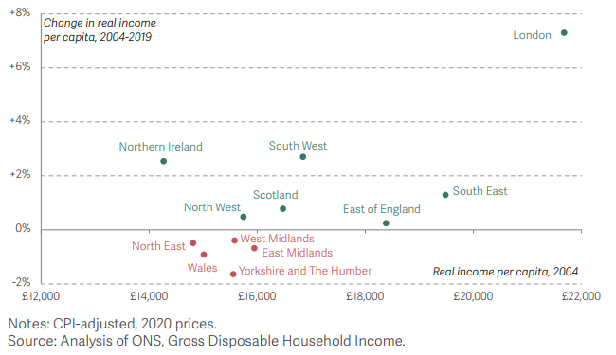
Change in real income per capita (GDHI cash measure) between 2004-2019, and level of income per capita in 2004: UK nations and regions

Slide 19
Relative vs. Absolute Poverty

Slide 20
“RELATIVE DEPRIVATION IN
THE SPACE OF INCOMES CAN
YIELD ABSOLUTE DEPRIVATION
IN THE SPACE OF CAPABILITIES”
Amartya Sen, Inequality Re-examined, 1992

Slide 21
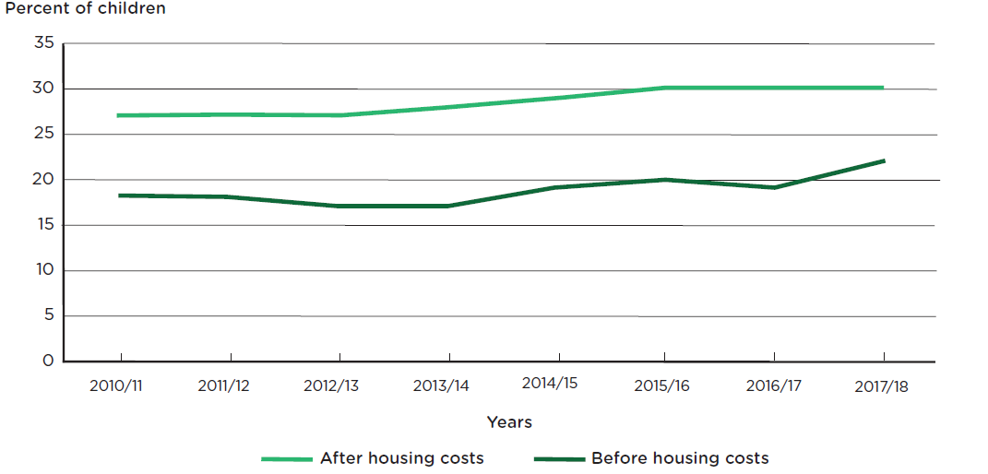
Children living in poverty before and after housing costs in England

Slide 22
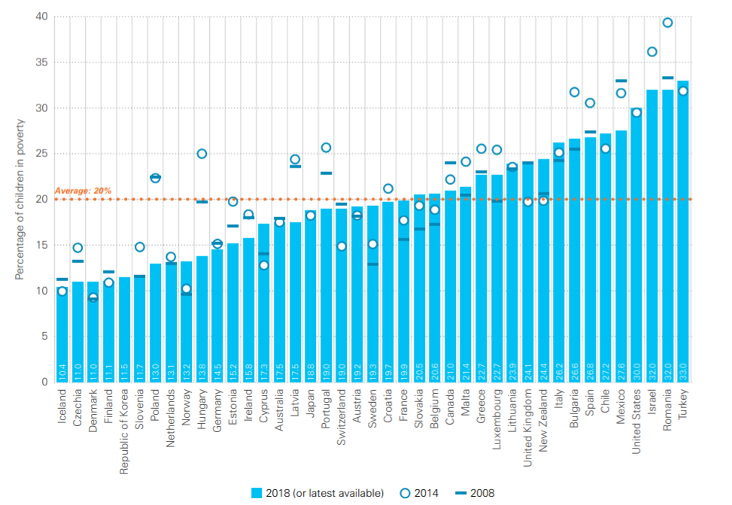
Child poverty (<60% median income)
UNICEF Report Card 16

Slide 23
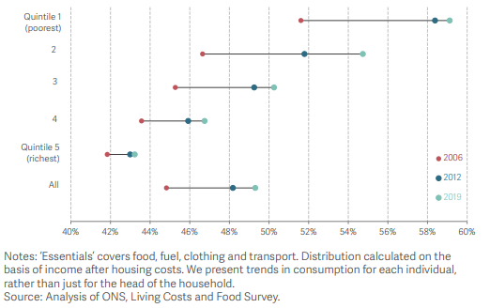
Proportion of equivalised non-housing household consumption spent on
‘essentials’, by quintile of the working age equivalised net household income distribution: UK, 2006-2019

Slide 24
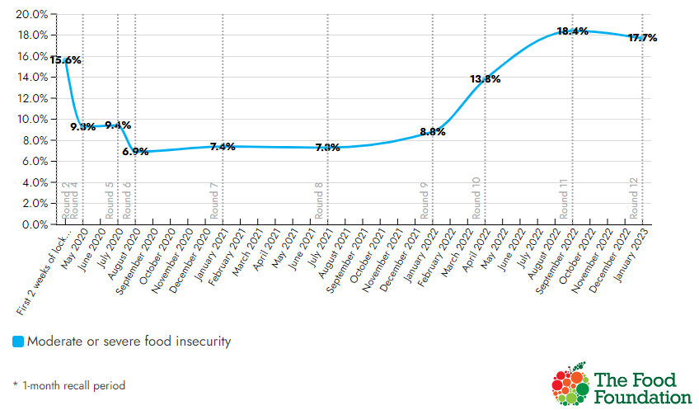
9.3 million adults (17.7% of households) experienced food insecurity in January 2023; Percentage of households experiencing food insecurity

Slide 25
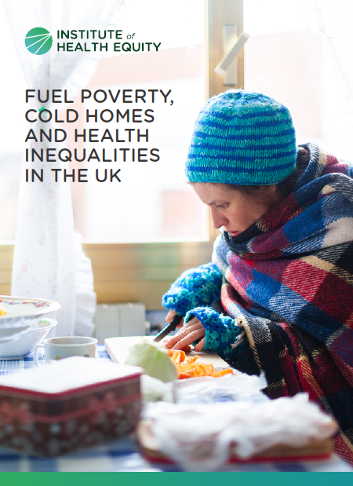
New Marmot Review: Thousands will die and millions of children will suffer from ‘humanitarian crisis’ of fuel poverty
Epidemic-levels of fuel poverty affecting half of UK households will cause a ‘significant humanitarian crisis with thousands of lives lost and millions of children’s development blighted’,

Slide 26
Drivers of fuel poverty
Household income
Current cost of energy
Energy efficiency of a home

Slide 27
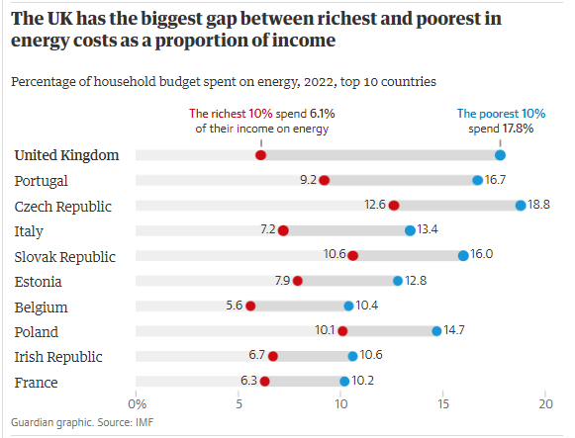

Slide 28
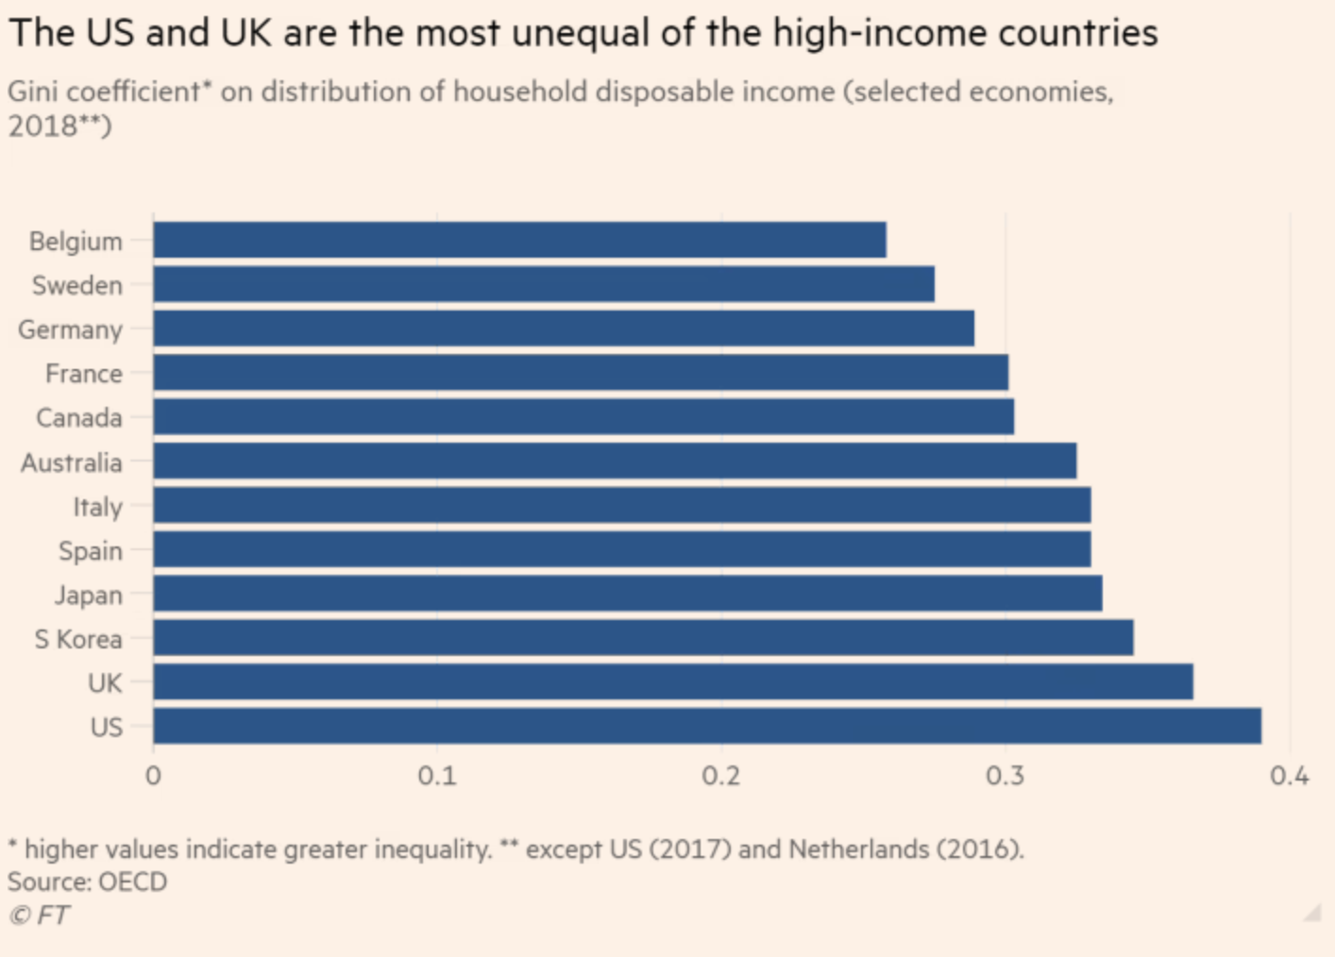

Slide 29
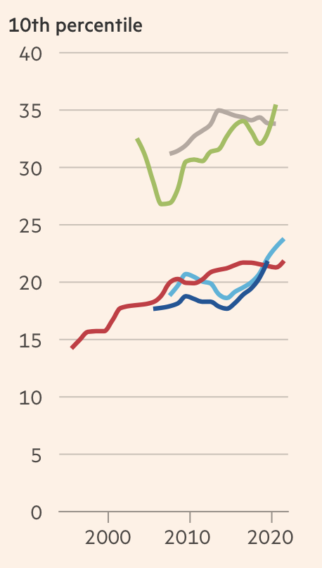
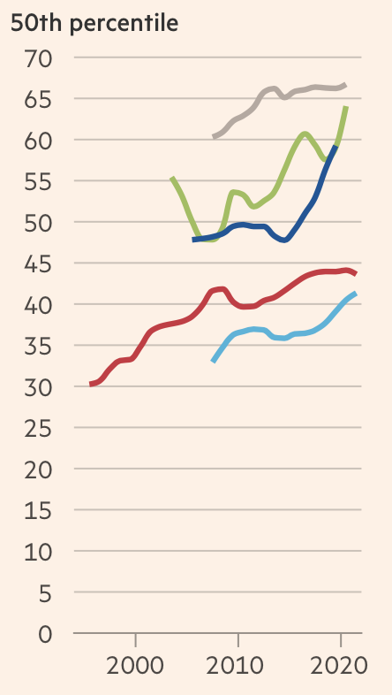
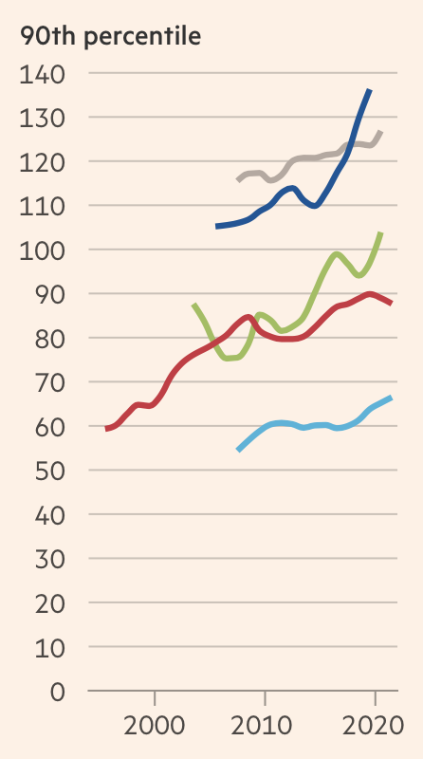
Countries Disposable HH income $’000 PPP
Burn-Murdoch FT 16.09.22

Slide 30
Funding of public services

Slide 31


Slide 32
“Levelling up” in Germany, incorporating former DDR.
€2 trillion over 25 years
£ 70 billion a year
Levelling up budget for 4 years 2021-24 £4.8 billion

Slide 33
Funding for ‘levelling up’ pales in comparison to local government austerity
The 2021 allocations of the Levelling Up Fund, £32 per person in the North
Drop in annual council service spending over the last decade of:
  £413 per person in the North,
  £388 drop across England,

Slide 34
Public sector expenditure (% of GDP) declined in the UK
Notes:
NOTE: this is updated

Slide 35
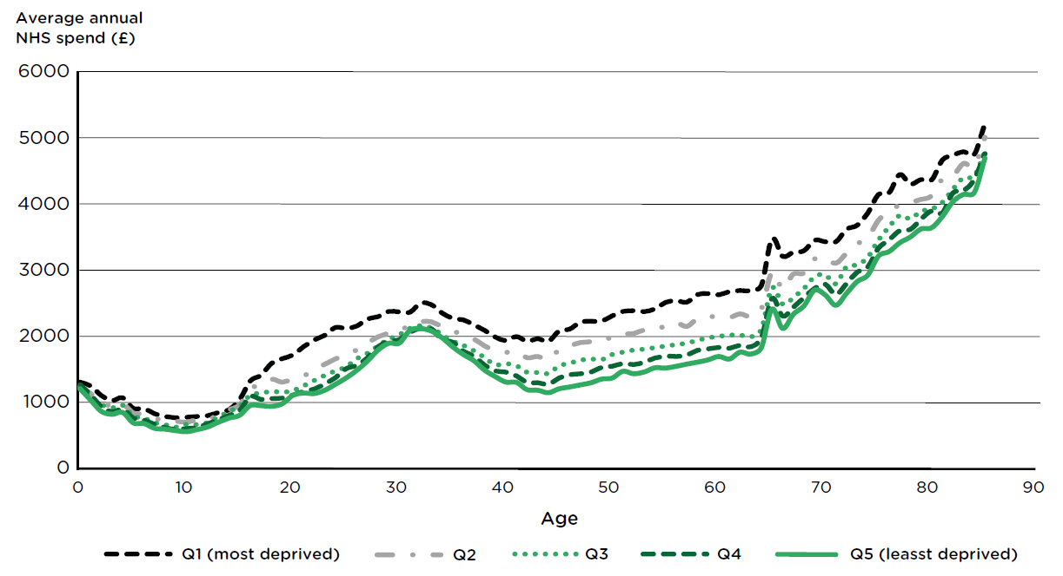
Average annual NHS spend by age and neighbourhood deprivation quintile group for males in England, 2011/12
Source: Asaria in IHE, Ten Years On

Slide 36
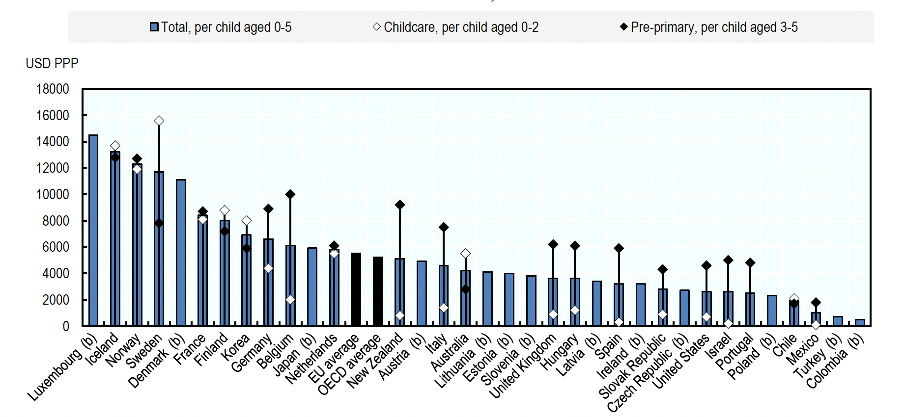
Public spending early child education and care
OECD Family Database

Slide 37
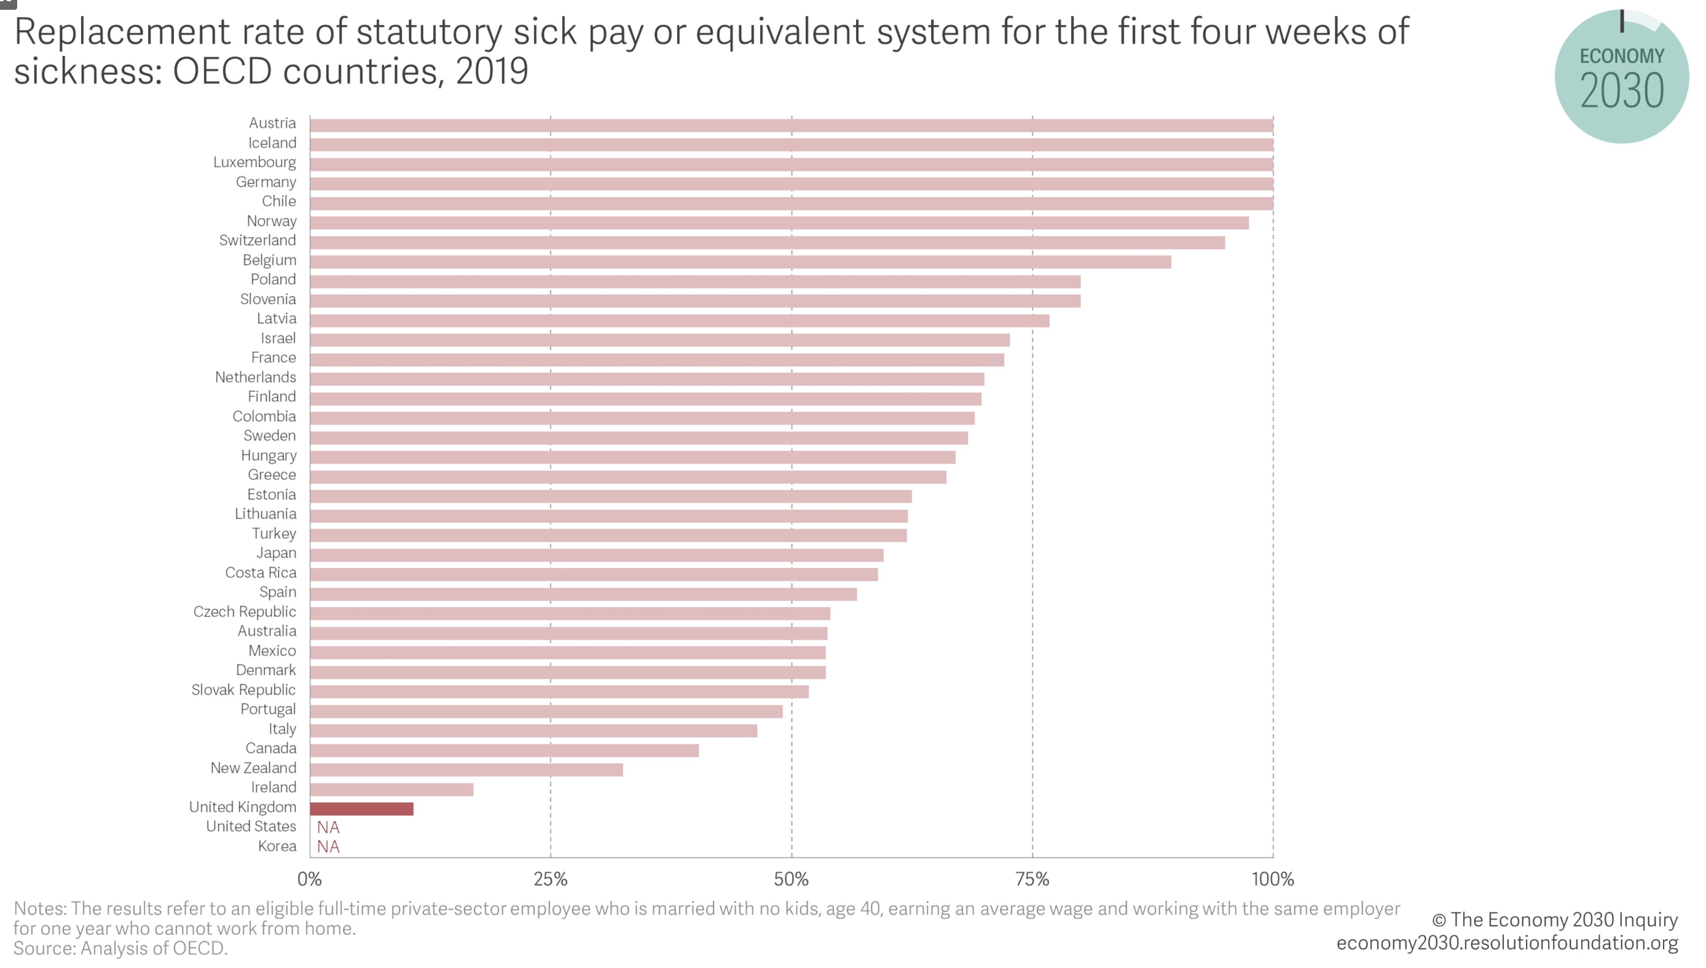

Slide 38
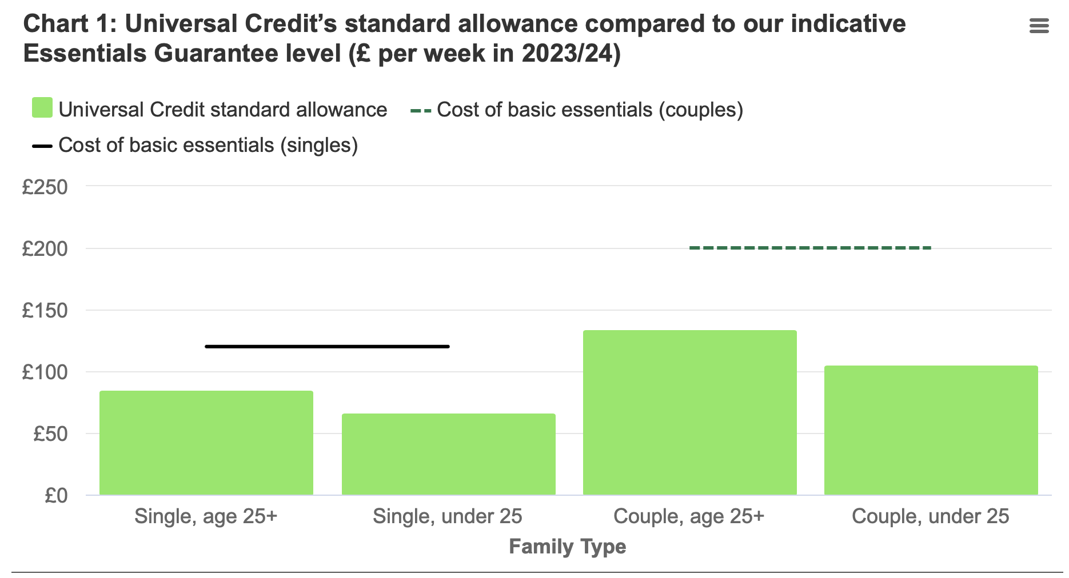
JRF and Trussell Trust “Guarantee Our Essentials” 2023

Slide 39
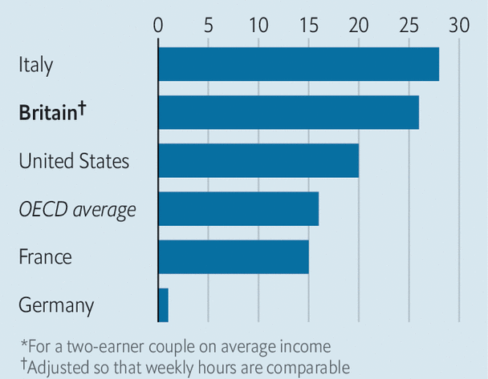
Child-care costs, % of net household income*, 2020
Source: OECD, IFS, Economist

Slide 40
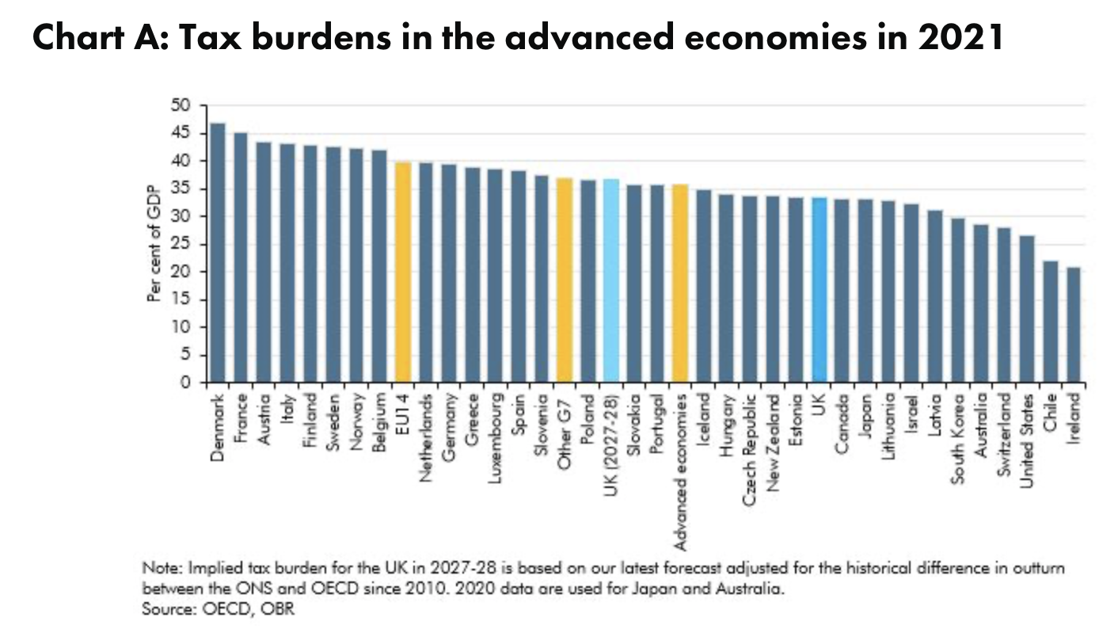

Slide 41
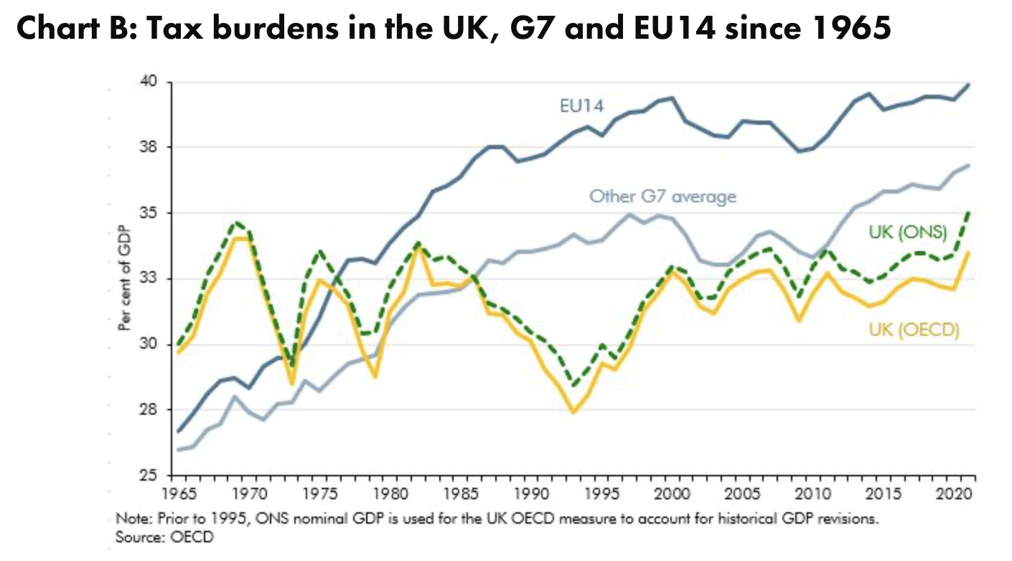

Slide 42





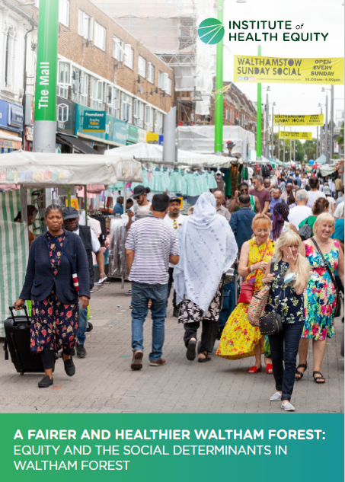

Slide 43
Marmot Places – 40+ local authorities
  Coventry
  Greater Manchester
  Cheshire and Merseyside
  Lancashire and Cumbria
  Luton
  Waltham Forest
  Gwent
  Southwest region
  Leeds
  TBC
  Kent/Medway

Slide 44


