Slide 1
UK Faculty of Public Health
- Public Health Career Pathways
- Continuing Professional Development
- MoU with WHO
Bob Fryatt, Victor Joseph, Liz Mason
FPH Global Health Committee

Slide 2
Public Health Career Pathways

Slide 3
UK PH TRAINING PATHWAY SUMMARY
“… ensures that local areas and national organisations have the relevant mix of social, scientific and clinical skills to respond to the multiple challenges of public health”
Multiple entry routes: medical, multidisciplinary, and equivalence pathways.
National recruitment is used for selection.
Four phases: (1) academic, (2) practice, (3) leadership, and (4) final preparation.
Completion leads to specialist registration with either the UK General Medical Council (medical) or UK Public Health Register (non‑medical).
20th May 2026

Slide 4
FPH PUBLIC HEALTH SPECIALIST TRAINING & EQUIVALENCE PATHWAYS
TRAINING
ROUTES & ELIGIBILITY
ASSESSMENT &
SELECTION
MECHANISMS
THE CORE SPECIALIST TRAINING(ST) JOURNEY (ST1–ST5+)
REGISTRATION &
ACCREDITATION
Standard Specialty Training (ST1):
(Single standard of professional excellence)
Medical Route (Clinical)
1
Phase 1: Foundation & Academic Basis (ST1-ST2)
National
Recruitment
MPH / MSc
Milestone:
Professional
Registration
Registers
(Masters Degree in
Public Health)
Core Placements
Diplomate Exam
(DFPH / Part A)
Non-Medical Route (Multidisciplinary)
UK General Medical Council
SPECIALIST
REGISTER
2
Phase 2: Advanced Practice & Application (ST3-ST4)
Expansion of Placements
Milestone:
On-Call Duties
For Medical
or Portfolio
Pathways
Academic Clinical Fellowships (Medical route + PhD)
Final Membership
Exam (MFPH /
Part B / OSPHE)
3
Phase 3: Competency Development & Leadership (ST4-ST5)
Alternative Previous Experience Based (Equivalence) Routes
Placements
• Policy
• Economics
• Evidence synthesis
• Leadership
Specialised Placements
Milestone:
Final Review of Progress
Outcome H / OSPHE
• Global Health
• NGOs
• Academic Research
UKPHR
SPECIALIST
REGISTER
Portfolio Pathway
(Medical)
Equivalence Routes
(Portfolio, UKPHR)
4
Phase 4: Completion & Transition (ST5+)
For Non-Medical
or UKPHR
Portfolio
Pathways
UK Public Health Register (UKPHR)
Specialist Registration by
Portfolio Assessment (Non-Medical)
• Consolidation
• Acting up as a Consultant
• Leadership, budgets,
multi-agency programs
Evaluation:
Final Progress review
Outcome

Slide 5
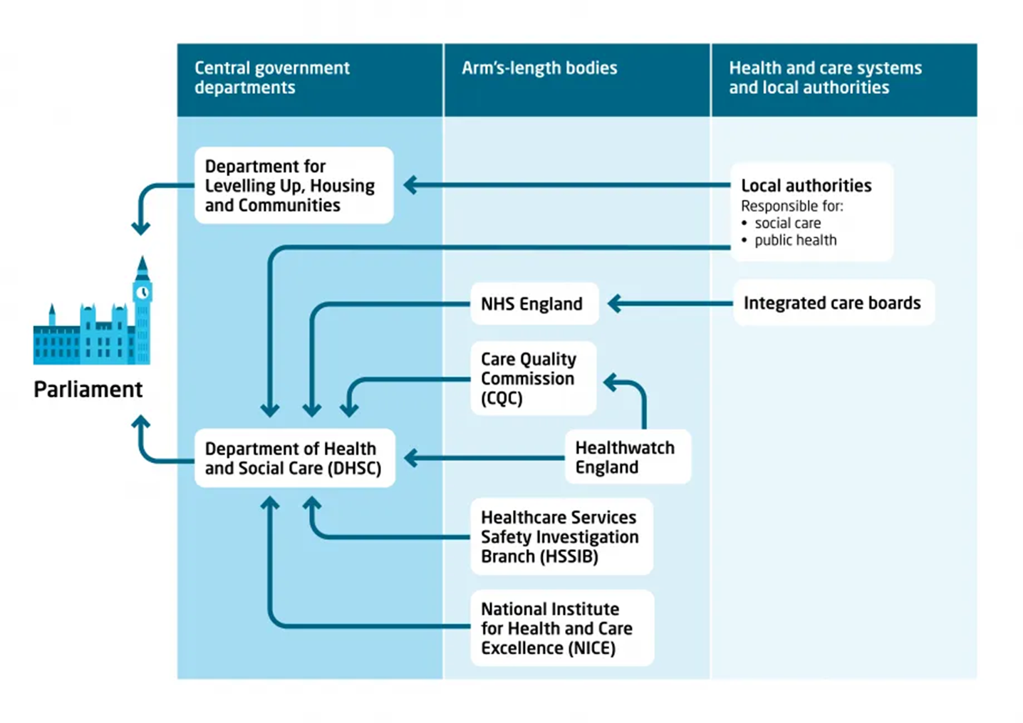
XXX
Two main structures accountable for health and care in England
Source: Kings Fund. https://www.kingsfund.org.uk/insight-and-analysis/long-reads/understanding-accountabilities-structures-health-care
20th May 2026

Slide 6
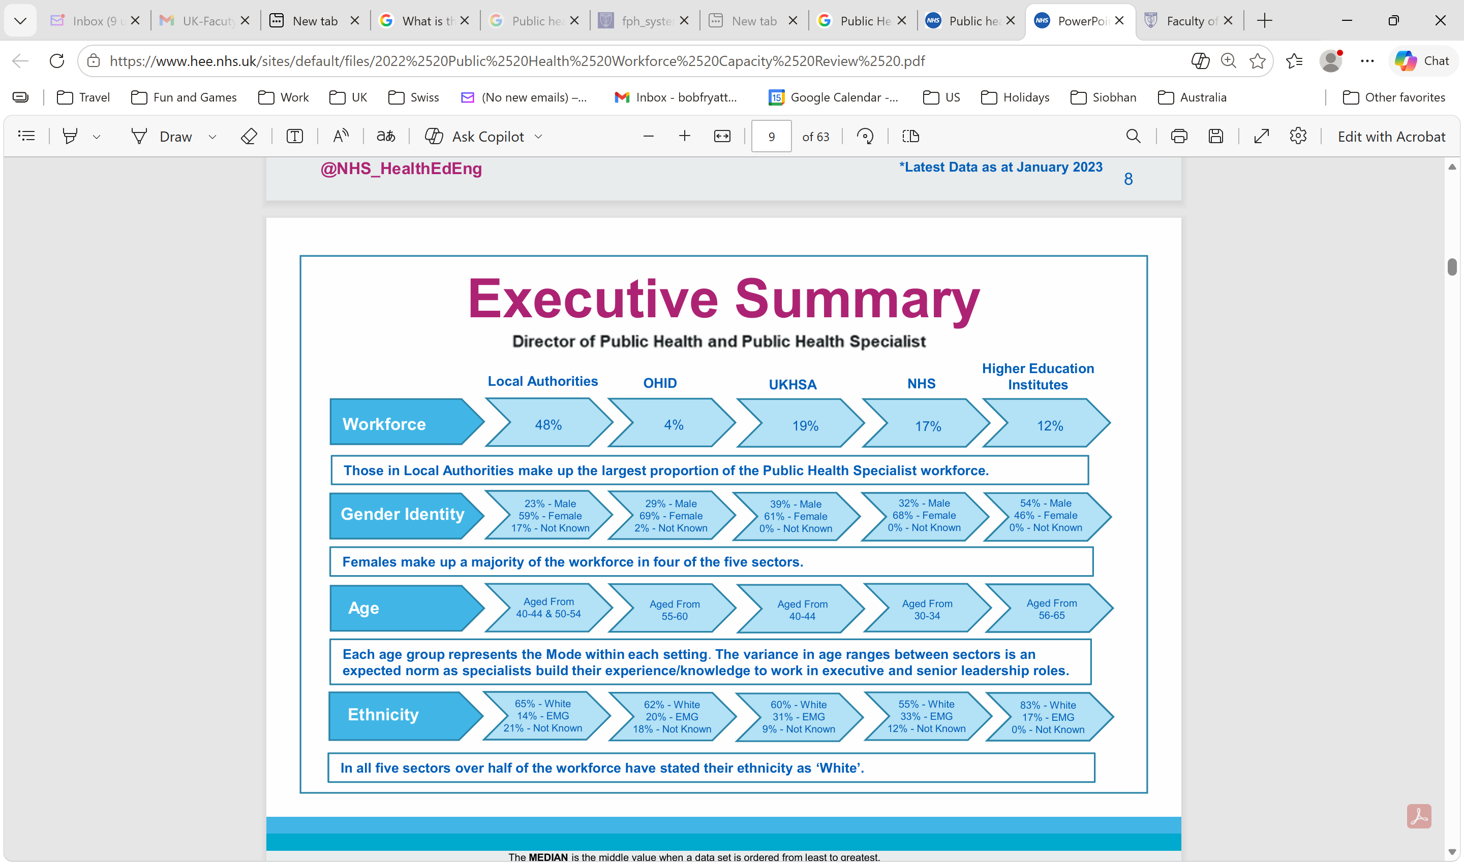
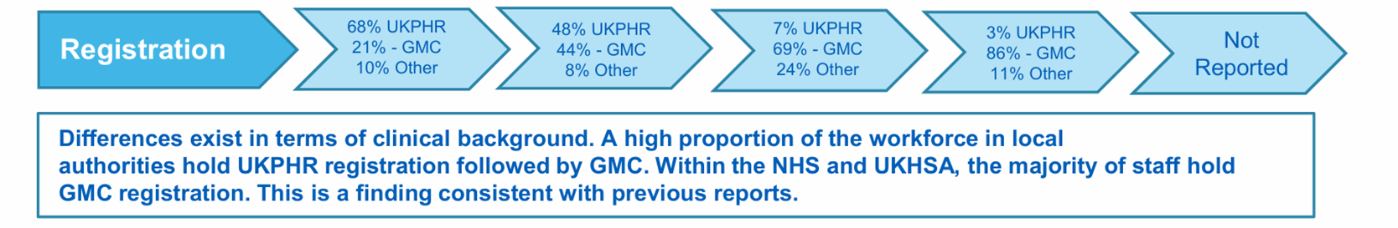
Public Health Careers in England (2022)
Directors of PH and PH Specialists (n=1227)
Source: https://www.hee.nhs.uk/our-work/public-health-specialist-capacity

Slide 7
Case Studies: Insights and Lessons Learned
These insights illustrate how PH competencies can be used in diverse contexts.
A “Ladder, Not a Gate”
The “Generalist”
2. SCOPING - KEY INSIGHTS & LESSONS LEARNED
Formalising existing capability through multi-route specialist training and recognition pathways that strengthen the workforce.
Training PH leaders to be generalists who can integrate and coordinate technical specialists (e.g., surveillance experts, epidemiologists etc.) using a shared competency framework.
Real-world implementation
Systems over lists
Competency lists alone are insufficient. Success depends on local ownership, as well as the inclusion of governance and equity considerations.
Treating political skill (influence, negotiation) as a core competency, developed through supervised, protected “learning-by-doing”.
Notes:
Introduction: Welcome. Before we dive into the specific case studies, I want to frame our core objective: the FPH GHET project aims to examine how the UK's Faculty of Public Health training pathways can inform international workforce development.
Point 1 (Ladder/Gate):
As we will see in Case Study 1, a strict specialist pathway can unintentionally displace experienced informal workers. We focus on a “ladder, not a gate” approach to recognize and build upon existing skills.
Competency frameworks can formalise and strengthen informal capability by creating recognised progression routes.
Point 2 (Generalist):
In Case Study 2, we’ll explore why complex health threats require generalists who can integrate science, operations, and politics, rather than relying solely on isolated technical experts. Health Systems need both generalists in public health (forintegration + delivery) and technical specialists (for domaindepth)
Competency-based systems can reproduce inequity unless equity monitoring and corrective action are builtinto governance processes
Point 3 (Real-World/Political):
Evidence alone doesn’t change policy. Political skill must be treated as a core public health competency, not an optional “soft skill”.
Case Study 4 shows why we teach political skill as a core requirement
Case Study 5 explains trainees' “learning-by-doing” time from becoming overwhelmed by low-value service work. Competencies become usable through supervised practice. Protect learning value against service overload and ensure supervision quality.
Point 4 (Systems Over Lists): Finally, Case Studies 3 and 6 highlight the biggest lesson: a published framework is not enough. If we don’t build in governance structures with equity monitoring and clear pathways, competency systems can reproduce inequity or fail to take root locally.
Build local ownership, strengthen workforce assurance and avoid pilot-only gains by designing the full system - not just the competency list.

Slide 8
Continuing Professional Development

Slide 9
FPH Annual CPD Certification of Members
Record Personal Development Plan (PDP) objectives.
Enter CPD activities linked to PDP.
During year enter reflective notes to a minimum of 3 CPD activities
CPD annual return submission
At the end of every year a supportive feedback exercise
Certification of good standing provided annually.
Revalidation of PH registration every 5 years
NB:
PDP is central
Feedback is essential
No pass/fail

Slide 10
What constitutes CPD?
Included
Learning as part of your job
Seminars and journal clubs
Conferences
Educational meetings
Formal courses
Private study and reading
Audit and research
Organisational development
Inspections and reviews
Exclusions
Teaching and examining
Routine business meetings and committee activity
Routine academic activities (such as writing articles for peer-reviewed journals
Chapters in books or official policy documents

Slide 11
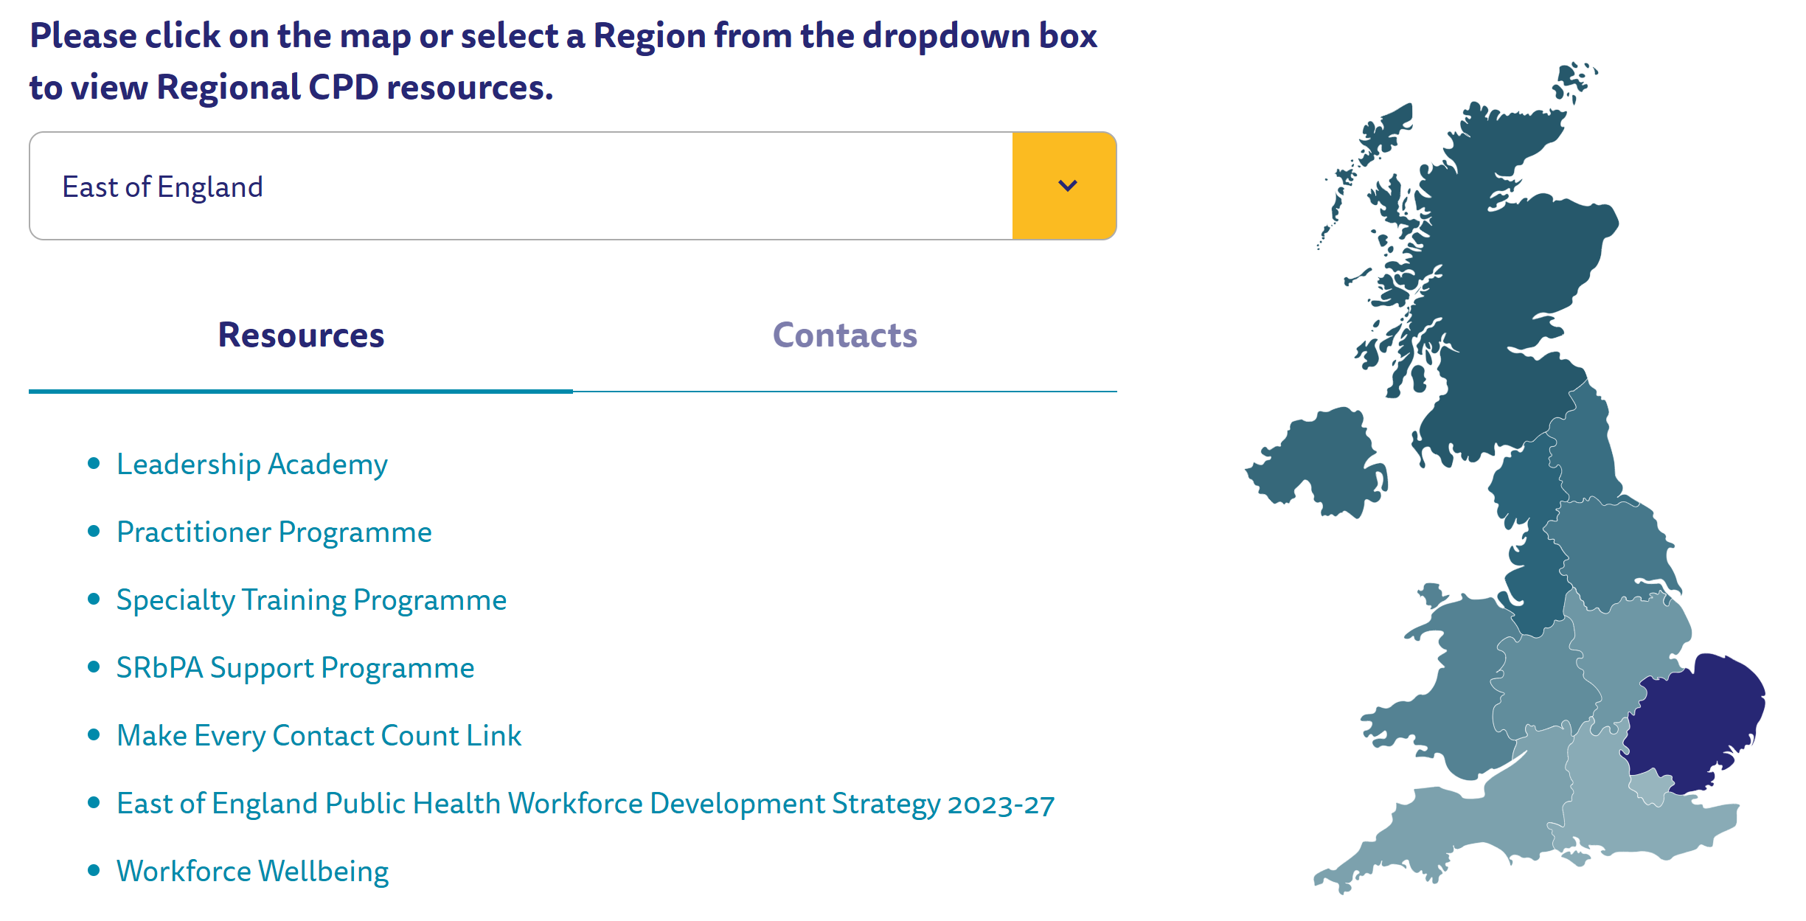
Regional CPD Resources

Slide 12
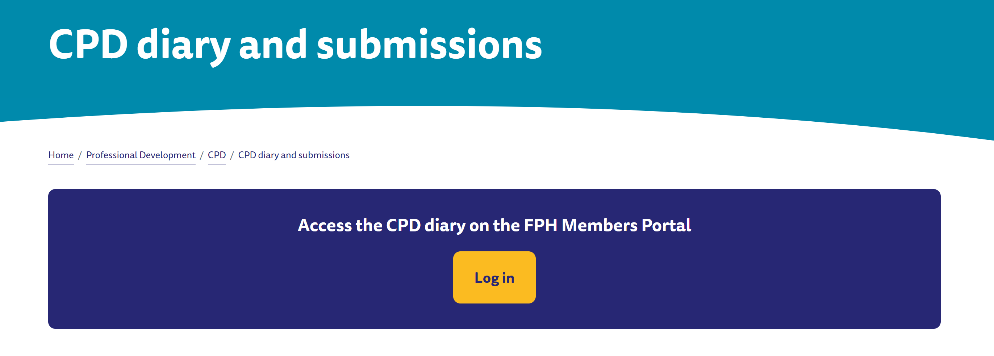
FPH Online Portal

Slide 13
FPH MoU with WHO

Slide 14
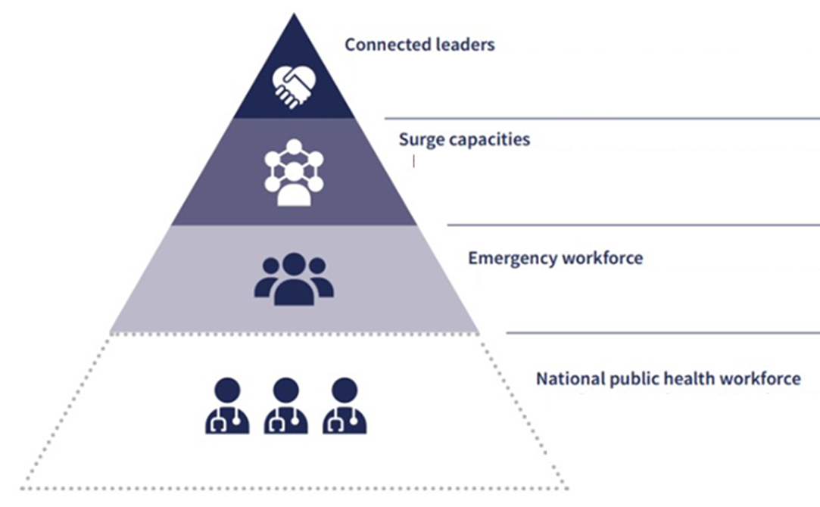
UK Faculty of Public Health- WHO Collaboration Agreement
Since 2022:
Joint work on Roadmap for PH workforce strengthening
Focus on essential public health functions (EPHFs) & emergency preparedness
Current phase - operationalising 5-year action plan:
Strengthen competency-based workforce education
Improve workforce mapping & measurement
Next 5 years:
Aim to deploy as WHO technical advisers
Support countries to strengthen PH systems & PH workforce capacity
20th May 2026

