Slide 1
Easy, Attractive, Social, and Timely: Behavioural insights and public policy
Dr Niamh Thompson,
Faculty of Public Health, September 23’

Slide 2
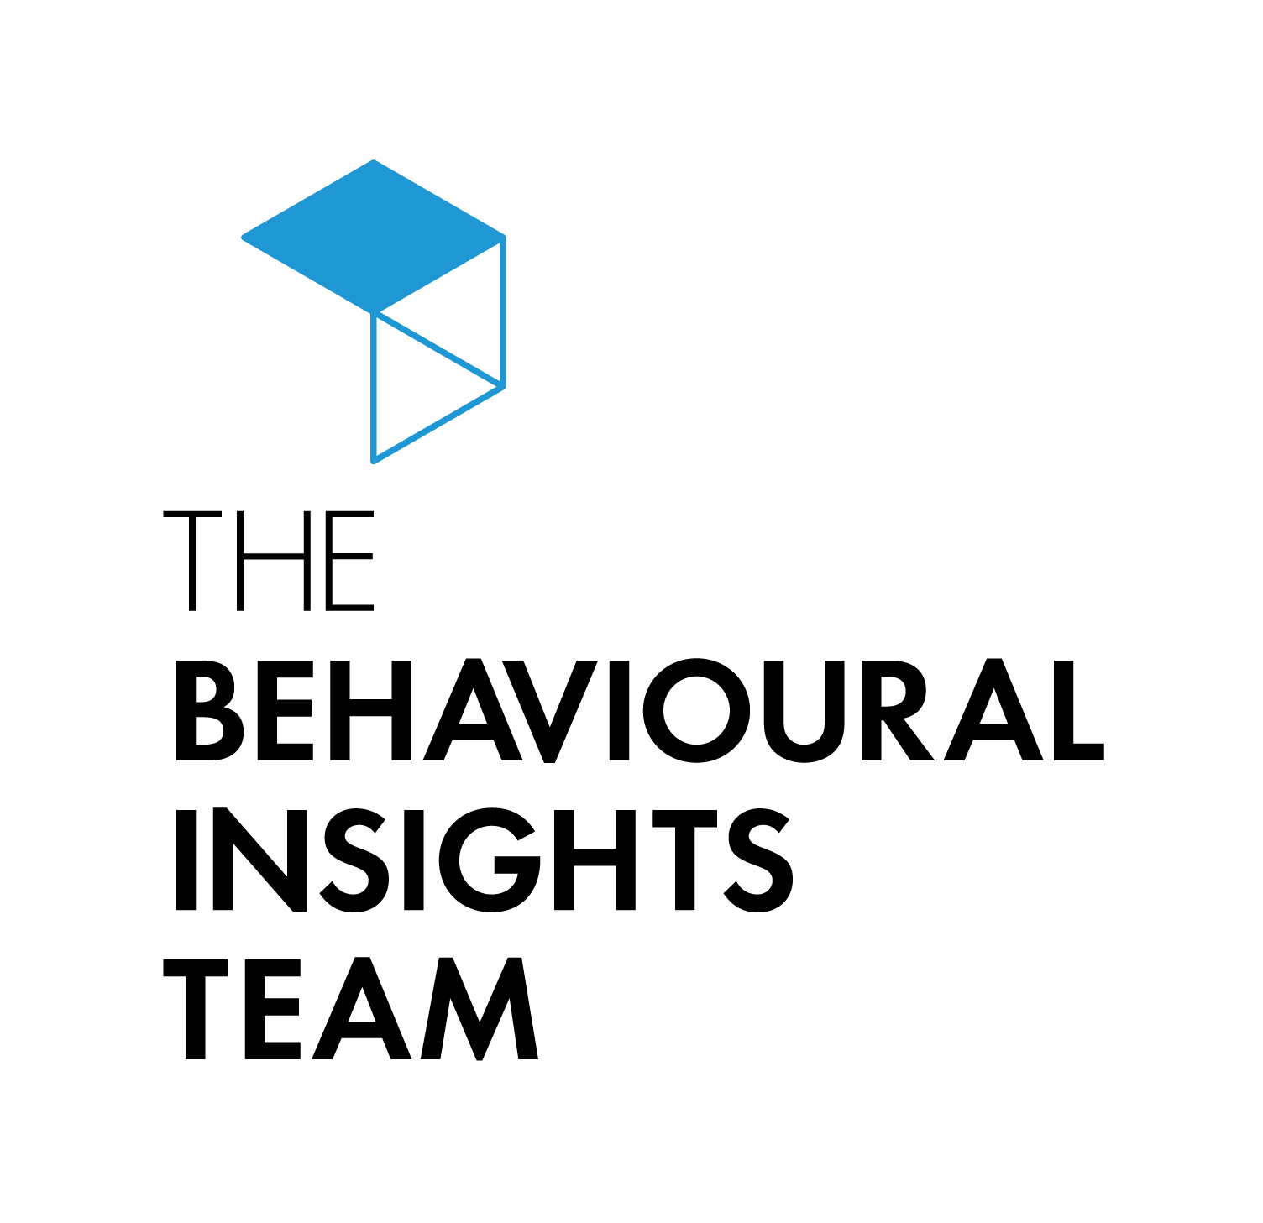
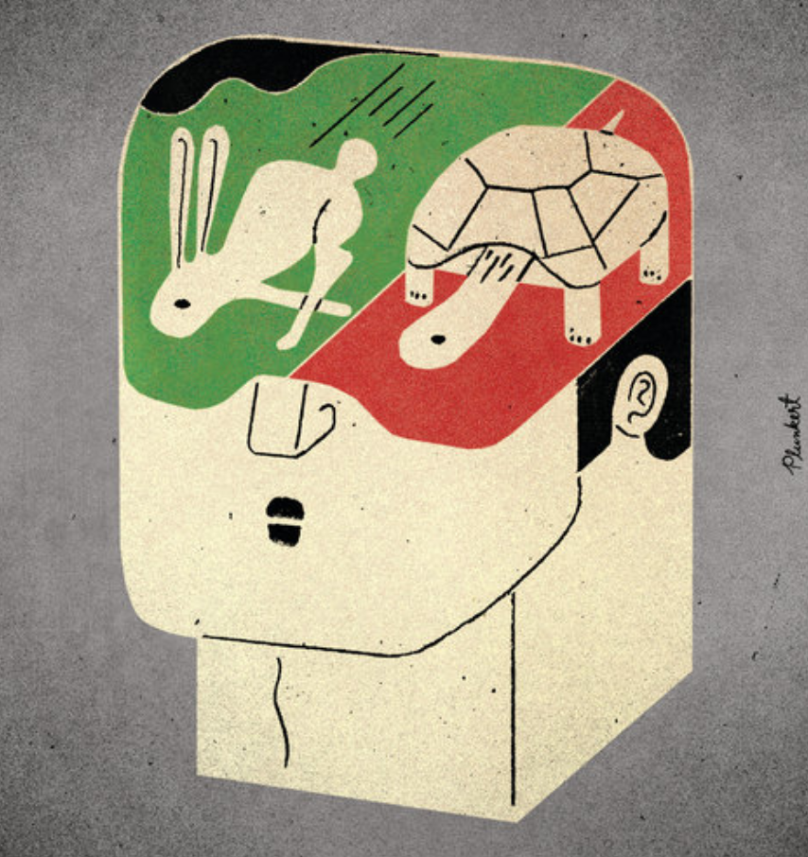
Overview
1.
2.
20XX
20XX
2. The Story of BIT
4. TESTS
1. Dual Process Models
3. The EAST framework
Understanding the drivers of human behaviour
Who we are, where we come from, and our mission
How to apply behavioural insights to design behavioural interventions
A guideline to structure behavioural science projects
Notes:
In this presentation like to provide some practical guidance for how to use behavioural insights to develop effective interventions to promote health.
I will start by giving a brief introduction to the Behavioural Insights Team - also known as the Nudge Unit to give some background about who we are and what we do
I will then present the core ideas behind the dual process models of human behaviour, which provide a very helpful lense through which to understand what drives human behaviours
And finally I will present some practical tools that BIT has developed to facilitate the application of behavioural sciences. These are:
The EAST framework, which you can use to develop behavioural interventions to prmote health
the TESTS framework, which you can use to structure your behavioural science projects.

Slide 3
Dual Process Models

Slide 4
Can I have a volunteer?

Slide 5
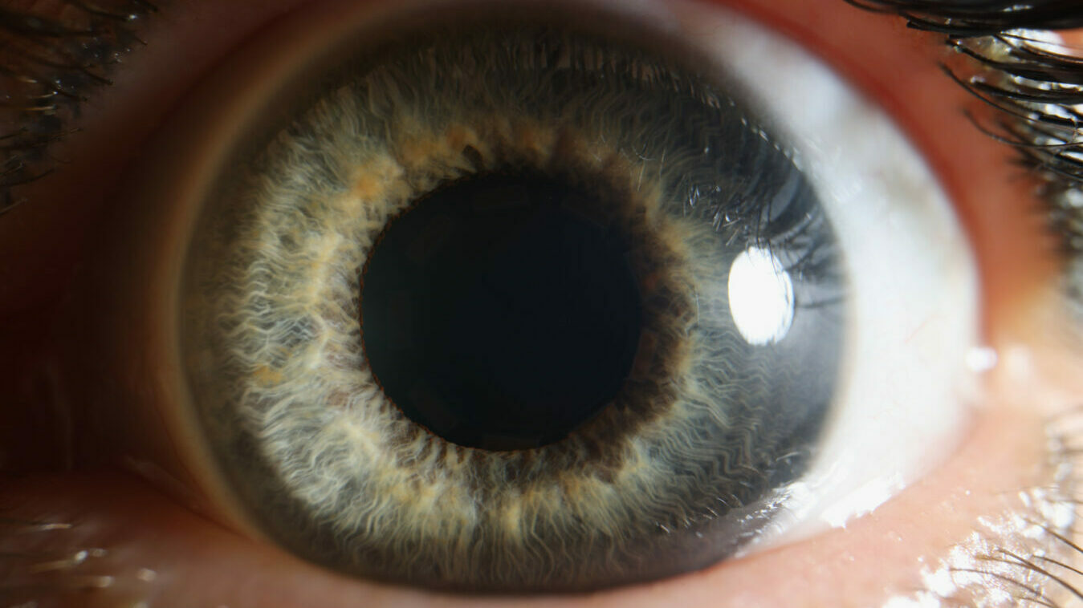
Cognitive demand
Notes:
Tversky and Khaneman 1967

Slide 6
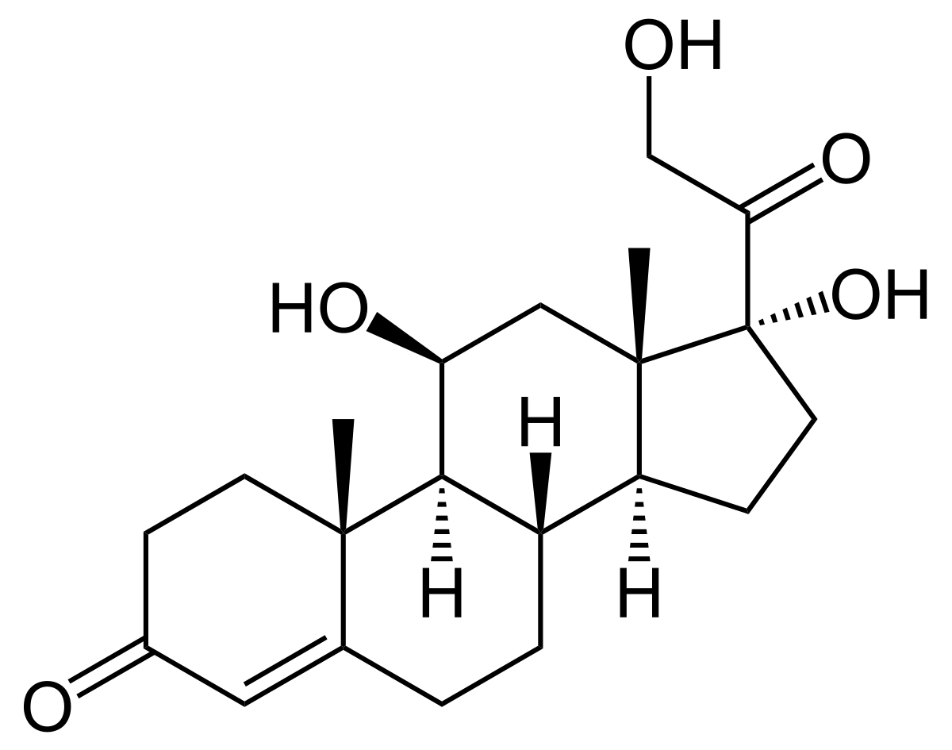
Neurophysiological basis
All stress ( emotional / physical) triggers a cortisol rush by activation the sympathetic nervous system, dilating the pupil and spiking blood glucose levels
Stimuli compete for limited resource - energy limitations allow only a small fraction of the brain to be engaged at one time
During periods of stress and tough self-control tasks, glucose levels plummet in the frontal cortex (the region associated with attention, planning, and motivation).
R

Slide 7
Notes:
The evolutionary advantages of this are clear: it’s exhausting, time-consuming and inefficient to depend on the reflective system at all times for all decisions and processes

Slide 8
“So why does any of this matter?”

Slide 9
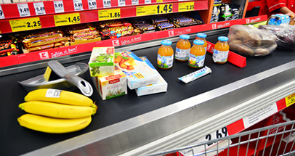
How many nudges can you see in this photo?
Anchoring
Space management: Size, associated goods, eye level, “non essentials” (essentials at the back of the store)
Sensory Cue - discount label price yellow
Normative size statement - expectation management
Sensory Cue - Branding
Stores change checkouts based on the socioeconomics of the area: areas of high-deprivation are shown more high sugar goods at the checkout than those in high-income areas.
R
Notes:
[1] Dreze, X., Hoch, S. J., & Purk, M. E. (1995). Shelf management and space elasticity. Journal of Retailing. 70(4), P. 301 – 326.
[2] Yang, M. H., & Chen, W. C. (1999). A study on shelf space allocation and management. International journal of production economics. 60, P. 309 – 317.
[3] Wansink, Brian; Just, David R.; Payne, Collin R. 2009. Mindless Eating and Healthy Heuristics for the Irrational. American Economic Review: Papers & Proceedings. 99(2). P. 165 – 169.
[4] Thorndike A.N., Sonnenberg, L., Riis, J., Barraclough, S., Levy D.E. 2012. A 2-Phase Labeling and Choice Architecture Intervention to Improve Healthy Food and Beverage Choices. American Journal of Public Health. 102(3). P. 527 – 533.
[5] Desmet, P., & Renaudin, V. (1998). Estimation of product category sales responsiveness to allocated shelf space. International Journal of Research in Marketing. 15(5). P. 445 – 457.
[6] Nogales, A. F., & Suarez, M. G. (2005). Shelf space management of private labels: A case study in Spanish retailing. Journal of Retailing and Consumer Services. 12(3). P. 205–216.
[7] Horsley, J.A., Absalom, K.A.R., Akiens, E.M., Dunk, R.J., Ferguson, A.M. 2014. The proportion of unhealthy foodstuffs children are exposed to at the checkout of convenience supermarkets. Public Health Nutrition.
[8] Dixon, H., Scully, M., & Parkinson, K. (2006). Pester power: Snack food displayed at supermarket checkouts in Melbourne, Australia. Health Promotion Journal of Australia, 17(2), P. 124 – 127.
[9] Cameron, A. J., Thornton, L. E., McNaughton, S. A., & Crawford, D. (2013). Variation in supermarket exposure to energy-dense snack foods by socio-economic position. Public health nutrition, 16(07), P. 1178 – 1185.
[10] Just, D. R., & Wansink, B. 2013. One man’s tall is another man’s small: How the framing of portion-size influences food choice. Health Economics, in press.
[11] North, A. C., Hargreaves, D. J., and McKendrick, J. 1997. In-store music affects product choice. Nature, 390(132).
[12] Garlin, F.V., Owen, K. 2006. Setting the tone with the tune: A meta-analytic review of the effects of background music in retail settings. Journal of Business Research. 59(6). P. 755–764.
[13] Wadhera, D., Capaldi-Phillips, E.D. 2014. A review of visual cues associated with food on food acceptance and consumption. Eating Behaviors, 15(1). P. 132 – 143.
[14] Wansink, B., Just, D.R., Payne, C.R., Klinger M.Z. 2012. Attractive names sustain increased vegetable intake in schools. Preventive Medicine, Volume 55(4). P. 330-332
[15] Wansink, B., Ittersum, K.V., Painter, J.E. 2005. How descriptive food names bias sensory perceptions in restaurants. Food Quality and Preference, Volume 16(5). P. 393–400
[16] Wansink, B., Kent, R.J., Hoch, S.J. 1998. An Anchoring and Adjustment Model of Purchase Quantity Decisions. Journal of Marketing Research. 35(1). P. 71–81.
[17] Baumeister, R.F., Bratslavsky, E., Muraven, M., Tice, D.M. 1998. Ego Depletion: Is the Active Self a Limited Resource? Journal of Personality and Social Psychology, 74(5). P. 1252 – 1265
[18] Baumeister, R.F., Vohs, K.D., Tice, D.M. 2007. The Strength Model of Self-Control. Current Directions in Psychological Science. 16(6). P. 351 – 355
[19] Langea, F. & Eggerta, F. 2014. Sweet delusion. Glucose drinks fail to counteract ego depletion. Appetite. 75(1). P. 54 – 63
[20] Dawson, J. 2013. Retailer activity in shaping food choice. Food Quality and Preference. 28(1). P. 339-347
[21] Hansen, P.G. (2010). Reasoning about coordination in the problem of conceptualization. In LogKCA-10: Proceedings of the Second ILCLI International Workshop on Logic and Philosophy, Knowledge, Communication and Action, Universidad del Pais Vasco, p. 227-254, 2010.
[22] Felsen, G. & Reiner, P.B. 2011. How the Neuroscience of Decision Making Informs Our Conception of Autonomy. AJOB Neuroscience, 2(3). P. 3 – 14
[23] Sonnenberg, L., Gelsomin E., Levy D.E., Riis, J., Barraclough, S., Thorndike A.N. 2013. A traffic light food labeling intervention increases consumer awareness of health and healthy choices at the point-of-purchase. Preventive Medicine. 57. P. 253 – 257
[24] Loewenstein, G. 2011. Confronting reality: pitfalls of calorie posting. The American Journal of Clinical Nutrition. 93(4). P. 679 – 680

Slide 10
Notes:
We didn’t evolve for the world we now inhabit - these systems are excellent and continue to help us massively, but they don’t marry perfectly for a world in which complex decisions are required every few seconds to navigate the extraordinarily complex world we have created

Slide 11
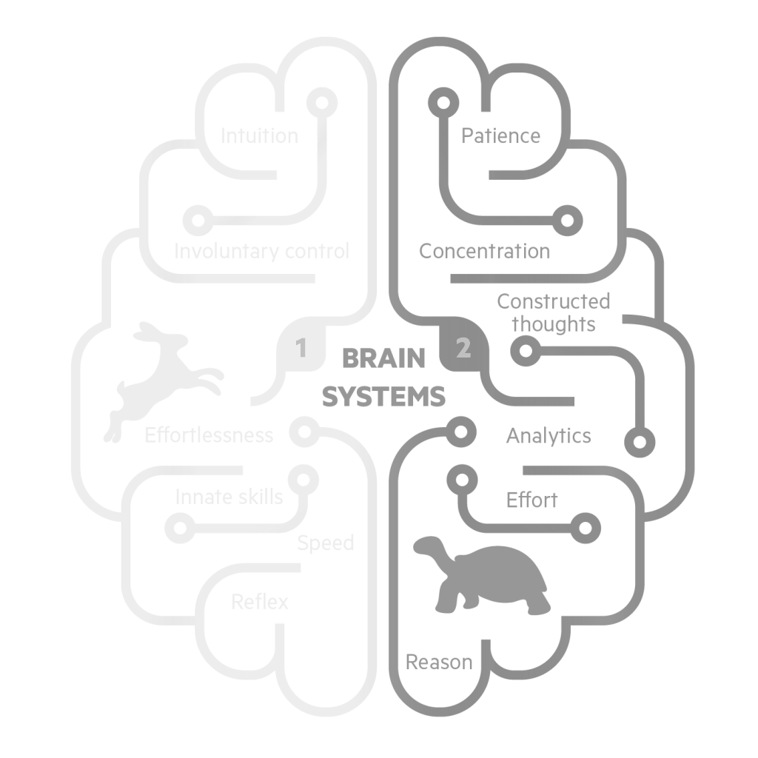
Dual process theory: How people process information
Automatic system
Intuitive and automatic responses
Reflective system
Slow, rational, and analytical processes
© The Behavioural Insights Team
Notes:
According to dual process models in behavioural sciences, there are two systems that drive human behaviour:
The first is the automatic system. This system is characterised by Intuitive and automatic responses. For example, taking out morning commute to work on “autopilot”
TIMING:
0.5 mins

Slide 12
Dual process theory: How people process information
Automatic system
Intuitive and automatic responses
Reflective system
Slow, rational, and analytical processes
© The Behavioural Insights Team
Notes:
The second is the reflective system. This system is characterised by rational and analytical processes. For example, if we are trying to lose weight or are calorie counting, when we choose what to have for lunch we we stop to reflect about the pros and cons of all the different food options available to us - we are using our reflective system.
Using this reflective system is effortful and requires lots of cognitive resources...
TIMING:
0.5 mins

Slide 13
Dual process theory: How people process information
Automatic system
Intuitive and automatic responses
Reflective system
Slow, rational, and analytical processes
© The Behavioural Insights Team
Notes:
Importantly, the environment plays a large role in influencing behaviour, both consciously and subconsciously. So, considering how the space people are in impacts their choices is extremely important
TIMING:
0.5 mins

Slide 14
Dual process theory: How people process information
Let’s try our two systems in action
I’m going to put up some words on the screen. Your task is to say the colours in which the words are written out loud.
Automatic system
Intuitive and automatic responses
Reflective system
Slow, rational, and analytical processes
© The Behavioural Insights Team
Notes:
I look forward to see how well this will work online...
But I’d like you to try your two behavioural systems in action, with an activity that my colleagues will know as the stroop test...
I’m going to put up some words on the screen. Your task is to say out loud the colours in which the words are written.
TIMING:
0.5 mins

Slide 15
Dual process theory: How people process information
Let’s try our two systems in action
I’m going to put up some words on the screen. Your task is to say the colours in which the words are written out loud.
BLUE
Automatic system
Intuitive and automatic responses
Automatic system
Intuitive and automatic responses
Reflective system
Slow, rational, and analytical processes
Reflective system
Slow, rational, and analytical processes
© The Behavioural Insights Team
© The Behavioural Insights Team
Notes:
For example, if I showed you this word….

Slide 16
Dual process theory: How people process information
Let’s try our two systems in action
I’m going to put up some words on the screen. Your task is to say the colours in which the words are written out loud.
BLUE
Automatic system
Intuitive and automatic responses
Automatic system
Intuitive and automatic responses
Reflective system
Slow, rational, and analytical processes
Reflective system
Slow, rational, and analytical processes
Red!!!
© The Behavioural Insights Team
© The Behavioural Insights Team
Notes:
For example, if I showed you this word….

Slide 17
Blue

Slide 18
Red

Slide 19
Green

Slide 20
Yellow

Slide 21
Pink

Slide 22
Green

Slide 23
Yellow

Slide 24
Blue

Slide 25
Pink

Slide 26
Green

Slide 27
Yellow

Slide 28
Pink

Slide 29
Red

Slide 30
Yellow

Slide 31
Yellow

Slide 32
Blue
Notes:
1 minute total

Slide 33
Green

Slide 34
Dual process models: a lens through which to explore drivers of human behaviour
Automatic system
Pink!!
Reflective System
Yellow!!!
© The Behavioural Insights Team
Notes:
Why is this so difficult? Our fast thinking, what Khaneman refers to as System 1, is our initial, automatic reaction to things we encounter.
When System 1 runs into difficulty, it calls on System 2 to support more detailed and specific processing that may solve the problem of the moment.” When it comes to the Stroop effect, System 1 (our automatic, fast thinking) seeks to find the quickest pattern available. Kahneman believes by understanding how our brains make connections, we can overcome them to reach more logical conclusions by calling on System 2, our controlled thinking, quicker.
TIMING:
1 mins

Slide 35
Dual process theory: How people process information
System 1
FAST
System 2
SLOW
Use heuristics and simple rules of thumb to:
Make quick decisions
Handle complex information quickly and efficiently
Initial reactions to challenges are swift and generally appropriate
Learns new things
Exercises self-control
Rationally evaluates all options and weighs up pros and cons of each option
Chooses option with greatest value
Efficient division of labor
© The Behavioural Insights Team
35
Notes:
KEY MESSAGE: THE DIVISION OF LABOUR
The division of labor between System 1 and System 2 is highly efficient: it minimizes effort and optimizes performance.
In this division of labor System 1 is given as much of the work as possible, acting as a kind of cognitive autopilot that replaces complex decision making with heuristics simple rules of thumb
(e.g. take the path of least resistance, only attend to something if it is urgent, watch how others act and follow suit).
This is hugely advantageous from an evolutionary perspective. If we didn’t have this we would burn all of our energy thinking through the minutiae of every decision we make.
The arrangement works well most of the time because System 1 is generally very good at what it does.
Equally System 2 can be deployed to learn new things, help us exercise self-control and to make calculated decisions by evaluating our options and weighing up pros and cons of each option
PURPOSE:
Illustrate that both systems are beneficial. TIMING:
2 mins

Slide 36
Dual process theory: How people process information
System 1
FAST
System 2
SLOW
More prone to cognitive biases (systematic errors in decision making)
Decision making driven by automatic reactions
Decision-making is influenced by the environment
Limited cognitive bandwidth / very resource-intensive
Often not aware of biased System 1 decision making
Efficient division of labor
© The Behavioural Insights Team
36
Notes:
KEY MESSAGE:
However each system also has its own limitations:
System 1 limitations
The heuristics that system 1 uses serve us incredibly well most of the time but, like any simplified rules, they can go wrong leading to poor outcomes even for decisions of great importance.
System 1 trips us up in predictable ways
Basing our decision making on heuristics means we are prone to cognitive biases
Cognitive biases are systematic errors in decision making
EXAMPLE - Confirmation Bias; favoring information that confirms your previously existing beliefs (e.g. left handed people are more creative)
System 1 decisions are driven by automatic reactions to our physical and social environments.
As we saw earlier, when we’re operating on System 1 our decision are influenced by the environment
We started the day with 3 games that illustrated how memory, judgement and preferences can be influenced by context.
System 2 limitations
At the same time we don’t have sufficient mental processing power to make all decisions using the slow system - we have limited cognitive bandwidth.
And System 2 is often not aware how decisions we make using System 1 may be influenced by cognitive biases.
We have limited cognitive bandwidth and will fail if we go beyond this.
PURPOSE:
Illustrate the limitations of both systems
TIMING:
2 mins

Slide 37
Traditional public health programs play on the reflective system...
High
Reflective motivation and willpower
Low
Based on "Diet, obesity and health: from science to policy", Dr. Susan Jebb
Typical day
© The Behavioural Insights Team
Notes:
This graph - taken from Prof Susan Jebb - shows the processes of the reflective system of somebody who intends to eat healthily and lose weight…. Over the course of a day somebody can have higher or lower reflective motivation and willpower to eat healthily...
When we develop public health interventions we tend to focus on these processed of the reflective processes and so we often develop interventions to increase people’s knOwledge, conscious intention, motivation, and willpower to eat healthily...

Slide 38
This underestimates the role of the automatic system…
High
Unhealthy environment
Reflective motivation and willpower
Environment
Healthy Environment
Low
Based on "Diet, obesity and health: from science to policy", Dr. Susan Jebb
Typical day
© The Behavioural Insights Team
Notes:
But as we have seen before, our reflective system is not the only thing that shapes our behaviour….
All of our food choices will take place in a specific context and environment and we will always have some automatic reactions to these environments...
So the environments in which we live can also have a powerful influence on our food choices…. And either support our intention to eat healthily and lose weight or make it very difficult...

Slide 39
And how our we interact with our environment…
High
Unhealthy environment
Reflective motivation and willpower
Environment
Healthy Environment
Low
Based on "Diet, obesity and health: from science to policy", Dr. Susan Jebb
Typical day
© The Behavioural Insights Team
Notes:
So if we live in environments that promote unhealthy food choices....

Slide 40
Leading to “breaks” in our willpower
High
Unhealthy environment
Walk past a vending machine?
“Salad or chips on the side?”
“Would you like dessert?”
Reflective motivation and willpower
Environment
Healthy Environment
Low
Based on "Diet, obesity and health: from science to policy", Dr. Susan Jebb
Typical day
© The Behavioural Insights Team
Notes:
our automatic reactions will sometimes lead us to make unhealthy choices, despite our conscious intentions and willpower to eat a healthy diet and lose weight...

Slide 41
So higher willpower…
High
Unhealthy environment
Walk past a vending machine?
“Salad or chips on the side?”
“Would you like dessert?”
Reflective motivation and willpower
Environment
Healthy Environment
Low
Based on "Diet, obesity and health: from science to policy", Dr. Susan Jebb
Typical day
© The Behavioural Insights Team
Notes:
Behavioural sciences have shown that there is definitely value in targeting people’s reflective systems, for example by:
Providing information about what is healthy and what isn’t
Keeping them motivated to eat healthily
Or boosting their willpower

Slide 42
May improve things to some extent, but will frequently fail…
High
Unhealthy environment
“Salad or chips on the side?”
“Would you like dessert?”
Reflective motivation and willpower
Environment
Healthy Environment
Low
Based on "Diet, obesity and health: from science to policy", Dr. Susan Jebb
Typical day
© The Behavioural Insights Team
Notes:
All these interventions are useful but they usually only achieve very small effect sizes that are not sustained long term… because they only take into account our reflective system...

Slide 43
Enough to meaningfully impact complex problems like obesity…
300-500 calories
300-500 calories
High
Unhealthy environment
“Salad or chips on the side?”
“Would you like dessert?”
Reflective motivation and willpower
Environment
Healthy Environment
Low
Based on "Diet, obesity and health: from science to policy", Dr. Susan Jebb
Typical day
© The Behavioural Insights Team
Notes:
Developing interventions that also target the environments in which we live to make sure that our automatic reactions to these environments are in line with our long term intentions can be a promising way of changing people’s behaviour...

Slide 44
Which explains why modifying our environment is so critical
High
Unhealthy environment
Reflective motivation and willpower
Environment
Healthy Environment
Low
Based on "Diet, obesity and health: from science to policy", Dr. Susan Jebb
Typical day
© The Behavioural Insights Team
Notes:
Going back to the analogy of the game we played before:
Interventions focussing on raising the orange bar to promote healthy diets can be compared to an intervention that aims to teach you conscious strategies to suppress your automatic instinct to read the word and instead to say the colour of the font…
These interventions will be helpful and over time you would get better at the task.. But you will always have the automatic reaction of reading out the word….
Interventions aiming to promote a healthy diet by lowering the blue line try to make food environments healthier to ensure that our automatic reactions to these environments are in line with our conscious intention to eat healthily. In the game before, these interventions would be comparable to changing all the slides to that the written word and the colour of the font always align… in that way your automatic reactions and your reflective goals would always be aligned
Developing effective behaviour interventions to promote public health need to address both systems of human behaviour - they need to raise the orange bar and lower the blue one…

Slide 45
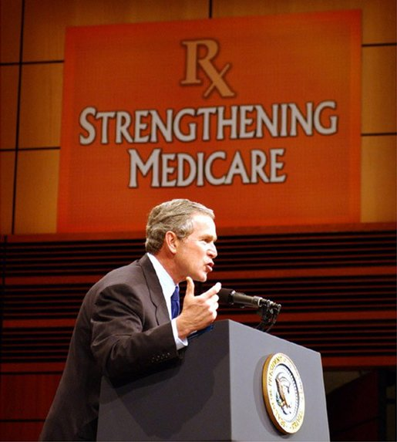
So what if we leave it to chance?
R
Notes:
6.2 million randomly assigned a healthcare program as their default

Slide 46
The story arc
1.
2.
20XX
20XX
2. The Story of BIT
4. TESTS
Dual Process Models
3. The EAST framework
Understanding the drivers of human behaviour
Who we are, where we come from, and our mission
How to apply behavioural insights to design behavioural interventions
A guideline to structure behavioural science projects
Notes:
In this presentation like to provide some practical guidance for how to use behavioural insights to develop effective interventions to promote health.
I will start by giving a brief introduction to the Behavioural Insights Team - also known as the Nudge Unit to give some background about who we are and what we do
I will then present the core ideas behind the dual process models of human behaviour, which provide a very helpful lense through which to understand what drives human behaviours
And finally I will present some practical tools that BIT has developed to facilitate the application of behavioural sciences. These are:
The EAST framework, which you can use to develop behavioural interventions to prmote health
the TESTS framework, which you can use to structure your behavioural science projects.

Slide 47
The Behavioural Insights Team

Slide 48
A bit about BIT
The Behavioural Insights Team is a social purpose company owned by Nesta. Our aim is to improve people’s lives through the application of behavioural insights and empirical methods.
BIT projects
BIT offices
Notes:
So just to provide some background about the Behavioural Insights team:
We started life in the Cabinet office around 10 years ago.
Mission to apply insights from behavioural sciences to help government design more effective interventions help people make better choices for themselves, such as living healthier lives
In 2014 we spun out of government and we now now operate as a social purpose company,
This means we essentially work like a consulting firm but with a twist:
We only take on projects that we believe will deliver positive social impact.
Mission of BIT has remained to help partners design more effective interventions - but having spun out of government we can now work with a much wider range of partners.

Slide 49
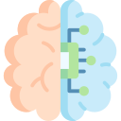
What are behavioural insights?
Using behavioural insights means applying scientific methods to better understand
How people make choices in their everyday life
How people react to the way in which options are presented to them
What factors drive human behaviour in practice
Behavioural insights can be used to develop effective interventions and policies to help people change their behaviour.
Behavioural science evidence, principles, and theories
Behavioural interventions and policies
Behavioural Insights
Scientific evaluation methods
© The Behavioural Insights Team
Notes:
When I talk about behavioural sciences, what I mean are disciplines such as psychology, economics, and anthropology that can help to better understand:
How people make choices in their everyday life
How people react to the way in which different options are presented to them
And the factors that influence human behaviour
This knowledge can then be applied to develop interventions aiming to promote health behaviours and the impact of these interventions should be tested empirically, which then feeds back into our understanding of what drives human behaviour and what works to promote healthy behaviours.

Slide 50
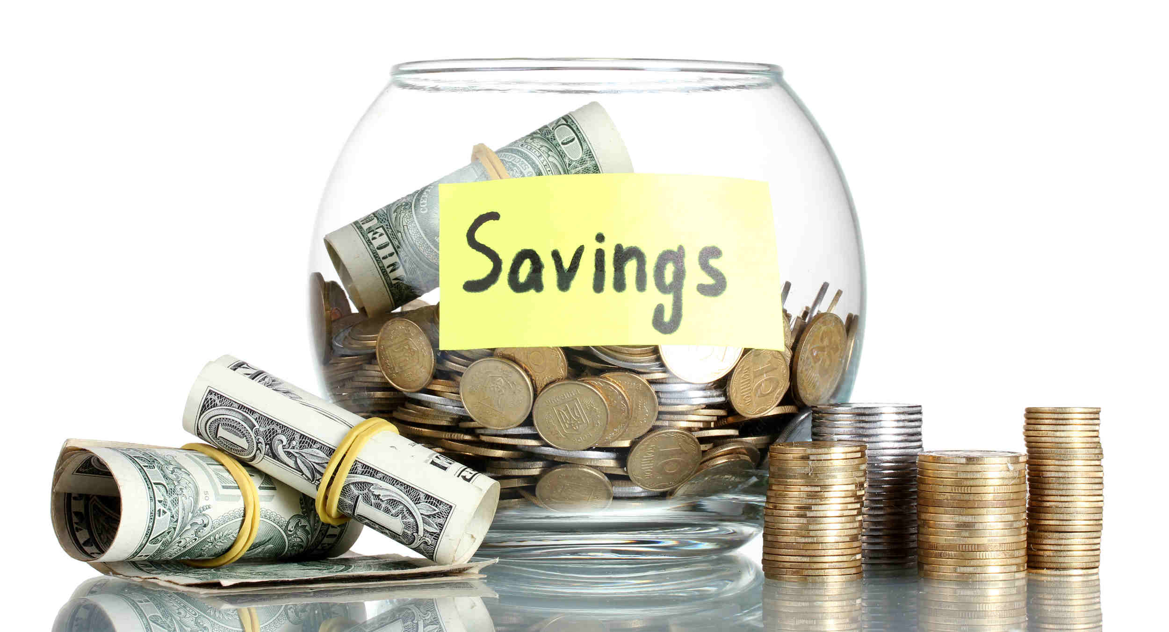
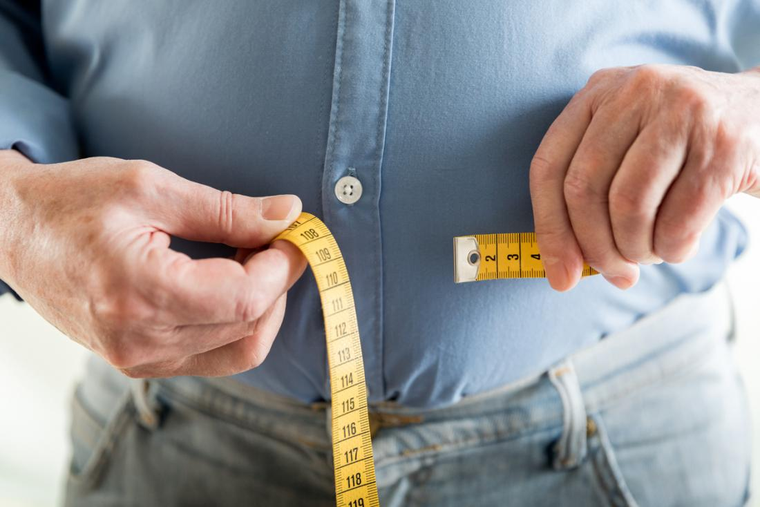
The mission of the Behavioural Insights Team
© The Behavioural Insights Team
Notes:
The reason I believe it is really important to consider behavioural sciences when developing interventions and public policies is that most of the challenges we face in the 21st century are in their core ‘behavioural problems’.
For example:
If we are thinking about how to encourage more people to vote in national elections we are thinking about changing a behaviour.
If we are thinking about how to help more people save money for their retirement or encourage people to recycle their waste, again we are thinking about changing behaviours.
And then there are a set of behavioural challenges that related to health, and are therefore particularly important for this course: how do we help people to quit smoking, how to we tackle antibiotic resistance, how can we help people to eat healthier diets or to maintain a healthy weight?

Slide 51
The contribution of behavioural sciences
How did behavioural sciences inform policies to tackle overweight and obesity?
General public
I want to be able to make healthier choices…
But I do not like to be forced and do not make me feel guilty!”
© The Behavioural Insights Team
Notes:
And behavioural sciences have already made an important contribution to the way in which we tackle some important public health issues
and I’d like to explain how behavioural sciences have made a difference taking the example of overweight and obesity.
In the UK 60% of adults are overweight and what we eat is the most important modifiable determinant of our risk to become overweight.
Now most people would not consciously chose to be overweight and they would like to live long and healthy lives… but at the same time we want to be free to choose what we eat.

Slide 52
The contribution of behavioural sciences
How did behavioural sciences inform policies to tackle overweight and obesity?
General public
I want to be able to make healthier choices…
But I do not like to be forced and do not make me feel guilty!”
Policy maker
“Let’s provide information about what is healthy so people will select the healthy options”
© The Behavioural Insights Team
Notes:
A common reaction from policy makers to this general public attitude is to focus on developing interventions that provide factual information about what constitutes a healthy diet.
The underlying assumption of these interventions and policies is that once people know what foods are healthy and what foods are not, they will naturally gravitate towards making healthier choices.

Slide 53
The contribution of behavioural sciences
How did behavioural sciences inform policies to tackle overweight and obesity?
General public
I want to be able to make healthier choices…
But I do not like to be forced and do not make me feel guilty!”
Policy maker
“Let’s provide information about what is healthy so people will select the healthy options”
Behavioural scientist
“Information is very important … but is it really sufficient to promote substantial and sustained behaviour change?”
© The Behavioural Insights Team
Notes:
And this is where behavioural sciences have made their biggest contribution in my opinion… because research from behavioural sciences has consistently shown that providing information is very important, but it is usually not sufficient to promote meaningful and sustained behaviour change...

Slide 54
The EAST Framework

Slide 55
Make it easy
EASY
ATTRACTIVE
TIMELY
SOCIAL
Notes:
So first thing we can do to encourage a behavior is to make it easy.
This is because people often tend to make the choice that requires the least effort from them.
We all know that when given the choices between an elevator and a staircase most people will go for the elevator despite knowing that taking the stairs would be better for their health.

Slide 56
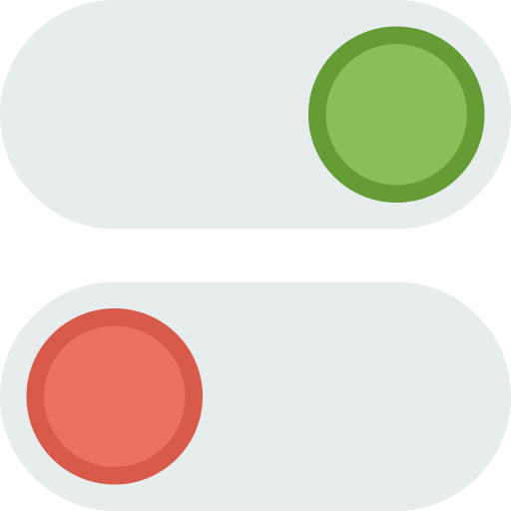
Make it easy
Set intelligent defaults
Reduce friction
Simplify messages
© The Behavioural Insights Team
Notes:
There are a number of things we can do to encourage behaviours by making them easy.
For example, you can set intelligent defaults. (e.g. we know that organ donations are much higher in countries where people are assumed to be donors compared to countries in which people need to actively express their willingness to donate organs)
You should reduce the friction and hassle. For example, if you are developing a physical activity app, you should make sure that the onboarding and registration process is as short as possible.
And finally it is really important to shorten up and simplify messages when you’d like people to perform a behaviour.

Slide 57
Defaults:
Reducing prescribing errors in clinical settings
Notes:
An example of how we improved a health service by making a behavior easy was a collaboration with imperial college London
where we were asked to reduce the number of prescribing errors in clinical settings
https://bmjopen.bmj.com/content/4/12/e005473 _

Slide 58
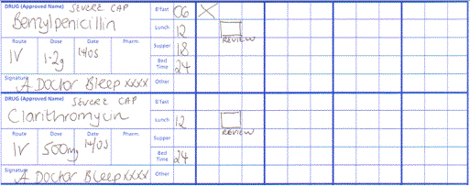
Imperial College collaborated with us to simplify hospital prescription charts
Notes:
Simplification, assisted redesign prescription charts Imperial College London.
Used by clinicians to record prescriptions made for patients.
Contained errors or were incomplete due to the design.
Micrograms/milligrams free hand v circle.
Prescribing errors affect an estimated 50% of admissions in hospitals using paper-based prescription charts (Lewis et al. 2009). There are concerns that such forms lead to medication errors by hindering clear communication between professionals. For example, it may be impossible to distinguish between milligrams and micrograms when written out by hand in a hurry. A study by Imperial College London, funded by the Behavioural Insights Team, sought to reduce these errors by redesigning forms to make them clearer and simpler (King et al. 2013). As the chart below shows, the microgram/milligram problem was addressed by creating distinct options that simply had to be circled. In simulation testing, the new charts were found to significantly improve correct dose entries, supporting information, and provision of contact information. If adopted more widely, improvements like these are likely to lead to reduced medical errors and better patient outcomes for little cost.

Slide 59
Imperial College collaborated with us to simplify hospital prescription charts
Notes:
Simplification, assisted redesign prescription charts Imperial College London.
Used by clinicians to record prescriptions made for patients.
Contained errors or were incomplete due to the design.
Micrograms/milligrams free hand v circle.
Prescribing errors affect an estimated 50% of admissions in hospitals using paper-based prescription charts (Lewis et al. 2009). There are concerns that such forms lead to medication errors by hindering clear communication between professionals. For example, it may be impossible to distinguish between milligrams and micrograms when written out by hand in a hurry. A study by Imperial College London, funded by the Behavioural Insights Team, sought to reduce these errors by redesigning forms to make them clearer and simpler (King et al. 2013). As the chart below shows, the microgram/milligram problem was addressed by creating distinct options that simply had to be circled. In simulation testing, the new charts were found to significantly improve correct dose entries, supporting information, and provision of contact information. If adopted more widely, improvements like these are likely to lead to reduced medical errors and better patient outcomes for little cost.

Slide 60
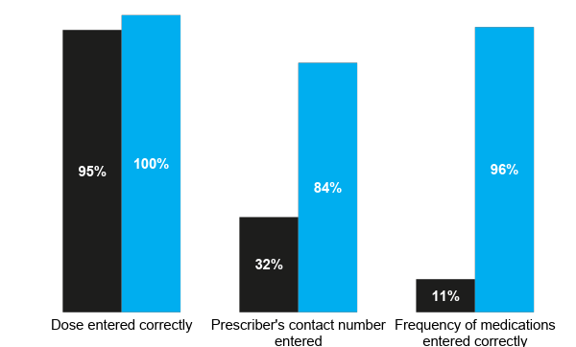
The revised chart reduced prescribing errors
Source: King et al., 2014 - https://bmjopen.bmj.com/content/4/12/e005473
Notes:
(n = 337)
Control group black / treatment group in blue.
Example of importance design to behaviour.
Not predicated by any additional education, information or support.
Prescribing errors affect an estimated 50% of admissions in hospitals using paper-based prescription charts (Lewis et al. 2009). There are concerns that such forms lead to medication errors by hindering clear communication between professionals. For example, it may be impossible to distinguish between milligrams and micrograms when written out by hand in a hurry. A study by Imperial College London, funded by the Behavioural Insights Team, sought to reduce these errors by redesigning forms to make them clearer and simpler (King et al. 2013). As the chart below shows, the microgram/milligram problem was addressed by creating distinct options that simply had to be circled. In simulation testing, the new charts were found to significantly improve correct dose entries, supporting information, and provision of contact information. If adopted more widely, improvements like these are likely to lead to reduced medical errors and better patient outcomes for little cost.

Slide 61
The revised chart reduced prescribing errors
Source: King et al., 2014 - https://bmjopen.bmj.com/content/4/12/e005473
Notes:
(n = 337)
Control group black / treatment group in blue.
Example of importance design to behaviour.
Not predicated by any additional education, information or support.
Prescribing errors affect an estimated 50% of admissions in hospitals using paper-based prescription charts (Lewis et al. 2009). There are concerns that such forms lead to medication errors by hindering clear communication between professionals. For example, it may be impossible to distinguish between milligrams and micrograms when written out by hand in a hurry. A study by Imperial College London, funded by the Behavioural Insights Team, sought to reduce these errors by redesigning forms to make them clearer and simpler (King et al. 2013). As the chart below shows, the microgram/milligram problem was addressed by creating distinct options that simply had to be circled. In simulation testing, the new charts were found to significantly improve correct dose entries, supporting information, and provision of contact information. If adopted more widely, improvements like these are likely to lead to reduced medical errors and better patient outcomes for little cost.

Slide 62
The revised chart reduced prescribing errors
Source: King et al., 2014 - https://bmjopen.bmj.com/content/4/12/e005473
Notes:
(n = 337)
Control group black / treatment group in blue.
Example of importance design to behaviour.
Not predicated by any additional education, information or support.
Prescribing errors affect an estimated 50% of admissions in hospitals using paper-based prescription charts (Lewis et al. 2009). There are concerns that such forms lead to medication errors by hindering clear communication between professionals. For example, it may be impossible to distinguish between milligrams and micrograms when written out by hand in a hurry. A study by Imperial College London, funded by the Behavioural Insights Team, sought to reduce these errors by redesigning forms to make them clearer and simpler (King et al. 2013). As the chart below shows, the microgram/milligram problem was addressed by creating distinct options that simply had to be circled. In simulation testing, the new charts were found to significantly improve correct dose entries, supporting information, and provision of contact information. If adopted more widely, improvements like these are likely to lead to reduced medical errors and better patient outcomes for little cost.

Slide 63
2. Friction:
Reducing barriers to behaviours
Notes:
Example from our work
Work with HMRC = UK DG Tax 🡪 asked for help to get more taxpayers to submit their tax declaration

Slide 64
Letters sent to taxpayers who failed to submit a tax declaration on time
E
Webpage
Direct to form
Notes:
Decided to focus on taxpayers who were already late in that year
receive letter from HMRC “last chance to get your things in order before we take action” – with a link that takes them to a website
Website has a number of links, one of them contains form for tax declaration that has to be filled in and submitted
We left the letter the same – could have applied more behavioural insights to content but: focus on insight that small frictions can deter behaviour
ASK: WHAT DO YOU THINK WE DID?
Changed the link – now it took the taxpayer directly to form 🡪 we removed 1 click (website to form)
ASK: WHAT DO YOU THINK HAPPENED?

Slide 65
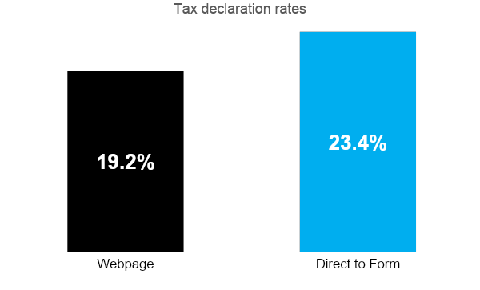
Removing small frictions makes a big difference
E
Notes:
Removing one mouse click – unexpected large effect of 4 ppt
NOTE: not revolutionary idea and maybe even intuitive – how often have you not done something because it seemed to require too much effort although you know it’s right thing to do – BUT: it wasn’t being done
LESSON LEARNED: if want people to take certain actions, systems can be re-designed to make easier to use 🡪 important to ask yourself question “which steps in process could be removed or simplified?”

Slide 66
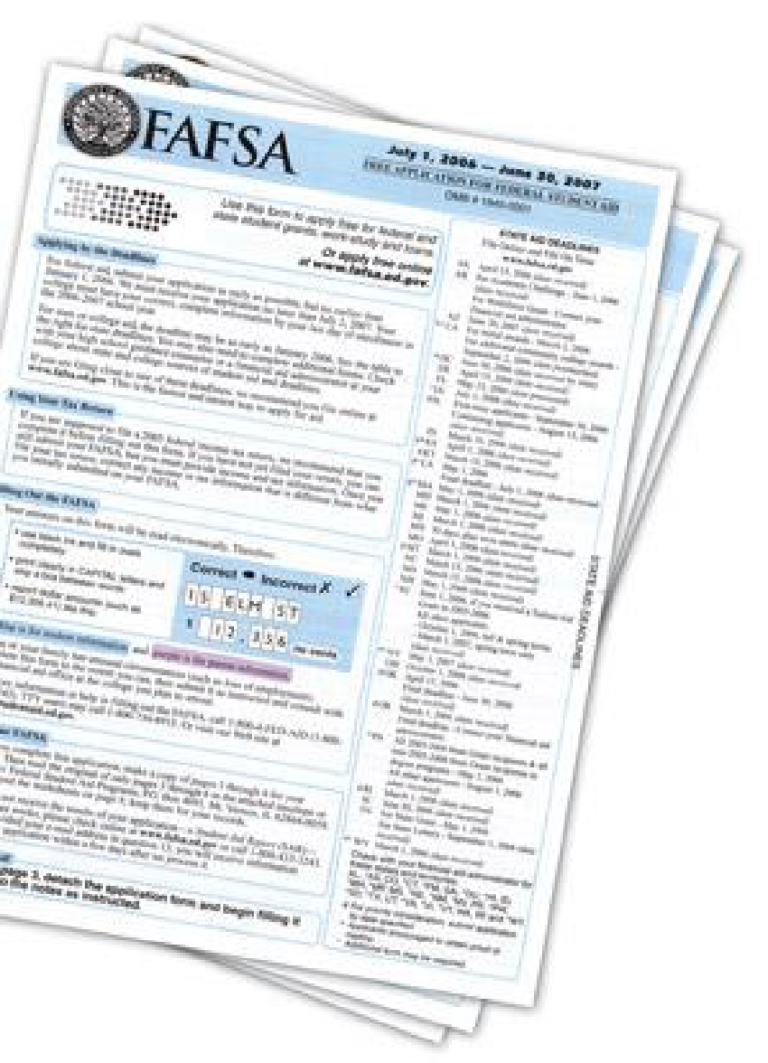
2. Simplification
Notes:
Example from our work
Work with HMRC = UK DG Tax 🡪 asked for help to get more taxpayers to submit their tax declaration

Slide 67
Make it attractive
EASY
ATTRACTIVE
TIMELY
SOCIAL
Notes:
Second insight from the EAST framework is that we can encourage people to engage a behaviour by making it attractive.
In the background an example from Melbourne where simply adding a colourful artwork on the staircase of a railway station attracted an additional 20% of people to take the stairs during peak hours.
https://zestevents.com.au/stair-art-for-the-national-heart-foundation-city-of-melbourne/

Slide 68
Make it attractive
Draw attention to specific features of your service
Personalise messages and services
Provide incentives for performing the desired behaviour
© The Behavioural Insights Team
Notes:
Again there are a number of different tools that can be used to make processes and behaviours more attractive
For example you can:
Design services in a way that attracts the attention of potential service users or that draws or diverts attention to specific features of a product. For example, if you want to promote the selection of vegetarian products in a restaurant one thing you can do is to divert customers attention from the fact that the product is vegetarian and instead make other aspects of that product more salient.
Personalize services (Drinkaware: men and women care about different consequences of alcohol consumption: personalize their online interventions to the sex of the users.)
And deliver rewards and incentives for positive behaviours (rewards and taxes)

Slide 69
How can we encourage bankers to give money to charity?

Slide 70
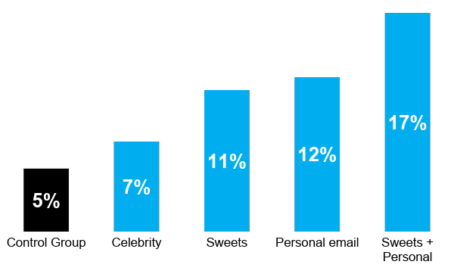
Proportion giving away a day’s salary to charity
Notes:
What’s incredible is that the impact of those candies are not significantly different from the impact of a personal email from your boss. The two of them together, however, are all powerful.
Clearly giving Skittles out is not a policy solution but considering ways in which we pull out the notion of reciprocity and work with it are completely viable.
When we think about incentives, we should go beyond the simple lens of monetary reward or sanction.
The average donation was £500.
Let’s move on to our next example of how to make it attractive?
We worked with a large investment bank to see if we could get their employees to donate a day’s worth of salary to charity. To do this, we tried a few different things:
1 - Getting a minor celebrity to ask them to donate
2 - Giving them candy
3 - A personalised email sent from the CEO
It’s a pretty hierarchical organisation… so what do you think worked best?

Slide 71
Proportion giving away a day’s salary to charity
Notes:
What’s incredible is that the impact of those candies are not significantly different from the impact of a personal email from your boss. The two of them together, however, are all powerful.
Clearly giving Skittles out is not a policy solution but considering ways in which we pull out the notion of reciprocity and work with it are completely viable.
When we think about incentives, we should go beyond the simple lens of monetary reward or sanction.
The average donation was £500.
Let’s move on to our next example of how to make it attractive?
We worked with a large investment bank to see if we could get their employees to donate a day’s worth of salary to charity. To do this, we tried a few different things:
1 - Getting a minor celebrity to ask them to donate
2 - Giving them candy
3 - A personalised email sent from the CEO
It’s a pretty hierarchical organisation… so what do you think worked best?

Slide 72
Proportion giving away a day’s salary to charity
Notes:
What’s incredible is that the impact of those candies are not significantly different from the impact of a personal email from your boss. The two of them together, however, are all powerful.
Clearly giving Skittles out is not a policy solution but considering ways in which we pull out the notion of reciprocity and work with it are completely viable.
When we think about incentives, we should go beyond the simple lens of monetary reward or sanction.
The average donation was £500.
Let’s move on to our next example of how to make it attractive?
We worked with a large investment bank to see if we could get their employees to donate a day’s worth of salary to charity. To do this, we tried a few different things:
1 - Getting a minor celebrity to ask them to donate
2 - Giving them candy
3 - A personalised email sent from the CEO
It’s a pretty hierarchical organisation… so what do you think worked best?

Slide 73
Proportion giving away a day’s salary to charity
Notes:
What’s incredible is that the impact of those candies are not significantly different from the impact of a personal email from your boss. The two of them together, however, are all powerful.
Clearly giving Skittles out is not a policy solution but considering ways in which we pull out the notion of reciprocity and work with it are completely viable.
When we think about incentives, we should go beyond the simple lens of monetary reward or sanction.
The average donation was £500.
Let’s move on to our next example of how to make it attractive?
We worked with a large investment bank to see if we could get their employees to donate a day’s worth of salary to charity. To do this, we tried a few different things:
1 - Getting a minor celebrity to ask them to donate
2 - Giving them candy
3 - A personalised email sent from the CEO
It’s a pretty hierarchical organisation… so what do you think worked best?

Slide 74
Proportion giving away a day’s salary to charity
Notes:
What’s incredible is that the impact of those candies are not significantly different from the impact of a personal email from your boss. The two of them together, however, are all powerful.
Clearly giving Skittles out is not a policy solution but considering ways in which we pull out the notion of reciprocity and work with it are completely viable.
When we think about incentives, we should go beyond the simple lens of monetary reward or sanction.
The average donation was £500.
Let’s move on to our next example of how to make it attractive?
We worked with a large investment bank to see if we could get their employees to donate a day’s worth of salary to charity. To do this, we tried a few different things:
1 - Getting a minor celebrity to ask them to donate
2 - Giving them candy
3 - A personalised email sent from the CEO
It’s a pretty hierarchical organisation… so what do you think worked best?

Slide 75
Our trial raised £500,000 in one day.

Slide 76
Make it social
EASY
ATTRACTIVE
TIMELY
SOCIAL
Notes:
Next is one of my favourite approaches of BIT, which is to encourage behaviours by making them feel social.
We all like to think of ourselves as independent beings, but the truth is that our behavior is strongly influenced by what other people do.
We all have had this experience:
we get to a crosswalk
We are watching our phones.
The streetlight is red.
But we notice that the people around us start to cross the street.
And without even doublecheck the streetlight we start crossing the street too
(essentially trusting a bunch of perfect strangers with our own lives.)

Slide 77
Make it social
Leverage the reciprocity effect
Use the power of existing social networks
Highlight helpful social norms
© The Behavioural Insights Team
Notes:
So it is possible to encourage people to engage in specific behaviours by
Using reciprocity effects. (We are likely to reciprocate favours that we receive) – organ donation, British Heart Foundation: if you need an organ would you want other people to donate?
We can leverage the power of people’s existing social networks. (so if we aim to help somebody change a behavior, we can target the social network in which this person is embedded) – study supporters
Highlighting positive social norms (essentially highlighting how most other people already engage in a behavior or a starting to do so).

Slide 78
Reducing unnecessary antibiotic prescriptions

Slide 79
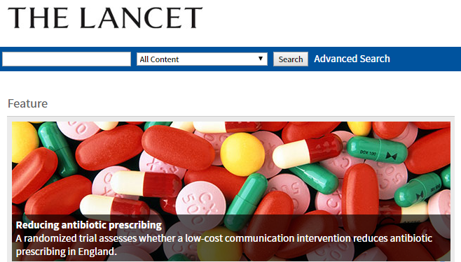
Reducing antibiotic prescriptions
Antimicrobial resistance could cause 10 million deaths by 2050 worldwide
© The Behavioural Insights Team
Notes:
Hugely human behaviour- not scientific “How much will this patient complain” “how sure am I of my diagnosis” How many tests have I done to confirm or exclude serious bacterial infection” - Meski

Slide 80
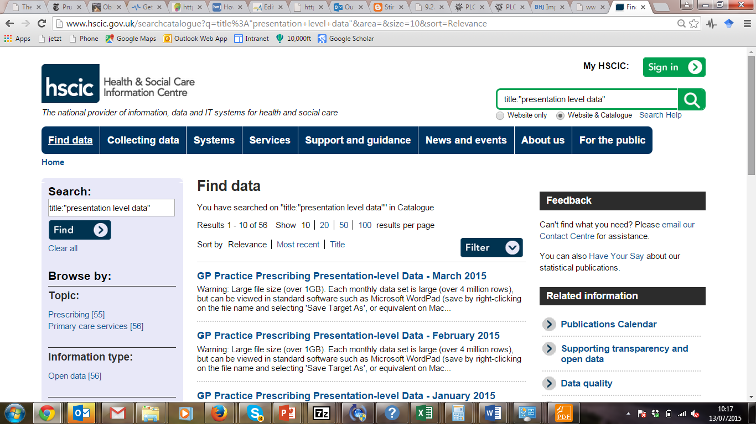
Reducing antibiotic prescriptions
© The Behavioural Insights Team
Notes:
So instead of taking the standard approach of saying that there is lots of overprescribing going on, what we did was exactly the opposite:
First, we identified the 800 GP practices, which were the top 20% prescribers
We divided them in two groups:
The first group received no intervention and served as a control for our study
While the second group received a letter highlighting the social norm of prescribing fewer antibiotics.

Slide 81
Reducing antibiotic prescriptions
“The great majority (80%) of practices in London prescribe fewer antibiotics per head than yours.”
© The Behavioural Insights Team
Notes:
Specifically the letter stated that “The great majority (80%) of practices in London prescribe fewer antibiotics per head than yours.”

Slide 82
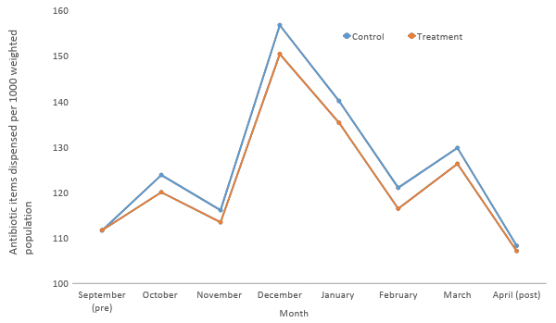
Reducing antibiotic prescriptions
n=1,581
© The Behavioural Insights Team
Notes:
The blue line shows the prescribing rate among the practices not receiving our letter...

Slide 83
Reducing antibiotic prescriptions
Antibiotic prescribing rate was 3.3% lower in the intervention group
n=1,581
© The Behavioural Insights Team
Notes:
While the orange line shows antibiotic prescribing among the practices that received our letter.
And antibiotic prescribing was on average 3% lower in these practices.
After a 6 months study we started to roll out the intervention across all 800 practices...

Slide 84
Reducing antibiotic prescriptions
Antibiotic prescribing rate was 3.3% lower in the intervention group
n=1,581
© The Behavioural Insights Team
Notes:
And we found that the difference in antibiotic prescription between the two groups disappeared, providing further evidence on the causal effect of our intervention.

Slide 85
Reducing antibiotic prescriptions
The intervention saved 73,406 doses in 791 medical practices
The intervention led to direct net savings of £92,356 in public sector prescription costs at a cost of 9p per letter
If scaled up across England the intervention could lead to a 0.85% reduction in antibiotic prescriptions
The national target for antibiotic prescription reduction is 4%
© The Behavioural Insights Team
Notes:
During the study period alone the letter:
Saved more than 73,000 antibiotic prescriptions
Direct savings to the NHS of more than £92,000
And if the letter was sent to all eligible practices it would have reduced England’s antibiotic prescription by almost 1% with a national target of reducing antibiotic prescribing by 4%
Letter costs 9 p each.

Slide 86
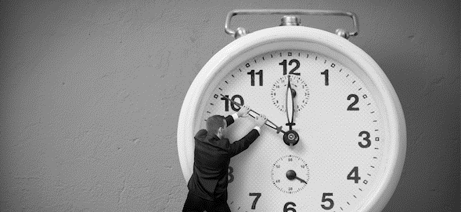
Make it timely
EASY
ATTRACTIVE
TIMELY
SOCIAL
Notes:
Coming to the end of our EAST framework, the last way to ensure that a policy works is by making it timely.

Slide 87
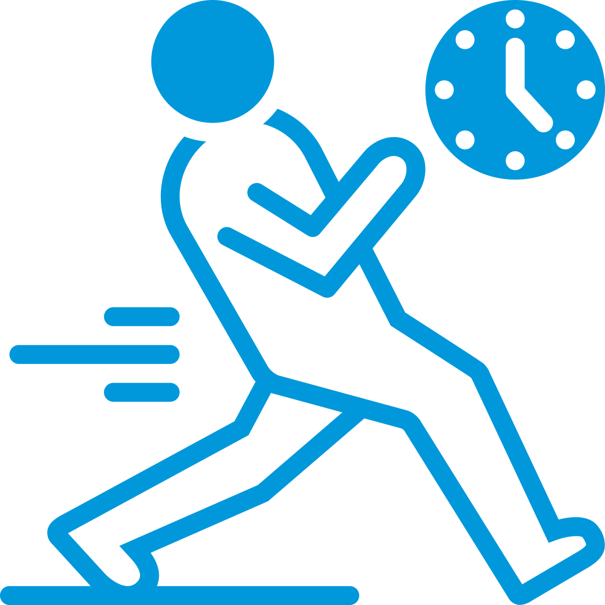
Make it timely
Tackle future discounting
Help people plan in
advance
Intervene when people are most likely to be receptive (ICU)
© The Behavioural Insights Team
Notes:
So, if we are developing a service to encourage a behaviour we should
First, highlight its immediate benefits of performing this behaviour and finding ways around its immediate costs, (because we know that people are more strongly influenced by immediate outcomes than by future outcomes.) – Drinkaware: calories intake.
Second, it is important to help people plan their behaviours in advance and develop contingency plans for when things do not go as expected. – implementation intentions.
And third thing, is that when we develop services to help people change behavior we should make sure that the support is provided to people when they most need it and when they are most likely to act on it.

Slide 88
Reducing waiting time for specialist medical care
Notes:
A good example of how to do this comes from some work we did with the NHS digital team
looking at how to encourage doctors to refer more patients to services with shorter waiting time.
Limited capacity trial: https://www.bi.team/blogs/green-means-go-how-to-help-patients-make-informed-choices-about-their-healthcare/

Slide 89
Reducing waiting time for medical visits
Waiting time for specialist medical care is increasingly a problem in the UK
Doctors find it difficult to quickly identify services with shorter waiting times during their consultations
Notes:
And in our exploratory work we found that a key barrier to speedier referrals is that they struggle to quickly identify the services with the shorter waiting times.

Slide 90
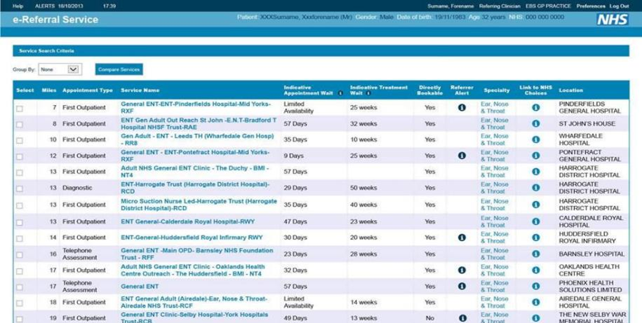
Reducing waiting time for medical visits
Notes:
This might partly be because the standard referral system looks like this.
It provides more than 99 referral options for any given search.
And in the short 10 minutes appointments doctors struggle to identify the options that would minimize waiting times.

Slide 91
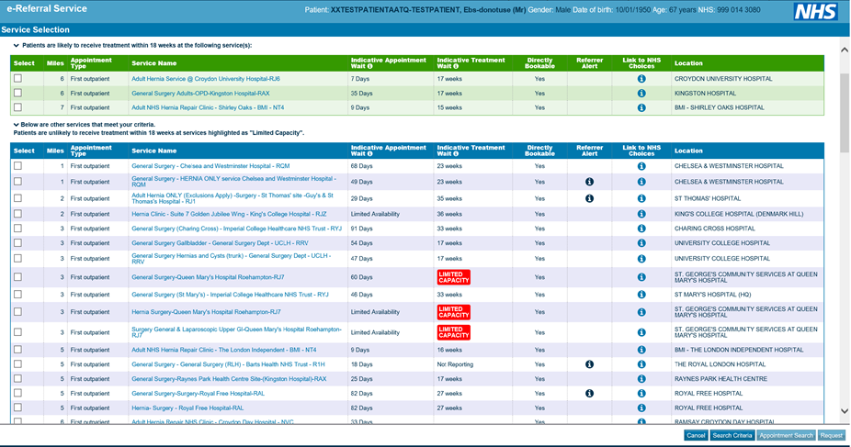
Reducing waiting time for medical visits
Notes:
What BIT did was to restructure the referral system to provide timely information to practitioners about the waiting time of different services:
Every time they looked for a referral those with the shortest waiting times were displayed separately in a green box.
Those with longer waiting times were marked with a red label reading ‘limited capacity”.

Slide 92
Reducing waiting time for medical visits
Notes:
If a practitioner selected the limited capacity option they received an additional timely prompt encouraging them to consider other options too.
This way doctors received timely information about the likely waiting time of different medical services, exactly when they needed it.

Slide 93
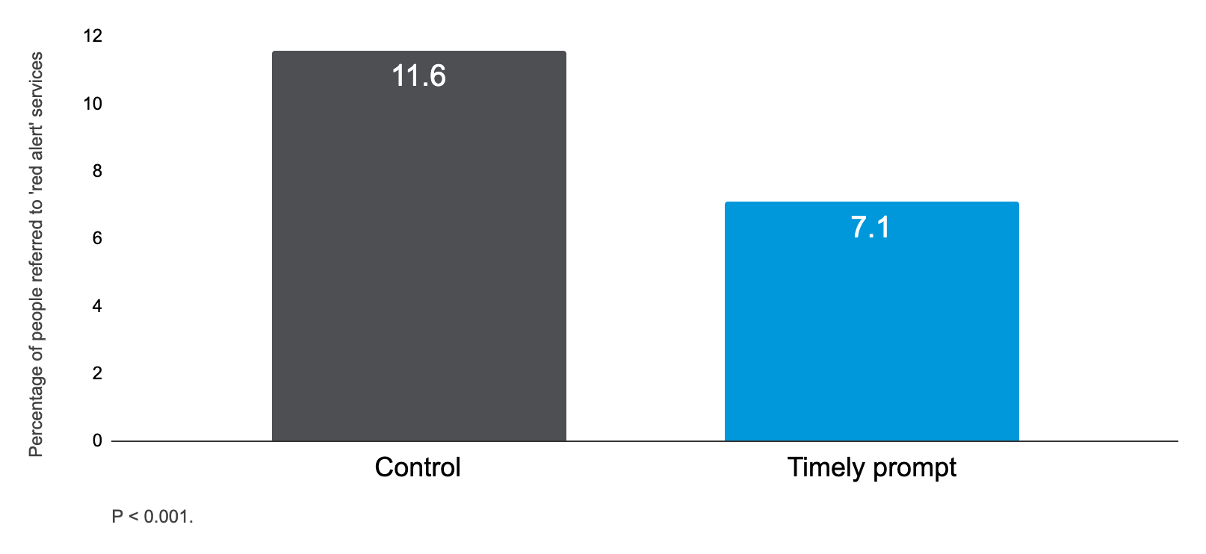
Reducing waiting time for medical visits
Green box?
Red box: 4.5 percentage points decrease
© The Behavioural Insights Team
Notes:
Adding the red alerts led to a 4.5 percentage points decrease in referrals to limited capacity services.
(FYI The green box highlighting services with shorter waits led to a small increase in referrals to those services but the result was not statistically significant)

Slide 94
Overview
1.
2.
20XX
20XX
2. The Story of BIT
4. TESTS
Dual Process Models
3. The EAST framework
Understanding the drivers of human behaviour
Who we are, where we come from, and our mission
How to apply behavioural insights to design behavioural interventions
A guideline to structure behavioural science projects
Notes:
In this presentation like to provide some practical guidance for how to use behavioural insights to develop effective interventions to promote health.
I will start by giving a brief introduction to the Behavioural Insights Team - also known as the Nudge Unit to give some background about who we are and what we do
I will then present the core ideas behind the dual process models of human behaviour, which provide a very helpful lense through which to understand what drives human behaviours
And finally I will present some practical tools that BIT has developed to facilitate the application of behavioural sciences. These are:
The EAST framework, which you can use to develop behavioural interventions to prmote health
the TESTS framework, which you can use to structure your behavioural science projects.

Slide 95
The TESTS methodology
TARGET
EXPLORE
SOLUTION
TRIAL
SCALE
© The Behavioural Insights Team
Notes:
The TESTS framework suggests to structure a behaviour change project in five iterative steps:
Target
Explore
Solution
Trial
Scale

Slide 96
The TESTS methodology: Target
Describing a problem in behavioural terms and
identifying the behaviour(s) that you want to change
TARGET
EXPLORE
SOLUTION
TRIAL
SCALE
© The Behavioural Insights Team
Notes:
The aim of the target phase is to describe a policy challenge in behavioural terms and narrow down the focus of the project to a specific set of behaviors that we want to encourage or discourage.

Slide 97
The TESTS methodology: Target
Describing a problem in behavioural terms and
identifying the behaviour(s) that you want to change
TARGET
EXPLORE
SOLUTION
TRIAL
SCALE
Tackle the rise of antimicrobial resistance
© The Behavioural Insights Team
Notes:
For example, you might be asked to reduce the spread in antimicrobial resistance.
This is not in and of itself a behaviour and so we need to identify all the specific behaviours that contribute to this problem.

Slide 98
The TESTS methodology: Target
Describing a problem in behavioural terms and
identifying the behaviour(s) that you want to change
TARGET
EXPLORE
SOLUTION
TRIAL
SCALE
Over-consumption of antibiotics
Tackle the rise of antimicrobial resistance
© The Behavioural Insights Team
Notes:
For example, we know that the overconsumption of antibiotics can contribute to antimicrobial resistance

Slide 99
The TESTS methodology: Target
Describing a problem in behavioural terms and
identifying the behaviour(s) that you want to change
TARGET
EXPLORE
SOLUTION
TRIAL
SCALE
Unnecessary over-prescription of antibiotics
Over-consumption of antibiotics
Tackle the rise of antimicrobial resistance
© The Behavioural Insights Team
Notes:
And that un-necessary over-prescriptions of antibiotics are a key determinants of overconsumption.

Slide 100
The TESTS methodology: Target
Describing a problem in behavioural terms and
identifying the behaviour(s) that you want to change
TARGET
EXPLORE
SOLUTION
TRIAL
SCALE
Support doctors to reduce the amount of unnecessary antibiotics prescriptions
Unnecessary over-prescription of antibiotics
(ca. 20%)
Over-consumption of antibiotics
Tackle the rise of antimicrobial resistance
© The Behavioural Insights Team
Notes:
So a target behaviour for a project could be to help GPs reduce the amount of unnecessary antibiotic prescriptions.
Usually the way in which we select a target behaviour in practice is to identify all the various behaviours that contribute to a specific problem and then select the behaviours that:
Would make the biggest difference to the problem we are trying to address
Can feasibly be changed through a behavioural intervention.

Slide 101
The TESTS methodology: Explore
Identifying the barriers that prevent or inhibit
your target behaviour
TARGET
EXPLORE
SOLUTION
TRIAL
SCALE
© The Behavioural Insights Team
Notes:
Once you have identified your target behaviour, you enter the explore phase...

Slide 102
The TESTS methodology: Explore
Identifying the barriers that prevent or inhibit
your target behaviour
TARGET
EXPLORE
SOLUTION
TRIAL
SCALE
What are the barriers to reducing the number of antibiotics prescribed?
© The Behavioural Insights Team
Notes:
The aim of this phase is to understand the behaviour in context and identify the barriers that are currently preventing the behaviour from happening.

Slide 103
The TESTS methodology: Explore
Literature reviews
Literature reviews
Identificare le barriere comportamentali che impediscono o diminuiscono
l'esecuzione del comportamento desiderato
TARGET
EXPLORE
SOLUTION
TRIAL
SCALE
© The Behavioural Insights Team
Notes:
There are various things you can do to identify these barriers:
You can consider the published literature (to see if other research teams have previously explored factors contributing to over-prescriptions of antibiotics)

Slide 104
The TESTS methodology: Explore
Literature reviews
Literature reviews
Identificare le barriere comportamentali che impediscono o diminuiscono
l'esecuzione del comportamento desiderato
TARGET
EXPLORE
SOLUTION
TRIAL
SCALE
Data analysis
Data analysis
© The Behavioural Insights Team
Notes:
You can conduct exploratory data analysis (e.g. do GPs tend to prescribe more antibiotics at specific times of the day? In specific locations?)

Slide 105
The TESTS methodology: Explore
Literature reviews
Fieldwork and observations
Literature reviews
Identificare le barriere comportamentali che impediscono o diminuiscono
l'esecuzione del comportamento desiderato
Fieldwork and observations
TARGET
EXPLORE
SOLUTION
TRIAL
SCALE
Data analysis
Data analysis
© The Behavioural Insights Team
Notes:
You can conduct some ethnographic research to observe the behaviour first hand in its context

Slide 106
The TESTS methodology: Explore
Literature reviews
Identificare le barriere comportamentali che impediscono o diminuiscono
l'esecuzione del comportamento desiderato
Fieldwork and observations
TARGET
EXPLORE
SOLUTION
TRIAL
SCALE
Data analysis
Qualitative research
© The Behavioural Insights Team
Notes:
And you can conduct more traditional qualitative research such as interviews and focus groups

Slide 107
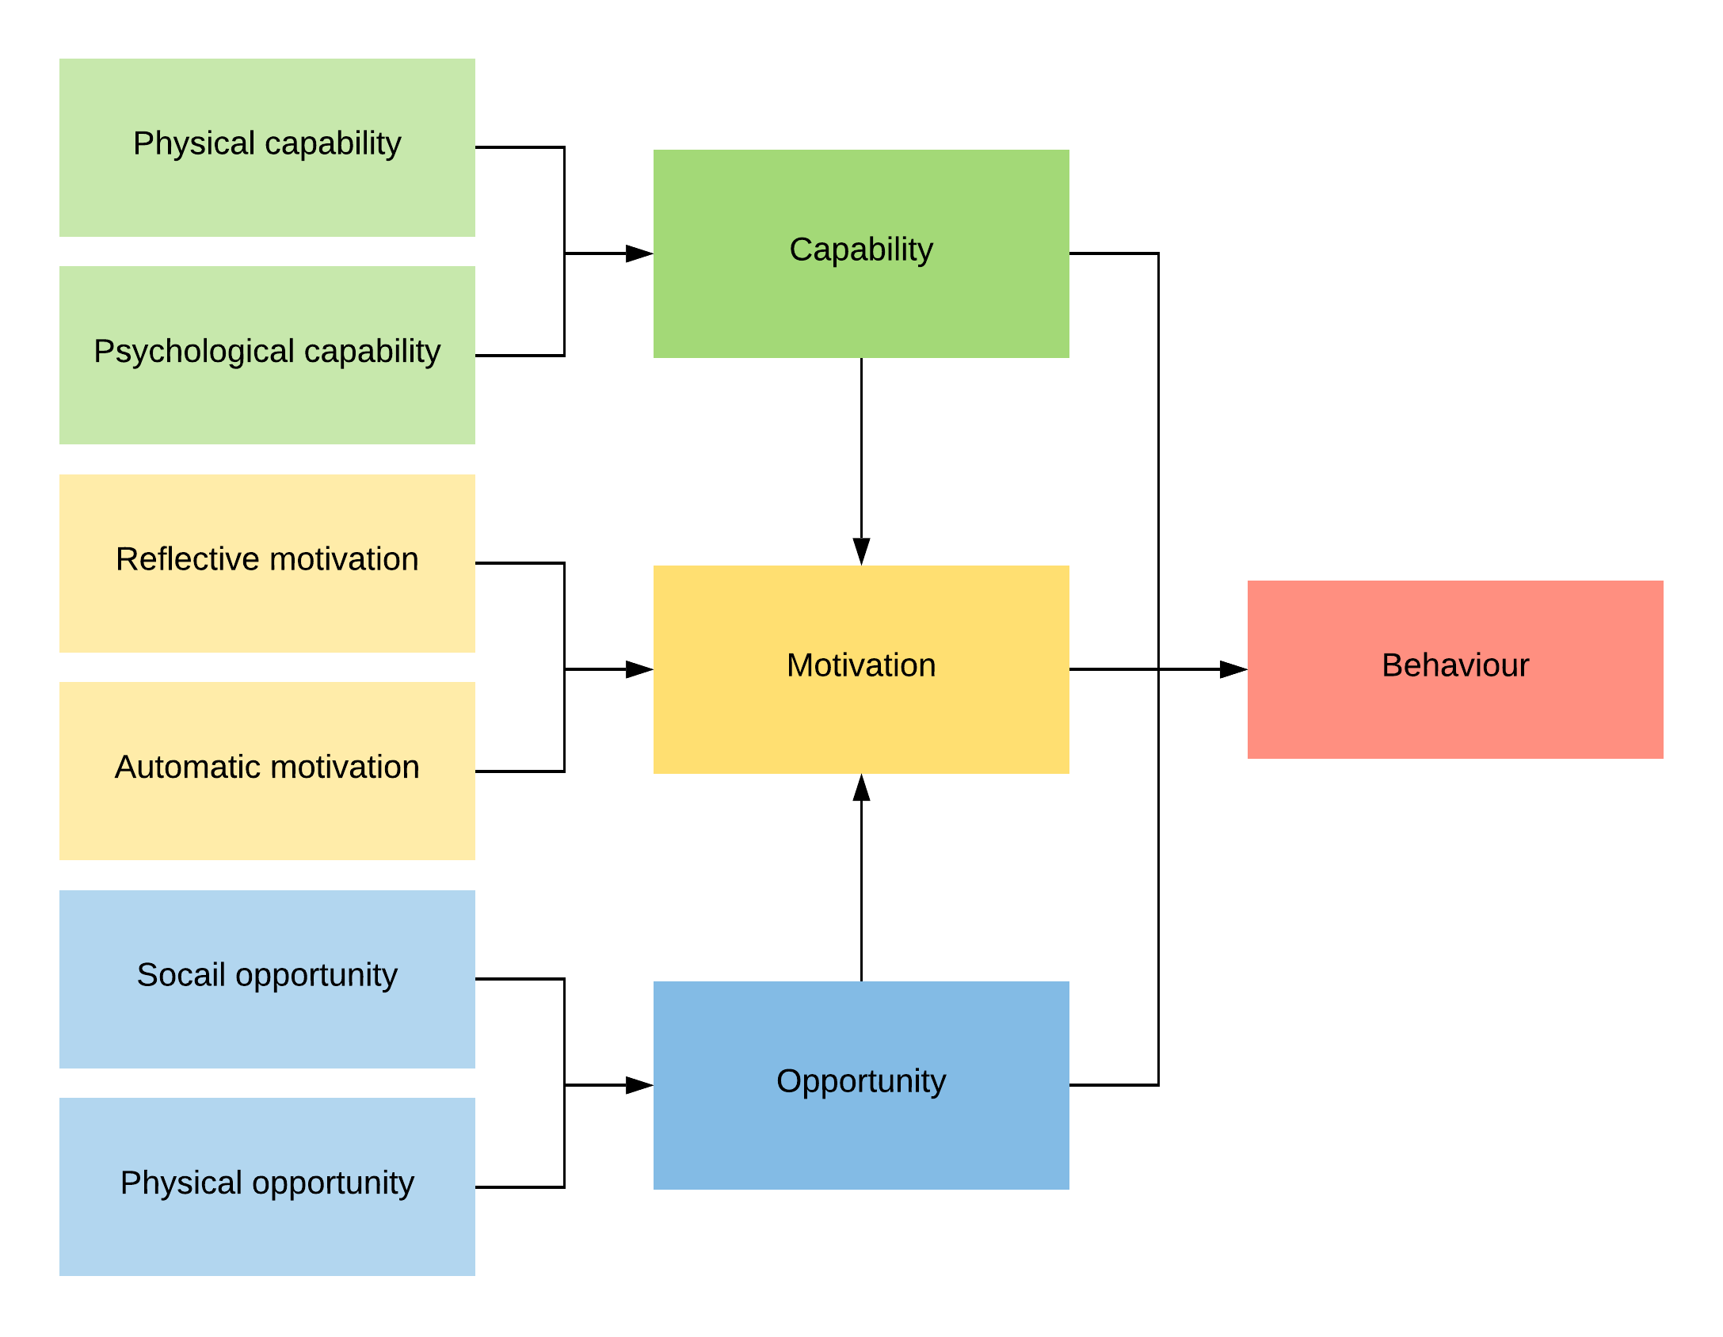
The TESTS methodology: Explore (COM-B)
Identificare le barriere comportamentali che impediscono o diminuiscono
l'esecuzione del comportamento desiderato
TARGET
EXPLORE
SOLUTION
TRIAL
SCALE
© The Behavioural Insights Team
Notes:
Ideally you would conduct multiple of these activities and triangulate their findings, but regardless of how you decide to explore the behaviour it is useful to have a framework in mind to guide your work.
And the COM-B model developed at UCL is an excellent framework to use. It suggests that people wont do a behaviour if they lack the capability, motivation, or opportunity to do so… and so when you are exploring barriers preventing the target behaviour making sure that you think about these three areas can really improve the output of your work...

Slide 108
The TESTS methodology: Solution
Develop behavioural intervention(s) to promote
your target behaviour
TARGET
EXPLORE
SOLUTION
TRIAL
SCALE
© The Behavioural Insights Team
Notes:
Having identified the barriers preventing your target behaviour you then move into the solution phase where you develop a behavioural interventions to tackle these barriers and promote your target behaviour.

Slide 109
The TESTS methodology: Solution
EASY
Develop behavioural intervention(s) to promote
your target behaviour
TARGET
EXPLORE
SOLUTION
TRIAL
SCALE
ATTRACTIVE
TIMELY
SOCIAL
© The Behavioural Insights Team
Notes:
This is where you can use the insights from the EAST framework….(there is a report published online with more details)

Slide 110
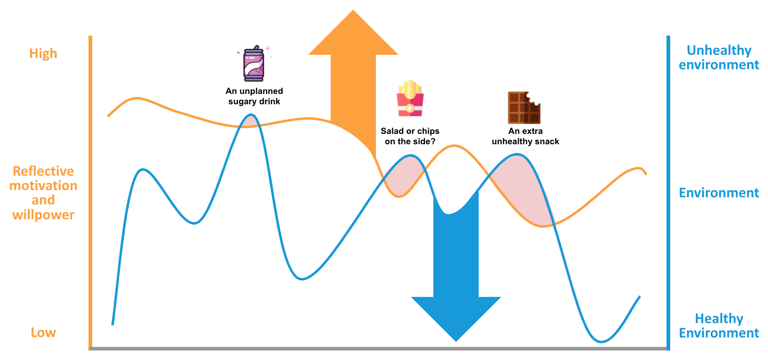
The TESTS methodology: Solution
Develop behavioural intervention(s) to promote
your target behaviour
TARGET
EXPLORE
SOLUTION
TRIAL
SCALE
ATTRACTIVE
TIMELY
© The Behavioural Insights Team
Notes:
And where it is really important for you to consider both targeting conscious determinants of human behaviour (so the reflective system) but also the automatic system by making changes to the environments in which people make choices.

Slide 111
The TESTS methodology: Trial
Evaluate your intervention to understand what works and
what does not
TARGET
EXPLORE
SOLUTION
TRIAL
SCALE
© The Behavioural Insights Team
Notes:
Finally it is really, really important to test the impact of your interventions…
Human behaviour is complex and behavioural interventions can sometimes be ineffective - or backfire - even when they are based on the best available theory or evidence.

Slide 112
The TESTS methodology: Trial
Condurre una valutazione scientifica per quantificare l’efficacia
dell’intervento comportamentale
TARGET
EXPLORE
SOLUTION
TRIAL
SCALE
Empirical measure
Outcome
(e.g. number of unnecessary prescriptions)
Pre-intervention
Post-intervention
© The Behavioural Insights Team
Notes:
Often the way in which interventions are evaluated in a policy context is with pre-post studies…
You collect data on your outcome of interest (e.g. antibiotic prescriptions)

Slide 113
The TESTS methodology: Trial
Condurre una valutazione scientifica per quantificare l’efficacia
dell’intervento comportamentale
INTERVENTION
TARGET
EXPLORE
SOLUTION
TRIAL
SCALE
Empirical measure
Outcome
(e.g. number of unnecessary prescriptions)
Pre-intervention
Post-intervention
© The Behavioural Insights Team
Notes:
Then you implement your intervention and measure your outcome again after the interventions
The changes in your outcomes are used to estimate the impact of your interventions...

Slide 114
The TESTS methodology: Trial
Condurre una valutazione scientifica per quantificare l’efficacia
dell’intervento comportamentale
INTERVENTION
TARGET
EXPLORE
SOLUTION
TRIAL
SCALE
Empirical measure
Outcome
(e.g. number of unnecessary prescriptions)
Pre-intervention
Post-intervention
© The Behavioural Insights Team
Notes:
Then you implement your intervention and measure your outcome again after the interventions
The changes in your outcomes are used to estimate the impact of your interventions...

Slide 115
The TESTS methodology: Trial
INTERVENTION
Post-intervention:
Empirical measurement of the outcome in both groups
Pre-intervention:
Sample is randomised
CONTROL
Sample
© The Behavioural Insights Team
Notes:
When it comes to quantifying the impact of an interventions, randomised controlled trials are therefore preferable...and I am sure you are all very familiar with all these study designs...
In these studies you randomly allocate people to either receive the intervention or to continue their business as usual… this way you ensure that the only systematic difference between the two groups is the intervention itself..
You then measure your outcome of interest and the difference between the intervention and the control group can then be attributed to the intervention making way fewer assumption than pre-post designs…
Once you’ve identified effective interventions it is then important to scale them up - which is the last phase of the TESTS methodology..

Slide 116
Reducing antibiotic prescriptions
Antibiotic prescribing rate was 3.3% lower in the intervention group
n=1,581
© The Behavioural Insights Team
Notes:
While the orange line shows antibiotic prescribing among the practices that received our letter.
And antibiotic prescribing was on average 3% lower in these practices.
After a 6 months study we started to roll out the intervention across all 800 practices...

Slide 117
The TESTS methodology: Scale
Consider the risks and merits of scaling the intervention and develop a plan for roll out
Process evaluation
Cost benefit analysis
Knowledge sharing
© The Behavioural Insights Team
Notes:
Process evaluation:
What are the mechanisms through which the intervention worked and are they likely to apply in the new setting?
Are some of the mechanisms through which the intervention worked likely to clash with the culture and values of the new population?
Cost benefit analysis:
It is great that the intervention worked but it is the best way in which we can spend our limited resources?
Is it cost effective or cost saving? ...Perhaps only if delivered among a specific population…
Knowledge sharing:
Make sure that the lessons learned through your research are as widely accessible as possible.
This can include publishing academic reports, blogs, or even organising knowledge sharing events (conferences)
It could also involve encouraging professionals to share knowledge with colleagues, leveraging the power of existing social networks and of credible messengers

Slide 118
Get in touch
Dr Niamh Thompson
niamh.thompson@bi.team
Notes:
I’ll stop here…. Will leave my e-mail address in case you want to get in touch.

Slide 119
Additional slides
EAST case studies

Slide 120
Reducing missed hospital appointments
Notes:
Un intervento che abbiamo sviluppato basato su questi principi era volto a ridurre gli appuntamenti mancati in ospedale

Slide 121
Reducing missed hospital appointments
That is 5.5 million appointments every year in England alone
On average, one in ten hospital outpatient appointments is missed
© The Behavioural Insights Team
Notes:
Around one in ten hospital outpatient appointments are missed every year in England.
This leads to:
worse patient care
waste NHS resources
Currently hospital use reminder text messages to encourage people to show up.
And we know that these messages work.
However, we wanted to find out whether applying BI in the design of these text messages would further increase their effectiveness and we conducted a This is partnership with the Department for Health and Social Care to explore this.

Slide 122
Reducing missed hospital appointments
```````
Appt at [hospital] on [Sep 16] at [10:00am]. To cancel or rearrange call the number on your appointment letter.
© The Behavioural Insights Team
Notes:
The standard reminder text message reads:
You have an appointment on this date and time. To cancel or rearrange, call the number on your appointment letter.

Slide 123
Reducing missed hospital appointments
We are expecting you at [hospital] on [Sep 16] at [10:00am]. Not attending costs NHS £160 approx. Call 02077673200 if you need to cancel or rearrange
Appt at [hospital] on [Sep 16] at [10:00am]. To cancel or rearrange call the number on your appointment letter.
© The Behavioural Insights Team
Notes:
The behaviourally enhanced message attracted user’s attention by highlighting the cost of a missed appointment to the NHS:
“Not attending costs £160 to the NHS.”
It also made it easier for people to cancel their appointment by providing the telephone number then and there.

Slide 124
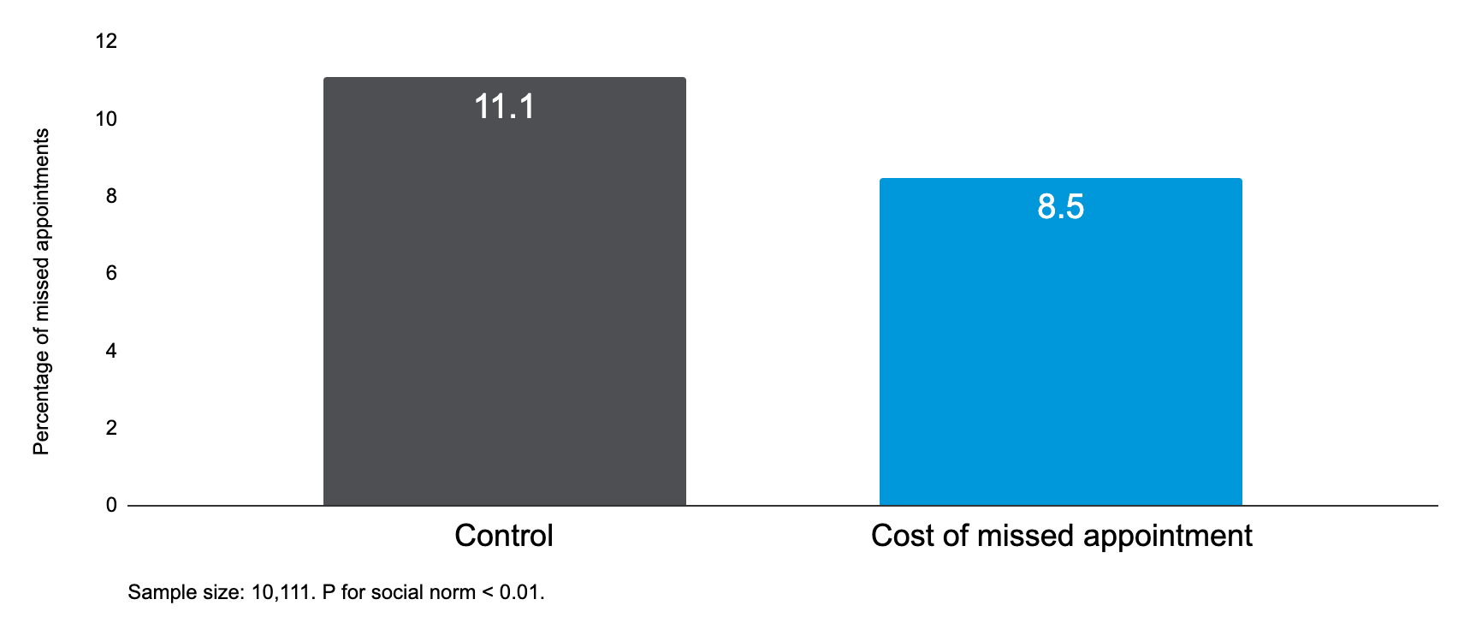
Reducing missed hospital appointments
© The Behavioural Insights Team
Notes:
The BI text message led to approx. 3pp reduction in missed hospital appointments compared to the standard text message.
N for comparison = approx. 5000; N=10,111 for full trial which had 4 arms: easy call, social norm)

Slide 125
Reducing missed hospital appointments
This result would lead to 5,800 fewer missed appointments if applied over one year in same location. This result would lead to 406,740 fewer missed appointments if applied over one year in England.
We are expecting you at [hospital] on [Sep 16] at [10:00am]. Not attending costs NHS £160 approx. Call 02077673200 if you need to cancel or rearrange
© The Behavioural Insights Team
Notes:
Whilst these may seem like small effects, if implemented at scale, we have estimated that simply making these small changes to the reminder message could prevent more than 400,000 missed hospital appointments, if rolled out in England for one year.

Slide 126
Involve pharmacists to reduce pressure on medical services
Notes:
As I mentioned before, future discounting is a very important bias influencing the choices we make… we tend to attribute much greater value to things that happen in the present or in the near future, compared to things that are perceived to be far into the future...

Slide 127
The 111 medical service during COVID-19
The NHS 111 service is a telephone service designed to help people deal with urgent medical problems.
During the phone call, you are asked to answer some questions about your symptoms. As a result of the consultation, the call handler might refer you to see a doctor, nurse, or pharmacist.
To reduce the pressure on medical doctors during COVID-19, we developed an intervention to encourage more patients to take up a consultation with a pharmacist for non-urgent matters.
© The Behavioural Insights Team
Notes:
And we applied this insight in a project that aimed to encourage more 111 service users to accept a consultation with a pharmacist as opposed to a doctor…
As many of you will know, The NHS 111 service is a telephone service designed to help people deal with urgent medical problems.
During the phone call, you are asked to answer some questions about your symptoms and as a result of the consultation, the call handler might refer you to see a doctor, nurse, or pharmacist.
To reduce the pressure on medical doctors during COVID-19, we developed an intervention to encourage more patients to take up a consultation with a pharmacist for non-urgent matters.

Slide 128
The 111 medical service during COVID-19
We asked people to imagine making a call to the 111 service for a non-urgent medical issue and being referred to a consultation with a doctor, nurse, or pharmacist. We had two conditions:
Control: no time specification
Get a call back from a pharmacist Get a call back from a nurse Get a call back from a doctor Any of the above
© The Behavioural Insights Team
Notes:
In our experiment, We asked people to imagine making a call to the 111 service for a non-urgent medical issue and having to choose between a consultation with a doctor, a nurse, or a pharmacist. We had two conditions:
Normally, the 111 service providers do not specify the time that it takes to speak with these healthcare professionals, and this is reflected in how the consultations were presented in our control condition.

Slide 129
The 111 medical service during COVID-19
We asked people to imagine making a call to the 111 service for a non-urgent medical issue and being referred to a consultation with a doctor, nurse, or pharmacist. We had two conditions:
Control: no time specification | Timely intervention: waiting time specification
Get a call back from a pharmacist Get a call back from a nurse Get a call back from a doctor Any of the above | Get a call back from a pharmacist within 2 hours Get a call back from a nurse within 4 hours Get a call back from a doctor within 12 hours Any of the above
© The Behavioural Insights Team
Notes:
In our intervention we specified that:
The call back from the pharmacist would be within 2 hours.
The nurse would call back within 4 hours.
And the doctor would come back within 12 hours.

Slide 130
The 111 medical service during COVID-19
Participants were more than twice as likely to select the pharmacist for their consultation when the waiting times were specified.
N=981 UK adults
© The Behavioural Insights Team
Notes:
Simply adding this information about the timelines more than doubled the percentage of people who selected the consultation with a pharmacist.

Slide 131
The 111 medical service during COVID-19
Participants were more than twice as likely to select the pharmacist for their consultation when the waiting times were specified.
N=981 UK adults
© The Behavioural Insights Team
Notes:
The information also increased the number of people who selected the consultation with the nurse,
But it substantially decreased the percentage of people who selected the consultation with the doctor.
Data collected on 981 UK adults by BIT on 28 April - 1 May 2020

Slide 132
Catching cancer early in Greater Manchester
Notes:
Early cancer diagnosis in Manchester: inhttps://www.bi.team/blogs/catching-cancer-early-in-greater-manchester-boosting-gp-referrals/

Slide 133
Catching cancer early in Greater Manchester
Almost 1 in 2 cases of cancer in the UK are diagnosed late
Early diagnosis and treatment are critical for improving cancer survival rates
Urgent cancer referral system is underused in many areas, including
Greater Manchester
© The Behavioural Insights Team
Notes:
The information also increased the number of people who selected the consultation with the nurse,
But it substantially decreased the percentage of people who selected the consultation with the doctor.
Data collected on 981 UK adults by BIT on 28 April - 1 May 2020

Slide 134
Catching cancer early in Greater Manchester
An anticipatory letter saying that the practice will receive feedback on how their cancer referral rate compares to other practices.
Almost half of people who develop cancer are diagnosed late. In the next few weeks I will be sending you feedback on how your practice’s cancer referral rate compares to others
© The Behavioural Insights Team
Notes:
The information also increased the number of people who selected the consultation with the nurse,
But it substantially decreased the percentage of people who selected the consultation with the doctor.
Data collected on 981 UK adults by BIT on 28 April - 1 May 2020

Slide 135
Catching cancer early in Greater Manchester
An anticipatory letter saying that the practice will receive feedback on how their cancer referral rate compares to other practices.
Recently we wrote to you to tell you that your practice had a lower urgent cancer referral rate than the great majority (70%) of practices in Greater Manchester.
The great majority (70%) of practices in Greater Manchester have a higher urgent referral rate than yours.
A feedback letter highlighting that many practices have higher urgent cancer referral rates than the targeted practice.
© The Behavioural Insights Team
Notes:
The information also increased the number of people who selected the consultation with the nurse,
But it substantially decreased the percentage of people who selected the consultation with the doctor.
Data collected on 981 UK adults by BIT on 28 April - 1 May 2020

Slide 136
Catching cancer early in Greater Manchester
An anticipatory letter saying that the practice will receive feedback on how their cancer referral rate compares to other practices.
Recently we wrote to you to tell you that your practice had a lower urgent cancer referral rate than the great majority (70%) of practices in Greater Manchester.
Recently we wrote to you to tell you that your practice had a lower cancer referral rate than
[many / the vast majority (70%) of] practices
A feedback letter highlighting that many practices have higher urgent cancer referral rates than the targeted practice.
A reminder letter reiterating the information included in the feedback letter.
© The Behavioural Insights Team
Notes:
The information also increased the number of people who selected the consultation with the nurse,
But it substantially decreased the percentage of people who selected the consultation with the doctor.
Data collected on 981 UK adults by BIT on 28 April - 1 May 2020

Slide 137
Catching cancer early in Greater Manchester
The intervention increased urgent cancer referral rates by 9.6% leading to an additional 21.5 referrals a month for every 100,000 people. If scaled up in England, this intervention could help to diagnose around 2,500 more cancer patients earlier and generate savings of up to £20m within 6 months.
© The Behavioural Insights Team
Notes:
The information also increased the number of people who selected the consultation with the nurse,
But it substantially decreased the percentage of people who selected the consultation with the doctor.
Data collected on 981 UK adults by BIT on 28 April - 1 May 2020

Slide 138
Pupil dilation as an index of effort in cognitive control tasks : van der Wel, P., van Steenbergen, H. A review. Psychon Bull Rev 25, 2005–2015 (2018).
Altering product placement to create a healthier layout in supermarkets: Outcomes on store sales, customer purchasing, and diet in a prospective matched controlled cluster study. Vogel C, Crozier S, Penn-Newman D, Ball K, Moon G, et al. (2021) PLOS Medicine 18(9): e1003729. https://doi.org/10.1371/journal.pmed.1003729
Theresa Marteau: the obesogenic environment https://www.nesta.org.uk/event/nesta-talks-to-theresa-marteau/
“energy limitations, which allow only a small fraction of the machinery to be engaged concurrently, provide a neurophysiological basis for the idea that selective attention arises from the brain’s limited capacity to process information (Lennie, 2003).” - https://www.sciencedirect.com/science/article/pii/S0042698911001544?via%3Dihub, http://www.pnas.org/content/99/16/10237.long
[1] Dreze, X., Hoch, S. J., & Purk, M. E. (1995). Shelf management and space elasticity. Journal of Retailing. 70(4), P. 301 – 326.
[2] Yang, M. H., & Chen, W. C. (1999). A study on shelf space allocation and management. International journal of production economics. 60, P. 309 – 317.
[3] Wansink, Brian; Just, David R.; Payne, Collin R. 2009. Mindless Eating and Healthy Heuristics for the Irrational. American Economic Review: Papers & Proceedings. 99(2). P. 165 – 169.
[4] Thorndike A.N., Sonnenberg, L., Riis, J., Barraclough, S., Levy D.E. 2012. A 2-Phase Labeling and Choice Architecture Intervention to Improve Healthy Food and Beverage Choices. American Journal of Public Health. 102(3). P. 527 – 533.
[5] Desmet, P., & Renaudin, V. (1998). Estimation of product category sales responsiveness to allocated shelf space. International Journal of Research in Marketing. 15(5). P. 445 – 457.
[6] Nogales, A. F., & Suarez, M. G. (2005). Shelf space management of private labels: A case study in Spanish retailing. Journal of Retailing and Consumer Services. 12(3). P. 205–216.
[7] Horsley, J.A., Absalom, K.A.R., Akiens, E.M., Dunk, R.J., Ferguson, A.M. 2014. The proportion of unhealthy foodstuffs children are exposed to at the checkout of convenience supermarkets. Public Health Nutrition.

Slide 139
[8] Dixon, H., Scully, M., & Parkinson, K. (2006). Pester power: Snack food displayed at supermarket checkouts in Melbourne, Australia. Health Promotion Journal of Australia, 17(2), P. 124 – 127.
[9] Cameron, A. J., Thornton, L. E., McNaughton, S. A., & Crawford, D. (2013). Variation in supermarket exposure to energy-dense snack foods by socio-economic position. Public health nutrition, 16(07), P. 1178 – 1185.
[10] Just, D. R., & Wansink, B. 2013. One man’s tall is another man’s small: How the framing of portion-size influences food choice. Health Economics, in press.
[11] North, A. C., Hargreaves, D. J., and McKendrick, J. 1997. In-store music affects product choice. Nature, 390(132).
[12] Garlin, F.V., Owen, K. 2006. Setting the tone with the tune: A meta-analytic review of the effects of background music in retail settings. Journal of Business Research. 59(6). P. 755–764.
[13] Wadhera, D., Capaldi-Phillips, E.D. 2014. A review of visual cues associated with food on food acceptance and consumption. Eating Behaviors, 15(1). P. 132 – 143.
[14] Wansink, B., Just, D.R., Payne, C.R., Klinger M.Z. 2012. Attractive names sustain increased vegetable intake in schools. Preventive Medicine, Volume 55(4). P. 330-332
[15] Wansink, B., Ittersum, K.V., Painter, J.E. 2005. How descriptive food names bias sensory perceptions in restaurants. Food Quality and Preference, Volume 16(5). P. 393–400

Slide 140
[16] Wansink, B., Kent, R.J., Hoch, S.J. 1998. An Anchoring and Adjustment Model of Purchase Quantity Decisions. Journal of Marketing Research. 35(1). P. 71–81.
[17] Baumeister, R.F., Bratslavsky, E., Muraven, M., Tice, D.M. 1998. Ego Depletion: Is the Active Self a Limited Resource? Journal of Personality and Social Psychology, 74(5). P. 1252 – 1265
[18] Baumeister, R.F., Vohs, K.D., Tice, D.M. 2007. The Strength Model of Self-Control. Current Directions in Psychological Science. 16(6). P. 351 – 355
[19] Langea, F. & Eggerta, F. 2014. Sweet delusion. Glucose drinks fail to counteract ego depletion. Appetite. 75(1). P. 54 – 63
[20] Dawson, J. 2013. Retailer activity in shaping food choice. Food Quality and Preference. 28(1). P. 339-347
[21] Hansen, P.G. (2010). Reasoning about coordination in the problem of conceptualization. In LogKCA-10: Proceedings of the Second ILCLI International Workshop on Logic and Philosophy, Knowledge, Communication and Action, Universidad del Pais Vasco, p. 227-254, 2010.
[22] Felsen, G. & Reiner, P.B. 2011. How the Neuroscience of Decision Making Informs Our Conception of Autonomy. AJOB Neuroscience, 2(3). P. 3 – 14
[23] Sonnenberg, L., Gelsomin E., Levy D.E., Riis, J., Barraclough, S., Thorndike A.N. 2013. A traffic light food labeling intervention increases consumer awareness of health and healthy choices at the point-of-purchase. Preventive Medicine. 57. P. 253 – 257
[24] Loewenstein, G. 2011. Confronting reality: pitfalls of calorie posting. The American Journal of Clinical Nutrition. 93(4). P. 679 – 680

Slide 141
https://www.milkenreview.org/articles/nudge

