Slide 1
Global Opportunities in Public Health training
This workshop will start shortly.
Join at slido.com #2546031

Slide 2
Global Opportunities in Public Health training
Sam Tweed & Ugonna Nwankpa
samuel.tweed@nhs.net
euronetmrphuk@gmail.com
Join at slido.com #2546031

Slide 3
Outline
Overview of Global Opportunities in Public Health training
Introduction to European Registrar Network (EuroNET)
Introduction to other global networks
Global Health placements and projects in PH training
How to get more involved
Join at slido.com #2546031

Slide 4
Blurb
This workshop will empower registrars to access opportunities in global public health including through:
membership of EuroNet and networks including ASPHER, EUPHA and WFPHA
Registrar placements and projects in global health
Join at slido.com #2546031

Slide 5
How are you doing so far today?
ⓘ
Click Present with Slido or install our Chrome extension to activate this poll while presenting.
Notes:
📣 This is Slido interaction slide, please don't delete it. ✅ Click on 'Present with Slido' and the poll will launch automatically when you get to this slide.

Slide 6
Which ST level are you?
ⓘ
Click Present with Slido or install our Chrome extension to activate this poll while presenting.
Notes:
📣 This is Slido interaction slide, please don't delete it. ✅ Click on 'Present with Slido' and the poll will launch automatically when you get to this slide.

Slide 7
What experience do you have of global health?
ⓘ
Click Present with Slido or install our Chrome extension to activate this poll while presenting.
Notes:
📣 This is Slido interaction slide, please don't delete it. ✅ Click on 'Present with Slido' and the poll will launch automatically when you get to this slide.

Slide 8
Overview of EuroNET
Founded as European Network of Medical Residents in Public Health in 2011
Has always been open for all registrars - UK FPH joined in 2011, shortly after established
Aims to “create a professional network among European residents in Public Health”
Focuses on:
Facilitating placements/internships across countries
Meetings/networks for registrars to collaborate
Supporting research projects across network
Advocacy & partnership work
Currently 10 national members + individual members from other countries
euronetmrphuk@gmail.com

Slide 9
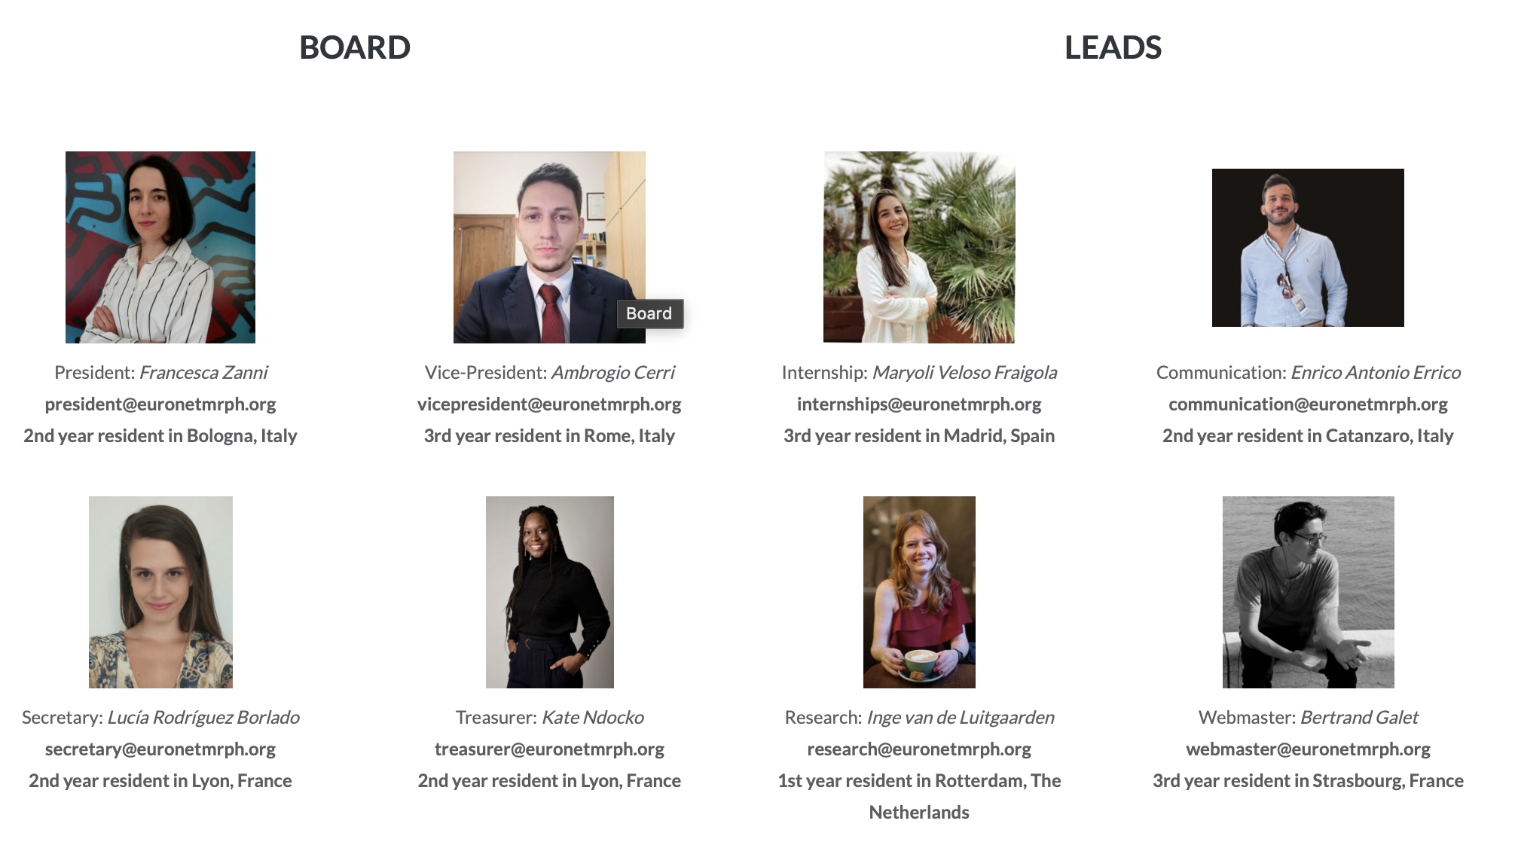
EuroNET Board/Leads
Elected at Winter Meeting
Currently 4 Lead roles (can vary):
Research
Internships
Communication
Website
Voting is 1 vote per national organisation as set out in statutes
Lots of links to external partners:

Slide 10
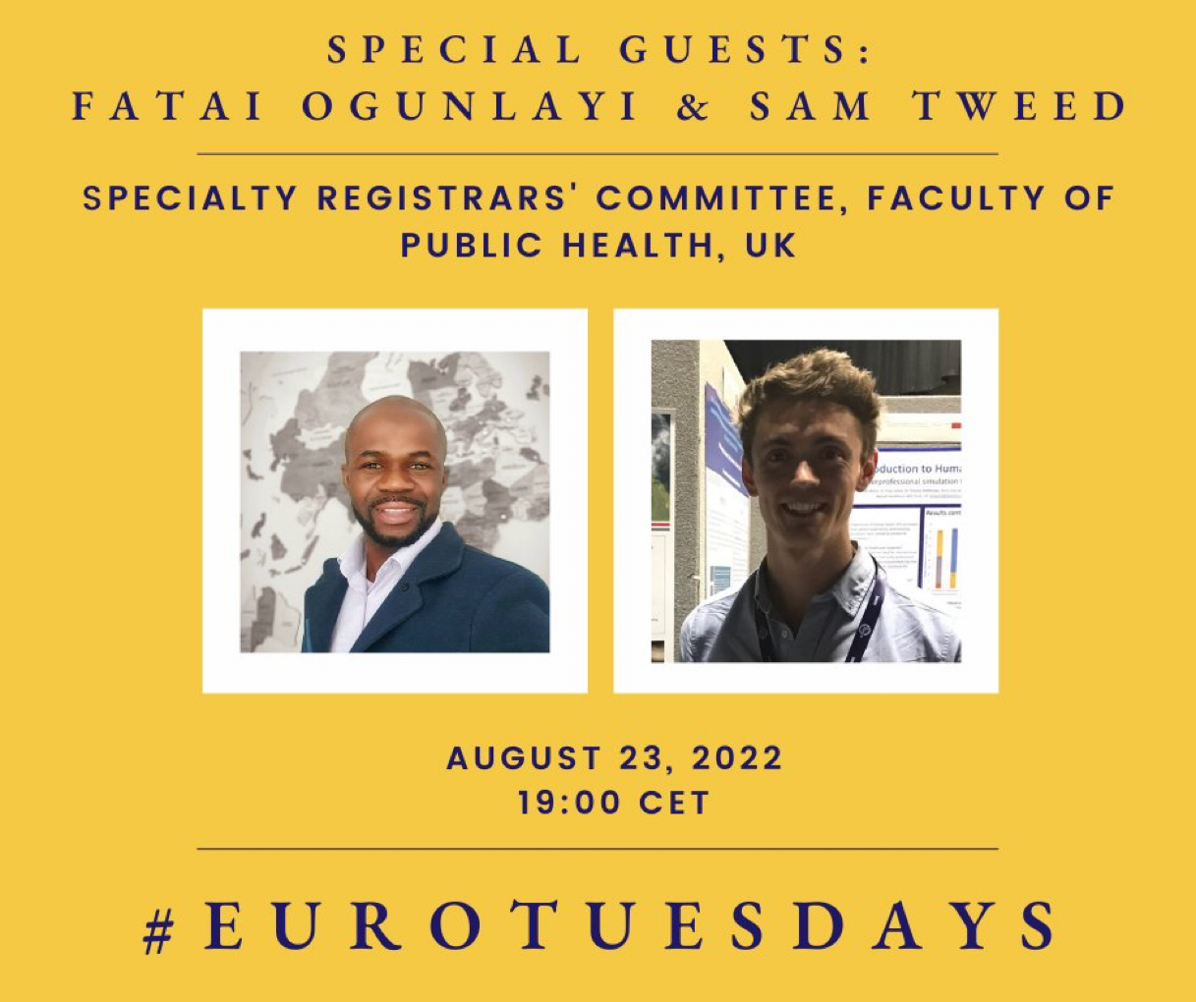
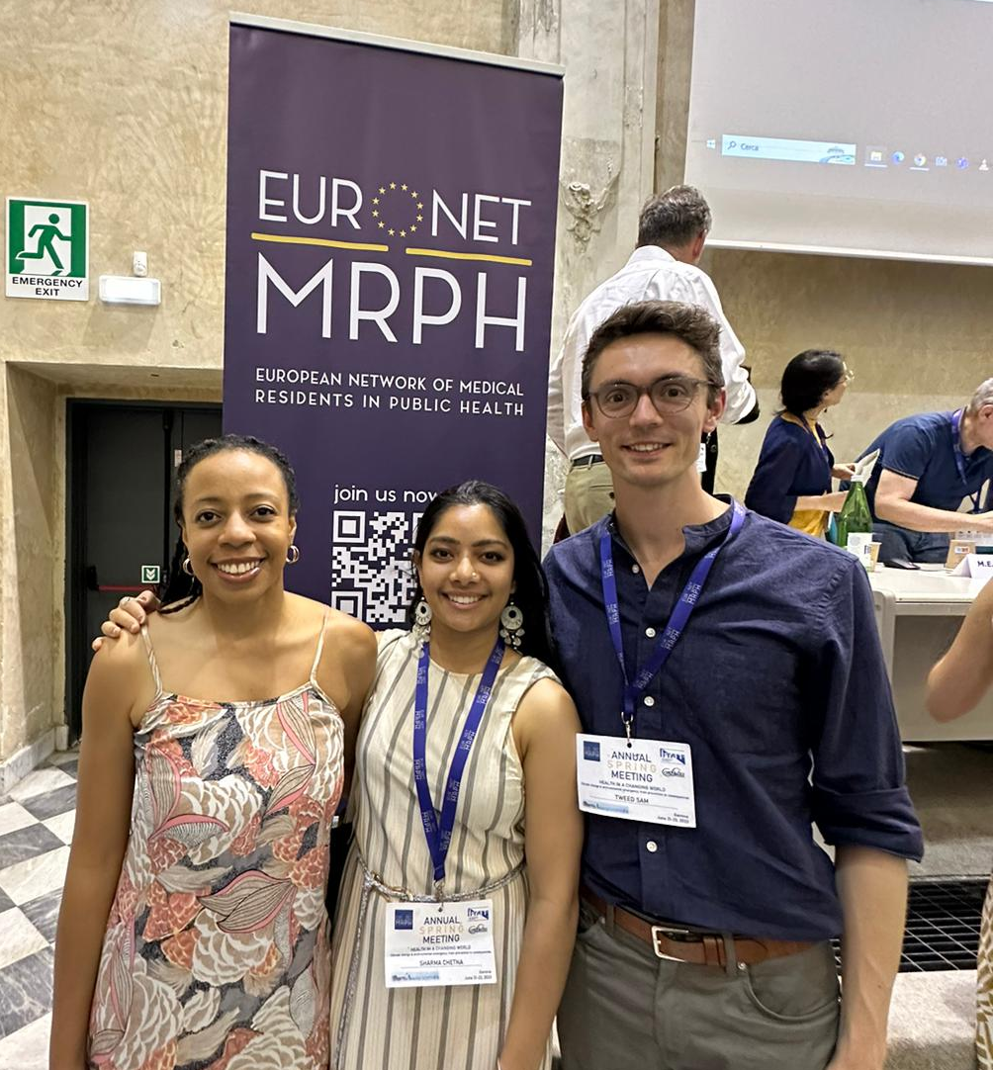
UK Involvement in EuroNET
Specialty Registrars’ Committee of UK Faculty of Public Health is the national representative for UK - SRC member designated as EuroNET lead
Has been a active member of network since establishment, previously hosted meetings, had board members/president a UK-based registrar
Dormant for a few years (esp with remote working/pandemic/Bre*it)
Spring Meeting 2022 Lyon + online meetings with board/SRC in July 2022
UK SRC presented UK training programme in August 2022 at webinar
Contributed to statements on war in Ukraine, Reproductive rights
Working on Internships/Placements
Open meetings including on Irish Public Health training programme
Spring Meeting 2023 Genoa, Italy
euronetmrphuk@gmail.com

Slide 11
Recent Meeting:
EuroNET Spring Meeting: 21-23 June 2023
Genoa, Italy
Theme: Climate Change & Public Health
Over 250 Public Health Registrars
Representing 9 countries
European Scientific Contest:
Poster & Oral Presentations

Slide 12
Conference Theme: Health in a Changing World
This conference was an opportunity to explore future public health challenges in a changing world, including environmental degradation, mental illnesses, emerging infectious diseases, migration, climate change communication in public health, and global inequities in the face of the climate crisis.
Through our plenary sessions, workshops, and debates, we also discussed possible ways forward and the frameworks that might guide Public Health in that direction, including One Health and Circular Health.

Slide 13
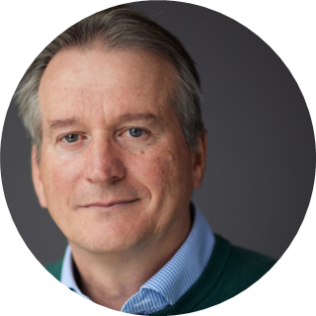
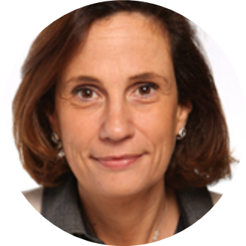
Speakers
Speaker's list included: Miles Carroll, Professor of Emerging Viruses at University of Oxford, Deputy Director of Head of Research and Development at UKHSA; Dr Tammy Boyce, Senior Researcher at Institute of Health Equity, UCL; Ilaria Capua, Virologist, former Italian Politician, director of One Health Center of Excellence, University of Florida.

Slide 14
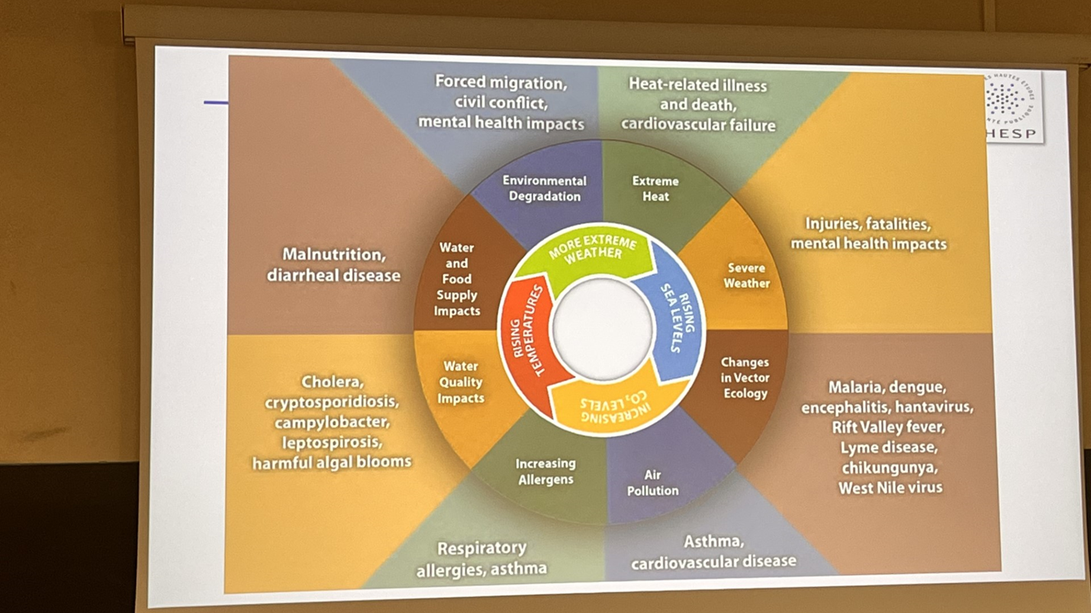
Conference key findings: Climate Change is a present health emergency

Slide 15
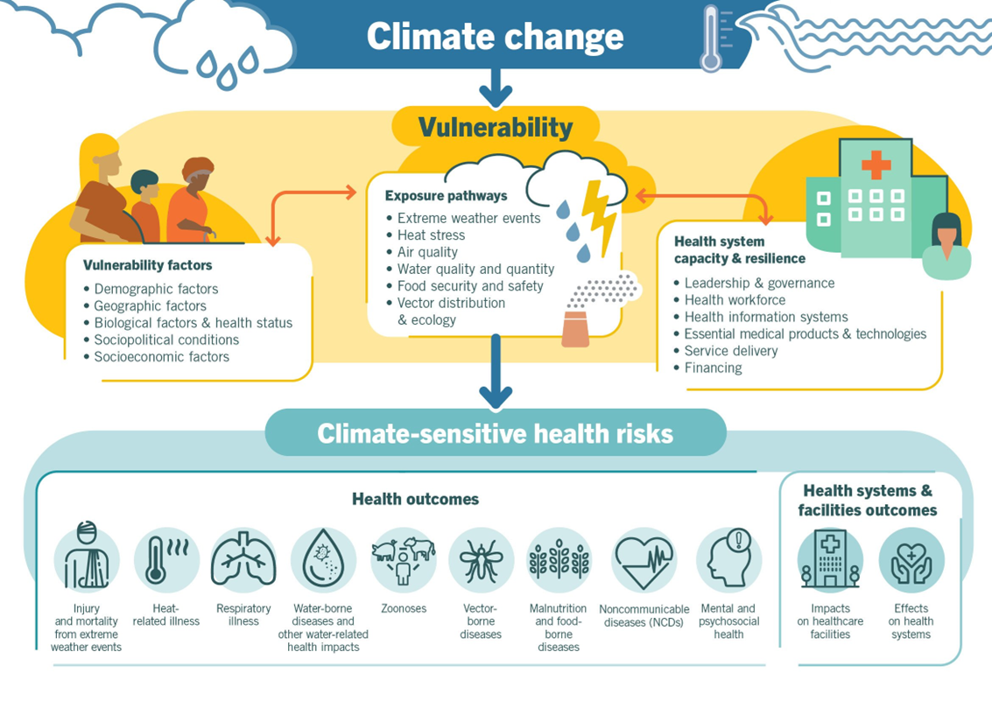
Conference key findings: Climate Change is widening health inequalities

Slide 16
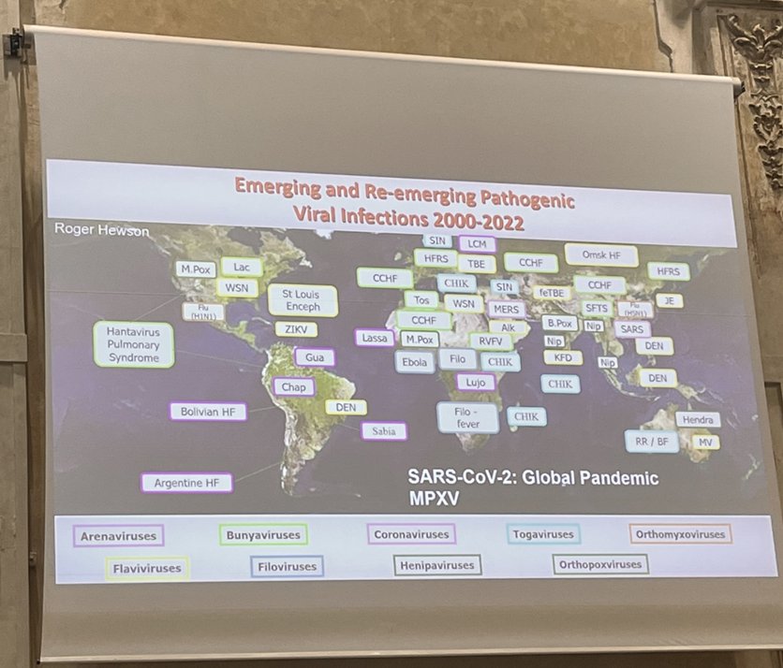
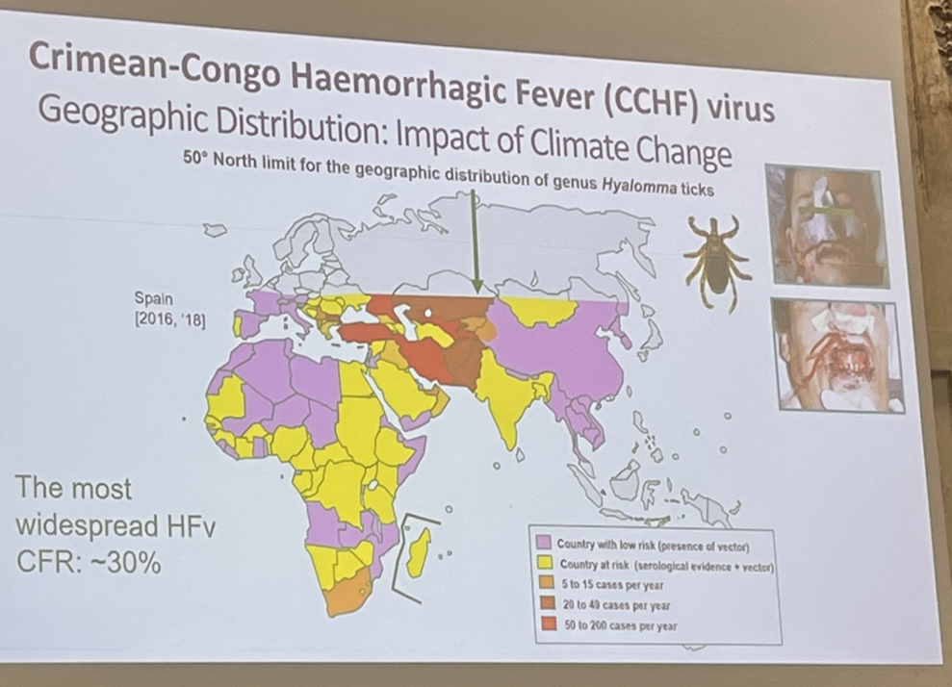
Conference key findings: Climate change is impacting emerging diseases and changing vector ecology

Slide 17
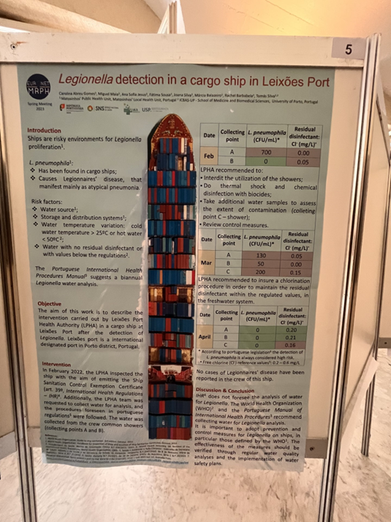
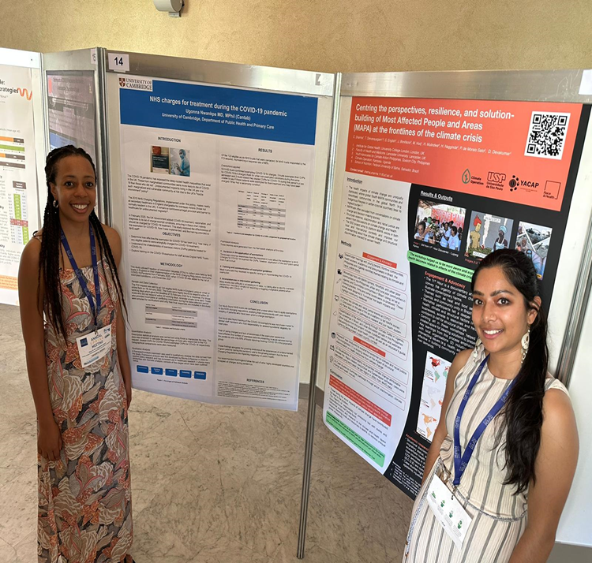
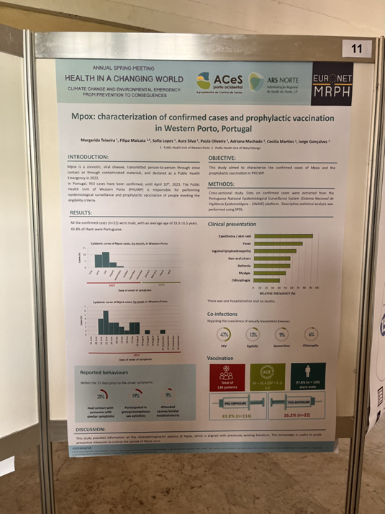
Poster Presentations: An opportunity to learn and share research and interventions

Slide 18
Upcoming meetings: EUPHA 2023 Pre-conference (Dublin)

Slide 19
Workplan for 2022-23
Where are we going? | How will we get there? | How are we doing?
Establish a functional National Commission for EuroNet in UK (approx 5-10 members) + link person(s) with EuroNET leads on internships/ communications/research | Expressions of interest from this meeting/wider networks | NC established and linked to wider EuroNET Board - Sam, Ugonna, João, Vicki, Hadjer
Develop internship links with view towards placements for registrars in UK + for UK registrars in member countries | 1. Led by Hadjer Nacer & Martin McKee’s group (open to having European residents placed there) 2. Work with GH placements group/FPH committees | Work ongoing, supportive in principle. Loss of Erasmus scheme is a challenge.
Increase attendance and engagement of UK registrars in EuroNET meetings (online + in person) | Whatsapp group/social media for advertising | Going ok so far - increased attendance at monthly webinars 8 participants interested in Genova Meeting
Develop communications/profile of EuroNET amongst UK public health registrars | Set up social media/chat groups etc Update UK webpage on EuroNET website Update FPH website? | Communicating via SRC Glasscubes and Registrar Google group at present. Whatsapp groups for NC and conferences.
Side event/meet up for UK registrars/ other European colleagues at European conferences | EPH Berlin meet up in Nov 2022 / networking at ESCAIDE | Successful meet up in European Public Health conference, linked up registrars at ESCAIDE, World Congress in Rome 2023

Slide 20
Global Health Placements & Projects
Survey completed in 2022 mapped global-focussed placements:
36 placements collated, full list: https://www.fph.org.uk/training-careers/specialty-training/training-placements/overseas-placements /
Usually 6 months, some 12 months
Variety of organisations: WHO, MSF, UKHSA Global Ops, projects with academic teams
Variety of topics
Usually nationally advertised, in-programme
Some self-funded/stipend and self-organised OOPE
Some only available to specific deaneries
Working group currently developing guidance/good practice for global health placements to:
Improve visibility of global health placements and opportunities for trainees
Facilitate the availability of more global health placements for trainees
Improve equity of uptake of global health placements both within and between regions
Connect with other public health colleagues globally
To join contact Stef Gissing on stefanie.gissing@nhs.net
Next up….Projects!

Slide 21
Project opportunity
Developing a fundraising strategy and investment cases in support of Africa CDC public health priorities
We would like to offer experience of resource mobilization and building investment cases for public health programmes to SpR/Ts working in global health who require to address their financial competences for FPH training programme. The person will work with an experienced resource mobilisation lead and the CEO of APHF providing Public Health expertise to develop the resource mobilisation strategy in support of these flagship programmes.
We are offering a short, remotely delivered project to meet high-level finance and strategic planning competences.
1. Support the development of APHF’s resource mobilization plan and investment cases for these flagship programmes.
Deliverables: 1. Resource mobilisation plan 2. Investment cases for the 5 flagship initiatives
2. Publish OpEd and research papers on the process and lessons learned (jointed ly APHF and Africa CDC
Deliverables: 1. OpEd on the process for developing the investment cases 2. Publication in one professional journal
Project location and supervision
The work will be delivered remotely with the SpR/T remaining under a UK training placement eg in UKHSA GPH or FCDO.
Project supervisor will be Dr Ebere Okereke, FFPH who is the CEO of APHF. The SpR/T will remain under the training and educational supervision of their current Educational Supervisor.
This is not a secondment or OOPT and should be delivered as activity under a UKHSA GPH placement.
Requirements:
An internet-enabled laptop with access to MS teams.
Access to WhatsApp for communication
You may be required to sign confidentiality agreements if access to sensitive material is required.
Timing:
As soon as possible, from Late September 2023, so no more than 3 months, working 2 – 3 days per week remotely.
To apply contact: eokereke@aphf.africa

Slide 22
Other networks:
FPH is a member of WFPHA, has early career/young WFPHA group
Young WFPHA website | Instagram | Young WFPHA sign up form
ASPHER - focusses on public health education and training
Keen to have registrars involved https://www.aspher.org/
EUPHA organises EPH conference (Dublin, November 2023)
EUPHAnxt is student/young professional group https://eupha.org/euphanxt
Topic sections particularly good for networking
Notes:
EUPHA meeting - participation gage

Slide 23
What’s next?
Attend Monthly webinars (Eurotuesdays) + conference
Planning to run educational sessions for UK registrars on European Public Health
Pre-EUPHA Meeting in Dublin
Join mailing list/membership on website: https://euronetmrph.org/membership/
Social Media: follow EuroNET MRPH on Instagram/Twitter
Join EuroNET MRPH Telegram Group
Are you interested in getting more involved?
Support us with comms/website/internships/research
New national commission in Oct 2023
Email interest to euronetmrphuk@gmail.com
First UK Euronet meeting end of October 2023
Any questions?
What would you like to see from our engagement in EuroNET and other networks?
Share your ideas and vision too
euronetmrphuk@gmail.com

Slide 24
Any questions?
What else would you like to see from engagement with EuroNet and other networks?
ⓘ
Notes:
📣 This is Slido interaction slide, please don't delete it. ✅ Click on 'Present with Slido' and the questions from your audience will appear when you get to this slide.

