Slide 1
Tackling ethnic health inequalities through London's public sector partnership
OHID London

Slide 2

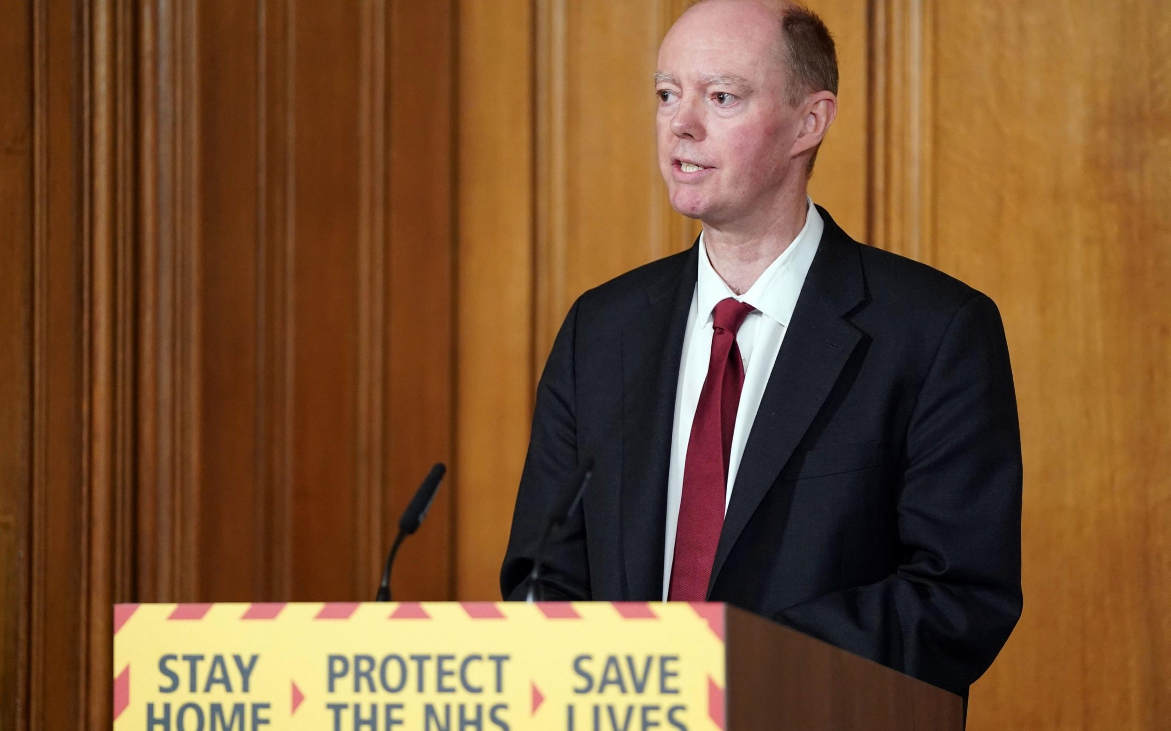

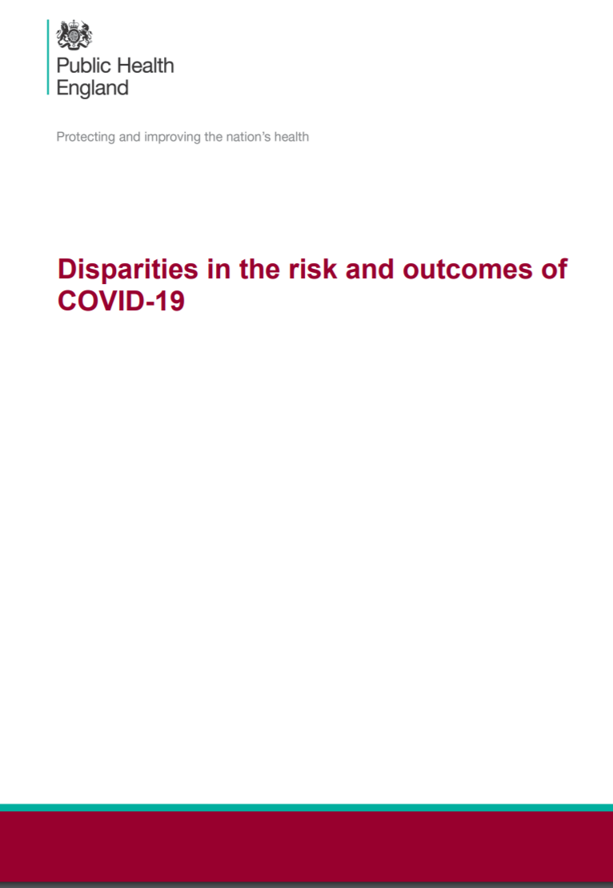



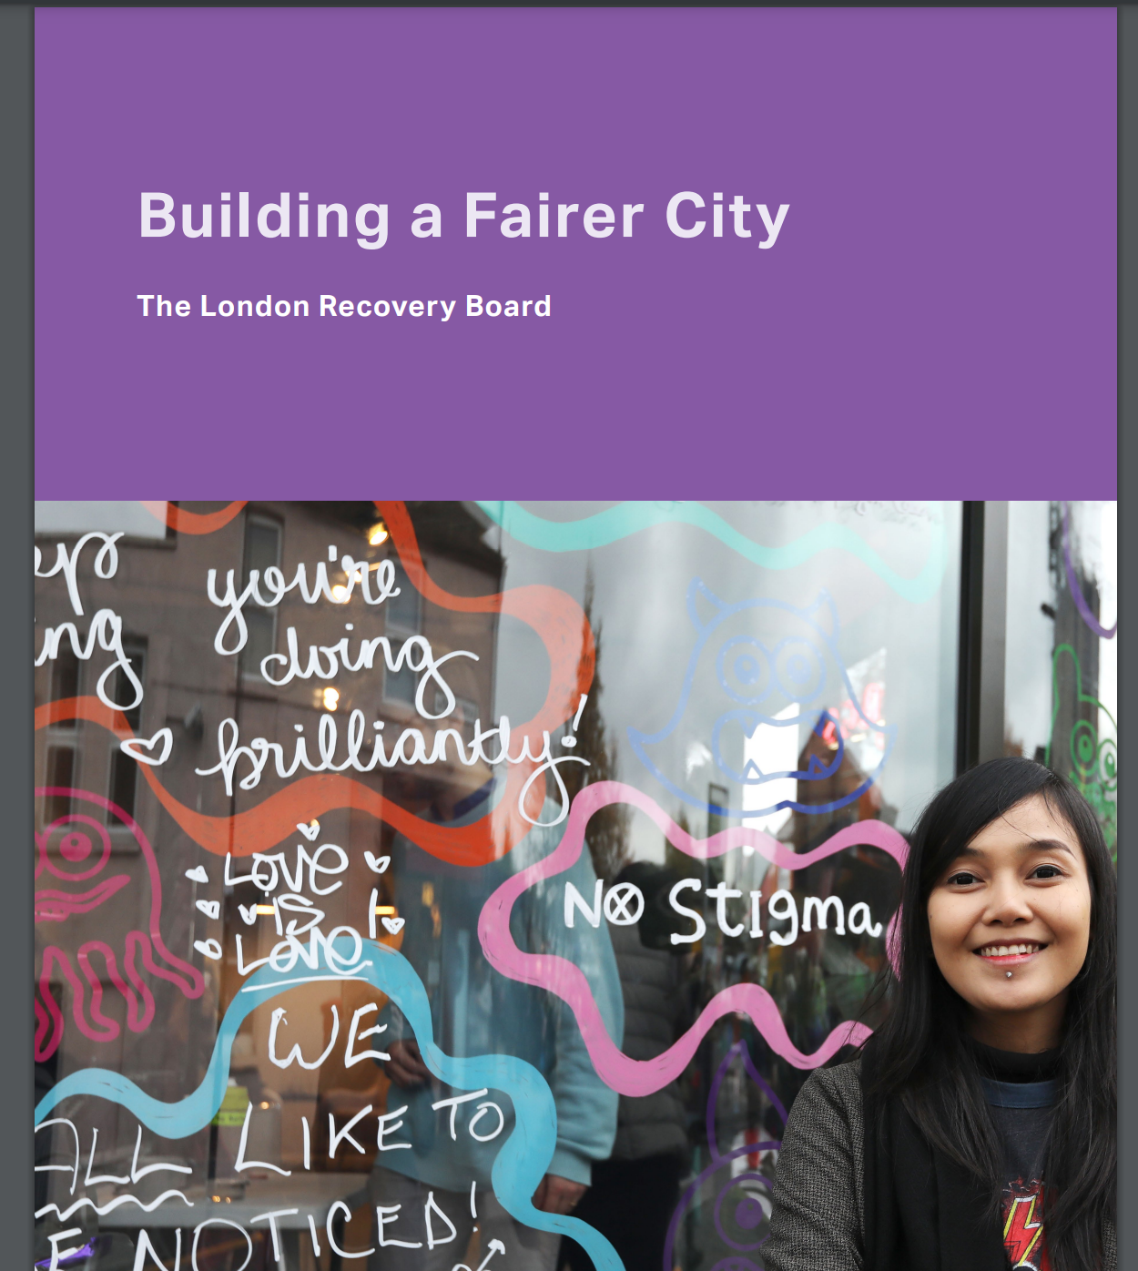




How Did We Get Here
April 20:
CMO Commissions PHE to investigate COVID-19 ethnic disparities
June 20:
PHE publishes Disparities and Beyond the Data
April 21: NHS race and Health observatory formally established
2022: Health and care partners collaborate and share their actions
May-June 2020:
Death of George Floyd and global BLM protests
April- May 20: PHE Epidemiological review and 4,000 stakeholders engaged
May 20:
NHS Race and Health Observatory announced
February 21: ADPH highlights racism as a public health issue in their position statement
June 21: Beyond the Data One Year On report and Event
Strategic London commitment

Slide 3
Addressing ethnic health disparities through AN anti-racism approach
Racism is a driver of the social determinants of health, and therefore of health inequalities. Though social determinants are universal, racism is one of a range of driving forces that exists in our societies that acts on these determinants. Anti-racism will progress our work towards race equity, but action on social determinants, culturally competent interventions to target community and behavioural risk factors and improve healthcare access are also key to addressing racialised health inequalities.
Race Equity is the ultimate ambition in our efforts to address racism, and racial disparities in outcomes. Race equity is when the distribution of opportunities and disadvantage is not dependent on race. In the health and care sector, this would manifest as comparable health outcomes between different ethnic groups, because the current disproportionate impacts is not due to biological differences, it is due to environmental and societal influences.
Conceptualising racism integrated with the social determinants of health. Adapted from Dahlgren and Whitehead, 1993
From: Yip and De Souza Thomas: Beyond the conversation about race | Better Health For All
Ref: Dahlgren and Whitehead: The Dahlgren-Whitehead model of health determinants: 30 years on and still chasing rainbows. Public Health Volume 199, October 2021, Pages 20-24

Slide 4






Anti-racism in London health and care system
Addressing ethnic health disparities through anti-racism approach
Evidence and data
Institute of Health Equity evidence reviews
Working with IHE, GLA, NHS and partners to deliver a range of evidence reviews incl. on structural racism with data companion pack
A literature review on anti-racist interventions:
Working with UCL partners to identify what works in anti-racism to provide evidence base for strategic approach
Improving ethnicity data
Supporting NHS and OHID colleagues to understand and improve validity of ethnicity data in routine datasets
Strategy and Partnerships
Tackling racism is part of a commitment in the London Health Inequalities strategy and Building a Fairer City
Working with partners, we have built on enthusiasm, need and ongoing work to develop:
Strategic approach to anti-racism in health and care sector in London, which asks organisations to make 5 commitments:
Leadership public commitment
Commitment to support ethnic minority workforce
Commitment to tackle racism as part of health equity programmes
Commitment to anchor institution principles to address wider determinants
Commitment to work with our communities to amplify their voice in the decision, design and delivery of services, to rebuild confidence and trust
Implementing Change
Coproduction and community participation is at the heart of health equity work.
Anti-racism practice learning hub
We have secured £200K (£150K partnership and £50K GLA) funding to develop a learning hub, led by a race equity organisation
Race Equality Foundation (REF) appointed a partner to develop governance and processes, using the IHE review and the strategic framework to test approaches
Delivery phase to be commissioned for Q1 23.
Learning hub will have community voice, communication and learning at the heart of its work:
Advises, advocates on how to embed communities in decisions, design, delivery and evaluation of services.

Slide 5





Leadership commitment: to being anti-racist health and care systems and organisations, with Board representation, strategy development and anti-racist approach to all policies.
Workforce Commitment: to support our ethnic minority staff and create enabling workplaces.
Governance
Our Vision
Our organisations oppose all forms of racism and will actively work to dismantle racist and discriminatory policies and practices across all of health and care and work towards race equity.
Data
Commitment to target health equity: to prioritise and deliver evidence informed, culturally competent interventions to narrow the gap, by reducing inequities people from ethnic minority groups face in access, uptake, experiences and outcomes of our health and care services
Commitment to becoming an anchor institution: to leverage our positions as anchor institutions to tackle the wider determinants of racial health inequalities.
Partnerships
Commitment to our local communities: to work with our communities to amplify their voices, in the decision, design and delivery of services, to rebuild trust and confidence
The 5 strategic commitments
Notes:
This will be linked to theory of change and work on implementation

Slide 6
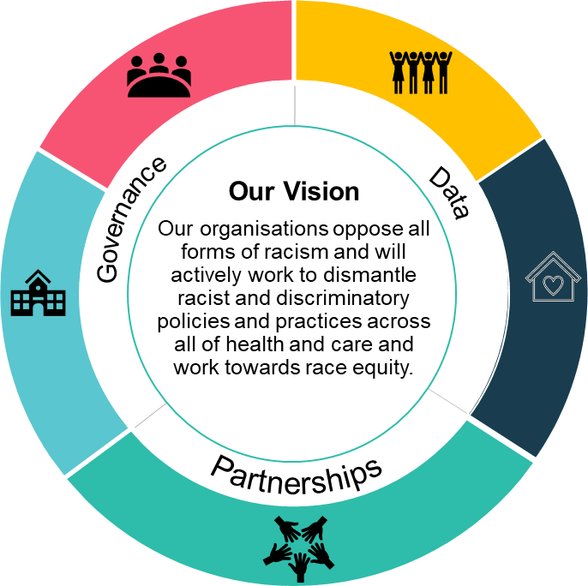
London’s strategic approach to Anti-racism
1. Leadership
4. Becoming Anchor institutions
Public commitment to being an anti-racist organisation with actions
Board-level review of strategy and monitoring objectives indicators
Assure anti-racist approach in all policies
Address wider determinants of health through anchor actions
Support education, employment and opportunities to reduce structural determinants of ethnic health inequalities
2. Workforce
5. Working with communities
Monitor and act on ethnic inequities in recruitment, well-being and promotion
Provide training and support to address cultural bias and discrimination
Implement and monitor robust equality, diversity and inclusion policies
Include community voice in decisions, design and delivery of services though participation in governance, funding and integrated delivery structures
Embed co-production
Supporting community groups with resources – funding and training to allow meaningful participation
3. Health Equity programmes
Embed anti-racist lens on health programmes
Data-led insights to prioritise areas of work with community groups to improve health and healthcare access
Integrated and personalised care that is culturally competent.
London Health and Care Partnership: London Anti-Racism Collaboration for Health (LARCH) – London Health and Care Partnership (transformationpartnersinhealthandcare.nhs.uk)
Notes:
What to do about it: London Framework for tackling structural racism as a framework for social care to apply to tackle systemic inequalities.
Speaker’s notes:
The London Anti-Racism Collaboration for Health (LARCH) is being developed as part of a commitment identified in both the London Health Inequalities Strategy and the Building a Fairer City plan for London and has been welcomed by the London Leaders and the London Health Board. LARCH has established a strategic framework with partners from across the London health and care network asking for commitment at all levels to tackle ethnic health inequalities through an anti-racist approach.

Slide 7
