Slide 1
Performance of polygenic risk scores in screening, individual risk prediction and population risk stratification
Cardiovascular Disease
Aroon Hingorani
University College London
FPH Registrar Conference, London, September 2023

Slide 2
Cardiovascular risk prediction – three key facts
FACT | CONSEQUENCE
Cardiovascular disease affects 1 in 3 people | Sufficiently common to justify preventative measures (if safe and affordable) in everyone
Cardiovascular risk factors are weak predictors: age is the most influential | Risk models based on multiple weak predictors will also be weak predictors
Statins and blood pressure lowering medicines are now inexpensive and have been proven to be safe | Justifies offering statins and blood pressure lowering medicines to everyone beyond a certain age, regardless of estimated cardiovascular risk
Wald and Law, BMJ, 2003
Wald et al., BMJ, 1999
Wald et al., J Med Screen, 2005
Hingorani and Hemingway, BMJ, 2011
Notes:
STATINS AND BLOOD PRESSURE LOWERING MEDICINES ARE EFFECTIVE, SAFE, AFFORDABLE, AND CONVENIENT
– JUSTIFIES THEIR USE IN EVERYONE BEYOND A CERTAIN AGE REGARDLESS OF ESTIMATED CVD RISK.

Slide 3
Will polygenic risk scores herald a transformation in disease prediction and prevention?
Claimed improvement in:
screening
risk prediction
risk stratification
Khera et al., Nat Genetics, 2018
Knowles and Ashley, PLoS Med, 2018
Lambert et al., Hum Mol Genet, 2019
Genomics PLC, White Paper, 2019
Riveros-Mackay et al., Circ Genom Prec Med, 2021
Mujwara et al., JAHA, 2022
Genome UK: the future of healthcare - GOV.UK
Allelica | Polygenic Risk Score. https://www.allelica.com/ (accessed June 5, 2022)
Notes:
AGAINST THIS BACK DROP, SOME STRIDENT CLAIMS HAVE BEEN MADE THAT POLYGENIC RISK CORES ARE SET TO TRANSFORM HEALTHCARE

Slide 4
Will polygenic risk scores herald a transformation in disease prediction and prevention?
Claims have been overstated in respect to:
screening
risk prediction
risk stratification
Khera et al., Nat Genetics, 2018
Knowles and Ashley, PLoS Med, 2018
Lambert et al., Hum Mol Genet, 2019
Genomics PLC, White Paper, 2019
Riveros-Mackay et al., Circ Genom Prec Med, 2021
Mujwara et al., JAHA, 2022
Genome UK: the future of healthcare - GOV.UK
Allelica | Polygenic Risk Score. https://www.allelica.com/ (accessed June 5, 2022)
Wald and Old, Genetics in Medicine, 2019
Sud et al., npj Precision Oncology, 2021
Groenendyk et al., JAMA Internal Medicine, 2022
Sud et al., BMJ, 2023
Huntley et al., Lancet Oncology, 2023
Notes:
YET, RECENTLY, OTHERS HAVE VOICED CONCERNS THAT THE PERFORMANCE AND ROLE OF POLYGENIC RISK SCORES IN DISESASE PREDICTION AND PREVENTION HAVE BEEN OVERSTATED.

Slide 5
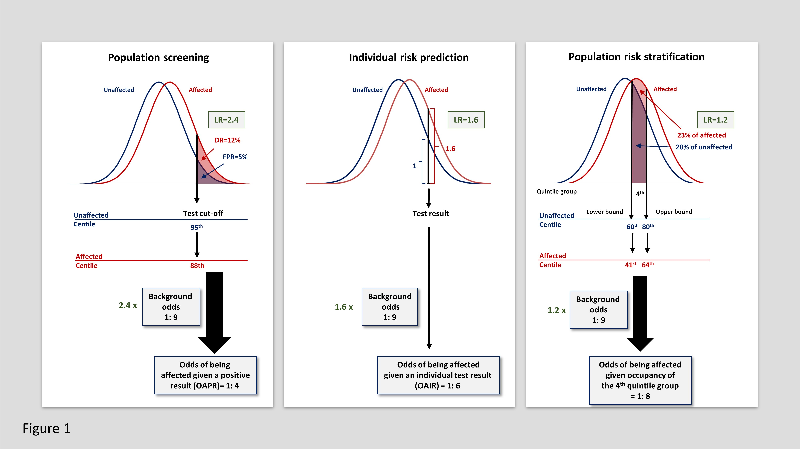

Slide 8
Polygenic Score Catalog
Lambert SA, et al. The Polygenic Score Catalog as an open database for reproducibility and systematic evaluation. Nat. Genet. 2021.
Reported performance metrics | n | Median value of reported performance metric [IQR]
Odds ratio per SD | 1216 | 1.31 [1.12; 1.56]
Hazard ratio per SD | 378 | 1.28 [1.18; 1.45]
AUC | 2077 | 0.65 [0.6; 0.73]
C-index | 244 | 0.71 [0.64; 0.76]
As of April 2022
Derive metrics relevant for evaluation of
performance in screening, individual risk prediction and risk stratification
Hingorani AD, Gratton J, Finan C, .. Wald NJ. Performance of polygenic risk scores in screening, prediction, and risk stratification. medRxiv, 2022
Notes:
UNFORTUNATELY, FEW IF ANY PRIMARY RESEARCH PUBLICATIONS NOR THE COMPREHENSIVE POLYGENIC RISK SCORE CATALOG REPORT THESE METRICS.
THE METRICS REPORTED ARE THE OR OR HR PER SD OR THE AUC
HOWEVER, THE RELEVANT METRICS CAN BE DERIVED MATHEMATICALLY FROM ANY OF THOSE REPORTED IN THE PGS CATALOG AS WE HAVE SHOWN IN A RECENT PRE-PRINT.
THIS ALLOWS US TO EVALUATE POLYGENIC RISK SCORE PERFORMANCE USING THE APPROPRIATE METRICS,
ALLOWS COMPARISON BETWEEN POLYGENIC RISK SCORES ON THE SAME SCALE,
AND ALLOWS BENCHMARKING OF THE PERFORMANCE OF POLYGENIC RISK SCORES AGAINST NON-GENETIC TESTS.

Slide 9
PERFORMANCE IN SCREENING

Slide 10
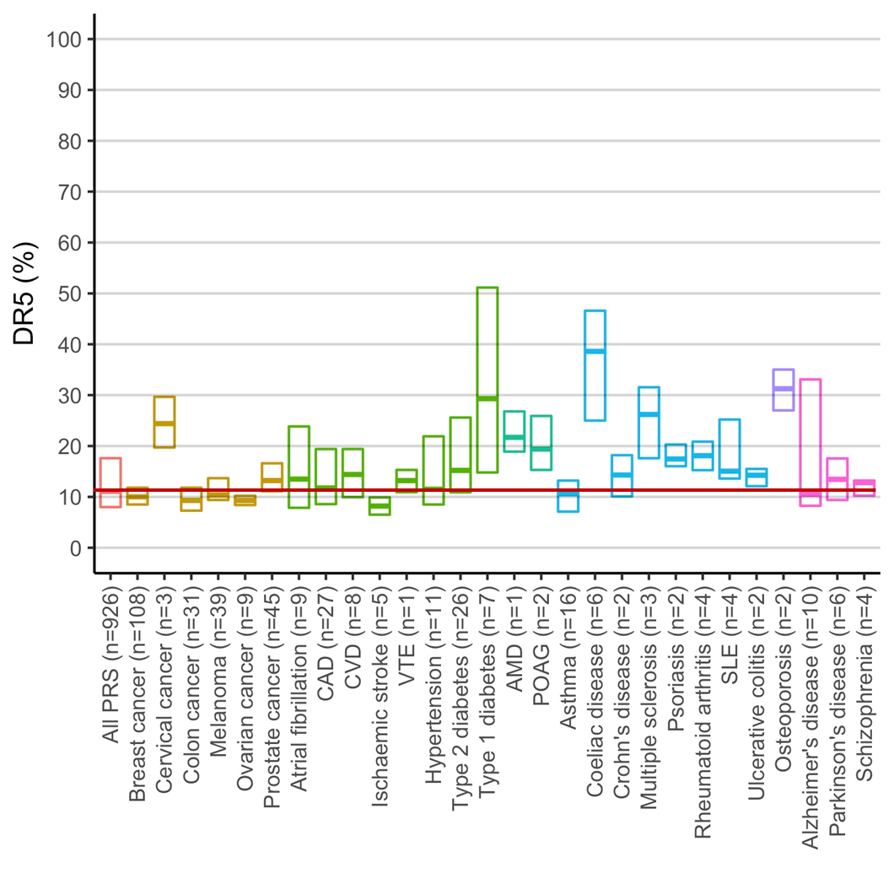
Performance in screening estimated for polygenic risk scores included in the PGS Catalog as of April 2022
All PRS
median DR5 = 11%
Hingorani AD, Gratton J, Finan C, et al. Performance of polygenic risk scores in screening, prediction, and risk stratification. medRxiv, 2022
Notes:
EXAMINING ALL 926 POLYGENIC RISK SCORES IN THE PGS CATALOG (REPORTED AS OF APRIL 2022), THE MEDIAN DR5 VALUE (THE DETECTION RATE FOR A 5% FPR) WAS JUST 11%.

Slide 11
Performance in screening estimated for polygenic risk scores included in the PGS Catalog as of April 2022
Coronary artery disease
median DR5 = 12%
Notes:
FOR CORONARY ARTERY DISEASE, THE DR5 WAS 12%.
THIS MEANS FOR A 5% FPR, 12% OF THOSE AFFECTED ARE DETECTED, BUT 88% ARE MISSED.

Slide 12
Negligible impact of ‘improved’ polygenic risk scores
for coronary artery disease
CAD polygenic score | AUC value | DR5 (%) | Cases missed (%)
Elliot, JAMA 2021 | 0.598 | 10 | 90
Khera, Nat Genetics, 2018 | 0.615 | 11 | 89
Abraham, JACC 2018 | 0.618 | 11 | 89
Riveros-Mackay, Circ Genom Prec Med, 2021 | 0.633 | 12 | 88
Notes:
… OR THE PROPORTION OF CASES MISSED..
SHOWS THE ‘IMPROVEMENT’ IN SCREENING IS NEGLIGIBLE.

Slide 13
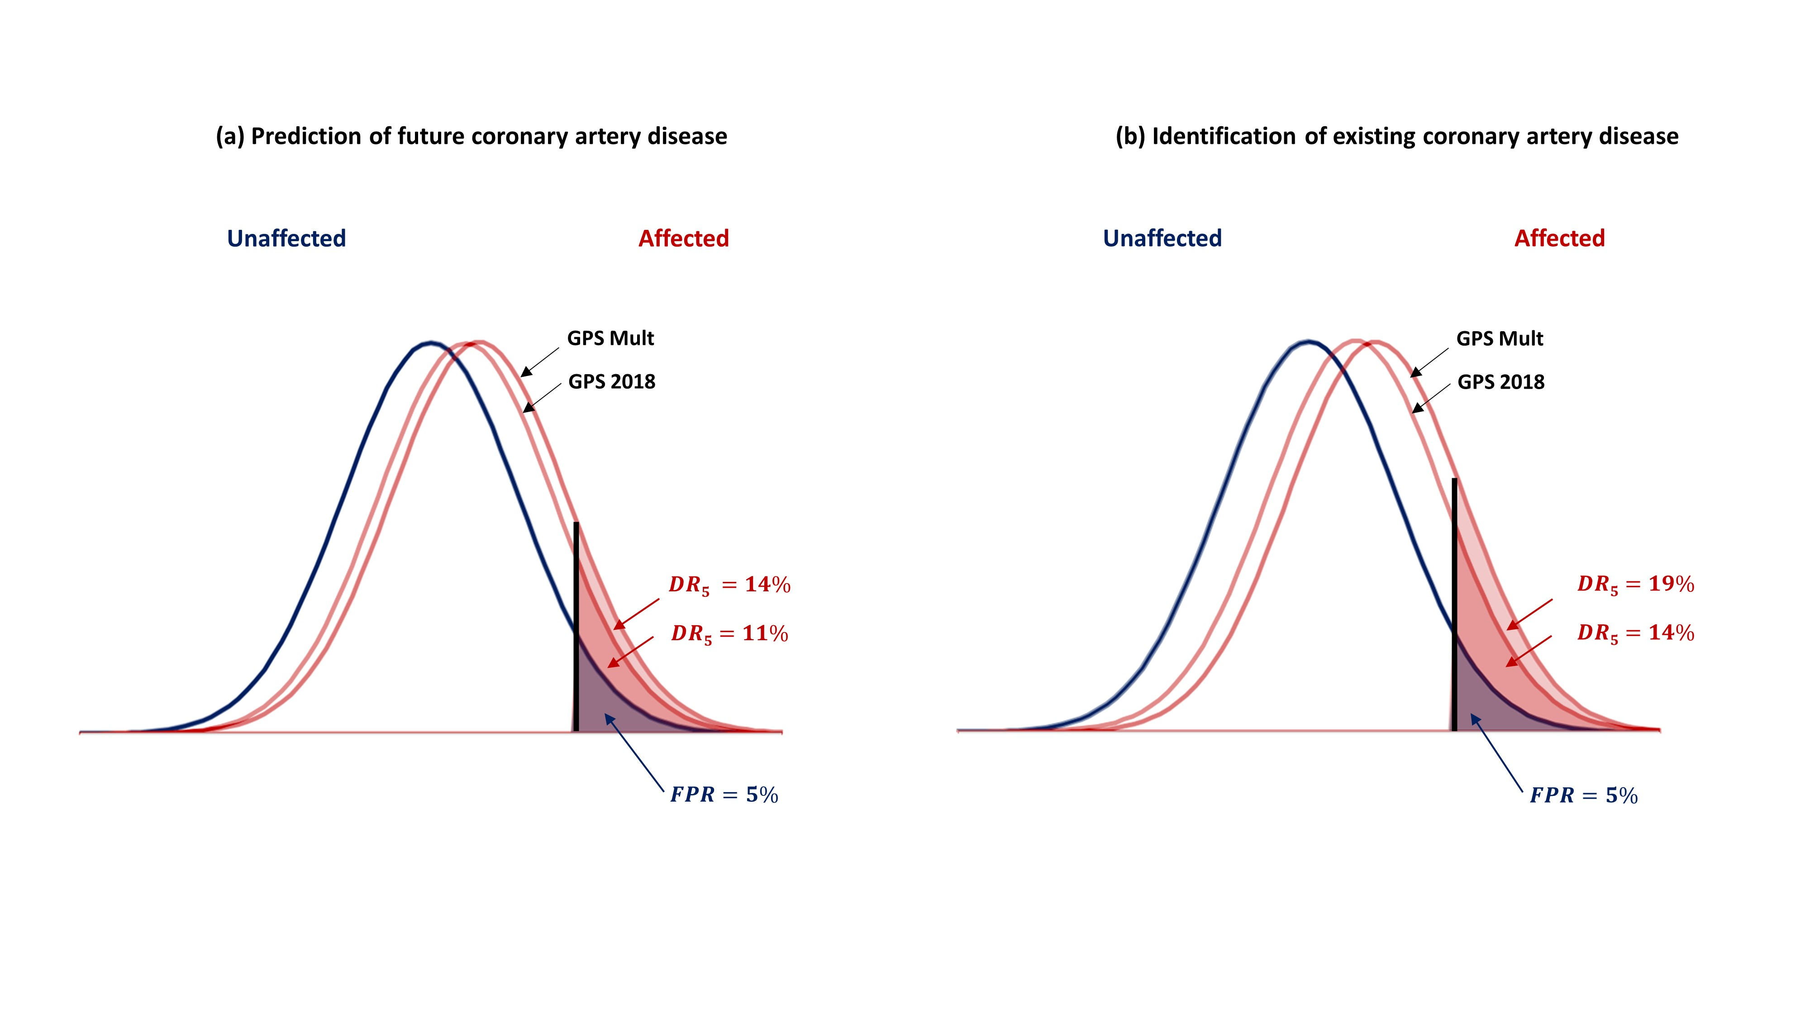
An ‘improved’ polygenic risk score for coronary artery disease
Calculated using data from: Patel, A.P., Wang, M., Ruan, Y. et al. A multi-ancestry polygenic risk score improves risk prediction for coronary artery disease. Nat Med 29, 1793–1803 (2023). https://doi.org/10.1038/s41591-023-02429-x

Slide 14
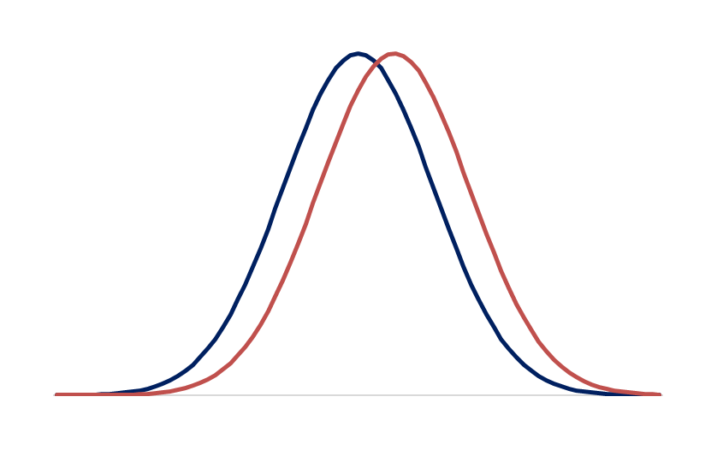
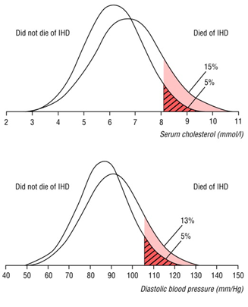
Polygenic risk scores perform ‘about as well as conventional risk factors’
Unaffected
Affected
Cholesterol
DR=12%
FPR=5%
Diastolic blood pressure
‘Polygenic risk scores perform
about as well as conventional risk factors’
BUT conventional risk factors are
poor screening tests
Wald and Law, BMJ, 2003
Notes:
BUT CONVENTIONAL RISK FACTORS (DESPITE BEING CAUSAL) ARE POOR SCREENING TESTS, SO THIS IS SIMPLY TO BENCHMARKING ONE POOR SCREENING TEST AGAINST ANOTHER.

Slide 15
Screening performance of a typical PRS for coronary artery disease
DR5=12%
10,000 people
10-year CAD incidence = 10%
Unaffected
Affected
 | Affected | Unaffected
Test positive | 120 | 450 | 570
Test negative | 880 | 8550 | 9430
 | 1000 | 9000 | 10,000
OAPR= 1: 4
DR=12%
FPR=5%
Odds= 1:9
0.48 SD
LR x background odds = OAPR
2.4 x 1: 9 = 2.4: 9
OAPR = 1: 4
LR= 12/5 = 2.4
Notes:
THE RATIO OF THE DR / FPR GIVES THE LR
LR MULTIPLED BY THE BACKGROUND ODDS GIVES THE OAPR

Slide 16
PERFORMANCE IN INDIVIDUAL RISK PREDICTION

Slide 17
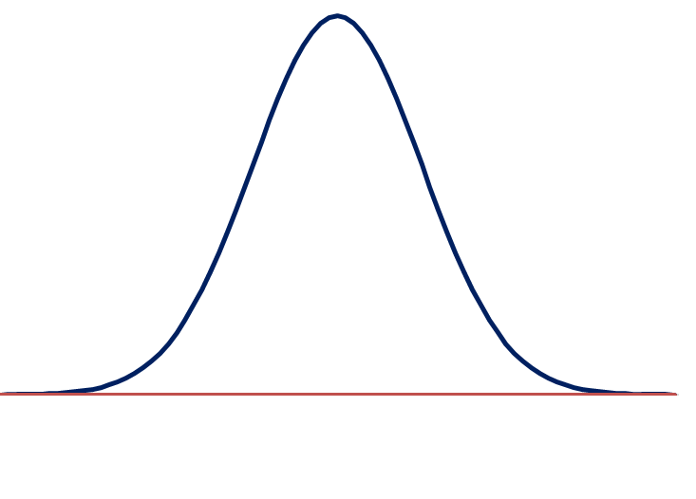
Interpreting an individual polygenic score result - CAD
90th centile
Notes:
INTERPRETATION OF A POLYGENIC RISK SCORE RESULT FOR AN INDIVIDUAL.
SOME COMPANIES ARE OR ARE AIMING TO PROVIDE SUCH INFORMATION TO CONSUMERS.
SOME MATERIALS INDICATE A PERSON’S POLYGENIC RISK SCORE IN RELATION TO THE POPULATION DISTRIBUTION,

Slide 18
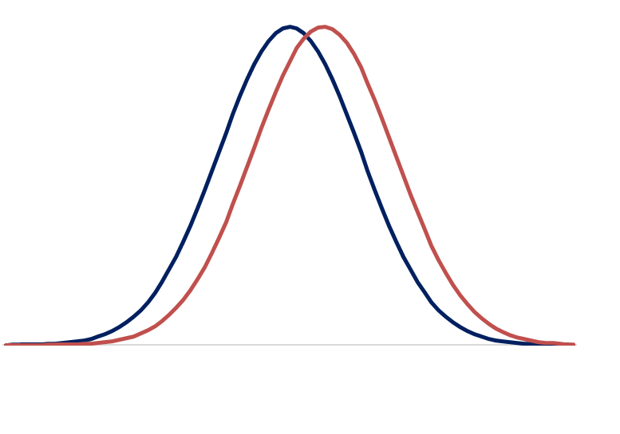
Interpreting an individual polygenic score result - CAD
90th centile
0.48SD
Notes:
HOWEVER, THE RELEVANT METRIC IS THE INDIVIDUAL’S ABSOLUTE RISK OR ODDSS ARISING GIVEN THE POLYGENIC SCORE RESULT.
FOR THIS WE NEED THE PRS DISTRIBUTIONS FOR AFFECTED AND UNAFFECTED INDIVIDUALS SEPARATELY.

Slide 19
Interpreting an individual polygenic score result - CAD
LR=1.64
1.64
1
90th centile
Notes:
GIVEN THE PRS RESULT, IN THIS CASE AT THE 90TH CENTILE FOR THE UNAFFECTED DISTRIBUTION, WE CAN CALCULATE THE LR AS THE RATIO OF THE HEIGHTS (RATHER THAN AREAS) OF THE TWO CURVES AT THIS POINT, WHICH IN THIS CASE GIVES A LR OF 1.64

Slide 20
Interpreting an individual polygenic score result - CAD
LR=1.64
Background odds
1: 9
1.64: 9
1: 6
1.64 x
Odds of being affected given a polygenic risk score result
at the unaffected 90th centile
=1: 6
1.64
1
90th centile
Notes:
AS BEFORE THE LR PROVIDES THE CORRECT MULTIPLIER FOR THE BACKGROUND ODDS OF DISEASE (IN THIS EXAMPLE 1: 9) TO GIVE THE ODDS OF BEING AFFECTED GIVEN THE INDIVIDUAL PRS RESULT.
IN THIS CASE THE ODDS INCREASES FROM 1: 9 TO 1: 6..

Slide 21
Interpreting an individual polygenic score result - CAD
2.5th
25th
75th
97.5th
LR=0.4
LR=0.7
LR=1.2
LR=2.3
1: 23
1: 13
1: 8
1: 4
10-year CAD incidence = 10%
Background odds = 1: 9
Notes:
CHANGES ARE BIGGER FOR THOSE WITH MORE EXTREME VALUES.
FOR EXAMPLE THE ODDS FOR AN INDIVIDUAL WITH A PRS AT THE UNAFFECTED 97.5TH CENTILE IS 1: 4

Slide 22
Genome-wide polygenic scores for common diseases identify individuals with risk equivalent to monogenic mutations
‘the empirical risk of coronary artery disease rising sharply in the right tail of the distribution’
Khera et al., Nat Genetics, 2018
Notes:
THIS HAS LED SOME AUTHORS TO FOCUS ON RISK IN THE TAILS OF THE DISTRIBUTION.
FOR EXAMPLE, IN A PAPER IN NATURE GENETICS IN 2018 WHICH REINVIGORATED INTEREST IN POLYGENIC RISK SCORES, THE AUTHORS HEADLINE WAS THAT POLYGENIC RISK SCORES FOR CORONARY ARTERY DISEASE IDENTIFY INDIVIDUALS WITH A RISK EQUIVALENT TO A MONOGENIC MUTATION (IN THIS CASE MONOGENIC MUTATIONS THAT CAUSE FH).
FOR EXAMPLE, THEY SHOWED THAT THOSE IN THE TOP 2.3% OF THE PRS DISTRIBUTION FOR CAD HAD A RISK 4-FOLD HIGHER THAN THE REST OF THE POPULATION.
RISK IN PEOPLE WITH AN FH MUTATION AT A YOUNG AGE IS IN FACT MUCH HIGHER THAN THIS.

Slide 23
Prevalence of CAD by PRS centile
GPS ₂₀₁₈
GPS _{Mult}
Patel, A.P., Wang, M., Ruan, Y. et al. A multi-ancestry polygenic risk score improves risk prediction for coronary artery disease. Nat Med 29, 1793–1803 (2023). https://doi.org/10.1038/s41591-023-02429-x

Slide 24
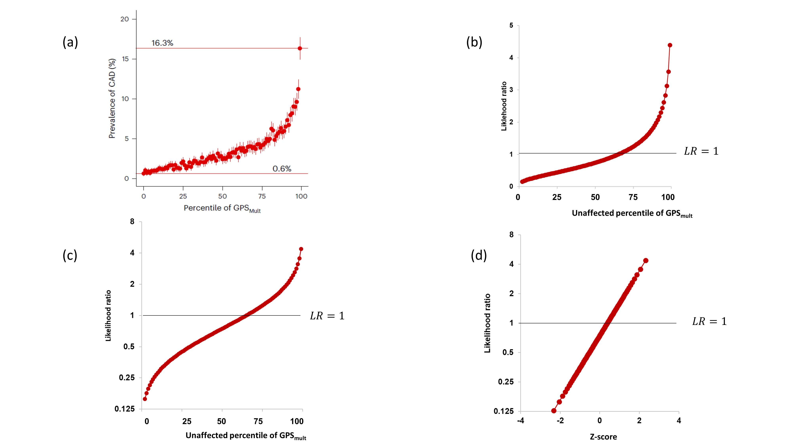
The tails of the PRS distribution are simply the ends of a continuum
Reported
Derived - LR
Derived – LR log scale
Derived – LR log scale and Z-score

Slide 25
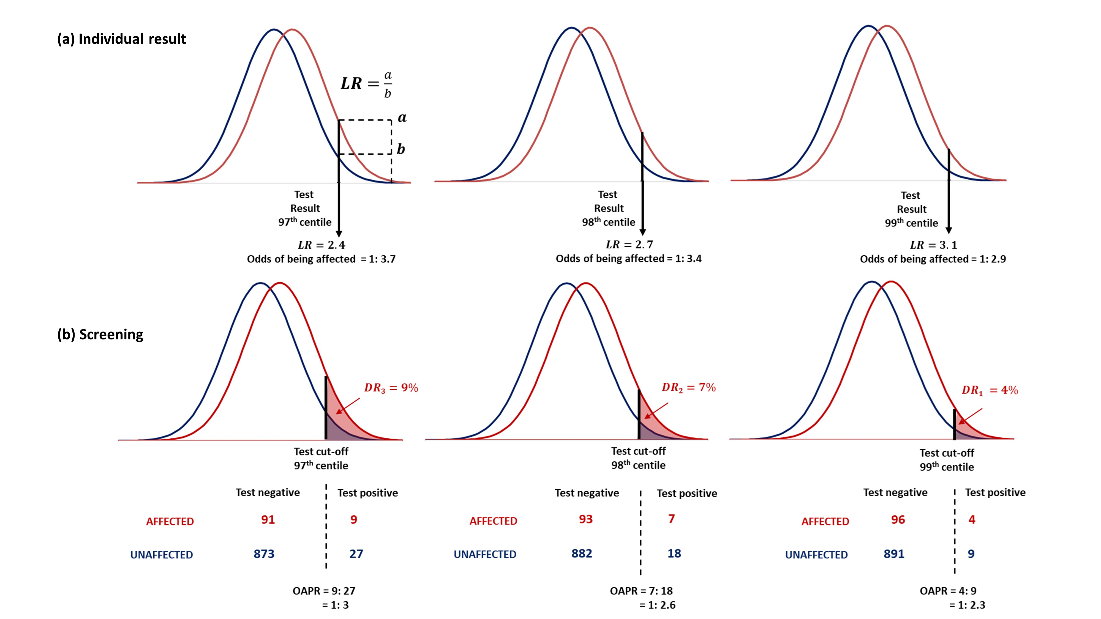
97th
98th
99th

Slide 26
PERFORMANCE IN RISK STRATIFICATION

Slide 27
Polygenic risk stratification for coronary artery disease
Quintile group
1
2
3
4
5
LR
0.5
0.7
0.9
1.2
1.8
100,000 people
Background odds 1:9
10,000 CAD events
Difference in means 0.48SD
EVENTS
938
1390
1790
2308
3574
ODDS
1:19
1:13
1:10
1:8
1:5
Notes:
IN THIS EXAMPLE, I’VE USED THE SAME PRS FOR CAD BUT DIVIDED THE POPULATION INTO 5THS BASED ON THE UNAFFECTED DISTRIBUTION.
THE GRAPH SHOWS THE LR RATIO, 10-YEAR ODDS AND THE NUMBER OF EVENTS FOR A HYPOTHETICAL POPULATION OF 100,000 PEOPLE WITH A BACKGROUND ODDS OF CAD OF 1: 9
WHILE THERE IS A GRADIENT OF RISK, IT IS NOT SO SUBSTANTIAL THAT THE UPPER 5TH OF THE DISTRIBUTION WOULD BE TREATED ANY DIFFERENTLY FROM THE MIDDLE OR SECOND FIFTH.
.. SOME HAVE ARGUED THAT PRS WOULD NOT BE USED ALONE BUT INTEGRATED WITH OTHER CAD RISK FACTORS IN A MULTIVARIATE RISK MODEL
.. SO HOW DO MULTIVARIABLE MODELS THAT COMBINE WEAK RISK FACTORD PERFORM?

Slide 28
INTEGRATING PRS WITH OTHER RISK FACTORS

Slide 29
Integrating PRS for cardiovascular disease with other risk factors
Population screened (CVD events) | Risk assessment | Risk cut-off | DR (%) | FPR (%) | Offered statin | CVD events above cut-off | Events prevented
100,000 (7997) | Conventional risk factors | 10% 10-year risk | 60 | 24 | 26,722 | 4783 | 957
 | Conventional risk factors +PRS | 10% 10-year risk | 61 | 23 | 26,445 | 4870 | 974
+87
+17
Sun et al., Polygenic risk scores in cardiovascular risk prediction: A cohort study and modelling analyses. PLoS Med, 2021
Number needed
to genotype
(detection)
= 1149
Number needed
to genotype
(prevention)
= 5882
Notes:
ASSUMING ALL THOSE OFFERED A STATIN TAKE IT AND THAT STATINS REDUCE CVD EVENTS BY 20%, THE MODEL WITH THE PRS WITH PREVENT AN ADDITIONAL 17 EVENTS GIVING A NUMBER NEEDED TO GENOTYPE TO PREVENT ONE ADDITIONAL EVENT OF 5882.
THE 10-YEAR NNT IS 27

Slide 30
Integrating PRS for cardiovascular disease with other risk factors
Population screened (CVD events) | Risk assessment | Risk cut-off | DR (%) | FPR (%) | Offered statin | CVD events above cut-off | Events prevented
100,000 (7997) | Conventional risk factors | 10% 10-year risk | 60 | 24 | 26,722 | 4783 | 957
 | Conventional risk factors +PRS | 10% 10-year risk | 61 | 23 | 26,445 | 4870 | 974
 | Population prevention | Age>40 | 100 | 92 | 100,000 | 7997 | 1600
Number needed
to genotype
= 0
Notes:
BUT CONSIDER AN ALTERNATIVE APPROACH.
THE AVERAGE 10-YEAR BASELINE RISK IN THIS COHORT IS 8% (JUST UNDER THE RISK THRESHOLD CURRENTLY RECOMMENDED BY NICE FOR STATIN PRESCRIPTION AND JUST OVER THAT RECOMMENDED BY US GUIDELINES.
IF ALL 100,000 WERE OFFERED A STATIN (IN EFFECT USING AGE AS THE RISK CUT OFF) 1600 EVENTS WOULD BE PREVENTED. THE DETECTION RATE WOULD BE 100% BUT THE FPR WOULD BE 92% BUT THIS IS NOT AN ISSUE BECAUSE STATINS ARE SAFE AND INEXPENSIVE. THE NNG IS 0, AND THE 10-YEAR NNT IS 63.

Slide 31
Polygenic risk scores and cardiovascular disease - conclusions
Polygenic risk scores perform poorly in population screening, individual risk prediction, and population risk stratification, whether used alone or conjunction with conventional risk factors.
Wider use of safe and inexpensive cholesterol and blood pressure lowering drugs (and less prediction) would make a greater impact on the population burden of cardiovascular disease.
The present analysis should help avoid unjustified expectations about the role of polygenic risk scores in predicting and preventing cardiovascular disease in the general population.
A later talk will consider prospects for using polygenic risk scores in the clinical setting.

Slide 32
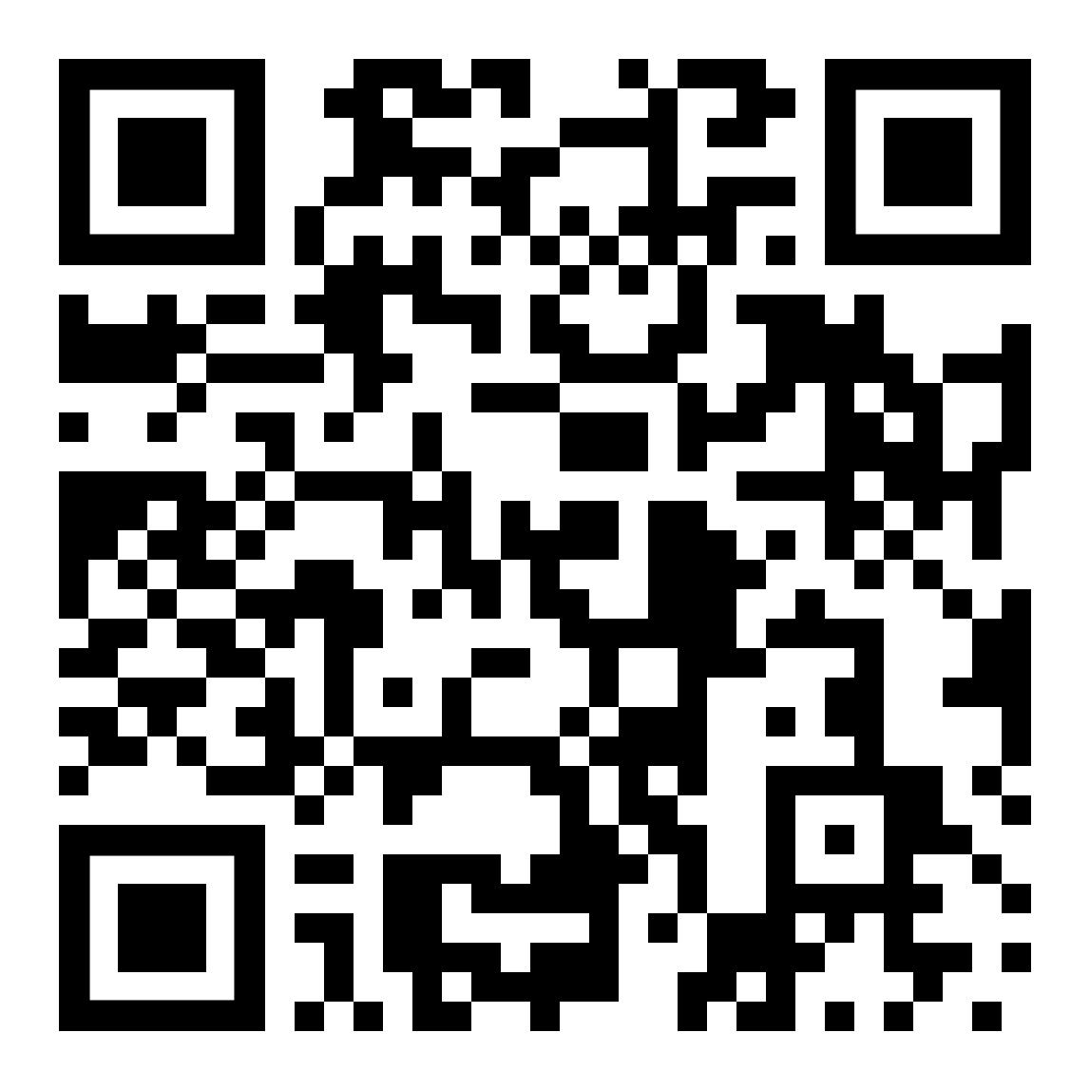
Performance of polygenic risk scores in screening, prediction, and risk stratification
Hingorani AD., FMedSci^{1,2,3,4}, Gratton J., PhD^{1, 2}, Finan C., PhD^{1,2,3,4}, Schmidt AF., PhD^{1,2,3,4,5}, Patel R., PhD^{1,2,3,4}., Sofat R., PhD^{3,4,6}, Kuan V., PhD^{1,2,3}, Langenberg C., PhD⁷, Hemingway H., FMedSci^{2,3,4,8}, Morris JK., PhD⁹, Wald NJ., FRS^{8,9}
https://www.medrxiv.org/content/10.1101/2022.02.18.22271049v2
BMJ Medicine, In Press

Slide 33
Reserve slides

Slide 34
Integrating PRS for cardiovascular disease with other risk factors
Population screened (CVD events) | Risk assessment | Risk cut-off | DR (%) | FPR (%) | Offered statin | CVD events above cut-off | Events prevented
186,451 (4247) | QRISK3 | 10% 10-year risk | 81 | 42 | 79,754 | 3450 | 690
 | QRISK3+PRS | 10% 10-year risk | 84 | 41 | 78,092 | 3557 | 711
+107
+21
Riveros-Mackay et al., Integrated Polygenic Tool substantially enhances coronary artery disease prediction. Circ Genom Prec Med, 2021
Number needed
to genotype
(detection)
= 1743
Number needed
to genotype
(prevention)
= 8879

Slide 35
Non-genetic screening tests and polygenic scores
Disease | Status of screening in UK | Non-genetic test |  |  |  | Polygenic score
 |  |  | Cut-off | DR | FPR | Reported performance | DR | FPR
Cervical cancer | Offered to women aged 25-49 very 3 years and women aged 50-64 every 5 years. | Cervical smear testing for high-risk HPV subtypes | PCR positive | 88 | 21 | AUC=0.547 | 7 | 5
Breast cancer | Offered to women from age 50 to their 71st birthday | Mammography | Malignancy score | 75 | 8 | OR per SD=1.61 | 12 | 5
Colon cancer | Offered to men and women aged 60-74 every 2 years. Also a one-off scope at age 55 in some parts of UK. | Faecal immunochemical test (FIT) | 10µg/g | 79 | 6 | OR per SD=1.22 | 7 | 5
Type 2 diabetes | Screening for type 2 diabetes is not currently recommended by UK National Screening Committee† | Leicester Risk Assessment Score | ≥25 | 29 | 11 | AUC=0.69 | 17 | 5
Prostate cancer | Screening for prostate cancer using PSA is not currently recommended by UK National Screening Committee | Prostate-specific antigen | 4ng/mL | 21 | 9 | AUC=0.66 | 15 | 5
Hingorani AD, Gratton J et al., (In preparation)

Slide 36
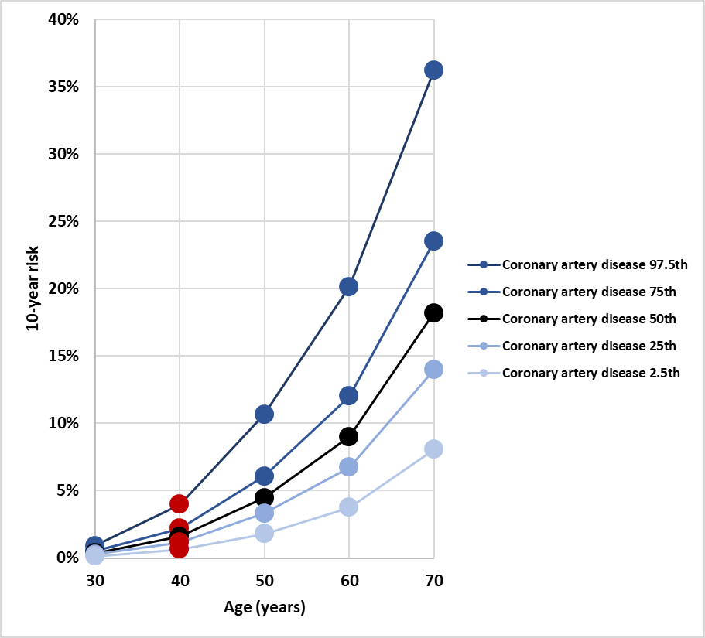
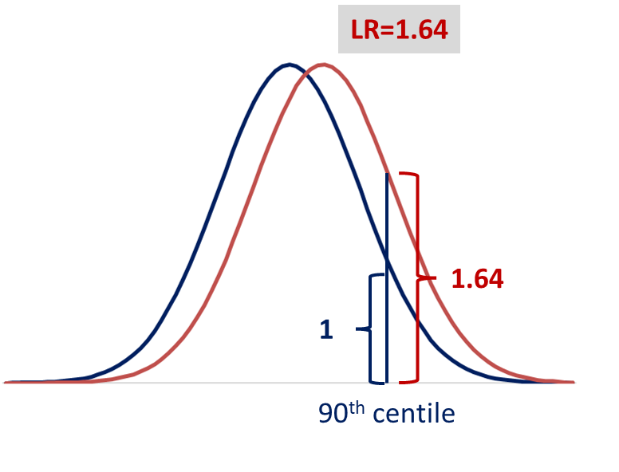
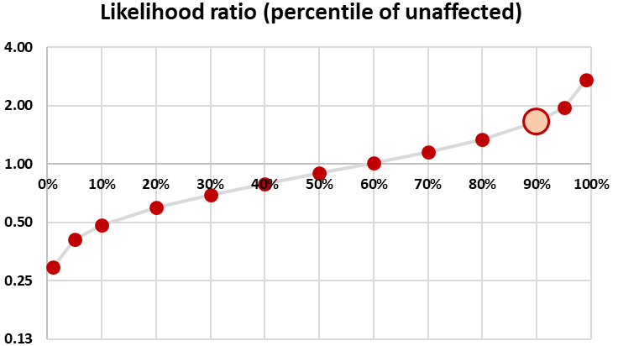
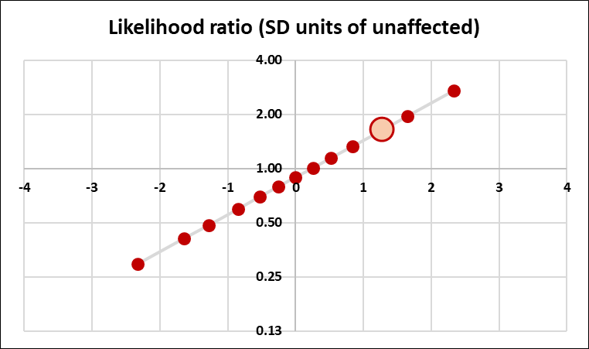
Four depictions of the same polygenic risk score for coronary artery disease
(a)
(b)
(c)
(d)

Slide 37
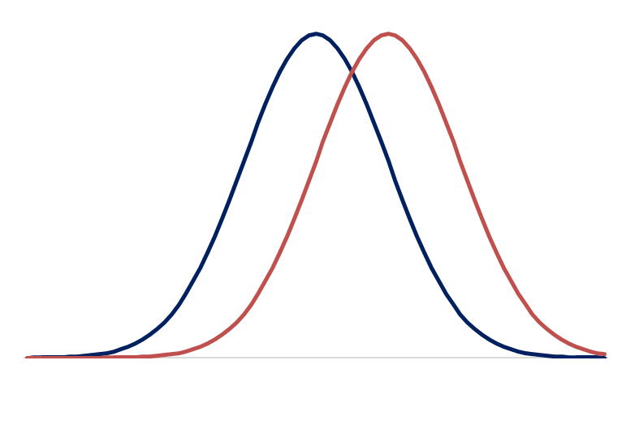
Evaluation of polygenic risk score performance in screening
Unaffected
Affected
1SD
Hingorani AD, Gratton J, Finan C, .. Wald NJ. Performance of polygenic risk scores in screening, prediction, and risk stratification. medRxiv, 2022
Notes:
POLYGENIC RISK SCORES HAVE A GAUSSIAN DISTRIBUTION.
THE RISK SCORE DISTRIBUTION AMONG THOSE LATER AFFECTED IS SHIFTED TO THE RIGHT.
BOTH DISTRIBUTIONS HAVE THE SAME SD
THERFORE THE PERFORMANCE OF POLYGENIC RISK SCORES IN ANY OF THEIR INTENDED APPLICATIONS IS DETERMINED BY THE DIFFERENCE IN THE MEAN VALUES OF THE POLYGENIC RISK SCORE BETWEEN THOSE AFFECTED OR NOT.
CONSIDER A POLYGENIC RISK SCORE WHERE THE MEAN OF THE DISTRIBUTION AMONG THE AFFECTED IS 1 SD TO THE RIGHT OF THOSE WHO REMAIN UNAFFECTED.

Slide 38
Evaluation of polygenic risk score performance in screening
DR5=26%
Detection rate = 26%
Unaffected
Affected
Test cut-off
False positive rate= 5%
Notes:
IF WE SET THE TEST CUT OFF TO GIVE A 5% FPR, THE DETECTION RATE IS 26%.
WE REFER TO THE DR FOR A 5% FPR AS THE DR5.
AS THE GRAPH SHOWS THERE IS A TRADE OFF BETWEEN THE DR AND FPR: A HIGHER DR IS ACCOMPANIUED BY A HIGHER FPR AND VICE VERSA.
THIS IS A HYPOTHETICAL EXAMPLE, WHAT ABOUT PERFORMANCE IN PRACTICE

