Slide 1
Omics and Precision Public Health Population Genomic Screening
Clare Turnbull, PhD FRCP FRCPath MFPH MSc (Epidemiology)
Professor in Translational Cancer Genetics, Institute of Cancer Research
NHS Consultant in Clinical Genetics (Honorary), Royal Marsden NHS Foundation Trust
Consultant in Public Health Medicine (Honorary), NDRS (NHS Digital/NHSE)
FPH Meeting Sept 2023

Slide 2
Financial Disclosures
Scientific Advisory Boards/ Educational Activities:
Astra Zeneca, Guardant, Roche
All monies donated to charity

Slide 3
OVERVIEW
Current applications of germline genomics in health
Future (proposed) applications of germline genomics in health
Principles of population screening
Newborn Whole Genome Sequencing
Population polygenic risk profiling (PRS)
Conclusions

Slide 4
Current applications of germline genomics in health
Diagnosis in patients with features of rare disease; management of immediate family
Small gene panels (hereditary breast-ovarian cancer)
Large gene panels (retinitis pigmentosa)
Whole exomes/genomes
Agnostic approach
Rapid service for acutely unwell neonates
Single gene tests (NF1, CDH1, TP53)
Very specific phenotype (NF1)
Test with caution, ie when problematic management implications (CDH1, TP53)
Though in USA/commercial gene panels widely included

Slide 5
Four horsemen of Genotype-Phenotype Prediction
1) Variable expressivity (burden of modifiers)
2) Biased Ascertainment
3) Variant-specific risks
4) Variant Interpretation

Slide 6
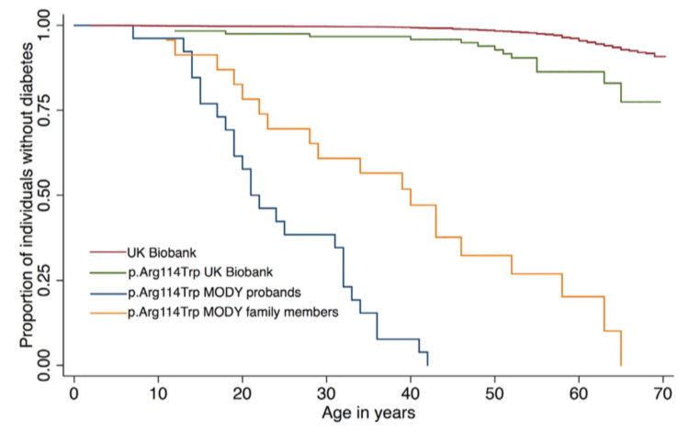
Variable Expressivity/Ascertainment bias
Mirshahi et al AHJG 2022 .

Slide 7
Four horsemen of Genotype-Phenotype Prediction
1) Variable expressivity (burden of modifiers)
2) Biased Ascertainment
3) Variant-specific risks
4) Variant Interpretation

Slide 8
OVERVIEW
Current applications of germline genomics in health
Future (proposed) applications of germline genomics in health
Principles of population screening
Newborn Whole Genome Sequencing
Population polygenic risk profiling (PRS)
Conclusions

Slide 9
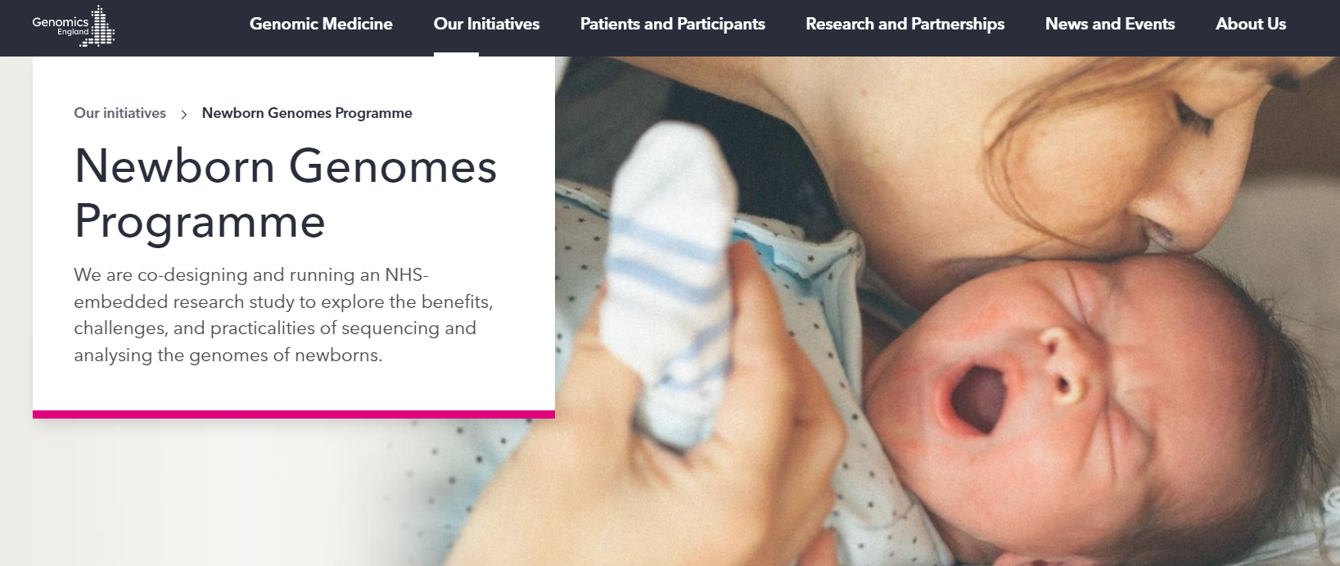
Future (proposed) applications of germline genomics in health
Population testing using whole genome sequencing
?at birth: ascertainment of neonatal/paediatric rare disease
NGP: 100,000 newborns from NHS
Genomic prediction of common diseases
Polygenic risk scores
Prioritise/deprioritise individuals for disease screening/preventative interventions
OFH: 5 million NHS users

Slide 10
OVERVIEW
Current applications of germline genomics in health
Future (proposed) applications of germline genomics in health
Principles of population screening
Newborn Whole Genome Sequencing
Population polygenic risk profiling (PRS)
Conclusions

Slide 11
1968: Wilson and Jungner (WHO): Criteria for population screening
Detailed disease-centric evaluation
Epidemiology and Natural History | Lethality/frequency: important public health problem Latent period well understood:
 | Natural History/outcomes: well characterised Reliable association/robust marker for serious disease
Intervention | Presymtomatic intervention improves long-term outcomes (survival, QoL) compared to intervention when symptomatic
 | Available to all (fully-funded)
Screening Test | Precise (sensitivity/specificity), validated
 | Known distribution of test values in the target population
Screening Prog Implementation | High quality randomised controlled trials show  mortality/ morbidity Health economic case
 | Clinically, socially and ethically acceptable: health professionals +public
Notes:
Recent history is littered with examples of tests used in diagnosis of patients presenting with symptoms or monitoring of disease treatment, that on evaluation for population screening showed no impact on outcomes. Even as early as 1968, Wilson and Jungner of the WHO recognised the many potential pitfalls of population disease screening and delineated 10 key principles, which hold up extremely well 55 years on

Slide 12
1996: UK National Screening Committee Established to ensure robust review of new screening approaches
1) Detailed disease centred review of epidemiology, natural history studies and existing trial data (Wilson Jungner)
2) Regional piloting with comparison of outcomes (akin to cluster randomised trial)
3) Detailed health economic evaluation (using observed metrics)
Notes:
recognising the costs of screening and the difficulty in reversing screening programs (think prostate screening in USA) in 1996 the National screening committee was set up in the UK, to ensure robust evaluation of proposed new screening approaches…
(1) In line with the principles of W&J, (2) (3)

Slide 13
OVERVIEW
Current applications of germline genomics in health
Future (proposed) applications of germline genomics in health
Principles of population screening
Newborn Whole Genome Sequencing
Population polygenic risk profiling PRS)
Conclusions

Slide 14
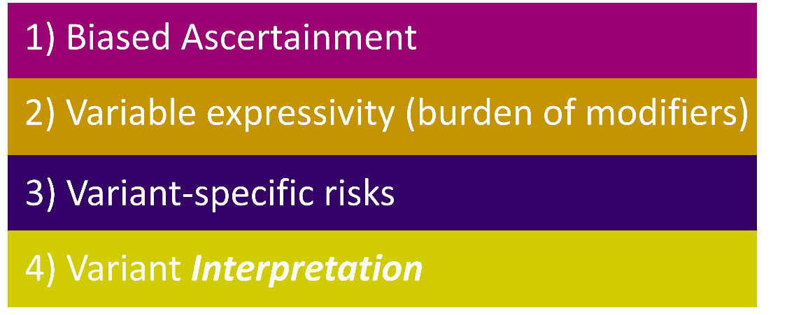
Newborn WES/WGS
 | Protein test (MS/MS) | Genomic Test (WES)
Sensitivity | 99.0% | 88%
Specificity | 99.8% | 98.4%
Technology-centric approach: >200 diseases
What does this mean in practice?
Many cases of metabolic disease will be present by time WGS is returned
Confirmatory (diagnostic tests)
Some cases will already have developed lethal/irreversible disease
What to do with positive genomic result if diagnostic tests normal
Is it a false positive or will the disease present later
No immediate superior confirmatory “diagnostic” test can rule out future disease
“Screen-positive, disease indeterminate (SPID)” CF
Follow-up of SPIDs
How: what tests/tools?
How often?
For how long?
For dominant diseases
Penetrance lower; onset later
NBSeq project
4.5 million newborns: bloodspots w FU data
California 2005-2013
48 Diseases (Inborn Errors of Metabolism)
Adhikari AN et al.
Nature medicine 2020; 26(9): 1392-7.
UK population
700,000 newborns: 11,200 FPs/year
Notes:
So one area of great interest is using whole genomes for newborn screening… with the advantage that this technology allows testing for many diseases in one assay. In fact…it is proposed that over 200 diseases will be included in NGP
So how good will this test be for screening?

Slide 15
1968: Wilson and Jungner (WHO): Criteria for population screening
Detailed disease-centric evaluation// Technology-centric approach:
Epidemiology and Natural History | Lethality/frequency: important public health problem Latent period well understood:
 | Natural History/outcomes: well characterised Reliable association/robust marker for serious disease
Intervention | Presymtomatic intervention improves long-term outcomes (survival, QoL) compared to intervention when symptomatic
 | Available to all (fully-funded)
Screening Test | Precise (sensitivity/specificity), validated
 | Known distribution of test values in the target population
Screening Prog Implementation | High quality randomised controlled trials show  mortality/ morbidity Health economic case
 | Clinically, socially and ethically acceptable: health professionals +public

Slide 16
1968: Wilson and Jungner (WHO): Criteria for population screening
Detailed disease-centric evaluation// Technology-centric approach:
Epidemiology and Natural History | Lethality/frequency: important public health problem Latent period well understood:
 | Natural History/outcomes: well characterised Reliable association/robust marker for serious disease
Intervention | Presymtomatic intervention improves long-term outcomes (survival, QoL) compared to intervention when symptomatic
 | Available to all (fully-funded)
Screening Test | Precise (sensitivity/specificity), validated
 | Known distribution of test values in the target population
Screening Prog Implementation | High quality randomised controlled trials show  mortality/ morbidity Health economic case
 | Clinically, socially and ethically acceptable: health professionals +public

Slide 17
OVERVIEW
Current applications of germline genomics in health
Future (proposed) applications of germline genomics in health
Principles of population screening
Newborn Whole Genome Sequencing
Population polygenic risk profiling (PRS)
Conclusions

Slide 18
1) “Complex” diseases are complex
common
rare
geneticc
environmental
31%
Breast Cancer
37%
Myocardial Infarction (male, fatal)
15%
Colorectal Cancer
Mucci LA et al.. Jama 2016; 315(1): 68-76.
Zdravkovic S,et al. J Intern Med 2002, 252:247-54.

Slide 19
1) “Complex” diseases are complex
common
rare
geneticc
environmental
13%
31%
Breast Cancer
37%
Myocardial Infarction (male, fatal)
15%
Colorectal Cancer
Mucci LA et al.. Jama 2016; 315(1): 68-76.
Zdravkovic S,et al. J Intern Med 2002, 252:247-54.

Slide 20
1) “Complex” diseases are complex
common
rare
geneticc
environmental
7%
13%
31%
Breast Cancer
37%
Myocardial Infarction (male, fatal)
15%
Colorectal Cancer
Mucci LA et al.. Jama 2016; 315(1): 68-76.
Zdravkovic S,et al. J Intern Med 2002, 252:247-54.

Slide 21
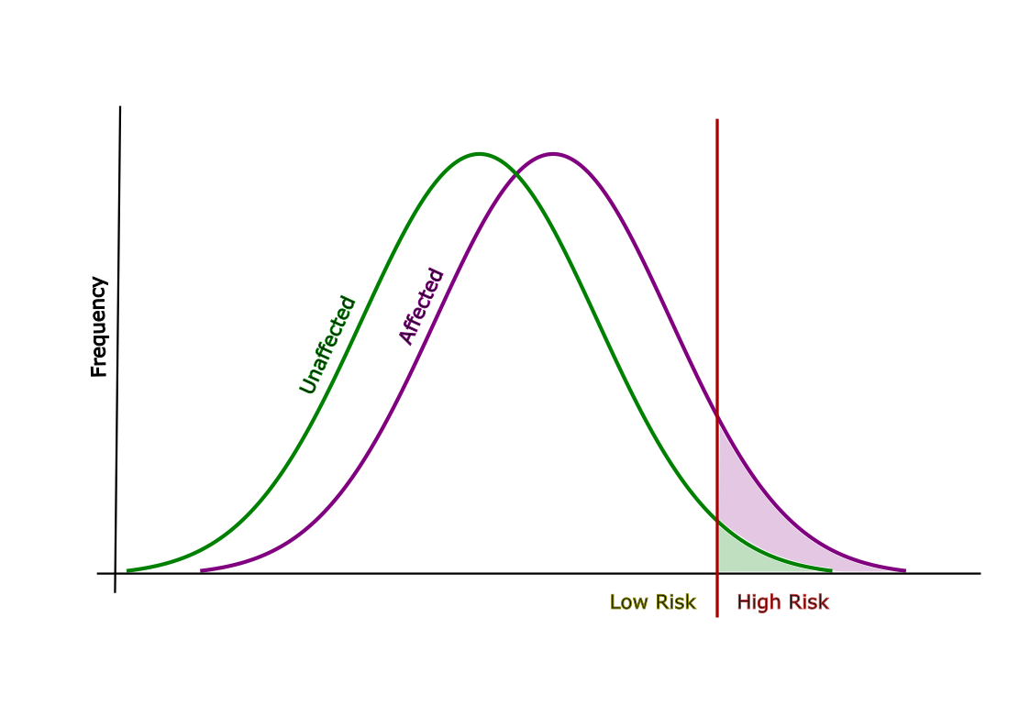
PRS for Breast Cancer:
AUC = 0.64
True positives (37%)
63% of cancers
False positives (19-20%)
Bottom 80% of PRS
Top 20% of PRS
Notes:
Essentially, what we need to do is test it. So we work out the polygenic risk score for a big group of people, and check to see how often the polygenic risk score correctly predicted the disease. Using that information, we can calculate, which is a numerical value which assesses the predictive accuracy of a PRS. In this particular instance, the curve is a receiver operating characteristic curve, which plots the sensitivity, or true positive rate, of a model, against its false positive rate. This essentially shows how much better the model is at predicting who will develop disease than just flipping a coin.

Slide 22
2) PRS inherently limited in predictiveness
 | Female Population | Current PRS |  | Future PRS |  | Optimised PRS
 |  | AUC=0.64 |  | AUC=0.69 |  | AUC=0.71
 | Female Population | Top 50% | Top 20% | Top 50% | Top 20% | Top 50% | Top 20%
% BC cases | 100% | 70% | 37% | 76% | 44% | 78% | 48%
Lifetime Risk | 14.3% | 19.5% | 25.3% | 20.9% | 29.3% | 21.6% | 31.3%
Risk age 40-49 | 1.7% | 2.4% | 3.2% | 2.6% | 3.8% | 2.7% | 4.1%
Fritsche LG, et al. American journal of human genetics. 2020;107(5):815-36.
Zhang YD, et al. Nature communications. 2020;11(1):3353.
Hingorani A, Gratton J, et al. medRxiv. 2022.
Huntley C, et al Lancet Oncology. 2023 (in press)
.

Slide 23
2) PRS inherently limited in predictiveness
 | Female Population | Current PRS |  | Future PRS |  | Optimised PRS
 |  | AUC=0.64 |  | AUC=0.69 |  | AUC=0.71
 | Female Population | Top 50% | Top 20% | Top 50% | Top 20% | Top 50% | Top 20%
% BC cases | 100% | 70% | 37% | 76% | 44% | 78% | 48%
Lifetime Risk | 14.3% | 19.5% | 25.3% | 20.9% | 29.3% | 21.6% | 31.3%
Risk age 40-49 | 1.7% | 2.4% | 3.2% | 2.6% | 3.8% | 2.7% | 4.1%
Fritsche LG, et al. American journal of human genetics. 2020;107(5):815-36.
Zhang YD, et al. Nature communications. 2020;11(1):3353.
Hingorani A, Gratton J, et al. medRxiv. 2022.
Huntley C, et al Lancet Oncology. 2023 (in press)
.

Slide 24
2) PRS inherently limited in predictiveness
 | Female Population | Current PRS |  | Future PRS |  | Optimised PRS
 |  | AUC=0.64 |  | AUC=0.69 |  | AUC=0.71
 | Female Population | Top 50% | Top 20% | Top 50% | Top 20% | Top 50% | Top 20%
% BC cases | 100% | 70% | 37% | 76% | 44% | 78% | 48%
Lifetime Risk | 14.3% | 19.5% | 25.3% | 20.9% | 29.3% | 21.6% | 31.3%
Risk age 40-49 | 1.7% | 2.4% | 3.2% | 2.6% | 3.8% | 2.7% | 4.1%
Fritsche LG, et al. American journal of human genetics. 2020;107(5):815-36.
Zhang YD, et al. Nature communications. 2020;11(1):3353.
Hingorani A, Gratton J, et al. medRxiv. 2022.
Huntley C, et al Lancet Oncology. 2023 (in press)
.

Slide 25
3) Two-stage Screening Approach
“Enrich” for disease incidence in “high-risk” quantile
Risk-Stratification
PGS
Detection of Disease
Screening Tool
Limited Predictiveness
“High-Risk”: modest risk
“Low-risk” group: majority of disease
Do not predict lethal disease
Differential performance with ancestry
Poor sensitivity for specificity
Over-diagnosis of indolent disease
Limited impact on survival
A
B
A
B
A

Slide 26
4) Population testing poorly studied in the actual population
Many unknowns around PRS risk profiling in real-world population
Studies to date (including OFH) based on atypical individuals who volunteer for screening studies
Uptake of PRS as condition to access screening
Widen health disparities for already underserved populations
PRS less predictive in non-Europeans
Unintended Behavioural Implications
“High” Risk individuals: anxiety, health-seeking
“Low” Risk individuals: neglect symptoms, disregard health prevention advice
Acceptability of withdrawal of screening in “low-risk”
who still have appreciable frequency of disease of equivalent lethality
just modestly more expensive to screen for

Slide 27
OVERVIEW
Current applications of germline genomics in health
Future (proposed) applications of germline genomics in health
Principles of population screening
Newborn Whole Genome Sequencing
Population polygenic risk profiling (PRS)
Conclusions

Slide 28
Conclusions

Slide 29
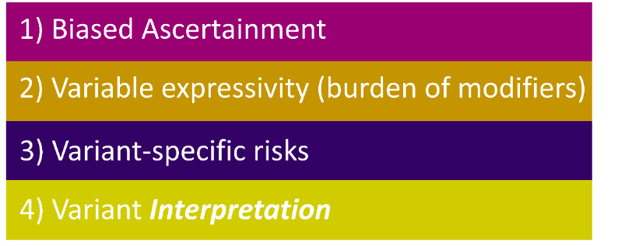
Population Genomic Screening vs Typical models of population screening
1) Limitations to Predictiveness | Uncertainty in prediction Rare pathogenic variants in Rare Disease
 | Modest enrichment Common Variants (PGS) in Common Disease
2) Longterm (Lifelong) Implications | Resource + cost: Monitoring/disease screening
 | Psychological and behavioural sequelae

Slide 30
1968: Wilson and Jungner (WHO): Criteria for population screening
Detailed disease-centric evaluation// Technology-centric approach:
Epidemiology and Natural History | Lethality/frequency: important public health problem Latent period well understood:
 | Natural History/outcomes: well characterised Reliable association/robust marker for serious disease
Intervention | Presymtomatic intervention improves long-term outcomes (survival, QoL) compared to intervention when symptomatic
 | Available to all (fully-funded)
Screening Test | Precise (sensitivity/specificity), validated
 | Known distribution of test values in the target population
Screening Prog Implementation | High quality randomised controlled trials show  mortality/ morbidity Health economic case
 | Clinically, socially and ethically acceptable: health professionals +public

Slide 31
1968: Wilson and Jungner (WHO): Criteria for population screening
Detailed disease-centric evaluation// Technology-centric approach:
Epidemiology and Natural History | Lethality/frequency: important public health problem Latent period well understood:
 | Natural History/outcomes: well characterised Reliable association/robust marker for serious disease
Intervention | Presymtomatic intervention improves long-term outcomes (survival, QoL) compared to intervention when symptomatic
 | Available to all (fully-funded)
Screening Test | Precise (sensitivity/specificity), validated
 | Known distribution of test values in the target population
Screening Prog Implementation | High quality randomised controlled trials show  mortality/ morbidity Health economic case
 | Clinically, socially and ethically acceptable: health professionals +public

Slide 32
Population Genomic screening
Patient Groups
Diagnostics
sector
Early detection Targets
Government
Pharma
All screening programs do harm; some do good as well, and, of these, some do more good than harm at reasonable cost”.
Genomics is not an amateur sport
Muir Gray, 2008
National Screening Committee
Prof Maria Bitner Glindzicz, 2015
Great Ormond St Hospital

