Slide 1
FPH Registrars Conference 2023
#FPHBackToTheFuture
Workshop: Registrar Showcase
Luke Robertshaw - North East Transport Plan
Anna Howells - SARS-CoV-2 Immunity and Reinfection Evaluation (SIREN) Study
Dr Emily Clark – Family Planning in Côte D’Ivoire
Dr Helen Skirrow - Pregnancy and childhood vaccination
Philip Broadbent – Modelling the Public Health implications of the cost-of-living crisis
Christina Downham – Public Health in the Ambulance Sector
Gemma Hobson – Vaping among Children and Young People

Slide 2
Transport and Health
Luke Robertshaw
Public health Registrar ST5 North East Region

Slide 3
North East Transport Plan

Slide 4
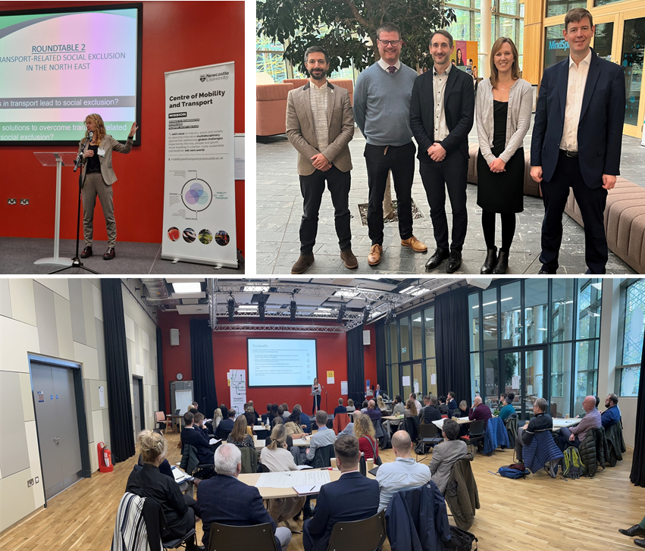
Public health placement
Health in all policies approaches
Healthy
Streets

Slide 5
Luke Robertshaw Public health Registrar ST5 North East Region
Transport and health blog:
https://www.transportnortheast.gov.uk/latest-news/whats-transport-got-to-do-with-it/

Slide 6
SARS-CoV-2 Immunity and Reinfection EvaluatioN (SIREN) study
SRC Registrar Conference, 21 September 2023
Anna Howells
anna.howells@wales.nhs.uk

Slide 7
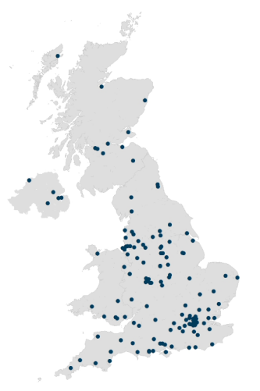
Introduction
A national multicentre prospective cohort study
44,546 participants
135 sites across the UK
Time period
Enrolment 18 June 2020 to 31 March 2021
Continuous follow-up from 18 June 2020 to 31 March 2023
Initial 12 months then optional extensions
Participants
Over 44,000 healthcare workers, support and administrative staff working at NHS sites joined the SIREN study
Data collection
Frequent PCR & antibody testing
Questionnaires
Study questions
Does previous infection protect you from reinfection and for how long?
How effective are COVID-19 vaccines at protecting you against infection?
10
Sites in Scotland
5
Sites in Northern Ireland
113
7
Sites in England
Sites in Wales

Slide 8
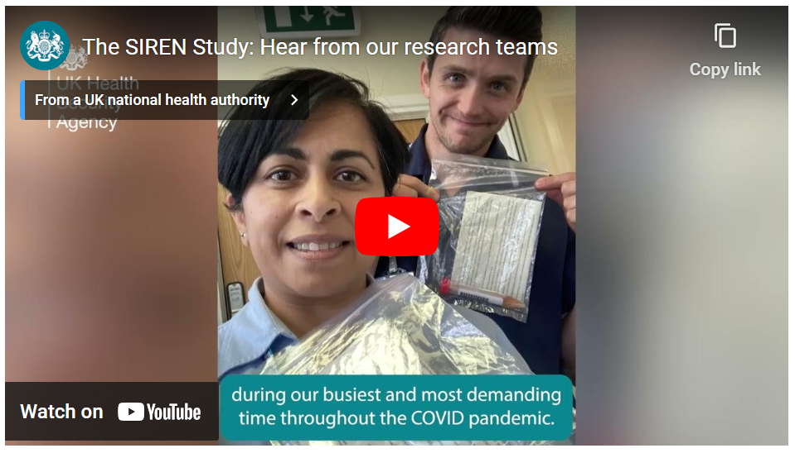
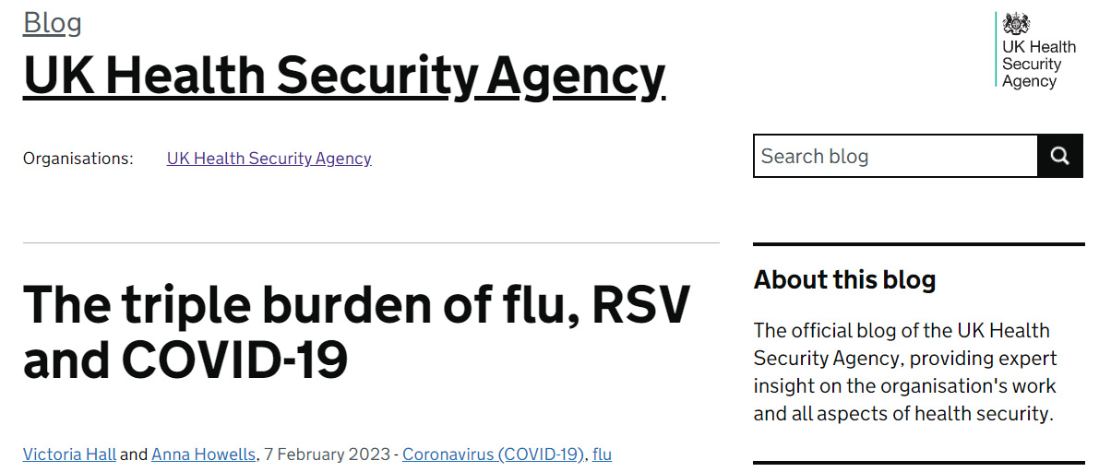
Working with SIREN
Roles
Cohort retention
Disseminating research and showcasing the study
Participant Involvement Panel (PIP)
Qualitative research
Paper writing
Regional lead

Slide 9
Cohort retention
85% of participants completed their 12-month follow-up (n=37,686).
88% of participants completed 24-months (n=7,274).
Retention varied with age, ethnicity and by SIREN site.
Feedback survey suggests 90% of respondents found SIREN easy to participate in.
93% of respondents agreed that SIREN made them feel like they were making valuable contribution to the pandemic response.
Successful PIP recruitment – increase from 30 to 485 applications to join panel between Phase 1 and Phase 2.

Slide 10
Thank you
Victoria Hall, SIREN Study Lead, Public Health Consultant and Consultant Epidemiologist
Dr Jasmin Islam, Consultant in Infectious Diseases and Microbiology
SIREN team
Webpage: www.gov.uk/guidance/siren-study
anna.howells@wales.nhs.uk

Slide 11
Pour une famille saine et prospère: Family planning in Côte d’Ivoire
FPH Registrar Conference
Dr Emily Clark
Emily.Clark4@wales.nhs.uk
21/09/2023

Slide 12
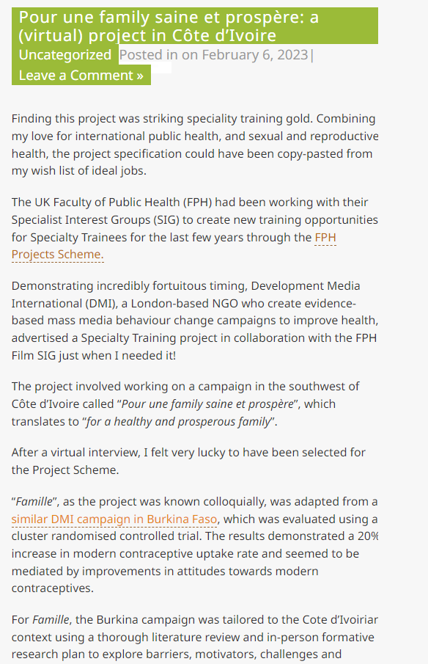
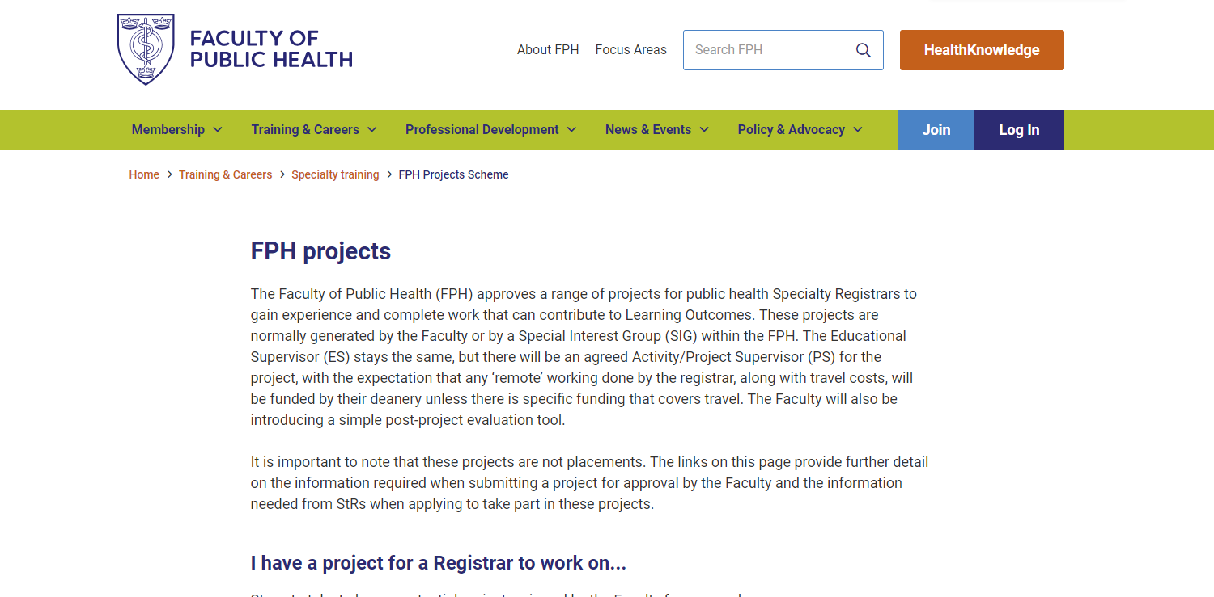
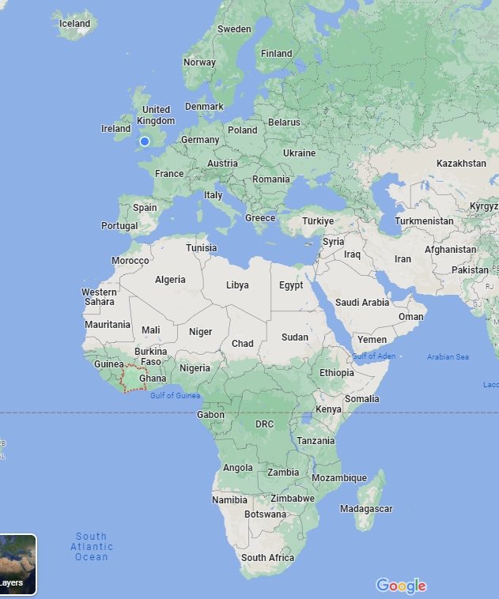
Introduction
FPH Projects Scheme - Development Media International (DMI) - Better Health For All

Slide 13
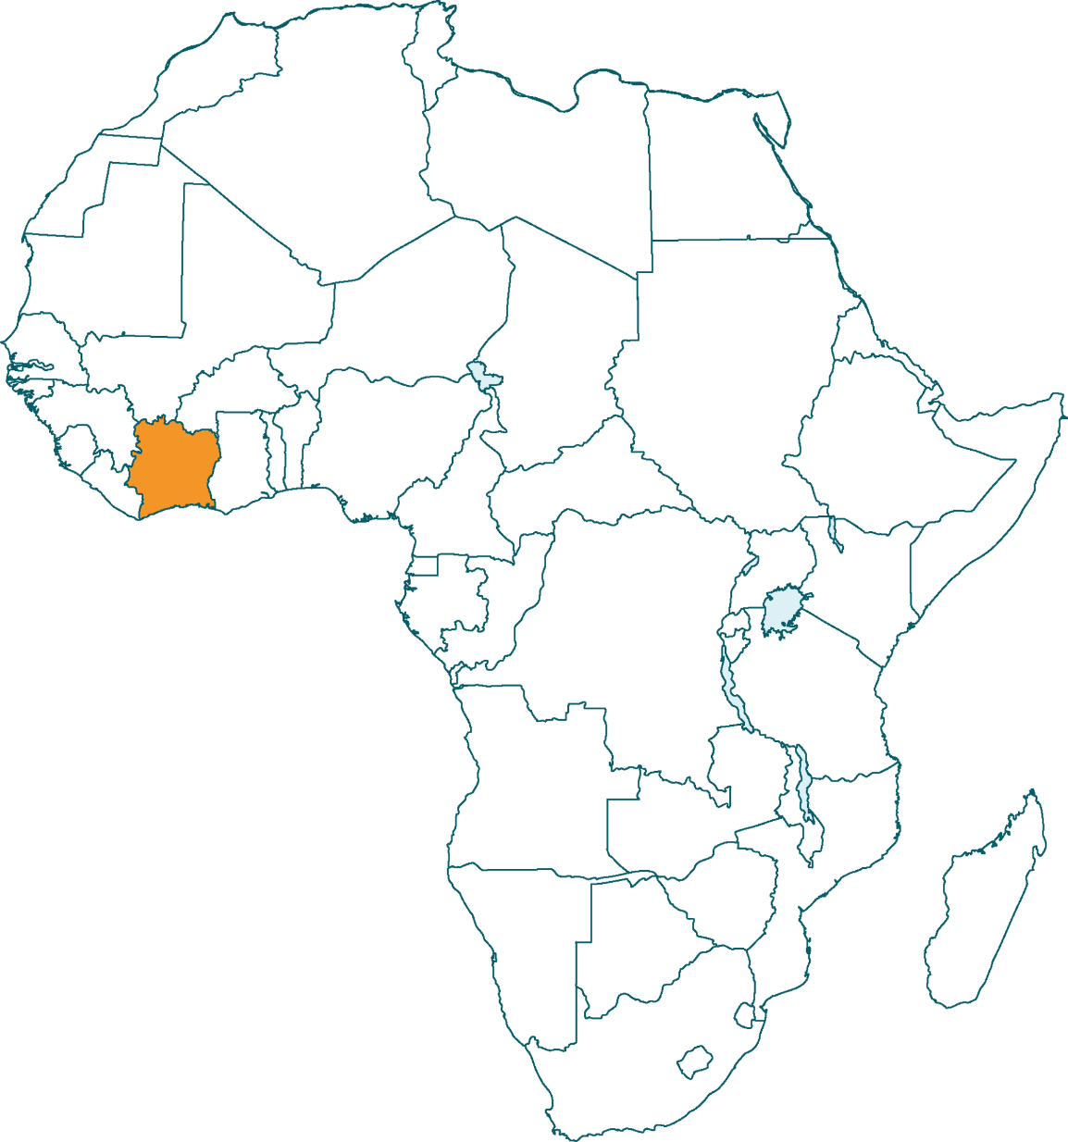
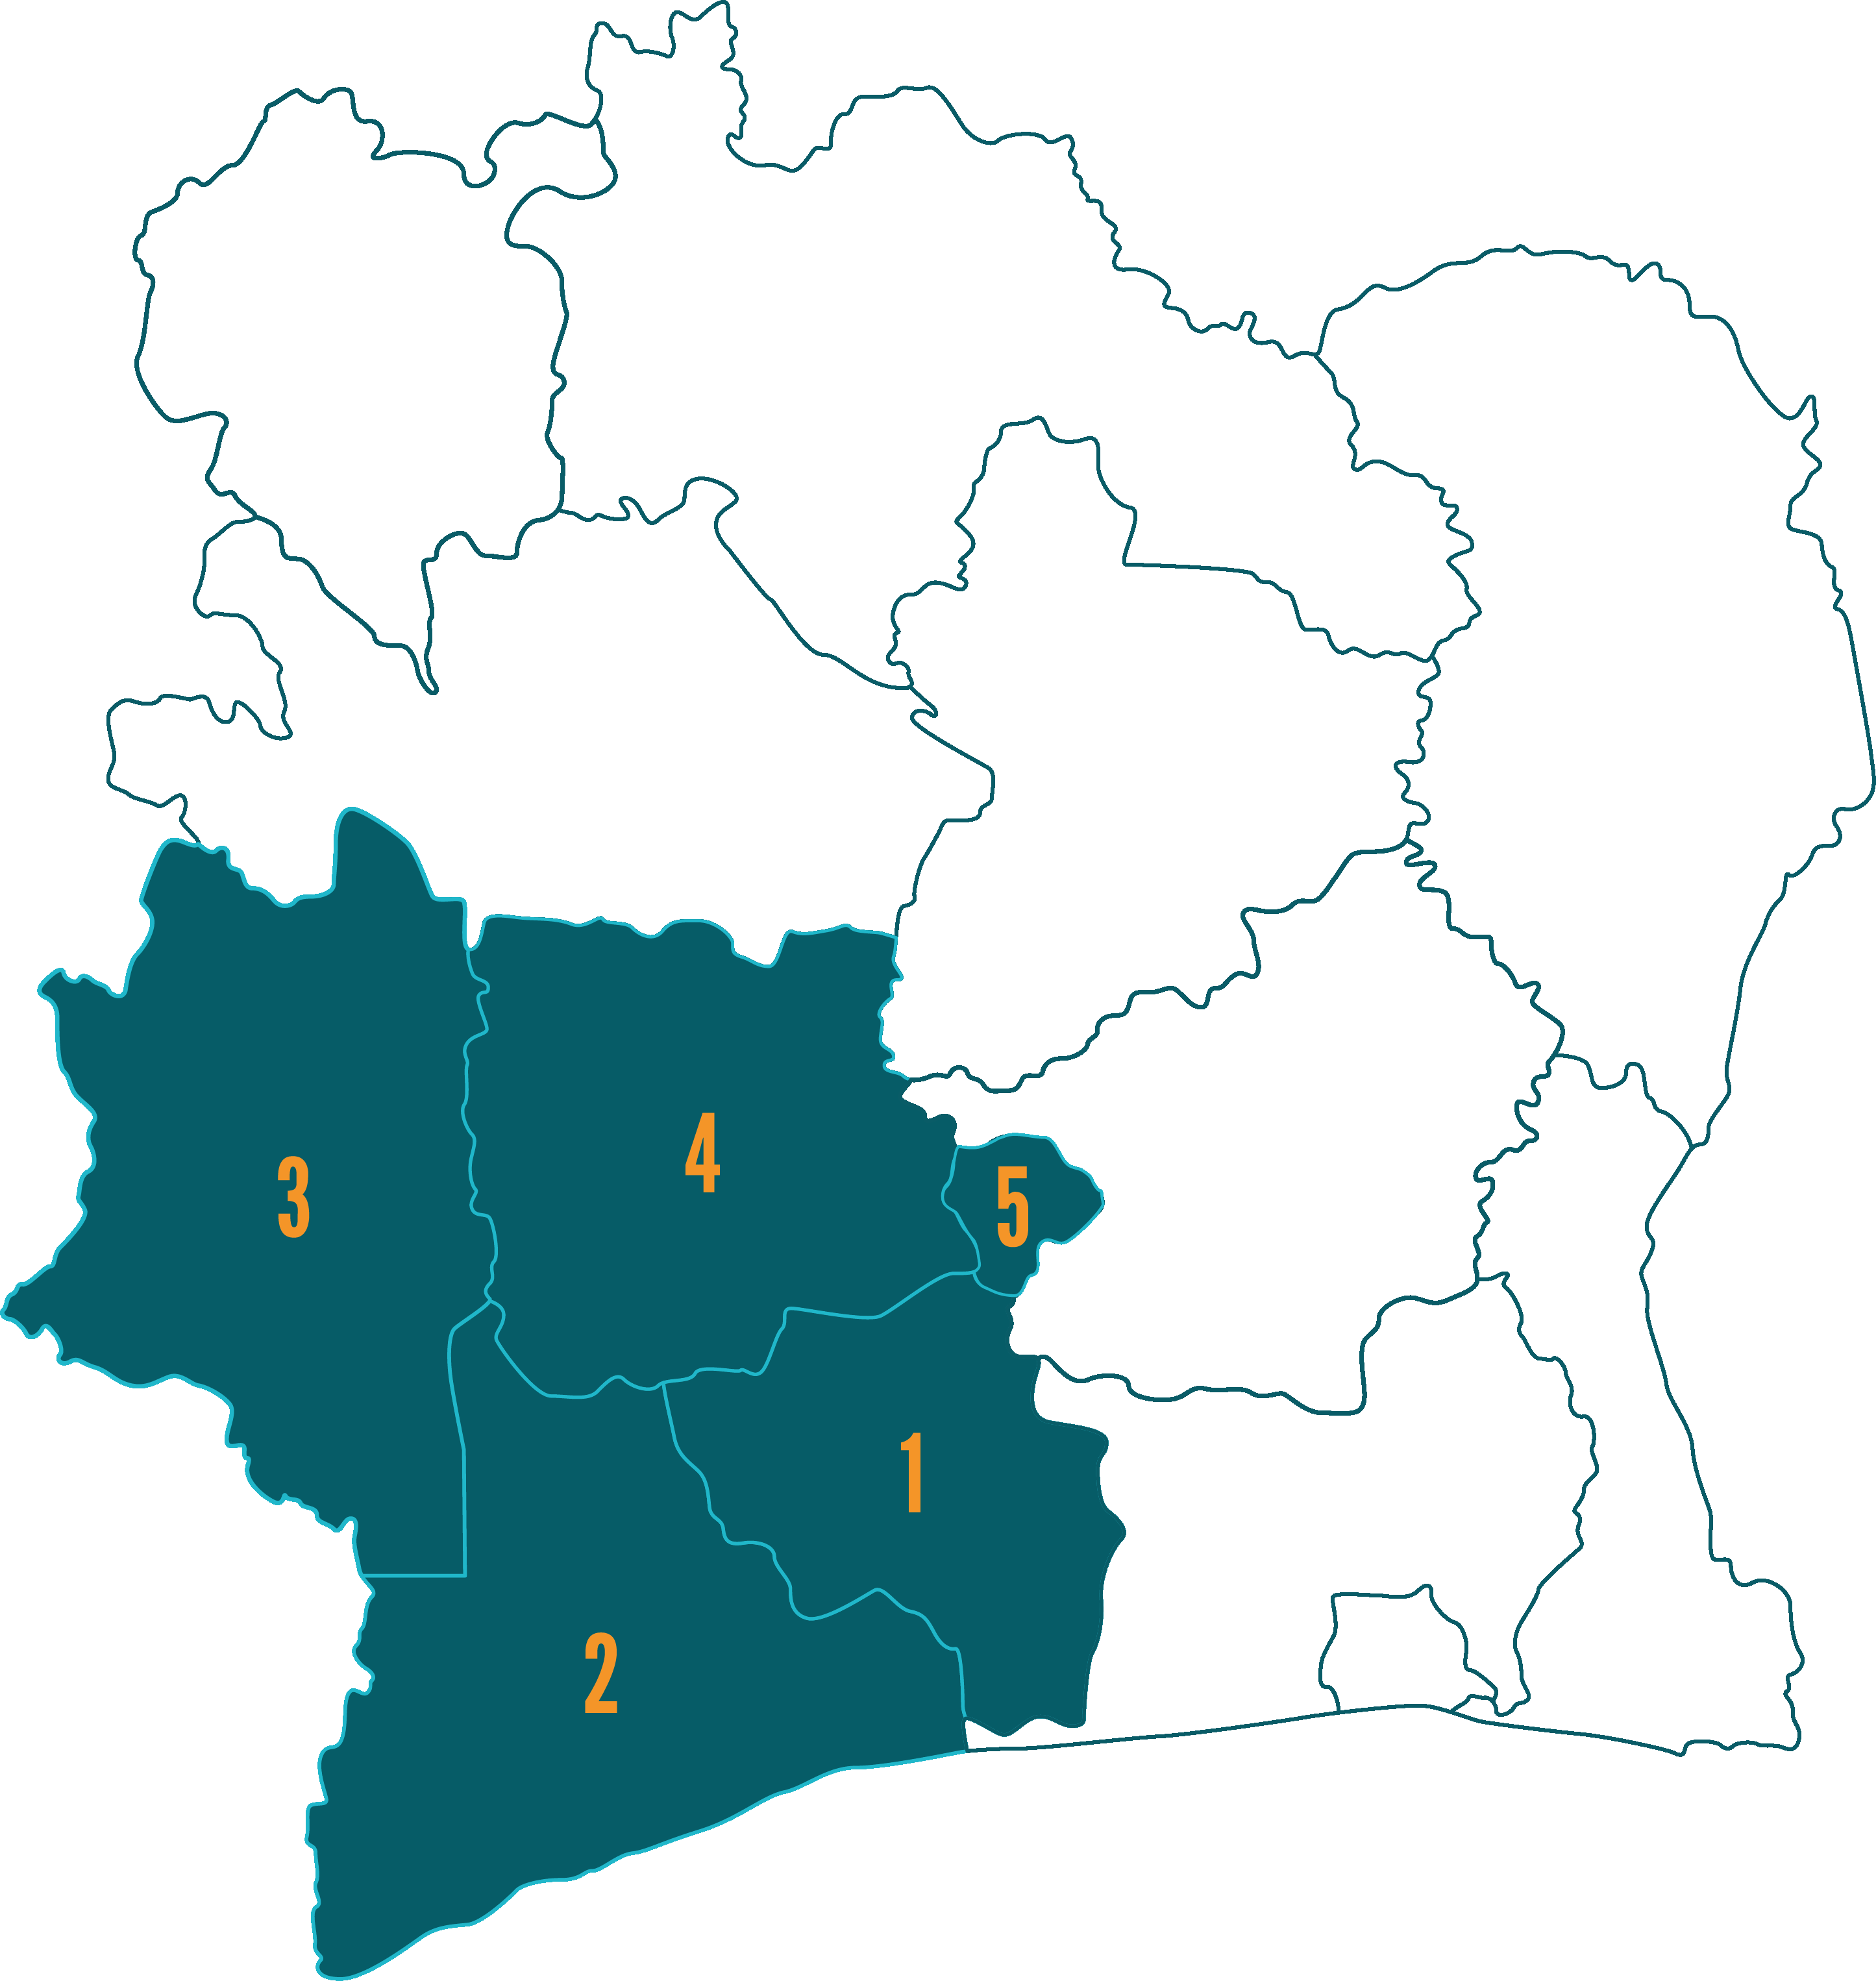
Pour une famille saine et prospère: Family planning in Côte d’Ivoire
Côte d’Ivoire
Very high rates of maternal mortality: 617/100,000 live births
Modern contraceptive use is low: 25%
Unmet need for family planning is high: 18.1%
Relatively high radio ownership: 45%
Project aims
Increase modern contraceptive uptake
Improve birth spacing
Avoid unplanned pregnancies
Formative research
Identify barriers and facilitators to modern contraceptive use and birth spacing
Inform radio spot “transcreation”
Ministry of Health approval
GOH-DJIBOUA 2. BAS-SASSANDRA
3. MONTAGNES
4. SASSANDRA-MARAHOUÉ
5. YAMOUSSOUKRO

Slide 14
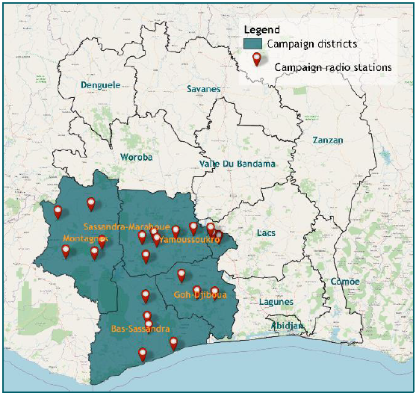
Radio campaign
Key messages
Modern contraception is safe, effective, and reversible
Modern methods of contraception can be used for birth spacing
Role of men in family planning
Spot development
14 radio spots recorded
Spots were recorded in 5 local languages: French, Baoulé, Bété, Malinké, Mooré
Pretesting
Radio broadcast
Saturation+
27 partner radio stations

Slide 15
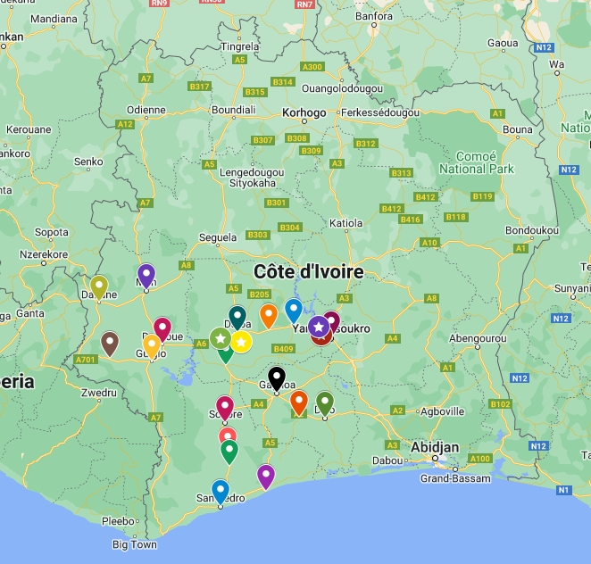
Evaluation
Evaluation design
Ethical approval from Ministry of Health in Côte d’Ivoire
Liaison with in country colleagues, Association des Sages-Femmes Ivoriennes, research consultants
Mixed methods approach
Campaign reach
The campaign reached an estimated 2.5 million people aged 15-49
Beyond those with access to a radio
Impact
Increased the demand for modern contraception which will have prevented approximately:
8,000 unintended pregnancies
30 maternal deaths
3,000 unsafe abortions

Slide 16
Thank you Any questions?
FPH Registrar Conference
Dr Emily Clark
Emily.Clark4@wales.nhs.uk
21/09/2023

Slide 17
Pregnancy and childhood vaccination
Dr Helen Skirrow, Clinical NIHR Doctoral Research Fellow

Slide 18
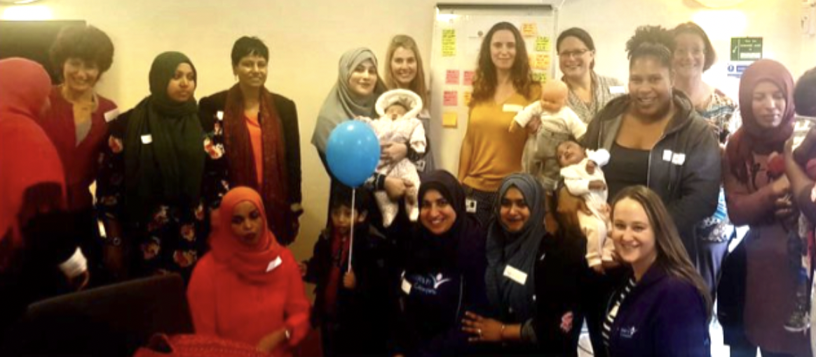
Phd Outline
Why did nobody ask us?!
Mixed-methods co-production study with Mosaic Community Trust, Westminster, North-West London
National studies using routine primary care data
1. Which children are most at risk of being vaccinated late or unvaccinated with measles, mumps and rubella (MMR) vaccines before age 5 years in the UK?
2. Do children whose mothers are not vaccinated with pertussis vaccine in pregnancy have a higher risk being vaccinated late or unvaccinated with measles, mumps and rubella (MMR) vaccines before age 5 years in the UK?
795,497 babies linked to 538,138 unique mothers born between 2000-2020
Minimum of one year follow up from birth
3. Why do parents and families think some children are vaccinated late or miss out on routine vaccines? 4. Impact of Covid-19 pandemic on parental routine vaccine attitudes?

Slide 19
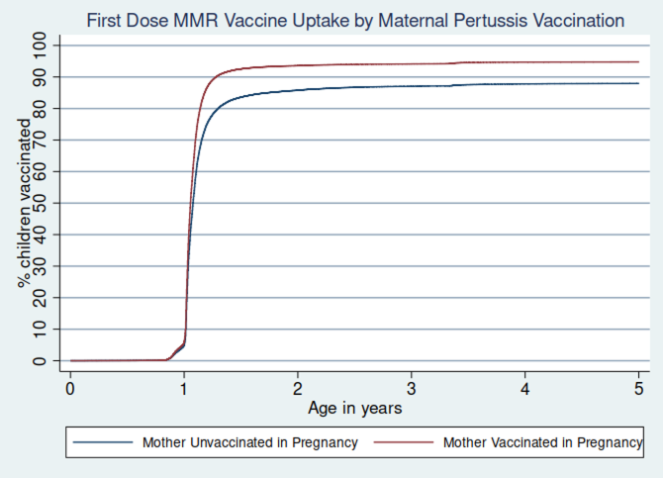
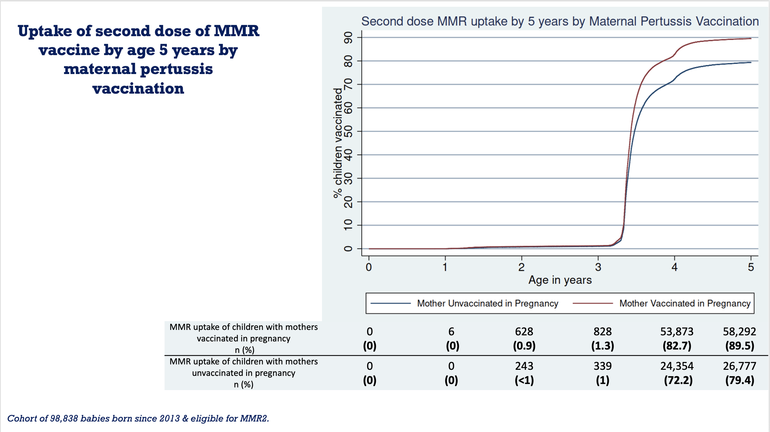
Uptake of first dose of MMR vaccine by age 5 years by maternal pertussis vaccination
If you adjust for ethnicity, deprivation and maternal age then children of vaccinated mothers still more likely to get their MMR vaccines: Adjusted HR from Cox proportional hazards model: first dose MMR 1.43 (95%CI: 1.41-1.45), second dose MMR 1.49 (95%CI: 1.45-1.53)
MMR uptake of children with mothers vaccinated in pregnancy n (%) | 0 (0) | 7,306 (5.8) | 118,712 (93.6) | 119,395 (94.1) | 120,120 (94.7) | 120,201 (94.8)
MMR uptake of children with mothers unvaccinated in pregnancy n (%) | 0 (0) | 3,881 (4.8) | 69,206 (85.8) | 70,239 (87.1) | 70,837 (87.8) | 70,961 (87.9)
Cohort of 207,531 babies born since 2013.
Notes:
Overall pertussis uptake per pregnancy
61.12% (126,846).

Slide 20
Why do parents think some children are not vaccinated?
Theme | Description | Example quote
Importance of reminders | Inconsistent reminders about childhood vaccines were common. | ‘I was expecting to get reminder… from our GP & that wasn't the case.’
Difficulties in booking or attending vaccine appointments | Parents struggle to get through to surgeries to make vaccine appointments for their children & then have difficulties attending vaccine appointments or having to take time off work to attend. | ‘It should be easier to book vaccines…to call up local surgery…increasingly difficult to get through and to plan around full-time work.’ ‘Nurse who does vaccines only available one day a week.’
Importance of conversations with trusted health care professional | Conversations with trusted healthcare professionals, often beforehand, are key (e.g. practice nurses/health visitors) & they also help parents make appointments. | ‘Because giving…a leaflet, it’s not going to absorb as well as actually having a real-life conversation.’ ‘Good to… have people, to get information (from), not leaflets and things like that.’
Increased questions or seeing childhood vaccines as a choice since Covid-19 pandemic | Some parents have more questions about childhood vaccines or now see them as a choice & not something to do automatically as previously. | ‘The impact of covid for me, has made me think that vaccinations are a choice.’ ‘Covid-19 vaccines…have made people think about potential risks of routine recommended childhood vaccines.’
Questionnaire: 536 parents.
Four focus groups: 22 parents.

Slide 21
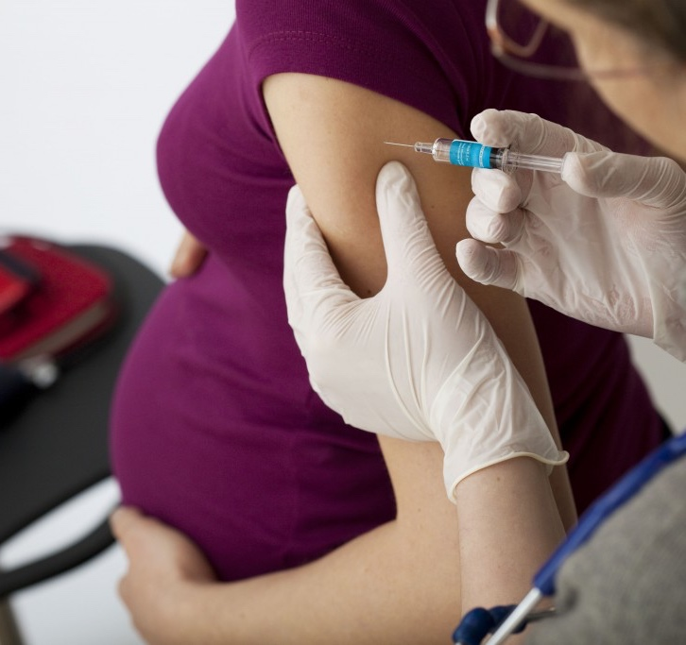
Implications
Babies born in the most deprived areas of England are less likely to be vaccinated.
Pregnancy and childhood vaccine uptake are related: pregnancy offers an opportunity to promote BOTH pregnancy & childhood vaccines.
.
Targeted interventions to promote vaccination among lower-income families needed.
Parents need consistent reminders & easier access to book & attend vaccine appointments, plus easier access to trusted healthcare professionals to answer vaccine questions.
The Covid-19 pandemic has meant some
parents have more questions about vaccines.

Slide 22
Thank you and any questions?
Profile: https://www.imperial.ac.uk/people/h.skirrow
Email: h.Skirrow@imperial.ac.uk
Twitter: @HelenSkirrow
NIHR fellowship award: https://fundingawards.nihr.ac.uk/award/NIHR300907
Selected papers:
Skirrow H, Barnett S, Bell S, Mounier-Jack S, Kampmann B, Holder B 2022, Women's views and experiences of accessing pertussis vaccination in pregnancy and infant vaccinations during the COVID-19 pandemic: A multi-methods study in the UK, Vaccine, Vol: 40, Pages: 4942-4954, https://doi.org/10.1016/j.vaccine.2022.06.076
Woodcock T, Novov V, Skirrow H, Butler J, Lovett D, Adeleke Y, Blair M, Saxena S, Majeed A, Aylin P. Characteristics associated with influenza vaccination uptake in pregnancy: A retrospective cohort study. British Journal of General Practice. 2023 Feb 1;73(727):e148-55.
Saxena S, Skirrow H, Wighton K, 2022, Vaccinating children aged under 5 years against covid-19, BMJ: British Medical Journal, Pages: o1863-o1863, https://doi.org/10.1136/bmj.o1863
Saxena S, Skirrow H, Maini A, Hayhoe B, Pollok N, 2022, Consenting children aged under 18 for vaccination and treatment, BMJ: British Medical Journal, Vol: 377, https://doi.org/10.1136/bmj-2021-068889
Skirrow H, Barnett S, Bell S, Riaposova L, Mounier-Jack S, Kampmann B, Holder B 2022, Women’s views on accepting COVID-19 vaccination during and after pregnancy, and for their babies: A multi-methods study in the UK., BMC Pregnancy and Childbirth, Vol: 22, Pages: 1-15, https://doi.org/10.1186/s12884-021-04321-3
Saso A, Skirrow H, Kampmann B, 2021, Prioritising immunisation across the life course, The Lancet, Vol: 398, Pages: 2145-2145,https://doi.org/10.1016/S0140-6736(21)02331-X
Saxena S, Skirrow H, Bedford H, Wighton K 2021, Covid-19 vaccines for teenagers: conversations and consent, BMJ, Vol: 374, Pages: 1-2, /doi.org/10.1136/bmj.n2312
Skirrow H, Flynn C, Heller A, Heffernan C, Mounier-Jack S, Chantler Tet al., 2021, Delivering routine immunisations in London during the Covid-19 pandemic: lessons for future vaccine delivery, BJGP Open, Vol: 5, Pages: 1-13, https://doi.org/10.3399/BJGPO.2021.0021
Saxena S, Skirrow H, Wighton K, 2021, Should the UK vaccinate children and adolescents against covid-19?, BMJ: British Medical Journal, Vol: 374, https://doi.org/10.1136/bmj.n1866
Saso A* & Skirrow H* & Kampmann B. Impact of COVID-19 on immunization services for Maternal and Infant Vaccines: Results of a survey conducted by IMPRINT - the Immunising PRegnant women and Infants NeTwork.Vaccines 2020, 8(3),556; https://doi.org/10.3390/vaccines8030556 *contributed equally.
Skirrow H, Beth Holder, Alison Meinel, Evelyn Narh, Beverly Donaldson, Anna Bosanquet, Sara Barnett & Beate Kampmann (2020) Evaluation of a midwife-led, hospital based vaccination service for pregnant women, Human Vaccines & Immunotherapeutics, DOI: 10.1080/21645515.2020.1770515
Saxena, S, Skirrow, H & Bedford, H. Editorial: Routine vaccination during covid-19 pandemic response. BMJ June 2020:369:m2392 https://doi.org/10.1136/bmj.m2392
Blogs on co-production
https://blogs.imperial.ac.uk/perc/2019/02/11/case-study-15-matimms-involve-women-in-research-addressing-low-maternal-vaccination-uptake/
https://blogs.imperial.ac.uk/perc/2022/01/24/why-has-nobody-asked-us-our-journey-so-far-to-co-produce-research/?_gl=1*x9s23c*_ga*NTU1MTI3Ni4xNTgwMjE4ODYw*_ga_LME5ZDDFS0*MTY4MTgxNTA2OS4yNDguMC4xNjgxODE1MDY5LjYwLjAuMA.

Slide 23
Modelling The public health implications of the cost-of-living crisis
Philip Broadbent, Rachel Thomson, Daniel Kopasker, Gerry McCartney
Petra Meier, Matteo Richiardi, Martin McKee, Srinivasa Vittal Katikireddi

Slide 24
CAUSES
HOW DID WE GET HERE?
2022 ONWARDS
2010
2020
2008
2016
2022
Austerity
COVID-19 Pandemic
Cost of Living Crisis
Economic crisis
Brexit
Russia-Ukraine Conflict

Slide 25
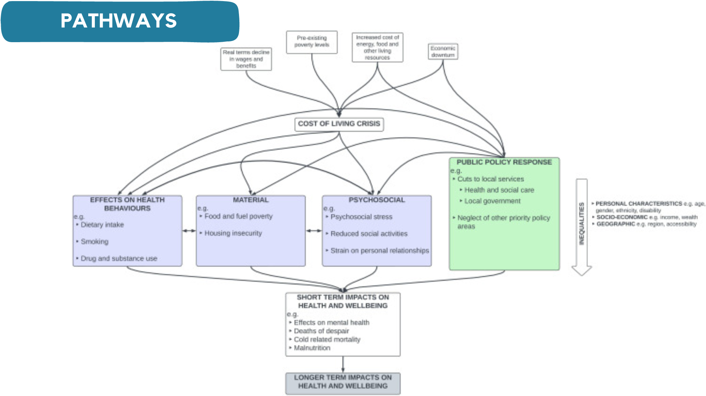
PATHWAYS
02 - PROJECT NAME

Slide 26
MODELLING
03 - PROJECT NAME

Slide 28
Thank you Any questions?
Philip Broadbent, Rachel Thomson, Daniel Kopasker, Gerry McCartney
Petra Meier, Matteo Richiardi, Martin McKee, Srinivasa Vittal Katikireddi

Slide 29
Public Health in the Ambulance Sector
Christina Downham
Public Health ST4 Registrar
North West Ambulance Service

Slide 30
Public Health Opportunities
NWAS takes 2 million BP readings per year
NWAS responds to 10,000 falls per month, 75% are in the over 65s
Accidents and Trauma
Ambulance Services may be the only healthcare contact following drug overdoses
Surveillance of overdoses, Take Home Naloxone distribution (Scottish Ambulance Service)
New or concerning trends can be identified and inform accident prevention work
Falls Prevention Referrals
BP data used to identify previously undiagnosed hypertension cases
Ambulance services in England attend 30,000 out of hospital cardiac arrests each year
The Patient Transport Service (PTS) attends potentially vulnerable patients in their homes
Raising awareness amongst crews about social prescribing e.g. for social isolation, cost-of-living issues
Mapping out areas of high incidence and low AED density to inform future AED placement
Incorporate social value into Trust strategies, social value considerations in procurement, transition to electric vehicles
Ambulance services are a large employer, procure many goods and services, and maintain a large fleet

Slide 31
Practical considerations
Educational Supervision: NWAS Registrars supervised by a consultant outside NWAS (e.g. NHSE, OHID, LA), ad-hoc arrangements made
Clinical Supervisor required: in NWAS, this is provided by the Medical Director
Lots of support networks:
National and regional networks of Registrars / Consultants in NHS Trusts
National network to support ambulance Public Health work
FPH Emergency Services SIG
Most learning outcomes could be accommodated
Opportunities for split placements
For more info please contact: Christina.Downham@nwas.nhs.uk
Notes:
CC

Slide 32
Thank you Any questions?
Christina Downham
Public Health ST4 Registrar
North West Ambulance Service

Slide 33
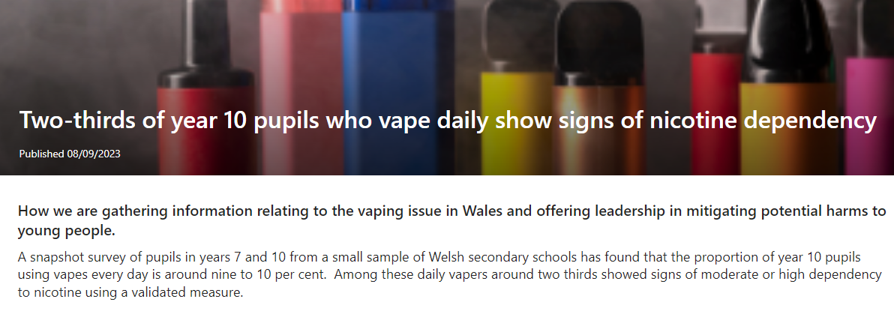
Vaping amongst children and young people in Wales Incident Response Group
“As a new and rapidly evolving product, the risks of vaping are not yet fully understood but it is already clear they are of no benefit to non-smokers and young people.”
Dr Julie Bishop, Director of Health Improvement at Public Health Wales
Gemma Hobson
21st September 2023
Notes:
The vaping industry has expanded rapidly over the last decade. Products are consistently marketed in ways that younger people find appealing with brightly-coloured packaging, modern designs, and flavours that mimic confectionary products. As a new and rapidly evolving product, the risks of vaping are not yet fully understood but it is already clear they are of no benefit to non-smokers and young people.

Slide 34
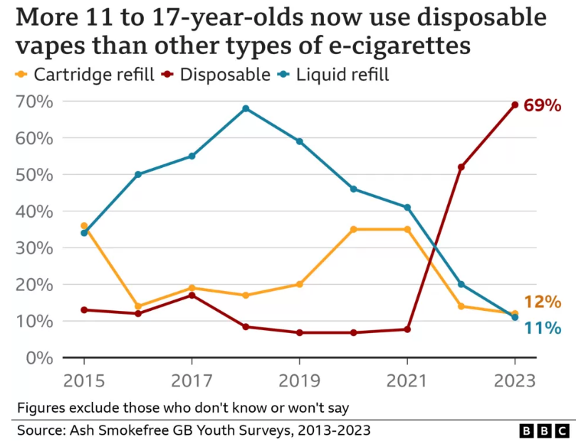
Vaping epidemiology and health harms
“It's like when you're having a really rubbish day and then you’re just kind of a bit, you feel a bit free in a way. It relieves you.”
“After a while as well… most really make you feel like a lot of shortness of … breath and like you’re not as fit as you used to be like with like athletics …”
20.5% have tried vaping (up from 13.9% in 2020
48% of those who have tried vaping have never tried smoking a cigarette
ASH Smokefree GB Youth Survey 2023 (11–17-year-olds):
Welsh focus groups with young people aged 12 –21 yrs

Slide 35
So why did we choose a Health Protection style response?
Typically, public health approaches to non-communicable and communicable disease differ. The former is more reliant on a strategy approach developed over a longer time horizon while the latter is managed through an outbreak or incident control team with a sense of urgency to act.
“The lack of a systematic response to NCDs may have increased variation in outcomes that is readily observed within populations. The failing of health and public health systems to effectively and efficiently tackle variation in outcomes is at odds with the significant achievements public health agencies have demonstrated in reducing the burden of CDs.”
Knight, J., Day, M., Mair-Jenkins, J., Bentley, C., Anderson, B. and Khaw, F.M., 2019. Responding to sustained poor outcomes in the management of non-communicable diseases (NCDs): an “incident control” approach is needed to improve and protect population health. BMC public health, 19(1), p.580.
Vaping amongst children and young people in Wales IRG

Slide 36
Reflections on the Incident Response Group approach
Identified strengths:
Moves at pace compared to typical health improvement approaches.
Articulation of a clear case and incident definition.
Defined structure and stepped phased approach facilitates partner engagement, robust data analysis, action planning and communication strategies.
However:
Delays in data present challenges in timely response
Lack of comparable data across different non-communicable diseases
Tensions in the prioritisation of ‘incidents’.
Vaping amongst children and young people in Wales IRG

Slide 37
Thank you Any questions?
Gemma Hobson
21st September 2023
Notes:
The vaping industry has expanded rapidly over the last decade. Products are consistently marketed in ways that younger people find appealing with brightly-coloured packaging, modern designs, and flavours that mimic confectionary products. As a new and rapidly evolving product, the risks of vaping are not yet fully understood but it is already clear they are of no benefit to non-smokers and young people.

